Slide 1
ELEG 5693 Wireless Communications
Propagation and Noise Part I
Dr. Jingxian Wu
wuj@uark.edu

Slide 2
OUTLINE
Wireless channel
Path loss
Shadowing
Small scale fading
Channel classifications
Noise and interference
Simulation model

Slide 3


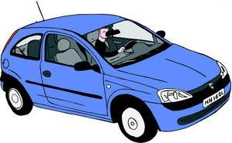
CHANNEL: PROPAGATION ENVIRONMENT

Slide 4
CHANNEL: PROPAGATION MODES
Free-space (line-of-sight)
  There is a clear transmission path between transmitter (Tx) and receiver (Rx).
  E.g. satellite
Reflection
  The bouncing of electromagnetic waves from surrounding objects
  Size of reflecting objects must be large compared to the wavelength of signal
  Reflecting surface must be smooth compared to the wavelength of signal
  E.g. ground, building, walls, windows, lakes

Slide 5
CHANNEL: PROPAGATION MODES (CONT’D)
Diffraction
  The bending of electromagnetic waves around objects (such as buildings), or through objects (such as trees).
  Due to diffraction, signals can propagate
    Around curved surface of Earth
    Beyond LOS horizon
    Behind obstructions
Scattering
  Electromagnetic waveforms incident upon rough or complex surfaces are scattered in many directions
    Relfection: smooth surface, one direction
Refraction (not common in terrestrial wireless communication).
  Electromagnetic waves bend as they move from one medium to another.

Slide 6
CHANNEL
Channel: a collection of propagation effects and
other signal impairments caused by the environments
Wireless channel: propagation, noise and interference
  Propagation effects: line-of-sight, reflection, diffraction, scattering
    Induced by the transmission of desired signals itself
    Impairments: large scale fading (path loss, shadowing), small scale fading
    Unique to wireless communication
  Noise and interference: unwanted electrical signals interfering with desired signal.
    Thermal noise (movements of electrons)
    Automobile ignition, electrical machinery, etc.
    Interferences from other users operating on the same frequency.
Present in all
communication systems

Slide 7
OUTLINE
Wireless channel
Path loss
Shadowing
Small scale fading
Channel classifications
Noise and interference
Simulation model

Slide 8
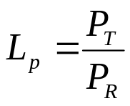
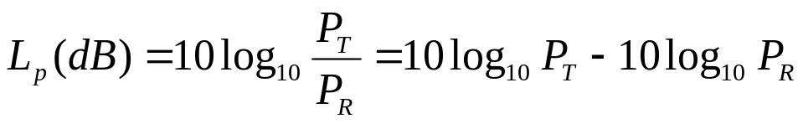
PATH LOSS
Path loss: the power loss during signal propagation from Tx to Rx
  Only a portion of the power from Tx will be captured by the receiver.
Path loss is defined as the ratio between the signal power at transmitter (PT) and signal power at receiver (PR).

Slide 9
PATHLOSS: MODELS
Free-space path loss model
  Clear, unobstructed LOS.
  Doesn’t consider surrounding objects.
  Highly simplified model
  E.g. satellite
Ray-tracing models
  Consider the effects of reflection, diffraction from surrounding environment
  More complex, depends on site geometry
General model
  Simple flexible mathematical model
  Captures the essence of path loss under various conditions
  Good for high level analysis

Slide 10
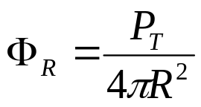

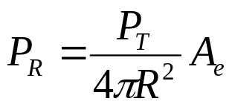
PATHLOSS: FREE-SPACE
Isotropic radiation
  Signal strength are equal in all directions
  Isotropic antenna: an antenna transmits equally
  in all directions.
Tx
At distance R from Tx antenna, the power per unit area
: Tx power
The surface area of a sphere with radius R
Power at Rx
Effective area of Rx antenna

Slide 11
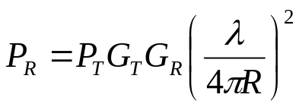





PATHLOSS: FREE-SPACE
Friis equation: path-loss equation for general antennas
Distance between Tx and Rx.
Transmit antenna gain
wavelength.
Receive antenna gain
For system with fixed PT, GT and GR
  R ↑ ➔ PR ↓
  f ↑ ➔ ↓ ➔PR ↓

Slide 12

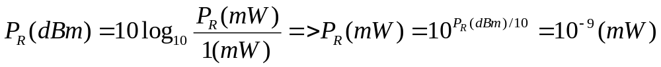
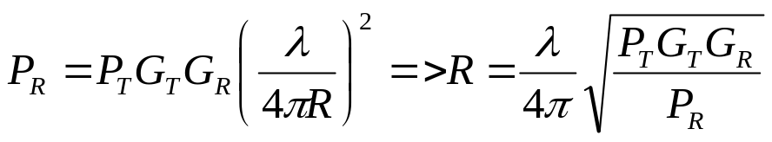
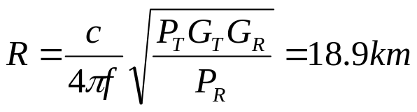
PATHLOSS: FREE-SPACE
Example
  In order to operate properly, a receiver must capture the signal power of at least -90dBm. Assuming a 100-miliwatt transmitter and free-space path loss. The antenna gain at Tx and Rx are 3dB. What is the service area radius of the Tx for a signal frequency of 800MHz?
Sol:

Slide 13


PATHLOSS: RAY-TRACING MODELS
Ray-tracing model
  Besides LOS, also considers the effects of reflection, diffraction and scattering ➔ considers the effects from each ray

Slide 14


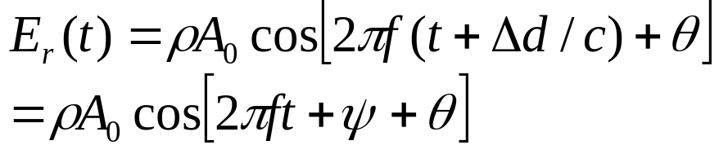


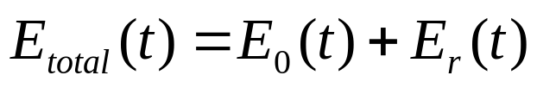
PATH LOSS: RAY TRACING MODEL
Example: plane-earth reflection
:Distance between two paths
Rx signal from LOS:
Rx signal from reflection:
: phase difference caused by distance difference
: due to reflection and distance difference
At the receiver:

Slide 15
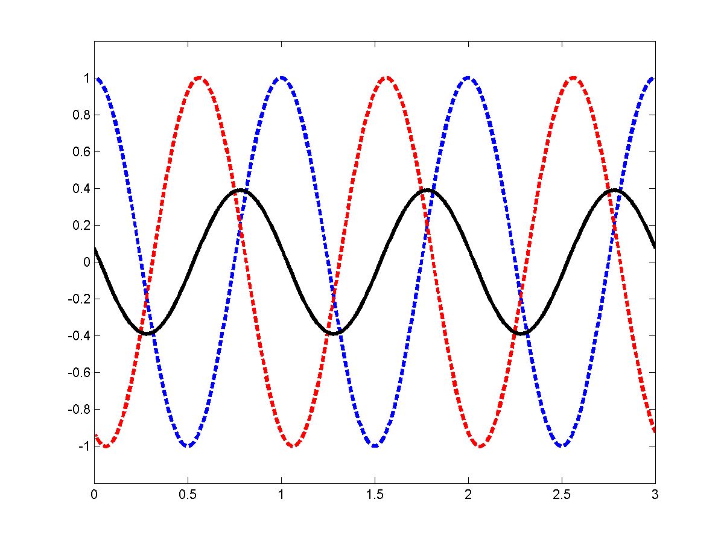
PATH LOSS: RAY TRACING MODEL
The phase difference between the two rays will result in construction or destruction effects of the Rx signal
LOS
Reflection
Total

Slide 16
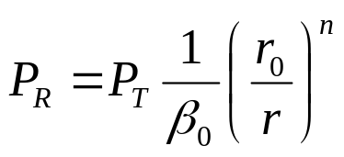




PATH LOSS: GENERAL MODEL
A general model capturing the essence of path loss in various environment
: reference distance (typically 1 meter)
: measured path loss at reference distance
: path loss exponent (can be obtained through measurement)
: distance between transmitter and receiver
n: path loss exponent
  r ↑➔ PR ↓
  The larger the value of n, the faster the Rx power falls off with the increase of distance.
  Free space: n = 2; rolling rural: n = 3.5; suburban: 4; dense urban: 4.5

Slide 17
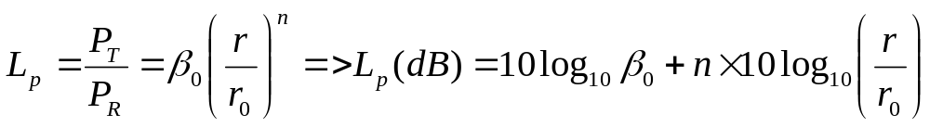
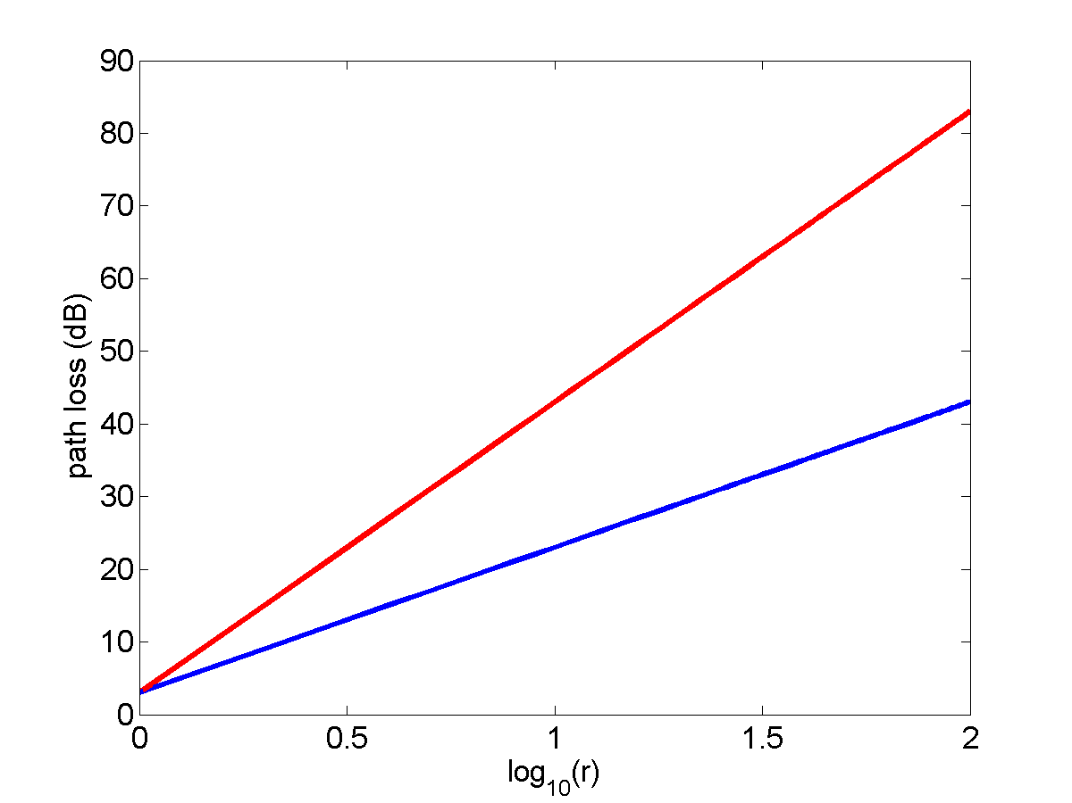
PATH LOSS: GENERAL MODEL
Usually represented in the unit of dB
n=4
Fix PT
Lp ↑➔ PR ↓
n=2

Slide 18


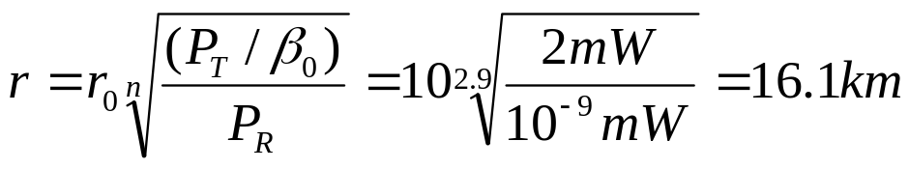
PATH LOSS: GENERAL MODEL
Example:
  At a distance meter from Tx, the measured power is . The path loss exponent is n = 2.9. The appropriate operation of the receiver requires the signal power at receiver must be at lease -90mW. What is the service radius? (using the general path loss model)
  Sol.

Slide 19
OUTLINE
Wireless channel
Path loss
Shadowing
Small scale fading
Channel classifications
Noise and interference
Simulation model

Slide 20
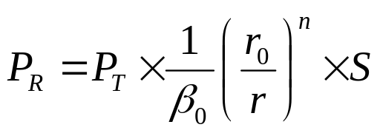

SHADOWING
Shadowing:
  Caused by large obstructions that are distant from MS
  Analogy: the shadow of light due to mountain.
  Effects of shadowing is random due to random # and type of obstructions.
  The existence of shadowing is verified through field measurement.
Consider the effects of path loss and shadowing
shadowing
path loss
: models the effects of shadowing. Random variable.

Slide 21
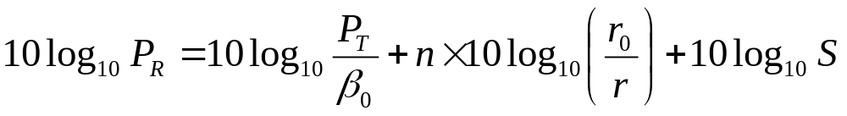

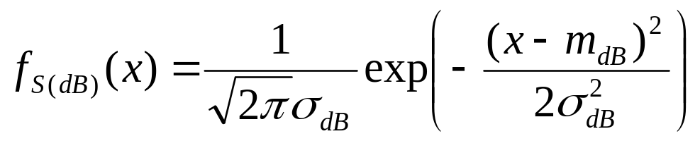
SHADOWING
dB representation
: follows Gaussian distribution (normal distribution)
S(dB) follows normal distribution➔ the log of S follows normal distribution
➔ The distribution of S is called lognormal distribution
Shadowing is called lognormal shadowing

Slide 22
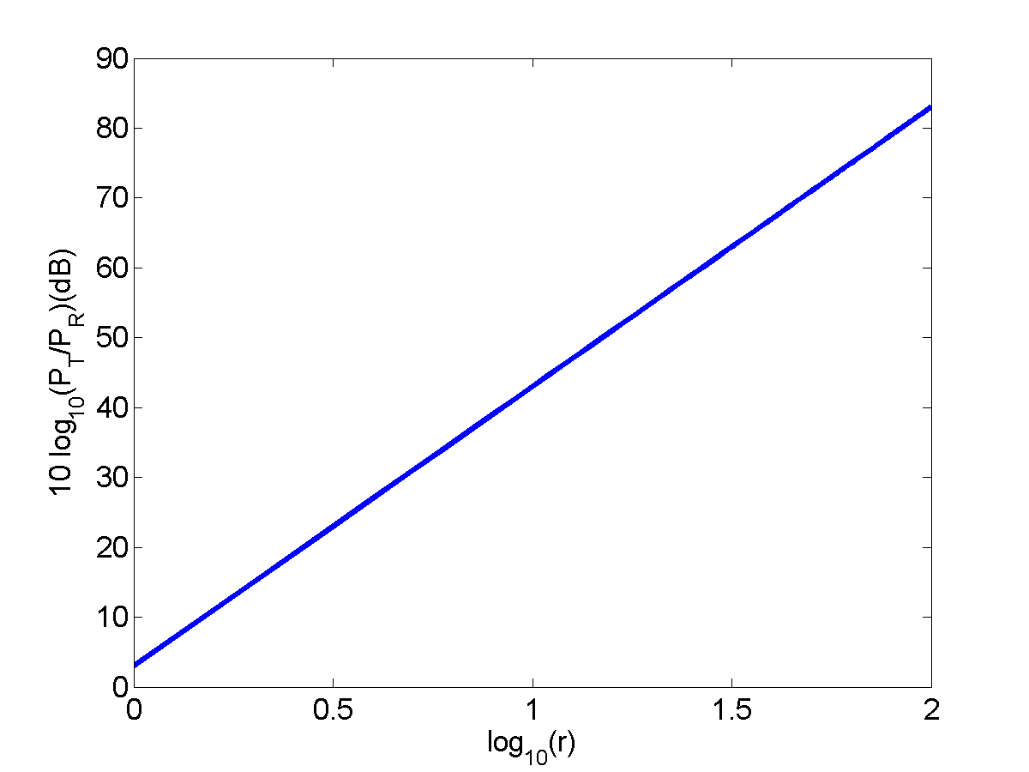
SHADOWING
path loss with shadowing (random)
path loss only
combined effects of path loss and shadowing (red curve)

