Slide 1
ELEG5693 Wireless Communications
Propagation and Noise Part II
Dr. Jingxian Wu
wuj@uark.edu

Slide 2
OUTLINE
Wireless channel
Path loss
Shadowing
Small scale fading
Simulation model
Channel classifications
Noise and interference

Slide 3
FADING: WHAT IS FADING?
Path loss and shadowing is caused by large objects that are distant from MS.
  Even the MS is moving, the change in the relative position between MS and those distant large objects is small.
  Therefore, the impairments caused by those large distant objects change very slow with respect to (w.r.t.) time and position.
  Shadowing is also referred to as large scale fading.
Small scale fading is caused by the effects of objects that are close to MS.
  The movement of MS w.r.t. nearby small objects will dramatically change the reflection or diffractions of propagated signals.
  The signal at receiver (sum of the signals from all multiple paths) will change rapidly with the movement of MS.
Small scale fading: rapid fluctuation of the received signals over
short distance.

Slide 4
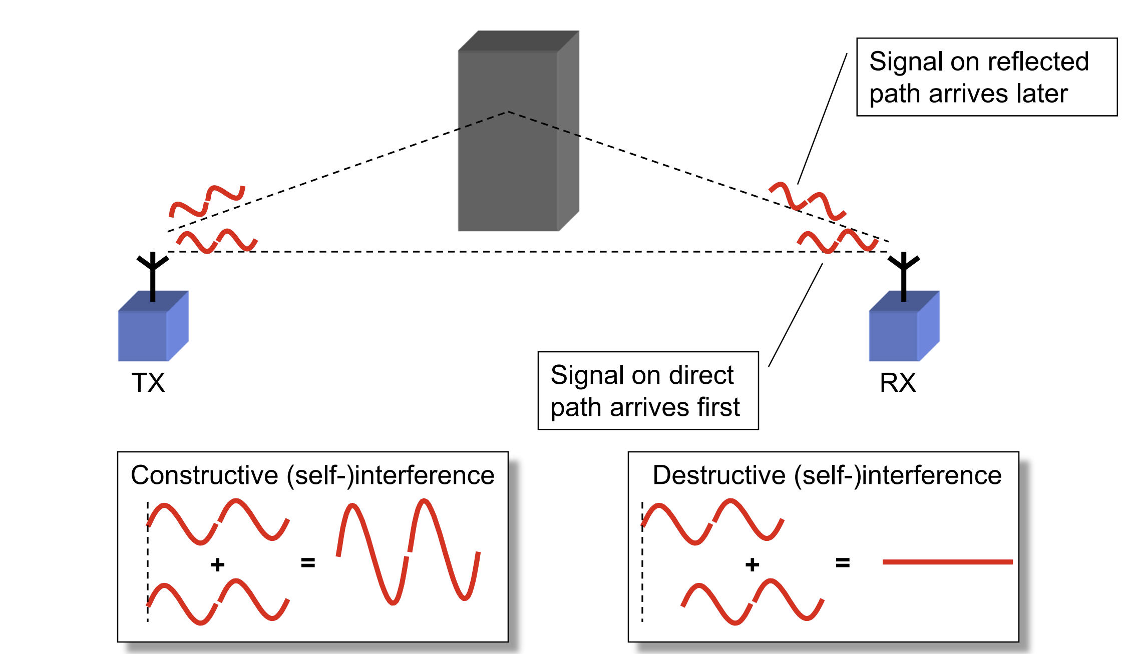
FADING: WHAT IS FADING

Slide 5


FADING: WHAT IS FADING?
Random # of multipath components
  The amplitude, phase, and frequency of each component change w.r.t. the movement of MS.
  The signal at the receiver is the summation of all the multipath components ➔ the amplitude, phase, and frequency of the received signal at receiver change w.r.t. the movement of MS.
  The movement of surrounding objects (e.g. vehicles) will also cause the time variation of the signals.

Slide 6
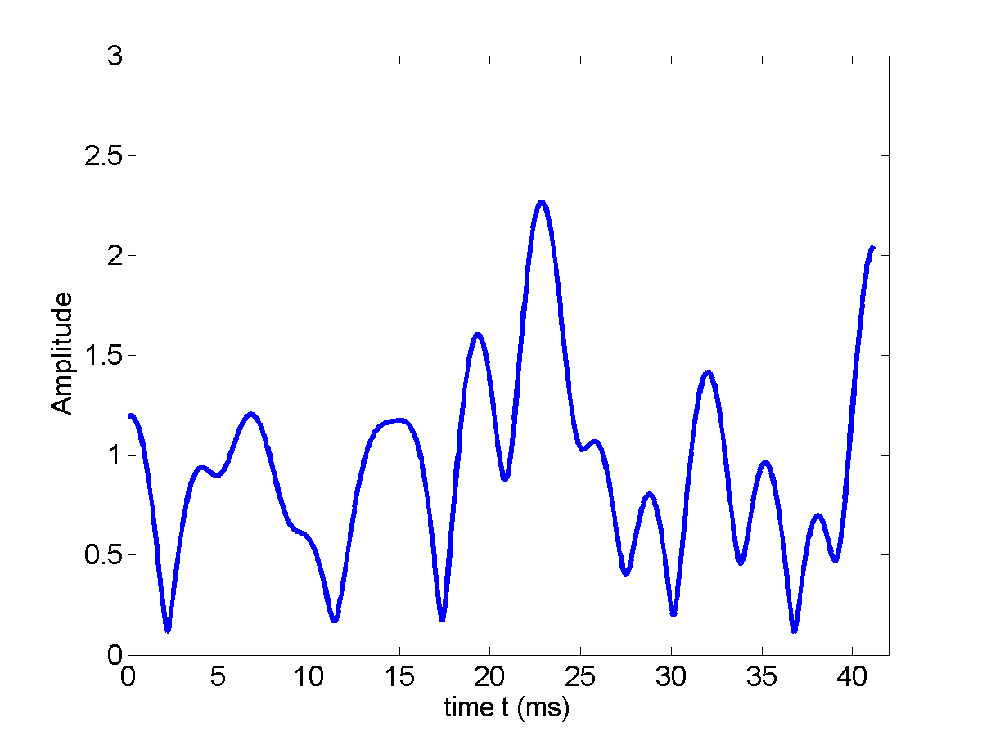
FADING: AN EXAMPLE
The rate of variation depends on two factors:
  Relative movement speed between Tx and Rx
  Speed of surrounding objects

Slide 7
FADING: DOPPLER
What is Doppler?
  The whistle of the train coming from opposite direction sounds different with the train passing by.
    The pitch of the sound (determined by sound frequency) is changing.
  Rx signal frequency will change if the Rx is moving w.r.t. Tx.
  Signal frequency change due to the relative movement between Tx and Rx is called Doppler effects.
t=0
c
b
a
c
b
a
a
t=0.5s
b
a
c
c
b
a
t=1s
c
b
a
c
b
a
T = 1s
T = 0.5s

Slide 8
FADING: DOPPLER
Consider Tx sends out a sinusoid with frequency 1Hz
  If Rx moves toward Tx, the signal observed by Rx will have a shorter period ➔ frequency increased
  If Rx moves away from Tx, the signal observed by Rx will have a longer period ➔ frequency decreased
The amount of frequency change is called Doppler shift
  Doppler shift depends on
    Relative speed between Tx and Rx
    The frequency of the original signal

Slide 9
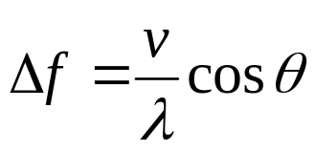


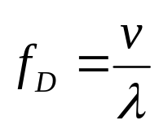
FADING: DOPPLER
Relationship between speed and Doppler shift
X
Base
Station
θ
v
: relative speed
: wavelength
Maximum Doppler shift:
Example: find the maximum Doppler shift of 900MHz system with mobile speed 120km/Hr
Notes:
V = 120*1000/3600 = 33.3m/s
Lambda = c/f = 3e8/900e6 = 0.33 m
Fd = v/lambda = 100Hz

Slide 10
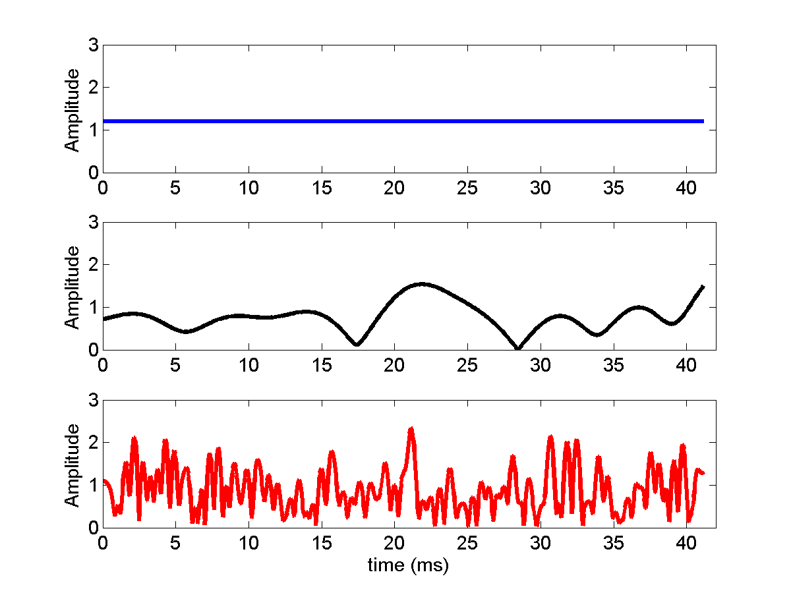
FADING: DOPPLER
At given frequency
  v ↑➔ fD ↑➔ channel changes more rapidly
fD = 0Hz
fD = 100 Hz
fD = 1000 Hz

Slide 11
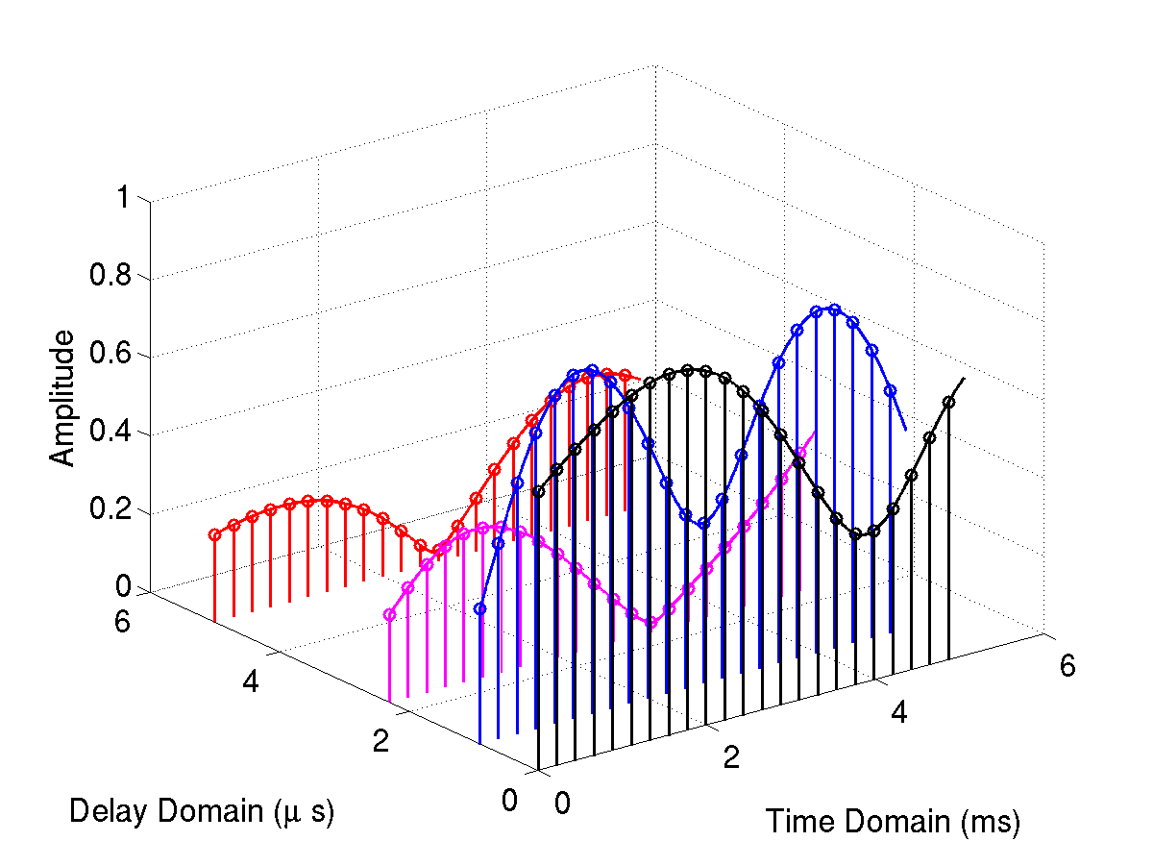


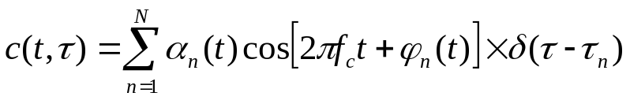




FADING: IMPULSE RESPONSE
The impulse response of fading is time-varying!
Relative multipath
delay
Time variation
N multipath components
  : system operating frequency (e.g. 900MHz, 1.8GHz)
  t: the time variation (both amplitude and phase changes with respect to time)
  : relative delay between multipath components
  : depends on path distance and Doppler shift

Slide 12
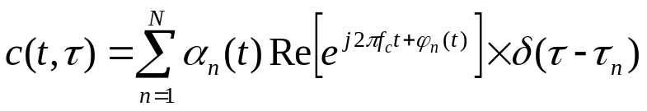
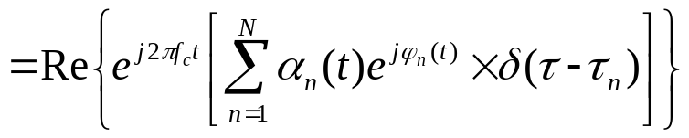
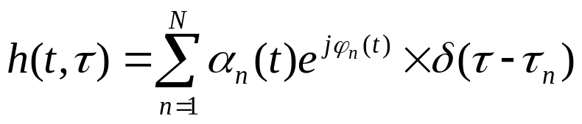
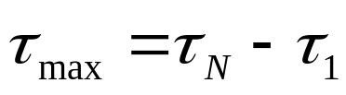
FADING: IMPULSE RESPONSE
Complex baseband representation
Maximum delay spread
  The time interval between the first multipath and the last multipath

Slide 13


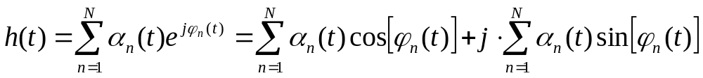
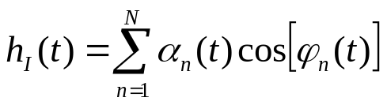
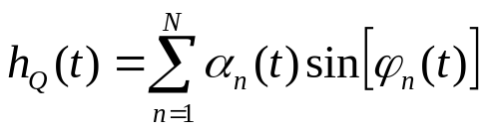
FADING: FLAT FADING
Flat fading
  Maximum delay spread << system symbol period Ts
  Relative to the symbol period, all the multipath components arrive at almost the same time ➔ Doesn’t need to consider the delay variable
  Inphase component
  Quadrature component

Slide 14

FADING: FLAT FADING
Both hI(t) and hQ(t) are the sum of many multipath components
  Each multipath component is a random process
  hI(t) and hQ(t) are random processes
Central limit theorem
  The sum of N independent and identically distributed (i.i.d.) random variables tends to Gaussian distribution when N is large enough.
Based on central limit theorem, at time time t, both hI(t) and hQ(t) are Gaussian distributed!

Slide 15

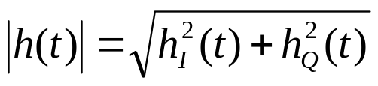
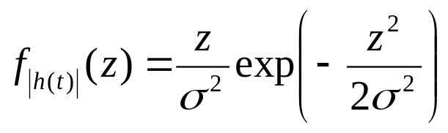
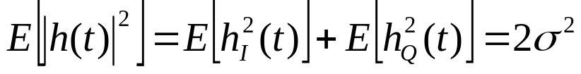
FLAT FADING: RAYLEIGH FADING
If there is no LOS between Tx and Rx
  hI(t) and hQ(t) are zero-mean Gaussian distributed ~
  The amplitude (or envelope) of h(t)
  The fading envelope |h(t)| follows Rayleigh distribution
  Average power of fading

Slide 16

FLAT FADING: RICIAN FADING
If there is LOS component
  hI(t) and hQ(t) are non-zero-mean Gaussian distributed ~
  The fading envelope
  follows Rician distribution

Slide 17
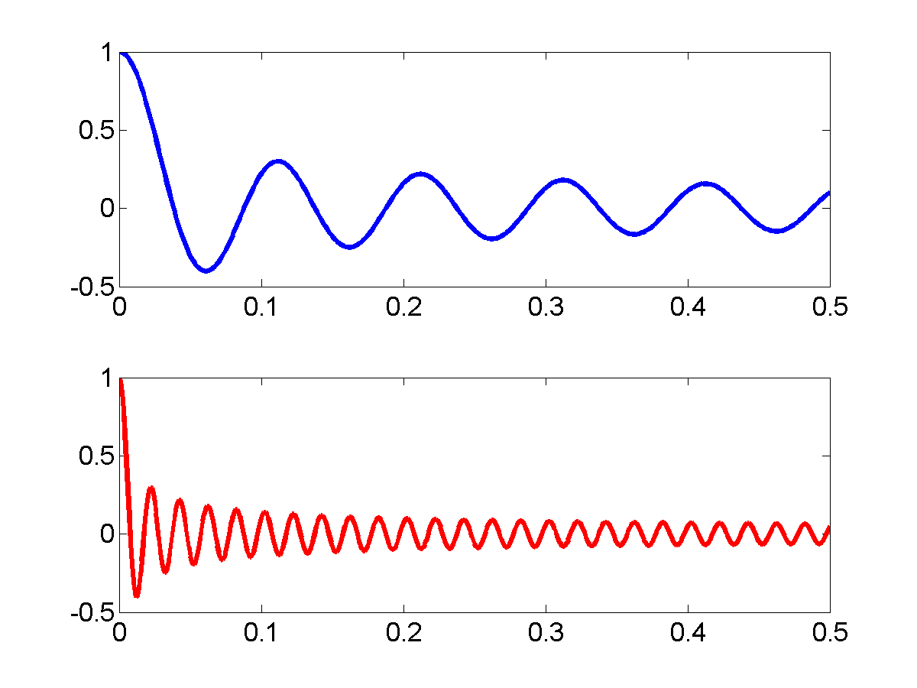


FLAT FADING: TIME DOMAIN CORRELATION
The time domain correlation of h(t) is
  J0(x): zero-order Bessel function of the first kind
Fd = 10Hz
Fd = 50Hz
  Generally speaking, for given time interval
    Larger speed v ➔ larger fD ➔ smaller .

Slide 18
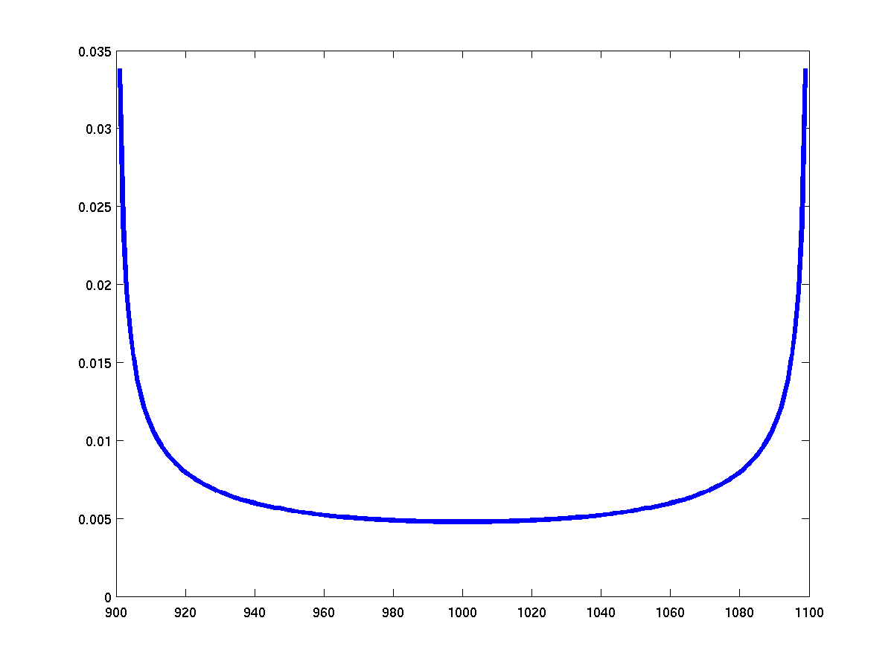
FLAT FADING: POWER SPECTRAL DENSITY
Power spectral density is the Fourier transform of auto-correlation function.
fc-fD
fc
fc+fD

Slide 19
OUTLINE
Wireless channel
Path loss
Shadowing
Small scale fading
Simulation model
Channel classifications
Noise and interference

Slide 20
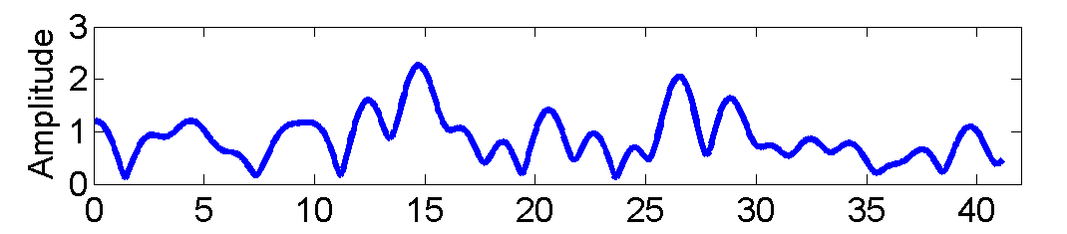





SIMULATOR
Flat Rayleigh fading is a random process
  At any time instant t, is Rayleigh distributed.
    Both the real part and the imaginary part are zero mean Gaussian distributed.
  The auto-correlation function must satisfy

Slide 21
SIMULATOR
How to generate flat Rayleigh fading with computer program?
  Method 1: Filtered Gaussian noise
    Rely on low-pass filter to introduce the time-domain correlation among symbols
White
Gaussian
Low-pass
Filter
hI(t)
hQ(t)
White
Gaussian
Low-pass
Filter
  The low-pass filter is hard to design.

Slide 22
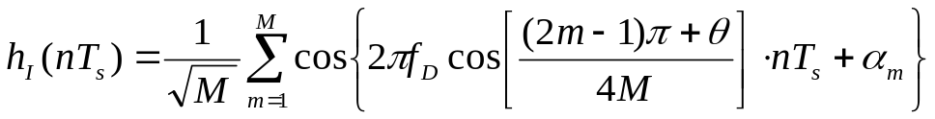
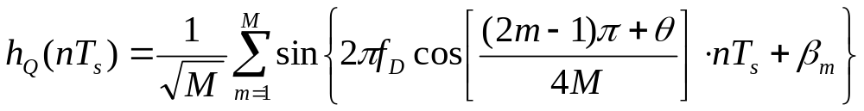





SIMULATOR
Method 2: Sum-of-sinusoid
: uniformly distributed in
: a constant. The larger, the more accurate. Usually 8 or 16.
: time duration between samples.
h = Rayleigh(N, fd, Ts)

Slide 23
OUTLINE
Wireless channel
Path loss
Shadowing
Small scale fading
Simulation model
Channel classifications
Noise and interference

Slide 24
CLASSIFICATION
Fading
  Amplitude and phase distortions of transmitted signal
Classification criterions
  Scale
    Large scale fading, small scale fading
  Small scale fading
    Flat fading v.s. frequency selective fading
    Fast fading v.s. slow fading
    Rayleigh fading v.s. Rician fading

Slide 25
CLASSIFICATION: SCALE
Large scale fading
  Path loss (signal power loss as a function of distance)
    Due to distance between Tx and Rx, reflection of large objects
  Shadowing
    Obstruction from large objects
Small scale fading
  Amplitude and phase distortions from local objects ➔ highly sensitive to locations of MS
  Due to the superposition of multiple electromagnetic waveforms
  Caused by two independent propagation mechanisms
    (1) time dispersion (delay spread)
      Determines frequency selective or flat
    (2) frequency dispersion (Doppler spread)
      Determines fast or slow

Slide 26
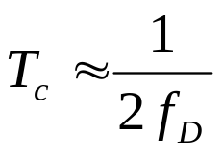
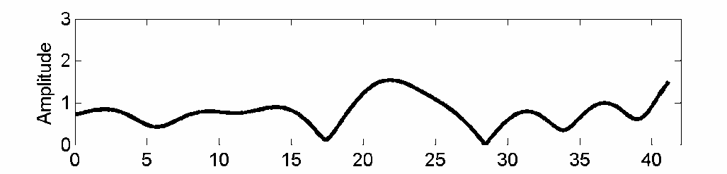
CLASSIFICATION: FAST FADING V.S. SLOW FADING
The time domain variation of fading is determined by maximum Doppler spread fD
  Doppler shift: signal frequency change due to relative movement between Tx and Rx.
  Larger speed v ➔ larger fD ➔ channel varies faster.
Coherence time Tc
  The time period over which the channel is strongly correlated (didn’t change too much)
  Inverse proportional to fD
Tc
Tc

Slide 27
CLASSIFICATION: FAST FADING V.S. SLOW FADING
System symbol period v.s. signal bandwidth
0
1
0
0
1
0
1
0
Symbol Period = T_{s}
Signal BW = B_{s} ≈ 1 / T_{s}
Fast fading
  If Ts > Tc, or Bs < fD
    Ts > Tc: channel changes within one symbol period➔ fast fluctuation
Slow fading
  If Ts << Tc, or Bs >> fD
    Ts << Tc : channel keeps constant during several symbol periods ➔ slow amplitude fluctutation.
(Coherence time Tc, Doppler spread fD) is related to fast fading or slow fading

Slide 28
CLASSIFICATION: FAST FADING V.S. SLOW FADING
Example: A cell phone user is in a vehicle moves at a speed of 120km/hr. The carrier frequency is 1800MHz.
  (a) What is the maximum Doppler spread?
  (b) What is the coherence time of the channel?
  (c) The symbol period of a system is 3ms. Is the system experiencing fast fading or slow fading?
  (d) The symbol rate of IS-136 system is 24.3ksym/s. Is the system experiencing fast fading or slow fading?
Notes:
V = 120 km/hr = 120 x 1000/3600 = 33.3 m/s
fd = v/(c/f) = v*f/c = 33.3*1800e6/3e8 = 210 Hz
Tc = 1/(2 fd) = 1/(2*210) = 0.0024 s = 2.4 ms
Ts = 3 ms, Tc = 2.4ms, Ts > Tc, fast fading
Ts = 1/24.3e3 = 4.1e-5 = 0.041 ms, Ts << Tc, slow fading

Slide 29
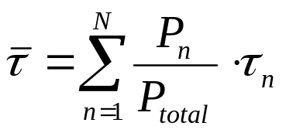

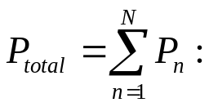
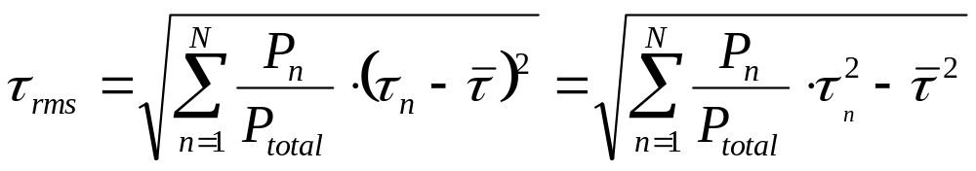
CLASSIFICATION: FLAT V.S. FREQUENCY SELECTIVE
Maximum delay spread
  The time interval between the first multipath and the last multipath
Mean delay spread
the average power of the nth multipath
the total power of the all multipath
Root mean square (rms) delay spread

Slide 30
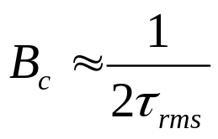

CLASSIFICATION: FLAT V.S. FREQUENCY SELECTIVE
Coherence bandwidth Bc
  The bandwidth over which the channel is strongly correlated (didn’t change too much)
    The spectrum over coherence bandwidth is almost “flat”
  Inverse proportional to rms delay spread
f
Bc
(Coherence bandwidth Bc, rms delay spread ) is related to fast fading or slow fading

Slide 31



CLASSIFICATION: FLAT V.S. FREQUENCY SELECTIVE
Flat fading
  If Bs << Bc, or Ts >>
  Bs << Bc: signal bandwidth << channel bandwidth
  Ts >> : relative arrival time between multipath components is negligible
    Doesn’t need to consider delay variable ➔
B_{c}
B_{s}
f
f_{c}
Frequency selective fading
  If Bs >> Bc, or Ts <<
  Bs >> Bc: signal bandwidth >> channel bandwidth
    Signal spectrum will be seriously distorted by channel!
  Ts << : symbol period smaller than rms delay spread
    The relative arrival time between the multipath components is no longer negligible!

Slide 32


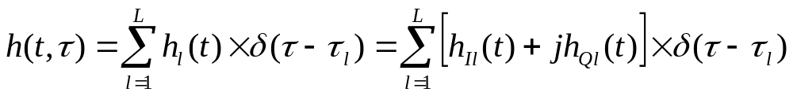
CLASSIFICATION: FREQUENCY SELECTIVE FADING
Frequency selective fading
  rms delay spread > > system symbol period Ts
    The relative arrival time between the multipath components is no longer negligible!
  The N multipath components are divided into L clusters
    Within each cluster, there are still many multipath components
    Multipath components belonging to the lth cluster arrives at approximately the same time .
  hl(t) is the sum of all the multipath components within the same cluster
    Resolvable multipath component
  The inphase and quadrature components of hl(t) are Gaussian distributed.
  The frequency selective fading can be viewed as the combination of multiple flat fading
    Each branch (cluster) hl(t) can be viewed as flat fading

Slide 33
CLASSIFICATION: FREQUENCY SELECTIVE FADING
Each branch of frequency selective fading can be viewed as a flat fading
  All the properties discussed for flat fading can be directly applied to each branch of frequency selective fading
    E.g. Inphase and quadrature components are Gaussian distributed.
    fading envelope: Rayleigh v.s. Rician

Slide 34
CLASSIFICATION: FREQUENCY SELECTIVE FADING
Relative multipath
delay
Time variation

Slide 35
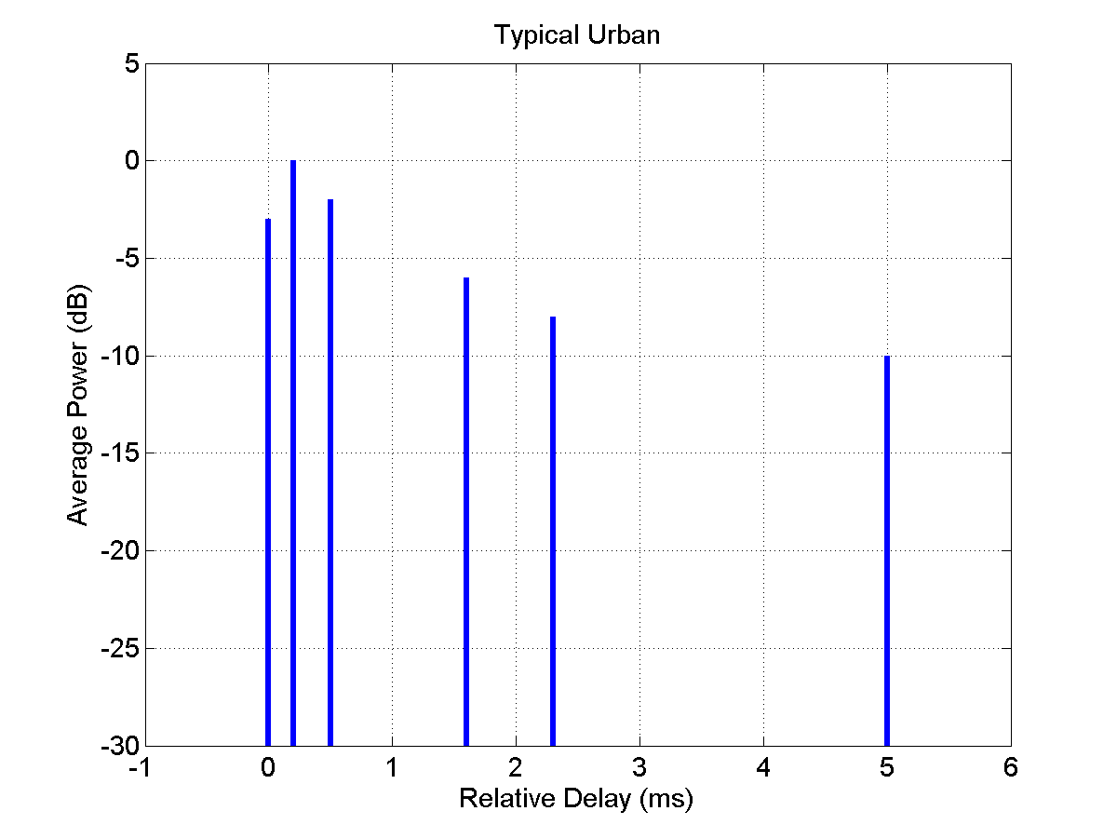
CLASSIFICATION: FREQUENCY SELECTIVE FADING
Power delay profile
  The average power of each resolvable multipath component, w.r.t. the relative delay
Relative delay (ms) | 0 | 0.2 | 0.5 | 1.6 | 2.3 | 5.0
Average power | 0.1897 | 0.3785 | 0.2388 | 0.0951 | 0.0600 | 0.0379

Slide 36
CLASSIFICATION: FREQUENCY SELECTIVE FADING
Example:
  (a) Find the maximum delay spread, mean delay spread, and rms delay spread of the following power delay profile.
  (b) What is the coherence bandwidth of the channel?
  (c) For a system with symbol rate 0.5KHz, is this a flat fading or frequency selective fading?
  (d) For a system with symbol rate 1000KHz, is this a flat fading or frequency selective fading?
Relative delay (ms) | 0 | 1
Average power | 0.4 | 0.6
Notes:
Max: 1 – 0 = 1 ms
Mean: 0*0.4 + 1*0.6 = 0.6 ms
rms:
(b) Coherence bandwidth

Slide 37
CLASSIFICATION: RAYLEIGH V.S. RICIAN
Fading envelope
Rayleigh fading
  Fading envelope |h(t)| follows Rayleigh distribution
  Non LOS (no dominant multipath components)
Rician fading
  Fading envelope |h(t)| follows Rician distribution
  One dominant component (LOS) along with weaker multipath signals

Slide 38
OUTLINE
Wireless channel
Path loss
Shadowing
Small scale fading
Simulation model
Channel classifications
Noise and interference

Slide 39
NOISE
Noise and interference
  Unwanted electrical signals interfering with the desired signal
  Arises from outside natural or artificial sources
    Artificial source: noise from automobile ignition, signal from other communication system, etc.
    Natural source: thermal noise, atmospheric disturbances.
Noise v.s. fading
  Noise arises from outside sources
    fading arises from the signal propagation itself
  Noise is added to the desired signal ➔ the desired signal is buried by noise (noise only has negative effects on signal).
    Fading results in signal power fluctuation ➔ signal power may become larger or become smaller (fading might benefit system performance).
  Noise is present in all communication systems.
    Fading is unique to wireless communications.

Slide 40
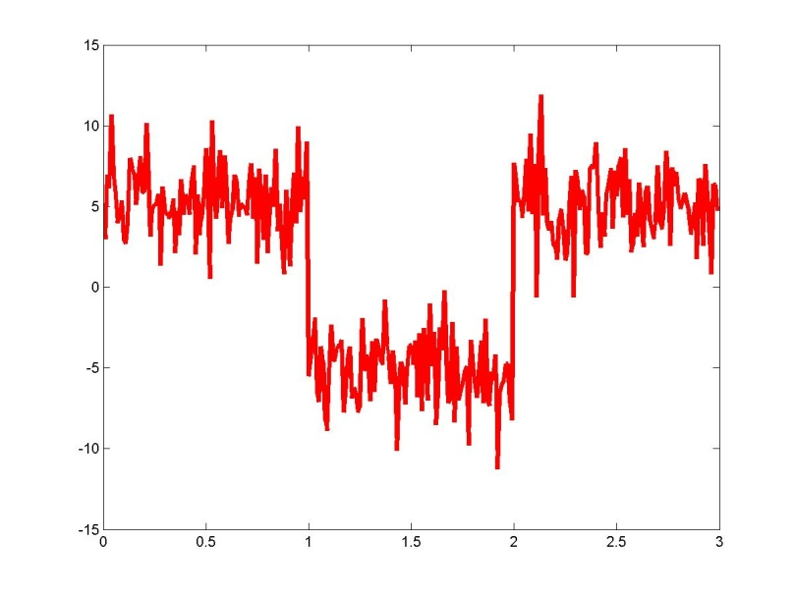
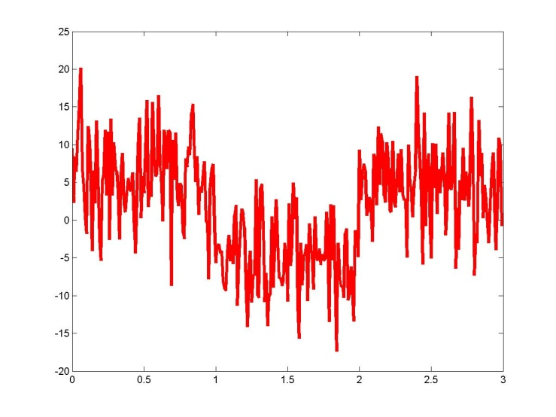
NOISE: SIGNAL TO NOISE RATIO
Signal to noise ratio (SNR):
  the ratio of the signal power to the noise power at the receiver.
  SNR = S/N, with S being the signal power, and N being the noise power observed by the receiver.
  High SNR ➔ Signal is strong, and noise is weak ➔ Better communication quality.
  Improve SNR ➔ Improve Tx power ➔ More power consumption
High SNR
Low SNR

Slide 41
NOISE: THERMAL NOISE
Thermal noise
  At the temperature above 0K (absolute temperature, =-273 centigrade), the electrons inside the conductor will move randomly.
  This random movement of electrons will cause random voltage fluctuations of the transmitted signals.
  Temperature increase ➔ electrons movement becomes stronger ➔ noise power increase

Slide 42
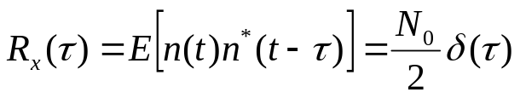
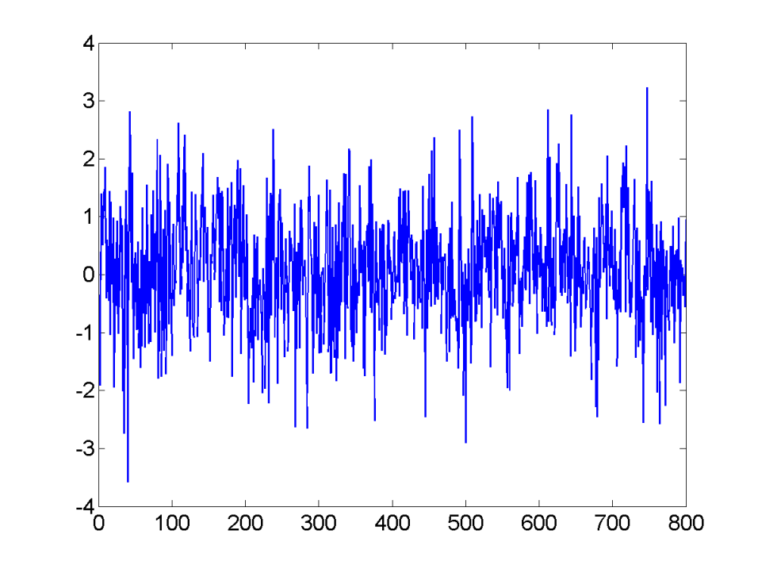
NOISE: THERMAL NOISE
Thermal noise is a random process
  At any time instant, the random voltage due to thermal noise follows Gaussian distribution with zero mean.
    The random voltage is caused by the sum of the motions of a large number of electrons (central limit theorem).
  The noise samples at any two different time instants are uncorrelated. Auto-correlation function

Slide 43
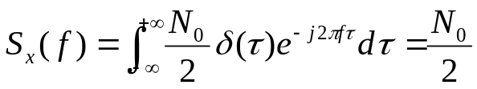



NOISE: THERMAL NOISE
Power spectral density
  Fourier transform of autocorrelation function
N0/2
N0/2
f
white spectrum
Additive White Gaussian Noise (AWGN)

Slide 44
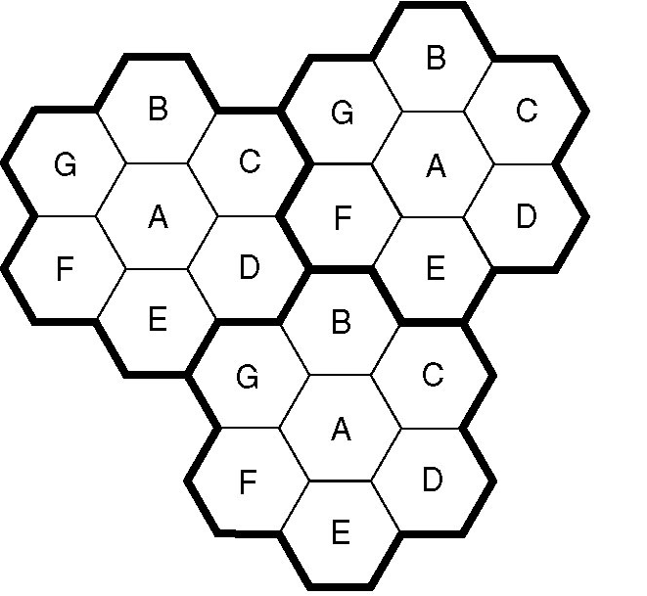
NOISE: COCHANNEL INTERFERENCE
Cochannel interference (CCI)
  Due to frequency reuse, cells using the same frequency range will generate interference with each other.
  Unique to cellular system.

