Slide 1
ELEG5693 Wireless Communications
Ch. 3 Modulation
Dr. Jingxian Wu
wuj@uark.edu

Slide 2
OUTLINE
Modulation
Linear Modulation I
Complex Signal Representation
Pulse Shaping
Linear Modulation II
Non-linear Modulation
FDMA

Slide 3
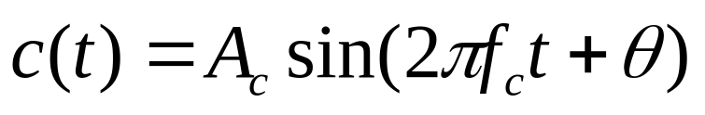
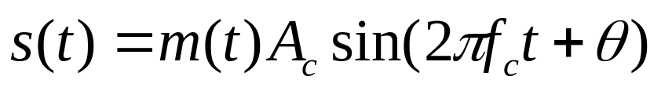
MODULATION: DEFINITION
What is modulation?
  The process of modifying a carrier signal (usually a sinusoid) in accordance with an information-bearing signal (modulating signal), such that the modified carrier signal (modulated signal) can be used to convey information.
  Carrier signal:
    Three parameters: amplitude, frequency, phase
    One or all of them can be modified to carry information.
      E.g. the amplitude is modified to carry information m(t)
m(t)
Modulator
s(t)

Slide 4
MODULATION: DEFINITION
What is modulation? (cont’d)
  Modulating signal m(t)
    Original electrical information-bearing signal
    E.g. electrical waveform representing voice, ASCII, digital video, etc.
    Usually at low frequency
    Also called baseband signal
  Carrier signal c(t)
    High frequency sinusoid to carry the information.
  Modulated signal s(t)
    Carrier signal modified by modulating signal
    At the output of the modulator.
    Also called bandpass signal, or RF signal
m(t)
Modulator
s(t)
c(t)

Slide 5
MODULATION: WHY?
Why modulation?
  Shift the frequency of the message signal to the pre-allocated channel.
    For example:
      speech signal: 300 ~ 3100 Hz m(t)
      Shift the signal to the allocated frequency range: 900MHz c(t)
  Transfer the message into a form more suitable for wireless transmission.
    Limited bandwidth
    Make better use of the limited spectrum
    High frequency signals are more suitable for wireless transmission.
  Enables multiple access
    Signals from different users can be shifted to different frequencies.
    Modulation allows the simultaneous transmission of multiple users.

Slide 6

MODULATION: TERMS
Demodulation
  Recover the original message signal m(t) from the modulated signal s(t).
Modulator
  Device used to perform modulation
Demodulator
  Device used to perform demodulation.
s(t)
r(t)
m(t)
Modulator
Demodulator
r(t): modulated signal impaired by fading and noise.

Slide 7
MODULATION: CLASSIFICATIONS
Linear modulation v.s. non-linear modulation
Analog modulation v.s. Digital modulation
Amplitude modulation v.s. Angle modulation

Slide 8




MODULATION: LINEAR V.S. NON-LINEAR
Principle of superposition
mi(t)
si(t)
Modulator
  If input is , then output is
  If input is , then output is
If the input-output of the modulator satisfies principle of superposition, then the modulator is called linear modulator.
  E.g.
If the principle of superposition is not satisfied, the modulator is non-linear modulator.

Slide 9
MODULATION: ANALOG V.S. DIGITAL
Analog modulation
  m(t) is an analog signal
    m(t) is a continuous function of time t.
    m(t) can take infinite number of values
  Analog modulation is also called continuous-wave (CW) modulation.
  AM radio, FM radio, first generation cell phone system
Digital modulation
  m(t) is a digital signal
    Take finite number of values
    E.g. {-1, 1}, {-2, -1, 1, 2}, …
  2nd generation cell phone system
  Digital modulation systems have become more and more popular.

Slide 10


MODULATION: AMPLITUDE V.S. ANGLE
Amplitude modulation
  The amplitude of the carrier, , is modified by the message signal m(t).
Angle modulation
  The angle of the carrier is modified by the message signal m(t).
  Frequency modulation: frequency is modified by m(t).
  Phase modulation: phase is modified by m(t)

Slide 11
OUTLINE
Modulation
Linear Modulation Techniques I
Complex Signal Representation
Pulse Shaping
Linear Modulation Techniques II
Non-linear modulation
FDMA

Slide 12



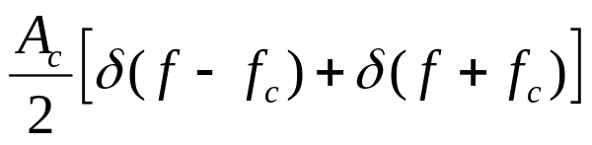


LINEAR MODULATION: AM
Amplitude modulation (AM)
  The term, AM, is usually used when m(t) is analog
message signal
carrier frequency
Spectrum of AM
  ➔
  ➔
  ➔ S(f) = ?

Slide 13






LINEAR MODULATION: AM
Spectrum of AM
M(f)
Baseband signal
0
W
f
-W
S(f)
bandpass signal
f
Center frequency shifted from 0 to
The bandwidth is doubled from W to 2W

Slide 14
LINEAR MODULATION: AM
Bandwidth
  Baseband bandwidth (bandwidth of baseband signal): from 0 to W
  Passband bandwidth (bandwidth of modulated signal): from Fc-W to Fc+W.
    Passband bandwidth is twice of baseband bandwidth.
How do we define bandwidth?
  There are many different definitions of bandwidth
  B’: half power bandwidth (3dB bandwidth).
  B’’: null-to-null bandwidth
  B’’’: absolute bandwidth
  FCC definition: bandwidth contains 99% of signal power
1
B’
0.5
f
power spectrum
f_{c}
B”
B”’

Slide 15
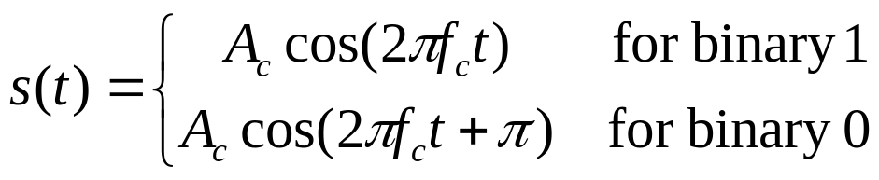
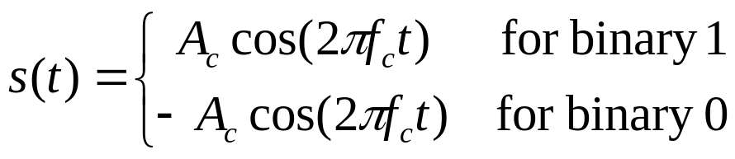
LINEAR MODULATION: BPSK
Binary phase shift keying (BPSK) ➔ Digital modulation
  Or alternatively
  Also called binary amplitude shift keying (BASK)

Slide 16
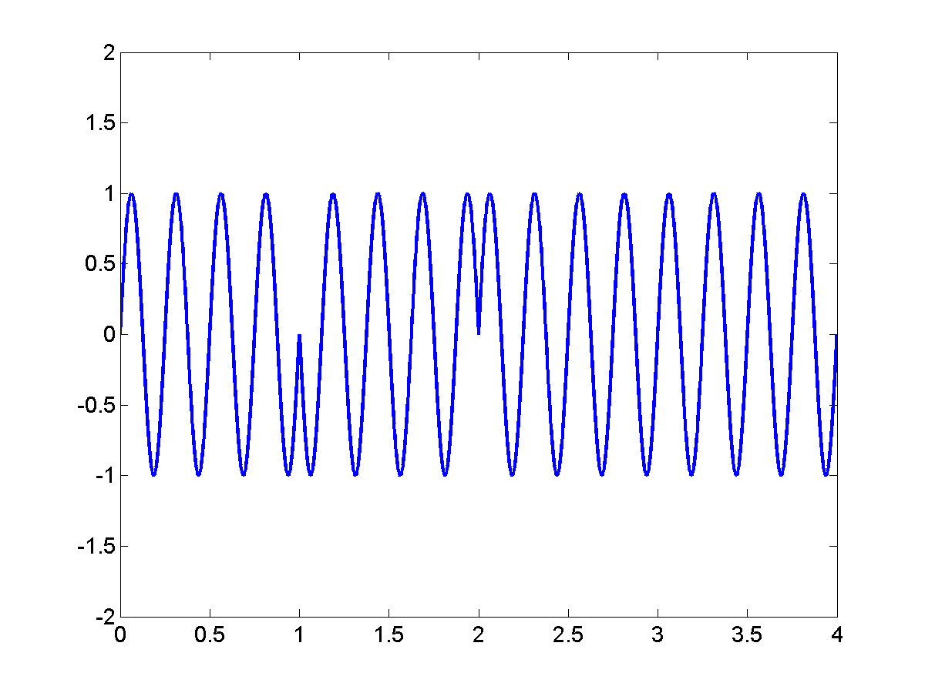
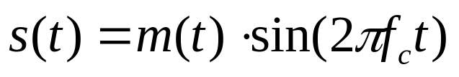
LINEAR MODULATION: BPSK
s(t)
1
0
1
1
1
m(t)
-1

Slide 17
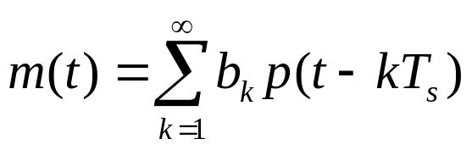
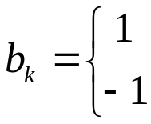
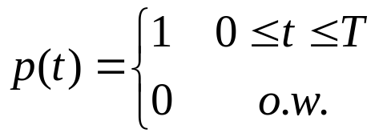
LINEAR MODULATION: BPSK
p(t)
p(t-kTs)
0
Ts
kTs
(k+1)Ts
Ts: symbol period. (The time duration to carry one symbol)
  usually inverse proportional to signal BW

Slide 18

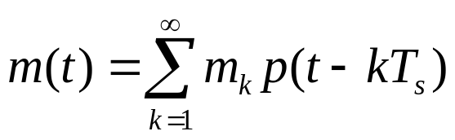


LINEAR MODULATION: MASK
M-ary amplitude shift keying (MASK)
  The information can take values
E.g. 4-ary amplitude shift keying (4ASK)

Slide 19
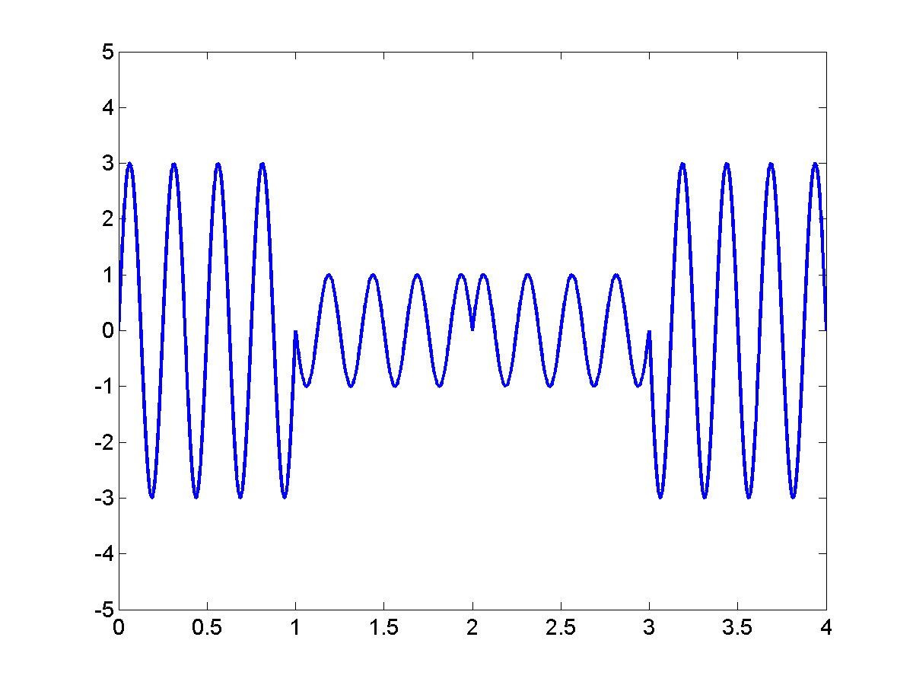
LINEAR MODULATION: MASK
s(t)
3
-1
1
-3
3
(00)
(10)
1
m(t)
-1
(11)
-3
(01)

Slide 20

LINEAR MODULATION: MASK
Each symbol can take M values
  Each symbol can represent bits of information.
E.g.
  4ASK ➔ M = 4 ➔ 2 bits/sym
  8ASK ➔ M = 8 ➔ 3 bits/sym
  16ASK ➔ M = 16 ➔ 4 bits/sym
Symbol rate (baud) Rs :
  # of modulation symbols/second
  Generally, signal bandwidth is proportional to symbol rate!
Bit rate Rb:
  Bits/second
Rb = Rs x (# of bits/sym)

Slide 21
LINEAR MODULATION: MASK
M-ary modulation
  At the same symbol rate, (or fixed bandwidth)
    Larger M ➔ more bits/symbol ➔ larger bit rate
  M-ary modulation is good for band-limited system
    In wireless systems, spectrum is precious
    M-ary modulation is widely used in wireless systems!
    Typical values used in wireless system: M = 2, 4, 8, 16
Why don’t we use a very large M?
  If M ➔ infinity, then analog signal
  At the same SNR
    Larger M ➔ signals are more closed to each other ➔ it’s harder to distinguish between all signals at receiver due to noise ➔ probability of error becomes larger!

Slide 22





LINEAR MODULATION: QPSK
Quadrature phase shift keying (QPSK)
  Combination of two BPSK streams
  Quadrature: orthogonal (two carriers that are 90 degree apart)
Inphase signal
quadrature signal

Slide 23

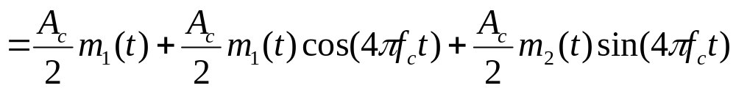
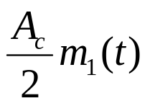
LINEAR MODULATION: QPSK
Demodulator
  How could these two signals not interfere with each other?
low pass filter
low pass filter
After low pass filter:

Slide 24



LINEAR MODULATION: QPSK
At each symbol period, two bits of information are transmitted
  2 bits/symbol
  Inphase signal has the same bandwidth as BPSK
  Quadrature signal has the same bandwidth as BPSK
  The sum has the same bandwidth as BPSK
    Sum in time domain ➔ sum in frequency domain ➔ bandwidth unchanged.
  The same bandwidth as BPSK, but twice the bit rate of BPSK!
  No interference between quadrature and inphase
    Inphase has the same error performance as BPSK
    Quadrature has the same error performance as BPSK
    QPSK has the same error performance of BPSK!
One of the rare occasions that increase bit rate without sacrificing error performance!

Slide 25
OUTLINE
Modulation
Linear Modulation Techniques I
Complex Signal Representation
Pulse Shaping
Linear Modulation Techniques II
Non-linear modulation
FDMA

Slide 26
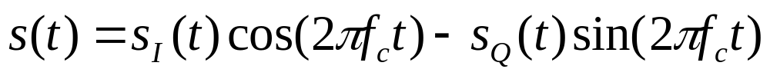
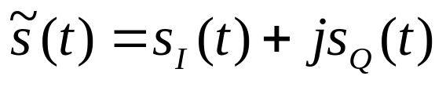
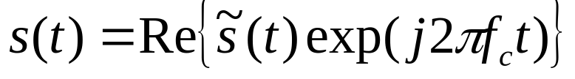
COMPLEX REPRESENTATION
Band-pass signal
Complex base-band signal (also called the complex envelope of the signal)
Relationship between complex baseband and band-pass

Slide 27
COMPLEX REPRESENTATION
Modulation can be decomposed into two steps:
  1. complex baseband modulation, 2. frequency upconversion
    The complex representation completely preserves the information of the modulating signal except the carrier frequency
  It’s suffice for us to examine baseband modulation only!
Baseband
modulation
Frequency
upconversion
Modulation

Slide 28
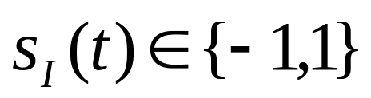
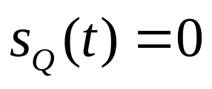
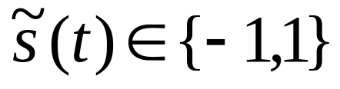

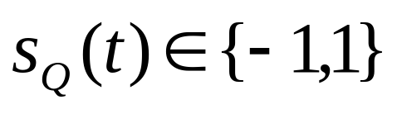
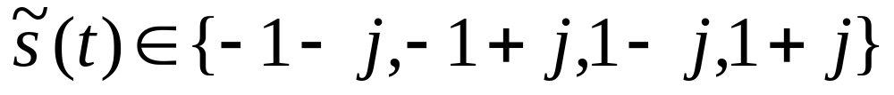

COMPLEX REPRESENTATION: BASEBAND MODULATION
BPSK
QPSK
Baseband
modulation
Frequency
upconversion
Modulation

Slide 29



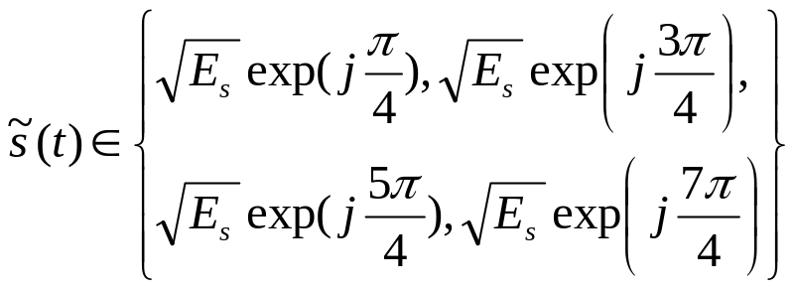

COMPLEX REPRESENTATION: CONSTELLATION
Modulation Constellation
  The collection of all modulation symbols in their complex representation.
  : the energy of one symbol
Im
Im
01
00
0
1
Re
Re
10
11
BPSK
QPSK

Slide 30
COMPLEX REPRESENTATION
Baseband modulation examples
Im
Im
01
00
0
1
Re
Re
10
11
BPSK
0010110111
BPSK:
QPSK:

Slide 31
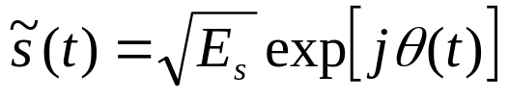



COMPLEX REPRESENTATION: SYMBOL ENERGY
Symbol energy Es
  If modulation symbol is
  The energy of one symbol is .
    Proof:
Bit energy Eb
  The energy of one bit
  # of bits per symbol:

Slide 32
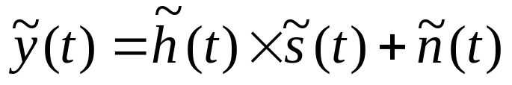
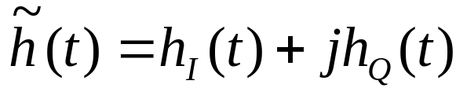
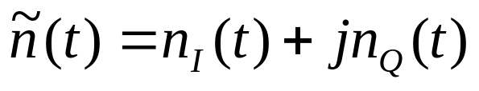
COMPLEX REPRESENTATION
Signals pass through channel with flat fading and AWGN
: time-varying flat fading
: AWGN
Both the inphase component and quadrature component
are going to be distorted.

Slide 33
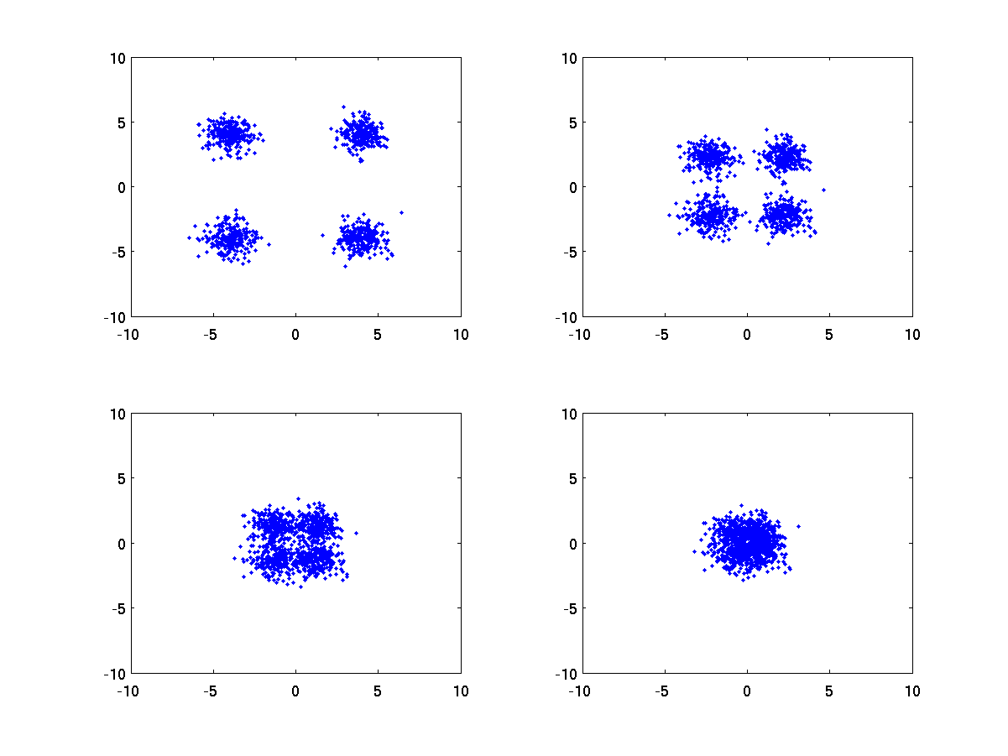

COMPLEX REPRESENTATION: SNR
Signal to noise ratio (SNR)
  The ratio between signal power and noise power
  E.g. same level of noise, signal power becomes smaller
SNR=15dB
SNR=10dB
SNR=5dB
SNR=0dB
QPSK:

Slide 34
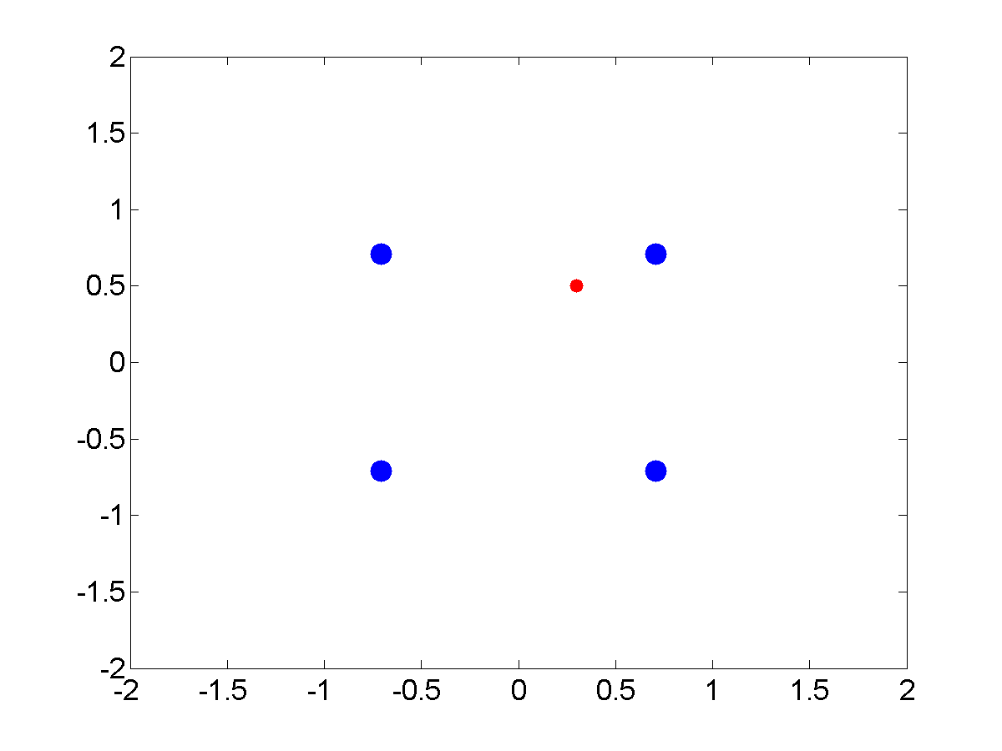




COMPLEX REPRESENTATION: SNR
Baseband demodulation
  Find the modulation symbol that has the smallest Euclidean distance with the received signal.
  E.g. QPSK: r = x + n
    r = 0.3 + j 0.5
Im
Re

Slide 35
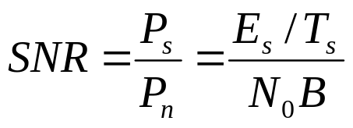
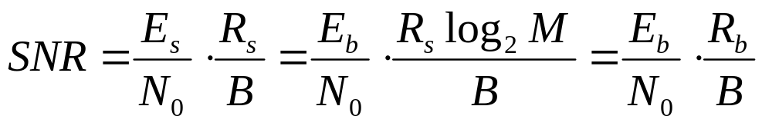
COMPLEX REPRESENTATION: SNR
SNR
  The ratio between signal power and noise power
Symbol period
Power spectral density of noise
Signal bandwidth
Symbol rate Rs = 1/Ts
Bit rate Rb

Slide 36
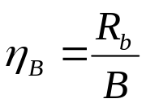



COMPLEX: BANDWIDTH EFFICIENCY
Bandwidth efficiency
  How many bits can be accommodated in unit bandwidth (bps/Hz)
bit rate
bandwidth
  Measures the ability of the modulation technique to accommodate data in a limited bandwidth
    Larger bandwidth efficiency ➔ more data can be transferred in limited bandwidth
Generally, the bandwidth is proportional to symbol rate
  For M-ary modulation, fixed bandwidth B ➔ fixed symbol rate
    Larger M ➔ larger ➔ larger bandwidth efficiency

Slide 37
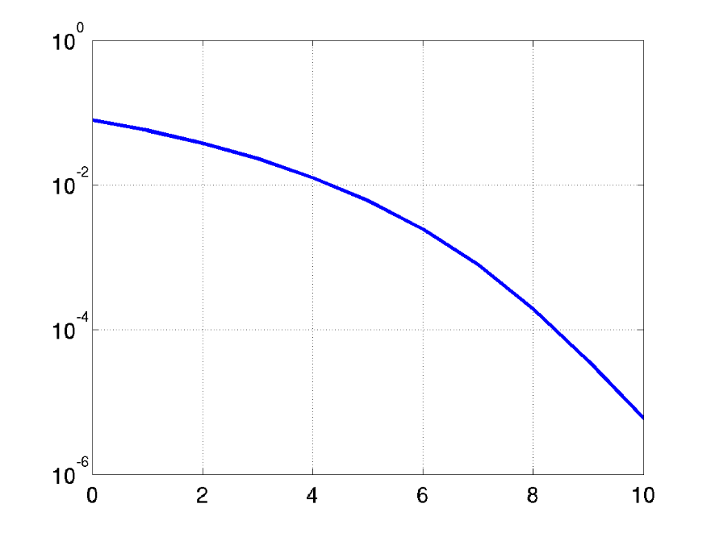
COMPLEX: ENERGY EFFICIENCY
Energy efficiency
  At given noise level, how much energy is required to achieve a certain bit error rate.
  Measured as the value of Eb/N0 required for certain bit error rate (BER).
    Eb: energy per bit. N0: noise power spectral density.
BER v.s. Eb/N0 is the most important
measure of digital communication systems!
BER
Eb/N0 (dB)

Slide 38
OUTLINE
Modulation
Linear Modulation Techniques I
Complex Signal Representation
Pulse Shaping
Linear Modulation Techniques II
Non-linear modulation
FDMA

Slide 39
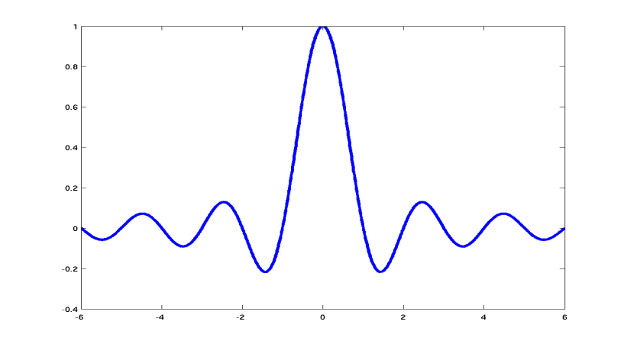
PULSE SHAPING
Why pulse shaping?
  In previous discussions, the message m(t) is represented as a series rectangular pulses.
1
0
1
1
1
m(t)
-1
  Rectangular pulse has unlimited bandwidth!
t
f
Fourier Transform

Slide 40
PULSE SHAPING
Why pulse shaping? (Cont’d)
  Baseband signal has unlimited bandwidth.
  Spectrum of pass-band signal is shifted from baseband signal.
  Thus, pass-band signal has unlimited bandwidth.
  In wireless channel, only limited bandwidth resource is available!
  We want to choose a non-rectangular pulse shape that is limited in bandwidth!
Baseband
Modulation
Pulse shaping
Frequency
Upconversion

Slide 41






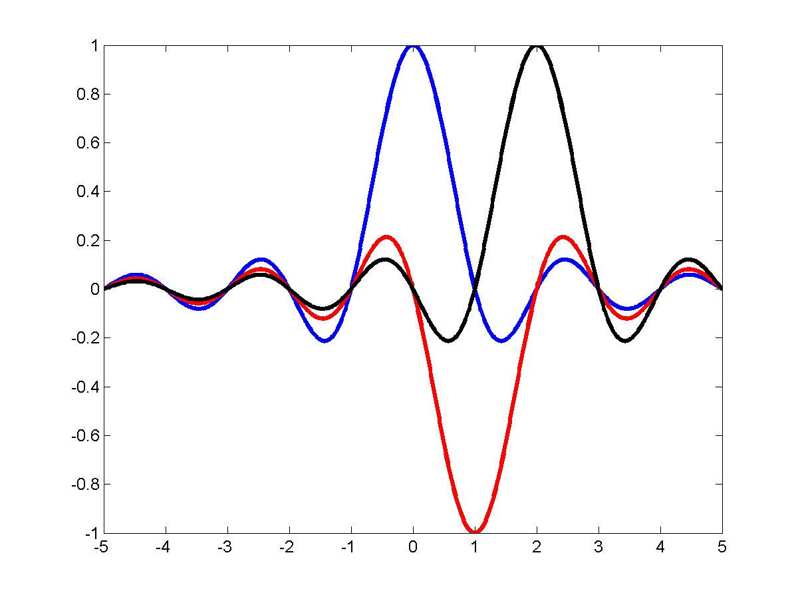
PULSE SHAPING
Sampling rate Ts
Tx filter
Channel
Rx filter
Continuous time waveform
Discrete time samples
Nyquist criterion
  Design the overall response of Tx filter and Rx filter,
  such that , and
  Avoid one symbol interferes with other symbols (Intersymbol interference)
1
1
-1

Slide 42
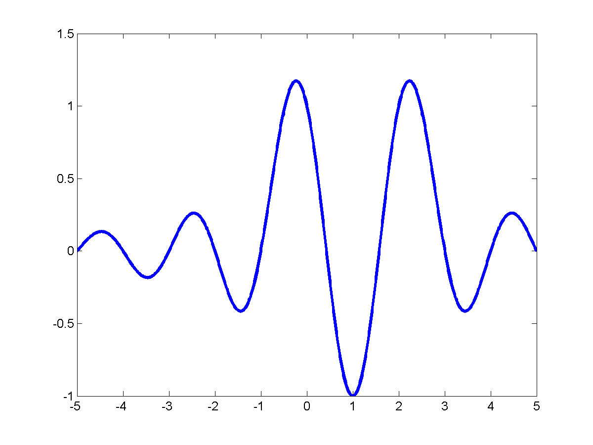
PULSE SHAPING
1
1
-1
1
1
Waveform at Rx

Slide 43
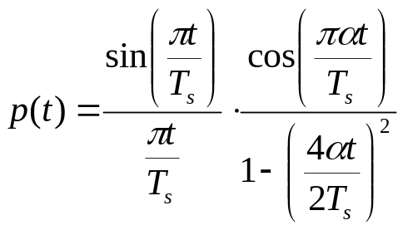
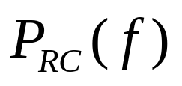
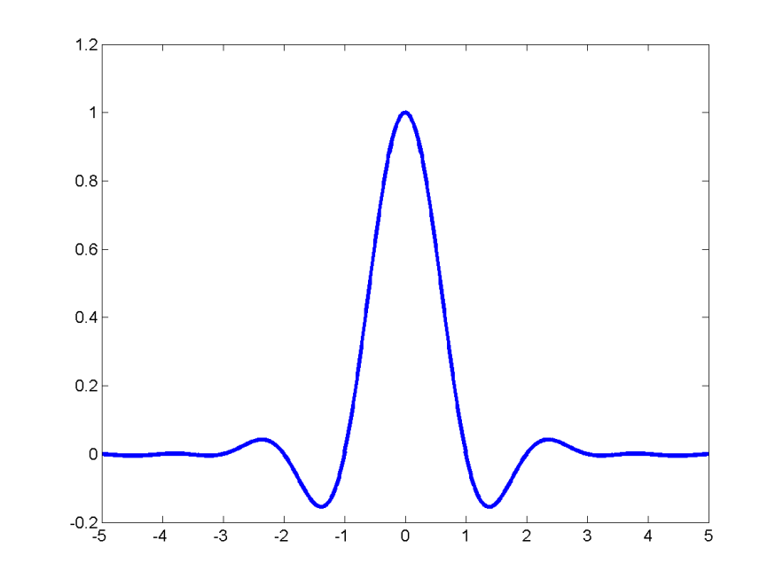
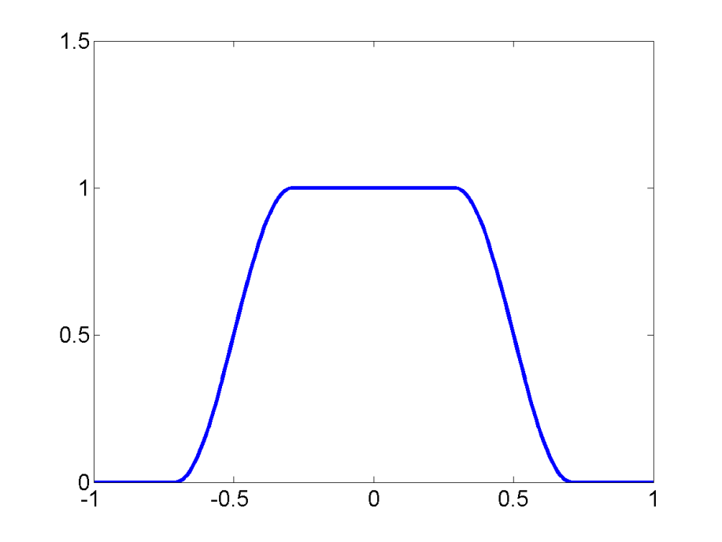



PULSE SHAPING
Raised cosine (RC) pulse
Time (Ts)
Frequency (Rs)
Satisfy Nyquist criterion
Roll-off factor

Slide 44
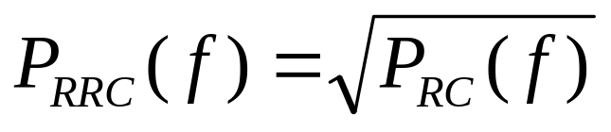

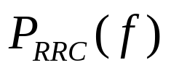

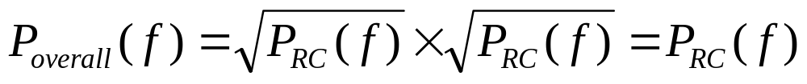
PULSE SHAPING
Root raised cosine (RRC) pulse
  The frequency domain response of RRC filter is the square root of the frequency response of RC filter
  RRC filter has the same bandwidth as RC filter
The overall response is RC filter
  Satisfy Nyquist criterion
Channel

Slide 45
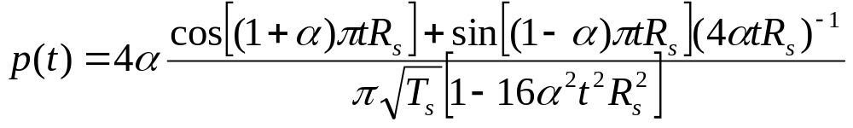


PULSE SHAPING
Root Raised Cosine (RRC)
RRC filter is used at both Tx and Rx
  Overall response is Raised Cosine
  Signal bandwidth is
    Symbol rate:
    Signal bandwidth is proportional to symbol rate

Slide 46
OUTLINE
Modulation
Linear Modulation Techniques I
Complex Signal Representation
Pulse Shaping
Linear Modulation Techniques II
Non-linear modulation
FDMA

Slide 47


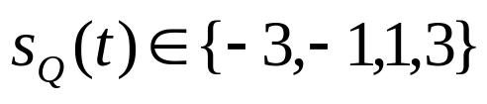
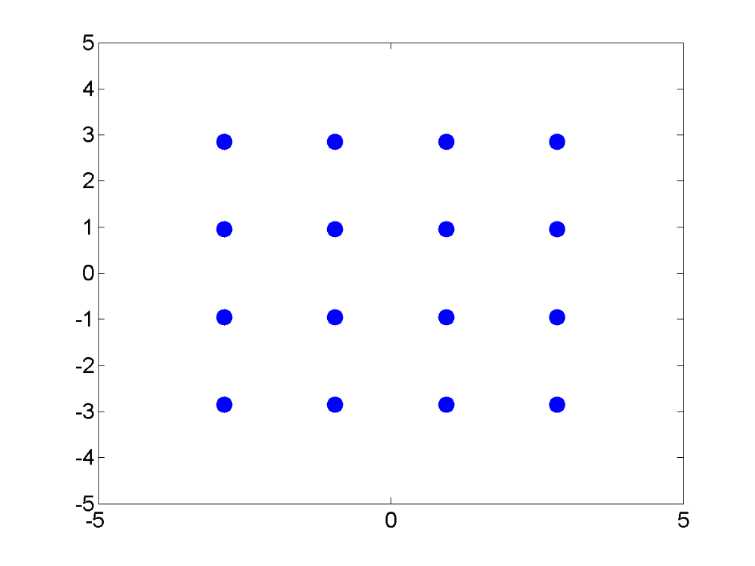

LINEAR MODULATION II: 16-QAM
16 Quadrature amplitude modulation (16QAM)
  Inphase: 4 amplitude shift keying
  Quadrature: 4 amplitude shift keying
Im
16-QAM symbols
  Total 4 x 4 = 16 possible combinations.
  M = 16 ➔ bits/sym
Gray mapping
  Two adjacent symbols differ only in 1 bit
  The most common error is that the receiver decide in favor of the neighbor of the correct symbol.
    With Gray mapping, only 1 bit error.
0010
0110
1110
1010
0011
0111
1111
1011
Re
0001
0101
1101
1001
0000
0100
1100
1000

Slide 48






LINEAR MODULATION II: OQPSK
Offset quadrature phase shift keying (OQPSK)
  Motivation:
    QPSK ( , , , )
    00 10 01 11 ➔ , , ,
    Rapid phase change ( e.g. ➔ )
    could result in amplitude fluctuation ➔ carries
    information in amplitude ➔ high requirement in amplifier
    ➔ increase error in wireless communication systems.
    We want to avoid phase change of
      Avoid two bits (inphase, quadrature) change at the same time !
  OQPSK: Delay the quadrature component by half symbol period such that the inphase bit and quadrature bit don’t change at the same time.
(01)
(00)
(11)
(10)

Slide 49


LINEAR MODULATOIN II: OQPSK
QPSK
OQPSK
OQPSK
  Delay the quadrature component by half symbol period
    It’s guaranteed at any moment, only one bit is changing
    The phase shift of is completely avoided!
  Disadvantage: phase change every Ts/2 ➔ larger bandwidth
BPSK
BPSK
Delay Ts/2

Slide 50
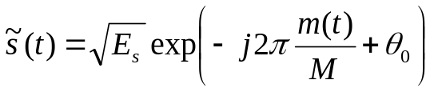

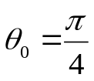


LINEAR MODULATION II: MPSK
Multi-ary Phase Shift Keying (MPSK)
  Phase modulation: use phase to carry information.
M = 4: QPSK.
M = 8: 8PSK.
  3 bits/sym
010
000
110
100
111
QPSK
101
011
8PSK
001

Slide 51


LINEAR MODULATION II: MPSK
MPSK demodulation
  Find the modulation symbol that has the smallest Euclidean distance with the received signal.
010
000
110
100
111
101
011
001

Slide 52
LINEAR MODULATION II: MPSK
Tradeoff between spectral efficiency and energy efficiency
  Spectral efficiency: data rate that is accommodated in unit bandwidth (bps/Hz) = data rate/bandwidth
    Given fixed bandwidth ➔ fixed symbol rate
    Large M ➔ large # bits/sym ➔ large data rate ➔ large spectral efficiency
  Energy efficiency: at given noise level, how much signal power is required to achieve a certain bit error rate.
    Measured as the value of Eb/N0 required for certain bit error rate (BER).
    Given fixed bandwidth ➔ fixed symbol rate
    Large M ➔ constellation symbols are more “dense” ➔ more sensitive to noise ➔ low energy efficiency
Increase modulation level M ➔ Increase spectral efficiency
Increase modulation level M ➔ Decrease energy efficiency

Slide 53
OUTLINE
Modulation
Linear Modulation Techniques I
Pulse Shaping
Complex Signal Representation
Linear Modulation Techniques II
Non-linear modulation
FDMA

Slide 54


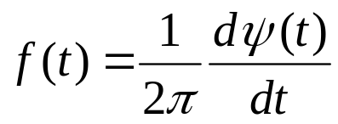
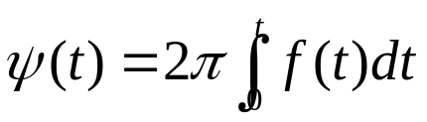

NON-LINEAR MODULATION: FREQUENCY MODULATION
Frequency modulation (FM)
  The term, FM, is usually used when m(t) is analog
    E.g. FM radio
  Use frequency to carry information
  Relationship between phase and frequency
    Fixed frequency
    Variable frequency
  FM

Slide 55


NON-LINEAR MODULATION: FREQUENCY MODULATION
FM

Slide 56




NON-LINEAR MODULATION: FREQUENCY MODULATION
FM bandwidth
  The spectrum of FM is much more complicated than the spectrum of AM
  Pass-band Bandwidth of FM signal can be approximated by Carson’s rule.
  :modulation index.
  :Bandwidth of baseband signal
E.g.
  AMPS,
  Bandwidth: 32 KHz

Slide 57


NON-LINEAR MODULATION: BFSK
Binary frequency shift keying (BFSK)
  Constant envelope
If continuous phase (CP) ➔
CP FSK ➔
No abrupt phase change!
0
1
0

Slide 58


NON-LINEAR MODULATION: MSK
Minimum shift keying (MSK)
  A special case of CP BFSK
  CP BFSK with
Advantages:
  bandwidth much smaller than BPSK/QPSK
  Constant envelope
  Very popular modulation scheme for mobile radio
Usually used with Gaussian pulse shaping filter
  GMSK (used by GSM)

Slide 59
NON-LINEAR MODULATION: PRACTICAL ISSUE
Power amplifier non-linearity
  Power amplifier: amplify signal power before transmission
    To meet the SNR requirement at receiver.
  Amplifier categories: Class A, Class B, Class AB, Class C, Class D
    Class A: linear amplifier
      Signals amplitude at the operational range is amplified linearly.
      The information in amplitude is preserved.
      Should be used for amplitude modulation.
      Requires more transmission power ➔ short battery life.
    Class C: non-linear amplifier
      Different amplitude range are amplified by different factors
      The amplitude of the signals is distorted.
      CANNOT be used for amplitude modulated systems. CAN be used for frequency modulated systems.
      Requires less transmission power ➔ longer battery life
    From A to B to C to D, linearity becomes worse.

Slide 60
OUTLINE
Modulation
Linear Modulation Techniques I
Pulse Shaping
Complex Signal Representation
Linear Modulation Techniques II
Non-linear modulation
FDMA

Slide 61
FDMA
Frequency division multiple access (FDMA)
  Available spectrum is divided into a set of frequency bands, and each frequency band is assigned to a user
FDMA is not FDD
  FDD: frequency division duplex
  The downlink and uplink of one user is using different frequencies.
Example: AMPS
  FDMA
  Analog voice: FM
  Digital control: BFSK (one frequency for ‘0’, one frequency for ‘1’).

Slide 62
FDMA: ACI
Adjacent Channel Interference (ACI)
  Interference from adjacent channels.
  For some modulations (FM, FSK), the modulated signal has unlimited bandwidth.
    The signal in one channel will leak into adjacent channels.
    To reduce ACI, introduce some guard bands between adjacent channels.
  To improve overall bandwidth efficiency, we want to have as many channel as possible in a limited spectrum.
    Tradeoff between bandwidth efficiency and power efficiency.

