Slide 1
ELEG 5693 Wireless Communications
Ch. 5 Equalization
Dr. Jingxian Wu
wuj@uark.edu

Slide 2
OUTLINE
Introduction
Maximum Likelihood Sequence Estimation (MLSE)

Slide 3
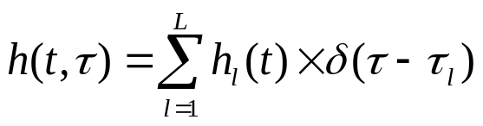

INTRODUCTION
Frequency selective fading
  Frequency domain: Signal bandwidth >> channel coherence bandwidth
  Time domain: symbol period << rms delay spread
    Relative arrival time of the multipath components is no longer negligible!
    t: time variation, : relative delay between multipath component.
  Power delay profile:
    The relative power and delay of the multipath component.
    E.g.
0.5
0.5
0
Ts
t
    If the first multipath component arrives at receiver at time 0, then the second multipath component arrives at receiver at time Ts.

Slide 4







INTRODUCTION: ISI
Intersymbol interference (ISI)
  E.g. two resolvable multipath components with relative delay Ts.
    1st multipath component:
    2nd multipath component:
  Tx symbol:
  In the channel
the 1st multipath:
the 2nd multipath:
  Rx symbols are the combination of the two multipath components
AWGN

Slide 5


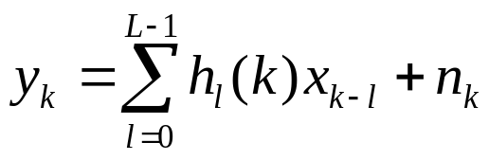
INTRODUCTION: ISI
ISI (Cont’d)
  The received symbol is a combination of two or more information symbols!
    desired symbol. Interference from multipath component.
  Intersymbol interference:
    Interference caused by multipath components of frequency selective fading.
ISI model
  L resolvable multipath components with relative delay Ts.

Slide 6









INTRODUCTION: DISCRETE-TIME MODEL
What if the relative delay between multipath component is not an integer multiply of symbol period ?
  Discrete-time model can convert the channel impulse response into desired form
Discrete-time model
Continuous-time System Representation
pulse shaping
fading
receiver filter
Discrete-time
Input
Discrete-time
Output
Statistical Continuous-time System Representation
Can we replace the continuous-time system with an equivalent discrete-time system
without changing system input-output relationship?

Slide 7


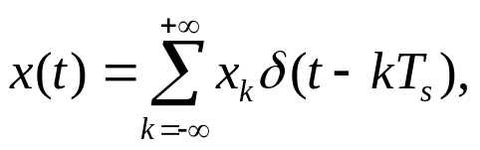
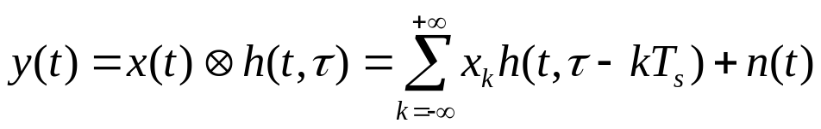
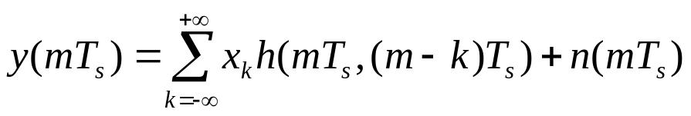

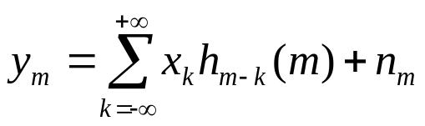
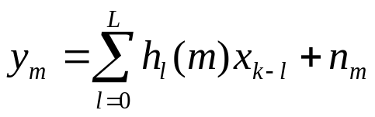
INTRODUCTION: DISCRETE-TIME MODEL
Composite impulse response
  System model
  After sampling
  Represent with discrete-time variables

Slide 8




INTRODUCTION: EQUALIZATION
What is equalization?
  Signal processing operation employed at receiver to mitigate the effects of ISI.
  Adaptive equalization
    Time-varying frequency-selective fading ➔Channel impulse response varies with time
    The equalizer should vary with time as well! ➔ adaptive equalization.
A possible equalization method:
  At time 1, (no ISI) ➔
  At time 2, ➔
  At time 3, ➔
  Problem: if is in error, all the remaining symbols will be affected!
    Error propagation.

Slide 9
INTRODUCTION: CLASSIFICATION
Classification
  Linear equalization: only linear operations are employed in equalizer.
    Zero Forcing (ZF), least mean square error (LMS), minimum mean square error (MMSE), etc
    Advantages: simple
    Not commonly used in wireless communication system.
  Non-linear equalization:
    Decision feedback equalization (DFE), Maximum Likelihood Sequence Estimation (MLSE), Delayed Decision Feedback Equalization (DDFE), Reduced State Sequence Estimation (RSSE), Turbo Equalization, ……
    More complex than linear equalization
    Better performance
    Widely used in wireless communication systems.
MLSE is the optimum equalizer
  It has the best performance among all the equalizers
  It has the highest computational complexity.

Slide 10
OUTLINE
Introduction
Maximum Likelihood Sequence Estimation (MLSE)

Slide 11

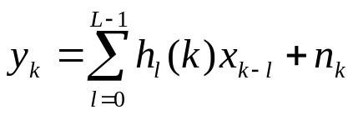
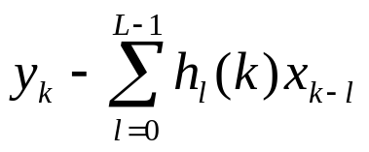


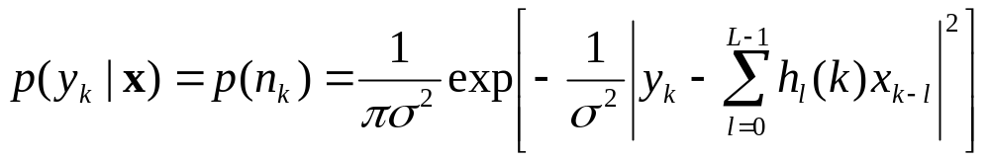
MLSE
System model
  Symbols are transmitted in block (assume N symbols per block)
  The kth symbol at receiver
  is AWGN with variance ➔ is Gaussian distributed

Slide 12



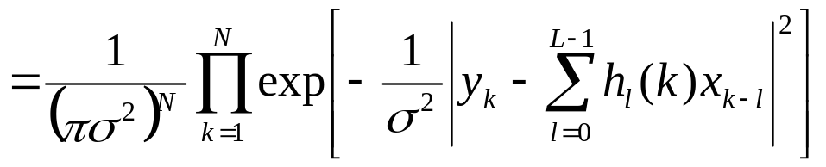

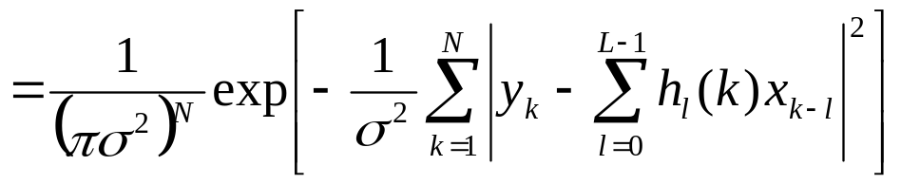

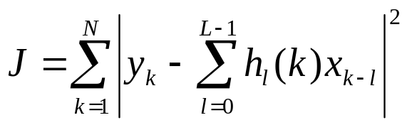
MLSE
Likelihood function
  White noise ➔ is independent of ➔
Maximum Likelihood
  Find that maximize
  Equivalent to: minimize

Slide 13

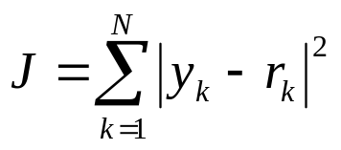
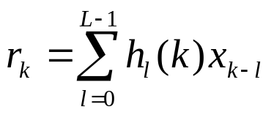


MLSE: COST FUNCTION
Maximum Likelihood Sequence Estimation
  Based on the information of the received symbols
  and the channel impulse response, find the sequence
  that minimizes the following cost function
where
Most direct way: exhaustive searching
  M-ary modulation
    Modulation constellation size: M ➔ each can take one of M possible values.
  N symbols per block
  There are totally possibilities of
  If N = 100, M = 8, then we need to search possibilities

Slide 14







MLSE: STATE REPRESENTATION
State representation of frequency selective fading
Cost function:
Im
(s2)
10
00
(s1)
E.g. QPSK
  How many states?
Re
11
01
(s4)
(s3)

Slide 15
MLSE: STATE REPRESENTATION
State representation
  E.g. QPSK (four symbols: s1, s2, s3, s4), L = 2
    M^(L-1) = 4 states: a: (s1), b: (s2), c: (s3), d: (s4).
Input | Current state now | Register contents | Next state after shift
s1 | a (s1) | (s1, s1) | a (s1)
s1 | b (s2) | (s1, s2) | a (s1)
s1 | c (s3) | (s1, s3) | a (s1)
s1 | d (s4) | (s1, s4) | a (s1)
s2 | a (s1) | (s1, s1) | b (s2)
s2 | b (s2) | (s1, s2) | b (s2)
s2 | c (s3) | (s1, s3) | b (s2)
s2 | d (s4) | (s1, s4) | b (s2)

Slide 16
MLSE: STATE REPRESENTATION
State representation
Input | Current state now | Register contents | Next state after shift
s3 | a (s1) | (s3, s1) | c (s3)
s3 | b (s2) | (s3, s2) | c (s3)
s3 | c (s3) | (s3, s3) | c (s3)
s3 | d (s4) | (s3, s4) | c (s3)
s4 | a (s1) | (s4, s1) | d (s4)
s4 | b (s2) | (s4, s2) | d (s4)
s4 | c (s3) | (s4, s3) | d (s4)
s4 | d (s4) | (s4, s4) | d (s4)

Slide 17
MLSE: TRELLIS REPRESENTATION
s1/(s1,s1)
a (s1)
s2/(s2,s1)
input/(register contents)
s3/(s3,s1)
b (s2)
c (s3)
s4/(s4,s1)
d (s4)

Slide 18
MLSE: TRELLIS REPRESENTATION
Example
  For a BPSK system with channel length three, how many states do we have? Draw the trellis diagram.

Slide 19





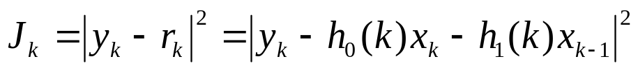
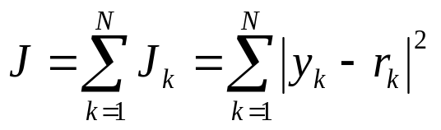
MLSE: VITERBI ALGORITHM
Viterbi algorithm
  Each state transition corresponds to one pair of
    E.g. (state a → state c) ➔
  Thus, for each state transition, we can calculate
  For each transition, we can find out the Euclidean distance between and
  Utilizing the trellis diagram, find out the path with the minimum accumulated Euclidean distance

Slide 20























MLSE: VITERBI ALGORITHM
Example
  BPSK
  Channel
  Rx symbols
  Using Viterbi algorithm finding out what are the sending symbols ?

Slide 21
MLSE: VITERBI ALGORITHM
Trellis diagram
  # of states M^(L-1) = 2^(2-1) = 2
s1/(s1,s1)
s1/(s1,s1)
s2/(s2,s1)
s2/(s2,s1)
s1/(s1,s2)
s2/(s2,s2)

Slide 22






MLSE: VITERBI ALGORITHM
s1/(s1,s1)
2.65
s2/(s2,s1)
0.41
a: (s1, s1) →
b: (s2, s1) →

Slide 23




MLSE: VITERBI ALGORITHM
2.65
2.65+4.9=7.55
s1/(s1,s1)
0.41+3.38=3.79
s2/(s2,s1)
0.41
a→a: (s1, s1) →
b→a:

Slide 24



MLSE: VITERBI ALGORITHM
s1/(s1,s1)
2.65
3.79
s2/(s2,s1)
0.41
2.65+0.82=3.47
0.41+2.5=2.91
a→b: (s2, s1) →
b→a:

Slide 25



MLSE: VITERBI ALGORITHM
2.65
3.79
3.79+11.08=14.87
s1/(s1,s1)
2.91+4=6.91
s2/(s2,s1)
0.41
2.91
a→b: (s2, s1) →
b→a:

Slide 26



MLSE: VITERBI ALGORITHM
3.79
6.91
s1/(s1,s1)
2.65
s2/(s2,s1)
0.41
3.79+3.4=7.19
2.91
2.91+0.4=3.31
a→b: (s2, s1) →
b→a:

Slide 27
MLSE: VITERBI ALGORITHM
3.79
6.91
s1/(s1,s1)
2.65
s2/(s2,s1)
0.41
2.91
3.31

Slide 28
MLSE: VITERBI ALGORITHM
3.79
6.91
s1/(s1,s1)
2.65
s2/(s2,s1)
0.41
2.91
3.31
1
1
1

Slide 29
MLSE
States
  M = 4, L = 3
    # of states:
  M = 8, L = 2
    # of states:
  M = 8, L = 3
    # of states:
  M = 8, L = 4
    # of states:
# of states = M^(L-1)

