Slide 1
ELEG 5693 Wireless Communications
Ch. 6 Diversity
Dr. Jingxian Wu
wuj@uark.edu

Slide 2
OUTLINE
Introduction
Classification
Space Diversity Techniques
Space Time Block Code

Slide 3
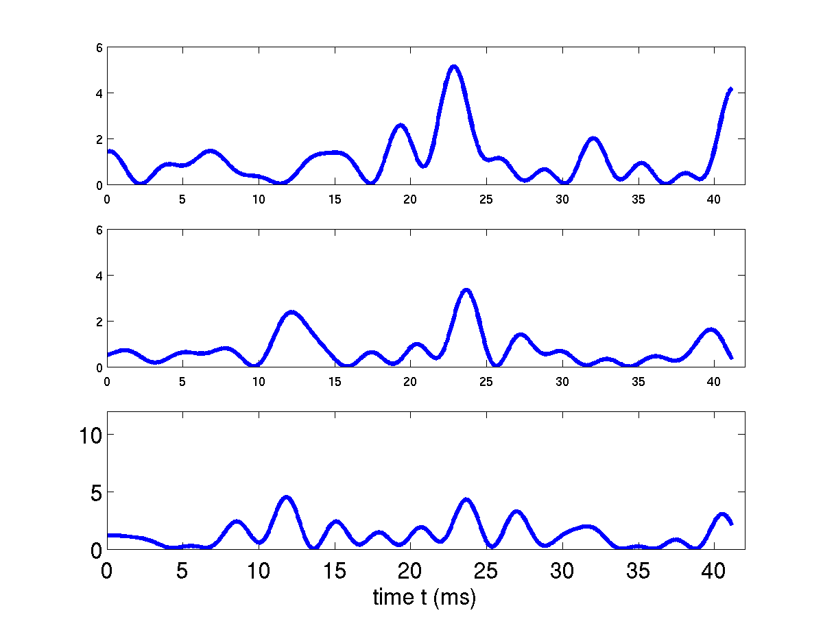
INTRODUCTION
What is diversity?
  E.g. Transmit the same signal several times.
    Receiver has multiple copies of the same signal.
    Each copy of the signal undergoes independent fading.
    The probability that all the signals are severely distorted (deeply faded) simultaneously is small.
  Diversity: Transmitting multiple replicas of the same signal at statistically independent fading channel to improve communication quality.
    The probability that all the signals are distorted by channel is smaller compared to the non-diversity case.

Slide 4
INTRODUCTION
Diversity can be achieved by utilizing the properties of fading
  So far, all of our discussions treat fading as a pure negative factor to reliable high speed wireless communication.
    Time-varying, frequency-selective
    Degrade system performance
  If properly handled, fading can also benefit system performance!!!
  E.g. Time-varying fading:
    Coherent time
      the time period over which the channel is strongly correlated.
    Transmit the same signal at different time periods with interval larger than coherent time
    Achieve diversity in the time domain ➔ Time diversity
Classifications:
  Time diversity
  frequency diversity
  space diversity.

Slide 5
OUTLINE
Introduction
Classification
Space Diversity Techniques
Space Time Block Code

Slide 6
CLASSIFICATION: TIME DIVERSITY
Time diversity
  Repeatedly transmit the information bearing signal at time spacing that exceeds the coherence time of the channel. (time varying fading)
    Signals undergo statistically independent fading in the time domain.
    If one copy of the signal is deeply faded, it’s likely that the other copies can still be detected by the receiver.
  Using redundancy in the time domain to tradeoff performance
    Tradeoff between bandwidth efficiency and power efficiency!
  Example: channel coding with interleaving
    Channel coding ➔ information + redundancy
    Interleaving ➔ spread out the codeword over time.
    If the interleaving depth is large enough, every bit of the codeword undergoes independent fading
      If one or more bit are in error, while the other bits are right, the information can still be recovered.

Slide 7
CLASSIFICATION: FREQUENCY DIVERSITY
Frequency diversity (multipath diversity)
  Transmitting the same information at different frequency bands with spacing larger than the coherent bandwidth (frequency selective fading)
    Signals at different frequency undergo independent fading
  Explanation from time domain:
    Frequency selective fading ➔ multiple copies of the same signal arrive at the receiver at different time due to multipath fading.
    Multipath components are independent ➔ signals propagating through different path are undergoing independent fading ➔ multipath diversity!
  Frequency selective fading ➔ ISI ☹
  Frequency selective fading ➔ mulitpath (frequency) diversity ☺
  Frequency diversity can be achieved by using equalization in frequency selective fading
    After ISI is partially removed, what is remaining is frequency diversity.

Slide 8





CLASSIFICATION: SPACE DIVERSITY
Space diversity (antenna diversity)
  Multiple antennas are used at transmitter and/or receiver, with spacing between two adjacent antennas being chosen to ensure the independence of fading.
    Most popular diversity technique.
  To ensure independence
    Mobile station: antennas are separated half wavelength or more.
      and are independent
    Base station: antenna spacing need to be several tens of wavelengths.
      and are independent
BS
MS

Slide 9
CLASSIFICATION: SPACE DIVERSITY
Space diversity classifications
  Receive diversity
    Single transmit antenna, multiple receive antenna
    SIMO (single input multiple output)
  Transmit diversity
    Multiple transmit antenna, single receive antenna
    MISO (multiple input signal output)
  Diversity on both transmitter and receiver
    Multiple transmit antennas, multiple receive antennas
    MIMO (multiple input multiple output)

Slide 10
OUTLINE
Introduction
Classification
Space Diversity Techniques
Space Time Block Code

Slide 11

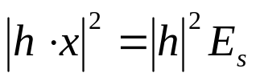
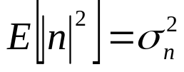
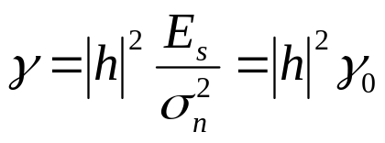
SPACE DIVERSITY
Instantaneous SNR of non-diversity system
  System model
  Signal power
Power of modulation symbol
  Noise power
  Instantaneous SNR: (signal power/noise power)
SNR without fading

Slide 12


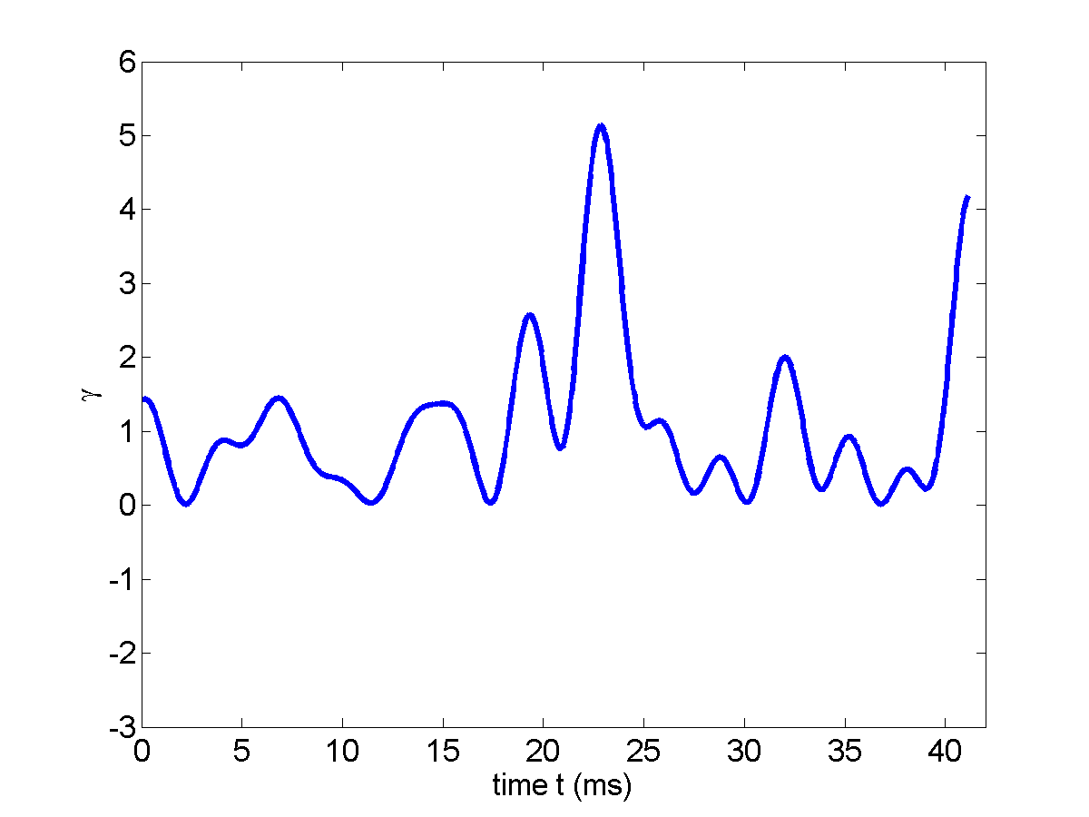
SPACE DIVERSITY
Instantaneous SNR
  Fading varies with time ➔ SNR varies with time
  The fluctuation of SNR degrades the performance of wireless communication system
  If there is no fading (AWGN only), the SNR is constant
    Space diversity will make the SNR more “flat”

Slide 13
SPACE DIVERSITY: COMMON TECHNIQUES
Common receive diversity techniques
  Selection diversity
  Maximal Ratio Combining (MRC)
  Equal Gain (EG) diversity
Common transmit diversity techniques
  Transmit diversity with feedback
  Space time block code
  Space time trellis code
MIMO
  Space time block code
  Space time trellis code

Slide 14

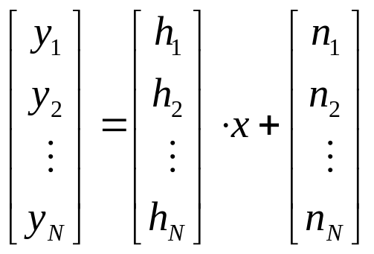



SPACE DIVERSITY: RECEIVE DIVERSITY
System model for receive diversity
  1Tx antennas, N Rx antennas.
  The signal at the kth Rx antenna:
  System equation in matrix format
  The same signal is received by N antennas.
    Each signal undergoes independent fading
Rx 1
Rx N

Slide 15



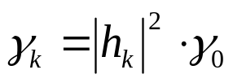

SPACE DIVERSITY: SELECTION DIVERSITY
Selection diversity
  Out of the N received signals, at each symbol period, choose the one with the maximum instantaneous SNR.
    Demodulation and decoding is performed for the signals with the maximal SNR.
    Signals on other antennas are discarded.
Logic
Circuits
Measure SNR
Output
Measure SNR
  SNR of the kth Rx antenna
  SNR after selection diversity

Slide 16
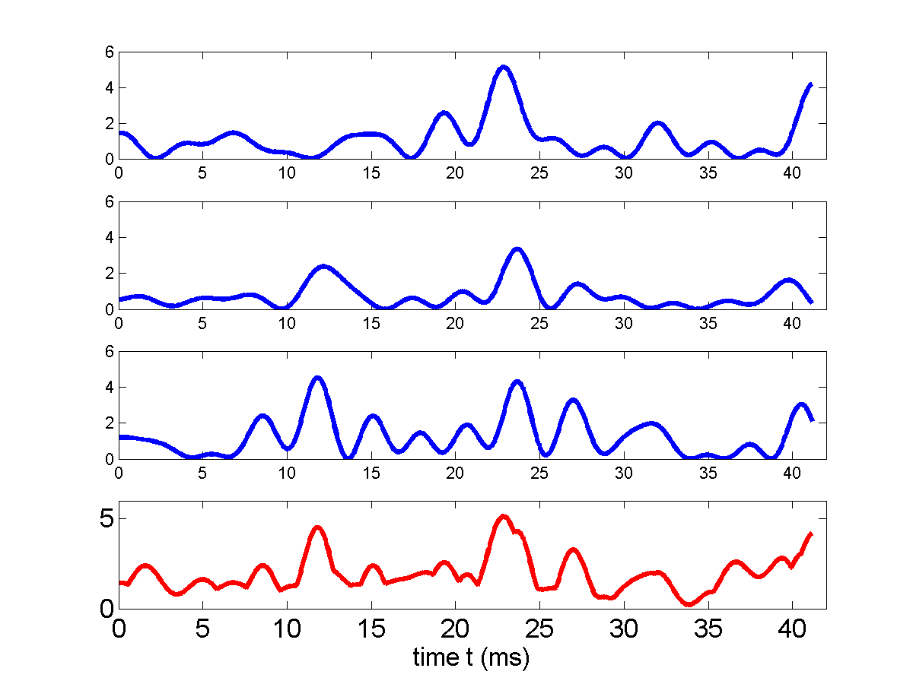




SPACE DIVERSITY: SELECTION DIVERSITY
SNR after selection diversity (N = 3)

Slide 17






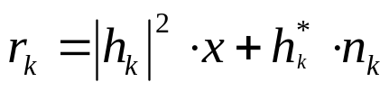
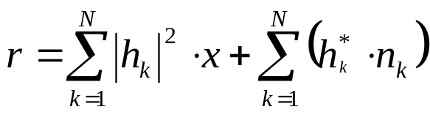
SPACE DIVERSITY: MAXIMAL RATIO COMBINGING
Maximal Ratio Combining (MRC)
Output
  The signals from all Rx antennas are processed and combined together
  The output on the kth branch
  The output of the MRC receiver

Slide 18
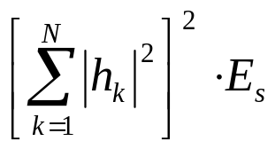
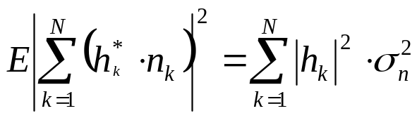
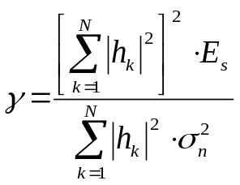
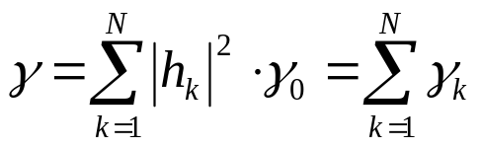
SPACE DIVERSITY: MRC
SNR of MRC
  Power of signal component
  Power of noise
  SNR
The SNR of MRC equals to the sum of SNRs of individual branches!
  MRC is the optimum diversity receiver (highest SNR among all diversity receivers.)

Slide 19
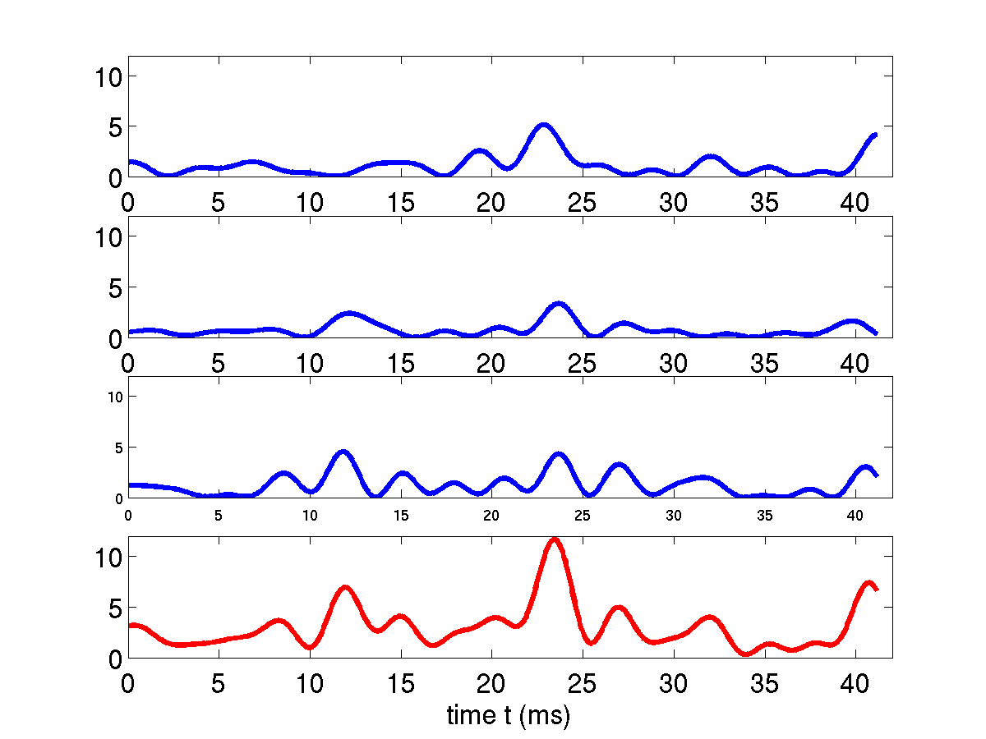
SPACE DIVERSITY: MRC

Slide 20






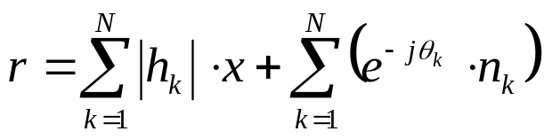
SPACE DIVERSITY: EQUAL GAIN COMBINING
Equal gain combining (EGC)
Output
  : the phase of , i.e.,
  The output of the kth branch:
  The output of the Equal Gain receiver

Slide 21
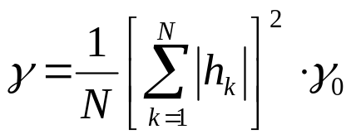
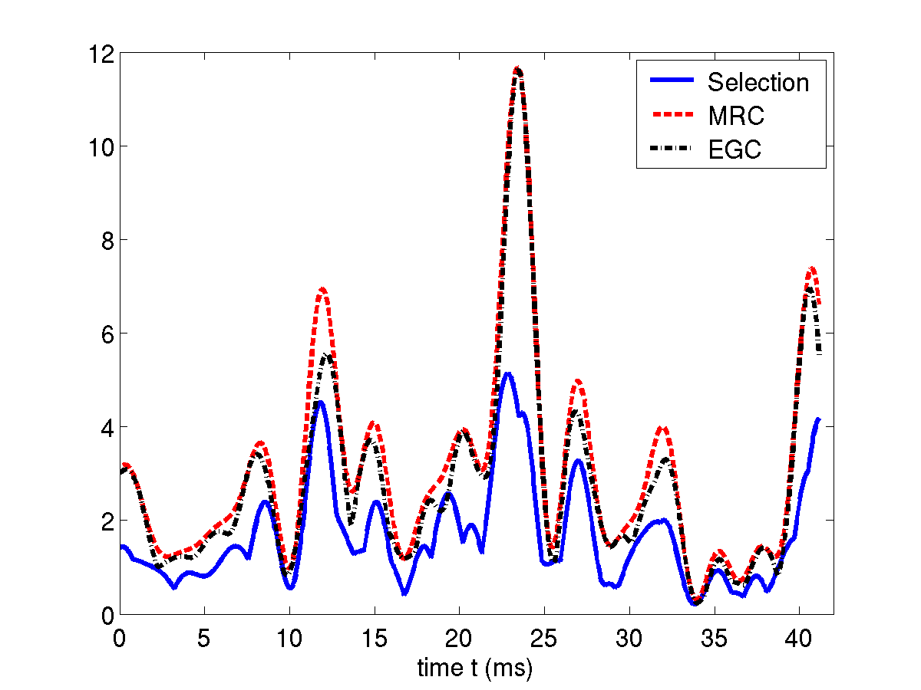
SPACE DIVERSITY: EQUAL GAIN COMBINING
SNR of equal gain combining
Comparison of Selection diversity, MRC, and EGC

Slide 22
OUTLINE
Introduction
Classification
Receiver Diversity
Space Time Block Code

Slide 23
STBC
Orthogonal Space Time Block Code
  Proposed by Alamouti in 1998
    “A simple transmit diversity technique for wireless communications”, IEEE Journal on Selected Areas of Communications, vol. 16, 1998.
  Suitable for system with 2 Tx antennas and arbitrary number of receive antennas
  A simple, yet powerful space diversity technique
    It doesn’t require any knowledge of the channel at transmitter.
      ALL transmit diversity techniques before STBC require some knowledge of the channel at the transmitter
      The transmitter can learn the channel state through feedback from receiver ➔ extra bandwidth is used for feedback
  It has been adopted by 3GPP HSDPA (High Speed Downlink Packet Access)

Slide 24










STBC
Structure (2 Tx, 1 Rx)
Space
time
  Assumption: the channel keeps constant during two consecutive symbol periods ( and ) .
  At time , transmit on antenna 1, transmit on antenna 2.
  At time , transmit on antenna 2, transmit on antenna 1.

Slide 25
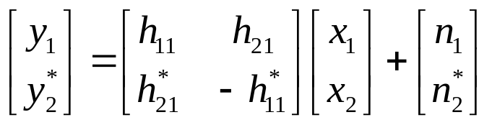





STBC
System equation
Channel matrix is orthogonal
Receiver

Slide 26


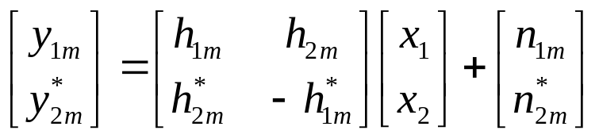

STBC
2 Tx, M Rx
  At time , transmit on antenna 1, transmit on antenna 2.
    At the m-th Rx antenna
  At time , transmit on antenna 1, transmit on antenna 2.
    At the m-th Rx antenna
  System equation at the m-th Rx antenna

Slide 27
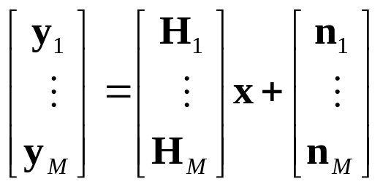


STBC
2 Tx, M Rx (Cont’d)
  System equation for all the Rx antennas
  Receiver

