Slide 1
ELEG 5693 Wireless Communications
Ch. 7 Multicarrier Modulation
Dr. Jingxian Wu
wuj@uark.edu

Slide 2
OUTLINE
Introduction
OFDM
Challenges in Multicarrier Systems

Slide 3
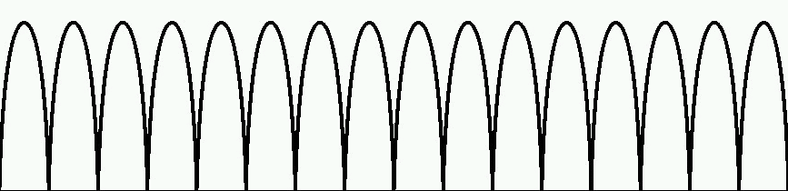
INTRODUCTION
Multicarrier Modulation (MCM)
  Achieves broadband communication by modulating a large number of narrow-band data streams over closely spaced sub-carriers.
  Divide a broadband channel into many narrow-band sub-channels in the frequency domain
    Each sub-channel is called a sub-carrier
  Divide the transmitted data stream into many sub-streams, and transmit one sub-stream in one sub-channel
  The data is transmitted over many sub-carrier → multicarrier modulation

Slide 4










INTRODUCTION
Why MCM?
  Alleviate the impairments caused by inter-symbol interference (ISI)
  Single-carrier broadband communication suffers serious ISI
Multipath 1
Time
Multipath 2
    will interfere with and ➔ ISI
  In MCM, each subcarrier delivers a narrow-band signal
    Narrow-band ➔ longer symbol period
Multipath 1
Multipath 2
    Less ISI
    ISI can be completely removed by using guard interval between adjacent symbols

Slide 5
INTRODUCTION
Why MCM (Cont’d)
  Original single-carrier system experiences frequency selective fading
    Data rate >> coherence bandwidth
    Symbol period << rms delay spread
    ➔ freqeuncy selective fading
  MCM: on each subcarrier: data rate decreases, the symbol period increases
    data rate << coherence bandwidth
    Symbol period >> rms delay spread
    ➔ frequency flat fading
    No equalization is necessary!

Slide 6
INTRODUCTION
MCM techniques
  Orthogonal frequency division multiplexing (OFDM)
    4G cell phone systems
    Most wireless LANs (IEEE 802.11x)
    IEEE802.15 UWB
    Digital audio and video broadcasting
    The most popular MCM technique
  Discrete multitone
    DSL
  Vector coding
  …

Slide 7
OUTLINE
Introduction
OFDM
Challenges in Multicarrier Systems

Slide 8
OFDM
Orthogonal Frequency Division Multiplexing (OFDM)
  Orthogonal: the subcarriers are mutually orthogonal → there is no inter-carrier interference (ICI) among the subcarriers
  The most popular MCM technique
  Can be implemented with fast Fourier transform (FFT) and inverse fast Fourier transform (IFFT)

Slide 9
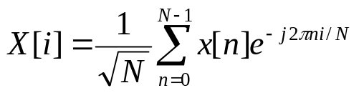
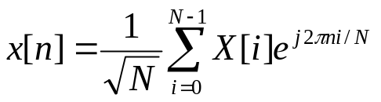
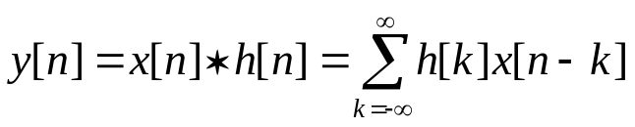
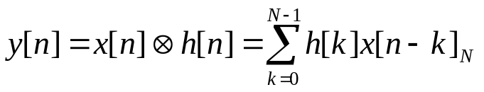

OFDM: DFT AND IDFT
Review: DFT and IDFT
  discrete Fourier transform (DFT)
  Inverse discrete Fourier transform (IDFT)
  Linear convolution
  Circular convolution

Slide 10








OFDM: DFT AND IDFT
Linear convolution v.s. circular convolution
  Linear convolution
  circular convolution

Slide 11
OFDM: DFT AND IDFT
DFT and Circular Convolution
  Circular convolution in the time domain → multiplication in the frequency domain
  Circular convolution is preferred in discrete time implementation
    However, practical system has the effect of linear convolution.
Notes:
Let m = (n-k)_N
n-k = m + uN
n = m + k + uN
M = 0…N-1

Slide 12
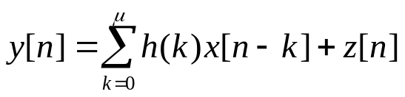

OFDM: CYCLIC PREFIX
Discrete-time model of a system with frequency selective fading
  Linear convolution
  Can we convert linear convolution to circular convolution?
  Linear convolution between
  and
  Circular convolution between
  and
  circular prefix

Slide 13




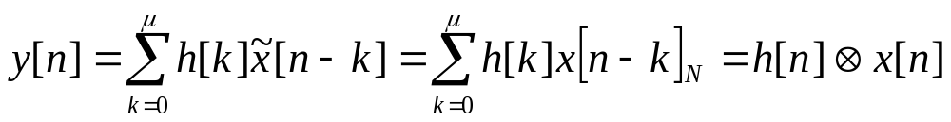
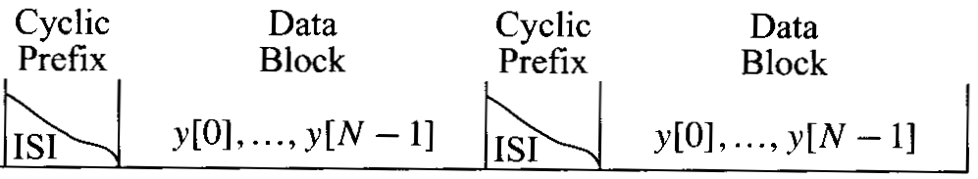
OFDM: CYCLIC PREFIX
Cyclic prefix
  Circular convolution between h (length: ) and x can be achieved if
    1. Add circular prefix to x, get
    2. Perform linear convolution between h and
  cyclic prefix
  N data
  In a practical system, we can
    1. Add circular prefix to the data
    2. Transmit the cyclic-prefixed data
    3. The channel functions like a linear convolution
    4. At the receiver, remove cyclic prefix, we get a circular convolution.

Slide 14
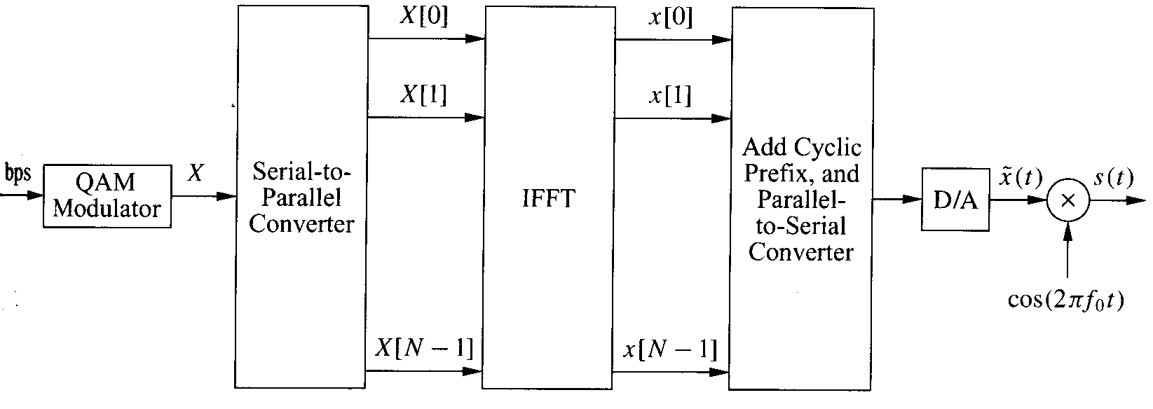

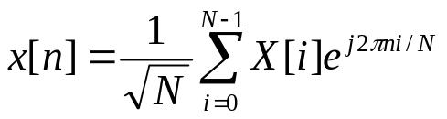
OFDM: TRANSMITTER
OFDM Transmitter
  R
  Modulated data:
  After IFFT:
  Add cyclic prefix:

Slide 15
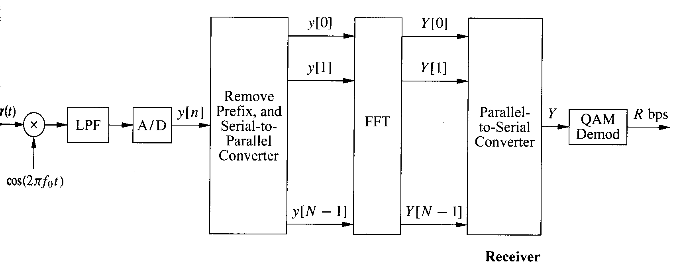



OFDM: RECEIVER
Receiver
  Received data sample:
  After FFT:
  the data symbol transmitted on the i-th sub-carrier
  H[i]: the channel coefficient of the i-th sub-carrier
  The i-th sub-carrier is equivalently modeled as a flat fading channel without ISI
  There is no interference among sub-carriers.

Slide 16
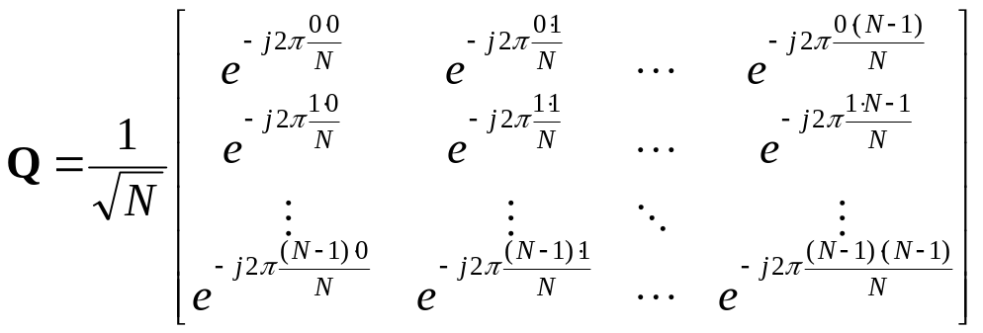
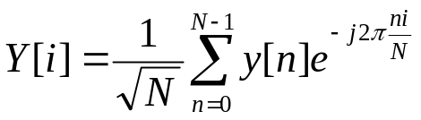
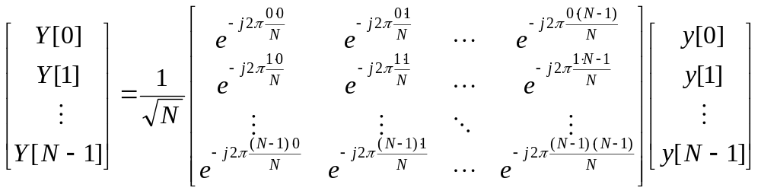

OFDM: MATRIX REPRESENTATION
Matrix representation of DFT
  Define: DFT matrix
  DFT
  DFT in matrix format

Slide 17
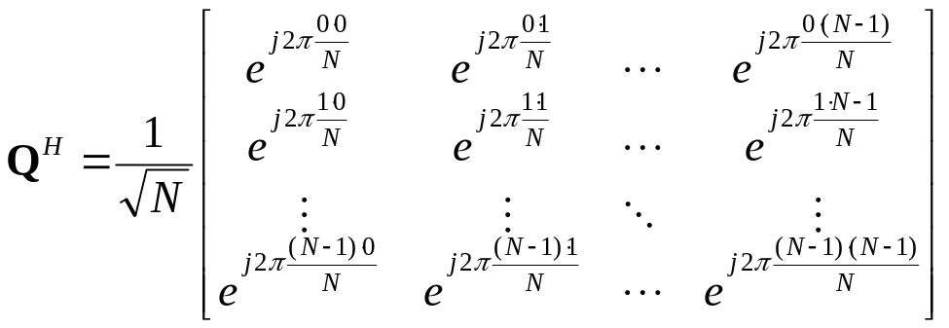
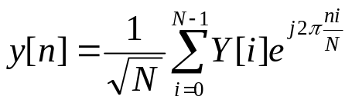
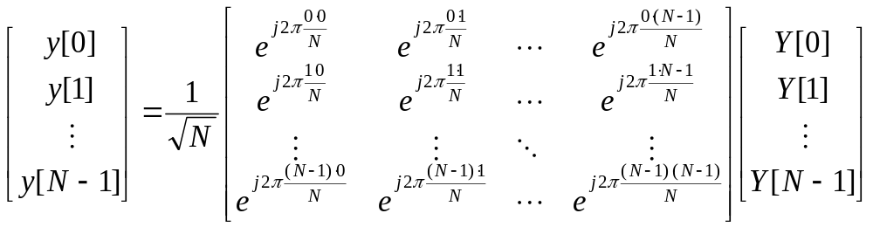

OFDM: MATRIX REPRESENTATION
Matrix representation of IDFT
  Define: IDFT matrix
  IDFT
  IDFT in matrix format

Slide 18



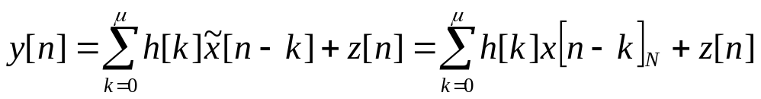
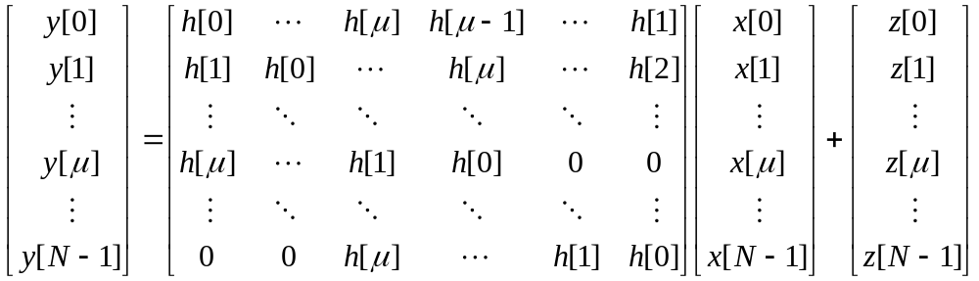

OFDM: MATRIX REPRESENTATION
Matrix representation of OFDM
  Transmitter:
    Data (frequency domain):
    IDFT:
    Cyclic prefix:
  Channel (time domain):
  H is a cyclic matrix
    Each row is a cyclic shift of the previous row

Slide 19

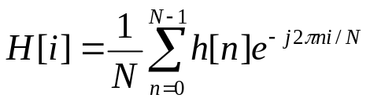
OFDM: MATRIX REPRESENTATION
Matrix representation of OFDM (Cont’d)
  Receiver
    Time domain:
    Frequency domain: apply DFT at the received signal
  Proposition
    The frequency domain channel matrix, , is a diagonal matrix, with the i-th diagonal element being
  Proof:
Notes:
The (m,n)-th element of QHQ’
The m-th row of QH
[\sum_k \exp(-j2\pi m k/N)h(k), \sum_k \exp(-j2\pi m k/N)h(k-1)_N, \cdots, \sum_k \exp(-j2\pi m k/N)h(k-N+1)_N]
2. The (m,n)-th element of QHQ’
\sum_i \sum_k \exp(-j2\pi m k/N) \exp(j2\pi i n/N) h(k-i)_N
3. Let (k-i)_N = u, then k – i = u + vN ➔ k = u + i + vN
4. If m = n
\sum_i \sum_k \exp(-j2\pi m (u+vN) /N) \exp(j2\pi i n/N) h(u) = \sum_u \exp(-j2\pi m u /N) h(u)
5. If m \neq n
\sum_i \sum_k \exp(-j2\pi m (u+i+vN) /N) \exp(j2\pi i n/N) h(u) = \sum_i exp(-j2 \pi i(m-n)) \sum_u exp(-j2 \pi (u+vN/N) h(u) = 0*\sum_u exp(-j2 \pi (u+vN/N) h(u) =0

Slide 20




OFDM: MATRIX REPRESENTATION
Matrix representation of OFDM
  Transmitter:
    Data (frequency domain):
    IDFT:
    Cyclic prefix:
  Receiver:
    After removal of cyclic prefix:
    DFT:
    Information on the i-th sub-carrier:
IDFT
Cyclic Prefix
Channel
Remove Prefix
DFT

Slide 21

OFDM: MATRIX REPRESENTATION
Example
  Consider a simple two-tap discrete-time channel with impulse response
  find the matrix representation in time and frequency domain of an OFDM system with N = 8.

Slide 22
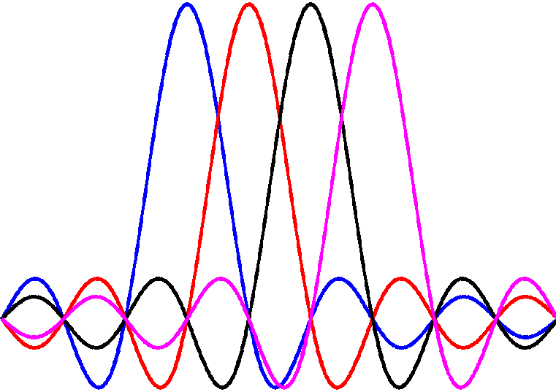




MCM: OFDM
OFDM: frequency domain
  Orthogonal in frequency domain ➔ no inter-carrier interference (ICI) in static channel.
s0
s1
s2
s3
Frequency
<number>/36

Slide 23
OUTLINE
Introduction
OFDM
Challenges in Multicarrier Systems

Slide 24
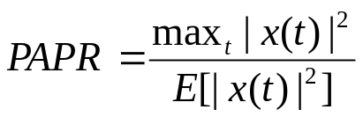
CHALLENGES: PAPR
Peak-to-average power ratio (PAPR)
  A low PAPR
    → the time domain amplitude does not change dramatically
    → we can use more efficient non-linear power amplifier
  A high PAPR
    → there is large variation in the time domain amplitude
    → a lot of information is carried in the amplitude
    → we have to use linear power amplifier, which usually has low efficiency

Slide 25
CHALLENGES: PAPR
Example
  What is the PAPR of a sin wave?
Notes:
E[|A*sin(x)|^2] = A^2/2
PAPR = A^2/A^2/2 = 2

Slide 26
CHALLENGE: PAPR
PAPR in OFDM
  The time domain samples are obtained from IDFT of modulated symbols
  Based on central limit theorem, when N is large, then x[n] follows zero-mean Gaussian distribution
  The theoretical value of the PAPR is infinity (why?)
  In practice, the PAPR increases approximately linearly with N
  Large N → large PAPR ☹
  Large N → small overhead due to cyclic prefix ☺
  There are many ways to reduce PAPR in practical system
    Clipping the peak signal
    Special coding techniques
    ……

Slide 27



CHALLENGE: FREQUENCY AND TIMING OFFSET
Frequency and timing offset
  Frequency offset:
    Due to the inaccuracy of the carrier frequency oscillator, there might be a small error in
    E.g. if the oscillator is accurate to 1 part per million, then the frequency offset for a 5GHz system is
    The frequency offset will degrade the orthogonality among the subcarriers.
Matched Filter

Slide 28
CHALLENGE: FREQUENCY AND TIMING OFFSET
Frequency and timing offset
  Timing offset
    During the sampling of the time domain signal, there might be a small offset during the sampling
    If the time offset is large, it will cause both ISI and ICI
    If the time offset is small, it will cause ICI
    Generally speaking, the ICI caused by the timing offset is smaller than that caused by frequency offset.
Matched Filter

Slide 29

CASE STUDY: IEEE 802.11a
IEEE 802.11a: Wireless LAN standard
  Carrier frequency: 5 GHz
  Total BW: 300 MHz
  Channel BW: 20 MHz
  Number of subcarriers: N = 64
    Data: 48; zeros: 12; pilot: 4
  Cyclic prefix:
  Subcarrier spacing: 20 MHz/64 = 312.5 kHz
  Sample period: Ts = 1/20 MHz = 50 ns
  Maximum delay spread that can be handled by the system:
  OFDM symbol time:
  Code: convolutional code with rates 1/2, 2/3 or 3/4
  Modulation: BPSK, QPSK, 16QAM, 64QAM
  Minimum data rate:
  Maximum data rate:
Notes:
Max delay spread: 50*16 = 800 ns = 0.8 us
Symbol time: (64+16)*50 ns = 4 us
minR:
BPSK, ½
½*1/4e-6*48 = 6 Mbps
Max R:
64QAM, ¾
¾*6/4e-6*48 = 54 Mbps

Slide 30
CASE STUDY: IEEE 802.11a
Example
  Find the data rate of an 802.11a system with 16QAM and 2/3 convolutional coding.
Notes:
4*2/3/4e-6*48 = 32 Mbps

