Slide 1
ELEG 5693 Wireless Communications
Ch. 8 CDMA
Dr. Jingxian Wu
wuj@uark.edu

Slide 2
OUTLINE
CDMA Fundamentals
Pseudo-noise sequence
Rake receiver

Slide 3
FUNDAMENTALS
Code Division Multiple Access (CDMA)
  Multiple users share the same channel and transmit at the same time.
  Different codes are used to separate the signals from different users.
  The signal occupies a bandwidth much larger than the minimum bandwidth necessary to send the information.
    Spread Spectrum Technologies.
Classifications
  Direct sequence CDMA (DS-CDMA)
    Also called Direct sequence spread spectrum (DSSS)
    Used in IS-95, WCDMA, cdma2000, IEEE 802.11, etc.
    The most commonly used CDMA technique.
  Frequency hopping CDMA (FH-CDMA)
    Also called Frequency Hopping spread spectrum (FHSS)
    Used in original IEEE 802.11, military applications, etc.

Slide 4


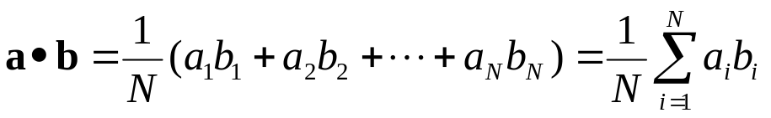
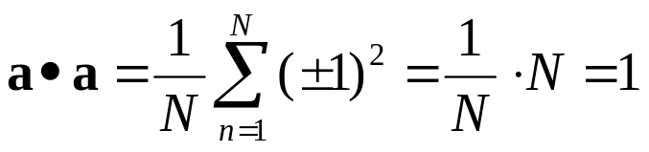

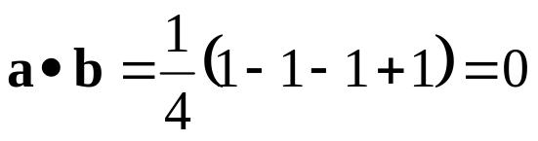
FUNDAMENTALS
Definitions
  Inner product (correlation between two sequences):
    The inner product of two length N vectors a and b is defined as
    For binary vector a (contains either -1 or 1)
  Orthogonal:
    Two vectors are orthogonal if their inner product is 0.
➔ a and b are orthogonal
    Example
      a = [1 -1 1 -1], b = [1 1 -1 -1]

Slide 5





FUNDAMENTALS: OPERATION
CDMA operations: Transmitter
  Each user is assigned a unique code
    Each bit in the code is called a “chip”
    E.g. user 1,
  For each user, the modulation symbol s is further modulated by the code sequence as (spreading)
    E.g. BPSK.
      To transmit BPSK symbol ‘1’, signal sent out by the user in one symbol period is
      To transmit BPSK symbol ‘-1’, signal sent out by user 1 in one symbol period is
    At each symbol period, instead of transmitting 1 symbol, N chips are transmitted
      Chip period Tc: time duration of one chip
      Symbol period

Slide 6




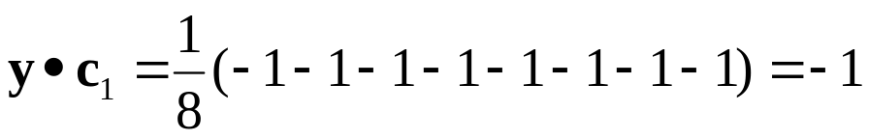
FUNDAMNETALS: OPERATIONS
CDMA operations: receiver
  Despreading: at receiver, performing inner product between received signal and the code sequence of the user
    Rx signal (after fading compensation)
    After despreading:
      is the noise component after despreading
  Example (Assume no noise)
    The Rx sequence is
    After despreading:

Slide 7

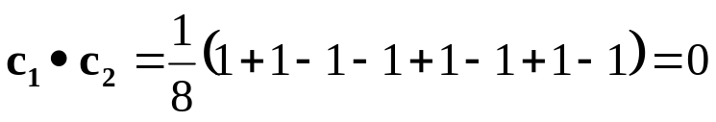


FUNDAMENTALS: OPERATIONS
CDMA operations: multiple access
  Each user is assigned a unique sequence
    Ideally, the sequences of different users are orthogonal to each other.
    E.g user 1:
    User 2:
  Signals from multiple users are transmitted at the same time and same bandwidth.
    E.g. user 1 “1”:
    User 2 “-1”:
    Signal at receiver:
  Detect signals from user 1
  Detect signals from user 2

Slide 8
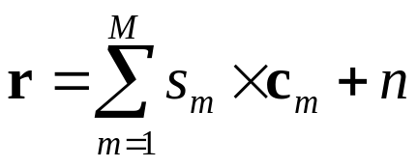
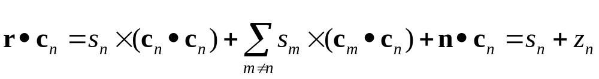
FUNDAMENTALS: OPERATIONS
Multiple access (Cont’d): why no interference among users?
  Because the spreading codes are orthogonal with each other, there is no interference among users!
  If there are M users
  To detect the signal of the nth user
noise after despreader
  To guarantee the orthogonality among users, all the M users must be synchronized.
    All users in system must transmit at exactly the same time!
    This requirement can be lowered by using PN code.

Slide 9
FUNDAMNETALS: PN CODE
PN Code (Pseudo-noise Code)
  Binary sequence with random properties ➔ noise like
  Approximately the same number of 0s and 1s.
  Very low correlation between time-shifted version of same sequence
    Auto-correlation of PN code ➔ noise like!
    E.g. [-1, -1, -1, +1, +1, -1, +1], time shift by 1: [+1, -1, -1, -1, +1, +1, -1]
      Inner product: (-1+1+1-1+1-1-1)/7 = -1/7
  Very low cross-correlation between different codes.
⇒
PSD
δ(t)
t
f

Slide 10
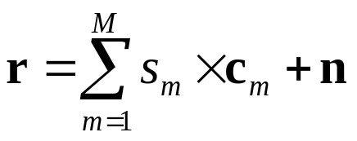
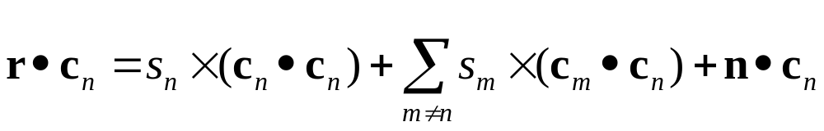
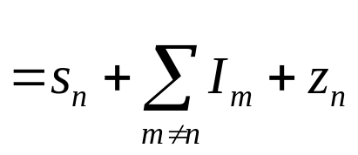

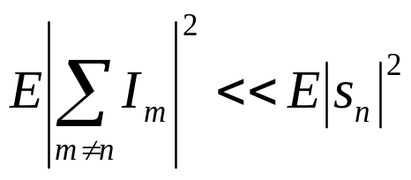
FUNDAMNETALS: MAI
Multiple access interference (MAI)
  In practical CDMA systems
    Users are not perfectly synchronized ➔ codes are time shifted ➔ codes are no longer orthogonal
    The spreading codes among users are not perfectly orthogonal
  MAI: interference among users in CDMA system because the codes among users are not perfectly orthogonal.
  To detect the signal of the nth user
MAI
  Usually:
therefore

Slide 11
FUNDAMENTALS: MAI
MAI (Cont’d)
  The power of MAI depends on two factors:
    the cross-correlation between different PN codes
    The signal power of interfering users
  Near-far effect
    Interfering users are close to BS (“near”) ➔ high power at Rx
    Desired user is far away from BS (“far”) ➔ low power at Rx
    the power of the interfering users is much higher than the power of the desired signal ➔ MAI is high ➔ signal to MAI ratio is low ➔ poor performance of desired user
    Near-far effect will seriously affect the performance of CDMA system
    To reduce the impairments of near-far effect, the power at Rx should be the same for all users
      Close to BS: low Tx power. Far from BS: larger Tx power
    Power control is very important for CDMA system.

Slide 12





FUNDAMENTALS: SPREAD SPRECTRUM
Bandwidth of CDMA signals
  TDMA or FDMA system: one symbol is transmitted at one symbol period (Ts)
    Each symbol passes through pulse shaping filter with parameter
    Bandwidth:
  CDMA system: N chips are transmitted at one symbol period (Ts)
    each chip passes through pulse shaping filter with parameter
    Bandwidth:
    : chip rate
      The bandwidth is proportional to chip rate (N times of symbol rate)
    The bandwidth of the signal is spreaded N times ➔ spread spectrum!
      Within one symbol period, signals changes N times faster due to spreading code.
    Due to the properties of PN code, signals look like noise ➔ high security
Modulation
Spreading
Pulse shaping

Slide 13
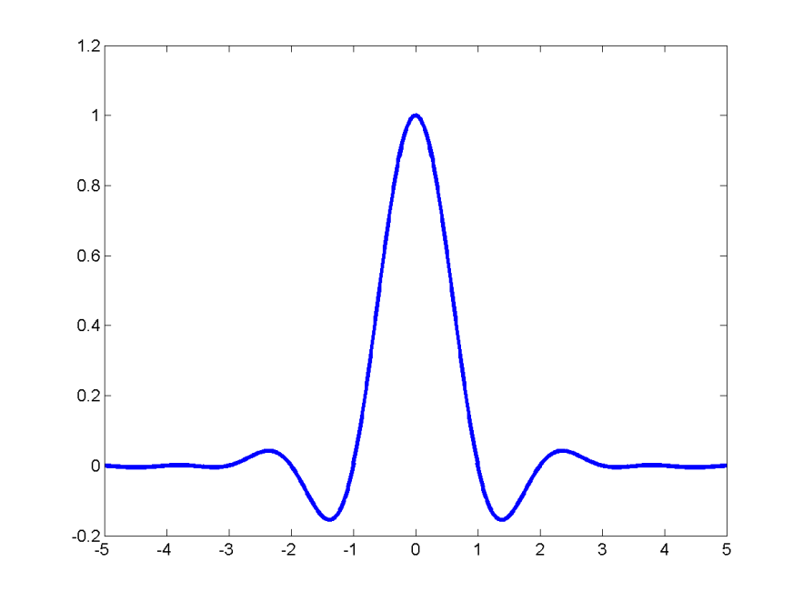
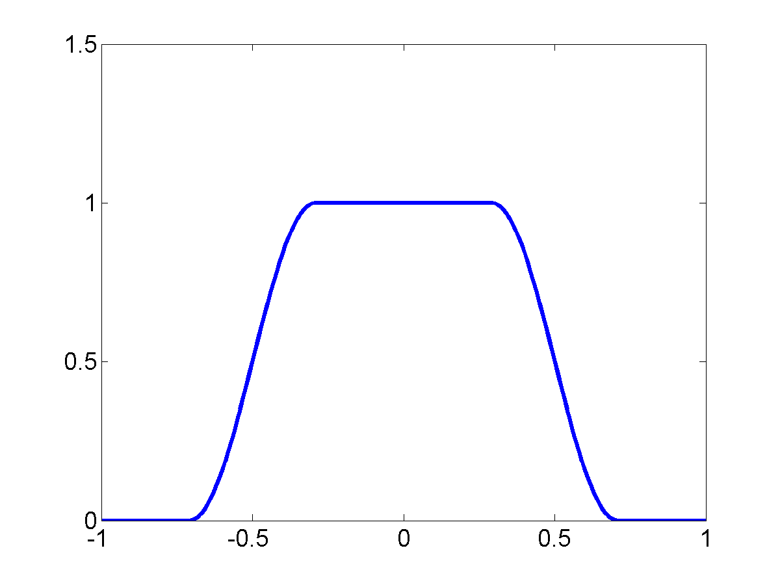


FUNDAMENTALS: SPREAD SPRECTRUM
Bandwidth of CDMA signals (Cont’d)
  Pulse shaping
Time (Tc)
Frequency (Rc)
bw ∝ 1 / T_{s}
Chip period
Chip rate
BW ∝ 1 / T_{C}
f
f_{c}

Slide 14
FUNDAMENTALS: SPREAD SPECTRUM
Bandwidth after despread
  After the operation of despread, each symbol period there is only one symbol ➔ BW ∝ 1 / Ts
    The bandwidth of the original signal is recovered after despread.
bw ∝ 1 / T_{s}
bw ∝ 1 / T_{s}
BW ∝ 1 / T_{C}
f
Before spread
f_{c}
after spread
after despread
  How about noise and signals from other users?
    Signals from other users: they use different codes ➔ cross-correlation is low ➔ they remain to be wideband interference (MAI)
    Noise: noise inner product with PN code ➔ noise properties remain the same.

Slide 15
FUNDAMENTALS: PROCESSING GAIN
Processing gain
  Narrow band interference
signal
interference
interference
f
f
f_{c}
f_{c}
signal
In channel
After despread
    At receiver, perform inner product between narrow band interference and PN code
      Equivalent to perform spreading operation over interference
    Interference is spreaded, while signal is recovered !
      Interference: BW∝ 1 / Tc
      Signal: BW ∝ 1 / Ts
      Most of the interference are removed!

Slide 16
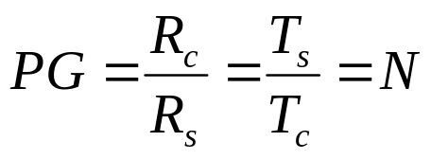
FUNDAMENTALS: PROCESSING GAIN
Process gain (Cont’d)
  Processing gain is an approximate measure of the interference rejection capability
  Process gain is equal to the number of chips per code.
  The higher the processing gain, the greater the ability to suppress narrow band interference.

Slide 17
FUNDAMENTALS: FHSS
Frequency-hopping spectrum
  A wide spectrum is divided into N sub-channels
  At each chip period, the carrier frequency of the signal is in one sub-channel
    At next chip period, the carrier frequency of the signal is in another sub-channel
    The signal “hops” from frequency to frequency
      The signal itself is still narrow band.
  At each symbol period, the signal hops N times
    The order of hopping is determined by the PN code.
  Very good security
    It’s hard to guess which sub-channel the signal is at without the knowledge of the PN code
    Usually used in military applications.

Slide 18
OUTLINE
CDMA Fundamentals
Pseudo-noise sequence
Rake receiver

Slide 19
PSEUDO-NOISE SEQUENCE
PN sequence
  A binary sequence with an autocorrelation resembles the autocorrelation of white noise.
  Nearly equal number of 0s and 1s
  Low correlation between time shifted versions of the same sequence
  Very low cross-correlation between any two sequences.
Many methods exist for the generation of PN sequences
  Walsh code
  m-sequence
  Gold sequence
  ……

Slide 20

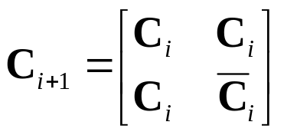

PN SEQUENCE: WALSH CODE
Walsh code
1 | 1 | 1 | 1 | 1 | 1 | 1 | 1
1 | 0 | 1 | 0 | 1 | 0 | 1 | 0
1 | 1 | 0 | 0 | 1 | 1 | 0 | 0
1 | 0 | 0 | 1 | 1 | 0 | 0 | 1
1 | 1 | 1 | 1 | 0 | 0 | 0 | 0
1 | 0 | 1 | 0 | 0 | 1 | 0 | 1
1 | 1 | 0 | 0 | 0 | 0 | 1 | 1
1 | 0 | 0 | 1 | 0 | 1 | 1 | 0
1 | 1
1 | 0
1 | 1 | 1 | 1
1 | 0 | 1 | 0
1 | 1 | 0 | 0
1 | 0 | 0 | 1
  Each row of the matrix is a PN sequence
  The PN sequences generated by using Walsh code are perfectly orthogonal with each other.
  Sequence length:
  There are N length-N sequences.

Slide 21

PN SEQUENCE: M-SEQUENCE
m-sequence
  Also called maximal length sequence
  Sequence length: (m: # of registers)
  Generated by using shift register
a2 = a1+a0
s(n) = a0
s(n)
a2
a1
a0
  E.g. m = 3 (N = 7)
a2 | a1 | a0 | s(n)
0 | 0 | 1 | 1
1 | 0 | 0 | 0
0 | 1 | 0 | 0
1 | 0 | 1 | 1
1 | 1 | 0 | 0
1 | 1 | 1 | 1
0 | 1 | 1 | 1
1 0 0 1 0 1 1
Periodic with period N = 7

Slide 22


PN SEQUENCE: M-SEQUENCE
m-sequence (Cont’d)
  15 registers: m = 15 ➔
    The sequence will repeat itself for every 32767 chips.
    Short code
    Can be used for synchronization between Tx and Rx
      Only when the clock between Tx and Rx are synchronized will the receiver gets strong signal ➔ adjust the receiver clock until a strong signal is obtained ➔ synchronization.
  42 registers: m = 42 ➔ billions
    The sequence will repeat itself for every 4398 billion chips
    Long code
    Can be used for scrambling (security)
      Different users start the sequence from different offsets.
      User data is XORed with chunks of long code with same length.
      Impossible to detect the data without knowledge of long code.

Slide 23



PN SEQUENCE: IS-95 CDMA
1.2288 Mchips/s
I-short
code
Pulses
shaping
19.2kbps
Source
code
Convolutional
code
interleaver
Pulses
shaping
long
code
Walsh
code
Q-short
code
19.2kbps
1.2288 Mchips/s
scrambling
spreading
synchronization
upconversion

Slide 24
OUTLINE
CDMA Fundamentals
Pseudo-noise sequence
Rake receiver

Slide 25



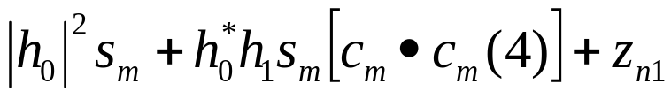

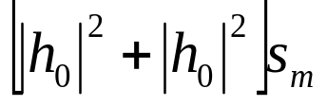



RAKE RECEIVER
Rake receiver
  Spread spectrum: signal bandwidth is very large ➔ signal BW >> channel coherence BW ➔ frequency selective fading
    Relative delay among multipath components is no longer negligible.
  The received signal is the combination of signals with different delays.
  E.g. two path equal gain channel, space between two channel taps: 4 chips
Time shifted version of code
interference

Slide 26



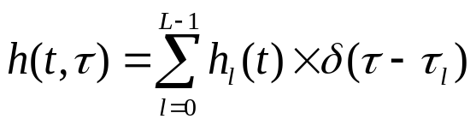
RAKE RECEIVER
Rake receiver
  Rake receiver is made up of several Rake fingers
    Each finger corresponds to one of the multipath components.
  Due to the low correlation between time shifted version of the same PN code, each finger can be treated as flat fading ➔ no equalization needed!
Delay
Delay
……
Delay

Slide 27
CDMA
Major advantages:
  Resistant to narrow band interference
  Combats multipath fading (no equalization required)
  Multiple users can share the same spectrum
  Good security
Major disadvantages
  MAI
    Near-far effect.

