Slide 1
ELEG 5693 Wireless Communications
Ch. 9 Wireless Netowrks
Dr. Jingxian Wu
wuj@uark.edu

Slide 2
OUTLINE
Ad hoc wireless networks
Protocol layers
Cross-layer design

Slide 3
AD HOC WIRELESS NETWORKS
Ad hoc wireless network
  A collection of wireless mobile nodes that self-configure to form a network without the aid of any established infrastructure.
  Ad hoc: with little or no planning, fashioned from whatever is immediately available
  Different from: infrastructure-based network (such as cellular network)
  Allow people and devices to seamlessly internetwok in areas with no preexisting communication infrastructure.
    No pre-installed basestations
  Self-organizing, Rapidly deployed
    Nodes cooperate to provide connectivity ➔ multihop relay.
    Easily enable instantaneous person-to-person, person-to-machine, or machine-to-person communications.
  Self-healing
    Even we one or some nodes break down, the network can still operate.

Slide 4
AD HOC WIRELESS NETWORKS
Examples
  Ad-hoc mode of IEEE 802.11
    IEEE 802.11 (Wireless LAN) has two modes
      Infrastructure mode: wireless router, laptops
      Ad-hoc mode: no wireless router.
        Laptops can directly talk with one another without router.
  Mesh extension of IEEE 802.16
    Regular operation of IEEE 802.16 (WiMax) requires basestation.
    Mesh extension can provide services to users that do not have good coverage from BS.
      Signals are relayed from other users.
  Soldiers equipped with multimode mobile communication devices on battle field
    No fixed wireless base station or pre-installed infrastructrue are needed.
  Small vehicular devices equipped with sensors in hostile environment to collect data.
    Data are relayed by the sensor nodes.
  Ship-to-ship ad-hoc communication
    Doesn’t need the assistance from satellite.
  Police, rescue, etc.

Slide 5
AD HOC WIRELESS NETWORKS
Evolution
  PRNET (packet radio network) : the first MANET
    Sponsored by DoD (Department of Defense), launchened in 1972
    Evolved into survivable adaptive radio networks (SURAN) in 1980s
    Goal: provide packet-switched networking to mobile battlefield elements in an infrastructureless, hostile environment.
    MAC layer: combination of ALOHA and CSMA (carrier sensing multiple access)
    Network layer: a variation of distance vector routing.
    Handled datagram traffic reasonably well.
  Ad-hoc mode of IEEE 802.11: 1990s
  NTDR (Near-term digital radio): sponsored by DoD
    Used by U.S. Army in late 2002
    Clustering, link-state routing, self-organized two-tier structure.
  Still largely an R&D activity
    IETF MANET workgroup: two protocols will become “proposed standards”

Slide 6
OUTLINE
Ad hoc wireless networks
Protocol layers
Cross-layer design

Slide 7
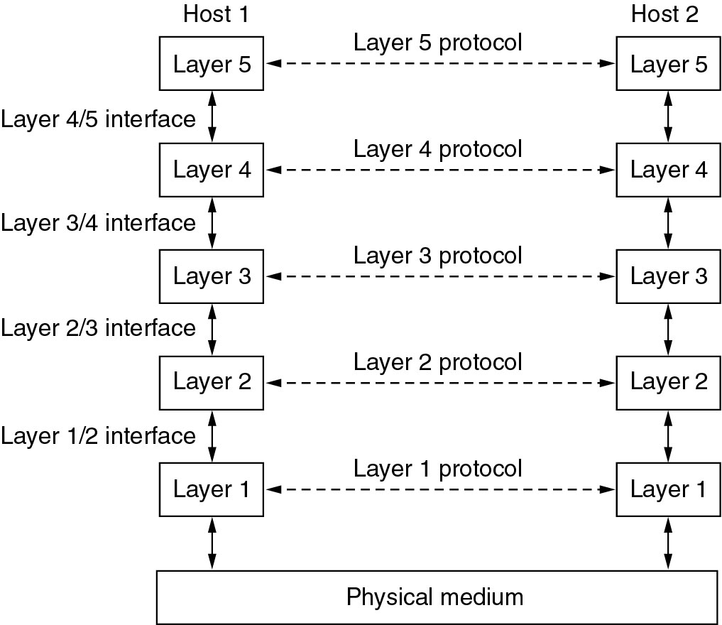
INTRODUCTION: SOFTWARE AND PROTOCOLS
Network software is organized as a stack of layers
  Modular architecture makes development easier and cheaper

Slide 8
INTRODUCTION: SOFTWARE AND PROTOCOLS
Layered structure: vertical
  Each layer provides services to the layers above
    Via the interface between layers.
    Details of the implementation of each layer is hidden to the higher layers → Data Encapsulation.
  Between each adjacent pair of layers is an interface
    Interface clearly defines the services the lower layer makes available to the upper layer.
    Clear cut interface make it simpler to change layer implementation → different host can use different implementation.
  A layer in a machine is represented by an entity in that machine.
    Entity (SW or HW) does the function of that layer.

Slide 9
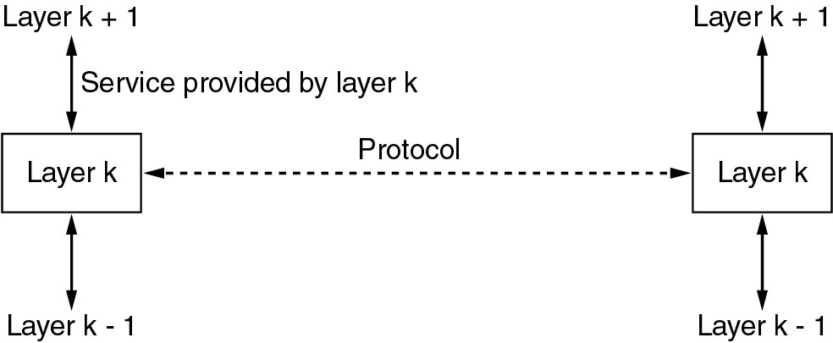
INTRODUCTION: SOFTWARE AND PROTOCOLS
Layered structure: horizontal
  Peer Entities
    Entities in the same layer, but in different machines.
    Layer n on one machine carries on conversation (exchanges information) with layer n on another machine.
    Peer entities communicate with each other using protocol.
  Protocol: An agreement between communication parties on how communication is to proceed.
    One of the most important concepts in computer network!
    Each layer has its own protocol.
    The protocol of a certain layer can only be understood by its peer entities.
  Physically, peer entities do not talk with each other directly.
    Using the layers below them until the physical medium.
    Actual communication occurs through physical medium

Slide 10
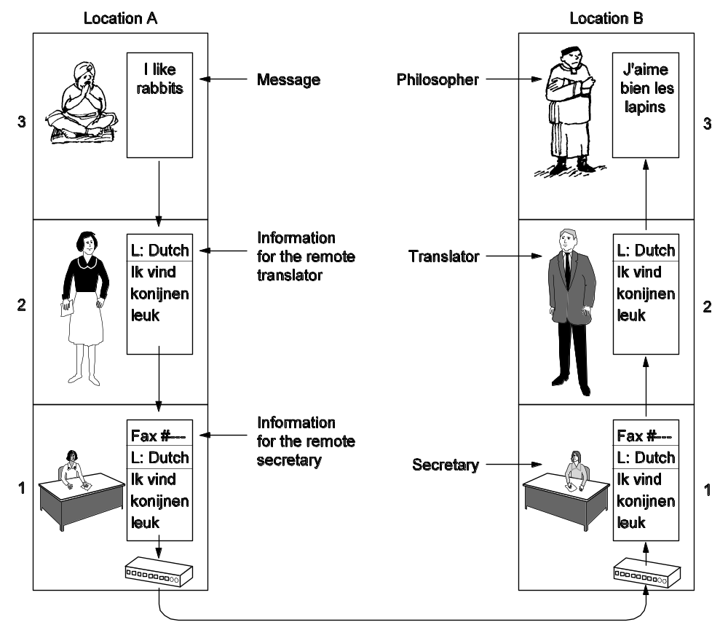
INTRODUCTION: SOFTWARE AND PROTOCOLS
The philosopher–translator–secretary architecture
English
French
Peer Entities
English
Dutch
French
Dutch
Peer Entities
Peer Entities

Slide 11
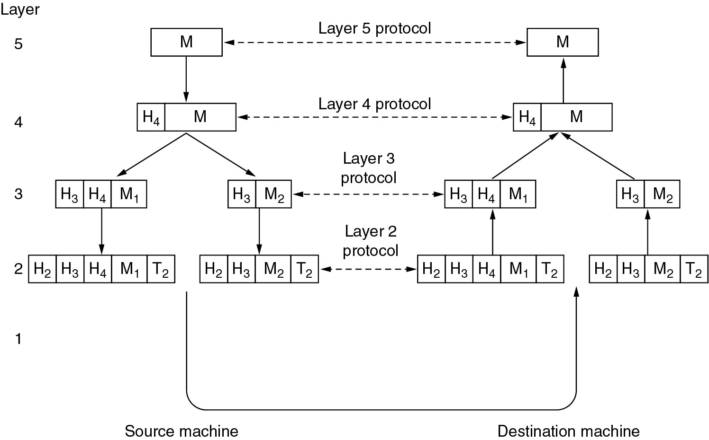
INTRODUCTION: SOFTWARE AND PROTOCOLS
Protocol Stack: A list of protocols used by a certain system, one protocol per layer.
Protocol Data Unit (PDU):
  A unit of data that is specified by a protocol of a given layer and delivered among peer entities.
  Consisting protocol control information of given layer and possibly data of that layer.

Slide 12
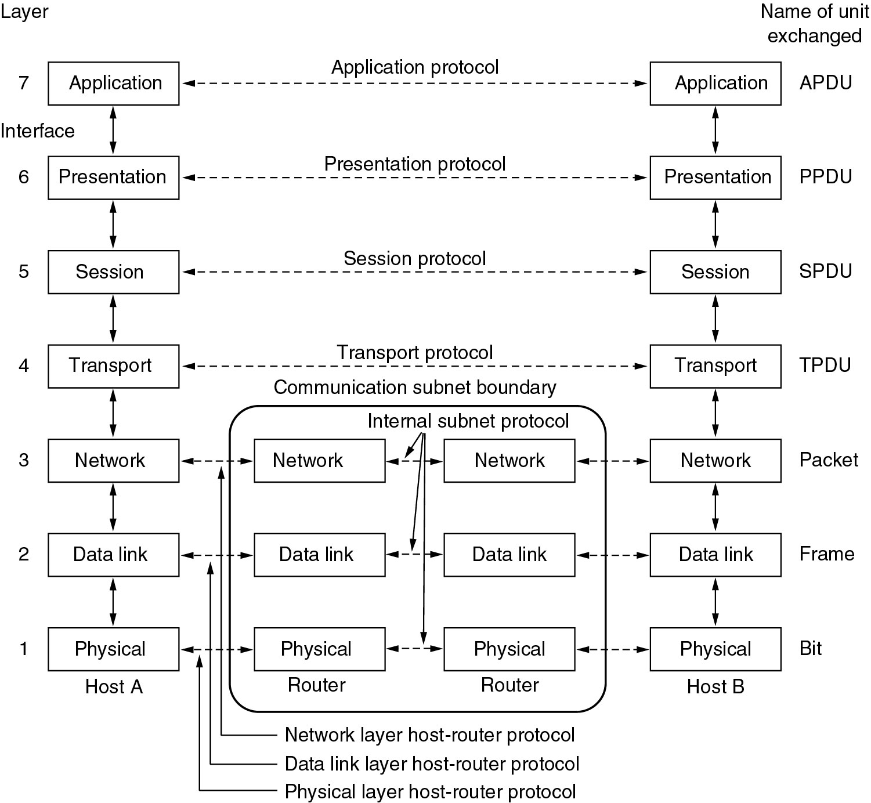
INTRODUCTION: SOFTWARE AND PROTOCOLS
Open System Interconnect (OSI) model
End-to-end layers
Chained layers

Slide 13
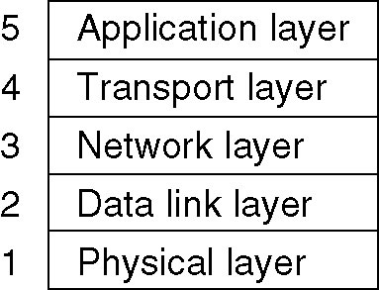
INTRODUCTION: SOFTWARE AND PROTOCOLS
A simplified model
Web, email, ftp, etc.
TCP
IP
MAC

Slide 14
PHYSICAL LAYER
Physical layer is responsible for
  Transmitting information over the physical medium
    Make sure that when a ‘1’ is sent out at Tx, a ‘1’ is received at Rx.
  Activation and deactivation of physical connections.
Physical layer specifies interface characteristics
  Mechanical interface.
    E.g. number of pins of the connector, the shape of the connector, etc.
  Electrical interface.
    E.g. volts used to represent ‘1’, how long should a bit last, etc.
  Procedural interface.
    E.g. the sequence of events to activate/deactivate a physical medium.
Example physical layer standards
  RS-232, V.92, X.21

Slide 15
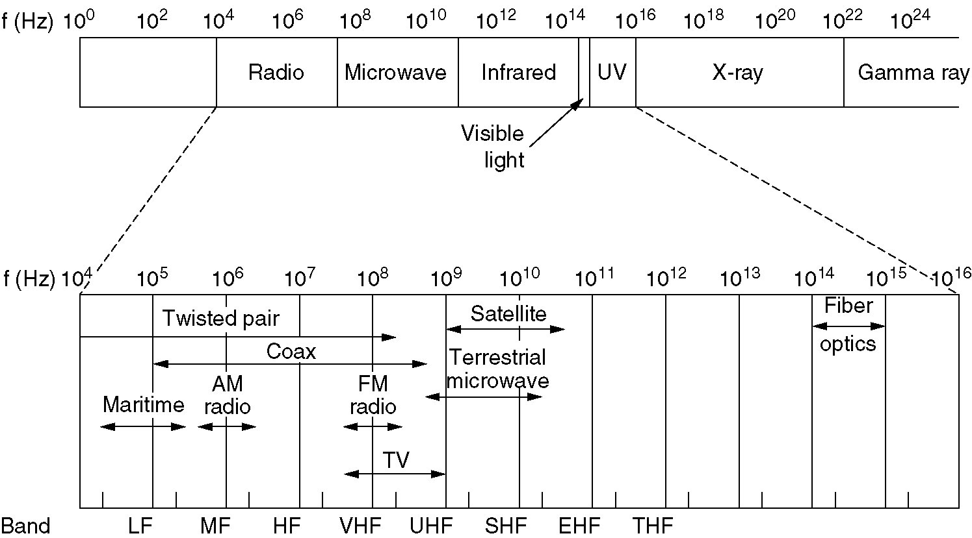
PHYSICAL LAYER
Unguided transmission media
  Electromagnetic Waves
    Change of electrical field causes change of magnetic field, and vice versa
    Electromagnetic waves can propagate through space
Low
Medium
High
Very
High
Ultra
High
Super
High
Extremely
High
Tremendously
High

Slide 16
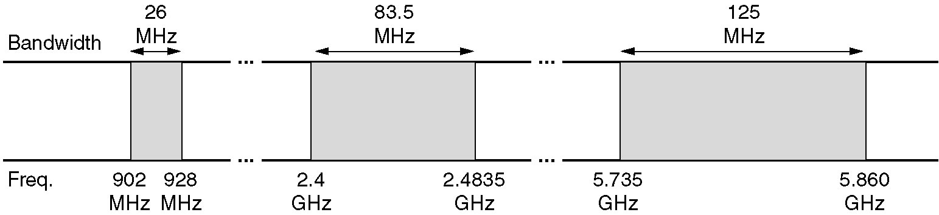
PHYSICAL LAYER
Spectrum Allocation
  Worldwide, ITU-R coordinates the allocation of spectrum
    One device can be used in multiple countries
  In U.S., FCC (Federal Communication Commission) is in charge of the spectrum allocation.
Spectrum Allocation Algorithms
  Beauty Contest: Each carrier explains why its proposal serves public best.
  Lottery: Lottery is held among interested companies
  Auctions: Certain bandwidth is given to the highest bidder.
ISM (Industrial, Scientific, Medical) bands
  Allocated by government for unlicensed use (device power must be under 1watt to avoid interference)
  Bluetooth, WiFi, cordless phone, etc.

Slide 17
LINK LAYER
Link layer
  Deals with reliable communication between adjacent machines.
  The channel acts as a wire ➔ no switching or routing
Functions of data link layer
  Providing well-defined service interface to the network layer
  Framing
    Encapsulates packets from network layer to frames.
  Flow control
    Keep fast transmitter from swamping slow receiver
  Dealing with transmission errors
    Error detection
    Error correction
  Media access control (MAC)
    Determine how to allocate a single broadcast channel (multi access channel) among multiple competing users

Slide 18
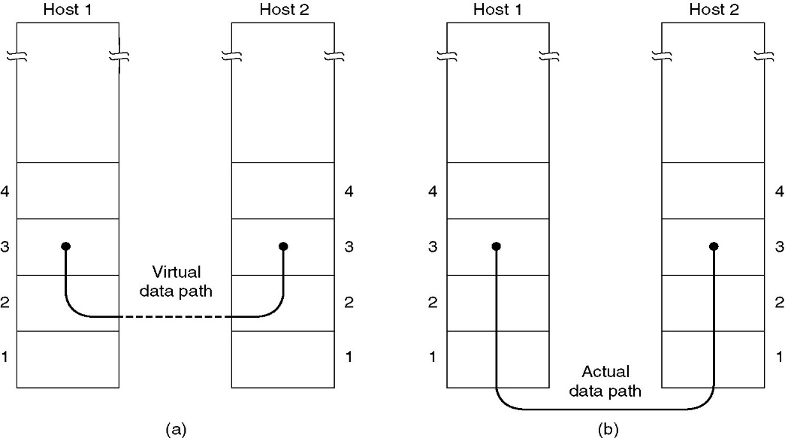
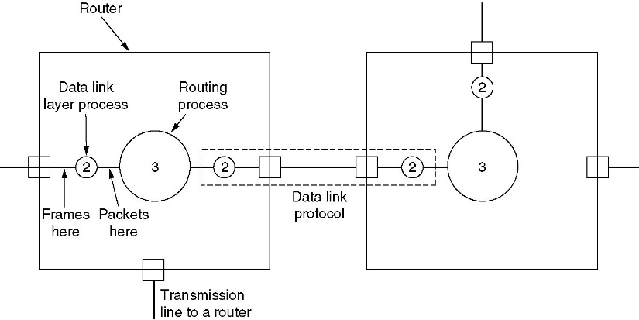
LINK LAYER
Services to upper layer
  The entity in data link layer is usually a software (might be embedded in a chip)
  One router might have multiple different data link layers
    E.g. connecting both wireless network and wired network
(a) Virtual communication
(b) Actual communication

Slide 19
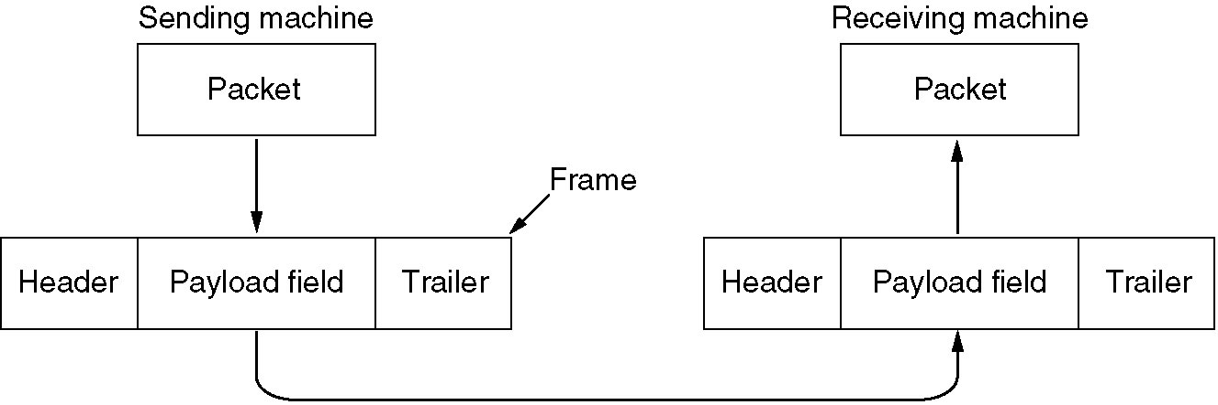
LINK LAYER
Framing
  Encapsulate packet from network layer to frame
    Breaks down larger packets
    Add header and trailer
  Break raw bit streams from physical layer into streams
    Process each stream individually

Slide 20
LINK LAYER
Flow Control
  Keep high speed Tx from swamping low speed Rx
  Feedback-based flow control
    Rx sends back information giving it permission to send more data.
Error Control
  Acknowledgement (Ack)
    Positive Ack: Tx successful. Negative Ack: Tx unsuccessful.
    Timer used at Tx➔no Ack before timer expired = negative Ack.
      If Ack is lost, Rx will have multiple copies of same frame
      Sequence # is used to ensure no duplication and loss.
  Error detection and correction code
    Cyclic redundancy check (CRC)

Slide 21
LINK LAYER
Media access control (MAC)
  Determine how to allocate a single broadcast channel (multiaccess channel) among multiple competing users
  Collision: Two devices transmit simultaneously, they overlap in time and collision occurs
MAC classifications
  Static channel allocation
    E.g. frequency division multiple access (FDMA): statically allocate a portion of the bandwidth to each user (broadcast TV)
    E.g. time division multiple access (TDMA): divide time into slots, and allocate different slots to different users (cell phone systems)
  dynamic channel allocation
    Dynamically allocate channel to competing users.
    Efficient for bursty traffics: data coming in irregularly.
      Most widely used in LANs

Slide 22
LINK LAYER
MAC example: CSMA
  Carrier sensing multiple access
  Before sending out data, hosts listen to the carrier to see if there is transmission in the channel.
  If there is transmission, host will back off.
  If there is no transmission, host will act differently for different CSMA protocols
Listens to channel
Channel
busy?
Yes
Wait for a random
Time.
No
Transmit
immediately
Nonpersistent
Collision?
Yes
No
Transmission
complete

Slide 23

NETWORK LAYER
Functions: getting packets from the source to the destination.
  Routing
    choose appropriate path for a packet; knowledge of the topology.
  Internetworking
    connect different types of networks (cooper, fiber optic, wireless, etc.).
  Quality of Service
  Congestion Control
    avoid overloading some of the lines.
  Service to transport layer
    Connectionless service
    Connection oriented service (virtual circuit service)
    Transport layer should be shielded from the number, type, and topology of the routers present.
Routers can be in either subnet (owned by operator) or
LAN (owned by end users).

Slide 24
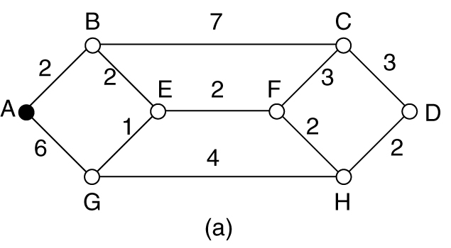
NETWORK LAYER
Routing
  Deciding which output line an incoming packet should be forwarded to.
  Datagram routing (connectionless):
    routing is performed for every packet.
    A packet is called a datagram
  Virtual circuit routing (connection oriented)
    routing is only performed at connection setup ➔ session routing.
    All packets of the same session following the same route
Shortest path: find out the route with the shortest “distance” between source and destination.
  Different measures can be used to measure “distance”
    E.g. # of hops, physical distance (km), queuing delay …
  In practical system, the “distance” measure is usually a function of the distance, bandwidth, average traffic, communication cost, mean queue length, delay, and other factors.

Slide 25
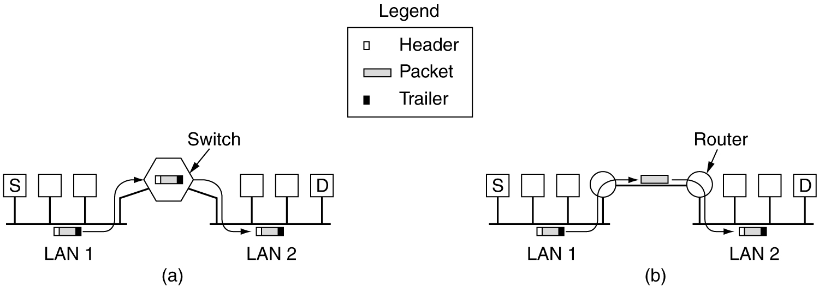
INTERNETWORK: CONNECTION
Internetworking: how networks can be connected
  Physical layer: repeater, Hub
  Data Link layer: switch, bridge
  Network layer: router (gateway: multi-protocol router)
  Transport layer: transport gateway
  Application layer: application gateway
Switch (the entire frame is transmitted)
Router (only IP packet is transmitted)

Slide 26
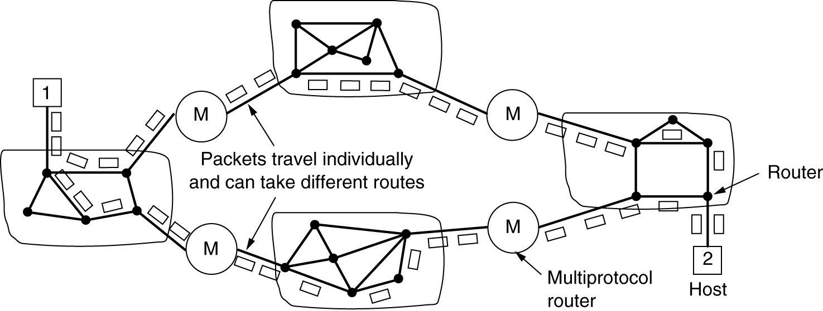
INTERNETWORK: CONNECTIONLESS INTERNETWORK
Connectionless Internetwork
  Packets might go through different paths.
  Protocol translation.
  Address mapping
  IP packet is a “universal” packet recognized by most networks.

Slide 27
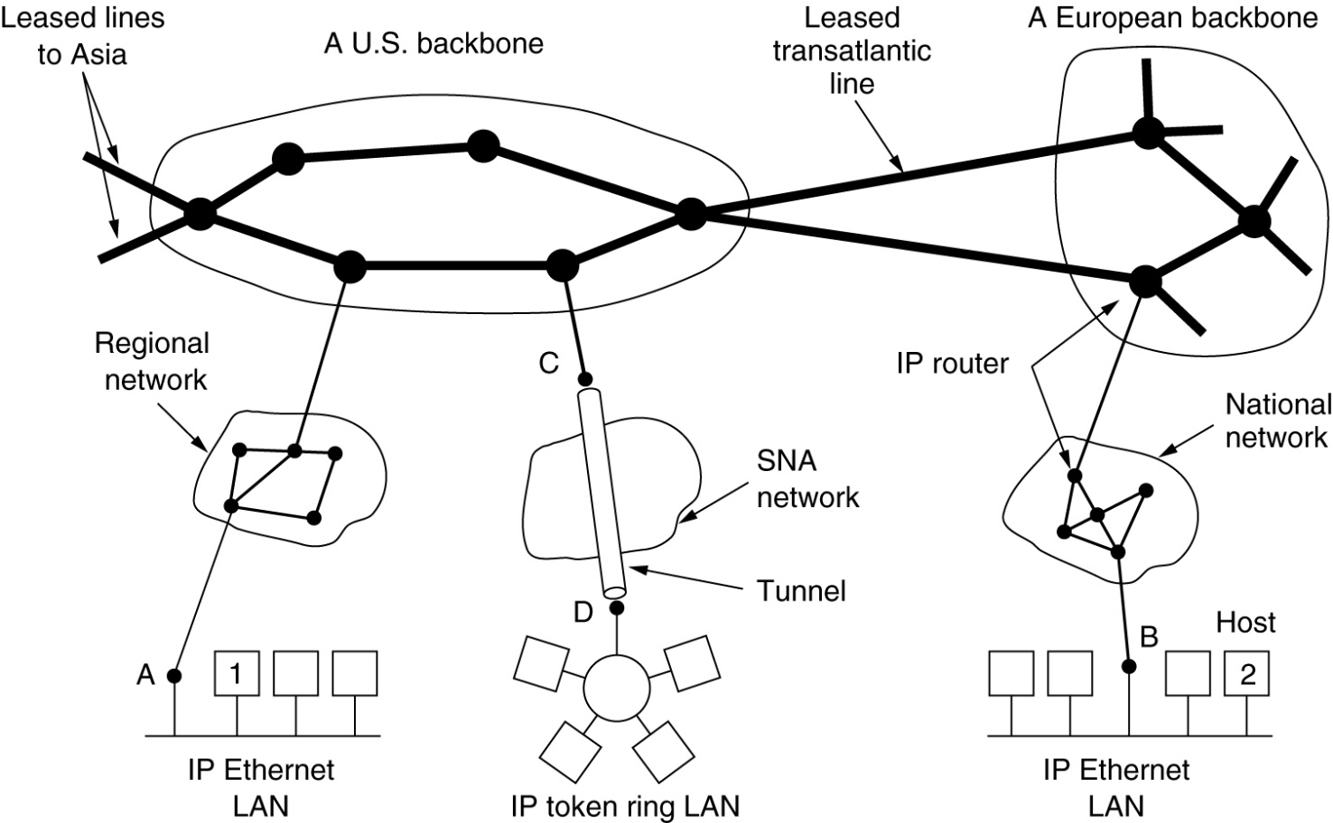
NETWORK LAYER IN INTERNET
Internet Protocol (IP) is the glue for Internet
  IP was designed with internetworking in mind.
  It provides best-efforts (not guaranteed) way to transmit datagram from source to destination.

Slide 28
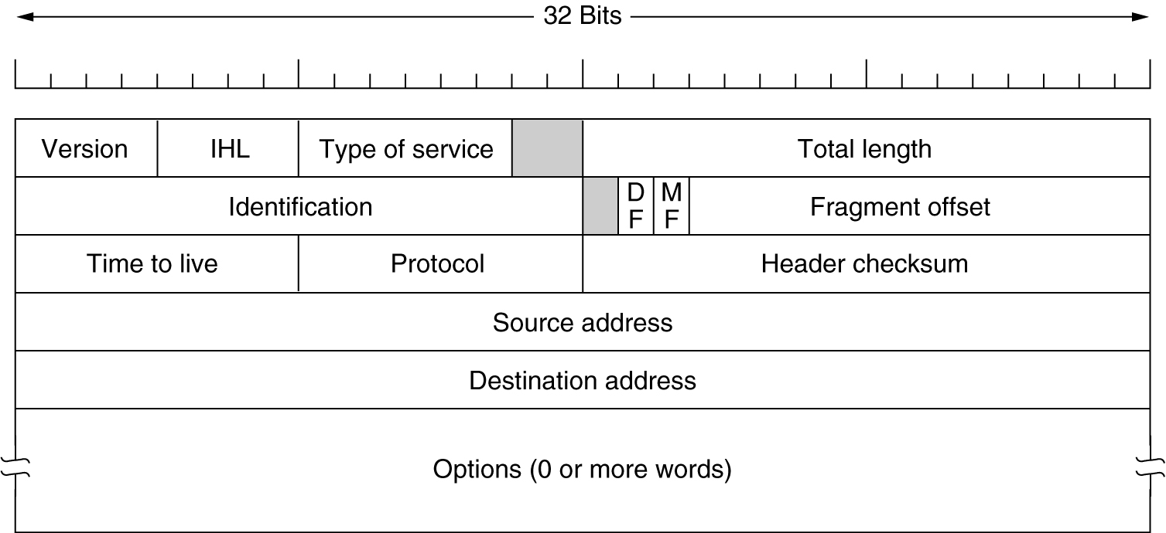

INTERNET: IP PROTOCOL
  Version: the version of the protocol (IPv4, IPv6)
  IHL (4 bits): header length (in the unit of 32-bit word, or 4-byte word).
    Min value = 5 ➔ 5 x 4 = 20 bytes. Max value = 15 ➔ 15 x 4 = 60 bytes.
  Type of service (6 bits): used to distinguish different service classes (QoS).
    Differentiated services: 4 queuing priorities, 3 discard probabilities, etc.
    This field has been ignored by routers.
  Total length (16 bits): the total length of the IP packet (including header and data)
    Maximum length: = 65536 bytes = 64KB

Slide 29

INTERNET: IP PROTOCOL
  Identification (16 bits): identify which datagram a fragment belongs to.
    Fragments belonging to the same datagram has the same ID field.
  DF: Don’t fragment.
  MF: More fragment. More fragments are following.
    All fragments except the last one have this bit set to 1.
  Fragment Offset (13 bits): the seq. # of the first elementary fragment in the current fragment. Elementary fragment: 8 bytes.
    = 8192 elementary fragments. ➔ 8192 x 8 = 65536 bytes.
  Time to live (8 bits): decrease by 1 after each hop.
    When hits 0, packet is discarded and a warning is sent back to source.
  Protocol: which protocol is on the transport layer (TCP, UDP, etc.)
  Header checksum: check header only. MUST be recomputed at each router! Why?
  Source address (32 bits): IP address of source.
  Destination address (32 bits): IP address of destination.

Slide 30
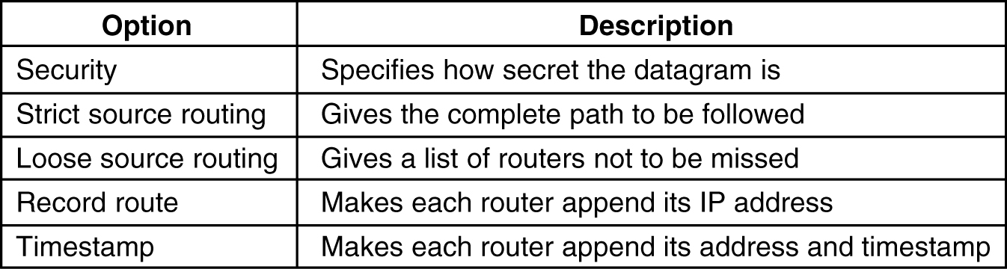
INTERNET: IP PROTOCOL
  Option: variable length. Can contain many options
    Each option starts with 1 byte word to identify the option
    Some options
    More options can be found at
    www.iana.org/assignments/ip-parameters

Slide 31

INTERNET: IP ADDRESS
IP address: 32-bit
  = 4295 million addresses.
  Format: dotted decimal.
    Binary: 11000000.00101001.00000110.00010100
    Hexadecimal: C0.29.06.14
      Hexadecimal:Binary
      0: 0000; 1: 0001; 2: 0010; 3: 0011
      4: 0100; 5: 0101; 6: 0110; 7: 0111
      8: 1000; 9: 1001; A: 1010; B: 1011
      C: 1100; D: 1101; E: 1110; F: 1111
    Decimal: 192.41.6.20
      12x16+0 = 192; 2 x 16+9=41; 0x16+6=6; 1x16+4=20.
  IP address assignment is managed by ICANN (Internet Corporation for Assigned Names and Numbers)

Slide 32
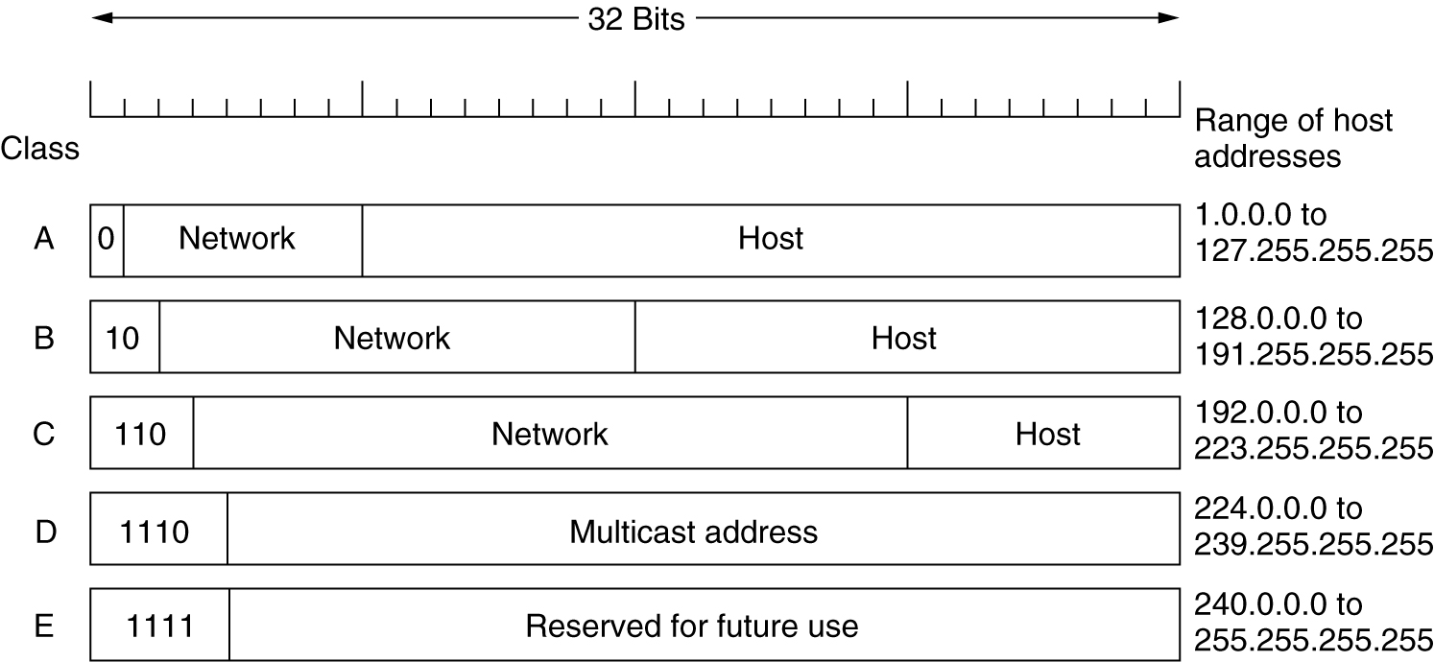
INTERNET: IP ADDRESS
IP addresses are divided into 5 classes
  0.0.0.0: this host
  255.255.255.255: broadcast
  128 networks with 16 million hosts
  16384 networks with 64K hosts.
  2 million networks with 256 hosts.
  Multicast
  Reserved

Slide 33
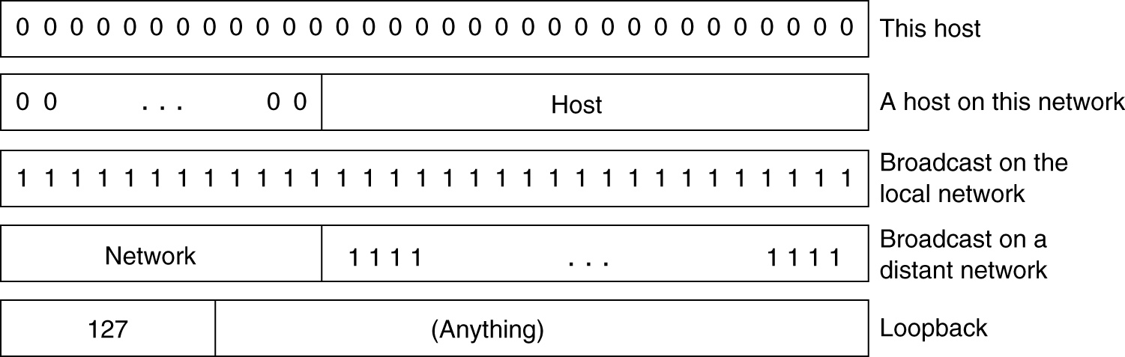
INTERNET: IP ADDRESS
Special IP addresses
  Loopback: for testing only.
    Packets sent to this address will not be put in the wire.
    They are going to be processed locally as incoming packets.

Slide 34
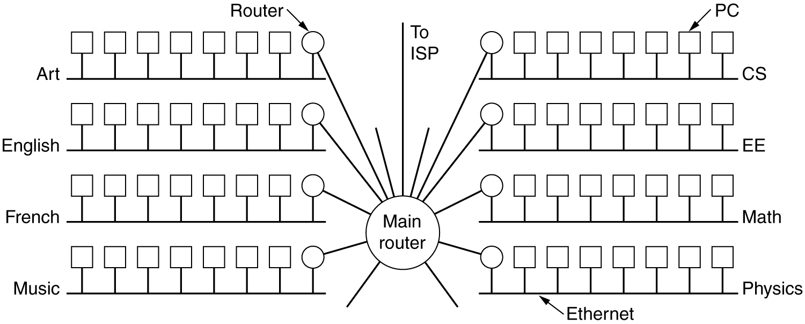
INTERNET: IP ADDRESS
Subnet
  Allow a single network be split into small parts for internal use but still act like a single network to the outside.
    E.g. Each LAN within the network is a subnet.

Slide 35
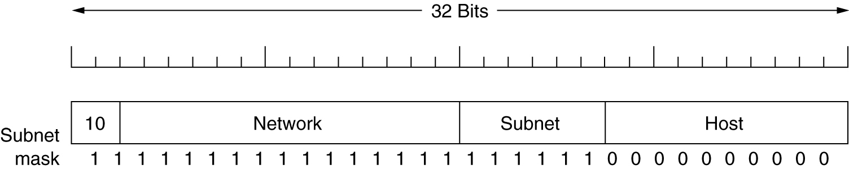
INTERNET: IP ADDRESS
Subnet (Cont’d)
  Some bits of the host number are used to identify subnet.
    E.g. in a class B network, 16-bits are used to identify hosts in the network. Among the 16-bit, 6 bits are used for subnet # (64 Ethernets), 10 bits are used for host # (1022 hosts in each subnet).
    Subnet mask: 11111111.11111111.11111100.00000000 (255.255.252.0, or 130.157.23.16.0/22)
      22 bits are used for network # and subnet #; 10 bits are used for host #
  Router in the network can route packet based on the subnet #.
E.g: subnet 1: 100000010 00110010 000001|00 00000001
subnet 2: 100000010 00110010 000010|00 00000001
Each IP contains three fields: network address, subnet address, host address

Slide 36
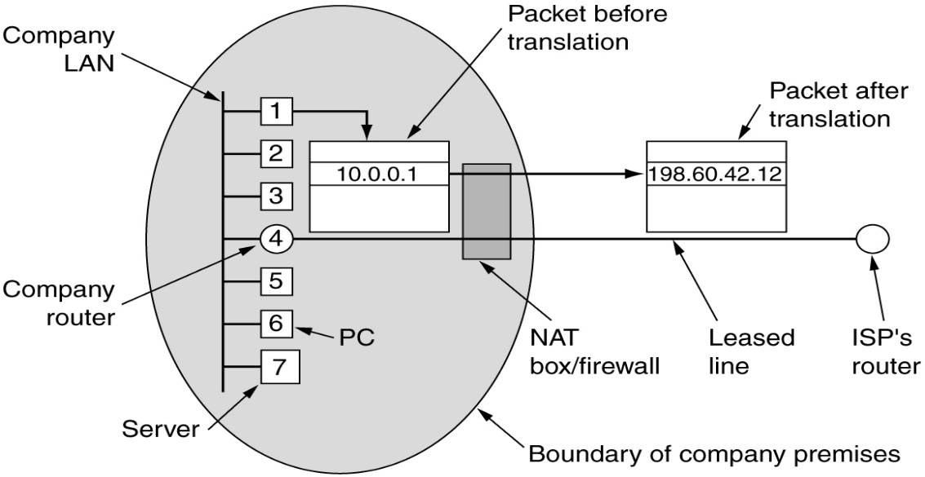
INTERNET: IP ADDRESS
NAT (Network Address Translation)
  Motivation: Most users want static IP address ➔ We are running out of IP addresses!
  Solution: Assign 1 or a few IP to company or ISP; Private IP are used inside company or ISP; NAT is used for address translation!
    Private IP address ranges
      10.0.0.0 - 10.255.255.255/8 (16,777.216 hosts)
      172.16.0.0 - 172.31.255.255/12 (1,048,576 hosts)
      192.168.0.0 - 192.168.255.255/16 (65,536 hosts)
    Packets leaving local network will be replaced with true IP address.

Slide 37
INTERNET: IP ADDRESS
NAT (Cont’d)
  All incoming packets are addressed to the real IP of the network.
    How to distinguish incoming packets for different hosts?
  TCP (or UDP) has header fields for source port and dest. port.
    Each port corresponding to one of the processes in host.
      E.g. port 80: http; port 21: ftp;
  NAT uses TCP source port to distinguish hosts!
    Each host is assigned a unique TCP port # at NAT.
    NAT maintains a table (host # and original port # v.s. NAT mapping port #)
    When a packet is sent to NAT from the private network
      its IP address is replaced by real IP address;
      its TCP src port is changed to the NAT port based on ( host # and original TCP port #).

Slide 38
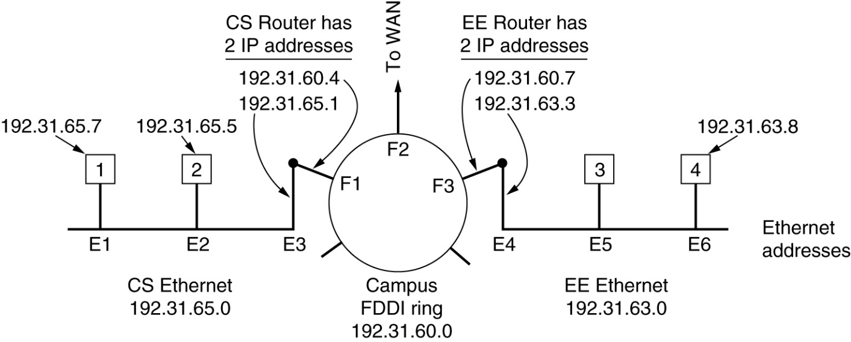
INTERNET: INTERNET CONTROL PROTOCOLS
Address Resolution Protocol (ARP)
  How to find Ethernet address (MAC) by IP address?
  E1 to E2: Host 1 broadcasts an ARP packet asking: what is the MAC address for 192.31.65.5?
    Host 2 answers with its own MAC address.
    All the hosts make an entry in their own (IP, MAC) mapping table for host 1 and 2.
  E1 to E4: Host 1 sends the packet with dest. MAC address being F1 (or broadcast).
    F1 builds a new MAC frame to F3
    F3 builds a new MAC frame asking about the MAC address of E4
Department of Engineering Science
Sonoma State University

Slide 39
INTERNET: INTERNET CONTROL PROTOCOLS
RARP (Reverse Address Resolution Protocol)
  A newly booted host broadcast its MAC address, and asking for IP address.
  RARP server replies with the IP by looking the MAC in its table.
  Router won’t forward MAC broadcast message (dest: all ‘1’s).
    Each network needs an RARP server.
BOOTP
  A newly booted host broadcast its MAC address using UDP messages
    UDP message can be forwarded by routers
  BOOTP server will reply with IP and other information
    E.g. the IP address of file server to download Operating System image.
  The MAC/IP mapping table must be configured by hand.

Slide 40
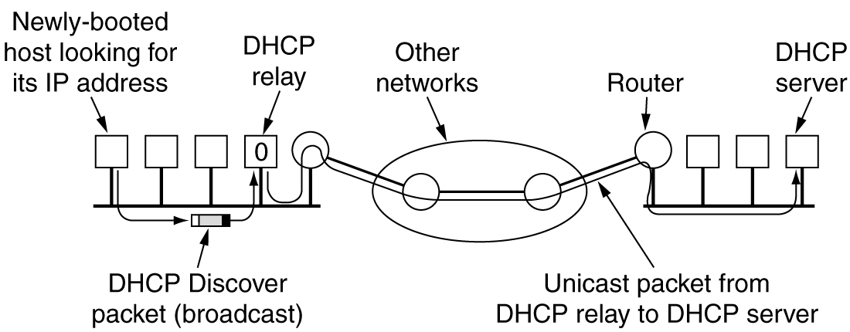
INTERNET: INTERNET CONTROL PROTOCOLS
DHCP (Dynamic Host Configuration Protocol)
  A newly-booted host broadcasts a DHCP DISCOVER packet.
  Each LAN has a DHCP relay agent
    Forward the message to DHCP server through unicast.
    The DHCP server might not be reachable through broadcasting.
  DHCP server automatically assigns an IP address to the host.
  Leasing: IP is assigned for that host for a period of time.
    Host must renewal before expiration.

Slide 41
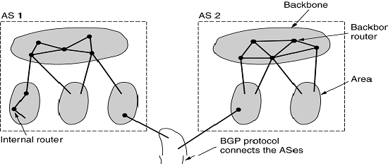
INTERNET: OSPF
OSPF (Open Shortest Path First) – RFC 2328
  An interior gateway (multi-protocol router) routing protocol: routing inside an independent network (autonomous system, or AS).
  AS is divided into areas: a network or a set of contiguous networks.
    Each AS has a backbone area connected to all other areas.
    Router connecting to two or more areas is part of backbone.
  Four types of routers:
    internal routers, area border router, backbone router, AS boundary router

Slide 42
INTERNET: BGP
BGP (Border Gateway Protocol)
  An exterior gateway routing protocol: routing between ASes.
  The major difference from interior gateway routing: need to consider politics
    E.g. Do not use United States for traffic from British Columbia to Ontario; Traffic starting at IBM should not pass Microsoft; Transit traffic of only paid customers, etc.
  The rules are manually configured in BGP routers.
  BGP used an enhanced distance vector protocol
    Exchanging information with neighbors about cost to all destinations.

Slide 43


INTERNET: IPV6
IPv6: the evolution of IP
  16 bytes of addresses: support effectively unlimited addresses.
    For the entire earth (water & land), allow per square meter!
  Header is simplifier compared with IPv4
    Fixed length: 40 bytes
    Packets can be processed faster in router ➔ lower delay, larger throughput.
  Better support of options
    Many required fields in IPv4 become options in IPv6
  Better security
  Better support of QoS.
  Not compatible with IPv4, but compatible with most other protocols
    TCP, UDP, ICMP, IGMP, OSPF, BGP, DNS

Slide 44
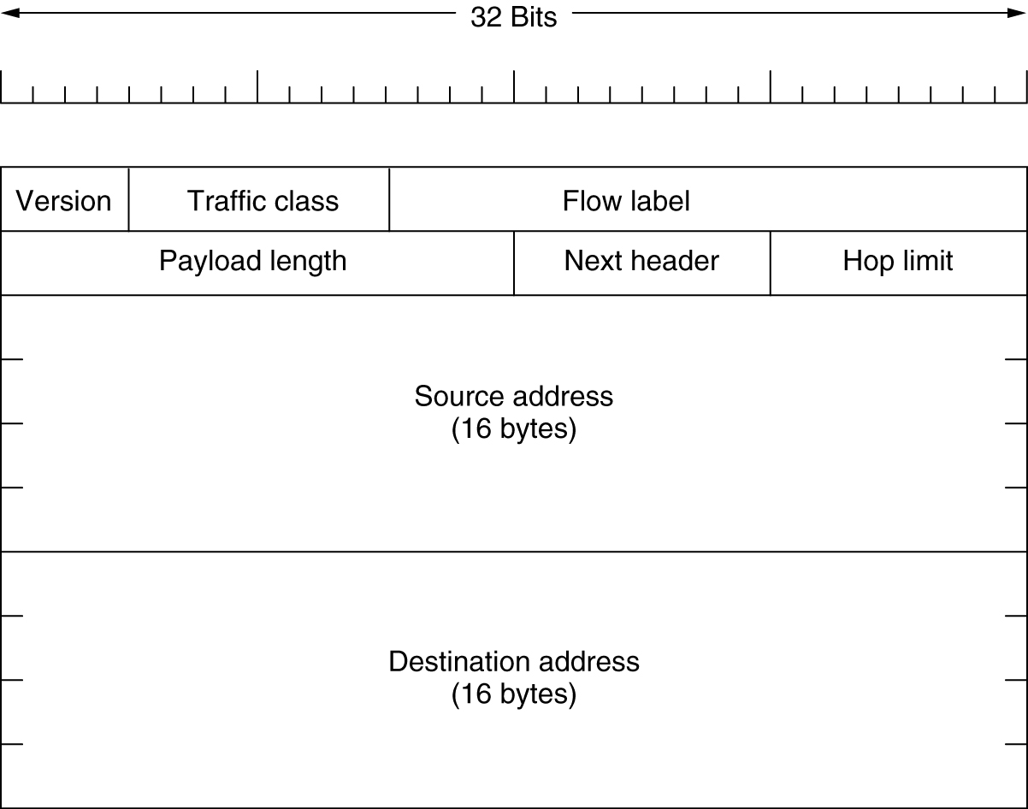
INTERNET: IPV6 MAIN HEADER
  Version: 6
  Traffic class: different service classes for QoS
  Flow label: the label of a particular connection. Routers can use this field for QoS purpose. (e.g., this flow is delay sensitive).
    Each flow is designated by source, destination, and flow #.

Slide 45
INTERNET: IPV6 MAIN HEADER
Main Header (Cont’d)
  Payload length: how many bytes following the 40-byte header
  Next header: which of the 6 optional header is following the main header.
    If no optional header, tells which transport protocol to pass the packet to.
  Hop limit: same as Time to live in IPv4.
  IPv6 address notation: eight groups of four hexadecimal digits
    8000:0000:0000:0000:0123:4567:89AB:CDEF
    Can be simplified as
    8000::123:4567:89AB:CDEF
      Consecutive zeros are replaced by ::
      Leading 0s are omitted.

Slide 46
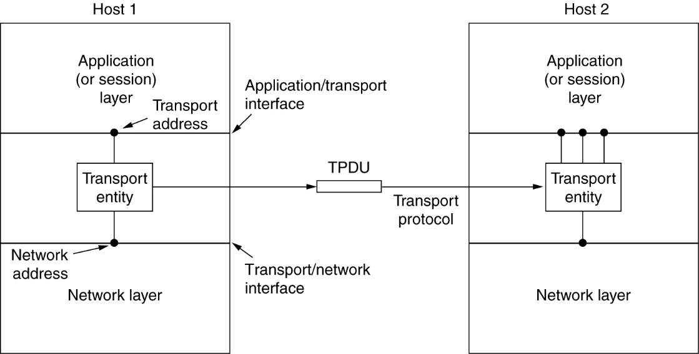
TRANSPORT LAYER
Functions: provide reliable, cost-effective data transport from source to destination.
  Independent of the physical network
  Independent of the network structure & topology
  The first true end-to-end layer
    Transport layer does not exist on routers.
    Transport layer on the source is directly talking with transport layer on the destination.
    On other layers, e.g. network layer, the conversation is usually between intermediate neighbors.

Slide 47
TRANSPORT LAYER
Connection-oriented service
  Three phases:
    Connection establishment
    Data transfer
    Connection release
  Packets belonging to the same connection might take different routes!
    If the underlying network layer is connectionless.
  Example: TCP (Transport Control Protocol)
Connectionless service
  No connection required
  E.g. UDP (User Datagram protocol)
  Could be on top of connection-oriented network layer

Slide 48
TRANSPORT LAYER: WHY TRANSPORT LAYER?
Network layer providing connectionless and connection oriented services as well.
  Why do we need another layer?
Network layer mainly resides on routers
  Routers are owned by operators
  Users have no control about the operation of the network layer.
  If something goes wrong in the network, the users could do nothing to stop it.
We need an addition layer on top of network layer to improve the QoS.
  If error happens in network, simply set up another connection.
  Lost data can be detected and compensated by transport layer.
  Provide a unified interface to users
    Application programmers do not need to worry about the underlying network

Slide 49
TRANSPORT LAYER: SERVICE PRIMITIVES
Service primitives
  A set of interfaces for the user to access the service
  Usually in the form of function calls.
  Analogy: printf( ) is the service primitive for the format printing service provided by C language.
    Users do not need to know the implementation of the function.
Different transport layer protocols have different service primitives

Slide 50
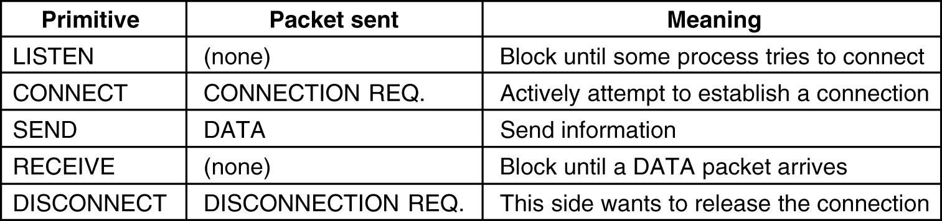
TRANSPORT LAYER: SERVICE PRIMITIVES
A simple example
The service primitives shield the underlying implementations from users
  Acknowledgement, lost packets, congestion, etc. are invisible to users.
  Provide reliable service on top of unreliable networks
  All users need to do is call SEND to send a packet at source, and call RECEIVE at destination to retrieve the packet.
Used directly by programmers or users
  Usually are convenient and easy to use.

Slide 51
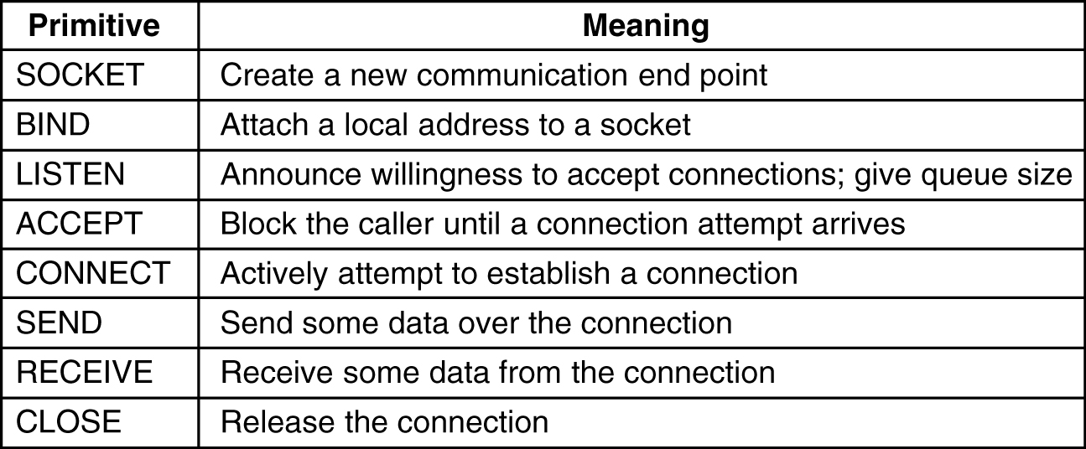
TRANSPORT LAYER: BERKELEY SOCKETS
Berleley sockets
  Socket: access point for the service in transport layer.
  Servives primitives used in Berkeley Unix for TCP.
  Part of the OS kernel.
  The most widely used service primitives for TCP.
In Linux or Unix system, use man command_name (e.g. man socket) to get more information.

Slide 52
TRANSPORT LAYER: UDP
User datagram protocol (UDP) – RFC 768
  Connectionless protocol
  Simple: IP with a short header
  Fewer message required (no connection setup, acknowledgement).
  Example: DNS (Domain Name System)
    Client send a request contains a domain name
    DNS server replies the IP of the domain name
    Only two messages.
  Good for short transaction, or delay sensitive applications.
Why UDP? Why not use IP directly?
  Each host has only one IP address
  Multiple network applications are running simultaneously.
  One UDP entity can provide services to multiple users.
    Each user has it’s own TCP port #.
  We can easily identify the destination application by using
    (IP, UDP port #)
We want to use the addressing element of UDP.

Slide 53
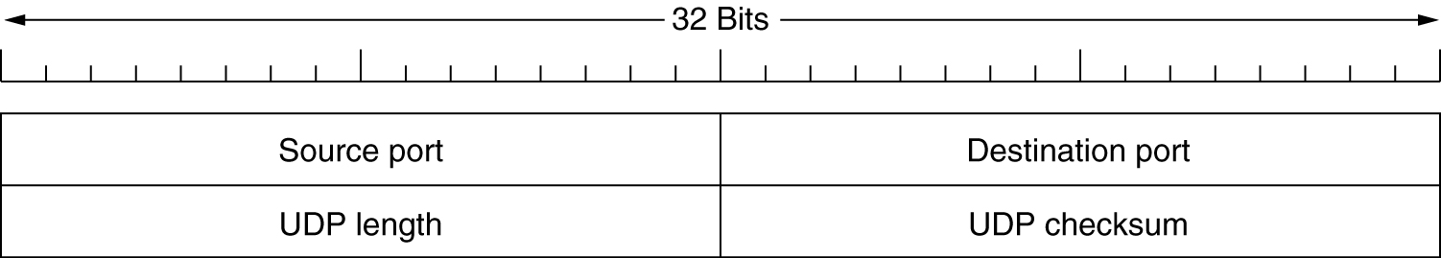
UDP
Header
  Source port: port # of source
  Destination port: port # of destination
  Length: the length of the entire UDP packet (head + payload).
  Checksum: optional. All 0s if not computed.
What the UDP does not do
  Flow control
  Acknowledgement
  Retransmission (retransmission is meaningless for real-time application)
These operations are left to the applications!

Slide 54
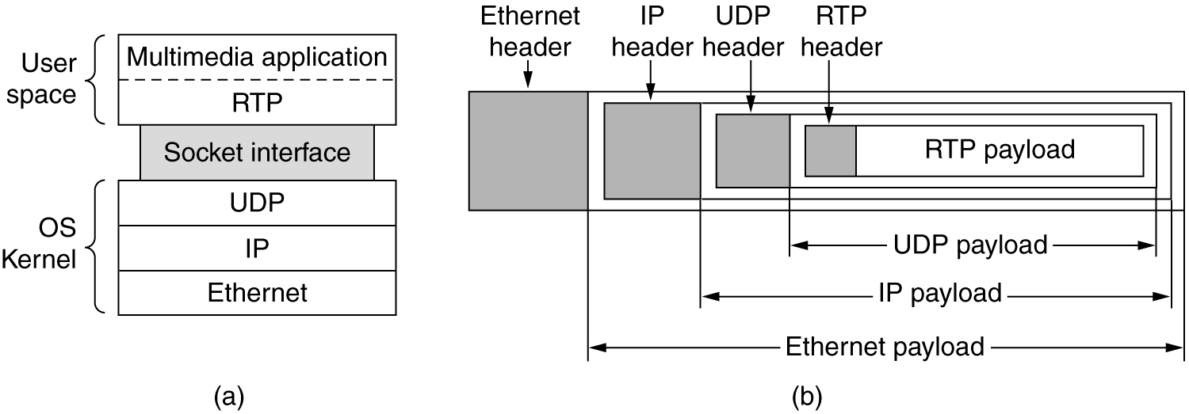
UDP: REAL-TIME TRANSPORT PROTOCOL
Real-time transport protocol (RTP)
  The engine for real-time applications
    Internet telephony, videoconferencing, video-on-demand, etc.

Slide 55
TCP: SERVICES
Transmission control protocol – RFC 793, 1122, 1323
  Reliable end-to-end byte stream over an unreliable internetwork
    IP gives no guarantee of the delivery of datagram
    It’s up to TCP to guarantee the in-order and reliable delivery of the data to application layer.
TCP service model
  Application access the services provided by TCP by creating sockets at both communication parties.
    Each socket is associated with a unique port number.
  Connections are established between sockets.
    One socket might be used for multiple connections.
      E.g. several users can connect to the same FTP server simultaneously.
  Byte stream: all bytes are treated equally.
  Full duplex: data transmissions can occur at both directions simultaneously.

Slide 56
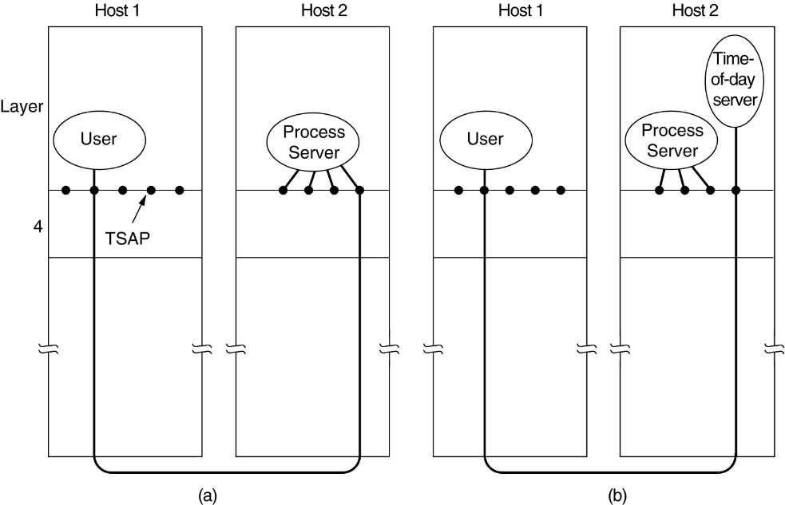
TCP: SERVICES
Daemon
  Server programs runs at background
    FTP daemon is associated with port 21
  Internet daemon (inetd)
    Attached to multiple ports and waiting for connection requests.
    When a connection request for a particular application comes in, inetd will fork of a new process and wake up the corresponding service daemon.

Slide 57
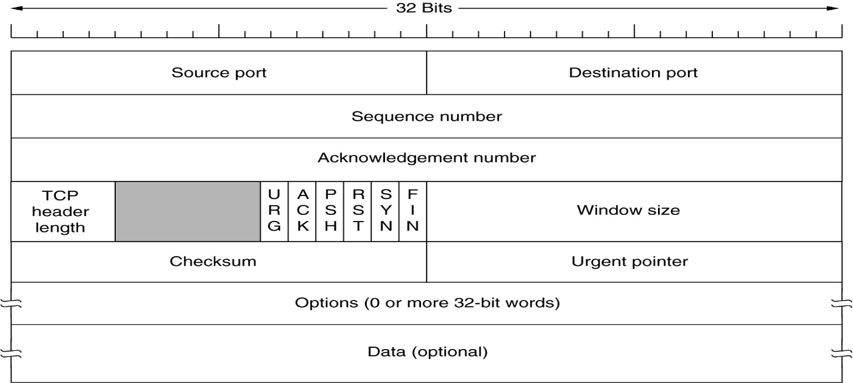
TCP: PROTOCOL
  Source port, destination port
    16-bit:
    Specify the sockets on source and destination.
  Sequence number:
    For a particular connection, each byte has its own sequence number
    The sequence number of the first byte in the payload
  Acknowledge number: (Used in combination with the ACK flag)
    All bytes (0, Ack# - 1) have been successfully received
    The next expected byte is Ack#.

Slide 58

TCP: PROTOCOL
  TCP header length (in the unit of 32-bit word)
    How many 32-bit words are in the TCP header.
    Fixed header: 20 bytes. Optional header: variable length.
  URG: urgent flag, used in combination with urgent flag
    If set to 1, indicating the urgent pointer is in use
  Urgent pointer: (relative offset from the seq#)
    pointing to a byte in the payload starting from which the data is urgent
    TCP will be notified by application which data is urgent
      E.g. telnet, ctrl+C to terminate an application.
    If the data is urgent, TCP cannot hold it in buffer. Must deliver it immediately even if the sender window is 0.

Slide 59
TCP: PROTOCOL
  Ack: when set to 1, the Ack# is valid. Otherwise Ack# will be ignored.
  PSH: PUSH flag
    When set to 1, notify TCP entity to send out data immediately.
    E.g. in remote login, hit enter.
  RST:
    when set to 1, reset a connection (due to crash or other reasons).
    Also used to reject invalid TCP packets (e.g. delayed duplicate).
  SYN: used for connection establishment
    Connection request: SYN = 1, ACK = 0.
    Connection accept: SYN = 1, ACK = 1.
CES440: Introduction
Jingxian Wu, 8/16/2005

Slide 60
TCP: PROTOCOL
  FIN: set to 1 used for connection release.
    After sending out a packet with FIN = 1, the host will no longer transmit more data. (but will continue receive data)
  Window size: used for flow control

Slide 61
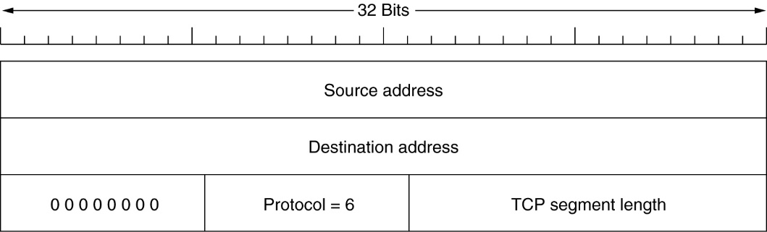
TCP: PROTOCOL
  Checksum
    checks TCP header, data, and part of the IP header (source IP, dest. IP, protocol (6), TCP packet length) ➔ violate the layered structure
    Other than TCP header, the following fields are checked.

Slide 62
TCP: CONNECTION ESTABLISHMENT
Service primitives
  Server: LISTEN, ACCEPT
  Client: CONNECT
Three-way handshake
  After CONNECT is called, a connection request packet will be generated.
    Connection request packet (SYN = 1, ACK =0, Seq# = x).
    When the connection request packet arrives at the receiver, the receiver checks if LISTEN and ACCEPT have been executed for the port.
    If server accepts request, send back Ack (SYN = 1, ACK=1, Ack# = x+1, Seq# = y)
      Client sends back an Ack (SYN=0, ACK=1, Ack#=y+1) to finish the three way handshake.
    If server rejects request, send back Rej (RST = 1, ACK = 1, Ack#=x+1)
    The initial sequence# (x, y) are assigned based on the clock at the hosts.

Slide 63
APPLICATION LAYER
  The applications directly used by the end users
  Examples
    HTTP (Hyper Text Transfer Protocol)
    FTP (File Transfer Protocol)
    E-mail

Slide 64
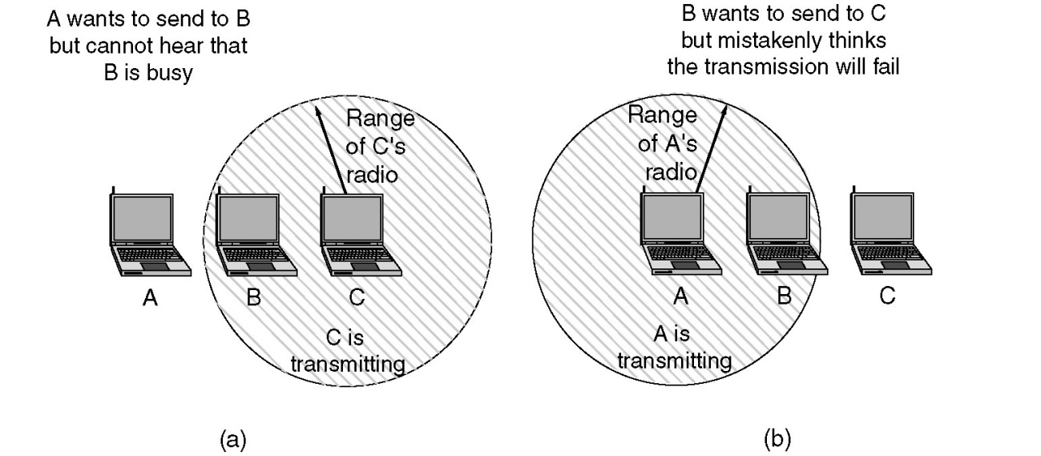
PROTOCOL: MAJOR CHALLENGES
Major challenges
  Network layer: dynamic routing
    Nodes are mobile
    Distributed multihop wireless network with time-varying topology.
  MAC sublayer:
    Hidden station problem
    Exposed station problem
  Physical layer
    Power consumption.
    Unreliable wireless link

Slide 65
OUTLINE
Ad hoc wireless networks
Protocol layers
Cross-layer design

Slide 66
CROSS-LAYER DESIGN
Cross-layer design
  Perform joint optimization across protocol layers
  Why?
    Layered structure works well for conventional wired networks
    The isolation of layers doesn’t work very well for wireless ad hoc network
      Can’t perform optimization across layers
      The physical channel and the network structure is constantly changing → the layered structure might not be able to respond to the change fast enough

Slide 67
CROSS-LAYER DESIGN
Example 1
  Physical layer: adaptive modulation and coding (AMC)
    Select the modulation and coding based on the channel condition
  Network layer:
    Adaptive routing: there might be multiple paths between source and destination. Select the path with the better physical layer performance.
Example 2
  Hybrid Automatic Retransmit Request (HARQ)
    In the MAC layer, if there is collision during transmission, re-transmit
    Perform maximal ratio combining (MRC) between the originally transmitted signal and the re-tx signal at the physical layer.
Example 3
  Cooperative diversity: multiple spatially distributed nodes to help the forward of a node
  Network diversity: multiple routes through the network are used to send a single packet

