Slide 1
ELEG 5693 Wireless Communications
Ch. 9 Ad Hoc Wireless Netowrks
Dr. Jingxian Wu
wuj@uark.edu

Slide 2
OUTLINE
Ad hoc wireless networks
Protocol layers
Cross-layer design

Slide 3
AD HOC WIRELESS NETWORKS
Ad hoc wireless network
  A collection of wireless mobile nodes that self-configure to form a network without the aid of any established infrastructure.
  Ad hoc: with little or no planning, fashioned from whatever is immediately available
  Different from: infrastructure-based network (such as cellular network)
  Allow people and devices to seamlessly internetwok in areas with no preexisting communication infrastructure.
    No pre-installed basestations
  Self-organizing, Rapidly deployed
    Nodes cooperate to provide connectivity ➔ multihop relay.
    Easily enable instantaneous person-to-person, person-to-machine, or machine-to-person communications.
  Self-healing
    Even we one or some nodes break down, the network can still operate.

Slide 4
AD HOC WIRELESS NETWORKS
Examples
  Ad-hoc mode of IEEE 802.11
    IEEE 802.11 (Wireless LAN) has two modes
      Infrastructure mode: wireless router, laptops
      Ad-hoc mode: no wireless router.
        Laptops can directly talk with one another without router.
  Mesh extension of IEEE 802.16
    Regular operation of IEEE 802.16 (WiMax) requires basestation.
    Mesh extension can provide services to users that do not have good coverage from BS.
      Signals are relayed from other users.
  Soldiers equipped with multimode mobile communication devices on battle field
    No fixed wireless base station or pre-installed infrastructrue are needed.
  Small vehicular devices equipped with sensors in hostile environment to collect data.
    Data are relayed by the sensor nodes.
  Ship-to-ship ad-hoc communication
    Doesn’t need the assistance from satellite.
  Police, rescue, etc.

Slide 5
AD HOC WIRELESS NETWORKS
Evolution
  PRNET (packet radio network) : the first MANET
    Sponsored by DoD (Department of Defense), launchened in 1972
    Evolved into survivable adaptive radio networks (SURAN) in 1980s
    Goal: provide packet-switched networking to mobile battlefield elements in an infrastructureless, hostile environment.
    MAC layer: combination of ALOHA and CSMA (carrier sensing multiple access)
    Network layer: a variation of distance vector routing.
    Handled datagram traffic reasonably well.
  Ad-hoc mode of IEEE 802.11: 1990s
  NTDR (Near-term digital radio): sponsored by DoD
    Used by U.S. Army in late 2002
    Clustering, link-state routing, self-organized two-tier structure.
  Still largely an R&D activity
    IETF MANET workgroup: two protocols will become “proposed standards”

Slide 6
OUTLINE
Ad hoc wireless networks
Protocol layers
Cross-layer design

Slide 7
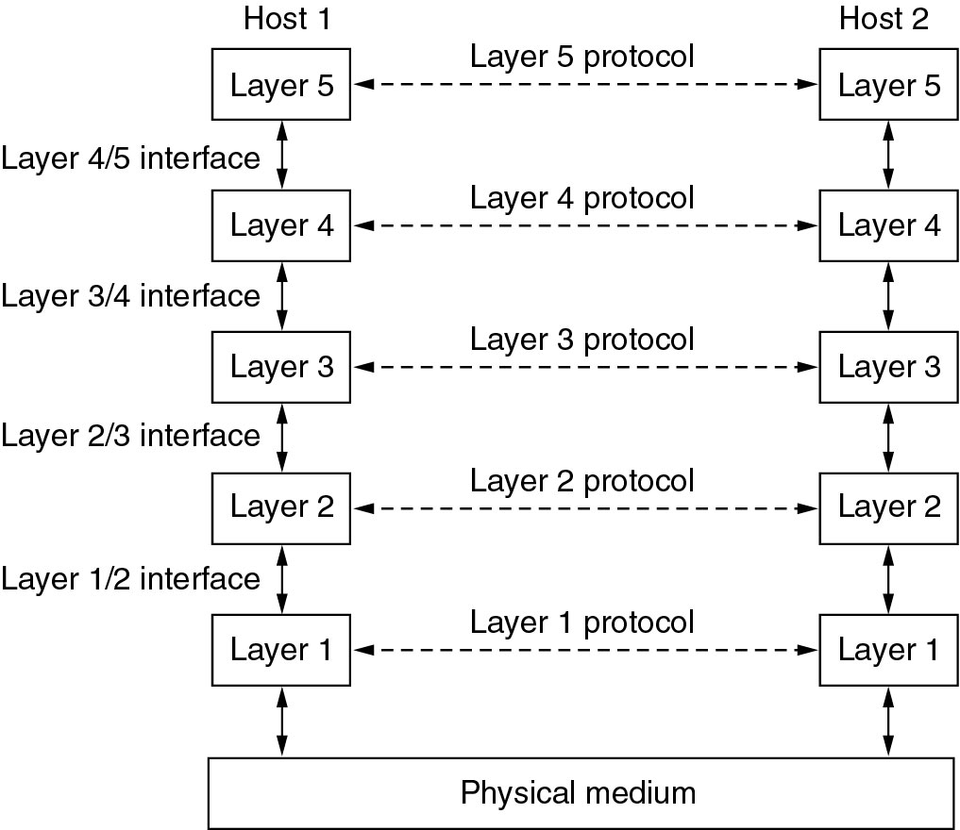
PROTOCOL
To reduce complexity, network software is organized as a stack of layers.
  Modular architecture makes development easier and cheaper.

Slide 8
PROTOCOL
Each layer provides services to the layers above
  Via the interface between layers.
  Details of the implementation of each layer is hidden to the higher layers → Data Encapsulation.
Protocol: An agreement between communication parties on how communication is to proceed.
  One of the most important concepts in computer network!
  Each layer has its own protocol.
  The protocol of a certain layer can only be understood by its peer entities.
Physically, peer entities do not talk with each other directly.
  Using the layers below them until the physical medium.
  Actual communication occurs through physical medium.

Slide 9
PROTOCOL
Network Architecture: A set of layers and protocols.
Protocol Stack: A list of protocols used by a certain system, one protocol per layer.
Protocol Data Unit (PDU):
  A unit of data that is specified by a protocol of a given layer and delivered among peer entities.
  Consisting protocol control information of given layer and possibly data of that layer.

Slide 10
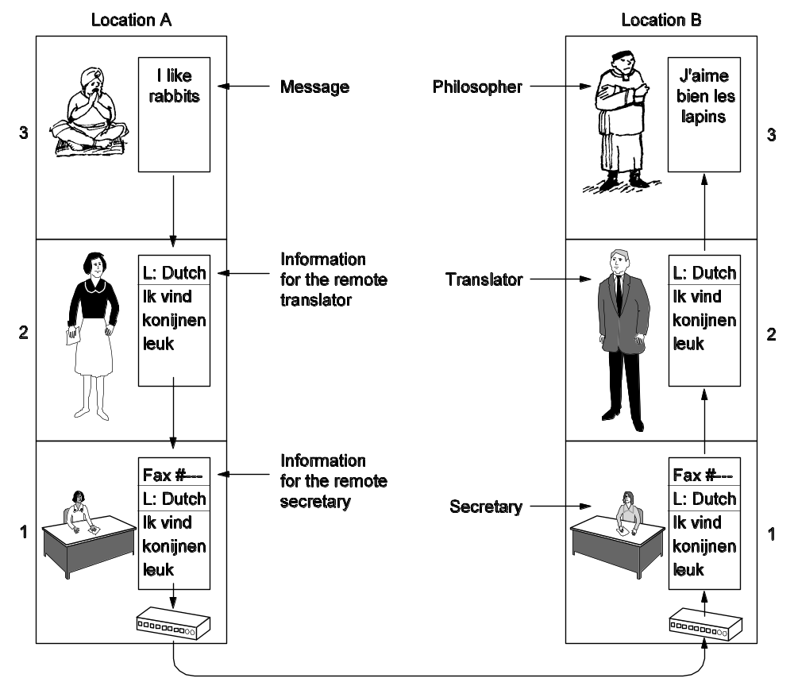
PROTOCOL
The philosopher–translator–secretary architecture
English
French
Peer Entities
English
Dutch
French
Dutch
Peer Entities
Peer Entities

Slide 11
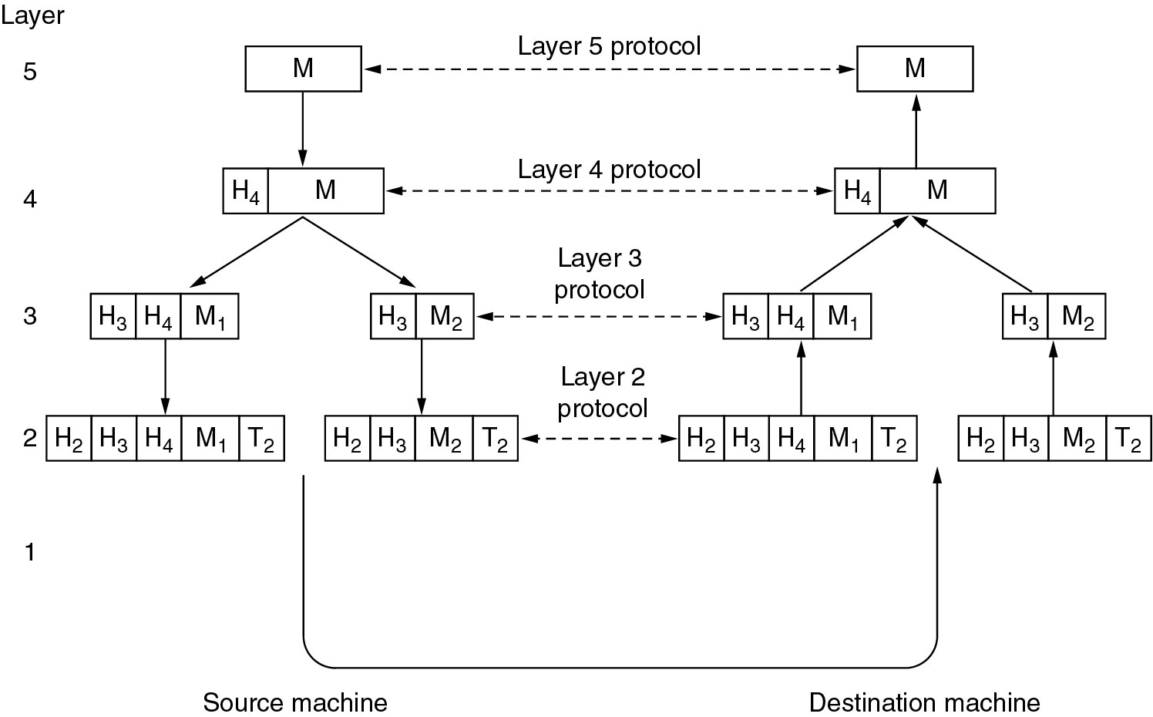
PROTOCOL
PDU comprises
  Control information: How peer entity should handle PDU.
  Data: Upper layer PDU.

Slide 12
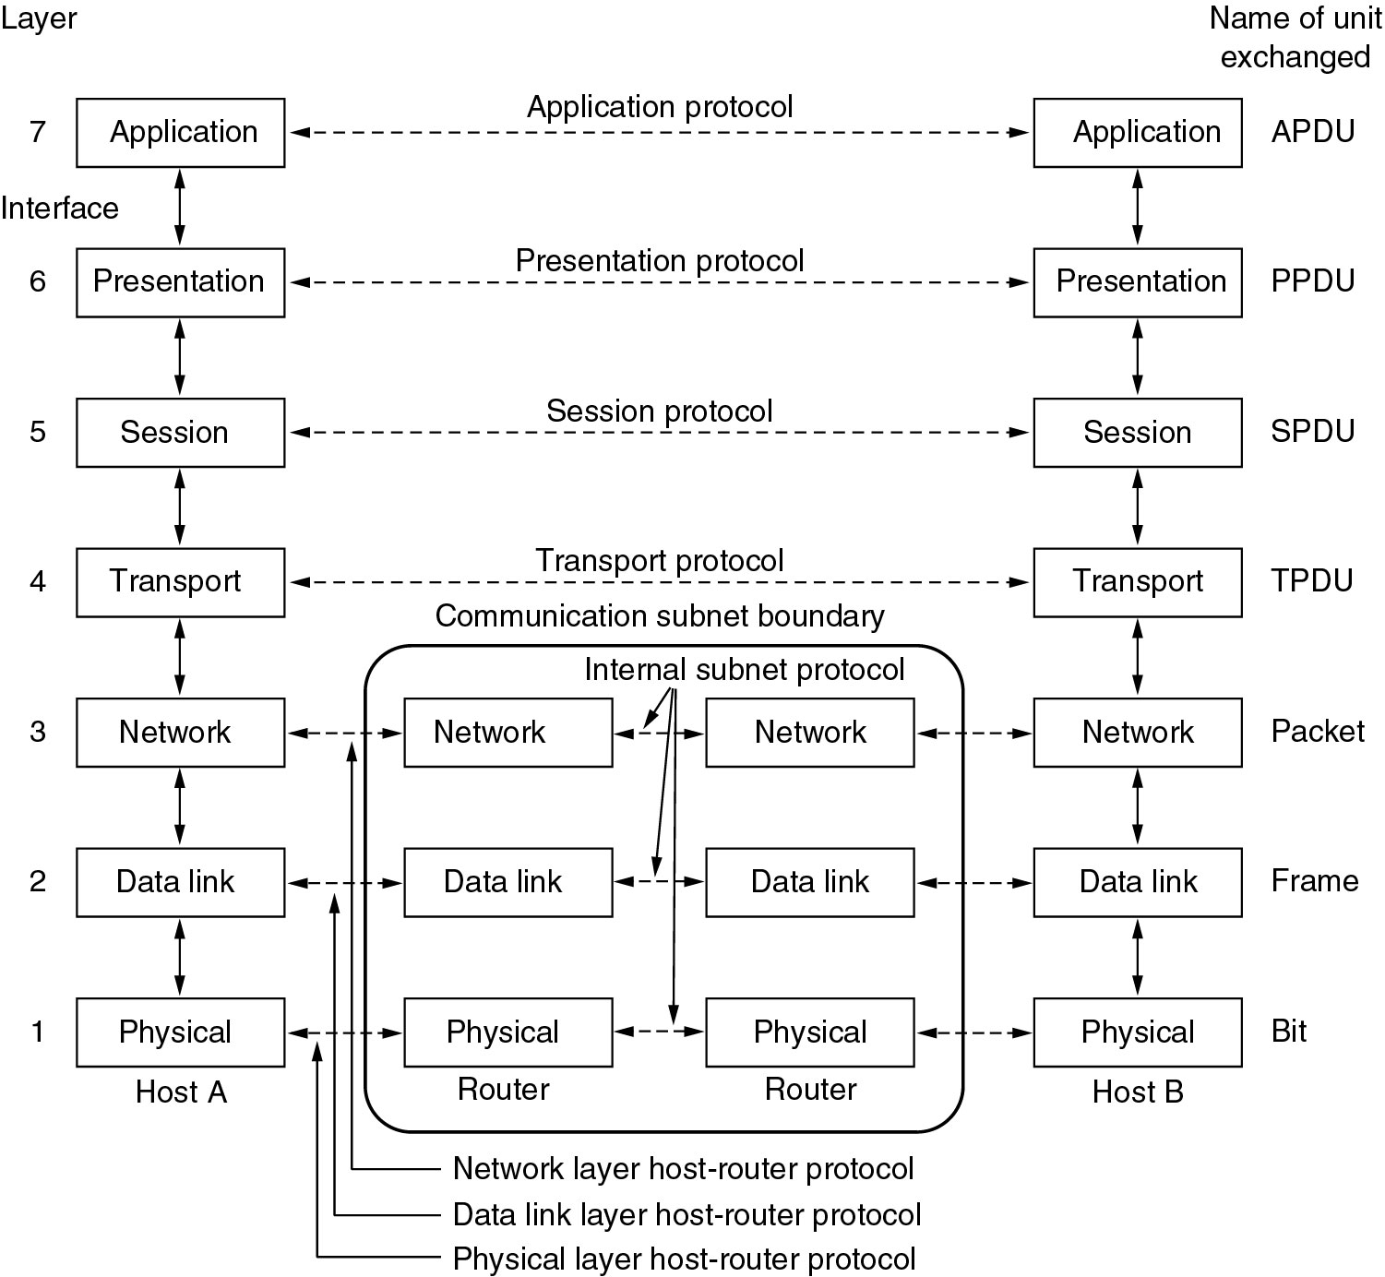
PROTOCOL: OSI MODEL
End-to-end layers
Chained layers

Slide 13
PROTOCOL: OSI MODEL
Physical Layer
  Concerned with transmitting raw bits over a communication channel
  The voltage for different symbols (e.g. ‘1’, ‘0’)
  The duration of each symbol (symbol period)
  How many pins the network connector has?
  The function of each network connector pin.
  Modulation, coding, equalization, etc.
Mainly deal with electrical, mechanical, and timing interfaces.

Slide 14
PROTOCOL: OSI MODEL
Data Link Layer
  Error Control: make the raw transmission facility (physical layer) appear as error free to the network layer.
    Error detection, error correction, acknowledgement, retransmission.
  Flow control: keep a fast transmitter from drowning a slow receiver
    Traffic regulation
  Media Access Control: control the access of the shared channel in a broadcast network.
    Media Access Control (MAC) sublayer

Slide 15
PROTOCOL: OSI MODEL
Network Layer: control the operation of subnet
  How packets are routed from source to destination.
  Congestion Control: avoid too many packets swarm the subnet at the same time.
  Quality of Service (QoS)
  Allow heterogeneous networks to be interconnected
  A popular routing protocol: destination sequenced distance vector (DSDV)

Slide 16
PROTOCOL: OSI MODEL
Transport Layer
  Split the data from upper layers into smaller pieces
  Pass the smaller pieces to lower layer
  Make sure the pieces arrive correctly at the receiver.
  Provide an error-free point-to-point channel to upper layers.
Transport Layer is true end-to-end
  Conversation carried out only between source and destination.
  Doesn’t care the intermediate machines – the intermediate machines doesn’t need to pass the message to transport layer.
    The intermediate machines DO NOT examine the contents of transport header
  In low layers, conversations are between machines and its immediate neighbors.

Slide 17
PROTOCOL: OSI MODEL
Session Layer
  Allows users to establish sessions between them
  Dialog control (whose turn it is to transmit)
  Token control (preventing conflicts)
  Synchronization (allow continue from a break point)
Presentation Layer
  Concerned with syntax and semantics
  Make it possible for different computers with different data representations (data structures) to talk with each other.

Slide 18
PROTOCOL: OSI MODEL
Application Layer
  The applications directly used by the end users
  Examples
    HTTP (Hyper Text Transfer Protocol)
    FTP (File Transfer Protocol)
    E-mail

Slide 19
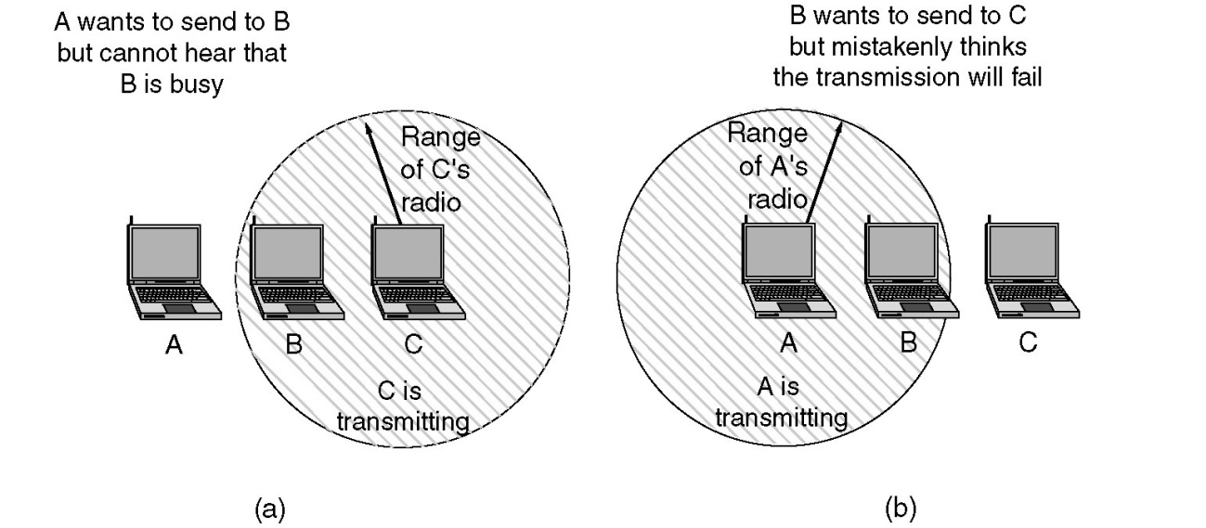
PROTOCOL: MAJOR CHALLENGES
Major challenges
  Network layer: dynamic routing
    Nodes are mobile
    Distributed multihop wireless network with time-varying topology.
  MAC sublayer:
    Hidden station problem
    Exposed station problem
  Physical layer
    Power consumption.
    Unreliable wireless link

Slide 20
OUTLINE
Ad hoc wireless networks
Protocol layers
Cross-layer design

Slide 21
CROSS-LAYER DESIGN
Cross-layer design
  Perform joint optimization across protocol layers
  Why?
    Layered structure works well for conventional wired networks
    The isolation of layers doesn’t work very well for wireless ad hoc network
      Can’t perform optimization across layers
      The physical channel and the network structure is constantly changing → the layered structure might not be able to respond to the change fast enough

Slide 22
CROSS-LAYER DESIGN
Example 1
  Physical layer: adaptive modulation and coding (AMC)
    Select the modulation and coding based on the channel condition
  Network layer:
    Adaptive routing: there might be multiple paths between source and destination. Select the path with the better physical layer performance.
Example 2
  Hybrid Automatic Retransmit Request (HARQ)
    In the MAC layer, if there is collision during transmission, re-transmit
    Perform maximal ratio combining (MRC) between the originally transmitted signal and the re-tx signal at the physical layer.
Example 3
  Cooperative diversity: multiple spatially distributed nodes to help the forward of a node
  Network diversity: multiple routes through the network are used to send a single packet

