Slide 1

BMW HealthKit
Shrikar Archak
George Balayan

Slide 2
Your bmw’s health status
Diagnostic's information
E.g. P0118 - Engine Coolant Temperature Circuit High Input
Battery level on the go
Find the closest charging station
Battery level while in park

Slide 3
Battery level on the go
Demo…

Slide 4
Battery level while in park
Would it be nice we have a charged car every morning without worrying about all the charing hassle?
Introducing ChargeSimple a service to help busy customer not worry about charging and have the car ready to go anytime.
Using BMW api's we can find out when the car is runnning out of charge.
ChargeSimple provide services where the car will be picked up from your location, Charged and then delivered back to the same place where it was picked up. All you need to do is click a button.
A flat fee for using the ChargeSimple service monthly.

Slide 5
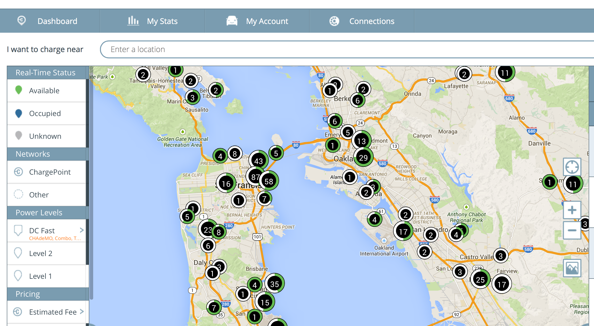
Low utilization of charging stations

Slide 6
Membership costs
$199 monthly fee for the hassle-free charging of your car OR
$499 monthly fee for lease of the BMW i3 and never worry about charging your car

Slide 7
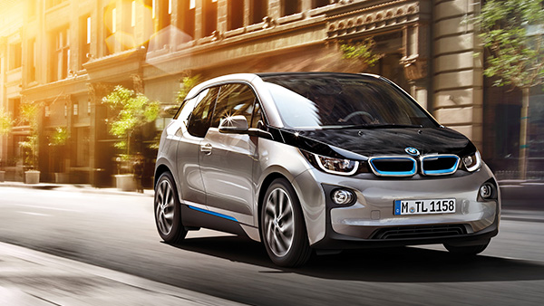
BMW HealthKit
Thank you!

