Slide 1
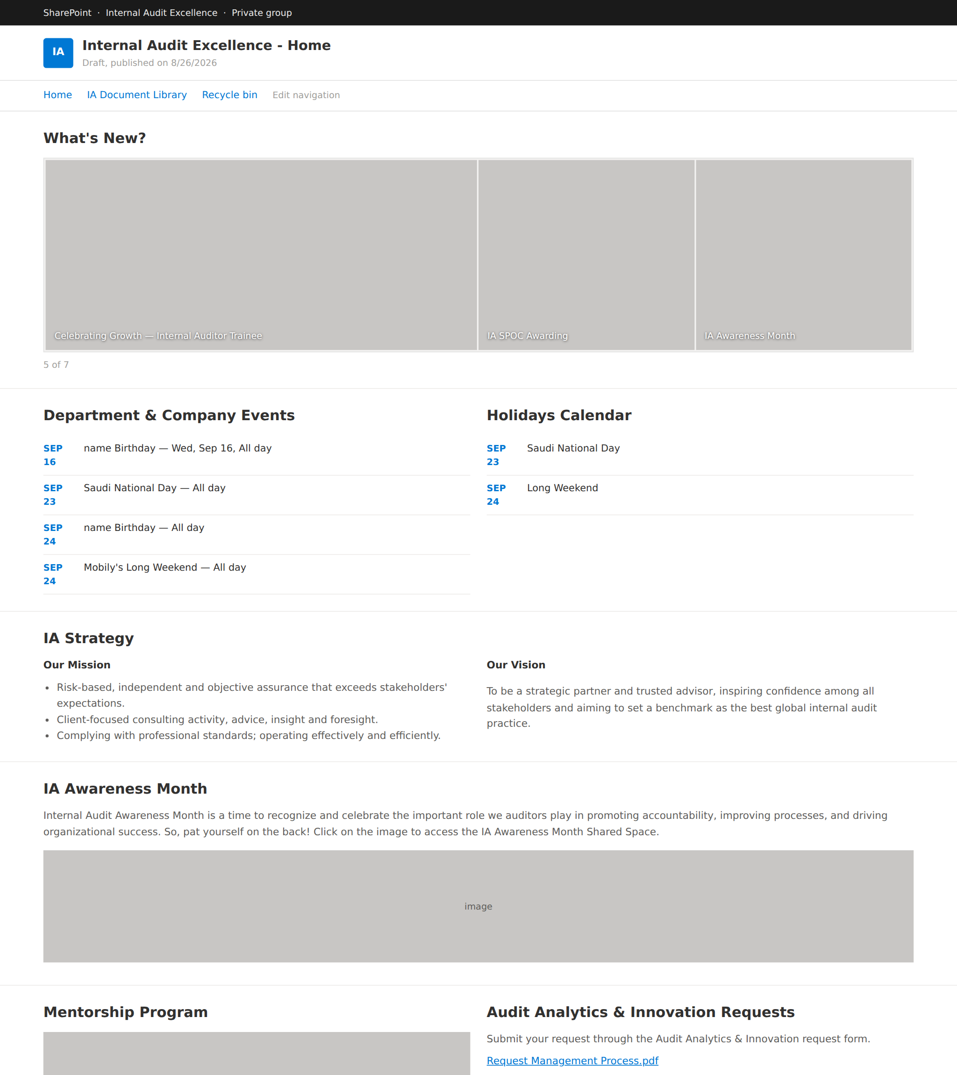
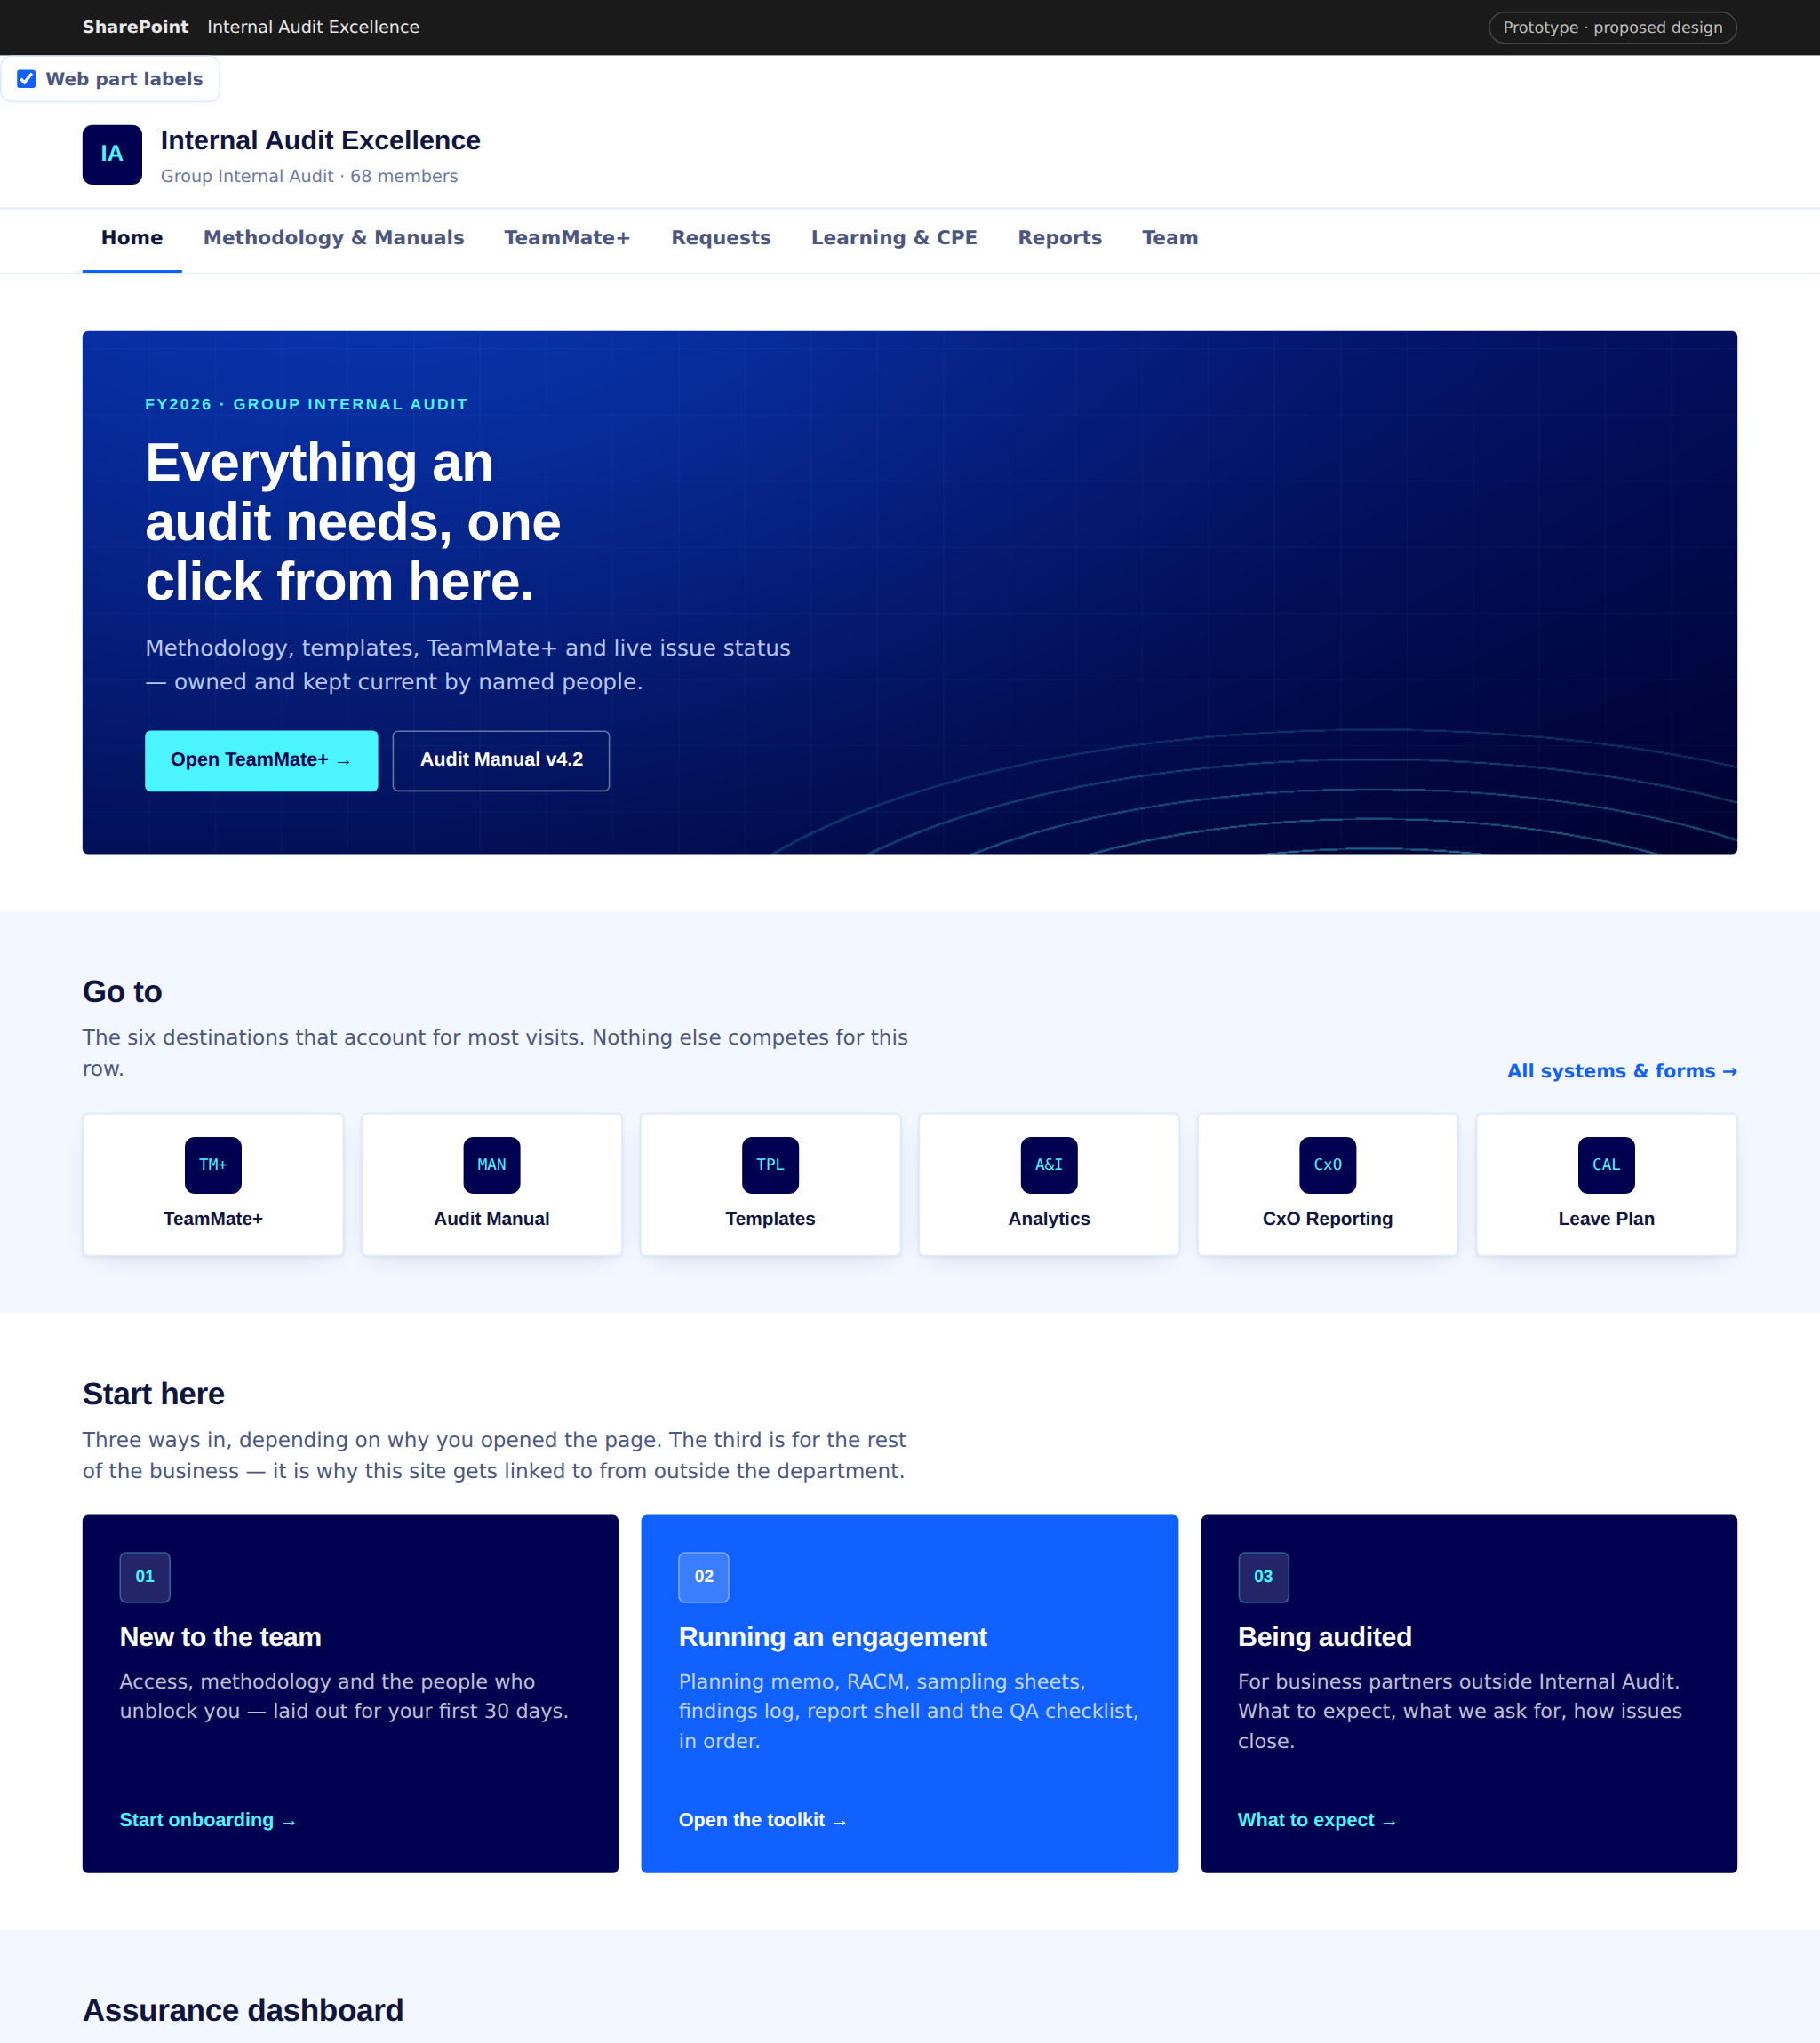
LOOK AND FEEL
What it is today, and what it becomes.
TODAY
PROPOSED
A noticeboard
A working surface
Opens with photo carousel, birthdays and the mission statement.
Tools, methodology and live plan status on the first screen.
Default SharePoint
On brand
Stock theme, stock icons, mixed image crops, no brand colour.
Navy, blue and cyan applied through the site theme and card backgrounds.
Read once
Changes weekly
Every block static. Links repeat. Nothing changes week to week.
Dashboard, issue ageing and a self-updating document list.
Tools absent
Open to the business
No TeamMate+, no manual, no dashboard on the first screen.
A path written for the departments we audit.
Same SharePoint. Same web parts. Same licences. The change is what the page is for.
Notes:
Left is the structure of the page as it stands. Right is the proposal, built from web parts already in our Toolbox.

Slide 2
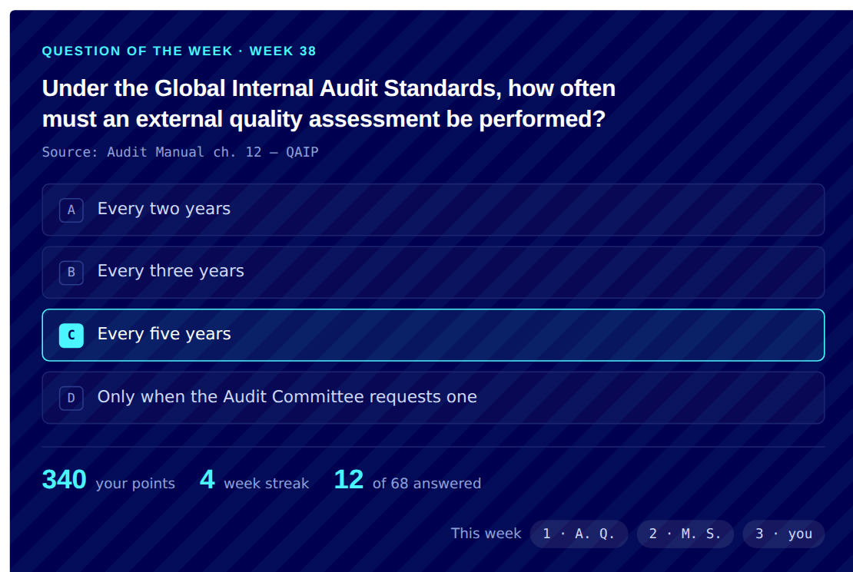
WHAT THE PLATFORM CARRIES
Everything kept. Five added. One new layer.
Get the work done
People & culture
Gamification layer
Quick links — TM+, Manuals, Shared folder
NEW
Our team page — who to ask
NEW
Question of the week
NEW
Assurance dashboard (Power BI)
NEW
Breakfast fund board
NEW
Points, streaks & weekly leaderboard
NEW
ATHEER bot — ask the manual
NEW
News & announcements
KEPT
CPE badges at 10 / 25 / 40 hours
NEW
Audit Analytics & Innovation requests
KEPT
Team birthday calendar
KEPT
Mentor badge for hours given
NEW
IA Document Library
KEPT
IdeIA initiative form
KEPT
IdeIA points for ideas shortlisted
NEW
IA Vacation Plan
KEPT
Recognition & SPOC awards
KEPT
First-30-days onboarding progress
NEW
Mentorship Programme
KEPT
Gamify participation, never audit outcomes.
Points go to answering the weekly question, logging CPE, mentoring and submitting ideas. Nothing is scored on findings raised or issues closed — scoring those would distort the judgement the department exists to exercise.
Notes:
Five genuinely new items: quick links to the systems, the assurance dashboard, ATHEER, the team page and the breakfast fund board. Everything else on the current site is carried across, not dropped. The gamification layer is new in full, and is deliberately limited to participation.

