Slide 1

INTERNAL AUDIT EXCELLENCE
Revamping the
Internal Audit platform
From a departmental noticeboard to the place the audit function actually runs from.
Proposal to management · September 2026
Notes:
Framing: this is not a redesign for its own sake. The page exists; almost nobody uses it. We are proposing to change what it is for.

Slide 2
WHERE WE ARE TODAY
The page works. It just is not what anyone needs.
1
Opens with culture
2
Tools are missing
Birthdays, awards and event photos occupy the first screen. The audit manual is below all of it.
TeamMate+ has no link on the home page. Auditors reach it from a bookmark, or they ask someone.
3
Nothing is live
4
Closed to the business
Every block is static text. There is no reason to return once you have read it.
A private group site. The departments we audit cannot open it at all.
Notes:
Be fair to the current page: it was built for a purpose and it serves culture well. The problem is that it was never built to carry the work.

Slide 3
THE DIAGNOSIS
What people come for, and what the page shows.
WHAT THEY COME FOR
WHAT THE PAGE LEADS WITH
TeamMate+
Birthdays this month
The audit manual
Awareness month photos
A workpaper template
The mission statement
Analytics support
Event calendar
Whether an issue is closed
Recycle bin link
What an audit involves
Holiday calendar
Neither list is wrong. They are simply in the wrong order.
Notes:
The left column is what an auditor opens a browser to find. The right column is what the home page currently offers first.

Slide 4
THE APPROACH
Three shifts, not a repaint.
1
2
3
Work first, culture second
Static becomes live
Open it to the business
The tools and the methodology take the top of the page. Culture keeps its place, below them, done properly.
A Power BI dashboard and self-updating document lists. The page shows this week’s position, so it earns a weekly visit.
A path written for the departments we audit. It is what makes the site worth linking to from outside Internal Audit.
All three are built with SharePoint web parts we already have. No new licence, no developer.

Slide 5
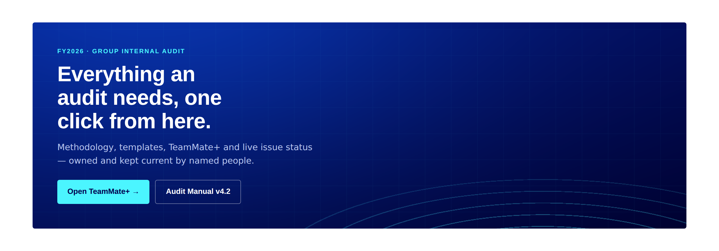
THE PROPOSAL
The new home page.
The first screen now answers: where do I go, and how is the plan tracking.

Slide 6
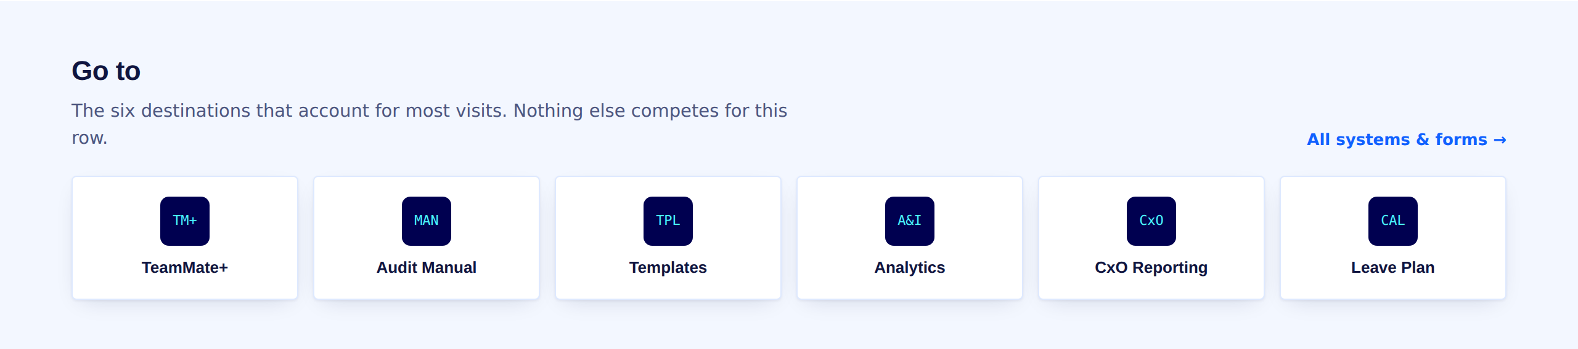
ACCESS
Six destinations, one click, nothing competing.
TeamMate+ leads
One line each
Order is the design
It is the most-used system in the department and had no link at all.
Saying what you get, not what the thing is called.
The bottom two get reviewed after a month of usage data.

Slide 7
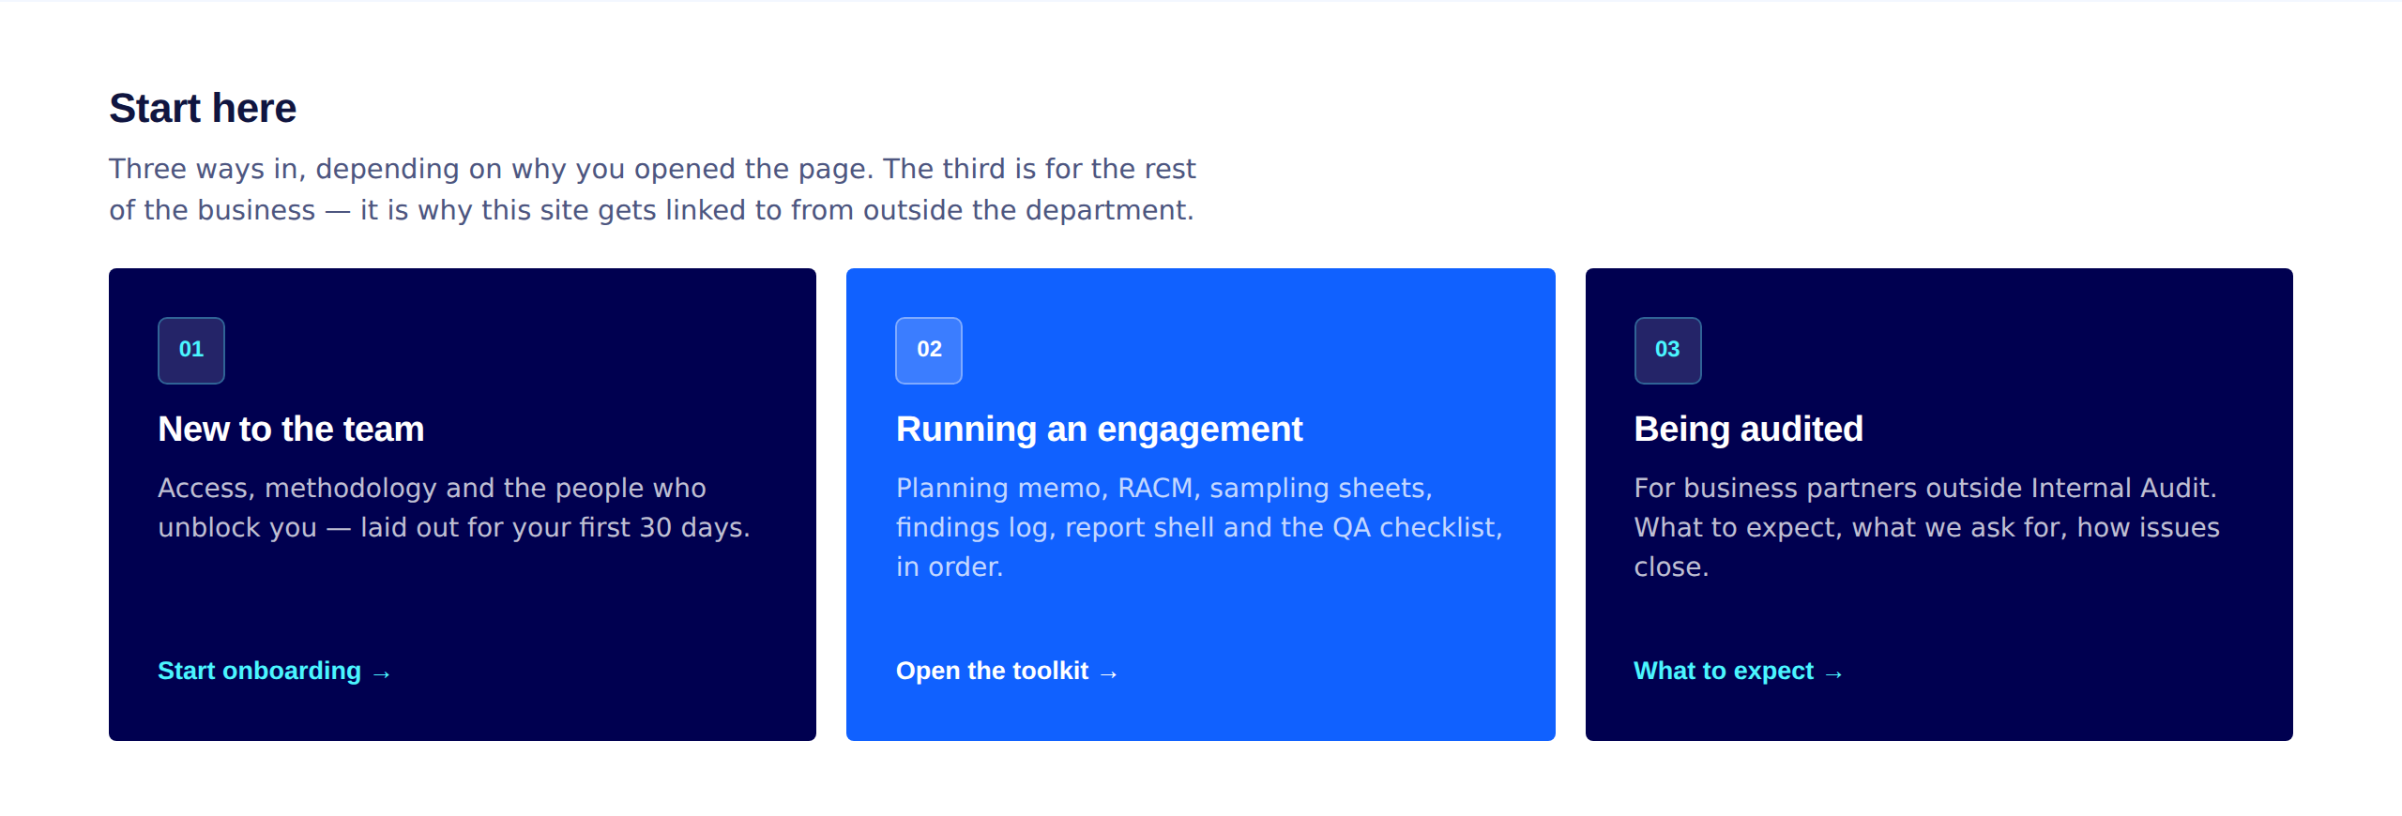
REACH
Three ways in — including one for the business.
The third card is the one that changes our standing. It explains an audit to the departments we audit — what we ask for, how findings get agreed, what closes an issue. Nothing like it exists today.

Slide 8
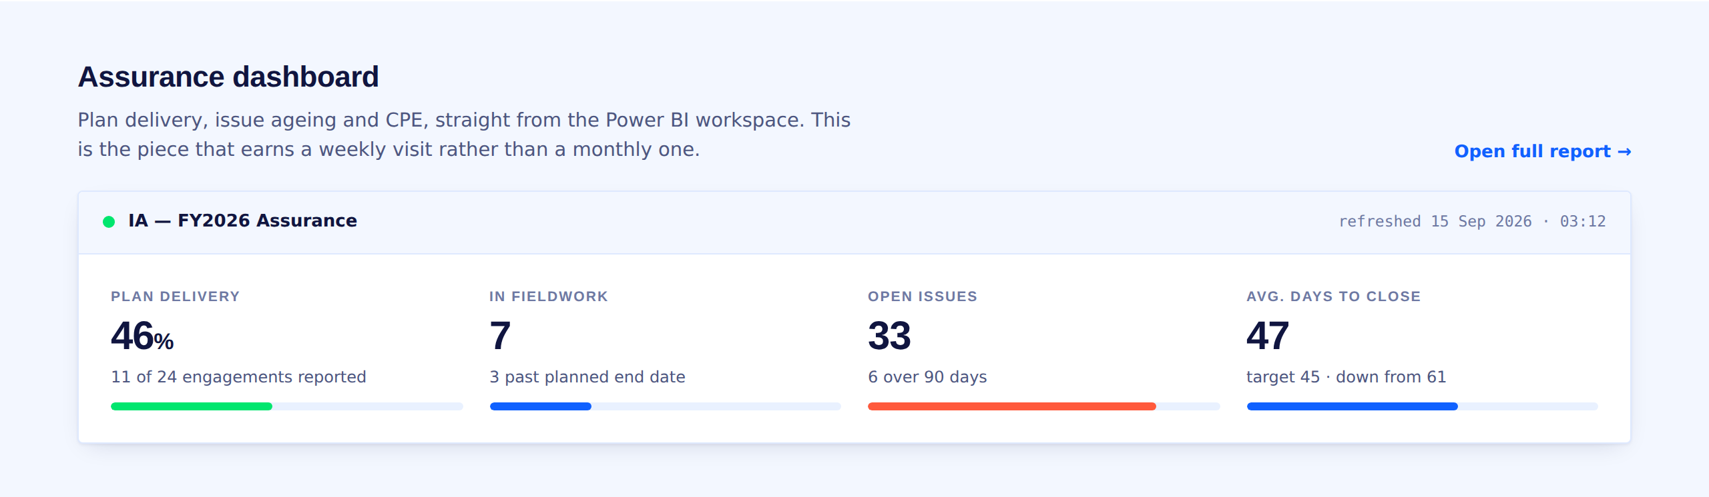
THE DASHBOARD
The page stops being a leaflet.
Plan delivery
engagements reported against the approved plan
Fieldwork in flight
and which are past their planned end date
Issue ageing
open actions bucketed at 30, 90 and 180 days
Days to close
trend against the 45-day target
Built on Power BI over two SharePoint lists — Engagements and Issues.
Those two lists are also the first data model of the in-house platform we want later, so this work is not thrown away — the migration becomes an export rather than a re-keying exercise.
Notes:
Figures on the screenshot are illustrative. Real values come from the Engagements and Issues lists once populated.

Slide 9
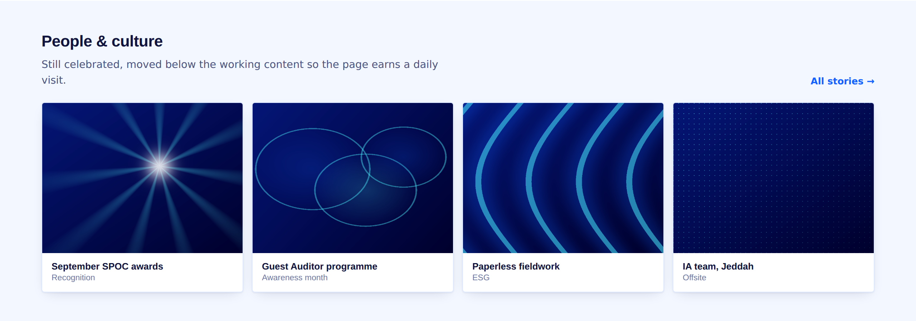
DEPARTMENT CULTURE
Culture is kept — and given a better setting.
Nothing is removed
SPOC awards, Awareness Month, the Guest Auditor programme, birthdays and the team calendar all stay.
Presented properly
A gallery with consistent crops and captions, instead of a carousel competing with the mission statement.
Placed deliberately
Below the working content, so the page earns a daily visit and culture is what people find when they stay.
Images shown are placeholder brand art. Final build uses the department’s own photographs.

Slide 10
EXPECTED OUTCOME
Why this gets visited, when the old page did not.
1
It holds the tools
2
The numbers move
An auditor who needs TeamMate+ or a template now has a reason to start here rather than at a bookmark.
Plan delivery and issue ageing change every week. Static pages are read once; live ones are checked.
3
It updates itself
4
It has an audience outside
Highlighted content queries the library, so publishing a document refreshes the page with no one editing it.
The “being audited” path gives other departments a reason to open and share the link.
How we will know: we baseline visits and unique visitors from SharePoint Site usage the week before launch, and review at 30 and 90 days. No target is claimed until that baseline exists.

Slide 11
DELIVERY
Three weeks, no developer, no new licence.
WEEK 1
WEEK 2
WEEK 3
Foundation
Content
Live data
Theme applied, page skeleton built, navigation rewritten to seven destinations.
Icon set, the three audience paths written, methodology index and request form live.
Engagements and Issues lists built, Power BI report pinned, then publish and baseline.
Roughly seven working days of effort inside the IA Excellence team.

Slide 12

WHAT WE NEED
Four decisions, then we build.
1
Open the site to the organisation
Read access for all staff, working files moved to a closed library.
And after this
The in-house platform
2
Power BI licences
For everyone expected to view the dashboard, or it shows them a sign-in prompt.
This build is the prototype of its data model, not a detour from it. The Engagements and Issues lists carry across; the SharePoint page becomes the front door while the platform is built behind it.
3
Three named owners
For methodology, TeamMate+ access and analytics requests. Not a shared mailbox.
4
Agreement on the audited-party page
The content is ours to write; the tone is a management call.

