Slide 1
MlaaS for Image analysis
Anwar ALFATAYRI

Slide 2
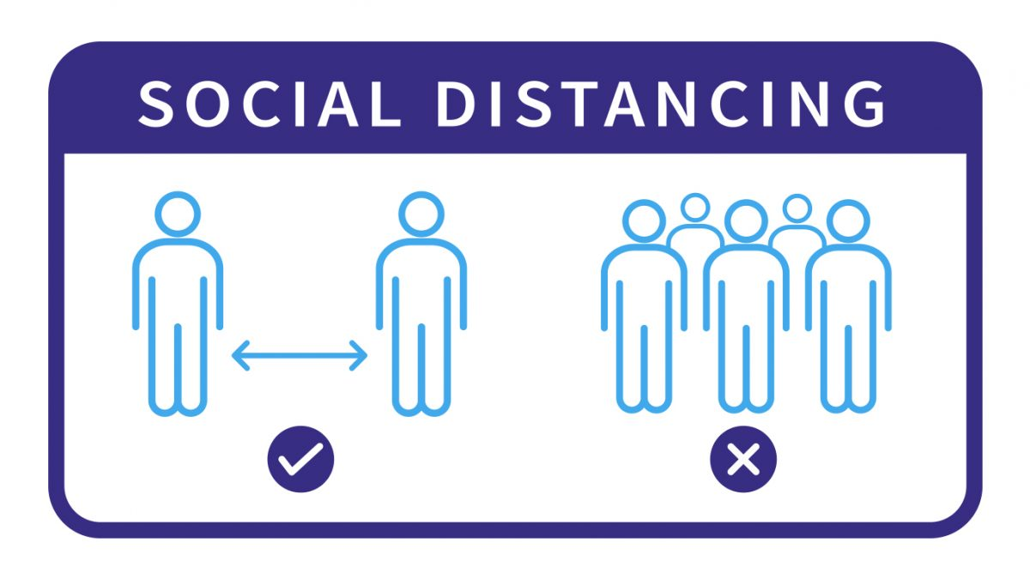






Real Life example: Social distancing
Number of people : 14
Groups of 2 people : 1
Groups of 3 people : 2
Groups of 4 people : 1
Groups >4 People: 0

Slide 3


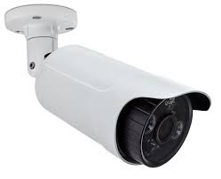
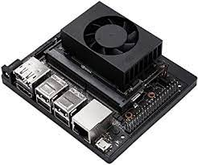
Two approaches
Machine learning on the edge
Street
Fiware Cloud
Image
3 people detected

Slide 4


Two approaches
Machine learning as a service
Street
Fiware Cloud
API Rest
Image
3 people detected

