Slide 1
Actuation, Federation and Interoperability of Context Brokers
Advanced and Novel Features available in NGSI-LD 1.6.1
Jason Fox, Senior Technical Evangelist, FIWARE Foundation.

Slide 2
Learning Goals
Overview advanced deployments
Multi-Attributes with datasetId (alternative sources, 1-n relationships)
Scopes (filter based on hierarchies)
Distributed deployments based on registrations (IoT Agents, Context Brokers)
Federated deployments (transparently give applications access to context information from different players running own Context Brokers)
Tenants (use same Context Broker instance, but isolate databases)
Outlook: New distributed deployment features in NGSI-LD v1.6.1

Slide 3
Multi-attributes: Use of datasetId

Slide 4
Multi-Attributes with datasetId (1)
Properties
There may be more than one source for the same information, e.g. speed of the same car from speedometer, navigation system, external sensor
They all provide the speed of the car but they may be systematically different, e.g. the speedometer shall never show a speed lower than the actual speed 🡪 in practice it will often show a slightly higher speed
If a single property value in a Context Broker was arbitrarily updated by the different sensors, such values would be quite volatile, especially when looking at a temporal evolution, even if the actual value was relatively stable
It is necessary to distinguish between the values from the different sources
“speed": {
"type" : "Property",
"value" : 100
}
“speed": {
"type" : "Property",
"value" : 95
}
“speed": {
"type" : "Property",
"value" : 93
}

Slide 5
Multi-Attributes with datasetId (2)
Properties
The datasetId has the purpose of distinguishing values from different sources
Property values with different datasetIds are considered distinct values and stored separately
Property values with a datasetId can thus be updated independently without affecting values of the same property with a different datasetId
Property values without a datasetId are considered to be the default value
An update without a datasetId updates the default value
A retrieve / query / notification returns all existing values for the same property – as JSON object if there is a single value, within a container, if there are multiple
"speed": {
"type" : "Property",
"value" : 100, "datasetId": "urn:speedometer"
}
"speed": {
"type" : "Property",
"value" : 95,
"datasetId": "urn:gps"
}
"speed": {
"type" : "Property",
"value" : 93,
"datasetId": "urn:speedcamera"
}

Slide 6
Multi-Attributes with datasetId (3)
Create Entity … Add further speeds
curl -iX POST \
'.../ngsi-ld/v1/entities' \
--header 'Content-Type: application/json' \
--data-raw '{
"id": "urn:HDXX234",
"type": "Vehicle",
"speed": {
"type": "Property",
"value": 100,
"unitCode": "KMH",
"datasetId": "urn:speedometer"
}
}'
curl -iX POST \
'.../ngsi-ld/v1/entities/urn:HDXX234/attrs' \
--header 'Content-Type: application/json' \
--data-raw '{
"speed": [
{
"type": "Property",
"value" : 95,
"unitCode": "KMH",
"datasetId": "urn:gps"
},
{
"type": "Property",
"value": 92,
"unitCode": "KMH",
"datasetId": "urn:speedcamera"
}
] }'

Slide 7
Multi-Attributes with datasetId (4)
Update Speedometer Speed Result
Query Vehicle urn:HDXX234
curl --iX PATCH \
'.../ngsi-ld/v1/entities/urn:HDXX234/attrs' \
--header 'Content-Type: application/JSON' \
--data-raw '{
"id": "urn:HDXX234",
"type": "Vehicle",
"speed": {
"type": "Property",
"value": 103,
"unitCode": "KMH"
"datasetId": "urn:speedometer"
}
}'
{
"id": "urn:HDXX234",
"type": "Vehicle",
"speed": [
{
"type": "Property",
"datasetId": "urn:gps",
"value": 95,
"unitCode": "KMH"
},
{
"type": "Property",
"datasetId": "urn:speedcamera",
"value": 92,
"unitCode": "KMH"
},
{
"type": "Property",
"datasetId": "urn:speedometer",
"value": 103,
"unitCode": "KMH"
}
]
}
curl -iX GET \
'.../ngsi-ld/v1/entities/urn:HDXX234' \
--header 'Accept: application/json'

Slide 8
Multi-Attributes with datasetId (5)
Relationships
In addition to 1:1 relationships, there are also 1:n relationships
Each element of a 1:n relationship can be represented with a datasetId
Each relationship may have different meta information (sub-attributes)
If David becomes the new best friend, the information can be updated accordingly, using the datasetIds.
"friend": {
"type" : "Relationship",
"object" : "David",
"datasetId": "urn:003",
"bestFriend": {
"type" : "Property",
"value" : true
}
}
"friend": {
"type" : "Relationship",
"object" : "John“,
"datasetId": "urn:001"
}
"friend": {
"type" : "Relationship",
"object" : "Paul",
"datasetId": "urn:002",
}

Slide 9
Logical Data Separation of Entities: use of scopeQ

Slide 10
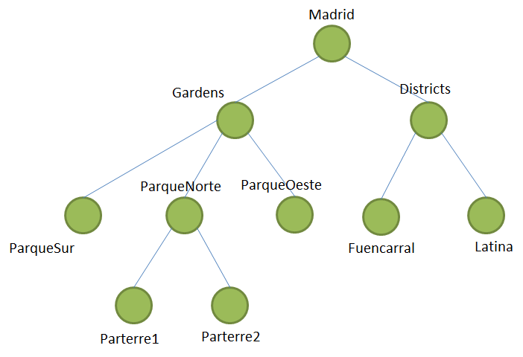
NGSI-LD Scopes (1)
Hierarchical structures play an important role for structuring and organizing our world, e.g. hierarchical location structures (example on the left) or organizational structures (e.g. of a company)
The special scope property allows giving an entity a hierarchical scope, e.g. ParqueSur in the example on the left
In queries and subscriptions, scopes can be used for filtering with the scopeQ parameter, e.g. scopeQ="/Madrid/Gardens/ParqueSur", which would only match entities that have this particular scope.
Note: NGSI-LD Scopes are the successor of NGSIv2 Fiware-ServicePath, but there are important differences

Slide 11
NGSI-LD Scopes (2)
"scope":[
"/Madrid/District/Latina",
"/CompanyA/DepartmentX/UnitC"
]
Entities can have multiple hierarchical scopes attached, e.g.
Scopes are optional and independent of the Entity ID
Scopes can be used to scope queries and subscriptions
The scope query language (scopeQ) allows wildcards
+ for an arbitrary value of one hierarchy level, e.g. scopeQ="/CompanyA/+/HR", for matching the HR groups of all departments of CompanyA
# matches the given scope and the whole hierarchy of scopes below, e.g. scopeQ="/Madrid/Gardens/# matches all entities with scope /Madrid/Gardens or any of its direct or indirect sub-scopes
/# matches all entities that have any explicit scope attached
The scope query language (scopeQ) also has logical and and or operators, e.g. scopeQ="/Madrid/District/Centro,/Madrid/District/Cortes" for all entities whose scope is /Madrid/District/Centro or /Madrid/District/Cortes
Scopes of entities can be updated
Scopes can be registered as part of registrations

Slide 12
NGSI-LD Scopes (3)
curl -iX POST \ '.../ngsi-ld/v1/entities' \
--header 'Content-Type: application/json' \
--data-raw '{
"id": "urn:HDMY185",
"type": "Vehicle",
"scope":[
"/Germany/Heidelberg",
"/CompanyA/DepartmentX/UnitC"
],
"speed": {
"type": "Property",
"value": 32,
"datasetId": "urn:speedometer"
}
}'
curl -iX POST \
'.../ngsi-ld/v1/entities' \
--header 'Content-Type: application/json' \
--data-raw '{
"id": "urn:BFF2016",
"type": "Vehicle",
"scope":[
"/Germany/Berlin/Charlottenburg",
"/CompanyA/DepartmentX"
],
"speed": {
"type": "Property",
"value": 32,
"datasetId": "urn:speedometer"
}
}'

Slide 13
NGSI-LD Scopes (4)
curl -iX GET \
'.../ngsi-ld/v1/entities?type=Vehicle&scopeQ=/CompanyA' \
--header 'Accept: application/json'
[]
[
{
"id": "urn:BFF2016",
"type": "Vehicle",
"scope": [
"/Germany/Berlin/Charlottenburg",
"/CompanyA/DepartmentX"
],
…
},
{
"id": "urn:HDMY185",
"type": "Vehicle",
"scope": [
"/Germany/Heidelberg",
"/CompanyA/DepartmentX/UnitC"
],
…
}
]
curl -iX GET \
'.../ngsi-ld/v1/entities?type=Vehicle&scopeQ=/CompanyA/%23' \
--header 'Accept: application/json' \
URL encoded Hash

Slide 14
Multi-tenancy: use of the NGSILD-Tenant header

Slide 15
Tenants (1)
If the same context broker instance is to be used for multiple different user (groups), their context information has to be isolated from each other
The concept for this is called multi-tenancy and each user (group) is associated with one tenant
NGSI-LD implementations can optionally support multitenancy. In all requests a tenant can optionally be specified.
In the HTTP binding this is done through the HTTP header “NGSILD-Tenant”
NGSILD-Tenant is the successor of Fiware-Service in NGSIv2

Slide 16
Tenants (2)
The support for tenants can be implicit, i.e. a tenant is created when first used in the context of a create (entity, subscription, registration) operation. There are currently no API operations for explicitly creating or deleting tenants.
Principle: if no tenant is specified, there is always a “default tenant” (which does not have to be created and does not necessarily have to have any information to provide).
How tenants are implemented, i.e. how isolation is achieved, is up to the implementation.
Registrations target a tenant (if not, the “default tenant” is assumed) – if the same context source / broker is to be registered for multiple tenants, multiple registrations are needed.

Slide 17
Accessing Different Tenants
Default Tenant
A named Tenant called "FIWARE"
curl -iX POST \
'.../ngsi-ld/v1/entities' \
--header 'Content-Type: application/json' \
--data-raw '{
"id": "urn:SZZ546",
"type": "Vehicle",
"speed": {
"type": "Property",
"value": 32,
}
}'
curl -iX POST \
'.../ngsi-ld/v1/entities' \
--header 'Content-Type: application/json' \
--header 'NGSILD-Tenant: FIWARE' \
--data-raw '{
"id": "urn:MYY456",
"type": "Vehicle",
"speed": {
"type": "Property",
"value": 66
}
}'
curl -iX GET \
'.../ngsi-ld/v1/entities?type=Vehicle' \
--header 'Accept: application/json'
curl -iX GET \
'.../ngsi-ld/v1/entities?type=Vehicle' \
--header 'Accept: application/json' \ --header 'NGSILD-Tenant: FIWARE' \
[{
"id": "urn:SZZ546",
"type": "Vehicle",
"speed": {
"type": "Property",
"value": 32
}
}]
[{
"id": "urn:MYY456",
"type": "Vehicle",
"speed": {
"type": "Property",
"value": 66
}
}]

Slide 18
Federations, Actuations and Advanced Deployments
Including new Registration features in NGSI-LD 1.6.1
https://www.etsi.org/deliver/etsi_gs/CIM/001_099/009/01.06.01_60/gs_CIM009v010601p.pdf

Slide 19
Overview: Advanced Deployments
Simple deployments typically:
are controlled by a single operator that can guarantee consistency
handle a few hundred entities
are used by a single application or a small set of applications
… and can be handled by a single Broker / single database
Advanced deployments may:
handle thousands or even millions of entities (scalability)
are controlled by multiple independent operators
have heterogeneous sources of overlapping information
require that only some of the information is shared
are used by many different applications
… and require interaction between many Brokers and/or aggregation of information from multiple data sources
🡪 NGSI-LD has features to support advanced deployments

Slide 20
Distributed deployments
NGSI-LD supports distributed deployments with multiple context sources, which can also be full context brokers
Context brokers, but also IoT agents or other context sources (partially) implementing the NGSI-LD API, can register with the context registry what information they can provide
The context broker uses the information from the context registry to access and aggregate information to be returned to the requesting
As the next level of context brokers can again have context brokers registered, whole hierarchies of context brokers can be created, possibly reflecting company structures or geographical structures

Slide 21
Federated deployments
Federated deployments are distributed deployments that transparently give applications access to context information from different players running own context brokers
a federated scenario is not technically different from other distributed scenarios, but the assumption is that it goes across administrative boundaries, there is no central control that can be assumed
In federated scenarios, the focus typically is on accessing (and possibly aggregating) context information from multiple context brokers, while the management of the information (create, update, delete) is done locally in each domain.

Slide 22
NGSI-LD Architectural Roles
Context Consumer
Query
Subscribe/ Notify
Discover
Subscribe/ Notify Discovery
Broker
Discover
Subscribe/ Notify Discovery
Context
Registry
Create
Update
Delete
Query
Subscribe/ Notify
Register
Context Producer
Context Source

Slide 23
Federation and Single Request for different Entities (1)
Application
{
"id": "urn:SZZ546",
"type": "Vehicle",
"speed": {
"type": "Property",
"value": 32,
"datasetId":"urn:speedometer"
}
}
Federation Broker
Context
Registry
{
"id": "urn:BVV987",
"type": "Vehicle",
"speed": {
"type": "Property",
"value": 75
}
}
"urn:SZZ546" "speed"
{
"id": "urn:HDXX234",
"type": "Vehicle",
"speed": {
"type": "Property",
"value": 100
}
}
Broker 1
Broker 2
"urn:HDXX234" "speed"
"urn:BVV987" "speed"

Slide 24
Federation and Single Request for different Entities (2)
curl -iX POST \
'.../ngsi-ld/v1/csourceRegistrations' \
--header 'Content-Type: application/json' \
--data-raw '{
"id": "urn:ngsi-ld:ContextSourceRegistration:vehicle1",
"type": "ContextSourceRegistration",
"information": [{
"entities": [{
"type": "Vehicle"
}]
}
],
"endpoint": "http://broker1:9090"
}'
Application
Federation Broker
Context
Registry
curl iX POST \
'.../ngsi-ld/v1/csourceRegistrations' \
--header 'Content-Type: application/json' \
--data-raw '{
"id": "urn:ngsi-ld:ContextSourceRegistration:vehicle2",
"type": "ContextSourceRegistration",
"information": [{
"entities": [{
"type": "Vehicle"
}]
}
],
"endpoint": "http://broker2:9090"
}'
"urn:SZZ546" "speed"
"urn:vehicle1"
"urn:vehicle2"
register
Broker 1
register
Broker 2
"urn:HDXX234" "speed"
"urn:BVV987" "speed"

Slide 25
Federation and Single Request for different Entities (3)
curl -iX GET \
'.../ngsi-ld/v1/entities?type=Vehicle' \
--header 'Accept: application/json'
Application
[
{
"id": "urn:BVV987",
"type": "Vehicle",
"speed": {
"type": "Property",
"datasetId": "urn:speedometer",
"value": 75
}
},
{
"id": "urn:SZZ546",
"type": "Vehicle",
"speed": {
"type": "Property",
"datasetId": "urn:speedometer",
"value": 32
}
},
{
"id": "urn:HDXX234",
"type": "Vehicle",
"speed": {
"type": "Property",
"value": 100
}
}
]
query
Federation Broker
Context
Registry
"urn:SZZ546" "speed"
"urn:vehicle1"
"urn:vehicle2"
query
Broker 1
Broker 2
query
"urn:HDXX234" "speed"
"urn:BVV987" "speed"

Slide 26
Federation and Single Request for the same Entity (1)
Application
{
"id": "ncc:1701-D",
"type": "Vehicle",
"class": {
"type": "Property",
"value": "Galaxy class"
} }
Federation Broker
Context
Registry
{
"id": "ncc:1701-D",
"type": "Vehicle",
"bearing": {
"type": "Property",
"value": "14 mark 68"
} }
"ncc:1701-D" "class"
"urn:vehicle1"
"urn:vehicle2"
{
"id": "ncc:1701-D",
"type": "Vehicle",
"speed": {
"type": "Property",
"value": 9.9,
"unit": "WARP"
} }
Broker 1
Broker 2
"ncc:1701-D" "speed"
"ncc:1701-D" "bearing"

Slide 27
Federation and Single Request for the same Entity (2)
curl -iX GET \
'.../ngsi-ld/v1/entities?type=Vehicle' \
--header 'Accept: application/json'
Application
query
[
{
"id": "ncc:1701-D",
"type": "Vehicle",
"class": {
"type": "Property",
"value": "Galaxy class"
},
"bearing": {
"type": "Property",
"value": "14 mark 68"
},
"speed": {
"type": "Property",
"value": 9.9,
"unitCode": "WARP"
}
}
]
Federation Broker
Context
Registry
"ncc:1701-D" "class"
"urn:vehicle1"
"urn:vehicle2"
query
Broker 1
Broker 2
query
"ncc:1701-D" "speed"
"ncc:1701-D" "bearing"

Slide 28
Federation and Single Request for the same Entity (3)
Add more values to speed property in Federation Broker, using datasetId
Application
curl --location --request POST 'http://localhost:9090/ngsi-ld/v1/entities/ncc:1701-D/attrs' \
--header 'Content-Type: application/json' \
--data-raw '{
"id": "ncc:1701-D",
"type": "Vehicle",
"speed": [{
"type": "Property",
"value": 21.468,
"unit": "c",
"datasetId": "urn:inspeedoflight"
},
{
"type": "Property",
"value": 6500000000,
"unitCode": "KMH",
"datasetId": "urn:inkmh"
}]
}'
Federation Broker
Context
Registry
"ncc:1701-D" "class", "speed"
"urn:vehicle1"
"ncc:1701-D" "class"
"urn:vehicle2"
Broker 1
Broker 2
"ncc:1701-D" "speed"
"ncc:1701-D" "bearing"

Slide 29
Federation and Single Request for the same Entity (4)
curl --location --request \ GET 'http://localhost:9090/ngsi-ld/v1/entities?type=Vehicle' \
--header 'Accept: application/json'
Application
[
{
"id": "ncc:1701-D",
"type": "Vehicle",
…
"speed": [
{
"type": "Property",
"value": 9.9,
"unitCode": "WARP"
},
{
"type": "Property",
"datasetId": "urn:inspeedoflight",
"value": 21.468,
"unit": "c"
},
{
"type": "Property",
"datasetId": "urn:inkmh",
"value": 6500000000,
"unitCode": “KMH"
}
]
}
]
query
Federation Broker
Context
Registry
Broker 1
"ncc:1701-D" "class", "speed"
"urn:vehicle1"
"urn:vehicle2"
query
Broker 1
Broker 2
query
Federation Broker
"ncc:1701-D" "speed"
"ncc:1701-D" "direction"

Slide 30
Tenants in Distributed/Federated Cases: Tenant Mapping in the Registry
As for other operations, a tenant can be specified in registry operations
Due to isolation between tenants, there are de facto separate registries per tenant (realization is implementation-dependent)
The available tenants in registered Context Sources or Brokers may be different from those in the Broker to which the registry belongs therefore a mapping is required
Thus: optional tenant information can be added to registrations (see next slide)
Brokers then use this tenant information from the registrations when interacting with the registered Context Sources / Brokers (not the tenant information provided in the original request)

Slide 31
Tenant Information in CsourceRegistrations
Name | Data type | Restriction | Cardinality | Description
id | URI | At creation time, If it is not provided, it will be assigned during registration process and returned to client. It cannot be later modified in update operations | 0..1 | Unique registration identifier. (JSON‑LD @id). There may be multiple registrations per Context Source, i.e. the id is unique per registration
type | string | "ContextSource Registration" | 1 | JSON-LD @type Use reserved type for identifying Context Source Registration
name | string | Non-empty string | 0..1 | A name given to this Context Source Registration
description | string | Non-empty string | 0..1 | A description of this Context Source Registration
Information | RegistrationInfo[] | See data type definition in clause 5.2.10. Empty array (0 length) is not allowed | 1 | Describes the Entities, Properties and Relationships for which the Context Source may be able to provide information
tenant | string |  | 0..1 | Identifies the tenant that has to be specified in all requests to the Context Source that are related to the information registered in this Context Source Registration. If not present, the default tenant is assumed. Should only be present in systems supporting multi-tenancy.
[…] | […] | […] | […] | […]

Slide 32
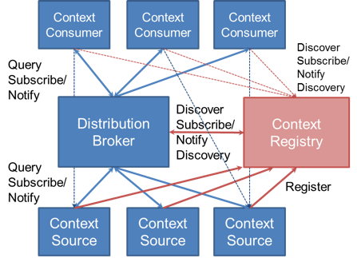
Beyond Federations: New distributed deployment features
Focus up to here has been on federated cases of context broker to context broker operations, which is defined as the default case for NGSI-LD
However, there are also other common distributed deployment scenarios:
Support for actuation (IoT Agents)
Support for “lazy” attributes (IoT Agents)
Explicit distribution of context information, e.g. one context
source for vehicles, another for bicycles
Backup context sources e.g. less frequently updated
Complex Data Sharing scenarios
These require a different subset of operations to the standard
federation case – a full context broker is frequently not required
Security concerns may be explicitly deny certain operations
In other cases, some entities or attributes may only be obtained from
a single specific context source (e.g. device actuation)
Others could be augmented from multiple sources with limited availability
NGSI-LD v1.6.1

Slide 33
Distributed Operation Modes (1)
Additive Registrations
A Context Broker is permitted to hold context data about the Entities
and Attributes locally itself, and also obtain data from (possibly multiple) external sources
An inclusive Context Source Registration specifies that the Context Broker considers all registered Context Sources as equals and will distribute operations to those Context Sources even if relevant context data is available directly within the Context Broker itself (in which case, all results will be integrated in the final response). This federative and is the default mode of operation.
An auxiliary Context Source Registration never overrides data held directly within a Context Broker. Auxiliary distributed operations are limited to context information consumption operations (see clause 5.7). Context data from auxiliary context sources is only included if it is supplementary to the context data otherwise available to the Context Broker.
registration options
additive
proxied
inclusive
auxiliary
exclusive
redirect

Slide 34
Distributed Operation Modes (2)
Proxied Registrations
A Context Broker is not permitted to hold context data about the Entities and Attributes locally itself. All context data is obtained from the external registered sources.
An exclusive Context Source Registration specifies that all of the registered context data is held in a single location external to the Context Broker. The Context Broker itself holds no data locally about the registered Attributes and no overlapping proxied Context Source Registrations shall be supported for the same combination of registered Attributes on the Entity.
An exclusive registration must be fully specified. It always relates to specific Attributes found on a single Entity. It can be used for actuations
A redirect Context Source Registration also specifies that the registered context data is held in a location external to the Context Broker, but potentially multiple distinct redirect registrations can apply at the same time.
registration options
additive
proxied
inclusive
auxiliary
exclusive
redirect

Slide 35
Limiting Distributed Operations: local
In order to avoid cascading distributed operations, the query parameter local can be used to limit all operations to be executed on locally available information only. (Clause 6.3.18)
Context Sources can also put localOnly in the management info, provided in the Context Source Registration to indicate that, for all requests forwarded to it, local should be set.
Name | Data Type | Cardinality | Remarks
local | boolean | 0..1 | If local=true then no Context Source Registrations shall be considered as matching to avoid cascading distributed operations (see clause 4.3.6.4)
NGSI-LD v1.6.1

Slide 36
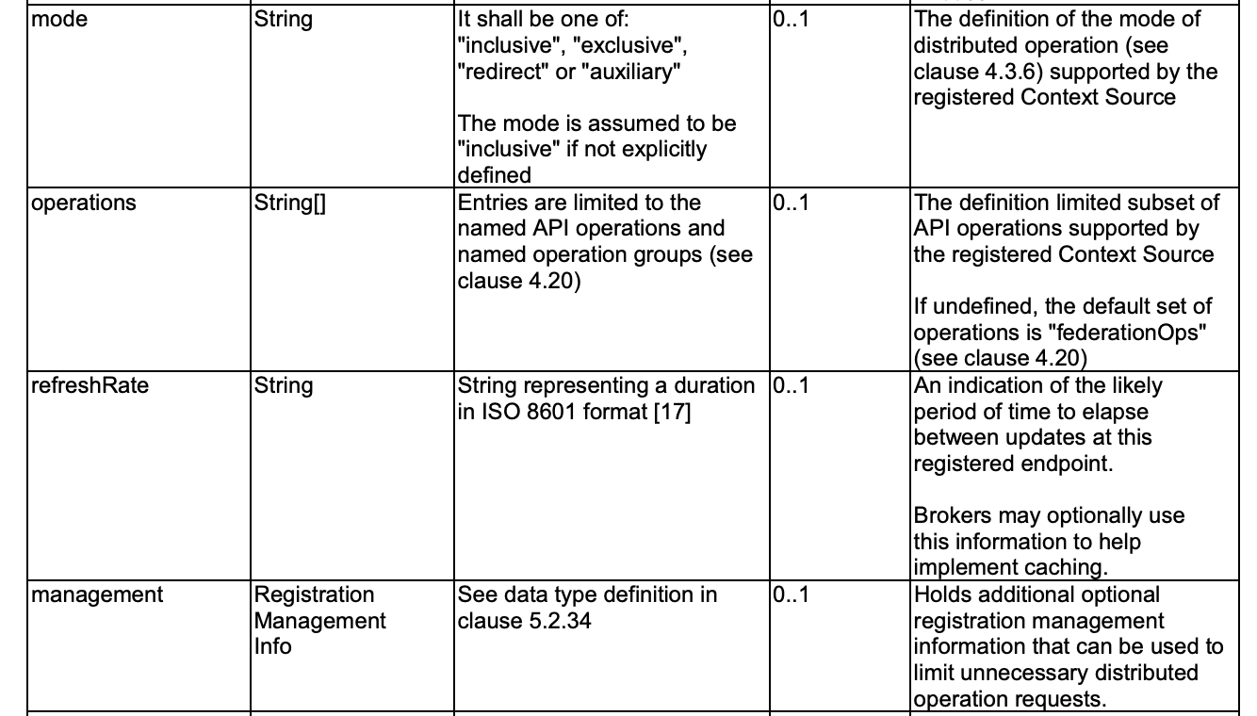
Context Source Registration
NGSI-LD v1.6.1

Slide 37
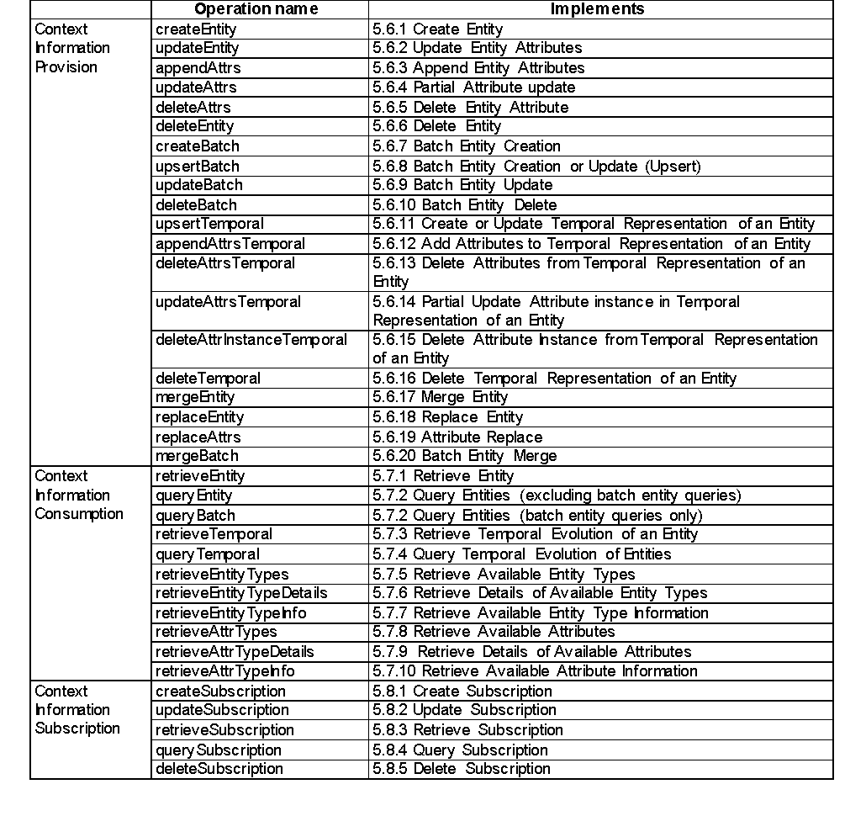
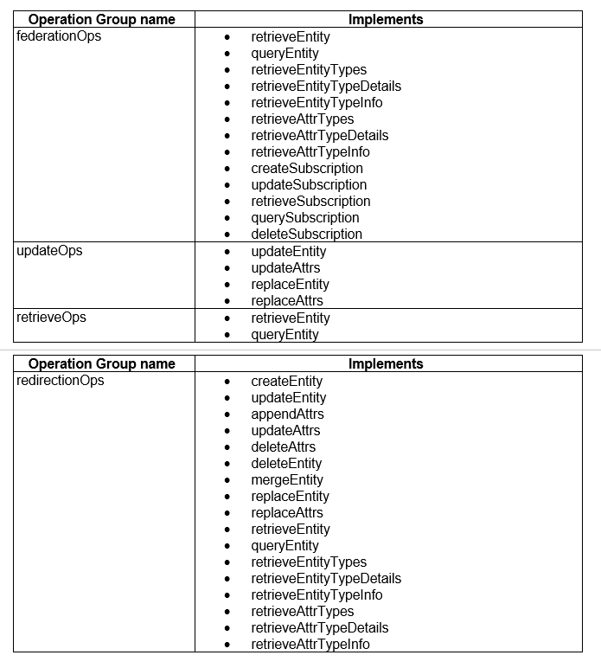
Supported Distributed Operations in Registration
Individual Operations
Pre-defined Operation Groups
default
⬅ Federations
⬅ Actuators
⬅ "lazy"
Attributes
⬅ CRUD Proxies

Slide 38
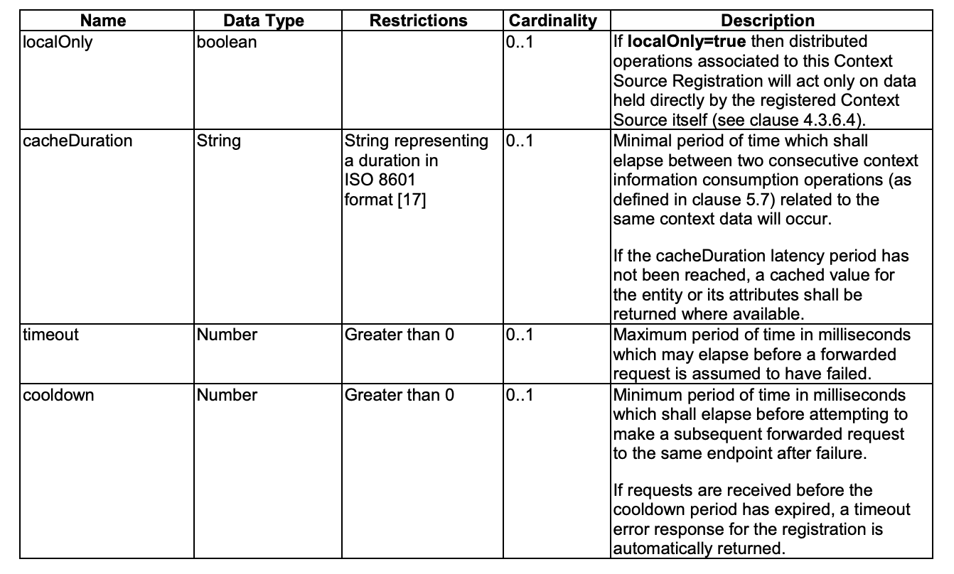
Optional Registration Management Info
NGSI-LD v1.6.1

Slide 39
Conclusions

Slide 40
Summary (1)
All NGSI-LD brokers (e.g Scorpio, Stellio, Orion-LD) are working towards a common NGSI-LD specification
The NSGI-LD Specification defines many advanced features, that Context Brokers support are obliged to support to comply.
These features are essential for certain advanced use cases, but in general usage of advance features is not mandatory and usually will not be required when running simpler installations.
Use Multi-Attributes with datasetId for alternative sources, 1-n relationships and sequential command actuations
Use Scopes to logically separate data. scopeQ filters hierarchical queries
Use Tenants and the NGSILD-Tenant header to isolate context data into separate databases.
Use Advanced Registration features to alter the scope of distributed operations

Slide 41
Summary (2)
Remember, specification runs before implementation:
As of September 2022, The latest specification revision was 1.6.1 and can be found at: https://www.etsi.org/deliver/etsi_gs/CIM/001_099/009/01.06.01_60/gs_CIM009v010601p.pdf.
Basic operations (e.g. from 1.3, 1.4) are commonly available across all brokers
Federation has already been achieved between different brokers.
Expect rollout of recently defined advanced distributed operation 1.6.1 features to arrive in brokers in the coming months based on commercial priorities.

Slide 42
Summary (3)
4 distributed operation modes have been defined :
inclusive = federation (default)
exclusive = IoT devices
redirect = distributed databases
auxiliary = weak secondary sources
The default list of supported distributed operations is explicitly defined as Federation (i.e. Query + Subscribe operations)
No changes required for existing federated environments
For advanced operations and the use of limited partial brokers such as IoT Agents, switch to using registration mode and the new operations list as soon as available
Limit unnecessary and unsupported forwarded requests whenever possible.
Registration management info (e.g localOnly) can be used to add further restrictions to avoid unnecessary traffic, but remember that support for these options is always defined as best effort only

