Slide 1
CS 739 P4 DEMO
Avinash, Ishaan, Sandeep, Vyom

Slide 2
Recap

Slide 3
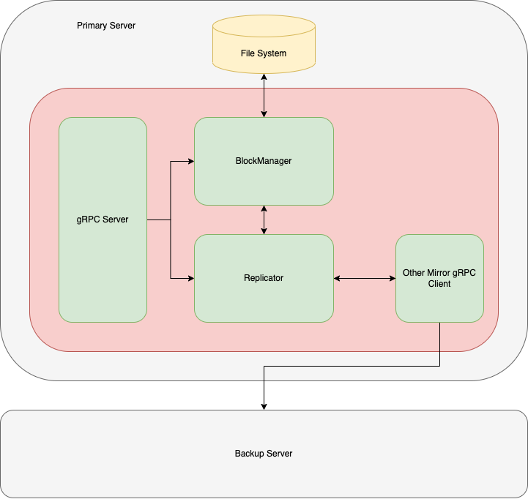
Internal Components of a shard
Functionality spread across components
Every component decoupled
Use gRPC for client server communication.

Slide 4
gRPC Interface (Need to Add other RPC Calls)
HeartBeat
Read
Write
ReplicateBlock
CommitBlock
CheckConsistency

Slide 5
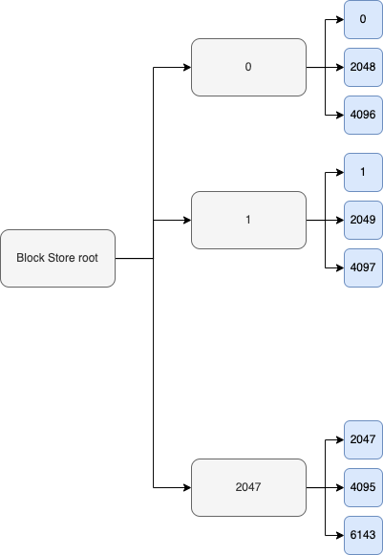
Block Manager of each Shard
Abstracts the management of blocks on a server
Each block stored in separate 4KB file, using a two level directory structure
Interface allows for write and commit.
Lock interface per address/block also exposed, upto to user to use it.

Slide 6
Replicator
Buffers write requests in case of failure of other server
Uses a queue and hashmap data structure.
Unique blocks are only queued - Only final block state is copied, write requests are ignored.
Multi threaded queue burn.
Queue not durable, since we assume server will never crash during recovery.
Also maintains state of the system(next slide)

Slide 7
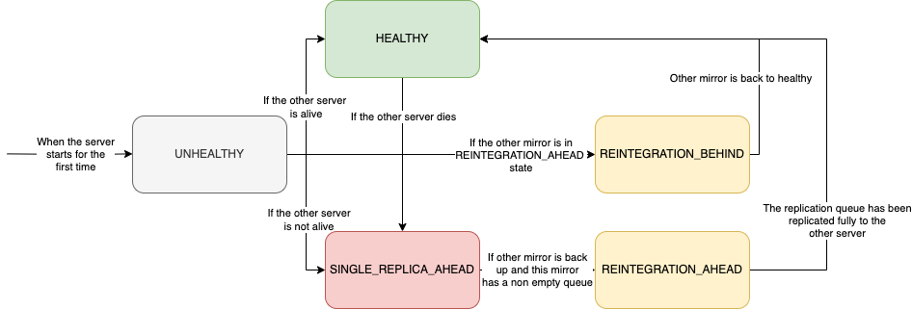
Replicator

Slide 8
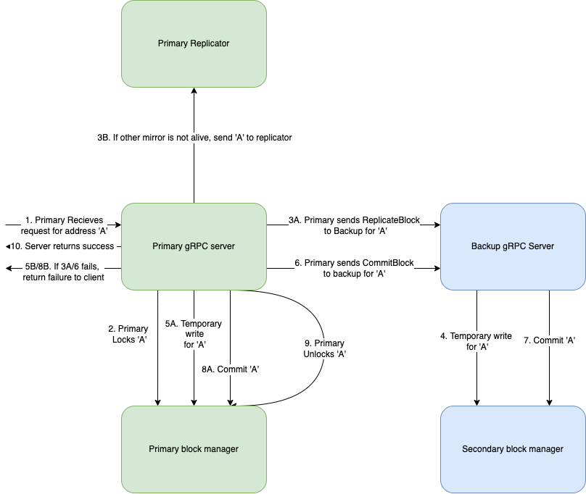
Write Protocol
Two Phase commit - Temp write ensures that existing data is untouched, commit just renames.
If backup can’t write even if alive, we reject assuming other failures.
Use locks to synchronize writes on the same block address. Assumed that heterogeneous address writes are dominant.

Slide 9
What’s New ?

Slide 10
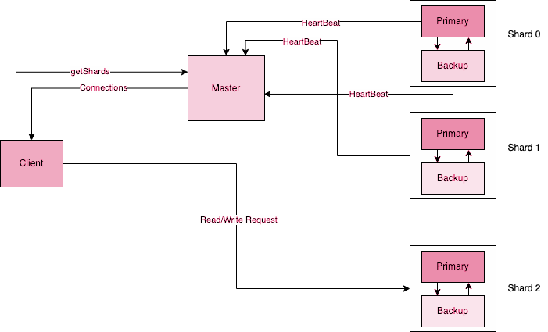
High Level Design

Slide 11
Master
“I am here to guide you all.”
Responsibilities:-
Provide list of connected shards to Client Lib.
Handle Add shards request to extend volume.
Trigger load balancing.
Monitor health and load of each shard.
Note: Master does not participate in read and write operations.

Slide 12
MetaData
All metadata are durable.
In Memory
Persistent
Location
1
Connection List (Per shard)
Master
2
Committed Block
Shard
3

Slide 13
Assumptions
Specifications
Failures during shuffling are transient.
Only one server in a shard can fail at a time.
Read and writes will be stalled during shuffling.
We don’t maintain checkpoint during shuffling.
Once a primary goes down shuffling is at halt and master will retry.
Once primary is up it will read the committed block from start

Slide 14
Read and Write Protocol
Who will manage the request routing?
Shard 0
Client
Client Lib
Shard 1
Request
Shard 2

Slide 15
Routing Algorithm (Aligned Operations)
Parameters | Meaning
N | Number of Shards
BLOCK_SIZE | 4KB (4096)
Address | Actual address given by client
Aligned : Mod(Address,BLOCK_SIZE) = 0
Check Connection table and send request
Address=A
A/BLOCK_SIZE
BlockID=BID
BID%N
ShardIndex

Slide 16
Routing Algorithm (Aligned Operations)
Parameters | Meaning
N | Number of Shards
BLOCK_SIZE | 4KB (4096)
Address | Actual address given by client
Aligned : Mod(Address,BLOCK_SIZE) = 0
Address=A
A/BLOCK_SIZE

Slide 17
Routing Algorithm (Aligned Operations)
Parameters | Meaning
N | Number of Shards
BLOCK_SIZE | 4KB (4096)
Address | Actual address given by client
Aligned : Mod(Address,BLOCK_SIZE) = 0
BlockID=BID
BID%N

Slide 18
Routing Algorithm (Aligned Operations)
Parameters | Meaning
N | Number of Shards
BLOCK_SIZE | 4KB (4096)
Address | Actual address given by client
Aligned : Mod(Address,BLOCK_SIZE) = 0
Check Connection table and send request
ShardIndex

Slide 19
Routing Algorithm (Aligned Operations)
Parameters | Meaning
N | Number of Shards
BLOCK_SIZE | 4KB (4096)
Address | Actual address given by client
Aligned : Mod(Address,BLOCK_SIZE) = 0
BlockID=BID
BID/N

Slide 20
Routing Algorithm (Aligned Operations)
Parameters | Meaning
N | Number of Shards
BLOCK_SIZE | 4KB (4096)
Address | Actual address given by client
Aligned : Mod(Address,BLOCK_SIZE) = 0
Use Logical Address to send request
LogicalAddr

Slide 21
Routing Algorithm (Unaligned Operations)
Parameters | Meaning
N | Number of Shards
BLOCK_SIZE | 4KB (4096)
Address | Actual address given by client
Unaligned : Mod(Address,BLOCK_SIZE) ≠ 0
We have added an additional parameters of size and offset in Write RPC call
Block manager is not responsible for managing these operations
Unaligned operations are always split across two Shards
Shard1
Offset = A%BLOCK_SIZE
Size = A - A%BLOCK_SIZE
BlockID = A/BLOCK_SIZE
Address=A
Shard2
A` = A+BLOCK_SIZE
Offset = 0
Size = A%BLOCK_SIZE
BlockID = A`/BLOCK_SIZE

Slide 22
Routing Algorithm (Unaligned Operations)
Parameters | Meaning
N | Number of Shards
BLOCK_SIZE | 4KB (4096)
Address | Actual address given by client
Unaligned : Mod(Address,BLOCK_SIZE) ≠ 0
For each Request we will follow this.
BlockID=BID
BID%N

Slide 23
Routing Algorithm (Unaligned Operations)
Parameters | Meaning
N | Number of Shards
BLOCK_SIZE | 4KB (4096)
Address | Actual address given by client
Unaligned : Mod(Address,BLOCK_SIZE) ≠ 0
For each Request we will follow this.
Check Connection table and send request
ShardIndex

Slide 24
Routing Algorithm (Unaligned Operations)
Parameters | Meaning
N | Number of Shards
BLOCK_SIZE | 4KB (4096)
Address | Actual address given by client
Unaligned : Mod(Address,BLOCK_SIZE) ≠ 0
For each Request we will follow this.
BlockID=BID
BID/N

Slide 25
Routing Algorithm (Unaligned Operations)
Parameters | Meaning
N | Number of Shards
BLOCK_SIZE | 4KB (4096)
Address | Actual address given by client
Unaligned : Mod(Address,BLOCK_SIZE) ≠ 0
For each Request we will follow this.
Use Logical Address to send request
LogicalAddr

Slide 26
Comments on unaligned writes
Based on our protocol design the data across primary and backup in a shard are consistent.
System consistency is under questions in case of concurrent unaligned writes on a same address.
“We may not read what we wrote.”

Slide 27

How to join the elite group?

Slide 28
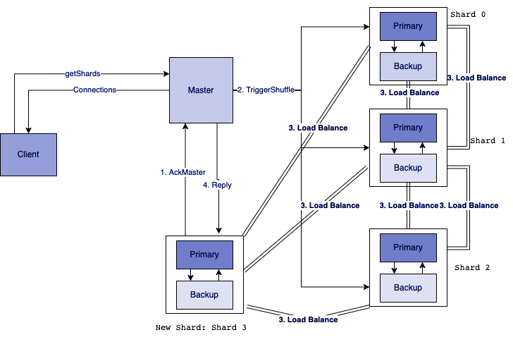
Add Shard Protocol

Slide 29
Load Balancing
Traverse the commit list after TriggerShuffle request.
Read the existing blocks.
Send write request via client lib.
Persist the incoming shuffle write request.
Traverse and Read
Send Write request
Persist new writes

Slide 30
Load Balancing
Reading and writing of same block might result in Data corruption
Our block manager takes care of this.
Curr_idx
Write
Read

Slide 31
Evaluation

Slide 32
Experiments
Consistency
Recovery Protocol
Rebalancing Protocol
Performance
Small Modifications in TF

Slide 33
Experiment Setup
CPU Name : AMD EPYC 7302P @ 3GHz
CPUs : 16
OS : Ubuntu
Memory : 128 GB
We have two active shards one master.
Tried Different types or read and write traffic.
All request we tested were concurrent.
Most tests are performed in the same cluster, couple of them on WAN.

Slide 34
Consistency experiment (Summary)
Test Scenarios : | Consistency Status
Different Address (Aligned) | Guaranteed (Strong)
Different Address (Unaligned) | Not Guaranteed
Same Address (Aligned) | Guaranteed (Strong)
Same Address (Unaligned) | Not Guaranteed
Primary/backup crash in a shard | Guaranteed (Strong)

Slide 35
Recovery experiments (Summary)
We performed controlled failures on specific addresses:
1. | Primary failing after sending msg to replicate on Backup | Consistency observed - only backup temp folder will have data
2. | Primary failing after ReplicateBlock | Consistency observed - only temp folders will have data
3. | Primary failing before sending ack | No ack sent to client, data present on both primary and backup,
4. | Primary failing in the middle of CommitBlock | Inconsistency - Not handled
5. | Backup failure (Server is down) | Messages are added in Pending Queue

Slide 36
Shuffling Protocol

Slide 37

Shuffling Demo
Old Shard Cnt | 2
New Shard cnt | 3
Nature of Write distribution | Different Address
Total No of writes | 1200

Slide 38
Master Crash Demo
Old Shard Cnt | 2
New Shard cnt | 3
Nature of Write distribution | Different Address
Total No of writes | 1200
Point of Crash | After sending Triggle Shuffle Request

Slide 39
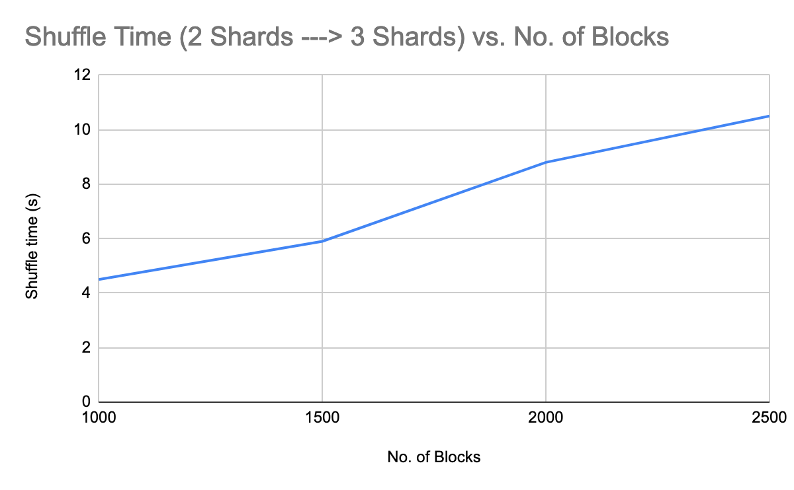
Shuffling Time

Slide 40
Performance

Slide 41
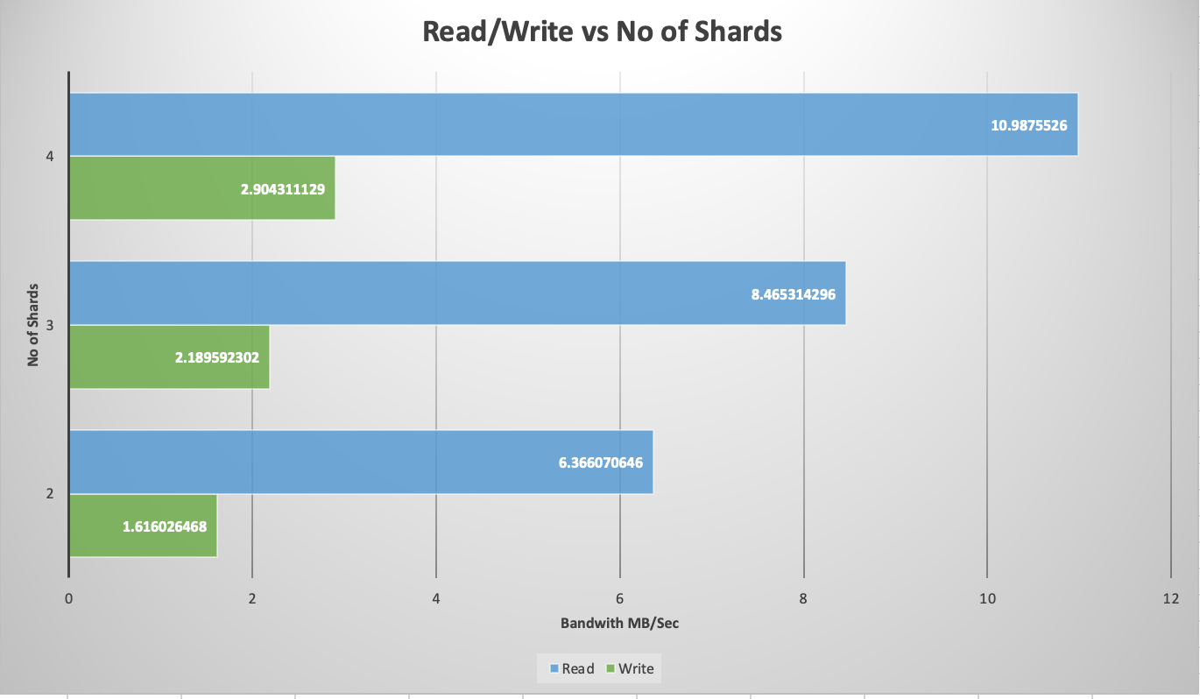
Sequential Reads/Write Performance (10000 request)
Single Client
No of Requests 10000
Evenly distributed Address request
All shards receive one request concurrently.

Slide 42
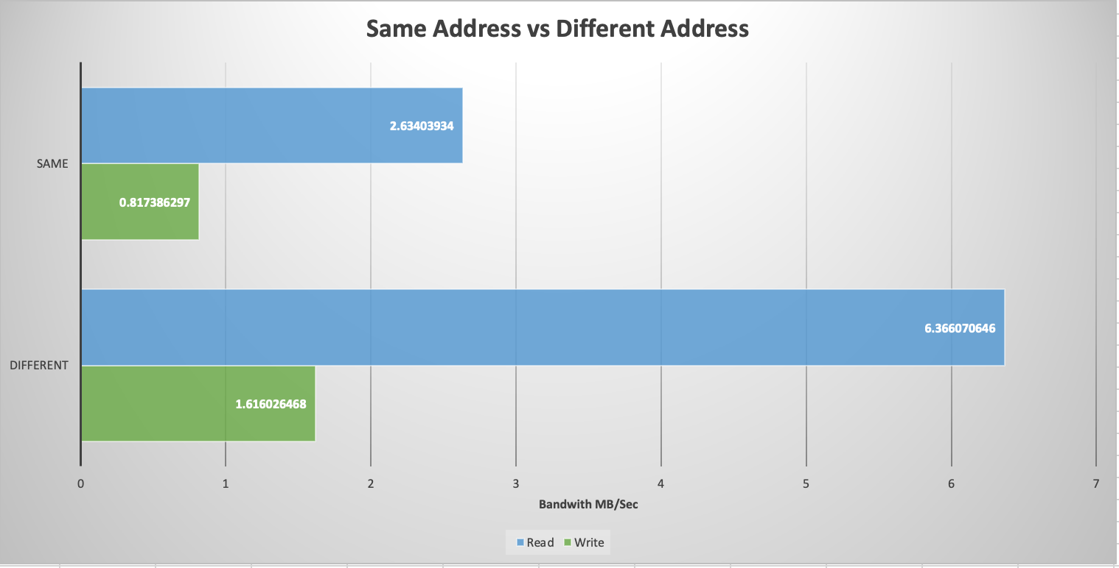
Same Address vs Different Address
Single Client
No of Requests 10000
No of Shards = 2

Slide 43
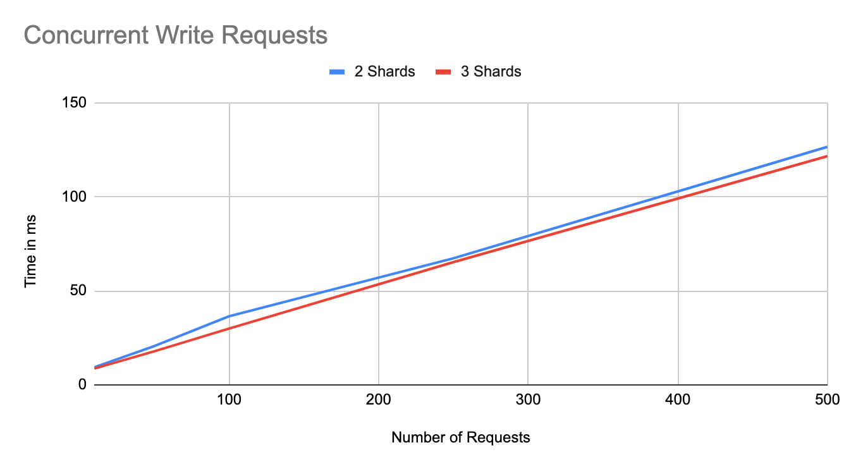
Concurrent write requests performance

Slide 44
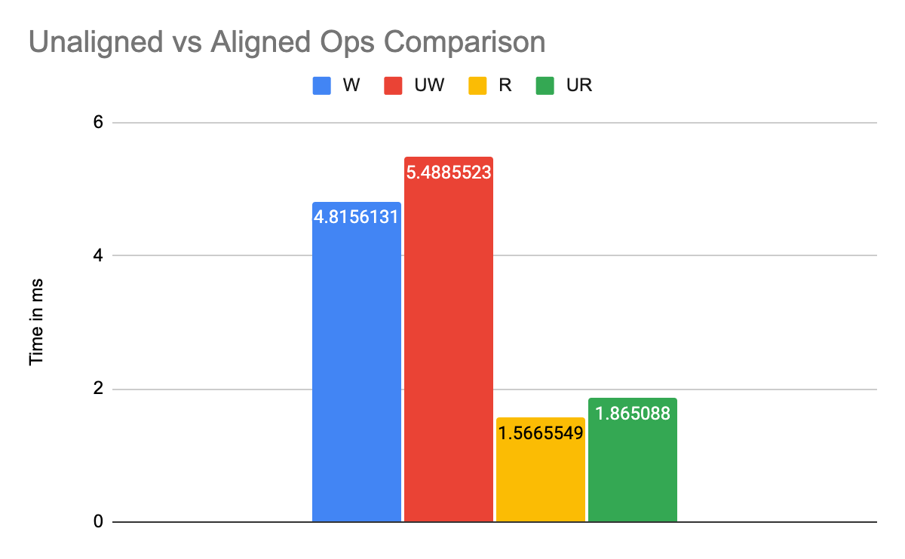

Slide 45
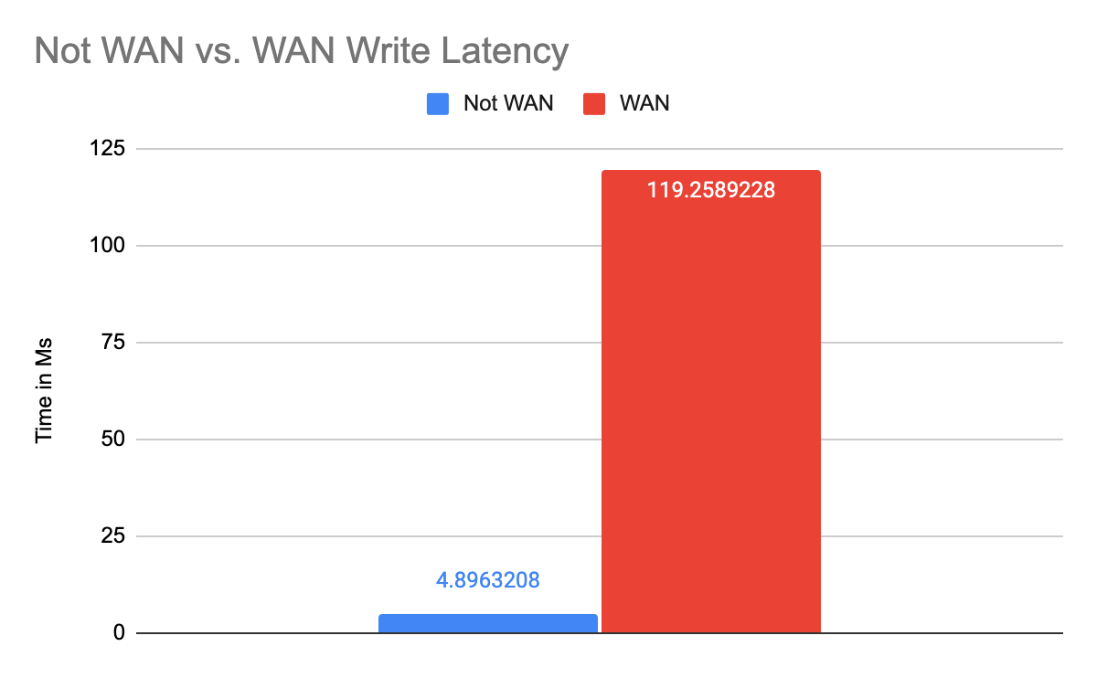
Comparison of Latency with WAN vs Same cluster

Slide 46
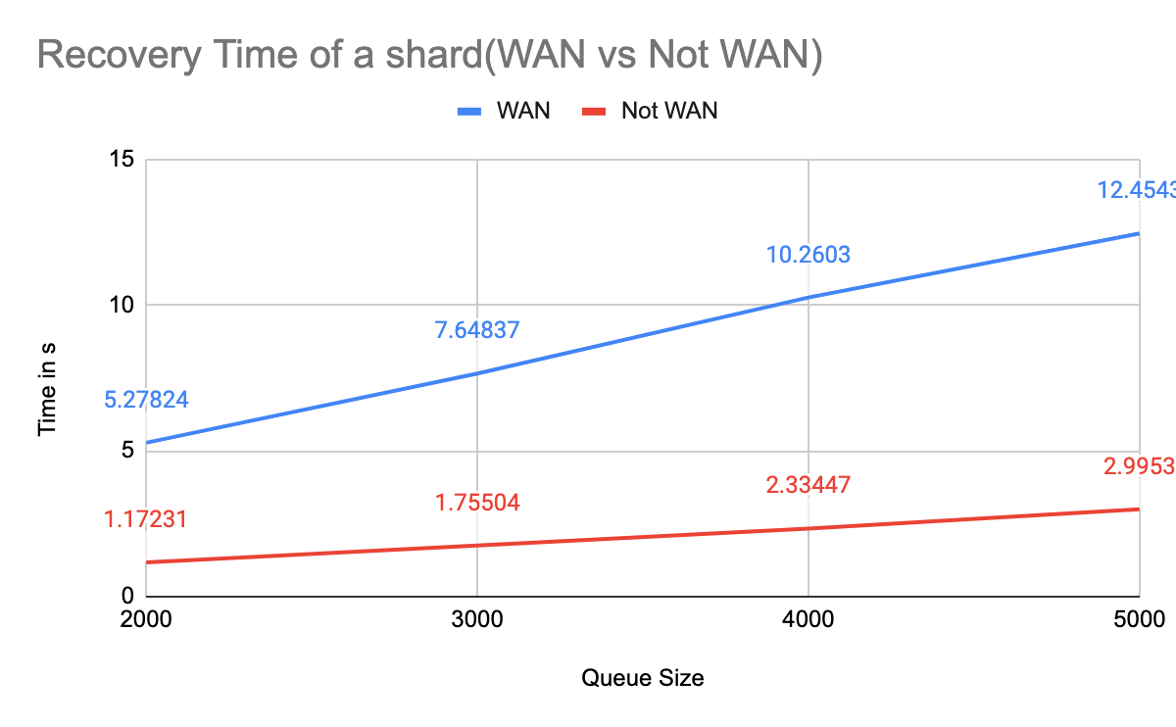
Average Slowdown by 4.3 times!
Recovery time effect of spreading shard across WAN

Slide 47
Thank You!

Slide 48
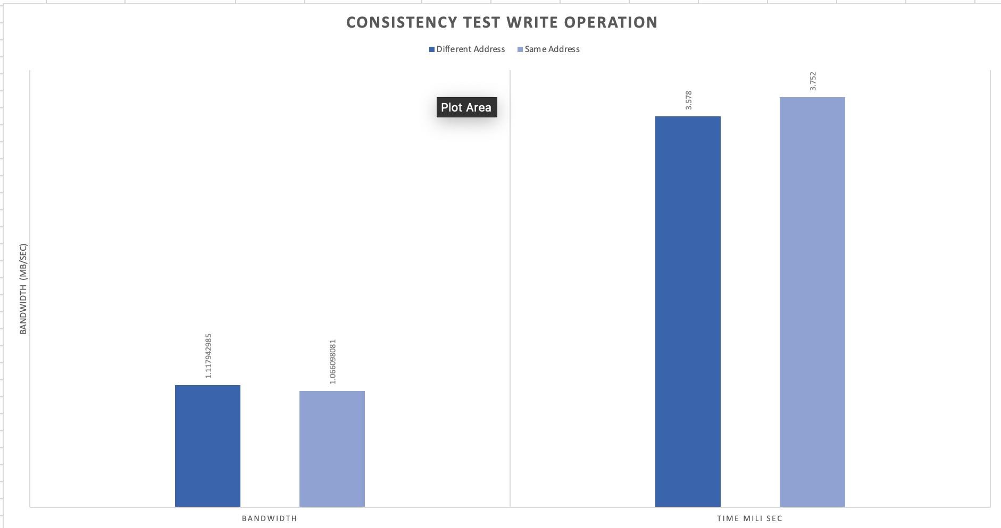
Experiment 1
Operation | Unaligned + Aligned Writes
No of Clients | 1
Nature of operation distribution | Different Address/Same Address

Slide 49
Specifications of testing framework for consistency evaluation
Our Test Framework uses SHA-256 to compute the hash for a given block address or set of block addresses.
It provides three main API’s which generate the nature of write traffic. These API’s are customisable can can be used to stimulate other Test Scenarios also.
Shard X
Different Addr. Writes
Primary Server
Client
Client
Test Framework
Client
Same Addr Writes
Client
Backup Server
Concurrent Clients
Crash simulation

Slide 50
Goals for evaluating consistency
“We believe to achieve strong consistency, as soon as the client receives the acknowledgement for the write commit, then data should be invariant across servers for the given block number”
Examine checksum after every write commit under both concurrent and non concurrent scenario.
Examine checksum after a batch of writes across different addresses.
Examine checksum after failure recovery.

