Slide 1
DATA ANALYTICS / GROUP 4
Heart Disease Analysis
♥
Exploring risk factors, medical patterns & data-driven insights
1,025
PATIENT RECORDS
TEAM MEMBERS
Doaa LinkedIn
Ibrahim LinkedIn
Doaa Mostafa Ahmed Mahmoud Bayoumi
Abdelrahman Ahmed Zaki Ali
Ibrahim Hossam El-Din Ibrahim Ibrahim
Laila Hamed Hamed Mesaad
Laila LinkedIn
Abdelrahman LinkedIn

Slide 2
01 • OVERVIEW
02
Project Overview
Turning patient-level medical data into clear, understandable insights
01 Analyze the dataset
02 Explore features
03 Identify relationships
Study medical records for 1,025 patients and identify meaningful patterns.
Compare demographic, clinical and test-related variables.
Find features associated with the heart-disease outcome.
04 Communicate visually
05 Translate data to insight
Use charts, comparisons and a dashboard to make patterns easier to understand.
Move from raw rows → analysis → visual evidence → conclusions.
GROUP 4 • HEART DISEASE ANALYSIS

Slide 3
02 • QUESTIONS
03
Key Project Questions
The analysis was organized around five practical questions
01
Higher-risk features
Which features are associated with a higher heart-disease rate?
02
Strongest relationships
Which features show the strongest relationship with heart disease?
03
Feature correlation
What is the correlation between the medical features?
04
Age patterns
How is heart disease distributed across different age groups?
05
Main insights
What key insights can be obtained from the dataset?
GROUP 4 • HEART DISEASE ANALYSIS

Slide 4
03 • DATA
04
Dataset Overview
A clean, balanced dataset with demographic and clinical variables
1,025
21
0
0
Patients
Columns
Missing values
Duplicate rows
Main features
Age • Sex • Chest-pain type • Blood pressure • Cholesterol Maximum heart rate • Exercise-induced angina • Oldpeak • ECG • Vessels • Thalassemia
Target variable: whether heart disease is present.
GROUP 4 • HEART DISEASE ANALYSIS

Slide 5
04 • METHOD
05
Data Preparation & Analysis Workflow
From raw records to structured evidence
01
02
03
04
05
Check
Prepare
Analyze
Visualize
Interpret
Review missing values and duplicates.
Structure categorical and grouped features.
Use Pivot Tables and summary calculations.
Build charts and dashboard views.
Compare outcomes and extract insights.
cleaned dataset → analysis → Pivot Tables → dashboard → insights
GROUP 4 • HEART DISEASE ANALYSIS

Slide 6
05 • FINDINGS
06
How Common Is Heart Disease?
The outcome classes are almost evenly split
51.3%
classified with heart disease
48.7%
classified without heart disease
Interpretation
The two groups are relatively balanced, supporting direct comparison.
GROUP 4 • HEART DISEASE ANALYSIS

Slide 7
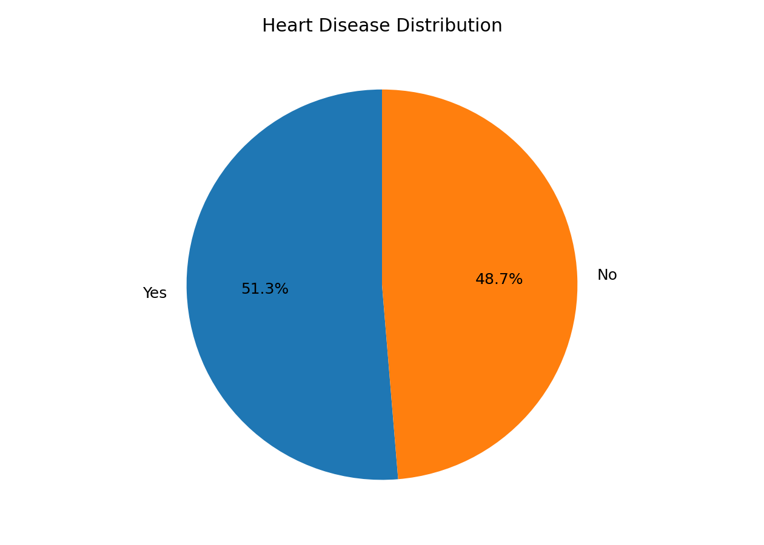
06 • FINDINGS
07
Chest Pain Type & Heart Disease
Clear differences appear across chest-pain categories
80.2%
Atypical Angina
77.1%
Non-Anginal Pain
66.2%
Asymptomatic
24.5%
Typical Angina
Share of patients in each category classified with heart disease.
GROUP 4 • HEART DISEASE ANALYSIS

Slide 8
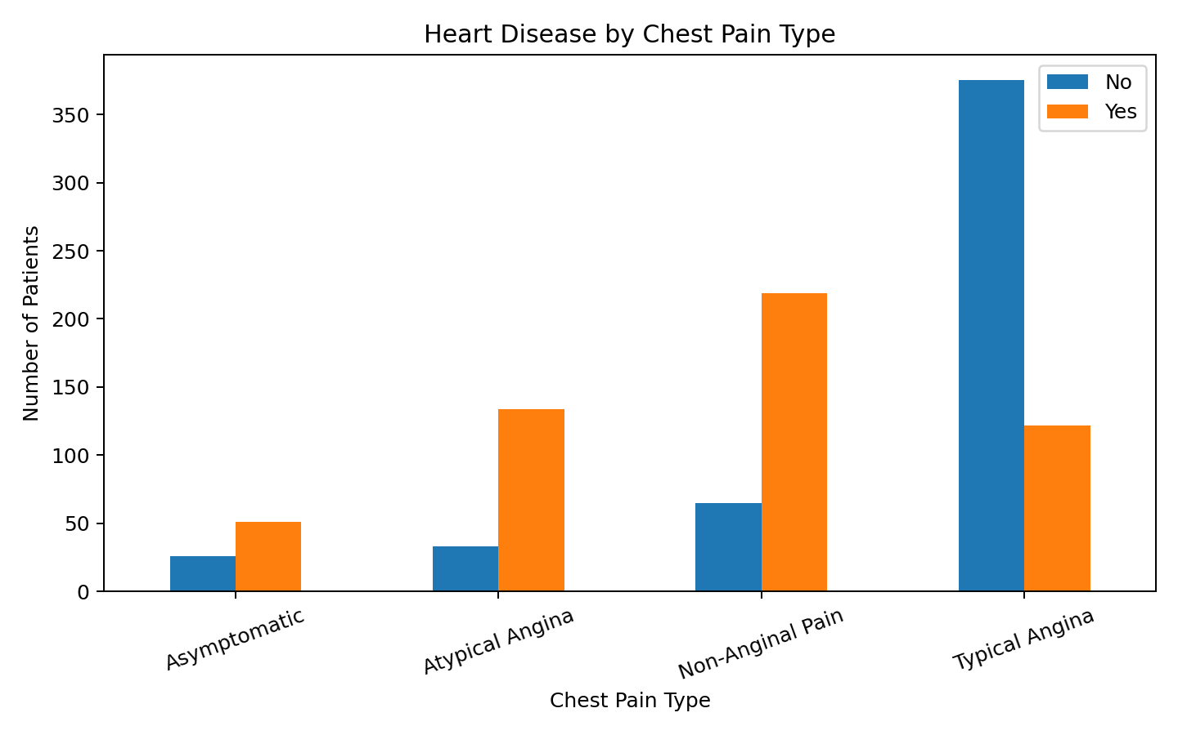
07 • FINDINGS
08
Heart Disease Across Age Groups
Age patterns are not a simple straight-line increase
Not linear
Some age groups show noticeably different rates.
Best interpretation
Age should be interpreted together with other medical features.
Source: project analysis
GROUP 4 • HEART DISEASE ANALYSIS

Slide 9
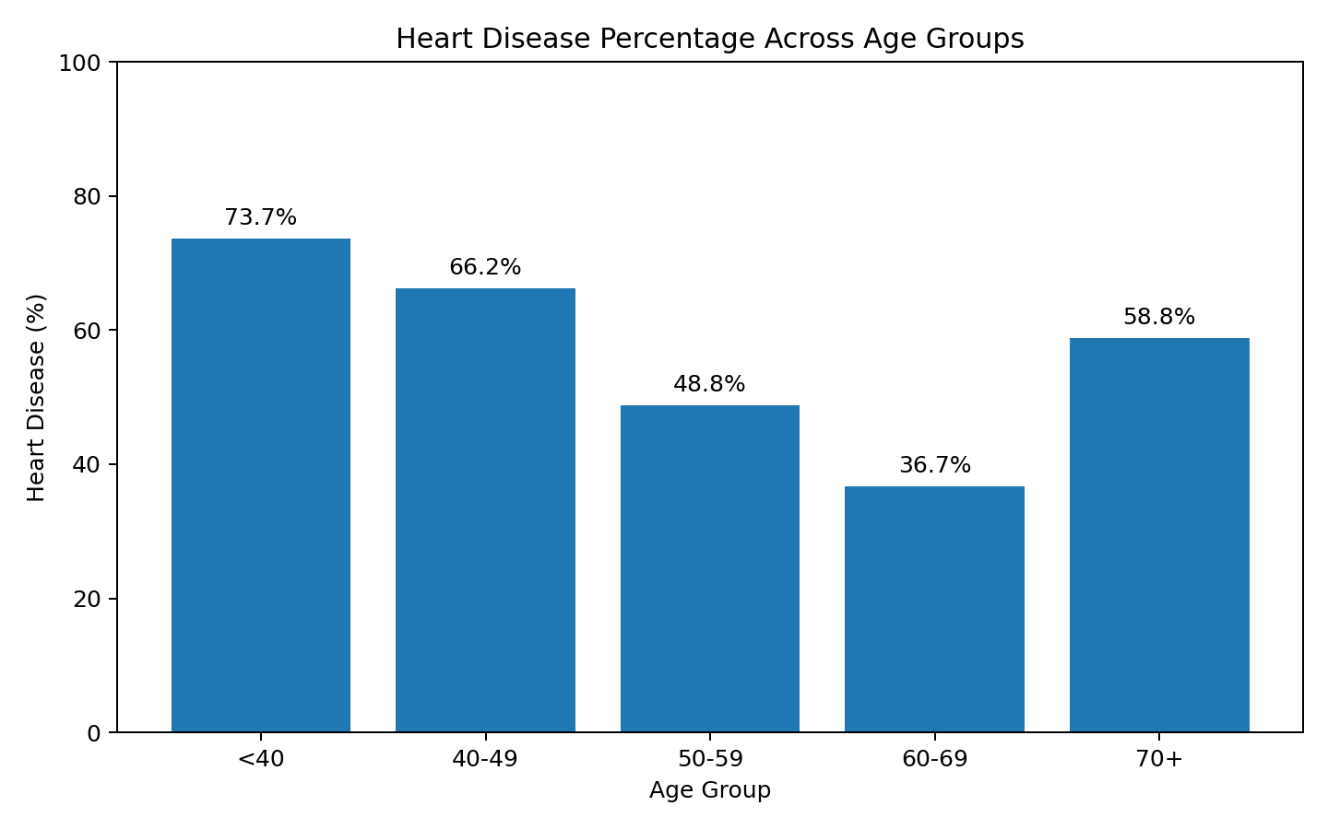
08 • FINDINGS
09
Medical Feature Distributions
Distribution plots reveal spread, overlap and outliers
Box plots
Highlight differences in distribution and spread.
Violin plot
Shows how maximum heart rate is distributed by outcome.
Together, the visuals show more than a single average.
GROUP 4 • HEART DISEASE ANALYSIS

Slide 10
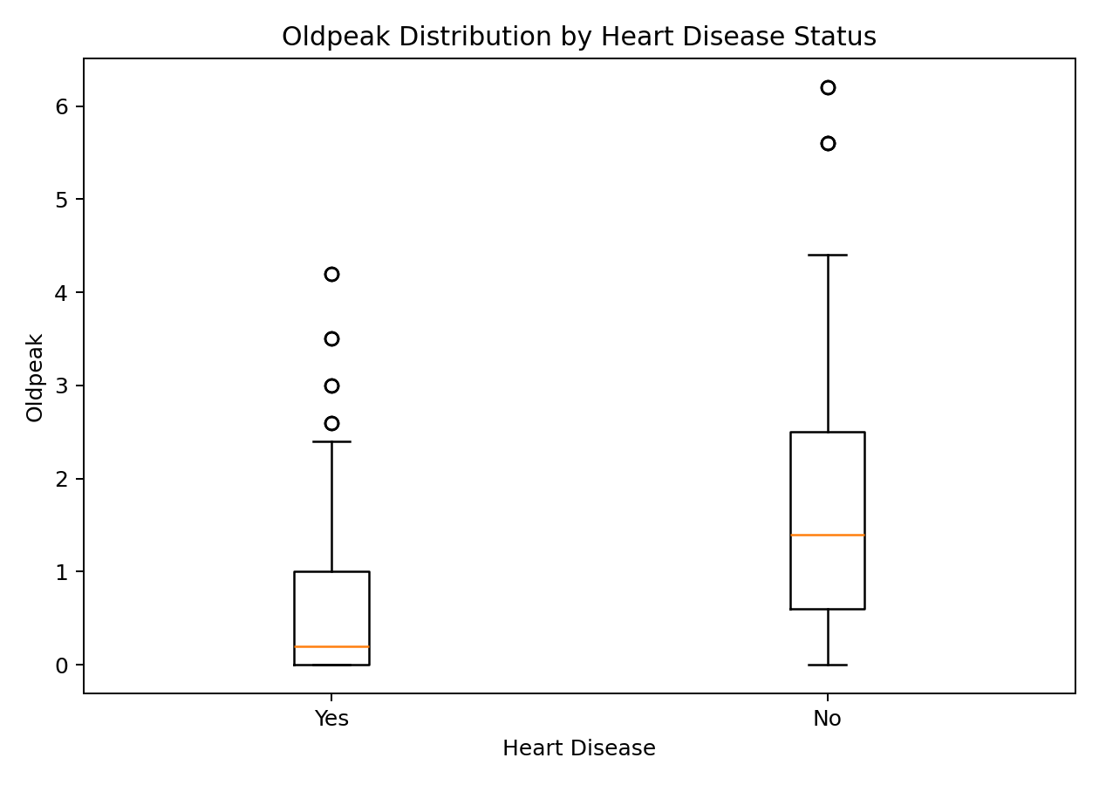
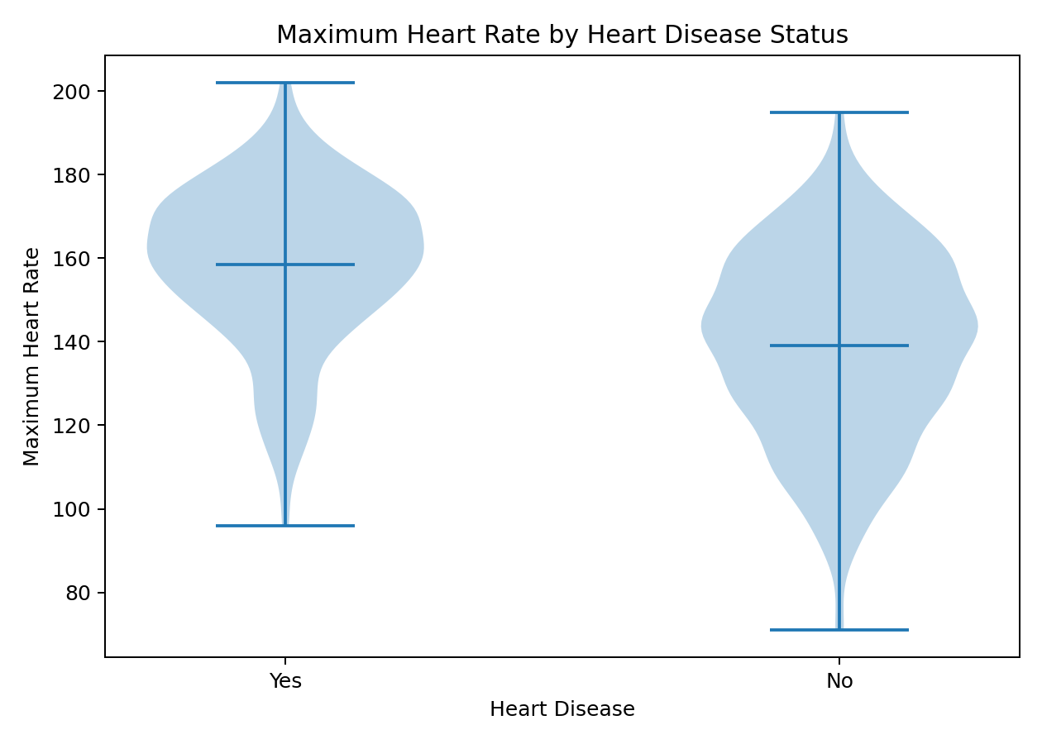
09 • RELATIONSHIPS
10
Correlation Between Medical Features
Numeric relationships provide a compact view of association
oldpeak
−0.44
Max_heart_rate
+0.42
age
−0.23
Correlation indicates association; it does not prove causation.
resting_blood_pressure
−0.14
cholestrol
−0.10
GROUP 4 • HEART DISEASE ANALYSIS

Slide 11
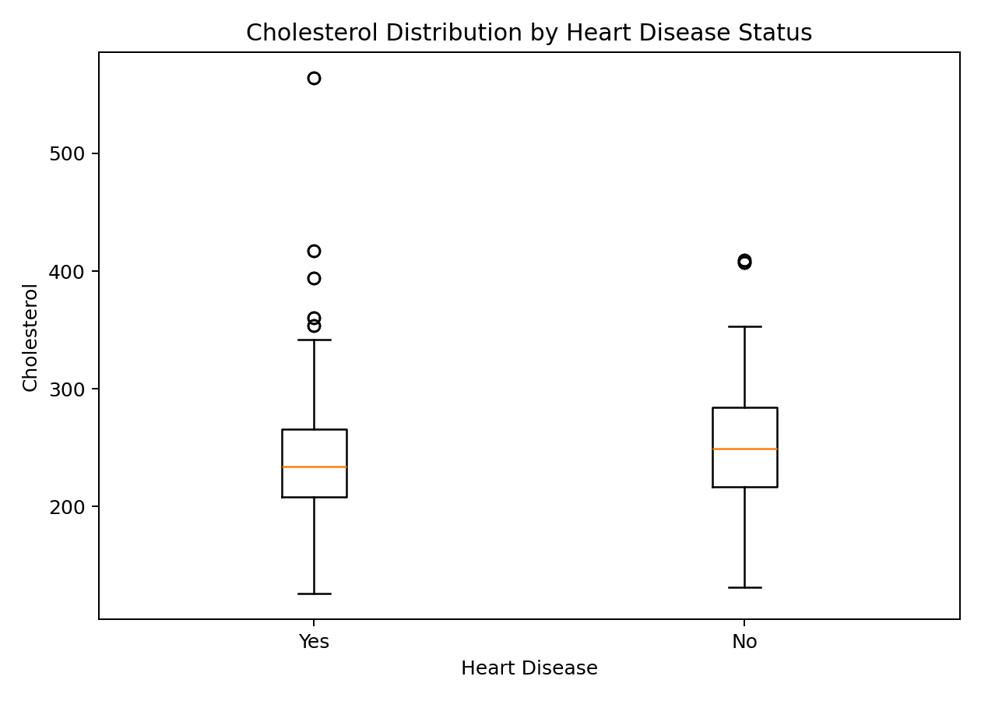
10 • FINDINGS
11
Cholesterol & Heart Disease
Compare distributions between the two outcome groups
Median
The box plot helps compare the center of each group.
Spread & outliers
Distribution gives more context than a single average.
Interpretation stays descriptive: the chart shows distribution, not causation.
GROUP 4 • HEART DISEASE ANALYSIS

Slide 12
11 • INSIGHTS
12
Key Insights
What the analysis tells us
51.3%
Heart disease is present in about half of the dataset.
Chest pain
Prevalence differs substantially across chest-pain categories.
Age
Age-group patterns are not purely linear.
Oldpeak + HR
These show notable numeric relationships with the target.
Visual evidence
Multiple views reveal patterns hidden in raw rows.
Caution
These are associations in this dataset—not medical causation.
GROUP 4 • HEART DISEASE ANALYSIS

Slide 13
12 • STORY
13
From Data to Decision
The project turns raw records into understandable evidence
01
Patient records
02
Data quality
03
Summaries
Start with patient-level medical data.
Check and prepare the dataset.
Use Pivot Tables and structured comparisons.
04
Visual evidence
05
Interpretation
06
Decision-ready story
Turn patterns into charts and dashboard views.
Compare symptoms, age groups and clinical measures.
Communicate the main findings clearly.
GROUP 4 • HEART DISEASE ANALYSIS

Slide 14
13 • CONCLUSION
14
Conclusion
A clear analytical story—with room for deeper modeling
What we learned
Next step
•
Several features show meaningful differences or associations with heart disease.
Further statistical or machine-learning analysis would be needed for clinical prediction.
•
Multiple visualizations provide a more complete view than raw rows alone.
•
The dashboard and analysis communicate the main patterns clearly.
The current analysis is descriptive and association-based.
THANK YOU
GROUP 4 • HEART DISEASE ANALYSIS

