Slide 1
Cost Optimization Models for SRF Linacs
TTC Workshop June 2013 Final
Tom Powers

Slide 2
JLAB C100 Cryomodule Commissioning
Tom Powers
(For Joe Preble and Mike Drury)

Slide 3
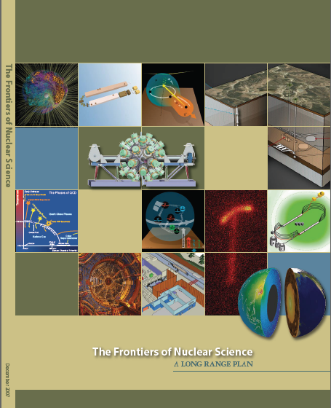
The 12 GeV Upgrade
Upgrade is designed to build on existing facility: vast majority of accelerator and experimental equipment have continued use
New Hall
Upgrade arc magnets
and supplies
Add 5 cryomodules
20 cryomodules
CHL upgrade
Maintain capability to deliver lower pass beam energies: 2.2, 4.4, 6.6….
Add arc
20 cryomodules
The completion of the 12 GeV Upgrade of CEBAF was ranked the highest priority in the 2007 NSAC Long Range Plan.
Add 5 cryomodules
Scope of the upgrade includes:
Doubling the accelerator beam energy
Doubling the injector energy
New Hall and beam-lines
Upgrades to existing Experimental Halls
Enhanced capabilities
in existing Halls

Slide 4
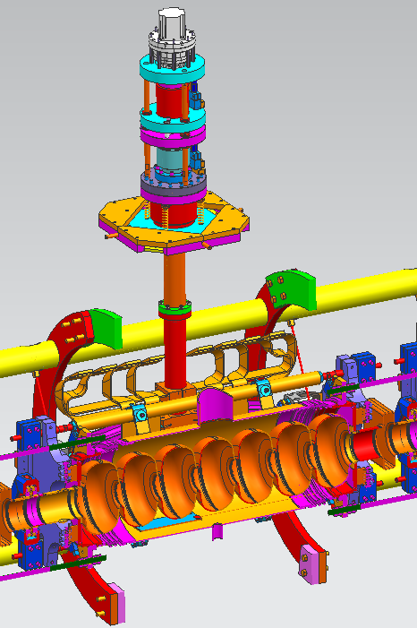
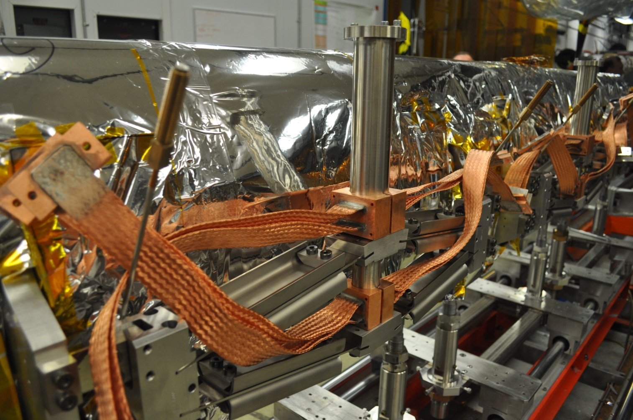
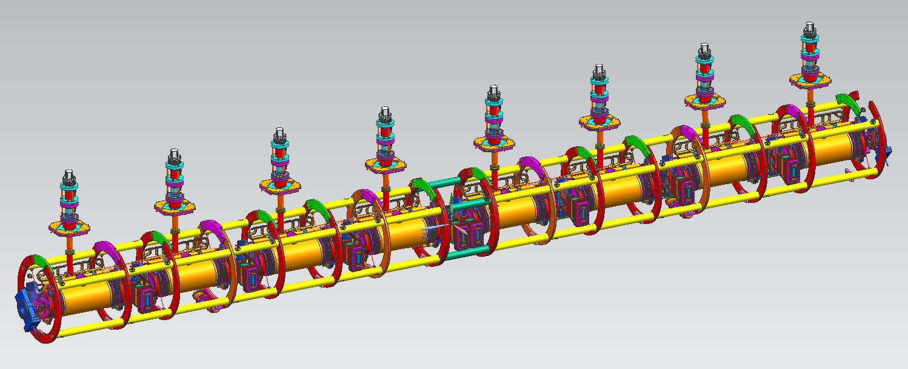
C100 Cryomodule

Slide 5
Standard Commissioning
C100 Cryomodules
Validate interlocks, LLRF, HPRF, and calibrate cables
Turn cavity on in self excited loop mode (SEL)
Ramp the gradient up to quench, trip, etc. over a period of ½ hour to 2 hours.
Run the cavity just below the trip level (Emax) for one hour.
Ramp the gradient down and determine radiation onset.
Perform Qo measurements from 7 MV/m to Emax in 1 MV/m steps.
Run all eight cavities at Emax for one hour.
Turn the zone over to the LLRF group so that they can tune up the field control chassis gains, bandwidths, etc.

Slide 6
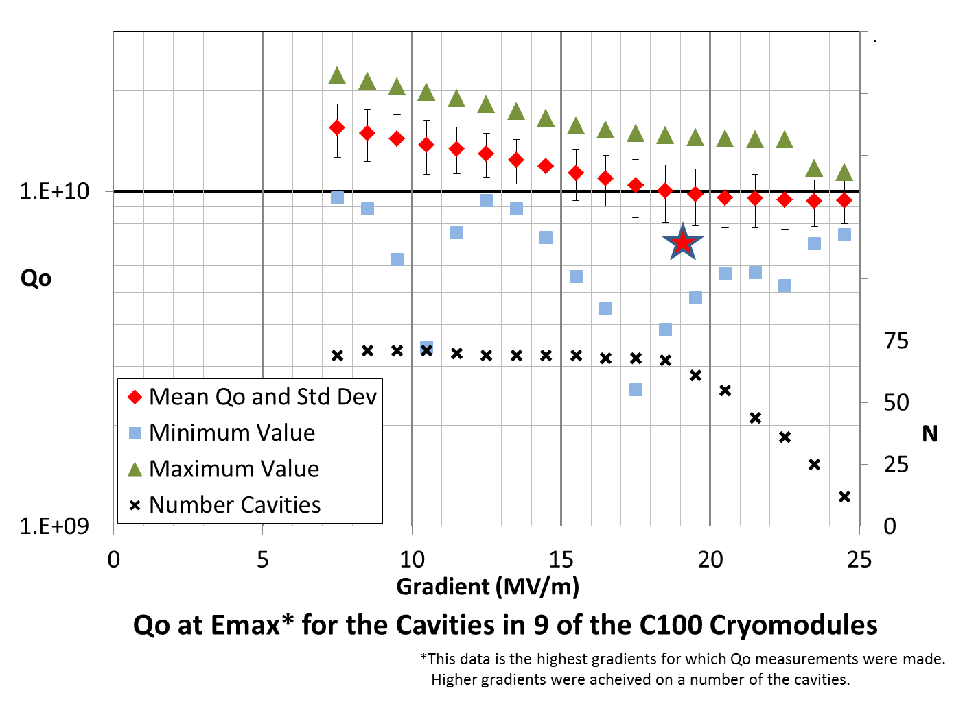
Q vs E results 1

Slide 7
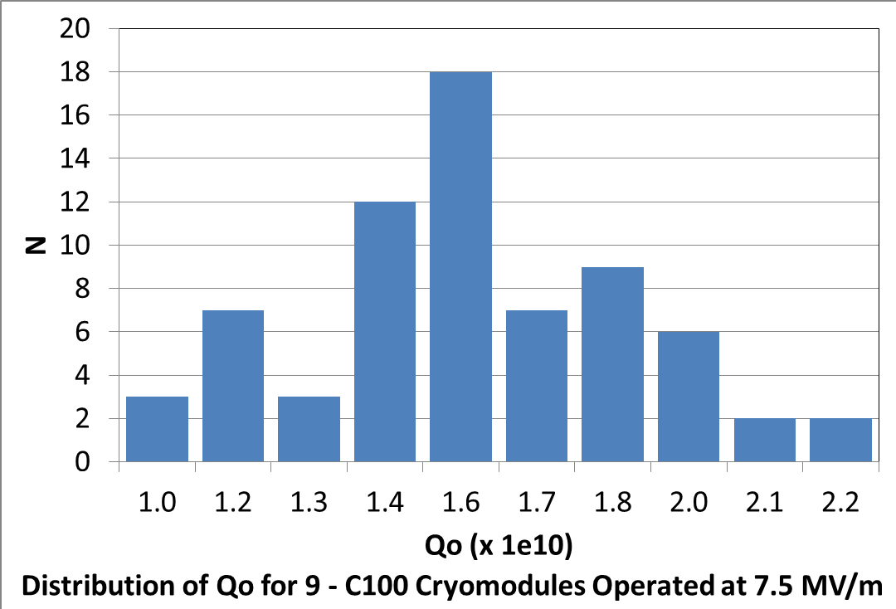
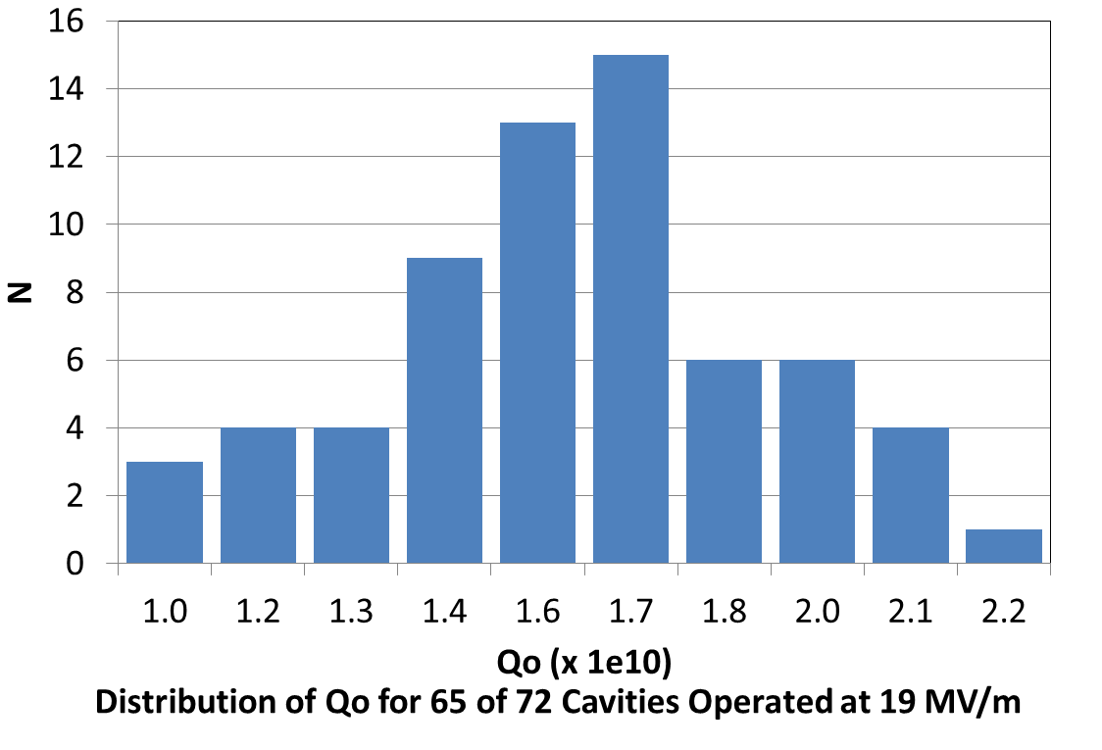
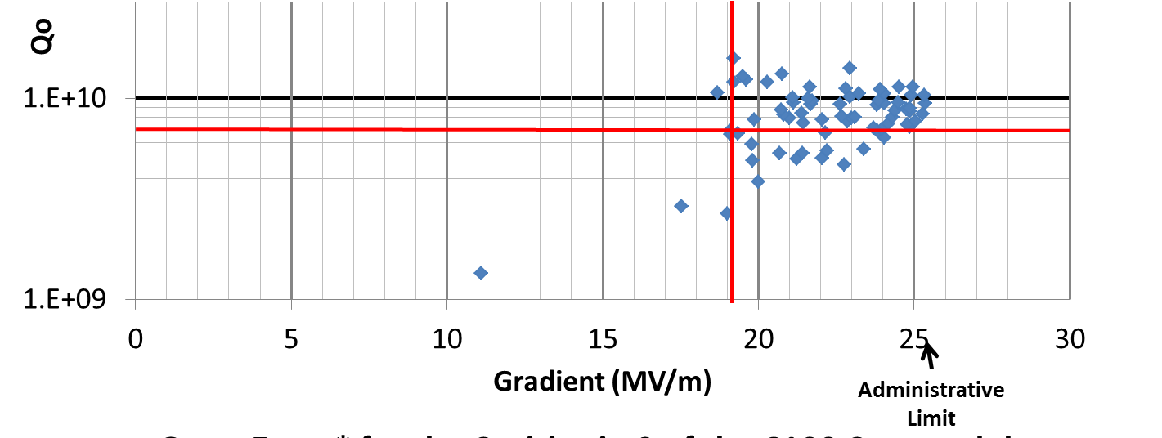
Qo vs E Statistics

Slide 8
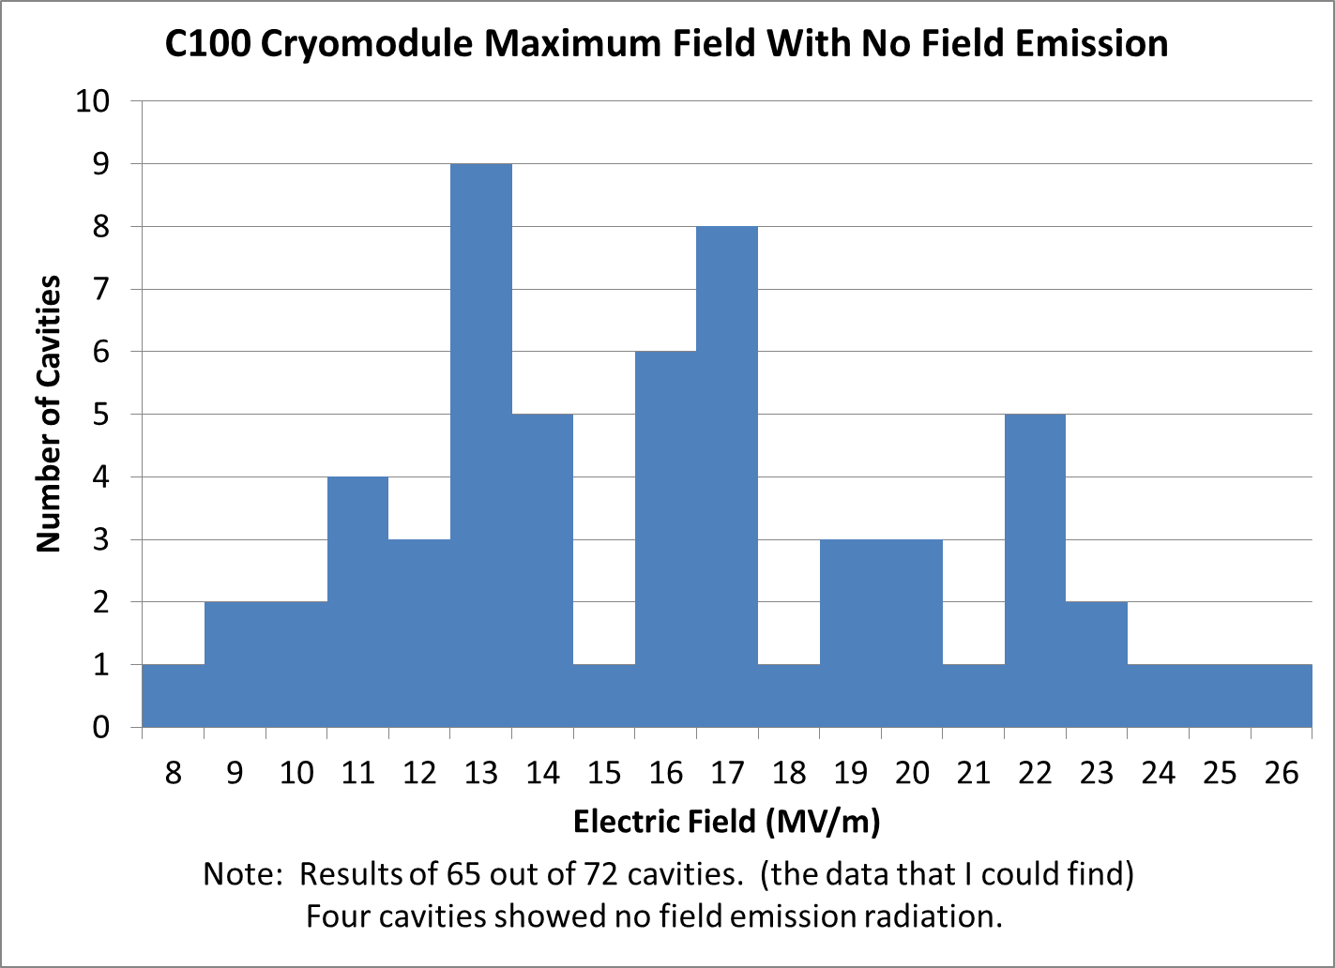
Radiation onset

Slide 9
Microphonics Studies
Microphonics were measured to be relatively high in the cryomodule test cave on the first production cryomodule.
By this time the first three were well into the cryomodule assembly process.
I was measured in the tunnel and while within system specifications it was high.
Cryomodule production was stopped while it was investigated.

Slide 10
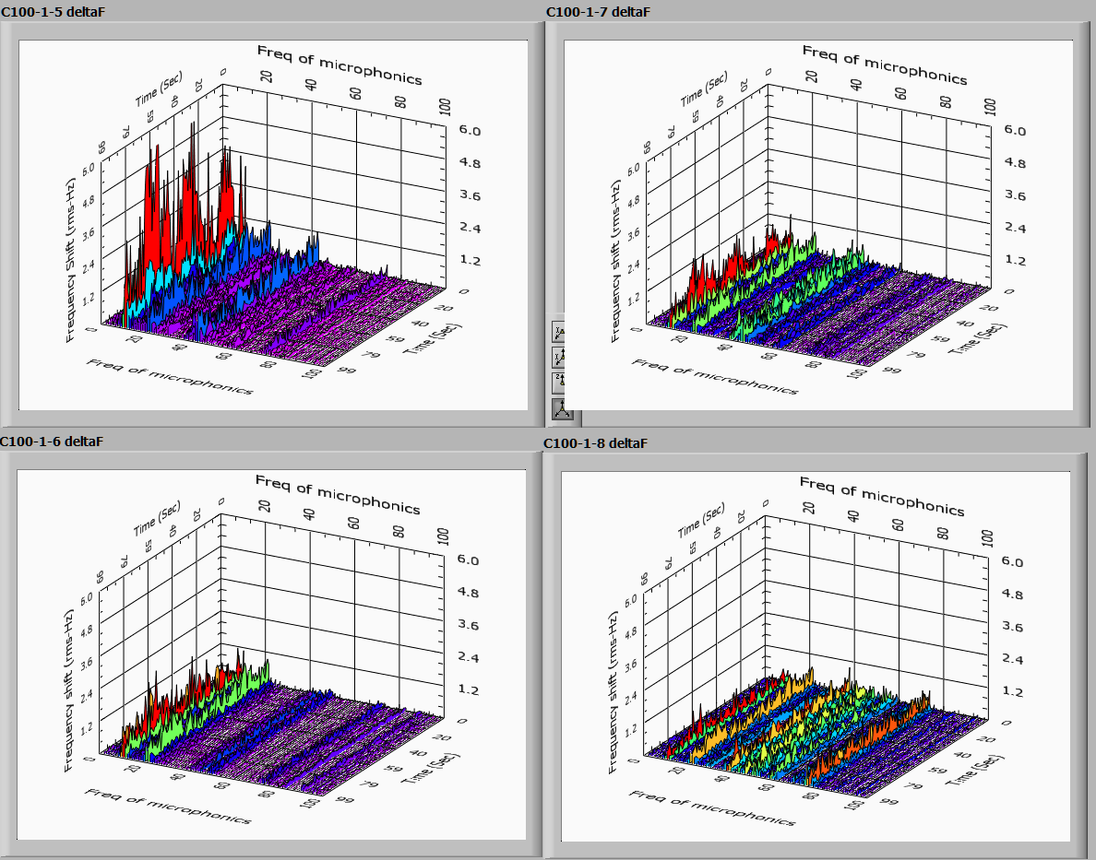
C100-1 Cryomodule Microphonics

Slide 11
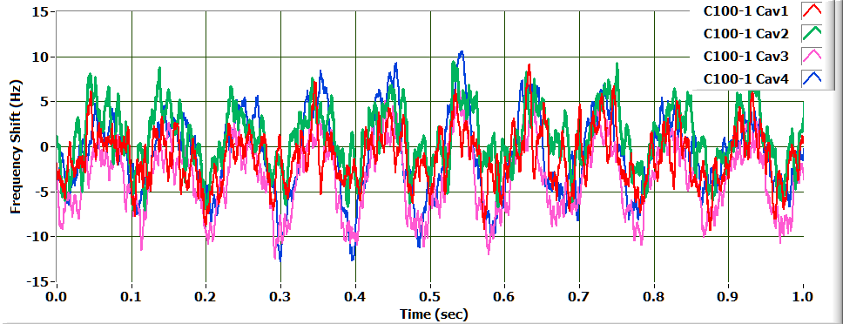
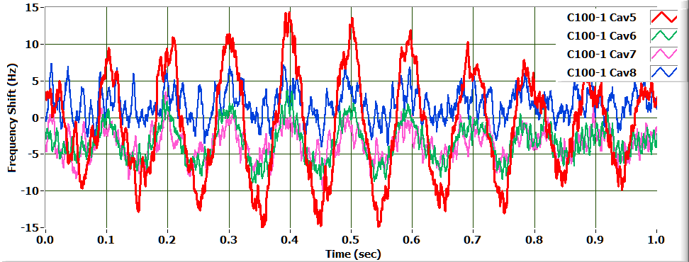
Microphoincs 2
First 4 Cavities (Upper) and Last 4 Cavities (Lower) in Cryomodule C100-1

Slide 12
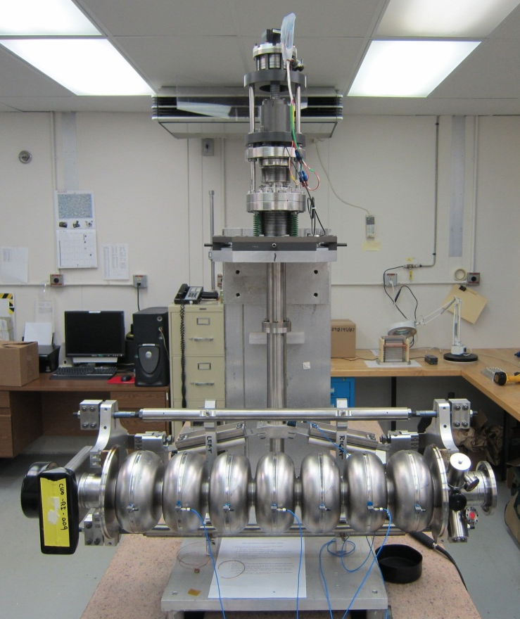
Modal Analysis and Off Line Measurements
Modal Response Testing
A warm cavity was instrumented with 9 triaxial accelerometers
A series of warm impulse hammer response tests were performed on structures ranging from bare cavities to a fully assembled cryomodule.
Results shown are for the response of a bare cavity with the original and stiffened tuners assemblies
Background Microphonics Testing
Data taken using digital low level RF system operated in a fixed frequency mode at 1497 MHz
The RF phase angles between the incident power and the cavity field probe readings were recorded at 1000 S/sec for 100 seconds.
Phase angle and cavity loaded-Q used to calculate the detune frequency
8 channels of data were acquired synchronously.

Slide 13
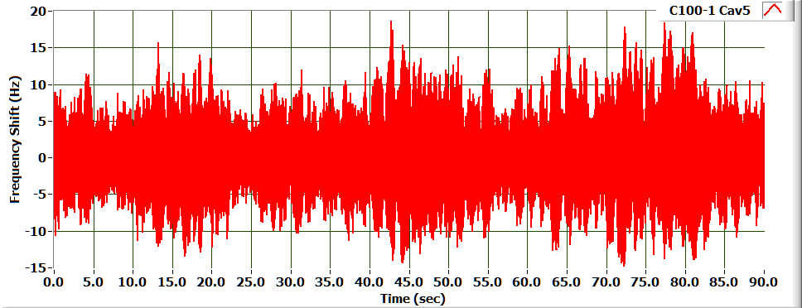
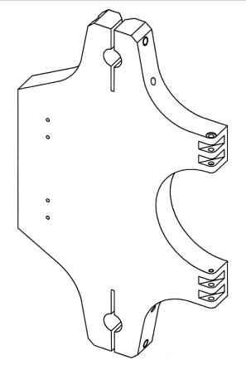
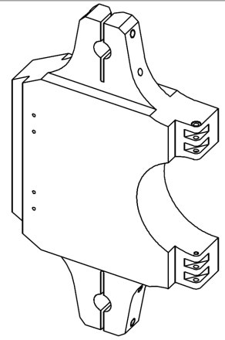
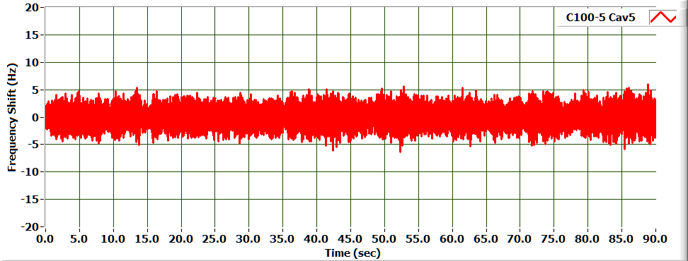
Microphonics
Determines the Feedback Gain needed for control.
Effects are driven by Q_{L} and the available klystron power for lightly loaded cavities
Microphonic Detuning* | C100-1 | C100-4
RMS (Hz) | 2.985 | 1.524
6σ(Hz) | 17.91 | 9.14
Minor change to the tuner pivot plate substantially improved the microphonics for the CEBAF C100 Cryomodules.
While both meet the overall system requirements the improved design has a larger RF power margin
Cavity C100-1-5
Cavity C100-4-5
Notes:
How one determines klystron margin in lightly loaded cavities.
Good shot of the cavities doing their own thing. Not vector sum friendly!
Point out the stiffened tuner in C100-4 and the impact on the better microphponics.
Mechanical modes at 11, 22 and 43 Hz (check with Kirk) are seen on the graphs.

Slide 14
Summary
All ten C100 cryomodules have been tested in the cryomodule test facility.
At least 5 have been tested in the tunnel
Although there are a few that do not the aggregate of the cavities meet the specified gradient and Qo specifications.
Microphonics issues observed in the first three zones were addressed for the remaining cryomodules.
One was operated in the machine with beam.
Operations are scheduled to start this fall.

