Slide 1
Cost Optimization Models for SRF Linacs
TTC Workshop June 2013 Final
Tom Powers

Slide 2
Overall Cost Calculation
How Many
Cryomodules?
Include Inner Cryomdule Girders
And Controls
Determine Qo
At E and F
Calculate Loaded-Q’s
Including
Variance
Calculate Linac Civil Costs
Calculate Heat
Load w/Margin
Number of Plants?
Permutations on RF Power
Calculate Cryo Plant Costs
Calculate Cost
Calculate
Linac Hardware Costs
Calculate Cryo
Infrastructure Costs
Calculate AC Power Overhead
And 10 Year Costs
Determine Linac AC PWR
Calculate AC Efficiency

Slide 3
Cryogenic Plant Considerations
A 2 K liquid helium cold box is limited by transportation infrastructure to about 18 kW at 4 K which equates to 5 kW at 2 K, and 3.8 kW at 1.8 K.*
It is beneficial from a design and maintenance standpoint to build mulitple copies of the same plant.
For these reasons in the model, any time that the plant exceeds a multiple of 5kW @ 2K the plant was split into two identical plants and the efficiency will come from the following curve.
The cost of a cryo plant doubles (at least) if you buy it turn key rather than buying the components, (compressors, coldboxes, oil removal systems, etc.) seperately.*
For this model we used $25M for the cost of a 5 kW@2K plant and $5M for civil and infrastructure costs (based on the CEBAF 12 GeV project).
The costs were escalated and the efficiency reduced by 30% at 1.8K. These factors can be adjusted by the user.
*Dana Arenius, Jefferson Lab, Personal Communication

Slide 4
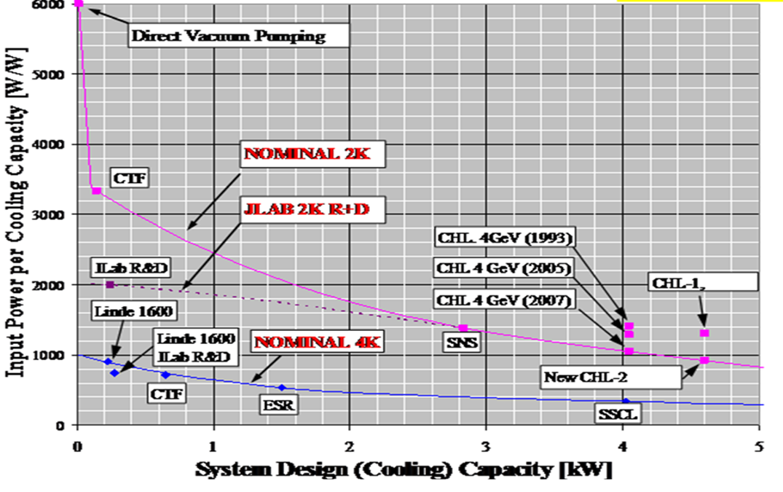
Cryo Plant Efficiency as a Function of Heat Load
Ganni, R., et. al., “Cryogenic Systems Improvements,” JLAB Science and Technology Review, May, 2008.

Slide 5
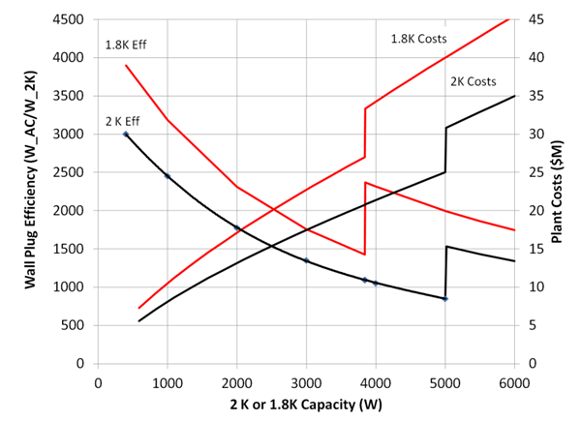
Resultant Cost and Efficiency Curves for the Cryo Plant

Slide 6
Different Approaches for Optimization.
Non causal cryomodules. Smooth curves of frequency dependence by.
Using a fixed active length per cryomodule and thus a fixed number of cryomodules,
Using fractional number of cavities within each cryomodule.
Variable number of cells per cavity and cavities per cryomodule.
Scale shunt impedance as 1/f.
Provides curves that have steps as you change cavity parameters and number of cryomodules
Variable gradient for specific cavity/cryomodule designs
Effectively optimizes on the number of cryomodules to reach the design energy gain.
Provides smooth results with steps for cryo plant configurations.

Slide 7
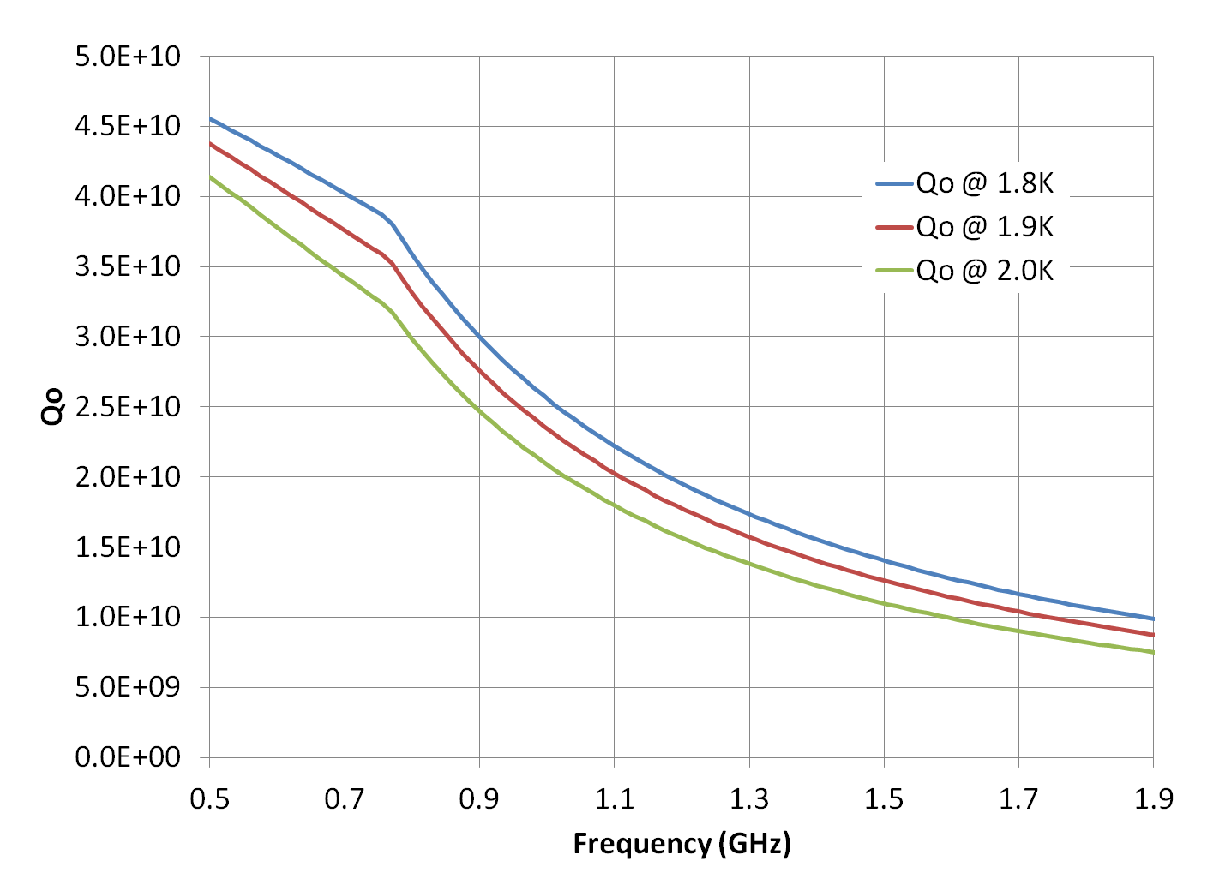
Qo Calculations
Q₀ as a function of frequency and temperature at 16 MV/m. All frequencies scaled from CEBAF C100 upgrade cavity.
Q₀ is calculated for each data point, and is based on a compilation of historic data. This historical data is a compilation from measurements taken in the vertical test area at Jefferson Lab.*
*Ciovati, G., et. al., “Residual Resistance Data from Cavity Production Projects at Jefferson Lab,” IEEE Transactions on Applied Superconductivity, Vol 21, No. 3, June 2011

Slide 8
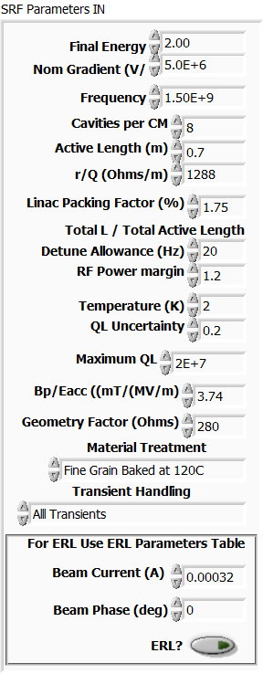
SRF Parameters Variables
Includes
General cavity parameters
Beam current and phase
Detune allowance for microphonics, helium pressure variations, tuning uncertainty, etc.
RF power margin
Maximum allowed loaded-Q
Material type and treatment
Linac energy
Linac Packing factor (Total L / Active L)
ERL? Uses resultant current and tune up beam for RF Power calculations

Slide 9
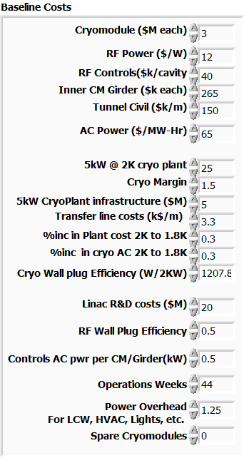
Baseline Costs Variables
Cryomodule fixed cost includes installation and testing.
RF power costs includes transmission, circulators, etc.
Inner cryomodule girder includes magnets, controls, valves, viewers, etc.
Tunnel civil costs includes service buildings, AC power, LCW, etc.
Cryo plant is based on CEBAF upgrade costs assumes you buy the major components double or triple the cost if you buy a turn-key plant.
Linac R&D costs includes prototype cryomodule as well as remainder of electronics.

Slide 10
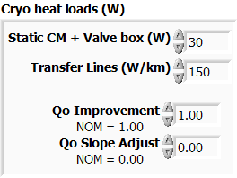
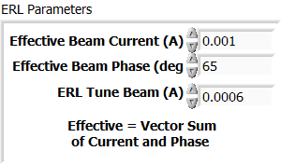
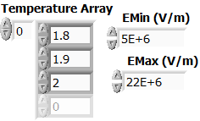

Other Inputs/Controls
Ability to what if Qo improvements by adjusting scale and slope.
ERL parameters to adjust resultant current and tune beam.
Temperature array allows one to change the parameter.
Cryomodule type allows one to select between several types with one being user defined. This is only used on the sweep gradient module.
Beam current slider.
Also have buttons to pause, save results, save and restore set up parameters.

Slide 11
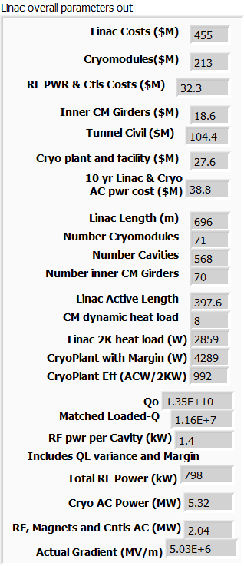
Output Parameters
Costs of different components of the overall costs.
10 year AC power costs
Linac Length
Match Loaded Q
Qo at E and F
RF power per cavity
All output parameters during a sweep can be written to a file or viewed on live graphs.

Slide 12
Summary
Executable files (Windows 32 Bit and Windows 64 bit) will be available by the end of next week at:
https://userweb.jlab.org/~powers/
Demonstration to follow
Comments and suggestions welcome.

Slide 13
Backup Slides

Slide 14
Jlab Cryomodule Cost History
A. McEwen
Data taken from closed projects, C100 is estimated
Engineering costs included
Overhead Rates lowered for C100,SNS,CEBAF projects
XFEL estimate ~$1.7M?
ILC estimate ~$1M?

Slide 15
Q_{L} Optimization for Minimum Power
Depending on the application (injector/LINAC or ERL) the cavity Q_{L} must be optimized for minimum power.
Beam Loaded Cavity
Lightly-non beam loaded Cavity
Cavity Detuning
I = 1 mA
I = 10 μA
Notes:
Beam loading pushes the QL lower …..less susceptible to microphonics.
Lightly loaded cavities, like and ERL, may have QLs closer to 5e7

Slide 16
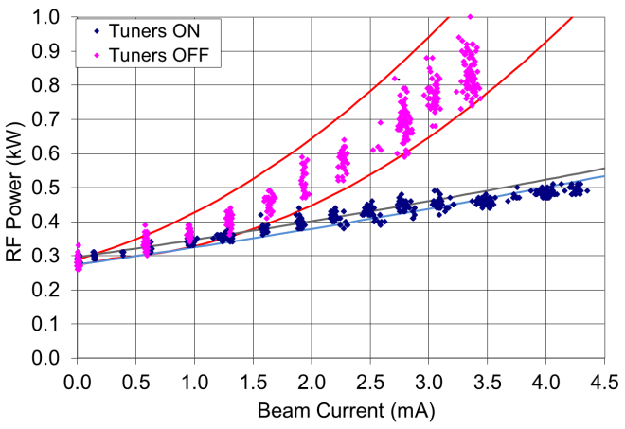
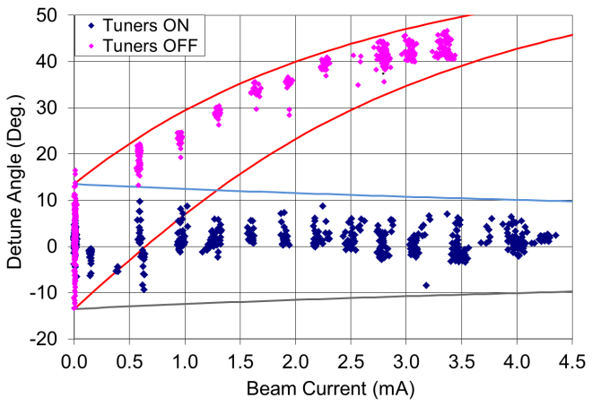
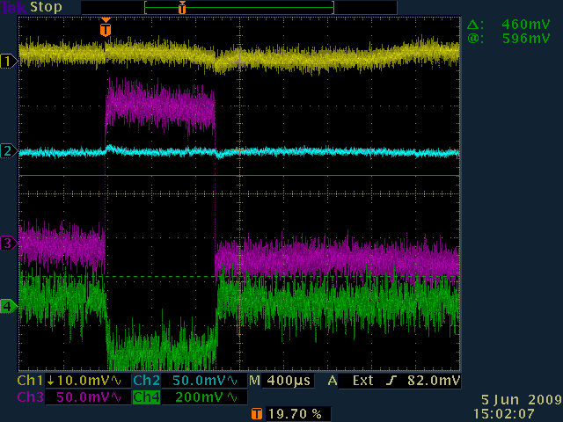
Allow for Transient Beam Loading?
Measured and predicted RF drive amplitude and phase due to CW beam loading in an ERL where the effective current is approximately 7% of the single pass beam at 75º.
Tune Beam Transient, 600 uA, Phase ≅ 0°
1 Measured gradient
2 Measured phase
3 Magnitude drive
4 Phase drive
0
No Transient Loading

