Slide 1

Jefferson Lab
Cryomodule Cost and Optimization
Notes:
Red Title Page

Slide 2
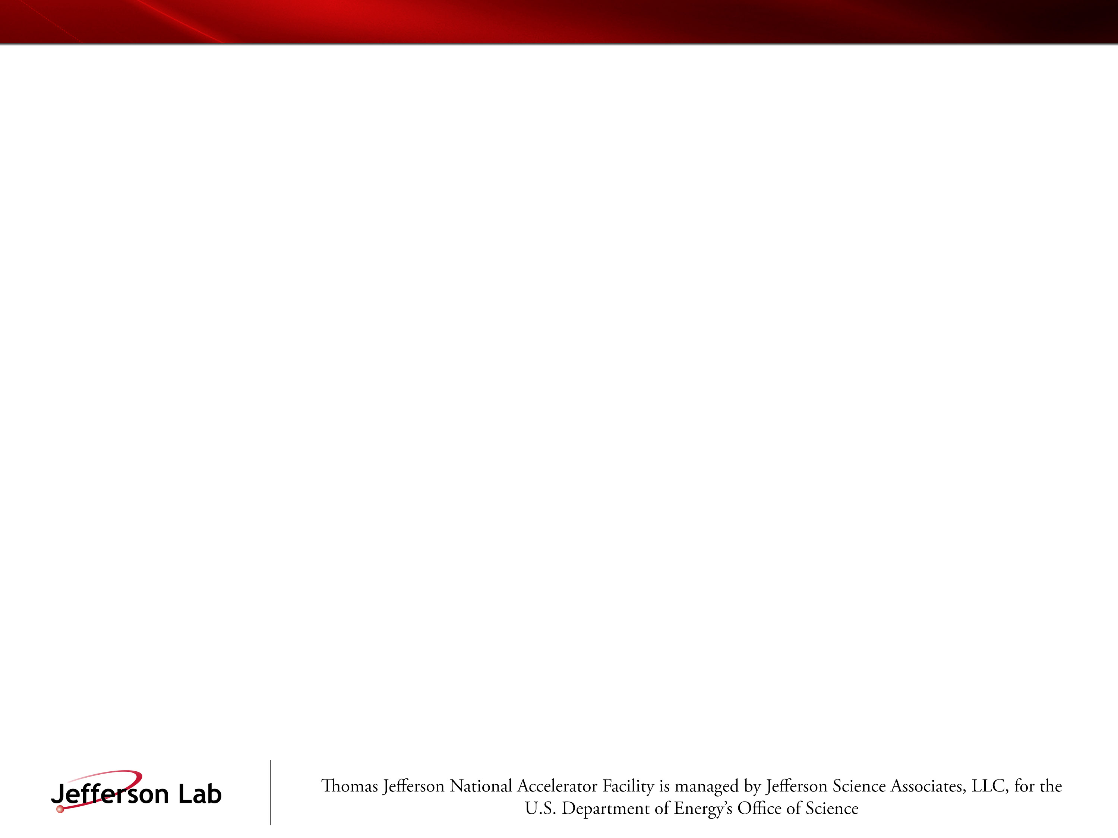
Based Jlab energy upgrade
Cryomodule design and produced to increase the energy gain of CEBAF to 12 GeV in 5 ½ passes
Increases the energy gain of each linac with 5 new cryomodules
Adds ½ pass to the machine
The new cryomodule design is the basis for this presentation on cost and optimization
10 cryomodule (5 each linac), 80 cavities and associated couplers, tuners, …..
Notes:
Red Interior Page Design 1

Slide 3

Production Costs
Procurements 49%, Labor 33%, Expenses 18%
12 GeV UPGRADE PROJECT – CRYOMODULE PRODUCTION *
J. Hogan, A. Burrill, G. K. Davis, M. Drury and M. Wiseman
Thomas Jefferson National Accelerator Facility, Newport News, Va 23606, USA
Labor
QA processes (cavities not included) | 33%
Cavity QA and Qualification | 21%
Cryomodule Assembly | 26%
Acceptance Testing | 8%
Installation and Commissioning | 7%
Tooling Design | 5%
Notes:
Red Interior Page Design 2

Slide 4
Production Costs
CM Production Costs - Through APR 2013
CM Component Breakdown | Quantity | Quan/CM | Percentage
Cavity |  |  | 52.3%
Niobium | 86 | 8 | 19.6% | Niobium
Fabrication | 86 | 8 | 32.7% | Cavity Fabrication
Power Couplers |  |  | 8.9%
Waveguides | 88 | 8 | 2.8% | Waveguides
TopHats (Air-side-FPC & HOMs) | 88 | 8 | 6.2% | TopHats (Air-side-FPC & HOMs)
Cryogenics |  |  | 17.6%
Helium Vessels | 90 | 8 | 3.4% | Helium Vessels
Helium Headers | 10 | 1 | 1.5% | Helium Headers
Thermal Shield | 10 | 1 | 2.4% | Thermal Shield
End Cans | 10 | 1 | 10.2% | End Cans
Structural |  |  | 8.4%
Vacuum Vessels | 10 | 1 | 5.9% | Vacuum Vessels
Space Frame | 10 | 1 | 2.5% | Space Frame
Misc. |  |  | 12.2%
Tuners | 90 | 1 | 4.7% | Tuners
Magnetic Shield | 10 | 1 | 2.6% | Magnetic Shield
Instrumentation | 10 | 1 | 1.6% | Instrumentation
Beampipes | 10 | 1 | 3.1% | Beampipes
Supports (stands & plates) | 10 | 1 | 0.2% | Supports (stands & plates)
Fixed Costs |  |  | 0.6%
Tooling | 10 | 1 | 0.3% | Tooling
Cavity String Assembly | 10 | 1 | 0.3% | Cavity String Assembly
Notes:
Red Interior Page Design 2

Slide 5
Jlab Cryomodule Cost History
A. McEwen
Data taken from closed projects, C100 is estimated
Engineering costs included
Overhead Rates lowered for C100,SNS,CEBAF projects
XFEL estimate ~$1.7M?
ILC estimate ~$1M?

Slide 6
Optimization
For the required voltage, minimize 2K heat load
40% increase in active length for the same overall length
Maximize Quality Factor
Extensive work on magnetic shield design
EP processing
Minimize the RF power required
High Qext,
Small cavity detuning
high resolution tuners
Low microphonics
Low level rf controls
Notes:
Red Interior Page Design 1

Slide 7
Optimization
Opportunities for improvement
Early prototypical cryomodule had power couplers with a single window, a double window was incorporated into the C100 design,
Leaky instrumentation feedthroughs
Small liquid inventory, liters/watt of 2K power, makes the cryomodule more sensitive to changes
Notes:
Red Interior Page Design 1

