Slide 1
Teaching a Model to Describe a Sick Leaf
How we built a Vision-Language Model pipeline for tomato leaf disease
Harish · Aakash · Kamaksha
Qwen2.5-VL-7B · LoRA fine-tuning · 150 manually validated captions
Notes:
One sentence to open: a classifier tells you a disease name. We wanted a model that tells you what it actually sees on the leaf — and this is how we built it.

Slide 2
Three kinds of model
What each one takes in, and what it can give back
CNN
LLM
VLM
Classifier
Language model
Vision-Language model
Image → One label
Text → Text
Image + Question → Sentences
Tomato_Early_blight
“Early blight is caused by
Alternaria solani…”
“Two brown patches, one near
the upper centre…”
No reason. No detail.
You cannot check it.
Fluent — but it has
never seen your leaf.
An answer with the
evidence attached.
A farmer cannot act on a label. A description can be read, checked, and questioned.
Notes:
Ask the room what they would build. They will say classifier. Then show what a label cannot do.

Slide 3
Why training a VLM is hard
Six problems we had to work around
1
Data hunger
2
Cost
3
Alignment
VLMs are pre-trained on millions of image-text pairs. We had thirty images.
A 7B model's full weights do not fit in 24 GB of VRAM.
The model must connect what it sees to what it says — not just describe pixels.
4
Hallucination
5
Domain knowledge
6
No datasets
It will confidently describe symptoms that are not in the picture.
General models have barely seen plant pathology.
Crop images come with labels, almost never with sentences.
Notes:
Keep this fast — one line each. The point is that none of these are solved by trying harder; each needs a design decision, which the rest of the talk shows.

Slide 4
The models we put on the bench
Open-weight VLMs we downloaded, ran, and fine-tuned on our data
Qwen2.5-VL-7B-Instruct
Alibaba
Fine-tuned · strong, stable output
LLaVA-1.6-Mistral-7B
LLaVA
Fine-tuned · adapters trained
BLIP-2 OPT-2.7B
Salesforce
Fine-tuned · lost the output format
BLIP-2 FLAN-T5-XL
Salesforce
Evaluated
Florence-2-base-ft
Microsoft
Attempted · needed source patching
No model is chosen from a leaderboard. We ran every one on our own leaves.
Notes:
Say plainly: benchmark numbers are published on generic datasets. Plant leaves on a plain background are not that, so we tested on our data.

Slide 5
How we compared them
Same images, same prompt, side-by-side outputs
Our
tomato
images
One fixed
prompt
Run every
VLM
Collect
outputs
Read them
side by side
Select the
best model
One-shot benchmarking
Qualitative comparison
Every model sees each leaf once, with no examples and no hints — exactly how it would meet a new photograph.
We read the outputs. Is it describing this leaf, or reciting textbook facts? Does it hold a usable format?
Notes:
Emphasise: at this stage we were not chasing a metric. We were reading text and asking whether it was grounded in the image in front of it.

Slide 6
Why Qwen2.5-VL
It described the leaf in front of it, and kept doing so
1
Visual grounding
2
Agricultural sense
Describes marks that are actually on this leaf, with positions.
Recognises lesions, chlorosis and leaf curling without coaching.
3
Consistency
4
Stability
Same prompt, same shape of answer, image after image.
Holds the output format through fine-tuning — several models did not.
What ruled a model out
BLIP-2 produced text, but after fine-tuning it never kept our field structure — so not one of its 200 test outputs could be read back automatically. Qwen held the format every time.
Notes:
The BLIP-2 story is the useful one: it is not that the model was bad at English, it is that it would not hold a structure we could parse. Format compliance is a real capability difference.

Slide 7
Our workflow
From a folder of leaf photographs to a fine-tuned model
PHASE 1 · PROVING THE PIPELINE
PHASE 2 · REAL SUPERVISION
Tomato dataset
Humans describe every leaf
Prompt engineering
Mentor reviews every caption
Captions built from labels
150 validated image-caption pairs
LoRA fine-tuning
Flashcard learning
Working demo app
LoRA fine-tuning → inference → evaluation
The validated captions are now our only supervision data.
Notes:
This is the heart of the talk. Phase 1 proved the machinery works end to end. Phase 2 replaced the weakest part of it — where the sentences came from — with human work.

Slide 8
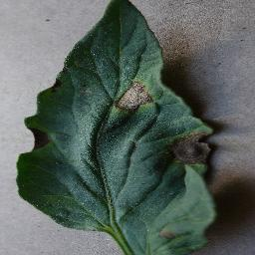
Flashcard learning
One leaf, five correct answers — a real example from our dataset
1
Two prominent brown patches stand out against the dark green background…
2
The leaf surface contains a mix of green tissue and several darker damaged regions…
3
The discoloration is distributed across separate locations rather than one continuous area…
4
Dark green leaf with multiple isolated lesions. Largest mark located on the right side…
5
Several damaged sections interrupt an otherwise dark green leaf surface…
Tomato · Early Blight · image 4
Five different sentences, all true. The model cannot memorise one — so it learns the leaf.
Notes:
Hold on this slide. The five captions are not duplicates — they are five valid descriptions. Because no single sentence minimises the error, the model is pushed toward the visual evidence they share.

Slide 9
Fine-tuning without retraining
We add to the model instead of rewriting it
0.484%
of the model's weights are trained
Qwen2.5-VL · frozen
Everything it already knows — what a leaf is, what “brown” means, how to build a sentence. We change none of it.
173 MB
the entire saved result
LoRA
adapter
LoRA
adapter
LoRA
adapter
~20 min
one full fine-tuning run
19.4 / 24 GB
peak memory on our workstation
small new weights, slotted in
The textbook stays untouched. We only add sticky notes in the right margins.
Peel the adapters off and the original model is exactly as it was — so one base model can serve many crops.
Notes:
Use the textbook analogy out loud. Full fine-tuning is rewriting the book; LoRA is sticky notes. Then give the four numbers — they make it concrete.

Slide 10
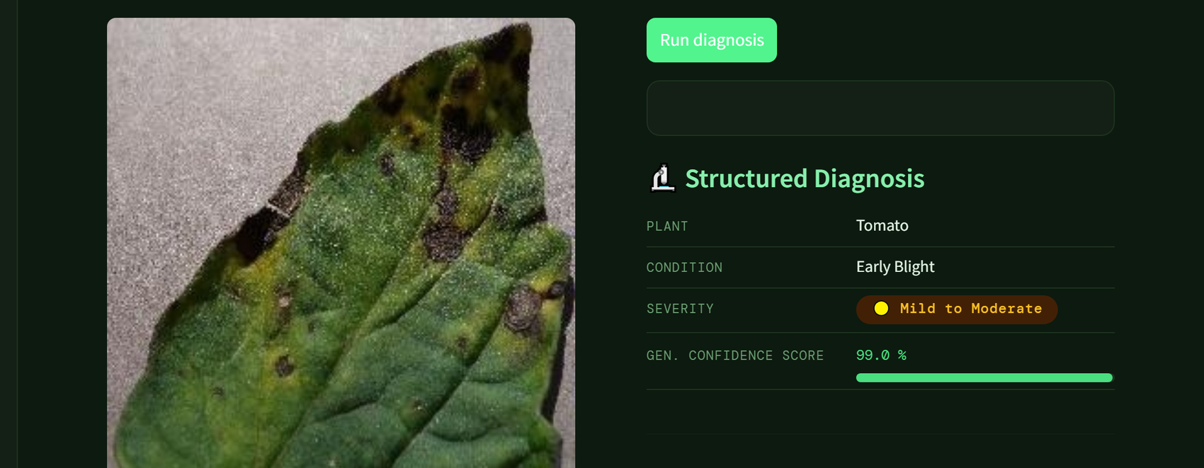
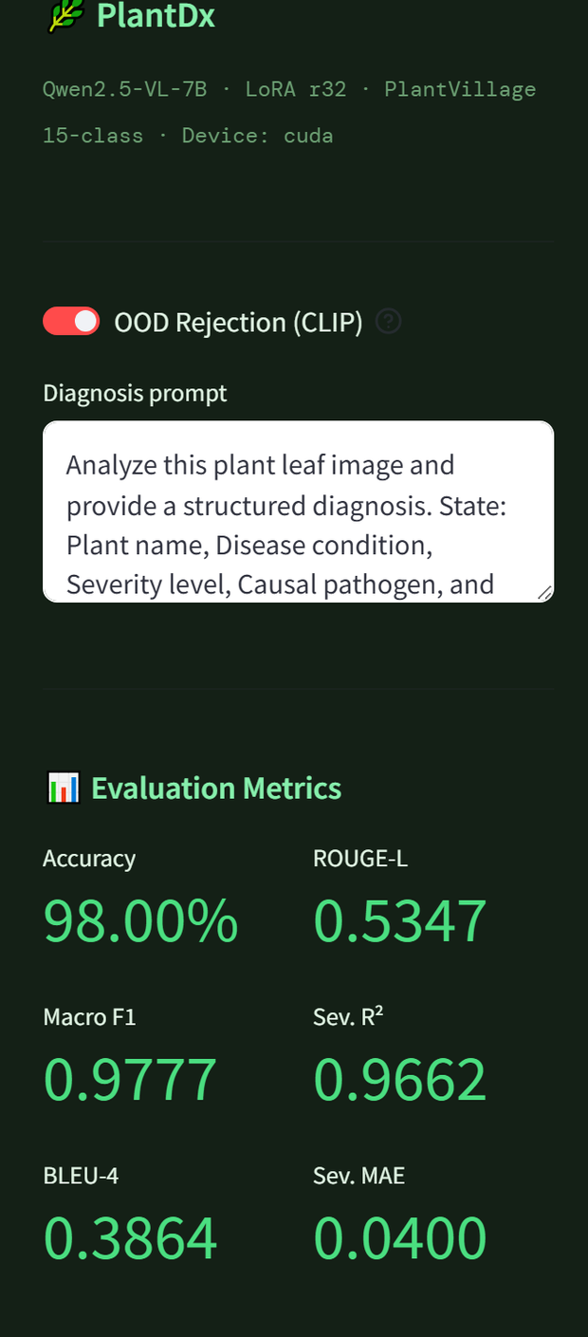
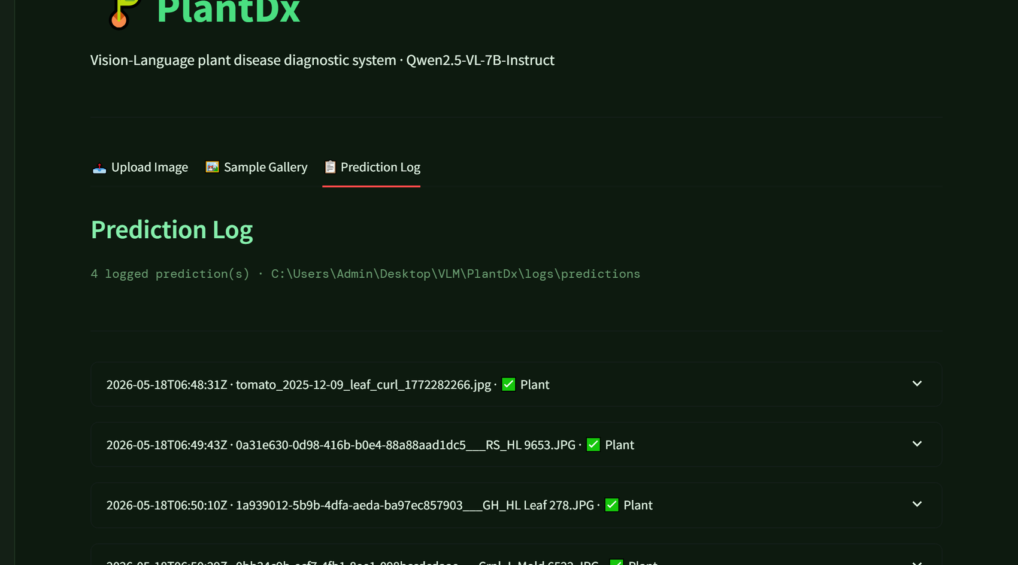
The system, running
Upload a leaf → the model reads it → a structured diagnosis comes back
Every prediction logged
Live app
Upload leaf
Not-a-leaf check
Model reads image
Structured diagnosis
Logged to disk
Notes:
This is a real screenshot from the app running on our workstation — a tomato early blight leaf, correctly identified, with the confidence the model reports. If the GPU is free, run it live instead.

Slide 11
Before and after
The same kind of leaf, described by the same model — untuned, then fine-tuned
BASE Qwen2.5-VL
AFTER FINE-TUNING
“The tomato leaf in the image appears to have some signs of disease or damage. There are dark, irregularly shaped spots… which could indicate various issues such as fungal infections, bacterial diseases, or physical damage from pests or environmental stressors… it would be advisable to consult with a horticulturist or plant pathologist for a”
“Plant: Tomato. Condition: Target Spot. Severity: Moderate. Circular brown spots with concentric lighter zones and chlorotic halos are scattered on this leaf surface.”
— Hedges across three possibilities
— Names what it sees
— Gives advice nobody asked for
— Same shape every time
— Runs past the length limit mid-sentence
— Short enough to read at a glance
Both outputs are real, from our own runs. Same model — the difference is what we taught it to say.
Notes:
Read the base output aloud — the rambling is the point. Then read the tuned one. Nothing about the model changed except the sentences we showed it.

Slide 12
Where we are
What comes next
— 6 tomato classes · 30 images · 150 validated captions
— More validated images
— Pipeline built, verified, and reproducible end to end
— More crops beyond tomato
— Fine-tuning ready to run on our own workstation
— Newer and larger VLMs
— A wider benchmark
— Disease diagnosis, not only description
— Explaining why the model said it
Thank you
Questions welcome — including the ones we have not answered yet.
Harish · Aakash · Kamaksha
Notes:
Close on the honest note: thirty images is a start, not a result. The methodology is what we are presenting.

