Slide 1
A TEACHING SESSION
Vision-Language Models
From pixels to sentences
Teaching a model to look at a diseased tomato leaf and describe what it sees —
including everything that failed along the way.
Harish · Aakash · Kamaksha
Notes:
🎯 LEARNING OBJECTIVE
Set the frame: a class about VLMs, with our project as the worked example.
🗣️ WHAT TO SAY
• Introduce all three of you by name.
• State the promise: by the end you'll know what a VLM is and how one is built.
• Warn them this is interactive — you'll be asking them questions throughout.
• Promise honesty: we show what failed, not just what worked.
🚫 WHAT NOT TO SAY
✗ Don't call this a project presentation — it is a lecture.
✗ Don't apologise for the level; assume zero VLM knowledge and say so positively.
❓ LIKELY STUDENT QUESTIONS
Q: Do we need prior deep-learning knowledge?
A: No — we start from AI and build up.
➡️ TRANSITION
Put a real leaf on screen and ask the room a question.

Slide 2
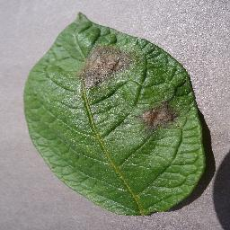
A farmer sends you
this photo.
What kind of AI could understand it?
a real image from our benchmark set · tomato, late blight
Notes:
🎯 LEARNING OBJECTIVE
Create the question the whole lecture answers, and get the room talking immediately.
🗣️ WHAT TO SAY
• Ask it out loud. Wait. Count to five in your head before accepting an answer.
• Take 2-3 answers from different parts of the room. Write nothing down; just repeat them back.
• Expect: 'a CNN', 'image classification', 'ChatGPT'. All are reasonable starting points.
• Say: we'll see exactly where each of those stops working.
🚫 WHAT NOT TO SAY
✗ Do NOT correct any answer yet — that kills participation for the rest of the hour.
✗ Do NOT resolve the question on this slide.
❓ LIKELY STUDENT QUESTIONS
Q: Isn't this just image classification?
A: That's the most common answer — and the next few slides show precisely why a label isn't enough.
➡️ TRANSITION
To answer properly we need vocabulary. Let's build it from the ground up.

Slide 3
SECTION 1 · FOUNDATIONS
Where VLMs come from
AI
Machine
Learning
Deep
Learning
Trans-
formers
LLMs
VLMs
›
›
›
›
›
do smart
things
learn from
data
learn the
features too
attention:
see it all
at once
language,
at scale
an LLM
that can
also see
Each step handed the machine one more job it used to be given by hand.
Notes:
🎯 LEARNING OBJECTIVE
Give a mental map so nothing later feels like it appeared from nowhere.
🗣️ WHAT TO SAY
• Roughly 10 seconds per box. Do not lecture on any single one.
• AI = the goal. ML = learn from data. DL = learn the features too.
• Transformers (2017) = attention, the unlock that made everything after it possible.
• LLM = transformer at scale on text. VLM = that same LLM, given eyes.
• Land the last line: a VLM is not built from scratch — it's an LLM plus a vision encoder.
🚫 WHAT NOT TO SAY
✗ Don't explain attention mathematically. One sentence maximum.
✗ Don't give dates and paper names — this is orientation, not history.
❓ LIKELY STUDENT QUESTIONS
Q: Do we need the maths of attention?
A: Not today — just that it weighs every part of the input against every other part.
Q: Is a VLM a different model from an LLM?
A: It usually *contains* one. We'll open the box shortly.
➡️ TRANSITION
Now the comparison you'll actually use in practice — three kinds of model.

Slide 4
SECTION 1 · FOUNDATIONS
Three kinds of model
CNN
LLM
VLM
Image → one label
Text → text
Image + question → sentences
“Tomato___Early_blight”
“Early blight is caused by
Alternaria solani…”
“Two brown patches with
concentric rings, upper left…”
No reason. You cannot check it.
Fluent — but it never saw your leaf.
An answer with the evidence attached.
A farmer cannot act on a label. A description can be read, questioned, and checked.
Notes:
🎯 LEARNING OBJECTIVE
Make the distinction concrete enough that students can classify any new model themselves.
🗣️ WHAT TO SAY
• Walk left to right. The input→output line is the thing to remember.
• CNN: brilliant at labels, silent about reasons.
• LLM: knows pathology from text, but is blind — it never saw *your* leaf.
• VLM: takes image AND question, answers in sentences.
• Land the bottom line — 'evidence attached' returns at the end of the session.
🚫 WHAT NOT TO SAY
✗ Don't claim VLMs are more accurate than CNNs — we never trained a CNN baseline.
✗ Don't go into architectures here; that's the next slide.
❓ LIKELY STUDENT QUESTIONS
Q: Isn't a CNN more accurate?
A: Often yes for pure classification — our argument is about the *form* of the output, not beating a CNN.
Q: Could I caption with an LLM?
A: No — it has no image input. It would be writing fiction.
➡️ TRANSITION
Before we open the box — a quick check that this landed.

Slide 5
PAUSE · QUICK QUIZ · #1
Which model would you use?
① Sort 50,000 photos into 10 folders. ② Answer “why does this leaf look sick?” ③ Summarise a textbook chapter.
Hands up — CNN, LLM, or VLM?
Notes:
🎯 LEARNING OBJECTIVE
Check that the CNN/LLM/VLM distinction actually landed before building on it.
🗣️ WHAT TO SAY
• Read all three scenarios, then take hands for each one in turn.
• Answers: ① CNN — cheap, fast, a label is all you need. ② VLM — needs image + explanation. ③ LLM — text in, text out, no image.
• For ①, praise anyone who says CNN: 'right — don't use a 7B model where a classifier will do.'
• Spend ~45 seconds total. Keep it brisk and light.
🚫 WHAT NOT TO SAY
✗ Don't let a wrong answer hang — correct it warmly and immediately.
✗ Don't turn this into a discussion; it's a temperature check, not a debate.
❓ LIKELY STUDENT QUESTIONS
Q: Could a VLM do all three?
A: Yes — and that's the trap. It would be slower and more expensive for jobs 1 and 3. Match the tool to the task.
➡️ TRANSITION
Good. Now let's open the box and see how a VLM manages to do job ②.

Slide 6
SECTION 1 · FOUNDATIONS
How a VLM works
Image
Vision
Encoder
Projector
LLM
Text out
“brown patches
with rings…”
→
→
→
the leaf photo
pixels → vectors
vectors → the LLM's
own “word” space
reads image + question,
writes the answer
The trick: the projector makes an image look like a sentence to the language model.
Once a picture behaves like words, the LLM just does what it always did — predict the next word.
Notes:
🎯 LEARNING OBJECTIVE
Demystify the architecture so fine-tuning makes sense later.
🗣️ WHAT TO SAY
• Eye → translator → mouth. Use those words.
• Vision encoder = the eye; produces vectors, not words.
• Projector = a small trained layer, the unsung hero of the whole design.
• LLM = completely unchanged; it just receives extra 'words' that came from an image.
• Say clearly: nothing here is magic — it is next-word prediction with a picture prepended.
• Mention in passing where this is used: medical reports, robotics, driving, education.
🚫 WHAT NOT TO SAY
✗ Don't discuss ViT patch sizes, embedding dimensions, or cross-attention variants.
✗ Don't say the model 'understands' the image — say it maps it into the same space as words.
❓ LIKELY STUDENT QUESTIONS
Q: Is the vision encoder trained from scratch?
A: Usually not — pre-trained, and often frozen.
Q: How does it know *where* something is?
A: The image becomes a grid of vectors, so position survives — that's why it can say 'upper left'.
➡️ TRANSITION
That's the machinery. Now let's use it on a real problem — ours.

Slide 7
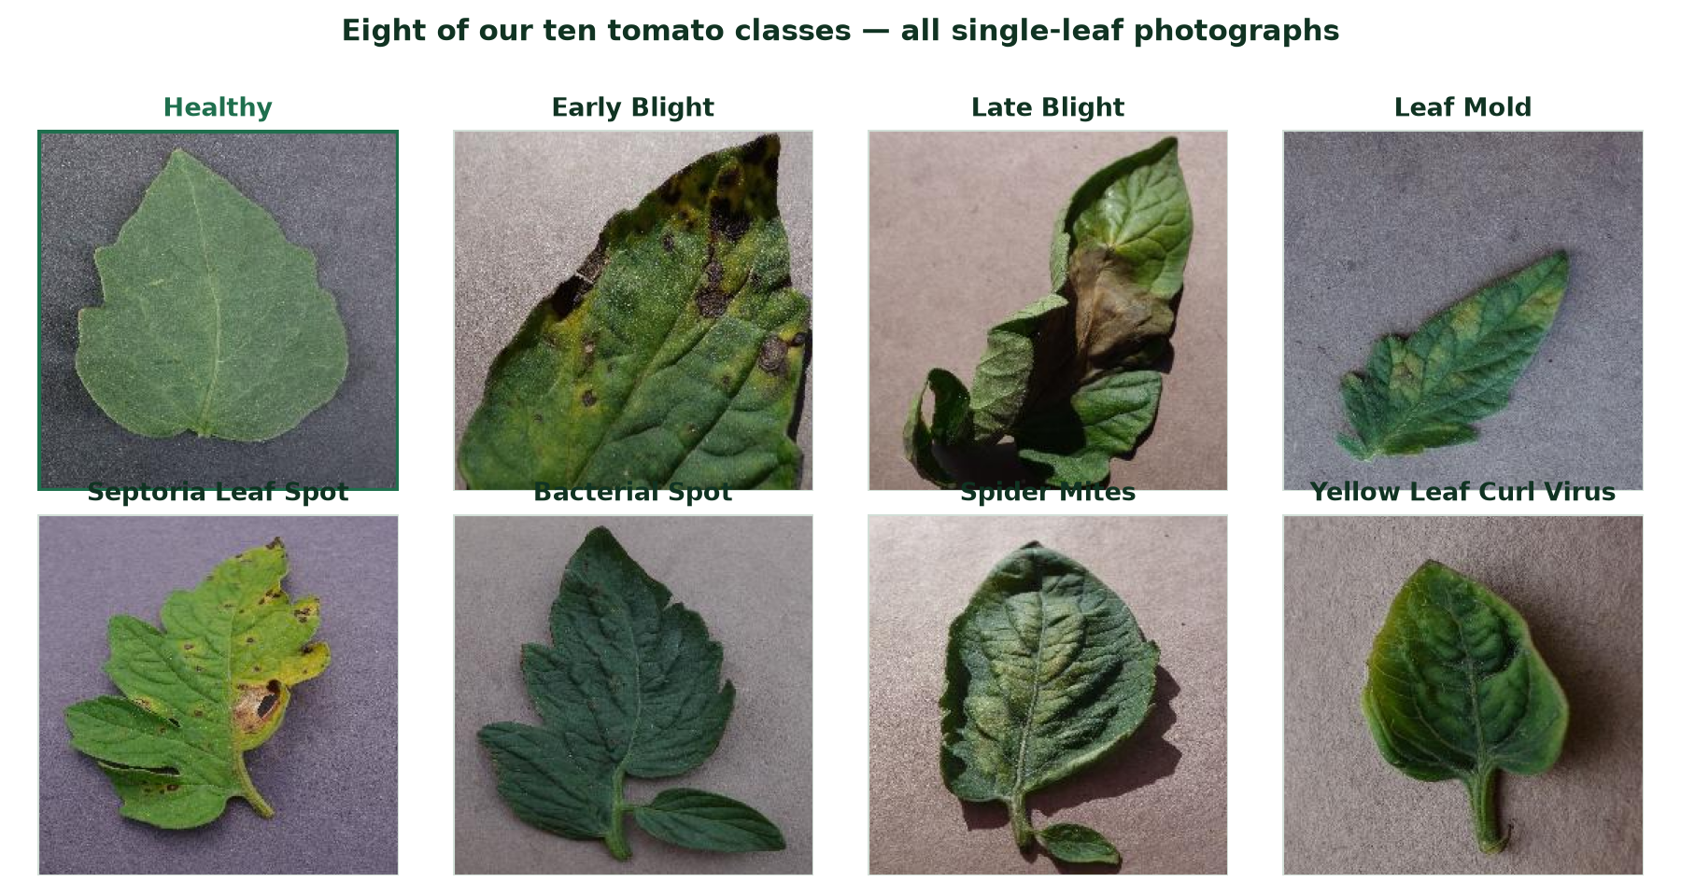
SECTION 2 · OUR DATA
This is our dataset
10 classes · 18,160 images · every one a single tomato leaf on a plain background
Notes:
🎯 LEARNING OBJECTIVE
Ground the whole lecture in the real data, so every later concept has the same referent.
🗣️ WHAT TO SAY
• These are real images from our dataset — not stock photos.
• Ask the room: 'which one looks healthy?' Let them find the green-bordered one.
• Then ask: 'could you tell early blight from late blight?' Most cannot — that's the point. This is genuinely hard, even for people.
• Note what they all have in common: ONE leaf, plain background, no fruit, no whole plant.
• That single-leaf fact decides what a truthful caption may say — it returns later.
🚫 WHAT NOT TO SAY
✗ Don't claim we have fruit images, whitefly, aphids or fruit borer — we do not. Our data is leaves only, 10 tomato classes.
✗ Don't dwell on plant pathology — students are here for the AI, not the biology.
❓ LIKELY STUDENT QUESTIONS
Q: Where did these come from?
A: PlantVillage-style tomato images; the class is the folder name.
Q: Are these real field photos?
A: No — controlled captures on a plain background. Real field images would be much harder, and that's a genuine limitation.
➡️ TRANSITION
Now — are those classes evenly balanced? Look at the numbers.

Slide 8
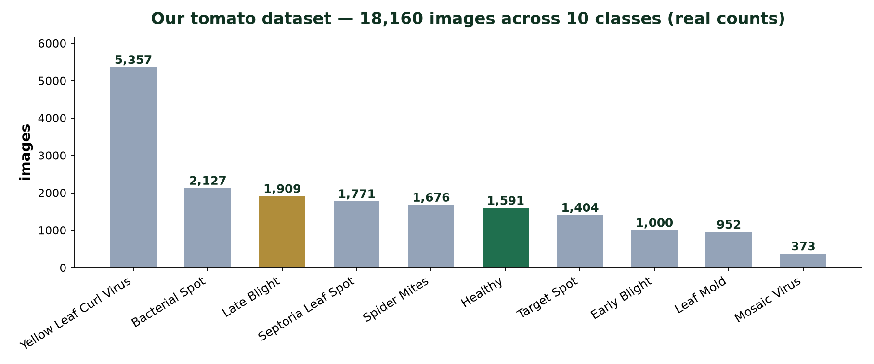
SECTION 2 · OUR DATA
Real data is never balanced
5,357 yellow-leaf-curl images · 373 mosaic-virus images — a 14× imbalance.
A model trained naively on this will be good at the common class and poor at the rare one.
Notes:
🎯 LEARNING OBJECTIVE
Teach class imbalance using our own numbers — a lesson that transfers to any ML project.
🗣️ WHAT TO SAY
• Point at the tallest and shortest bars. 5,357 versus 373.
• Ask: 'if you trained on this, which disease would the model be worst at?' — the rare one.
• This is one of the first things to check in ANY dataset, before any modelling.
• Say what we did about it: we report per-class results, not just overall accuracy, so a good average cannot hide a bad class.
🚫 WHAT NOT TO SAY
✗ Don't go into resampling / class weighting / focal loss — name the problem, not the cures.
✗ Don't pretend we fully solved it. We report per-class scores; that's a mitigation, not a fix.
❓ LIKELY STUDENT QUESTIONS
Q: Why not just collect more of the rare class?
A: Ideally yes — but you photograph what the season gives you. This is the normal situation in agriculture.
Q: Does imbalance explain the benchmark failures?
A: No — the benchmark models were never trained on our data at all. This matters for *fine-tuning*, later.
➡️ TRANSITION
So this is our data. What do we actually want a model to do with it?

Slide 9
SECTION 2 · OUR DATA
Our goal: describe, don't just classify
What a classifier gives you
Tomato___Early_blight
Correct — and useless on its own.
What we wanted
“Circular brown spots with concentric rings and yellow halos, scattered on this leaf.”
Every claim can be checked against the photo.
Our data: single-leaf tomato photos. Benchmark set — 16 images, 6 conditions.
One leaf per photo. So a truthful caption may never mention fruit, stems, or the whole plant.
Notes:
🎯 LEARNING OBJECTIVE
Frame the engineering goal precisely and introduce the single-leaf constraint.
🗣️ WHAT TO SAY
• Read both boxes aloud — the contrast does the work.
• The right-hand text is a real output from our fine-tuned system.
• Single-leaf constraint: it decides what a truthful caption may say. It returns in the caption section.
• Be exact about scale: 16 images, 6 conditions for the benchmark.
🚫 WHAT NOT TO SAY
✗ Do NOT inflate the dataset size. Never round 16 up to 'a few dozen'.
✗ Don't promise the system diagnoses better than an expert — it doesn't.
❓ LIKELY STUDENT QUESTIONS
Q: Why so few images?
A: It was a fast qualitative sweep, not a statistical benchmark — and we'll say exactly that when we show the results.
Q: Where's the data from?
A: PlantVillage-style tomato leaves; labels come from filename codes.
➡️ TRANSITION
Goal set. Now the first real engineering question — which model do we even start from?

Slide 10
SECTION 3 · BENCHMARKING
Which model should we even start from?
1
Leaderboards mislead
They're won on cats and street signs. That says nothing about a diseased leaf.
2
Our constraints are ours
One laptop, 24 GB shared memory, no cloud budget.
3
We need a fixed format
Our code must read the answer automatically.
So we ran our own benchmark — on our own leaves, on our own hardware.
Notes:
🎯 LEARNING OBJECTIVE
Justify benchmarking as an engineering necessity rather than a formality.
🗣️ WHAT TO SAY
• Ask first: 'if I gave you five models, how would you pick one?' Most say leaderboard.
• Then dismantle it: leaderboards measure general images, not your domain, not your hardware.
• Point 3 is the one nobody predicts — output format is a hard engineering requirement.
• This is one of our strongest contributions. Give it room.
🚫 WHAT NOT TO SAY
✗ Don't dismiss benchmarks as useless — say they answer a *different* question than yours.
❓ LIKELY STUDENT QUESTIONS
Q: Why not just take the biggest model?
A: Biggest lost. Llama-3.2-11B was 10x slower and ignored our format — you'll see the data.
➡️ TRANSITION
Before I show you how we compared them — I want you to design the experiment.

Slide 11
PAUSE · THINK · PAIR · #2
You have 4 models and 16 leaf photos.
Turn to the person next to you. In 60 seconds:
what would you keep IDENTICAL, and what would you MEASURE?
Notes:
🎯 LEARNING OBJECTIVE
Have students derive experimental control themselves — it sticks far better than being told.
🗣️ WHAT TO SAY
• Give a genuine 60 seconds. Let the room get noisy; that's the point.
• Then harvest 3-4 answers on the board or verbally.
• Fish for: same prompt, same images, same settings. Measure: correctness, speed, format, memory.
• Praise anyone who says 'the prompt must be identical' — that's the key insight.
• Then reveal the next slide as 'here's what we actually did' — they'll recognise their own answers.
🚫 WHAT NOT TO SAY
✗ Don't answer it yourself if the room is quiet — wait. Silence is uncomfortable but productive.
✗ Don't skip this to save time; it is the pedagogical centre of the benchmarking section.
❓ LIKELY STUDENT QUESTIONS
Q: Should we measure accuracy only?
A: Ask them back: 'what if a model is accurate but takes a minute per image?' Let them arrive at multi-criteria evaluation.
➡️ TRANSITION
Let's see how close that is to what we did.

Slide 12
SECTION 3 · BENCHMARKING
Change one thing at a time — the model
1
Zero-shot
Every model sees each leaf once. No examples, no hints.
2
One identical prompt
Different prompts would mean comparing prompts, not models.
3
Temperature 0
No randomness. Run it again, get the same answer.
16 images · 6 conditions · 4 models here · 64 runs · 0 failures · ~22 minutes
Notes:
🎯 LEARNING OBJECTIVE
Teach experimental control — the transferable skill of this whole section.
🗣️ WHAT TO SAY
• Connect explicitly to what they just said: 'several of you said keep the prompt the same — exactly.'
• Zero-shot = no examples in the prompt. The honest test of what a model already knows.
• Temperature 0 = greedy decoding = reproducible.
• Read the bottom line as the true scale of the sweep.
🚫 WHAT NOT TO SAY
✗ Don't oversell the scale — 16 images is small and we say so later. Don't pre-empt that here.
✗ Don't explain sampling/top-p; 'no randomness' is enough.
❓ LIKELY STUDENT QUESTIONS
Q: Zero-shot vs one-shot?
A: Zero = no examples. One = a single worked example in the prompt. We gave none.
Q: Why does temperature matter?
A: With sampling, two runs disagree and you can't attribute the difference to the model.
➡️ TRANSITION
Here's the actual prompt — there are no tricks in it.

Slide 13
SECTION 3 · BENCHMARKING
The same prompt, for every model
You are an agricultural expert.
Analyze this crop image carefully. Return:
Plant species · Visible symptoms · Leaf color
Leaf texture · Spots or lesions · Severity
Most likely disease · Alternative diagnoses
Confidence (0-100) · Reasoning
Only describe what is visible.
If uncertain, explicitly state uncertainty.
Do not hallucinate diseases.
Remember these
three lines.
We explicitly told every model not to invent anything, and to admit doubt.
Notes:
🎯 LEARNING OBJECTIVE
Show the real instrument, and plant the trap for the hallucination reveal.
🗣️ WHAT TO SAY
• Read the three gold lines aloud, slowly.
• Stress: we TOLD every model not to hallucinate and to state uncertainty.
• Say 'remember that' — you will call back to it in two slides.
• Fixed fields = machine-readable answers, which becomes a selection criterion later.
🚫 WHAT NOT TO SAY
✗ Don't read out all ten fields — it's boring and the detail doesn't matter.
✗ Don't claim this is an optimal prompt; it's a *fair* one.
❓ LIKELY STUDENT QUESTIONS
Q: Could a better prompt fix the failures?
A: Possibly some — prompt sensitivity is real. But the same prompt was fair to all, and the failures we saw were factual, not formatting.
➡️ TRANSITION
Eight models went through this. Here's the bench.

Slide 14
SECTION 3 · BENCHMARKING
Eight open models, two setups
SETUP A · Apple Silicon, 4-bit
SETUP B · CUDA workstation
Qwen2.5-VL-7B
Alibaba
Qwen2.5-VL-7B
also here
LLaVA-1.6-Mistral-7B
LLaVA
Gemma-3-12B
Google
BLIP-2 OPT-2.7B
Salesforce
InternVL3-8B
OpenGVLab
BLIP-2 FLAN-T5-XL
Salesforce
Llama-3.2-11B-Vision
Meta
Florence-2-base
Microsoft
Not one was chosen from a leaderboard. Every one was run on our own leaves.
Notes:
🎯 LEARNING OBJECTIVE
State the bench precisely and honestly, including the two-machine split.
🗣️ WHAT TO SAY
• Eight distinct models; Qwen appears on both setups.
• Setup A is the sweep whose numbers you'll see — that data is fully recorded.
• Setup B was our other pipeline; BLIP-2 later lost the output format, Florence-2 needed patching.
• Every chart in this deck comes from Setup A. Be precise if asked.
🚫 WHAT NOT TO SAY
✗ Don't blur the two setups together — if challenged, you must be able to separate them.
✗ Don't claim a scored eight-model ranking; we never ran the automated judge.
❓ LIKELY STUDENT QUESTIONS
Q: Why 4-bit?
A: Quantisation shrinks the model so 7-12B fits in 24 GB of shared memory.
Q: Which numbers come from where?
A: Every chart here is Setup A, the Apple Silicon sweep.
➡️ TRANSITION
Let's look at what came back — one leaf, two models.

Slide 15
SECTION 3 · BENCHMARKING
One leaf. Four models. Four answers.
Qwen2.5-VL
InternVL3
Gemma-3
Llama-3.2-V
species
Uncertain
its diagnosis
leaf spot
confidence
70%
✗ not late blight
species
“possibly a legume”
its diagnosis
leaf spot disease
confidence
70%
✗ not late blight
species
Soybean (likely)
its diagnosis
Cercospora leaf blight
confidence
75%
✗ not late blight
species
Unknown
its diagnosis
“some fungal disease”
confidence
60%
✗ not late blight
TRUTH
Tomato
Late Blight
5.4 s
8.4 s
16.8 s
52.4 s
Four models. Four different answers. All four wrong — and every one of them confident.
Notes:
🎯 LEARNING OBJECTIVE
Make hallucination visceral using one image and four real, recorded answers.
🗣️ WHAT TO SAY
• Slow right down. This is the emotional centre of the lecture.
• Same leaf you saw on slide 2 — we are following ONE image through the whole talk.
• Read the four species answers across: Uncertain · a legume · SOYBEAN · Unknown.
• Gemma-3 looked at a tomato leaf, said Soybean, then named a soybean disease to match — at 75%.
• Call back to the prompt: 'we explicitly told them not to hallucinate and to admit doubt.'
• Then the killer line: not one of them said late blight. Four models, four answers, all wrong.
🚫 WHAT NOT TO SAY
✗ Don't mock the models — this is a systemic property, not a funny bug.
✗ Don't imply Qwen 'won' here. It also failed to identify the disease.
✗ Don't skip the confidence row — confident-and-wrong is the whole danger.
❓ LIKELY STUDENT QUESTIONS
Q: Why soybean?
A: Probably a prior from training data — soybean leaves are common in agricultural datasets. It pattern-matched shape, not species.
Q: Would a bigger model fix it?
A: Gemma-3-12B was the biggest here, and it hallucinated most.
Q: Is 'leaf spot' not close enough?
A: No — it's a generic family, not a diagnosis. A farmer cannot act on it.
➡️ TRANSITION
That's one leaf. Before I show you all sixteen — I want you to make a prediction.

Slide 16
PAUSE · PREDICTION · #3
Across all 16 leaves,
how many will the BEST model get right?
Hands up: 16 / 16 · 12–15 · 8–11 · 4–7 · fewer than 4
Notes:
🎯 LEARNING OBJECTIVE
Create a prediction gap — students remember a result far better when they committed to a guess first.
🗣️ WHAT TO SAY
• Read the five bands and take a show of hands for each. Count them out loud.
• Most rooms cluster around 8-15. Note that publicly: 'so most of us expect at least half.'
• Do NOT hint at the answer with your tone.
• Then move to the next slide and let the chart do the work.
🚫 WHAT NOT TO SAY
✗ Don't reveal the answer here, even if someone shouts it out.
✗ Don't say 'you'll be surprised' — that leaks the result.
❓ LIKELY STUDENT QUESTIONS
Q: Does 'best' mean best overall or per image?
A: Best-performing single model across the 16.
➡️ TRANSITION
Let's see. Here is what actually happened.

Slide 17
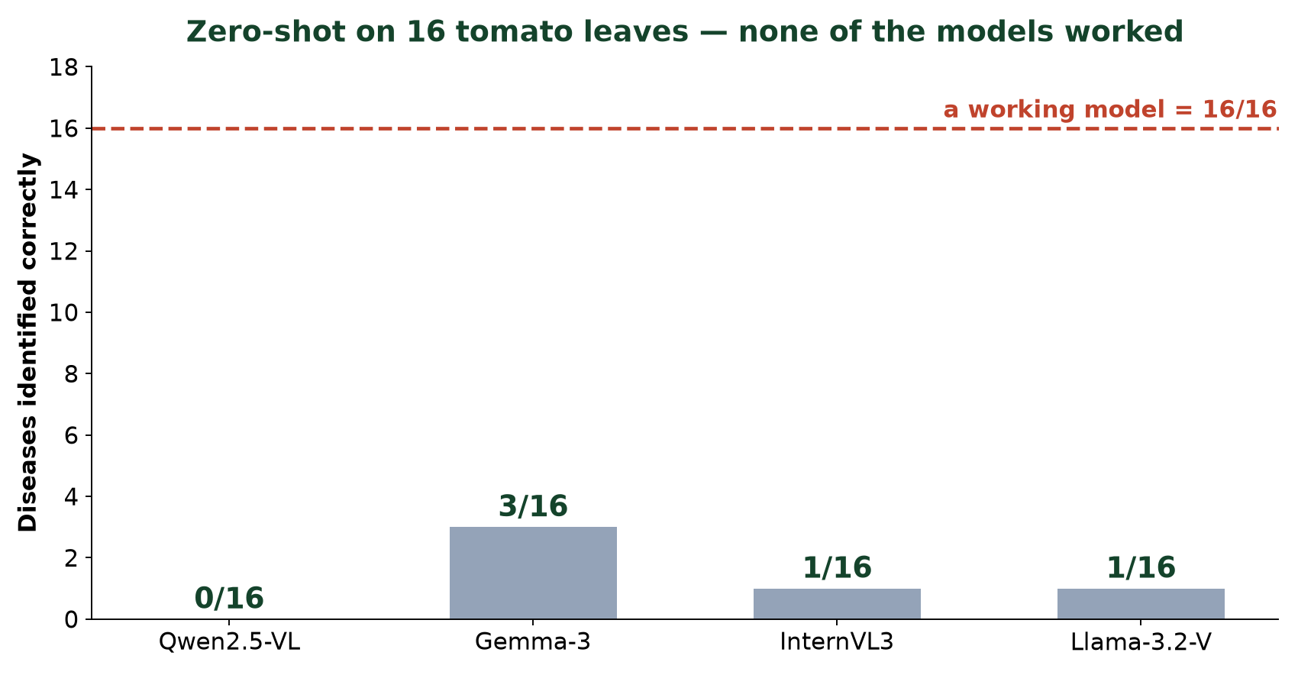
SECTION 3 · BENCHMARKING
The result we did not want
None of them
were reliable.
Best: 3 of 16.
Qwen: none.
Zero-shot VLMs cannot diagnose crop disease out of the box.
This is why the rest of the project exists — and why fine-tuning was not optional.
Notes:
🎯 LEARNING OBJECTIVE
Deliver the central empirical finding without spin, and model honest reporting.
🗣️ WHAT TO SAY
• Let the chart sit in silence for three seconds before you speak.
• Then say it flatly: none of the models were reliable. The best got 3 of 16.
• Compare to their predictions: 'most of you said 8 or more. So did we.'
• Frame it as valuable: a negative result that redirected the entire project.
🚫 WHAT NOT TO SAY
✗ Do NOT rescue this. Never say 'but Qwen showed promise'. The honesty IS the content.
✗ Don't blame the models or the prompt — state the finding and move on.
❓ LIKELY STUDENT QUESTIONS
Q: Then why use VLMs at all?
A: Because the failure is fixable by fine-tuning — and we'll show it was.
Q: Isn't 16 too few to conclude that?
A: For a precise ranking, yes, and we say so. But 0-3 out of 16 across four models is a clear signal.
➡️ TRANSITION
So if none of them can diagnose — on what basis do you choose one at all?

Slide 18
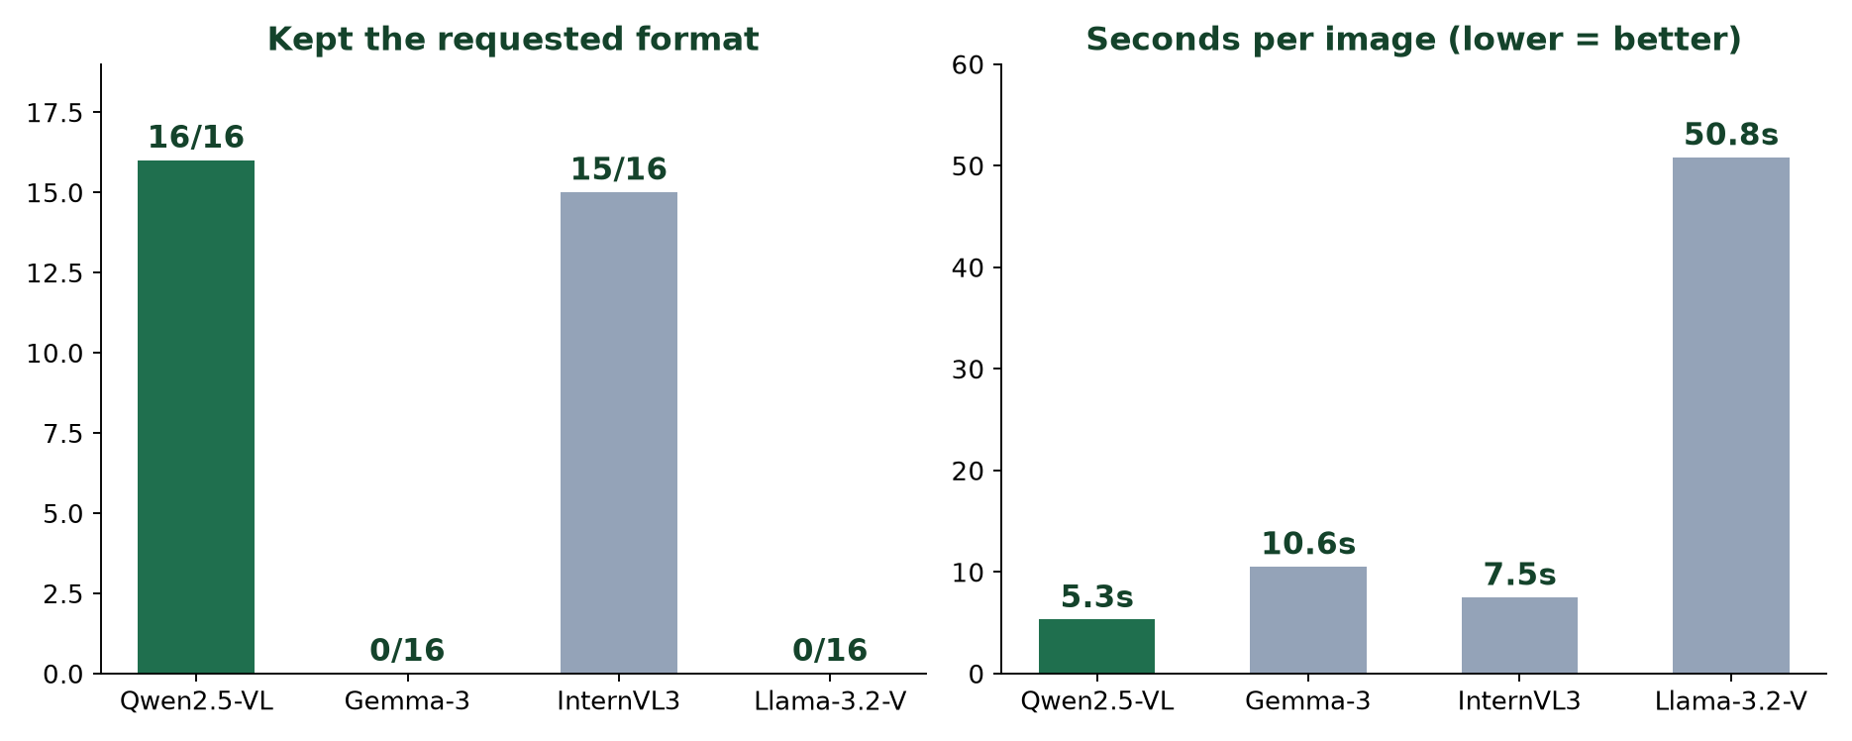
SECTION 3 · BENCHMARKING
So we chose the best student, not the best doctor
Held the format
16/16 · others 0/16
Fastest
5.3 s · Llama 50.8 s
Honest when unsure
said “Uncertain”
Not the most accurate — it was the least. But consistent, fast and honest. That is what you want in a model you are about to teach.
Notes:
🎯 LEARNING OBJECTIVE
Teach a genuine engineering trade-off and pre-empt the obvious objection.
🗣️ WHAT TO SAY
• Say the objection before they do: 'you're thinking Gemma got 3 and Qwen got 0 — correct.'
• Answer: 3/16 isn't usable either. Neither is a diagnostician.
• So select for trainability: format stability, speed, calibrated doubt.
• Supporting evidence from our other setup: BLIP-2 lost the format after fine-tuning; Qwen held it.
🚫 WHAT NOT TO SAY
✗ Don't claim Qwen 'understood agriculture better' — our own data contradicts that.
✗ Don't present this as a scored decision; it was a qualitative judgement plus these measurements.
❓ LIKELY STUDENT QUESTIONS
Q: Isn't choosing the least accurate model strange?
A: It would be if we shipped it as-is. We were choosing a starting point to teach.
Q: Was it formally scored?
A: No — we designed an automated judge but never ran it. We're clear about that.
➡️ TRANSITION
We have our student. Now — how do you teach it? First, a question for you.

Slide 19
PAUSE · DISCUSSION · #4
We need thousands of example captions.
Where should they come from?
Ask a VLM to write them? · Write them by hand? · Generate from the labels?
What could go wrong with each?
Notes:
🎯 LEARNING OBJECTIVE
Let students discover the circularity trap themselves rather than being told.
🗣️ WHAT TO SAY
• Take answers for each option. Most rooms suggest 'ask a model' first — it's the obvious one.
• When they do, ask the killer question: 'which model? The one that just got 3 out of 16?'
• Let the silence land. That's the lesson.
• Then draw out hand-written: accurate but slow. Label-derived: fast but generic.
• Tell them there is no clean answer — and that our honest answer is on the next slides.
🚫 WHAT NOT TO SAY
✗ Don't give the answer before they've tried. This slide fails if you rush it.
✗ Don't dismiss 'ask a VLM' as stupid — it's what most of the field does. It's just circular.
❓ LIKELY STUDENT QUESTIONS
Q: Couldn't we use a much bigger model like GPT-4o?
A: Better, but same problem — you'd inherit its errors, and you can't verify them at scale in a specialist domain.
➡️ TRANSITION
Here's what we actually did — and where each approach falls down.

Slide 20
SECTION 4 · TEACHING THE MODEL
Fine-tuning = specialising a generalist
The base model knows
a little about everything
cats · receipts · landmarks · memes
We need it to know
a lot about one thing
early blight vs target spot — said the same way every time
General
VLM
→
+ examples from
our domain
→
Fine-tuned
specialist
Notes:
🎯 LEARNING OBJECTIVE
Motivate fine-tuning as specialisation, using the benchmark failure as the reason.
🗣️ WHAT TO SAY
• Analogy: a bright graduate who has read everything and practised nothing.
• Fine-tuning is the residency — many examples from one domain.
• Tie directly back: this is the fix for the 0-3/16 result.
• Second goal, easy to miss: consistency of format, not only correctness.
🚫 WHAT NOT TO SAY
✗ Don't say fine-tuning 'adds facts' — it teaches a behaviour: what to look at and how to say it.
✗ Don't get drawn into RAG vs fine-tuning; park it for Q&A.
❓ LIKELY STUDENT QUESTIONS
Q: Why not put the knowledge in the prompt?
A: You can, and it helps a bit — but it costs tokens every call and doesn't fix format drift.
Q: How much data does it need?
A: Hundreds to thousands, not millions.
➡️ TRANSITION
To teach by example you need examples. What does one example actually look like?

Slide 21
SECTION 4 · TEACHING THE MODEL
One training example = one flashcard
FRONT
BACK
→
the caption
“Circular brown spots with concentric rings, scattered across the leaf.”
+ “Describe this leaf.”
It guesses one word at a time while we hold the answer key.
Each time it wasn't sure enough about the correct next word, it nudges itself. Thousands of nudges = learning.
Notes:
🎯 LEARNING OBJECTIVE
Explain supervised learning intuitively — no loss equations.
🗣️ WHAT TO SAY
• Flashcards is the entire metaphor. Front = image + question. Back = the caption.
• Be precise about the mechanism: it does NOT compare whole sentences.
• Word by word, it checks 'how much probability did I give the correct next word?'
• That gap is the error; the nudge is the update. Say 'one word at a time' twice.
🚫 WHAT NOT TO SAY
✗ Don't write cross-entropy on the board. Don't say 'loss function' unless asked.
✗ Don't say the model 'remembers' the caption — it adjusts weights.
❓ LIKELY STUDENT QUESTIONS
Q: Does it compare its sentence to ours?
A: No — per word, how much probability it gave the correct next word.
Q: What if two captions are both right?
A: Excellent — that's exactly the next problem we hit.
➡️ TRANSITION
So where do those answer keys come from? The question you just discussed.

Slide 22
SECTION 4 · TEACHING THE MODEL
Where our captions came from — honestly
We refused the shortcut: a model that gets 3/16 cannot be trusted to teach.
Built from labels
Written from a cited reference of what each disease looks like.
+ scales, traceable, consistent
– describes the DISEASE, not THIS leaf
Written by hand
We looked at each leaf and wrote what we saw. Mentor-reviewed.
+ truly grounded in this image
– only 30 images · one annotator
Neither is perfect. The honest next step is a hybrid.
Notes:
🎯 LEARNING OBJECTIVE
Model intellectual honesty — the single most important slide for credibility.
🗣️ WHAT TO SAY
• Red bar first: the shortcut we refused, justified by our own benchmark.
• Then both approaches — and READ THE MINUS LINES OUT LOUD.
• Approach 1's flaw is real: captions grounded in the LABEL, not the pixels.
• Approach 2's flaw is real: 30 images is small; one annotator means no agreement statistic.
• Close on the hybrid as honest future work — not as something we've already built.
🚫 WHAT NOT TO SAY
✗ Do NOT skip or soften the minus lines. They are the point of the slide.
✗ Don't claim the hybrid is implemented — it isn't.
❓ LIKELY STUDENT QUESTIONS
Q: Isn't caption-from-label just classification in disguise?
A: Largely fair — it's why our hardest class performs badly, and why the hybrid is next.
Q: Which did you finally use?
A: Both, in two pipelines. One gave scale, the other grounding.
➡️ TRANSITION
One more caption idea worth seeing — why we wrote five per leaf.

Slide 23
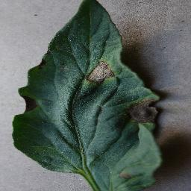
SECTION 4 · TEACHING THE MODEL
Five right answers for one leaf
1
Two prominent brown patches stand out against the dark green background…
2
A mix of green tissue and several darker damaged regions…
3
The discoloration is distributed across separate locations…
4
Multiple isolated lesions. Largest mark on the right side…
5
Several damaged sections interrupt an otherwise dark green surface…
Tomato · Early Blight
All five are true. The model cannot memorise one — so it has to learn the leaf.
Notes:
🎯 LEARNING OBJECTIVE
Explain multi-reference supervision and why it prevents parroting.
🗣️ WHAT TO SAY
• These are our real captions, unedited.
• Ask the room: 'which one is correct?' Wait. Answer: all five.
• If we gave only one, the model would learn that exact sentence — parroting, not seeing.
• Five phrasings force it to learn the underlying visual facts.
🚫 WHAT NOT TO SAY
✗ Don't imply five is a magic number — it was a practical choice.
❓ LIKELY STUDENT QUESTIONS
Q: Why five?
A: A practical balance between annotation effort and variety.
Q: Do all five get used?
A: Yes — each becomes its own training example for the same image.
➡️ TRANSITION
Now the trick that makes training this possible on a laptop.

Slide 24
SECTION 4 · TEACHING THE MODEL
LoRA — add, don't rewrite
Qwen2.5-VL · frozen
Everything it already knows stays exactly as it is.
LoRA
adapter
LoRA
adapter
LoRA
adapter
0.484%
of weights trained
173 MB
the whole result
~20 min
one run
19.4 / 24 GB
peak memory
The textbook stays untouched. We only add sticky notes in the margins.
Notes:
🎯 LEARNING OBJECTIVE
Explain parameter-efficient fine-tuning without matrix maths.
🗣️ WHAT TO SAY
• Problem: a 7B model's full weights won't fit in 24 GB for training.
• LoRA: freeze everything, insert small trainable matrices, train only those.
• The four stat boxes are real numbers from our run.
• Sticky-notes metaphor is the takeaway — say it twice.
• Consequence worth naming: one base model + many small adapters = many crops.
🚫 WHAT NOT TO SAY
✗ Don't show the low-rank decomposition or write W + BA.
✗ Don't claim LoRA is as good as full fine-tuning in general — say 'close enough, and it's the difference between possible and impossible on our hardware.'
❓ LIKELY STUDENT QUESTIONS
Q: Does LoRA hurt quality?
A: Slightly in theory; very close in practice for tasks like this.
Q: What's QLoRA?
A: LoRA on top of a 4-bit quantised base — that's what we ran.
➡️ TRANSITION
Put it all together and you get a working system. Let's look at it.

Slide 25
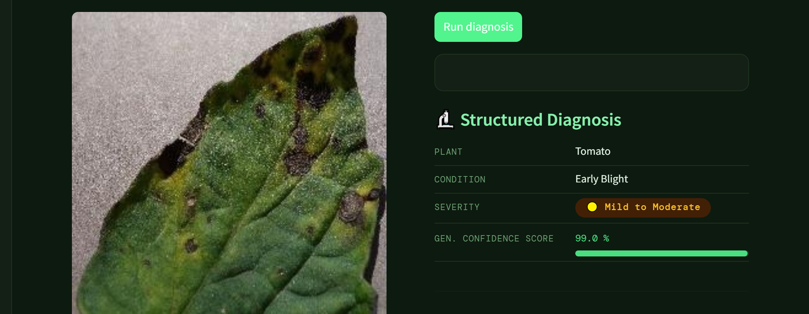
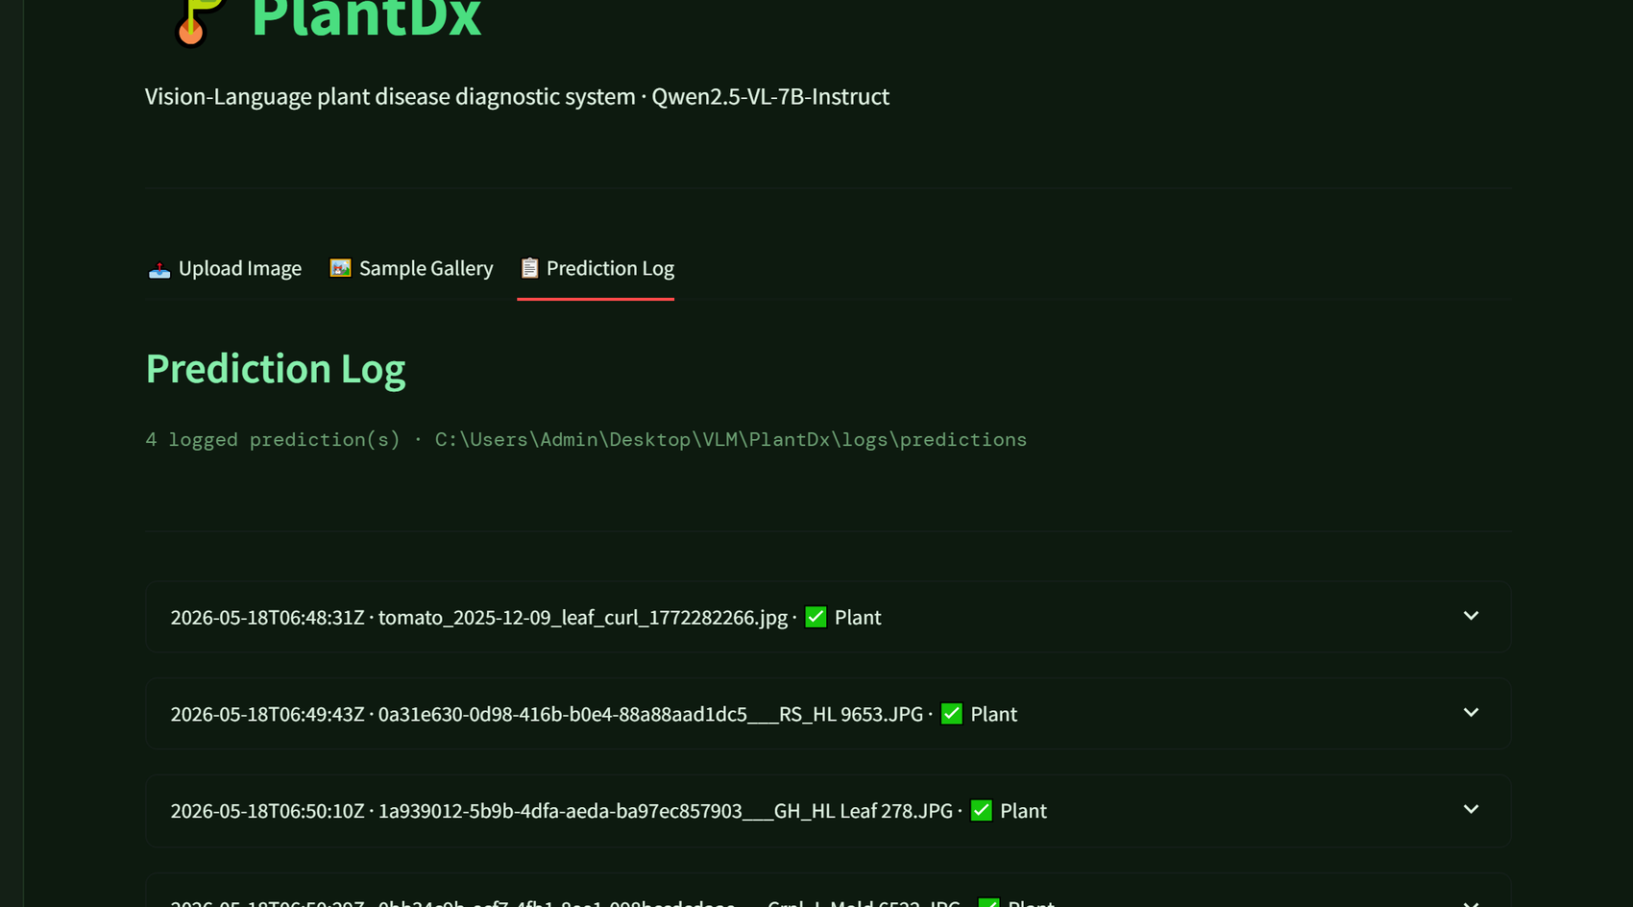
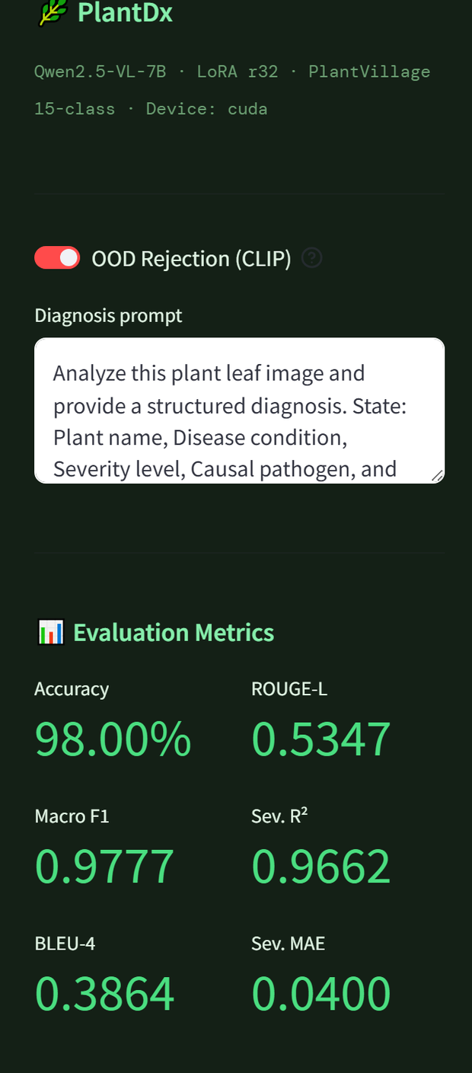
SECTION 5 · THE SYSTEM
The system, running
diagnosis
prediction log
metrics
Upload leaf
→
Model reads it
→
Structured answer
→
Logged
real screenshots of our own application
Notes:
🎯 LEARNING OBJECTIVE
Show that the pipeline became a usable thing, not just a notebook.
🗣️ WHAT TO SAY
• These are genuine screenshots of our app, not mock-ups.
• Walk it: upload → prediction → structured fields → logged to disk.
• Explain the confidence number: the average probability the model gave the words it chose.
• Note the logging — every prediction is auditable after the fact.
🚫 WHAT NOT TO SAY
✗ Don't demo live unless you've tested it that morning on that machine.
✗ Don't present the confidence number as a probability of being correct — it isn't.
❓ LIKELY STUDENT QUESTIONS
Q: Can we try it?
A: Yes — come find us afterwards.
Q: What does the confidence mean?
A: How sure the model was about the words it produced. Low value = unsure, and we flag it.
➡️ TRANSITION
But is it actually better than where we started? Judge for yourself.

Slide 26
SECTION 5 · THE SYSTEM
Before and after fine-tuning
BASE
FINE-TUNED
“…appears to have some signs of disease or damage… could indicate fungal infections, bacterial diseases, or physical damage… advisable to consult a plant pathologist for a”
— hedges across three possibilities
— unasked-for advice
— cut off mid-sentence
“Plant: Tomato. Condition: Target Spot. Circular brown spots with concentric lighter zones and chlorotic halos are scattered on this leaf surface.”
— names what it sees
— same shape every time
— readable at a glance
Both are real outputs from our own runs. This shows changed behaviour — not proof of accuracy.
Notes:
🎯 LEARNING OBJECTIVE
Show the payoff concretely — and mark the boundary of what it proves.
🗣️ WHAT TO SAY
• INTERACTION: show the BASE side first (cover the right half), ask 'what's wrong with this answer?' Take two answers, then reveal the fine-tuned side.
• Read a little of the base waffle aloud — the hedging is the point.
• Connect back to slide 4: 'an answer with the evidence attached'.
• Then the honesty line: this is behaviour change, not an accuracy claim.
🚫 WHAT NOT TO SAY
✗ Do NOT present this as evidence of accuracy — accuracy needs a held-out test set.
✗ Don't cherry-pick language like 'dramatically better' — let them see it.
❓ LIKELY STUDENT QUESTIONS
Q: Is the fine-tuned answer always right?
A: No. More consistent and specific. Accuracy needs a held-out test set, and some classes remain hard.
Q: Why is the base output cut off?
A: It hit the token limit mid-sentence — a practical problem with unfocused models.
➡️ TRANSITION
Let's check what stuck before we finish.

Slide 27
PAUSE · RECAP QUIZ · #5
Three quick ones.
① Name the three parts of a VLM.
② Why couldn't we ask a VLM to write our captions?
③ In LoRA, what percentage of the model do we train?
Notes:
🎯 LEARNING OBJECTIVE
Retrieval practice — the strongest single thing you can do for retention.
🗣️ WHAT TO SAY
• Take each in turn, hands up, ~20 seconds each.
• ① vision encoder → projector → LLM.
• ② circularity — it can't diagnose, so it can't teach; our benchmark measured 3/16.
• ③ about half a percent — 0.484% in our run.
• Praise partial answers. The act of retrieving matters more than being right.
🚫 WHAT NOT TO SAY
✗ Don't let it run long — 60 seconds total.
✗ Don't move on if the room is silent on ②; that's the one that matters most. Prompt them.
❓ LIKELY STUDENT QUESTIONS
Q: Was that in the exam scope?
A: Deflect warmly — this is about understanding, not assessment.
➡️ TRANSITION
Last slide — where we actually stand.

Slide 28
WHERE WE ACTUALLY STAND
What works
What doesn't
What's next
· A benchmark of 8 open VLMs
· 16 images is too few to rank
· Hybrid captions
· A pipeline that runs on a laptop
· Label-built captions aren't leaf-specific
· More images, more crops
· Consistent, structured descriptions
· Hand-written set is only 30 images
· Finish the scored benchmark
· A working, logged application
· No CNN baseline trained
· Explain *why* it said that
We'd rather tell you what's unfinished than have you find it in the questions.
Thank you — questions welcome, including the ones we haven't answered yet.
Harish · Aakash · Kamaksha
Notes:
🎯 LEARNING OBJECTIVE
Model scientific honesty, then close and open the floor.
🗣️ WHAT TO SAY
• Read the middle column as confidently as the left one. That is the whole point.
• Naming your own limitations first removes their power as attacks.
• The CNN admission matters — we used CNN-vs-VLM as an argument but never trained one.
• Recap the three takeaways verbally: a VLM is an LLM that can see · benchmark on YOUR data · none worked zero-shot, which is why we fine-tuned.
• Invite hard questions explicitly.
🚫 WHAT NOT TO SAY
✗ Don't rush the middle column or mumble it.
✗ Don't end with an apology — end with the invitation.
❓ LIKELY STUDENT QUESTIONS
Q: Which limitation worries you most?
A: Caption grounding — captions built from labels describe the disease, not this leaf. It changes what the model can learn.
Q: What would you do differently?
A: Start with a bigger labelled benchmark set and hybrid captions from day one.
➡️ TRANSITION
— end of session · open the floor —

