Slide 1
Colorization
Project’s field: Computer Vision
Abdullah Abdulrahman Alahiadeb, 442019225

Slide 2
Problem Statement
The problem is to train a deep learning model to colorize grayscale images, using the ImageNet dataset.
The task involves converting black-and-white images into realistic color versions.
This has applications in restoring old photographs, enhancing medical images, and creative fields like art and film.

Slide 3
Challenges
Mapping Grayscale to Accurate and Natural Colors
High Computational Power Requirement for Training Deep Learning Models
Proper Preprocessing and Formatting of the Dataset
Learning the mapping between grayscale and color images is complex since many color combinations are possible.
Training the model requires significant compute power, especially with large datasets like ILSVRC2017_DET (55GB).
Preprocessing and formatting the dataset appropriately before training the model is crucial. Ensuring that the model receives the data in the correct format and that the dataset is prepared properly can be a technical challenge.

Slide 4
Dataset
ILSVRC2017_DET dataset
Subset of ImageNet
55GB of diverse images
Standard benchmark for computer vision tasks

Slide 5
Methodology
Modified ResNet-50 as Feature Extractor
Encoder-Decoder Architecture with LAB Color Space
Freezing Encoder Parameters for Speed and Performance
A modified version of the ResNet-50 architecture is used as the feature extractor for this project. The first convolutional layer of ResNet-50 is adapted to accept grayscale images instead of RGB images. The pretrained weights of ResNet-50 are utilized to encode grayscale features.
The colorization model follows an encoder-decoder architecture, with the encoder utilizing the modified ResNet-50 to extract features. The decoder then learns to predict the color components (ab channels) in the LAB color space.
To leverage the general feature extraction capabilities of the pretrained ResNet-50 and improve training speed and performance, the parameters of the encoder are frozen. This approach is beneficial when computational resources are limited.

Slide 6
Evaluation
Mean Squared Error (MSE) as Primary Evaluation Metric
Current MSE Loss and Ongoing Improvement with Further Training
The primary metric for evaluating the colorization model is the Mean Squared Error (MSE) loss between the predicted and actual ab channels. This metric quantifies the closeness of the predicted colors to the true colors.
The current MSE loss stands at 0.01495. The model is undergoing further training, and the loss is expected to decrease as the training progresses, indicating an improvement in colorization accuracy.

Slide 7
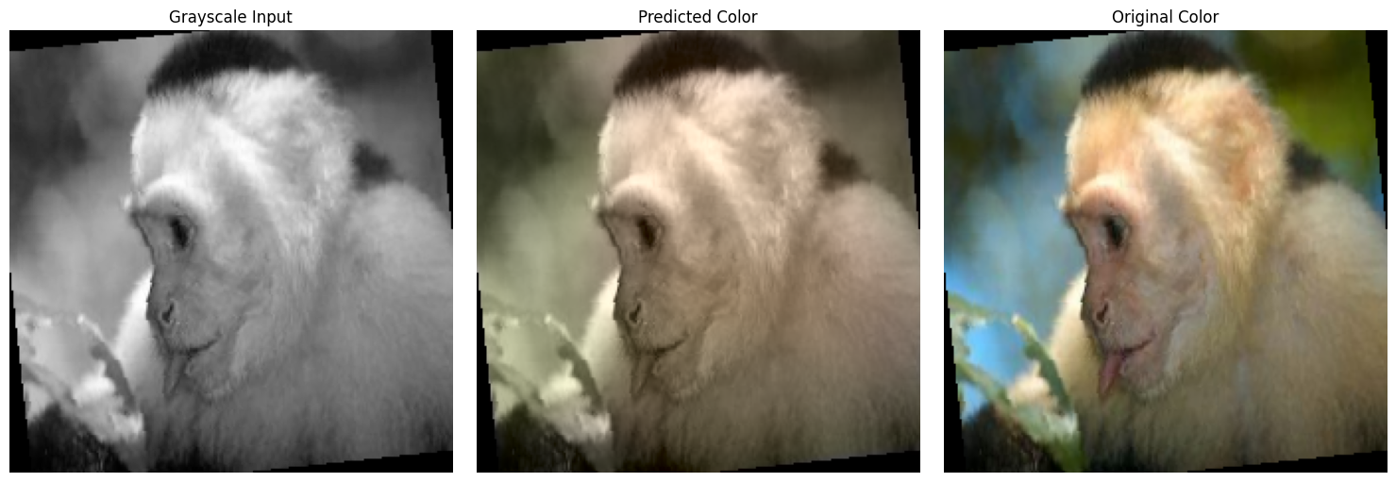
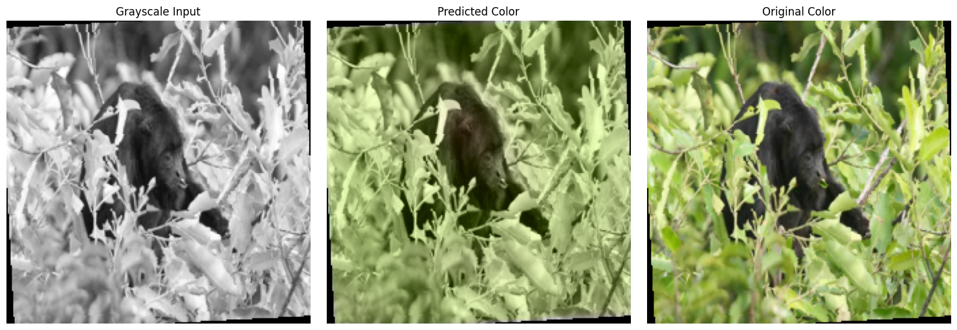
Results

Slide 8
Conclusion
In conclusion, this project aims to colorize grayscale images using a deep learning model. The challenges lie in mapping grayscale to accurate colors, the computational requirements for training deep learning models, and proper dataset preprocessing. The ILSVRC2017_DET dataset is being used, and the methodology involves a modified ResNet-50 as the feature extractor and an encoder-decoder architecture with the LAB color space. The evaluation is based on the Mean Squared Error (MSE) metric, with ongoing improvements expected through further training.

