Slide 1
Memento Design Pattern

Slide 2
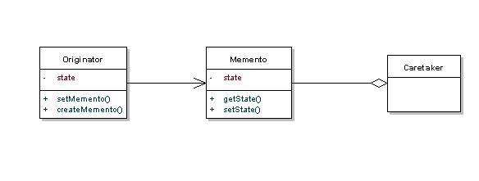
UML

Slide 3
When to Use
Used to externalize object state to provide rollback functionality

Slide 4
Code
Github repo link

Slide 5
Programing Scenario

Slide 6
Pitfalls
Can be expensive large copy
Deleting history
Don’t expose information except for the Memento

Slide 7
Thanks.

