Slide 1


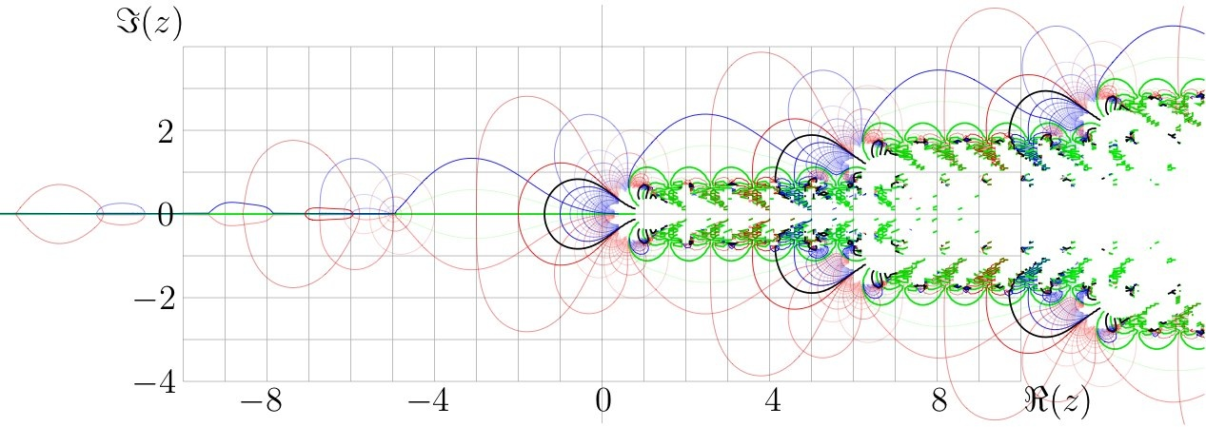
GexVisor: A Cross-Platform Framework for Interactive Gamma Exposure Analysis
CS-PhD
Architecture, WebAssembly, and Test Infrastructure for a .NET Financial Visualization Platform
GEX Visualizer
Research Arcade
The Problem
RESEARCH ARCADE
• Existing GEX tools: fragmented JS scripts, no tests, no CI
• Options visualization needs real-time + historical views
• Research workflows disconnected from analysis tooling
• No cross-platform solution (browser-based needed)
GEX VISUALIZER
Pattern discovery + data pipeline state
Interactive chart + regime timeline + annotations
System Architecture
Task Board & CI/CD
Research Notebook
ARCHITECTURE DIAGRAM
TASK BOARD
CI/CD PIPELINE
3-tier: UI → Core → API
RESEARCH NOTEBOOK
GitHub Kanban
GitHub Actions
KDD process tracking + complexity radar
Technology Stack
Test Infrastructure
• .NET 10 / Blazor WebAssembly (runs in browser via WASM)
• C# throughout — replaced JS/Python prototype entirely
• ApexCharts for interactive financial visualizations
• SQLite caching layer for market data persistence
• ASP.NET Core API with options chain services
• GitHub Actions CI/CD + Husky.Net pre-commit hooks
Paper Trading Journal
TEST RESULTS
BACKTEST TRACKER
xUnit + Moq + Coverlet
Strategy validation
PAPER TRADING
Trade grid + decision timeline + regime context
Key Engineering Decisions
• JS/Python → .NET: type safety, single-language stack
• WebAssembly: full app runs client-side in browser
• 3-tier separation: UI / Core / API testable independently
• Load testing suite for API performance validation
• StyleCop + EditorConfig for consistent code quality
15 pages • 35+ Blazor components • Full keyboard navigation
QR CODE
Link to repo/demo
Christopher Regan
Advisor: Dr. Ying Xie
College of Computing and Software Engineering

