Slide 1
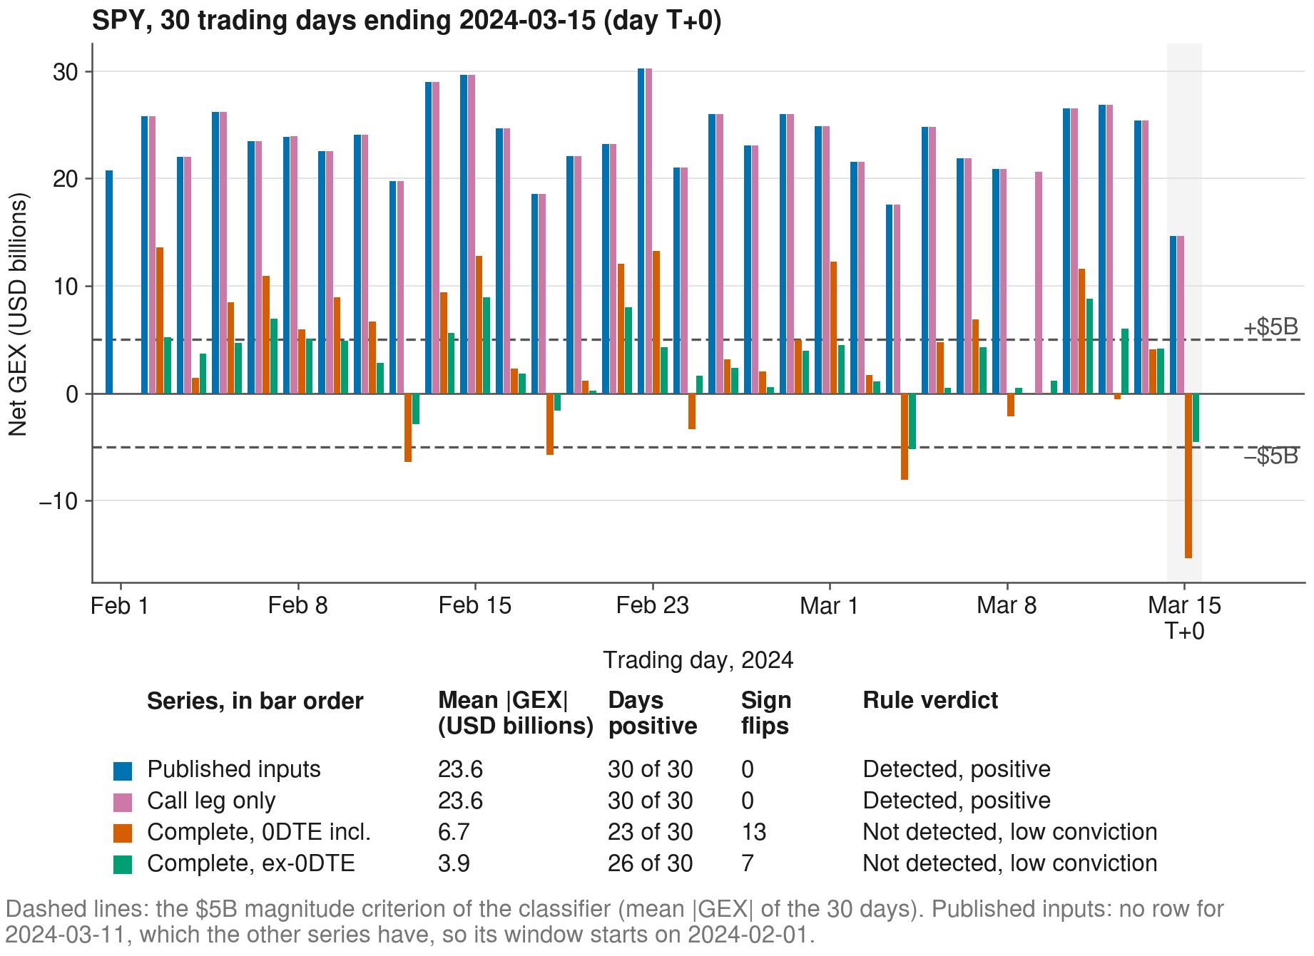
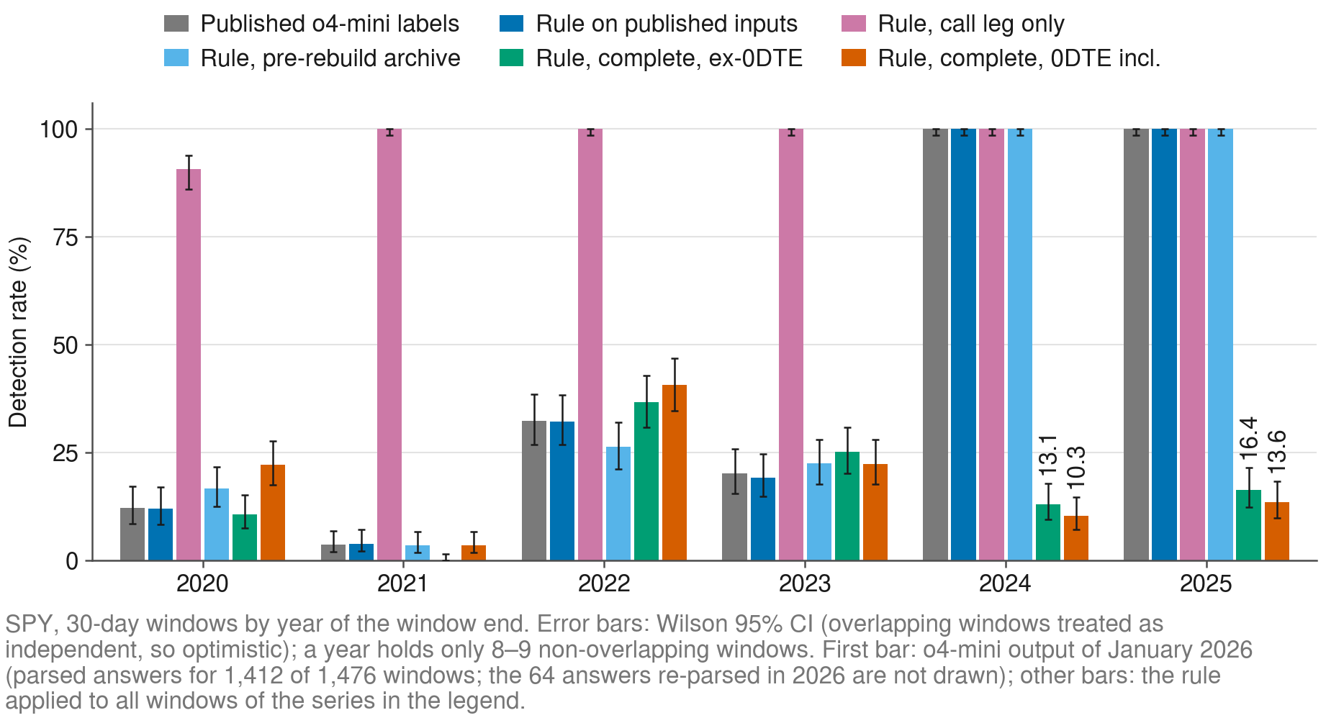
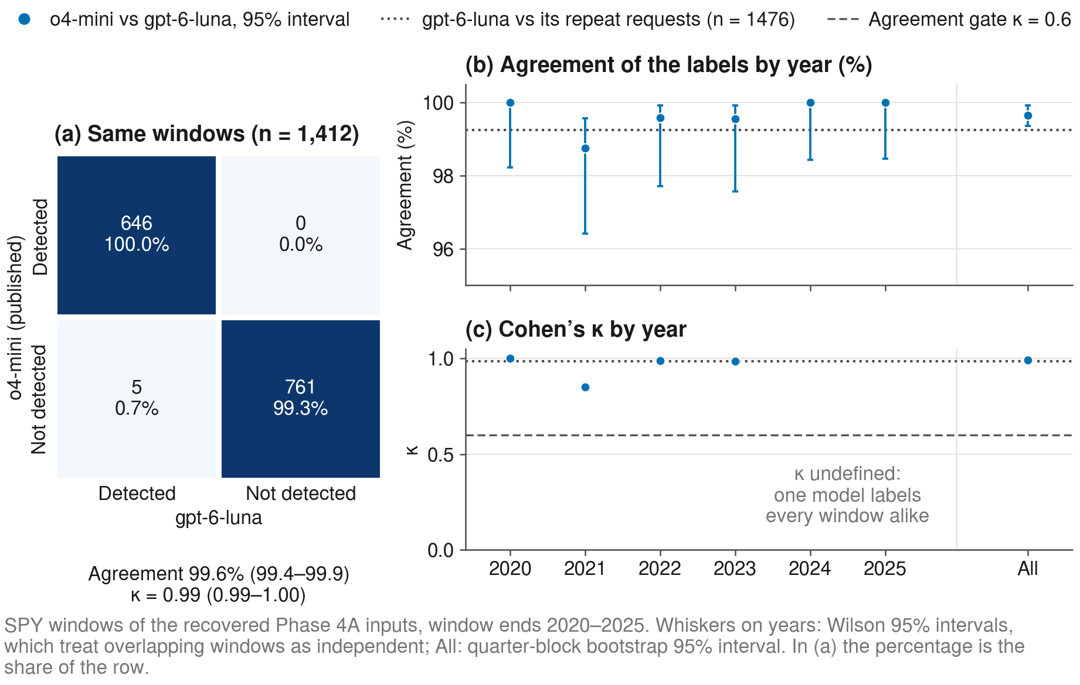
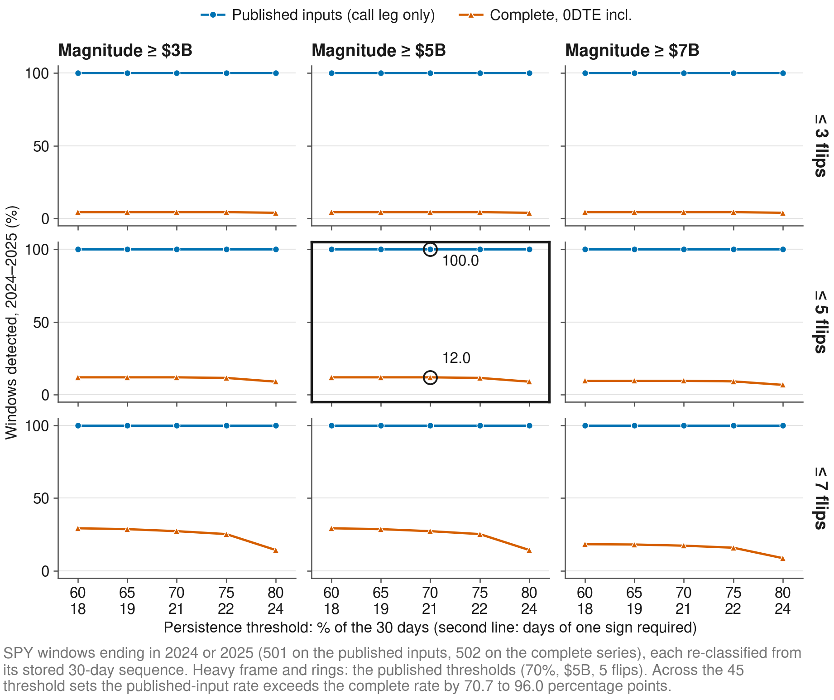


XX-000
Persistent Dealer-Gamma Regimes Under Temporal Obfuscation:
A Re-Run on Complete Inputs with a Controlled LLM Re-Test
Christopher Regan · Ying Xie
College of Computing and Software Engineering · Kennesaw State University, Marietta, GA
Abstract
Approach: Same Rule, Same Prompt, Different Inputs
Does It Hold Elsewhere?
Temporal obfuscation tests whether a large language model (LLM) reasons about numbers or recalls market history: dates and tickers are removed from 30-day windows of daily dealer gamma exposure (GEX). Our earlier work reported a persistent regime in every SPY window of 2024–2025. We re-run the test on the complete data, because the published 2024–2025 inputs lacked the put leg. On the complete series the deterministic rule detects 12.0% of those windows and gpt-6-luna 12.5%. The model follows the rule in 99.7% of 4,691 windows, dates change 1 of 223 verdicts, and an open-weights model run locally gives the same rates.
The rule (each 30-day window)
Share of windows detected on the complete series:
Mean |GEX| < $5B
Check | Windows | Rule | gpt-6-luna
Without 0DTE, 2024–25 | 502 | 14.7% | 15.3%
2026, after publication | 194 | 11.3% | 11.3%
SPY 2008–2013 | 1,482 | 0.0% | 0.0%
QQQ and IWM | 8,569 | 0.0% | 0.0%
→ Not detected: below the magnitude floor
< 70% of one sign or > 5 sign flips
→ Not detected: the sign does not persist
All three criteria hold ✓
Same-day expiries carry 41–46% of |net GEX| in 2024–26, yet dropping them gives 14.7%, not 100%. Before 2014 and for QQQ and IWM no window reaches $5B.
→ Regime detected, positive or negative
Introduction
The model gets the 30 values and these criteria only: no dates, no tickers.
Agreement (Cohen’s κ)
Window ending 2024-03-15 in four series (paper Fig. 2).
Dealer gamma exposure (GEX) sums the gamma of open options, with the dealer side imputed by a sign convention; a sign that holds for weeks marks a regime.
Obfuscation removes dates and tickers: the model has only the values and the criteria, not its memory of the period.
A re-run needs the same inputs and a model that still answers: o4-mini is retired and the daily GEX table was rebuilt in 2026, so we recovered the published inputs from the stored batch file.
Same rule, five daily series: share of the 2024–2025 windows that the rule detects
κ = 0.988
κ = 0.948
κ = 0.000
The published 2024–25 inputs carry the call leg only, so every day is positive and large.
The rule then detects every window.
Both legs: 12.0%. Without 0DTE: 14.7%.
gpt-oss-20b vs rule
Qwen3-8B vs rule*
Llama 3.1 8B vs rule
*Windows it answered (90%). Bootstrap, rule 2024–25: 12.0% [5.1, 19.6]
Conclusions
RQ1 ✓ Published 2024–25 inputs: call leg only. Complete series: 12.0%, and no rise after 2023.
RQ2 ✓ gpt-6-luna matches o4-mini (99.6%) and the rule (99.7%); dates change 1 of 223 verdicts.
RQ3 ✓ Without 0DTE 14.7%, 2026 11.3%, gpt-oss-20b 12.4%, Qwen3-8B 14.5–35.1%. Llama 3.1 8B: “detected” almost always.
Next: thresholds scaled by symbol and price, intraday open interest, more model families.
Research Questions
Results
RQ1
Which daily series were the published inputs, and how do the rule’s labels change on the complete series?
12.0%
99.6%
99.7%
1 of 223
Does a current model reproduce the published answers, and does its call follow the numbers, not the dates?
2024–25 windows detected
o4-mini = gpt-6-luna
gpt-6-luna = rule
verdicts changed by dates
Take-home: a detection rate is only as sound as its input series; version the data and test a contrast, not a level.
RQ2
published inputs gave 100%
1,412 published windows
4,691 complete windows
2024 baseline, gpt-6-luna
RQ3
Do the answers hold without 0DTE, in other years and assets, and with open-weights models run locally?
Acknowledgments
KSU CCSE for computing resources; Alpha Vantage for options data.
Materials and Methods
Contact Information
Data
Daily net GEX of SPY, QQQ and IWM, 2008–2026, from stored option chains, in six series: the published inputs, the call leg only, the pre-rebuild archive, the complete series with and without same-day expiries (0DTE), and an intraday snapshot.
Windows and rule
30 trading days, stride 1, labeled Day T−29 … T+0; no dates, no tickers; 38,592 windows.
Rule: ≥ 70% of days of one sign, mean |GEX| ≥ $5B, ≤ 5 sign flips.
Models
o4-mini: the published answers (January 2026), now retired.
gpt-6-luna: OpenAI Batch API; all its runs cost USD 10.02.
gpt-oss-20b, Llama 3.1 8B, Qwen3-8B: open weights at fixed revisions, vLLM on local A100 GPUs.
Statistics
Cohen’s κ for agreement; Wilson and quarter-block bootstrap intervals, since the windows overlap. Every input, prompt and answer is stored.
Christopher Regan cregan1@students.kennesaw.edu
Ying Xie yxie2@kennesaw.edu
Code: github.com/iAmGiG/gex-llm-patterns
Repository: scan the QR code
Rule by year: 100% in 2024–25 on the published inputs, 10.3% and 13.6% on the complete series.
Bridge: gpt-6-luna gives the o4-mini verdict on 1,407 of 1,412 published windows.
Thresholds: over 45 threshold sets the published inputs stay 70.7–96.0 points higher.
Five labelers compared (o4-mini is retired, so it has no answers on the complete series)
References
Published inputs, 2024–25
% of windows detected
Complete series, 2024–25
% of windows detected
2024 minus 2020 baseline
percentage points, prompts with dates
1. Regan C., Xie Y. Validating LLM structural reasoning: detecting persistent market regimes through temporal obfuscation. AIAI 2026, IFIP AICT, 127–140.
2. Regan C., Xie Y. Inferring latent market forces: evaluating LLM detection of gamma exposure patterns via obfuscation testing. LLM-Finance, IEEE BigData 2025; arXiv:2512.17923.
3. Regan C., Xie Y. Temporal obfuscation testing for LLM structural reasoning. J. Risk Financial Manag. 2026, 19, 382.

