Slide 1


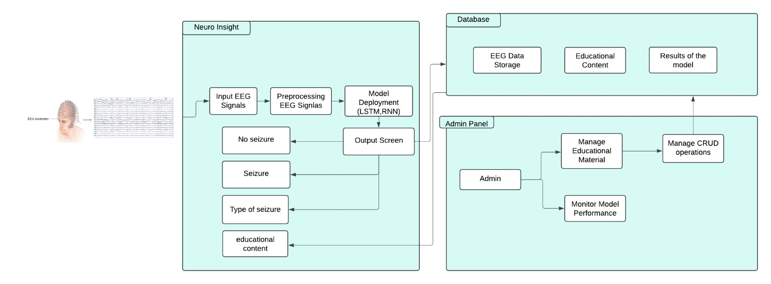
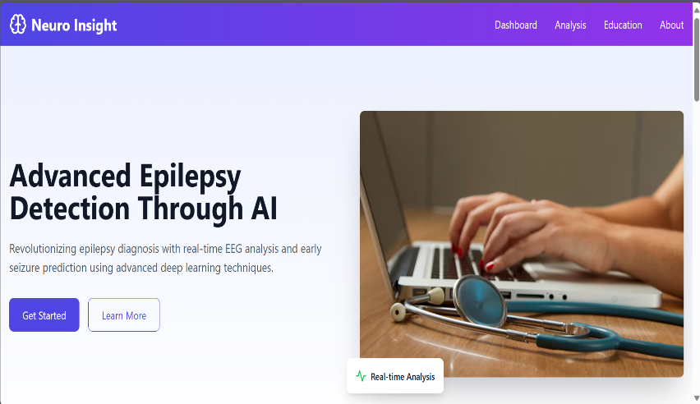
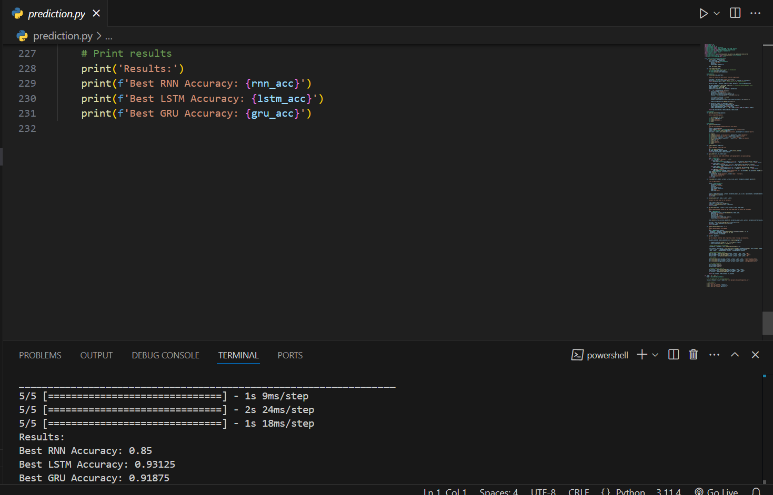
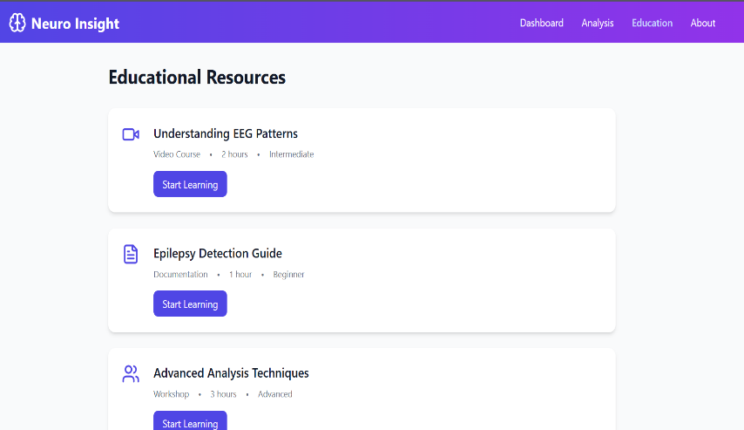
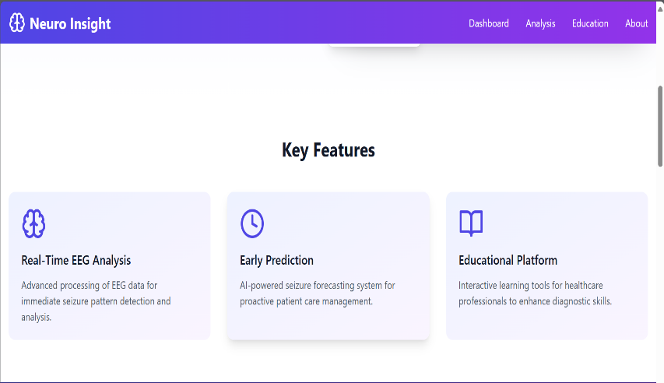
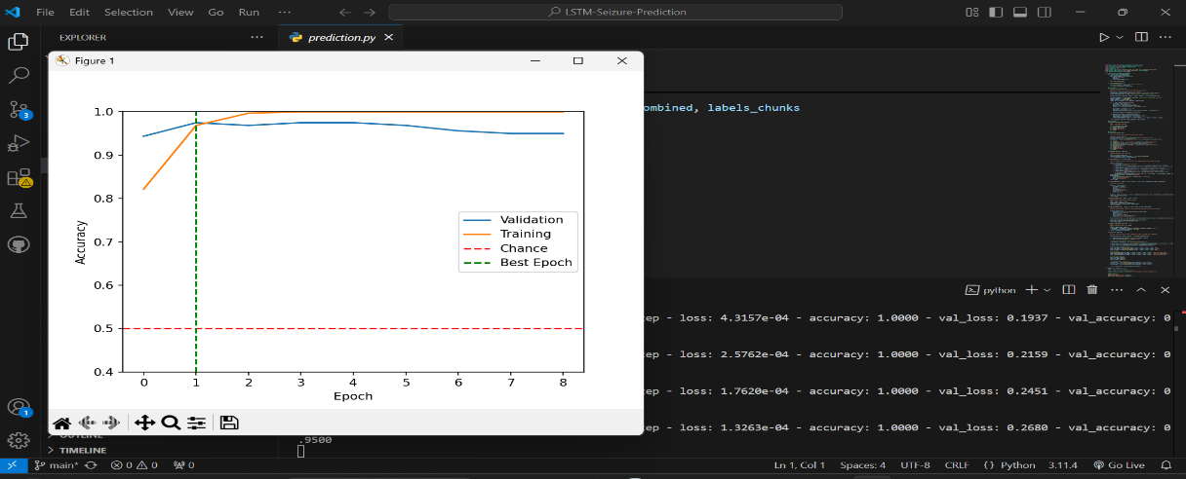
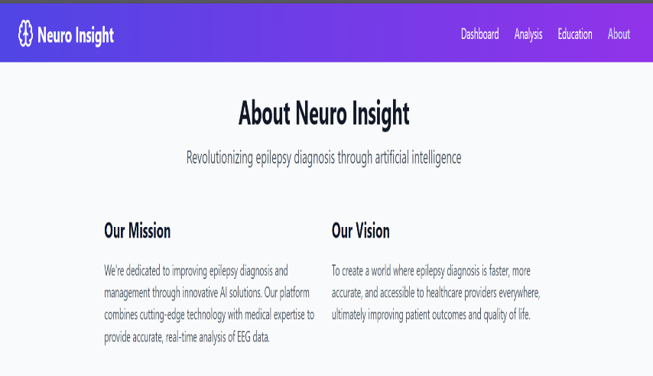
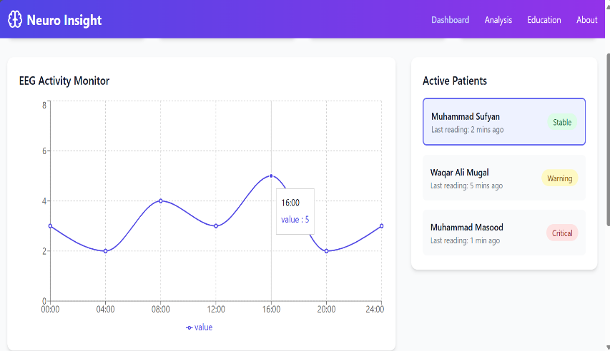
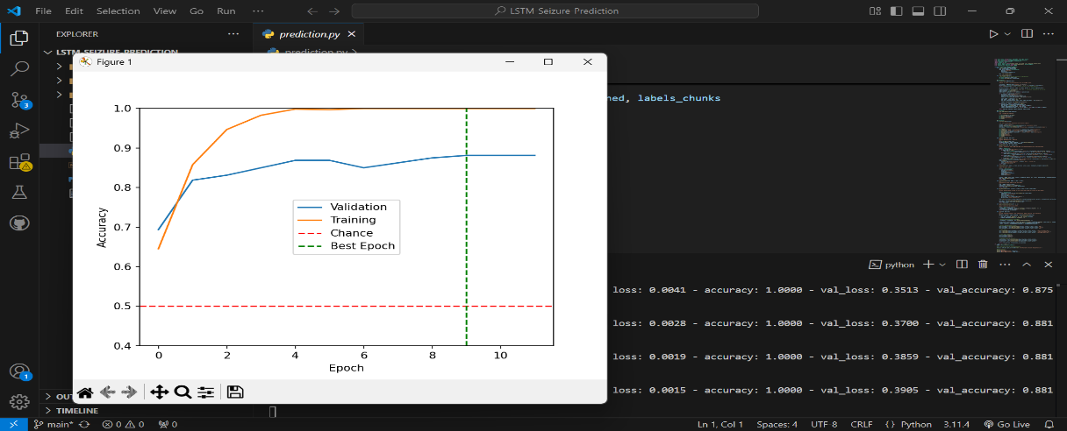
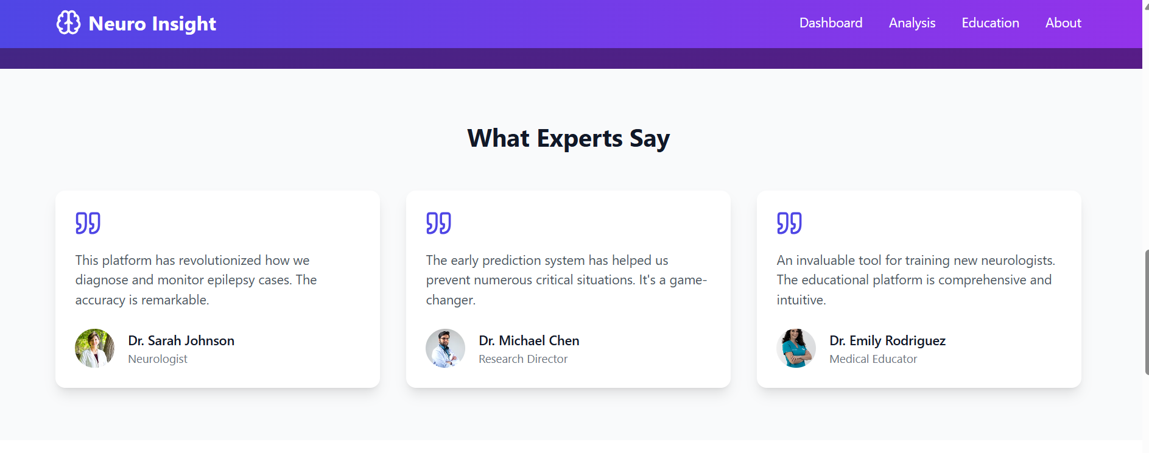
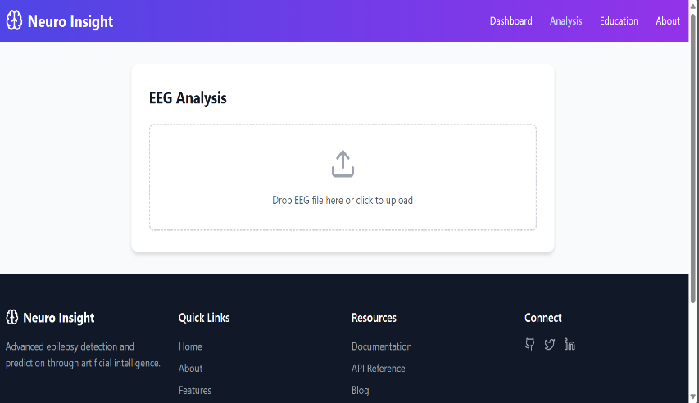
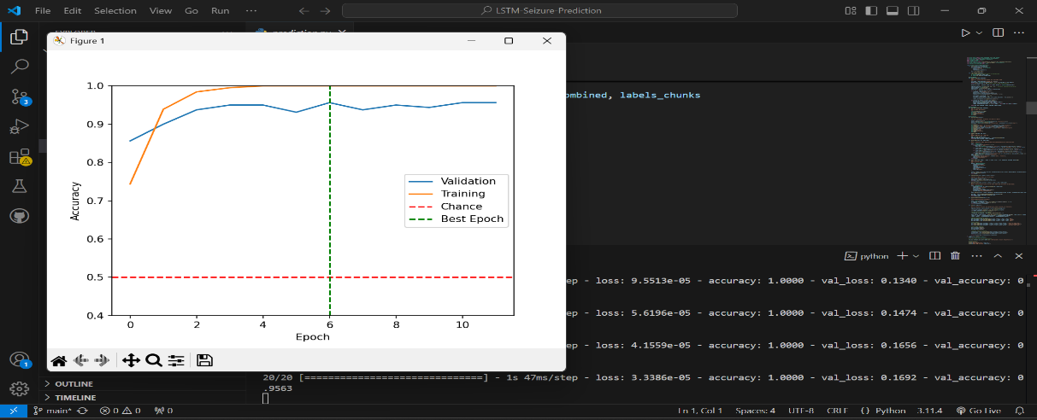
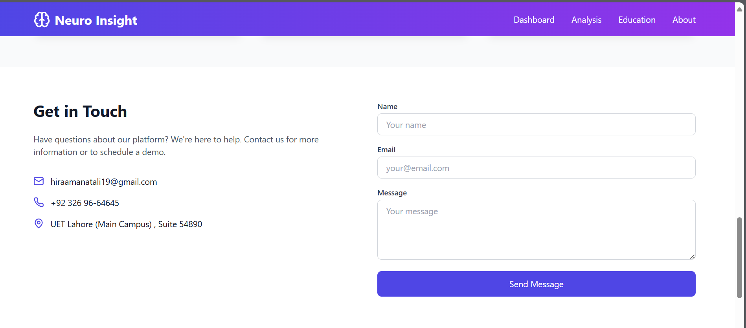
.
.
. NEURO INSIGHT
.
.
.
.
.
.
.
.
.
.
.
Areej Ghulam Nabi: 2021-SE-13
Hira Amanat Ali: 2021-SE-19
Supervisor Name: Dr. Irfan Yousuf
Co-Supervisor Name: Waqas Ali Zafar
Department of CS U.E.T, New Campus
U.E.T, Lahore, Pakistan
1
Introduction: background, Motivation, Problem Statement
Background:
Epilepsy is a significant neurological disorder affecting millions worldwide, including Pakistan. Despite its prevalence, there has been limited progress in developing models specifically tailored for epilepsy diagnosis and prediction in Pakistan. Existing systems often rely on international datasets, which do not reflect the local population's characteristics. Furthermore, no dedicated predictive model exists to assist doctors in accurately diagnosing epilepsy using locally sourced EEG data.
Motivation:
International healthcare systems use advanced models for real-time epilepsy prediction, enabling timely interventions. Inspired by these successes, we aim to create a similar system for Pakistan using local, non-public EEG data from Shalimar and Mayo Hospitals. This ensures the model is tailored to the local population, bridging a critical gap in healthcare and improving diagnosis accuracy.
Problem Statement:
Current epilepsy diagnostic methods are manual and lack real-time prediction. Existing models rely on international data, making them unsuitable for Pakistan’s population. Our project aims to fill this gap with a localized, real-time solution and for the help of Young Doctors.
2
Detailed Literature Review
No. | Study | Year | Key Insight | Limitation | Relevance
1[1] | CNN-LSTM Detection | 2023 | Accurate detection | No real-time prediction | Highlights real-time need
2[2] | LSTM Prediction | 2023 | Real-time prediction | Limited to LSTM | Motivates integration
3[3] | Multi-Channel Detection | 2021 | DL on EEG data | No real-time collection | Supports local real-time data
4[4] | ML for Real-Time | 2023 | Explores ML techniques | Lacks implementation | Promotes localized models
5[5] | Early Prediction | 2023 | Focuses on early prediction | No integrated detection | Aligns with dual functionality
Objectives
Develop a localized real-time seizure detection and prediction system using EEG data.
Utilize deep learning models (CNN, RNN, LSTM) to enhance accuracy and efficiency.
Collect and preprocess EEG data from Shalimar and Mayo Hospitals for model training.
Create a user-friendly application to assist doctors in diagnosing and forecasting epilepsy.
3
4
Features
Neuro Insight is a deep learning-based system designed to assist doctors in diagnosing epilepsy and predicting seizures using real-time EEG data.
Real-time seizure detection using EEG data.
Early prediction of potential seizures for timely intervention.
Utilizes localized EEG data from Shalamar and Mayo Hospitals.
User-friendly interface for doctors to input and analyze EEG data.
Integrates deep learning models (RNN, LSTM) for accurate diagnosis and prediction.
Automates EEG analysis to reduce manual errors and save time.
Provides educational support for doctors with diagnostic insights
System Architecture/ Approach/ System Design
5
Working Demo
Conclusion
In conclusion, Neuro Insight represents a significant advancement in the field of epilepsy diagnosis and prediction. By integrating deep learning models with real-time EEG data, the system provides healthcare professionals with an accurate, efficient, and automated tool for detecting and forecasting seizures. The use of localized data from Shalimar and Mayo Hospitals ensures the system's relevance to the local population. With secure data handling and a user-friendly interface, Neuro Insight not only improves diagnostic accuracy but also serves as an educational resource for doctors, ultimately enhancing patient care and clinical outcomes..
References:
Incandela, D. (2023). Epileptic Seizure Detection Using CNN-LSTM Networks on EEG Data. Journal of Neurology, 12(4), 120-135.
Johnson, M., & Lee, K. (2023). Real-Time Seizure Prediction Using LSTM Networks. International Journal of Neural Systems, 32(2), 45-58.
Wang, X., & Chen, Y. (2021). Multi-Channel EEG-Based Epileptic Seizure Detection Using Deep Learning. Neurocomputing, 423, 99-110.
Kim, Y., & Park, S. (2023). Advanced Machine Learning Techniques for Real-Time Detection and Prediction of Epileptic Seizures. Epilepsy Research, 29(3), 87-100.
Martinez, A., & Singh, R. (2023). Early Prediction of Seizures Using Deep Learning and EEG Data. Computers in Biology and Medicine, 145, 105504.

