Slide 1
Exploratory Data Analysis
For used car market in UK

Slide 2
TABLE OF CONTENTS
1
Introduction
2
Methodology
Data
3
4
5
6
Conclusion
Visualization
Overview

Slide 3
Introduction :
Cars are one of the most important necessities for every family, as they are the most popular means of transportation these days.
This project aims to analyze the used car market in the UK, compare car prices by type, engine, and car model, for example, which cars are most in demand. With the presence of more than one car company.
We will do a comprehensive analysis to find the best used cars to attract customers so that our exhibition are among the best and we can achieve the company's goal and vision for development in the used car sectors

Slide 4
Methodology :
Data Cleaning and Filtering
Idea and Problem
Data Analysis and Visualization
Data Exploring

Slide 5
Data :
Our data set is about most common cars brand in UK, and its contain two brands Ford and Volkswagen
The data set is provided in .csv format, contains information of price, transmission, model, mileage, etc.
Our data contains thirty-three thousand of rows and 8 columns of information of used Cars.

Slide 6
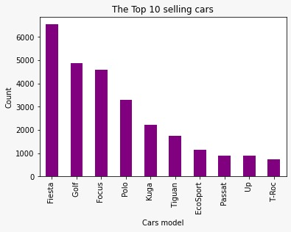
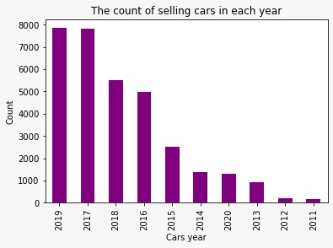
Graphs:
This graph represent most common used car in UK model most manufacturer year of our data set.

Slide 7
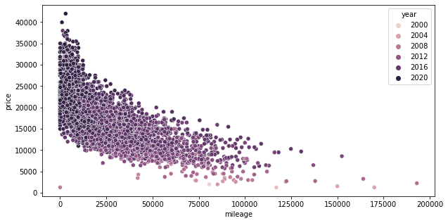
Graphs:
This graph shown the relationship between price, year, mileage

Slide 8
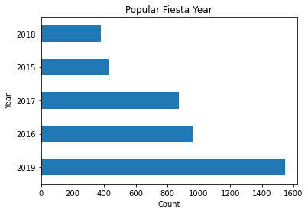
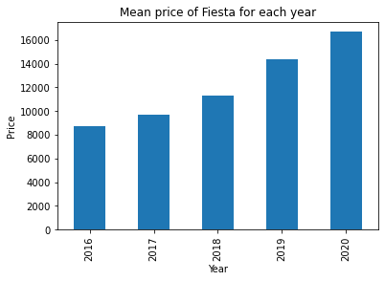
Graphs:
This bar graphs shows most popular Fiesta year is 2019 and the mean price is 14,371 Pound .

Slide 9
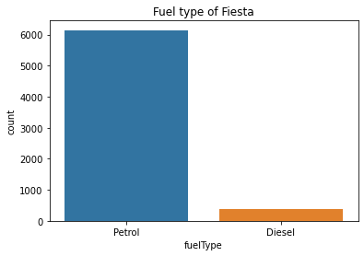
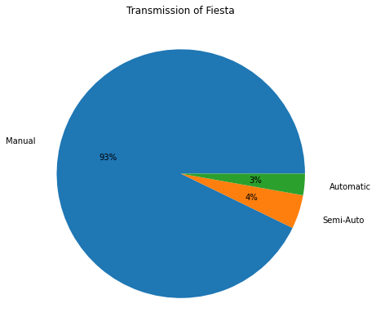
Graphs :
This graph shown the percentage of transmission for Fiesta and fuel type.

Slide 10
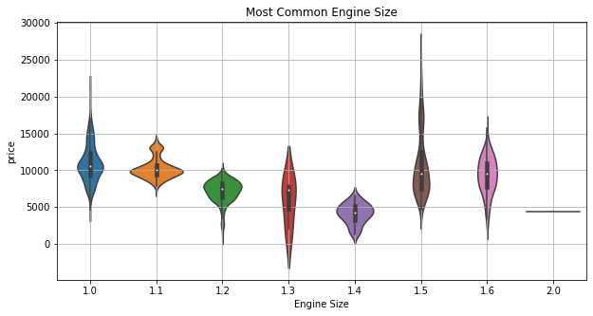
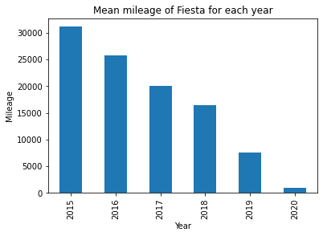
Graphs :
This graph show the most common Engine which is 1.5 and the mean mileage for Fiesta for each year and we noticed the mean mileage for 2019 is 7502 kilo.

Slide 11
Overview
So the top 5 used car is Fiesta, Golf, Focus, Polo, Kuga.
The most common manufacturer year is 2019

Slide 12
Overview
We found that the newer car will be more expansive, and the lower mileage also increase the price

Slide 13
conculosion
We will focus in top 5 cars to make our exhibition more competitive and attract the costumer, but the exhibition will be diversified at the same time so that everyone has the choices.

Slide 14
THANKS !
Any questions?

