Slide 1

HACKED 2022
Team members
Aniket Mishra
Nhung Nguyen
Anh Nguyen

Slide 2
GOALS
Visualize projects
Create issue, break them into tasks, track relationships, add custom fields, and have conversations.
Align and delegate tasks

Slide 3
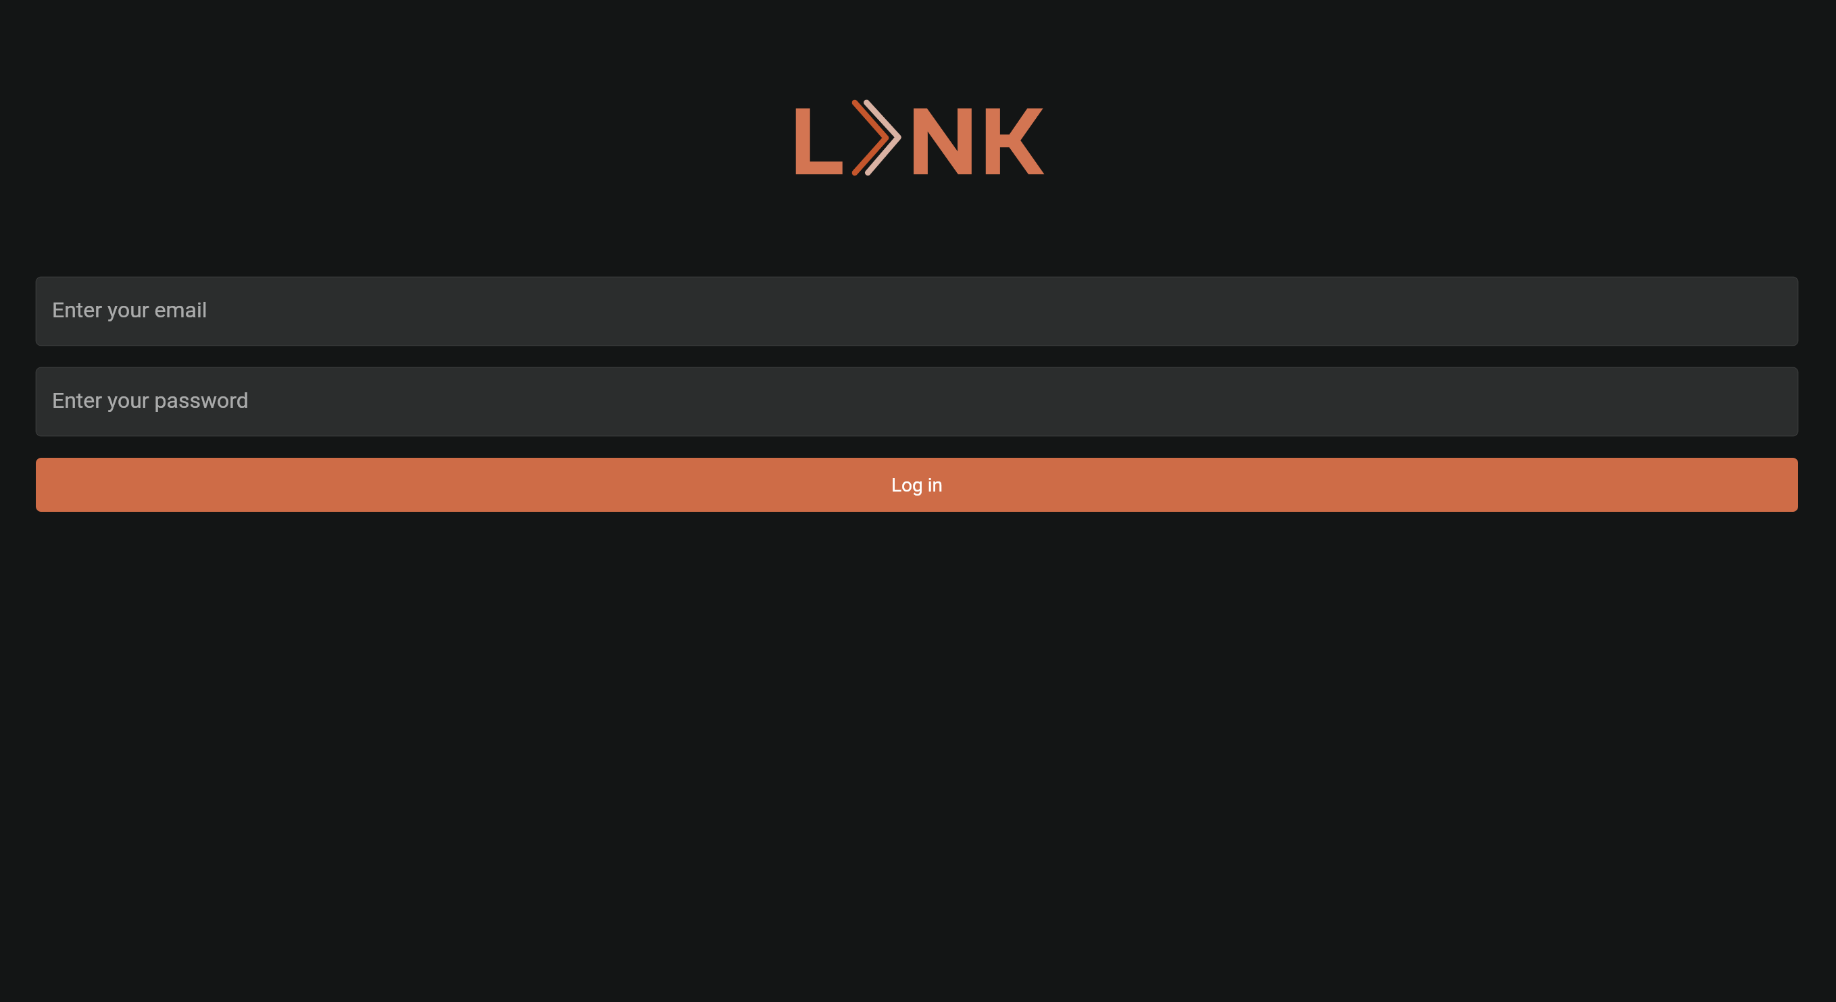
UI Design

Slide 4
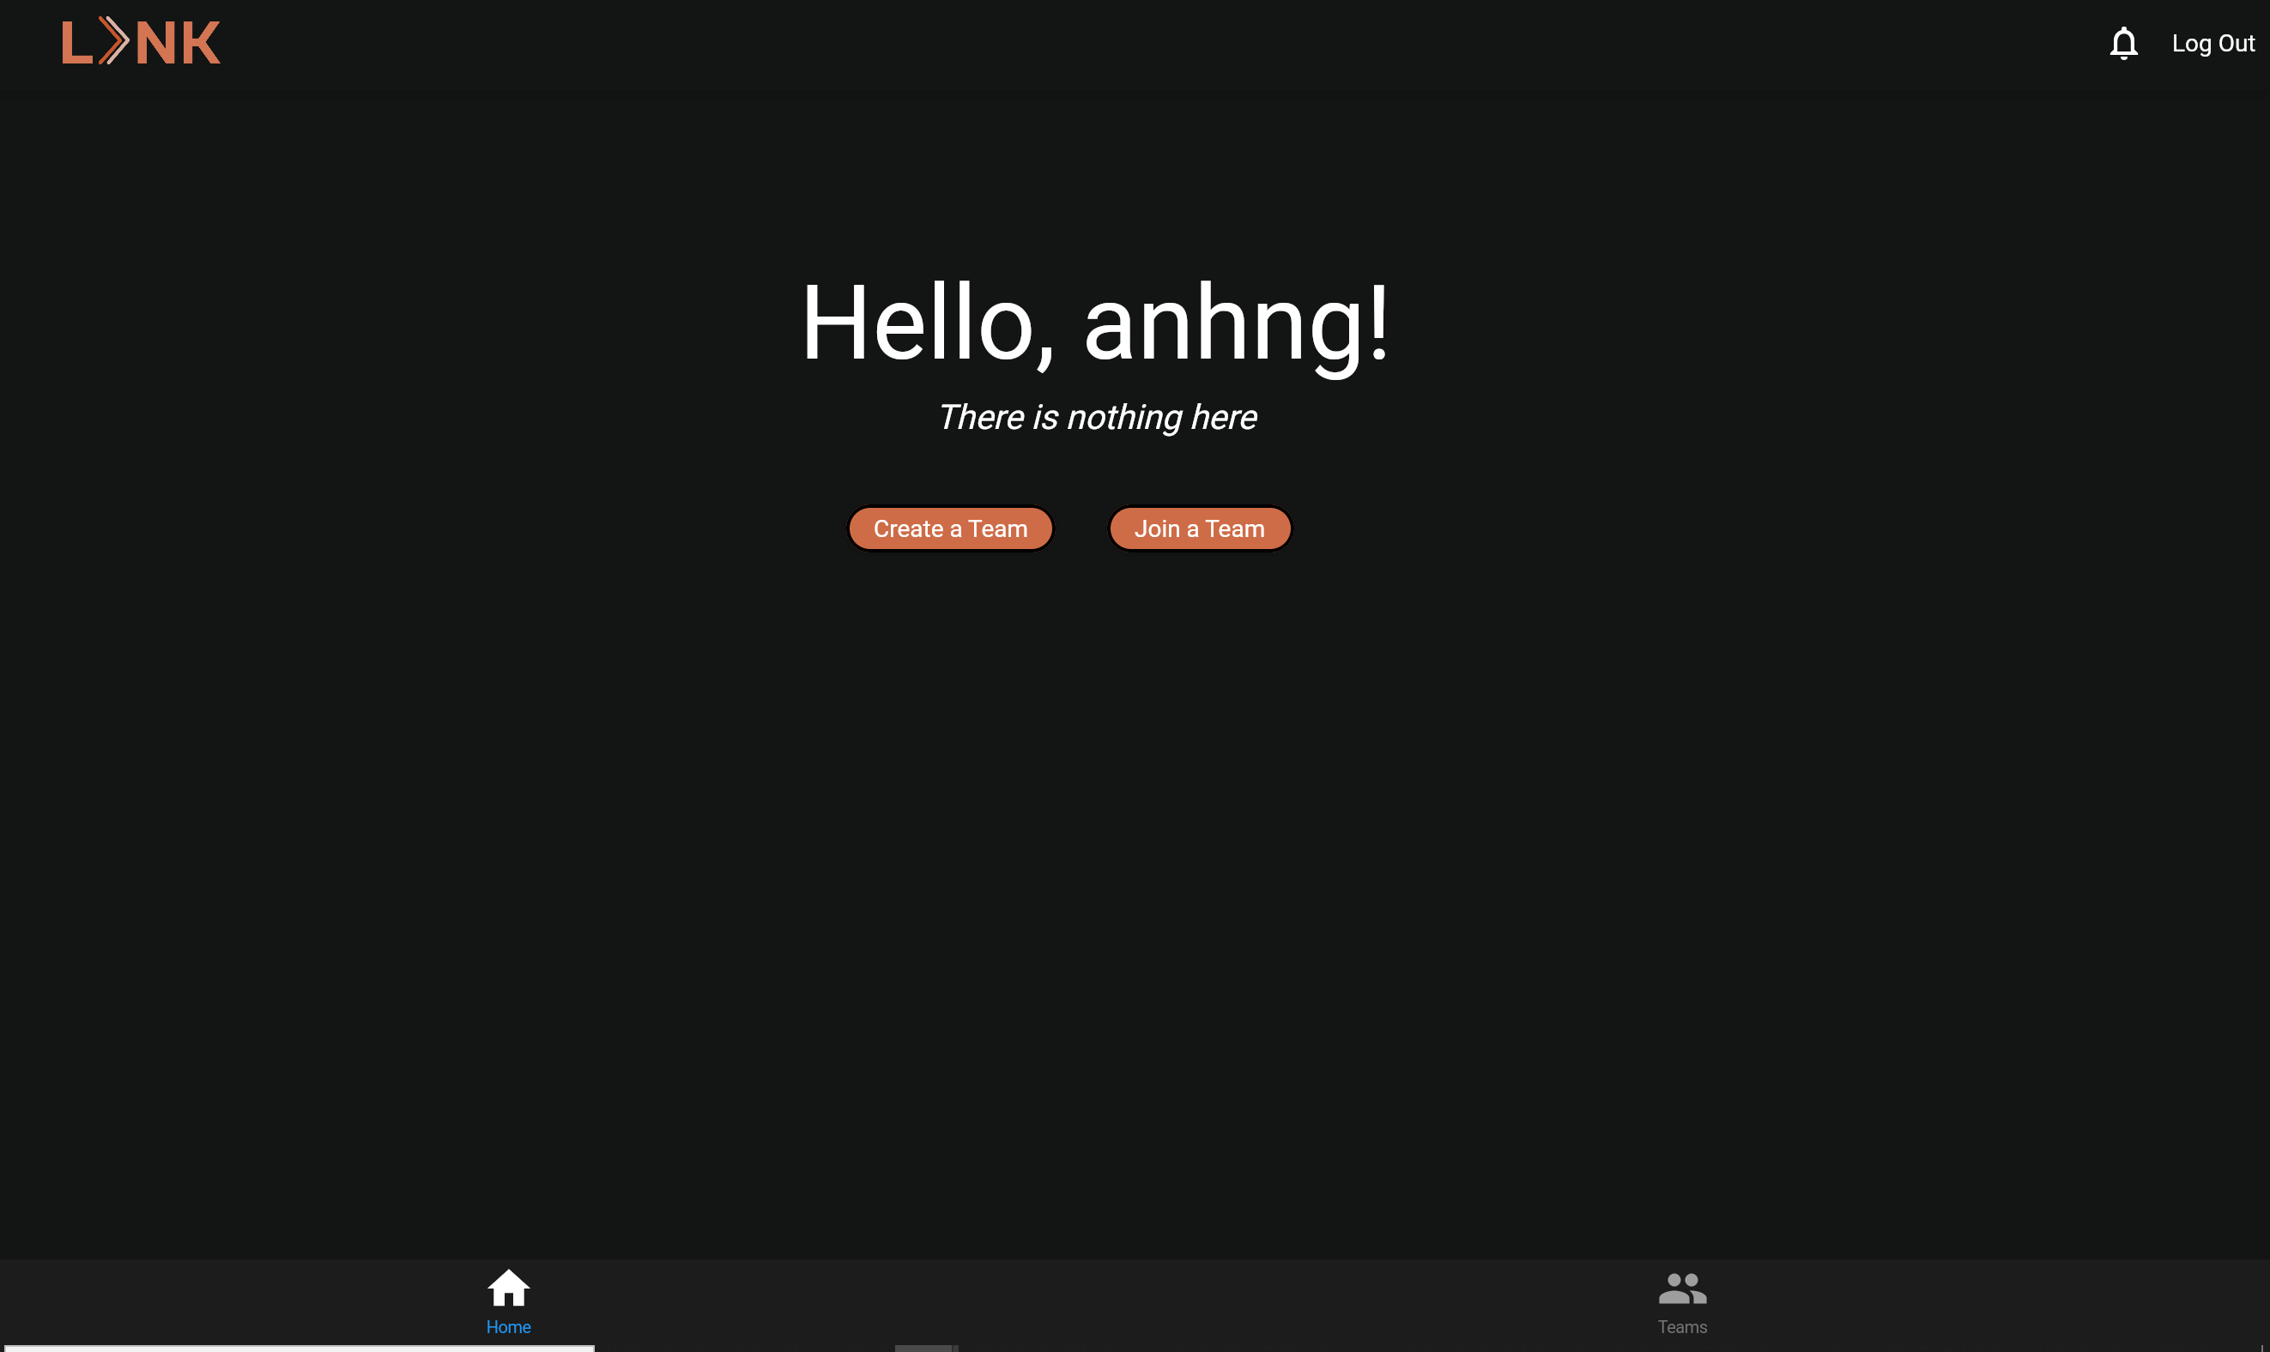
UI Design

