Slide 1
Machine Learning [C]
Submitted by-
MD Mashrurul Haque
ID: 20-43751-2
Submitted to-
Mohammad Saef Ullah Miah

Slide 2
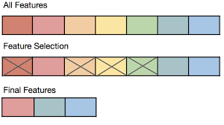
Feature Selection
What is feature selection?
Choosing a subset of the most relevant features from the original set of features while keeping the original feature intact.

Slide 3
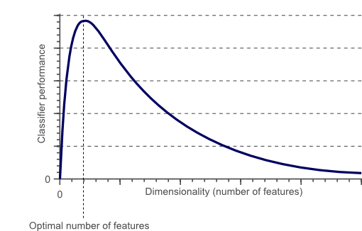
Feature Reduction
What is feature reduction?
Transforming the original features into a lower-dimensional representation

Slide 4
Difference between feature selection and reduction
Feature Selection | Feature reduction
Choose a subset of relevant features. | Transform original features into a lower-dimension
Maintains original set of features | Transform original set of features
Choose based on relevance. | Transform mathematically for simplicity

Slide 5
Where to use feature selection
High-Dimensional Data
Redundant or Irrelevant Features
Improved Model Performance

Slide 6
Where to use feature reduction
Dimensionality reduction
Correlation or Collinearity
Visualization Needs
Preprocessing for deep learning

Slide 7
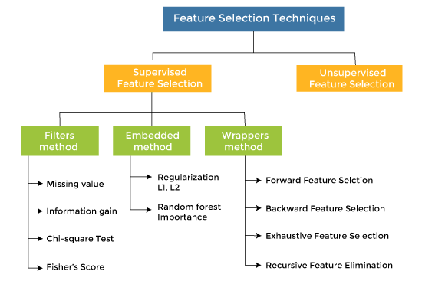
Techniques for feature selection

Slide 8
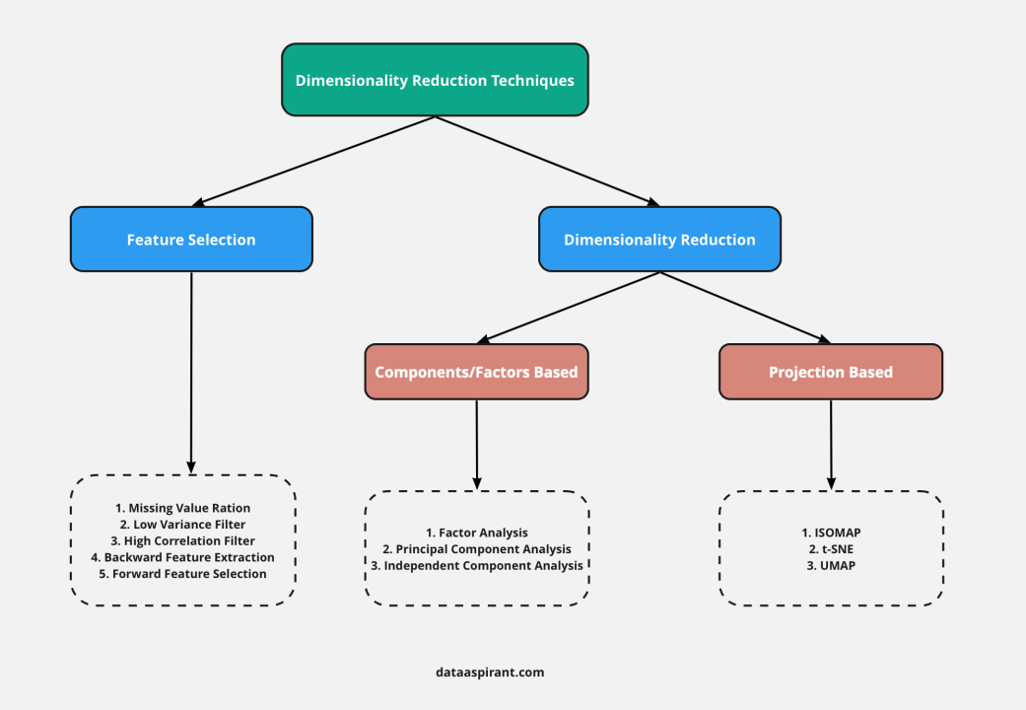
Techniques for feature reduction

Slide 9
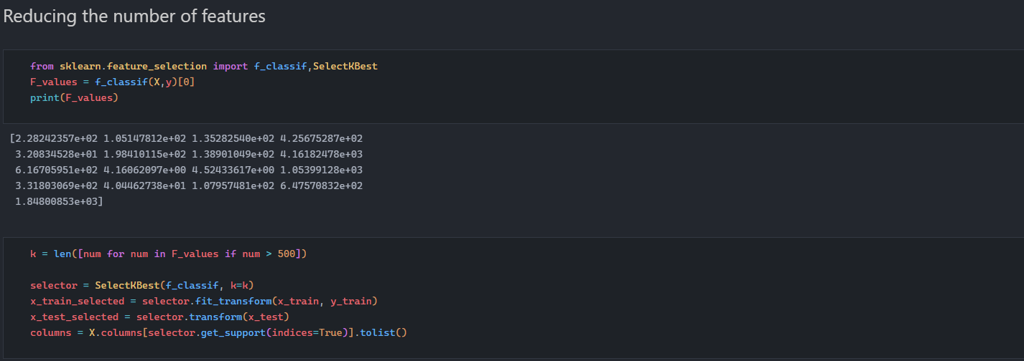
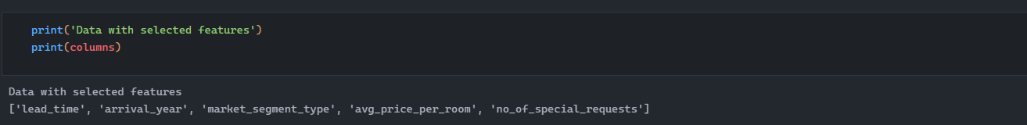
Implementation of a feature selection technique

Slide 10
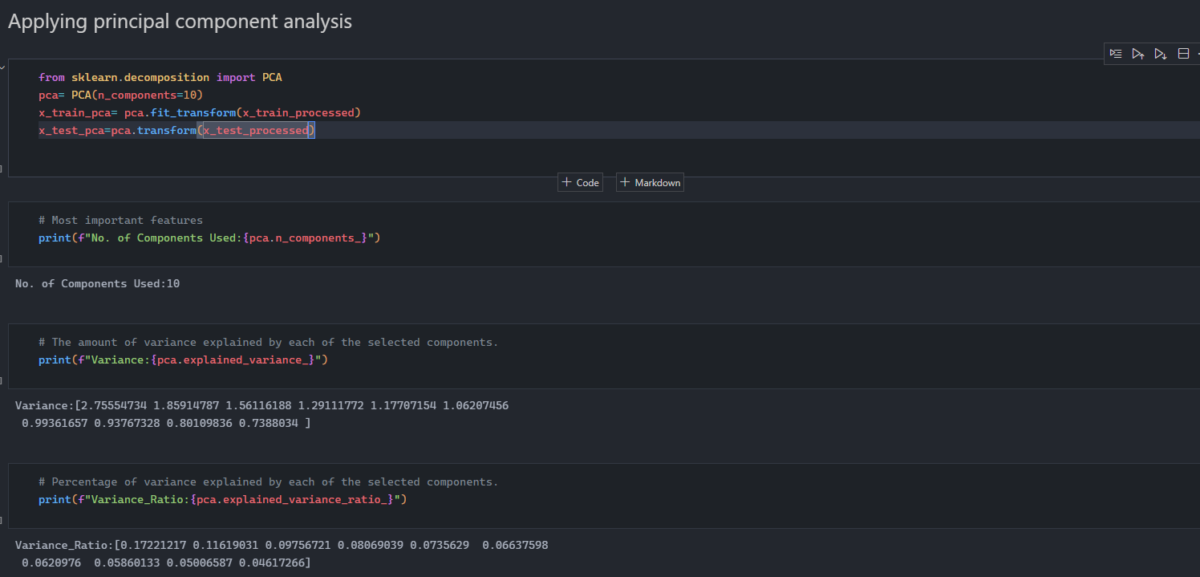
Implementation of a feature reduction technique

Slide 11
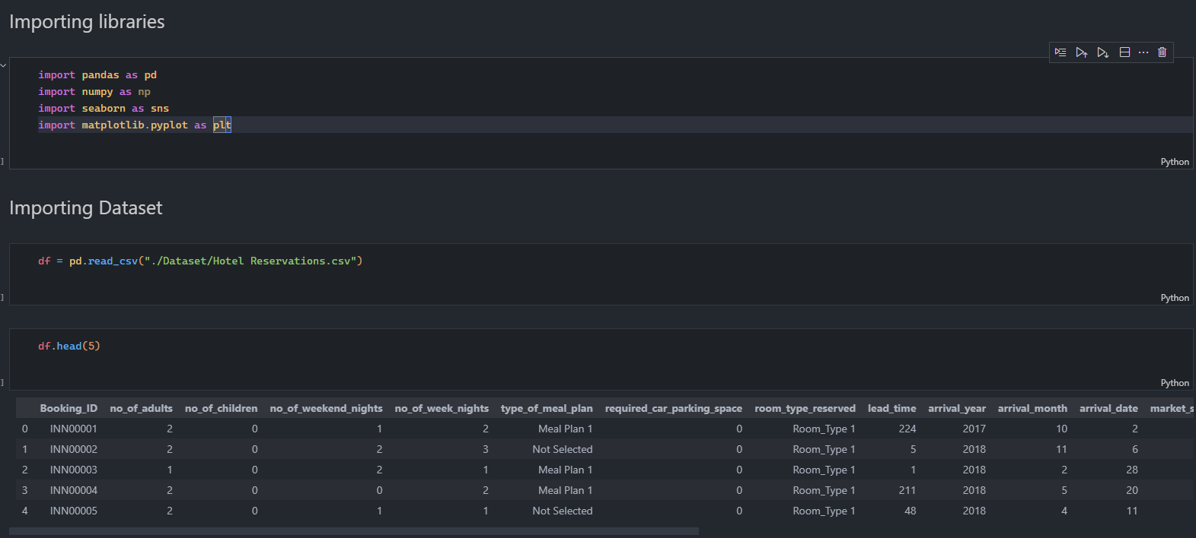
Steps required to implement feature reduction
Step-1: Import Libraries and dataset

Slide 12
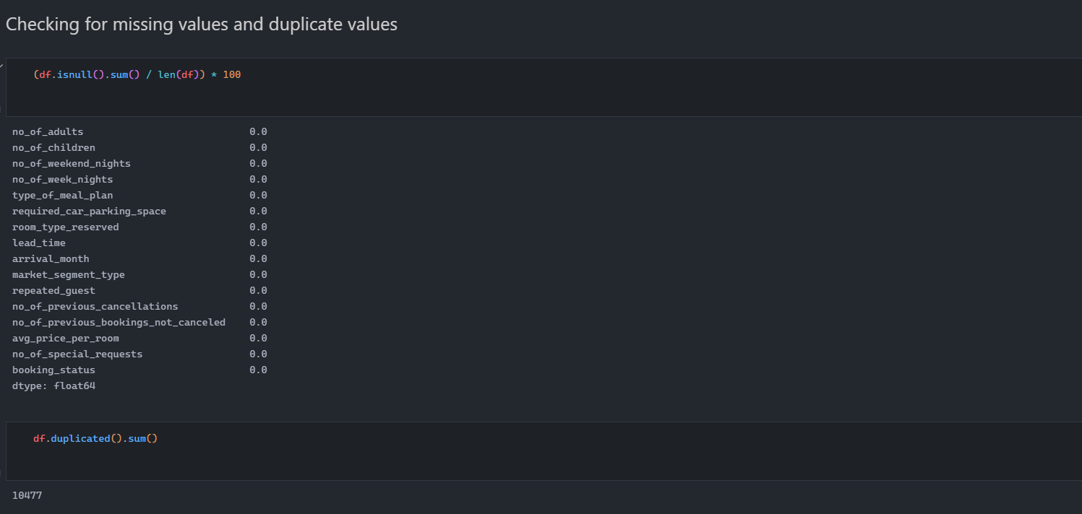
Steps required to implement feature reduction
Step-2: Missing values and duplicates

Slide 13

Steps required to implement feature reduction
Step-3: Encoding categorical values

Slide 14
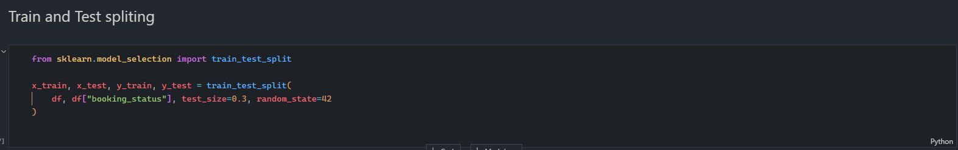
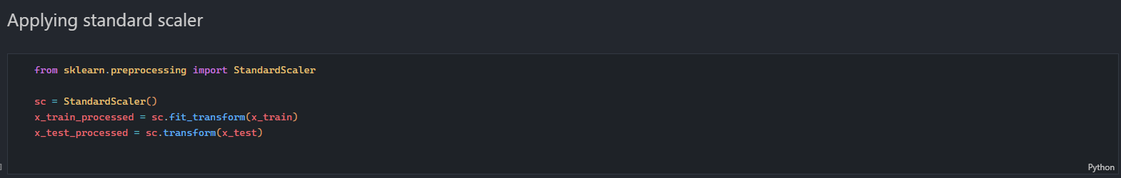
Steps required to implement feature reduction
Step-4: Train-test split and standardization

Slide 15

Steps required to implement feature reduction
Step-5: Principal component analysis (PCA)

Slide 16

Outcome of feature reduction

Slide 17
What would happen if we don’t apply feature reduction
Curse of Dimensionality
Increased Computational Complexity
Model Overfitting
Noise Sensitivity
Thank you

