Slide 1

Hajee Mohammad Danesh Science And Technology University
Project Name : Unit Converter
Course Code: CSE 254
Course Title: Object Oriented Programming (Java) Sessional

Slide 2
Submitted by
Md. Minto Mia (1702036)
Md Jahidul Islam Jahid (1702037)
Anupam Roy Argho (1702038)

Slide 3
Objective of the Project
To Convert Various units
from one to another

Slide 4
Inspirations of the project
Calculator And Mathematical
Unit Conversion Problems
Descriptions of the Project
Simple To Use
Converts Units
Get data
Shows Result

Slide 5
Advantages
Easy to operate
Simple User interface
Light weight
Fast And Accurate

Slide 6
Technical Description
Technical Function:
Select Any Unit
Get the Value Of Input
3.Convert and Back
Technical Tools Used:
Java Language, Netbeans IDE, Java Swing

Slide 7
Project’s Internel Structure
Procedure of Execution:
Interface (Java Swing)
Input Textfield
Convert button
Back button
Exit on close.

Slide 8
Algorithm:
Initialization Step:
Title of Frame
Default Close Operation
Set Frame size
Creation Step:
Create JFrame
Create Combobox
Create Jtextfield
Set the Operation
Final Step:
Run program.

Slide 9
Flowchart
Start
Home
Select Unit Name
Take Input
Back
Convert
Finish

Slide 10
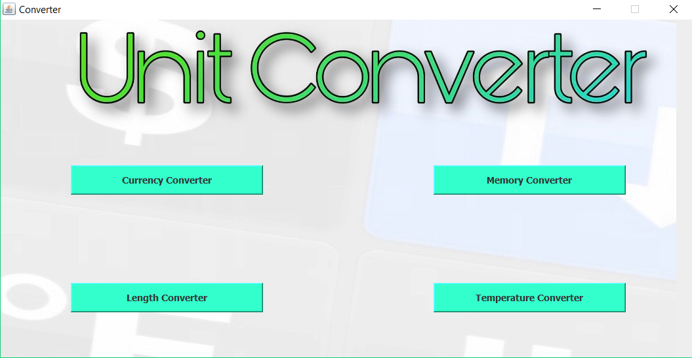
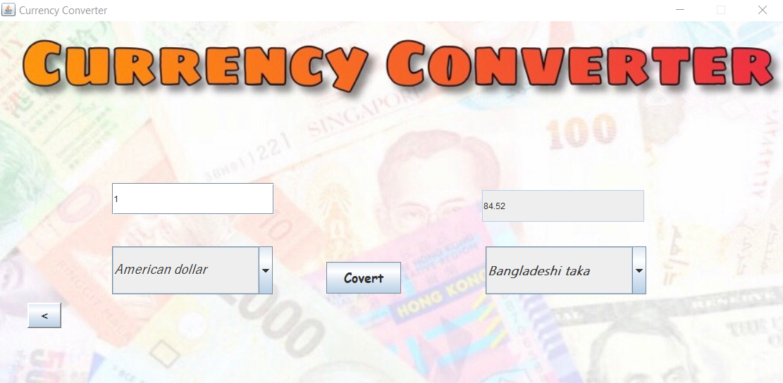
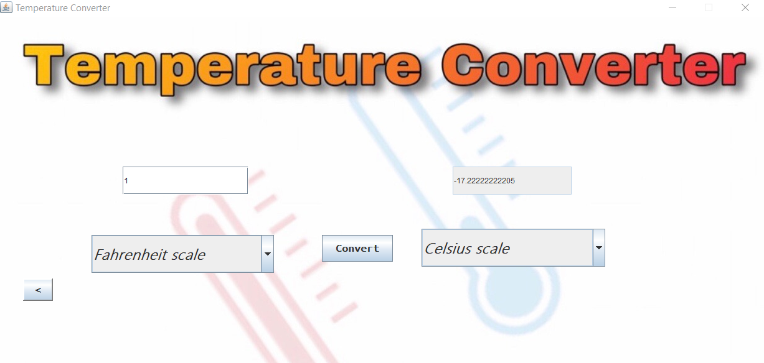
OutPut of the Project

Slide 11
Limitations of the Project
It can not save history
It has not custom convert option
The value of currency is fixed

Slide 12
Summary of the Project
Though some limitations here, we have done this project successfully.
We have created a Simple Unit Converter the basic GUI elements
of Java language.

Slide 13
Thank you
THE END

