Slide 1
OPERATION MANUAL

Slide 2
System Security

Slide 3
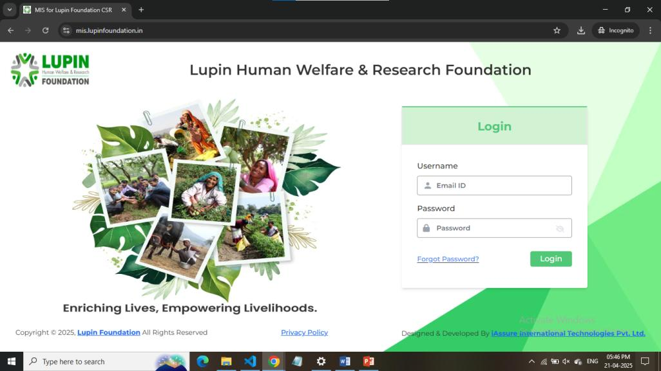
-
This is the Login Page of Lupin MIS. Fill your correct credentials into the input boxes (Username and Password) and then click on Login button.

Slide 4
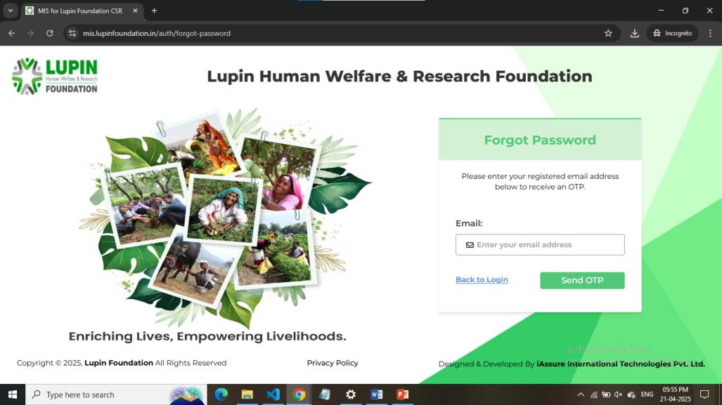
This is Forgot Password page. Fill your email and then click on Send OTP to receive OTP on your email.

Slide 5
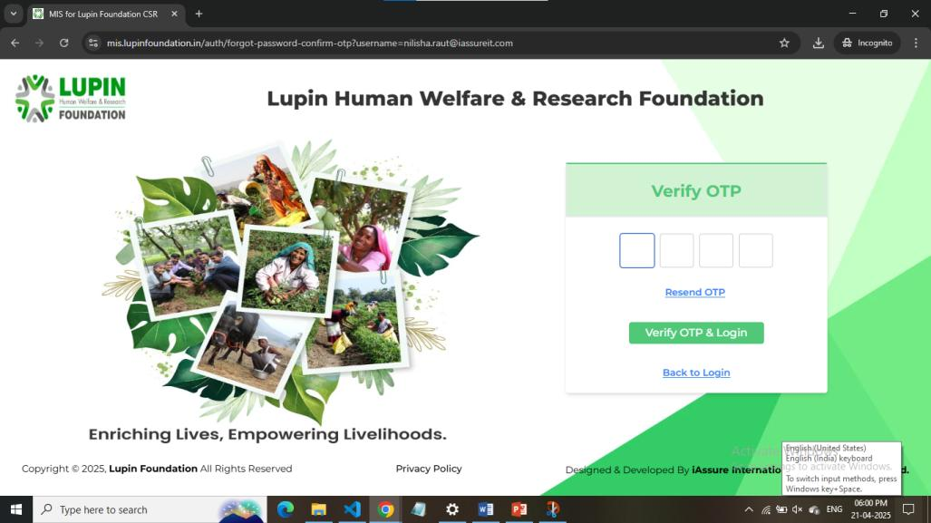
This is Verify OTP page. Enter the OTP which you have received on your email.

Slide 6
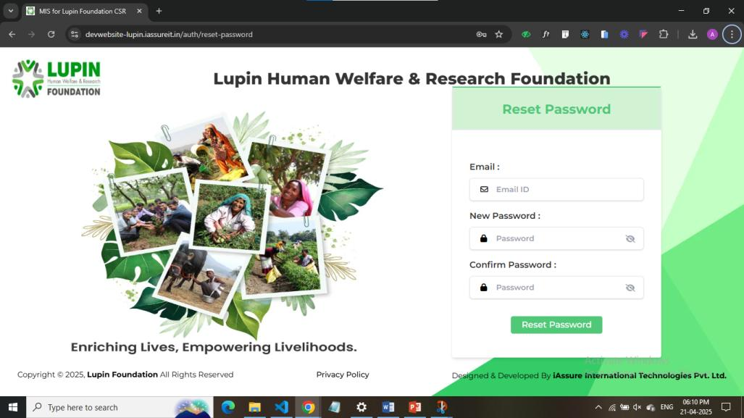
This is the Reset Password Page. Enter your Email, New Password and Confirm the New Password.

Slide 7
User Management

Slide 8
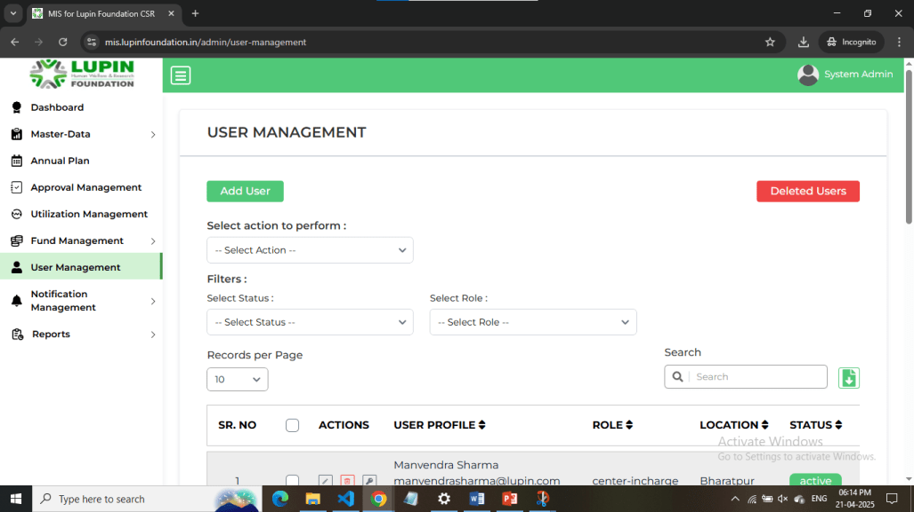
This is User Management page. See the Users List along with their details. Click on Add User to Create a New User. Click on Deleted Users to see the list of Deleted Users. Select user and perform action or see different users after adding filters.

Slide 9
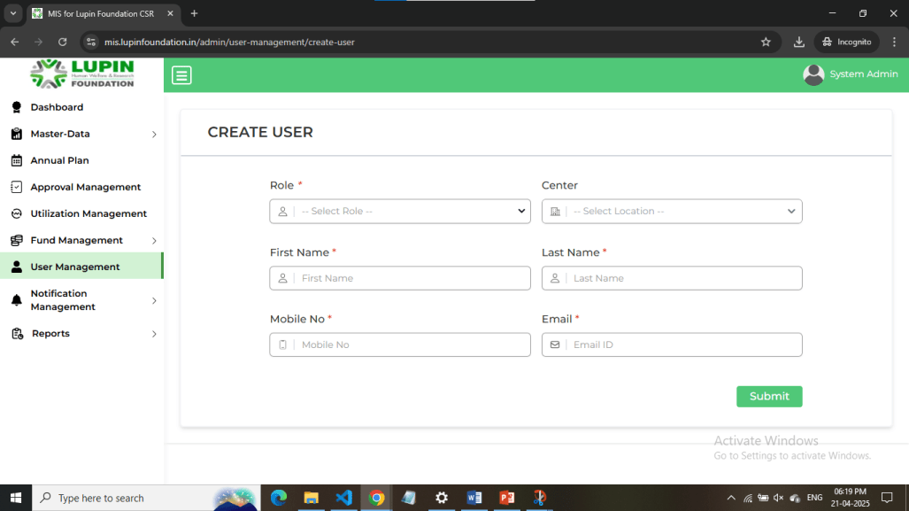
This is Create User page. Fill data of the user which you want to add in the system, assign the correct roles and click on Submit.

Slide 10
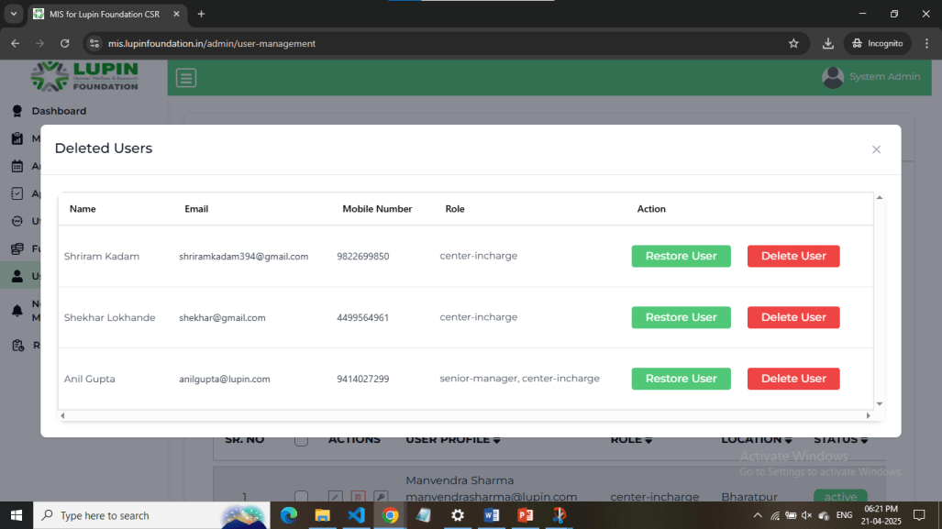
This is the Deleted Users page. See the list of temporarily deleted users. Click on Restore User to restore the user in the system again. Click on Delete User to delete the user permanently.

Slide 11
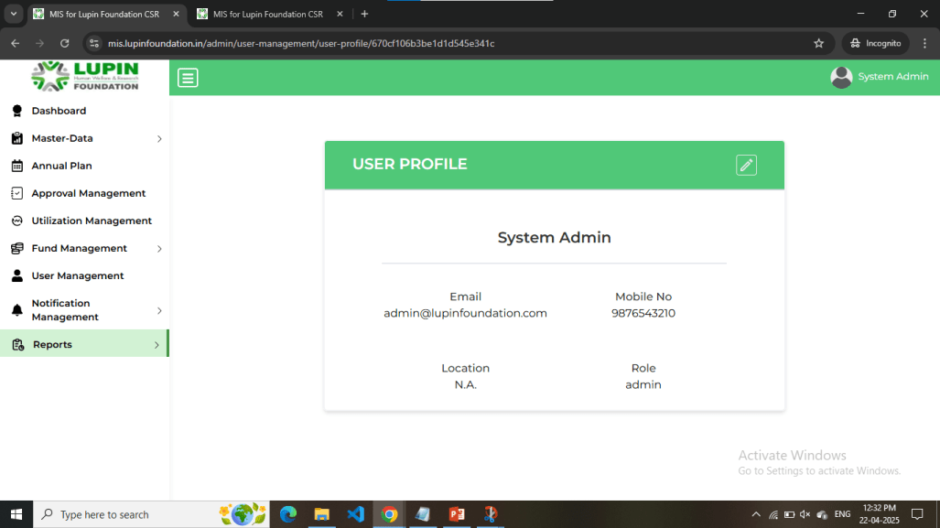
This is User Profile page. You can edit user details by clicking on Pencil icon in top-right corner.

Slide 12
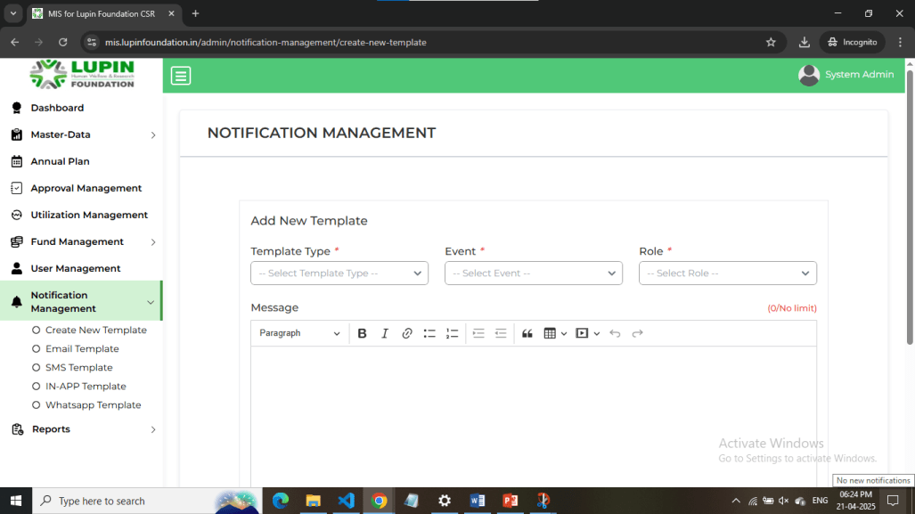
This is the Create New Template page. Select the Template type, Notification event and Role and add the message body.

Slide 13
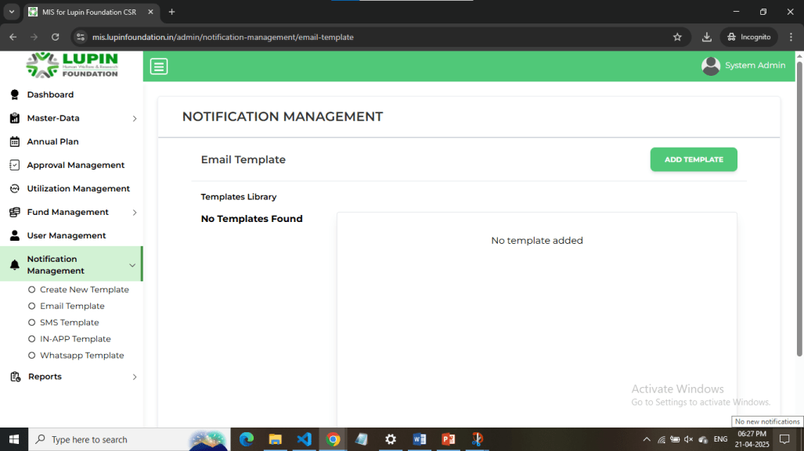
This is the Template list page. Select template list pages according to template type to see the list of Notification templates added in the system.

Slide 14
Dashboard

Slide 15
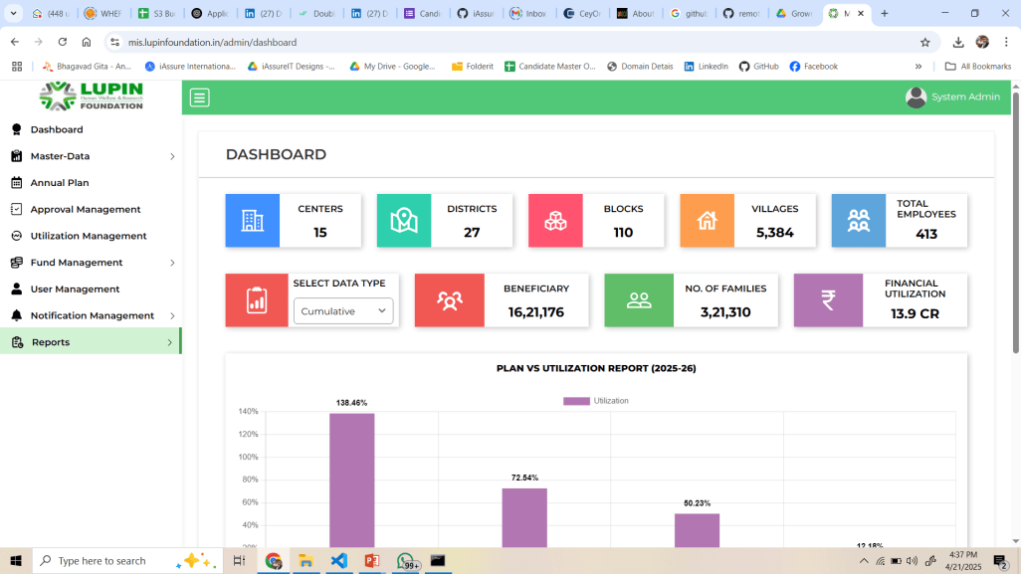
This is the Dashboard to see the summary of whole application. You can see the data of all centers for admin and executive roles. For centerwise data, you have to login as a center-incharge.
You can change the Duration to see different figures.

Slide 16
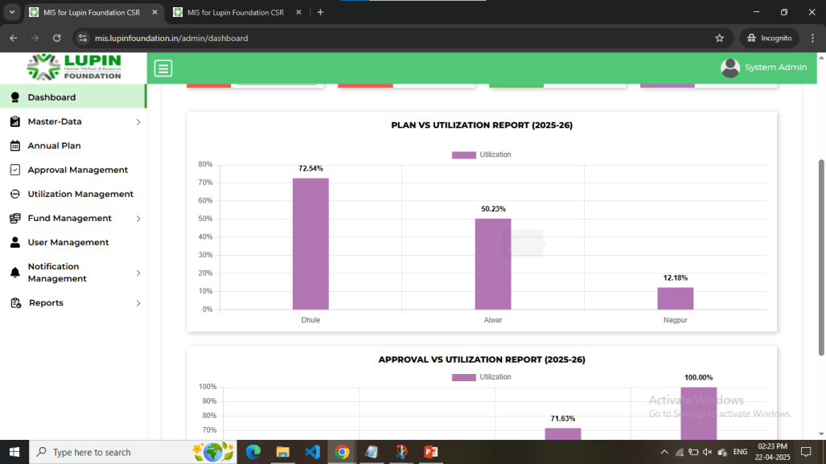
This is Plan vs Utilization Report. The Percentage Utilization for the current financial year against an Annual Plan is calculated and shown in the bar chart format.

Slide 17
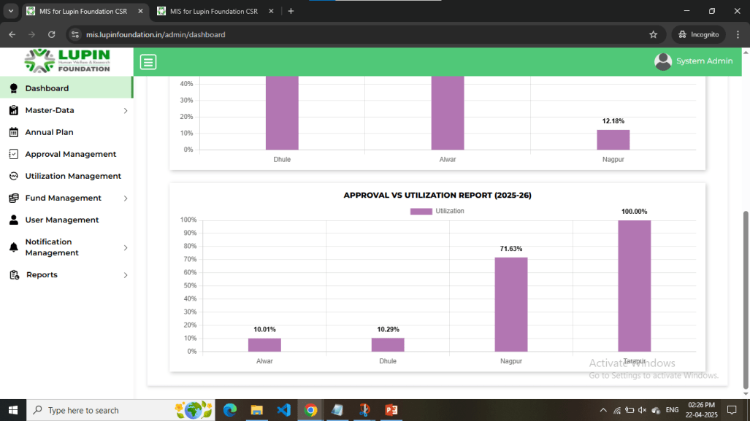
This is Approval vs Utilization Report. The Percentage Utilization for the current financial year against an Approval is calculated and shown in the bar chart format.

Slide 18
Master Data

Slide 19
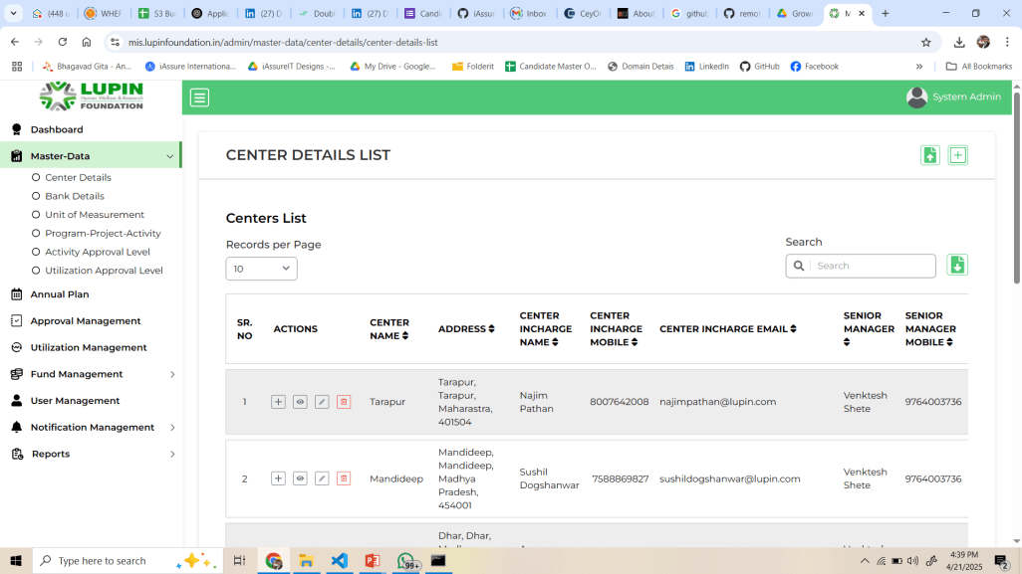
This is Center List Master. On Top-right, click + icon to open a New Center Details Form. Click on Upload icon to add Geographical data via bulk upload.

Slide 20
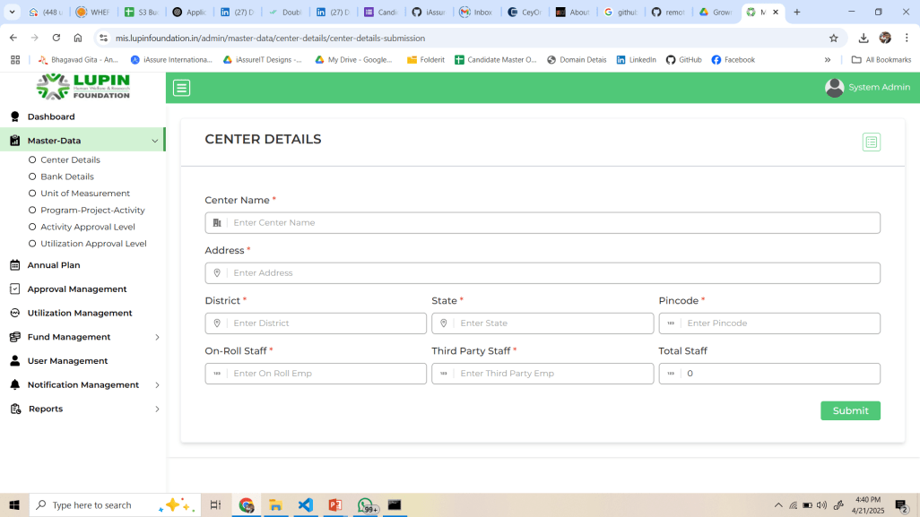
This is New Center Form. Enter all details and Submit.

Slide 21
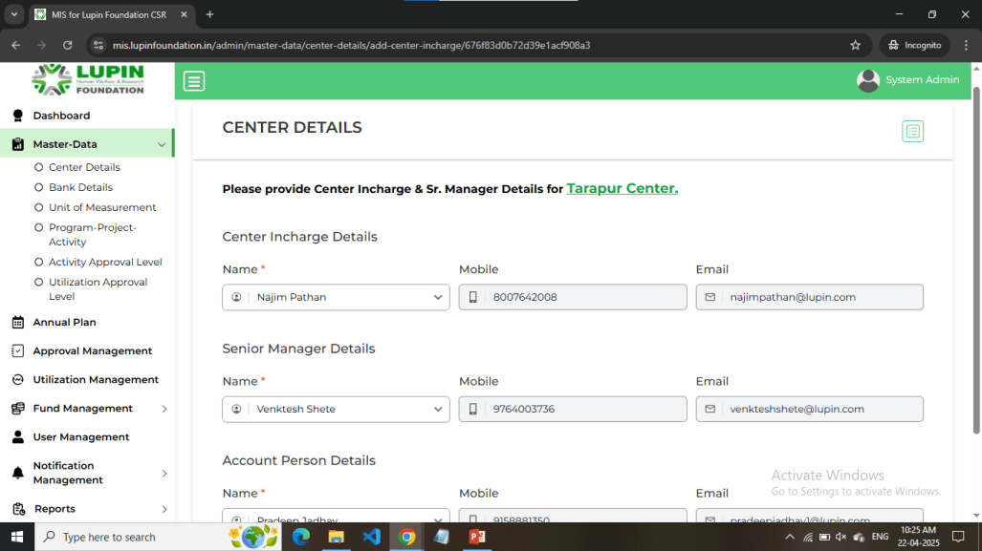
This is Add Center Incharge page. Assign Center Incharge, Senior Manager and Account Person for a specific center.

Slide 22
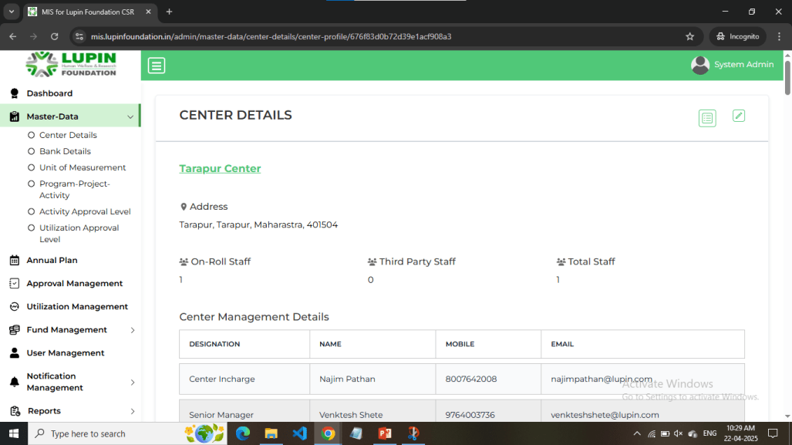
This is Center Details page. All information about the center such as geographical data will be shown here.

Slide 23
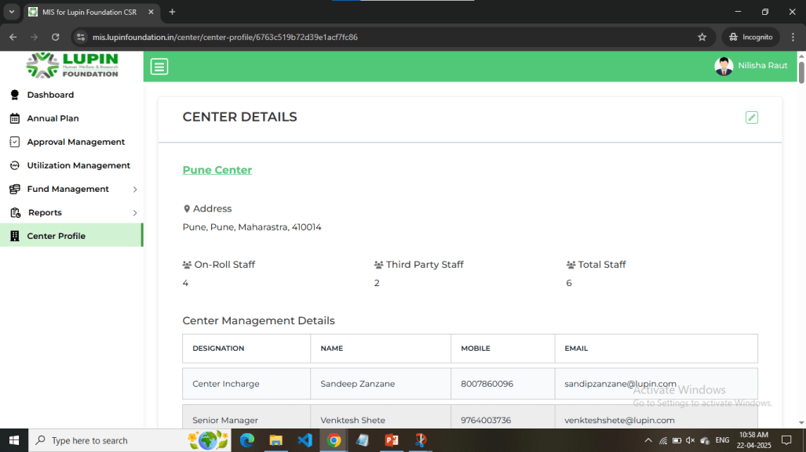
This is Center Profile page accessible for Center Incharge only.

Slide 24
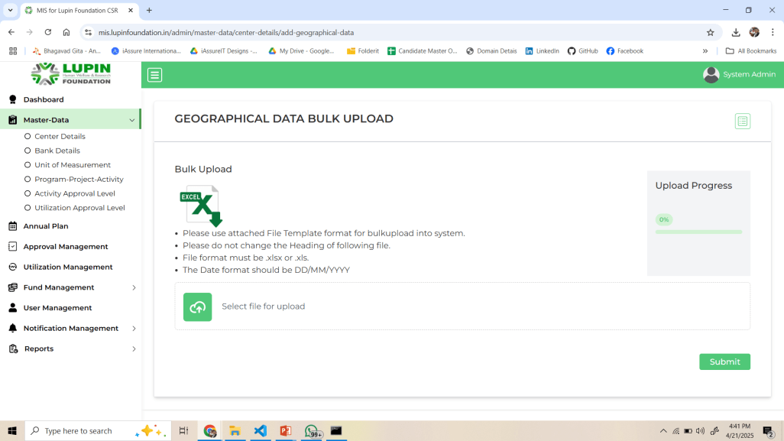
This is Bulk Upload facility for Geographical Locations. Download the Template and fill up your data. Then upload again.

Slide 25
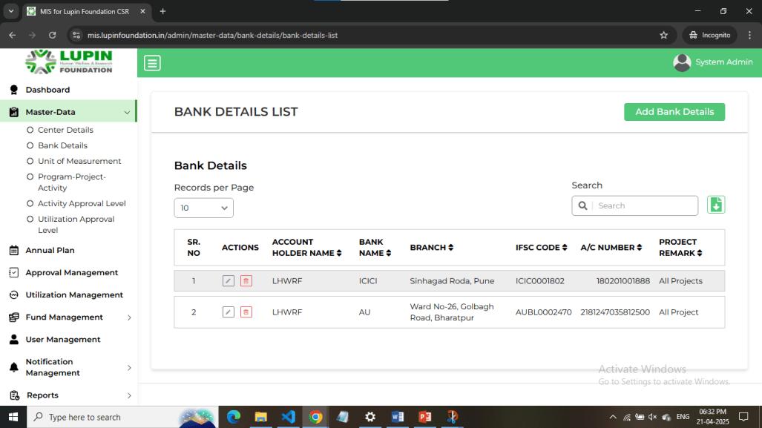
This is Bank Details List page. Click on Add Bank Details in the top right corner to add new Bank Details.

Slide 26
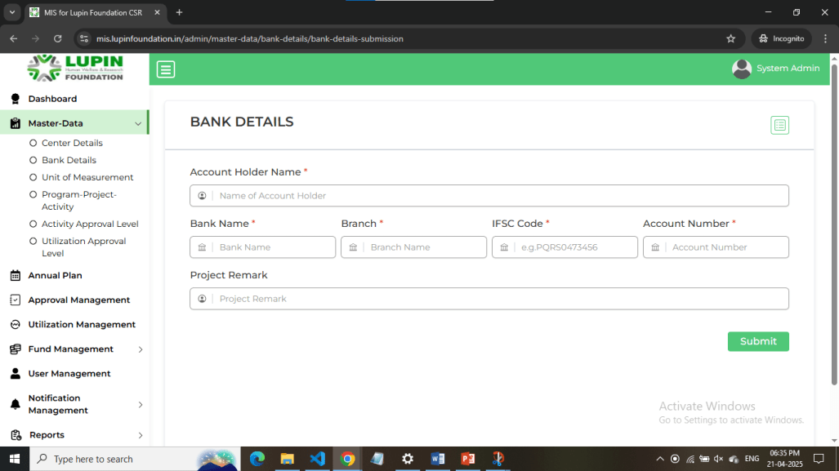
This is Bank Details Page. Fill up Bank Details and click on Submit.

Slide 27
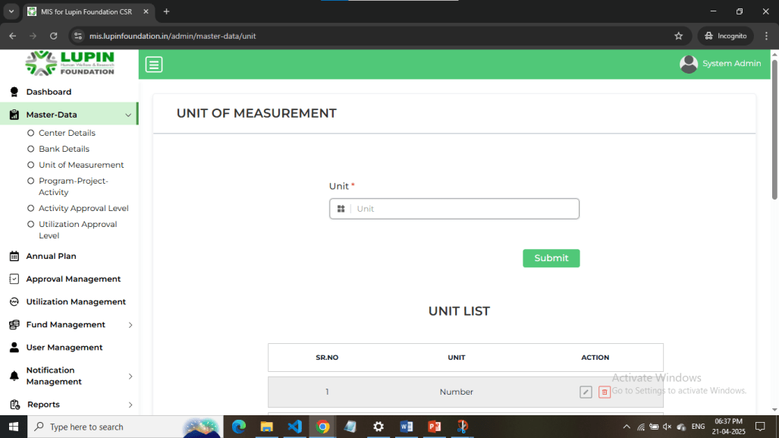
This is Unit of Measurement page. Add Units or See the List of Units below.

Slide 28
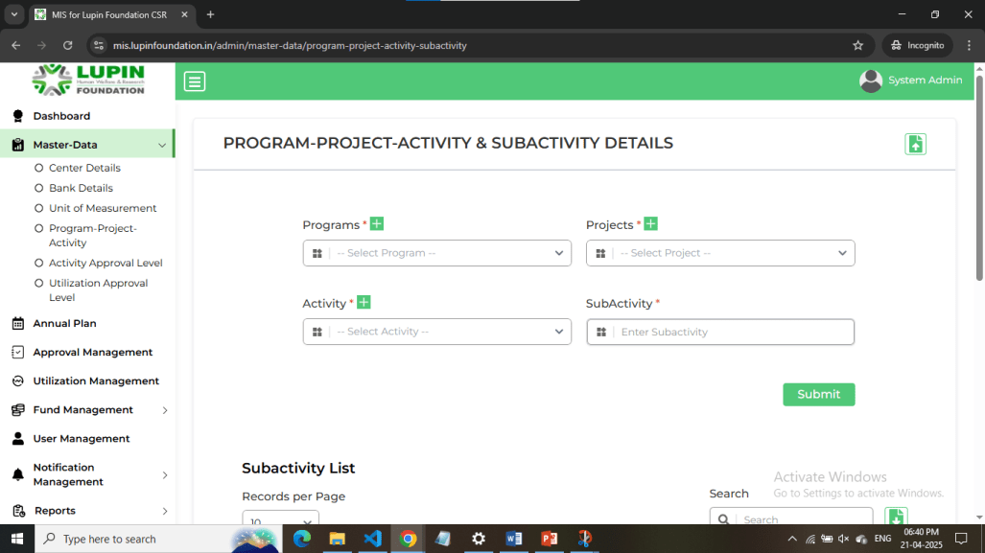
This is Program-Project-Activity-Subactivity List page. Link the 4 fields to each other and see the list below. Click on + icon to open the respective field page. Click on upload icon in the top-right to upload the data.

Slide 29
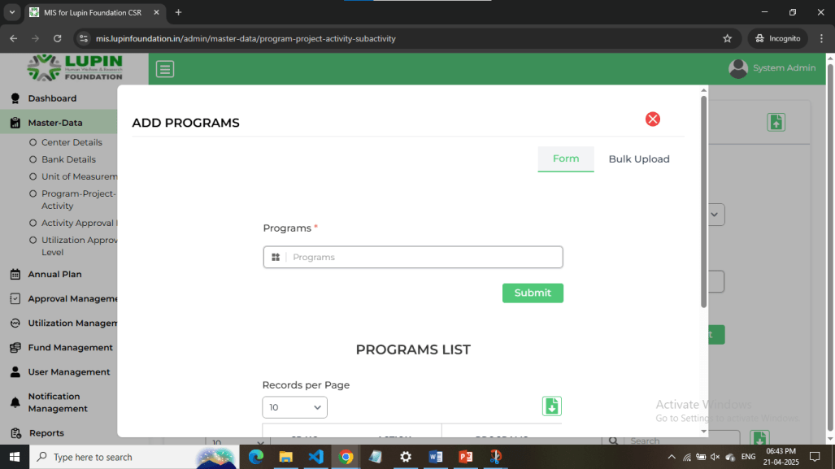
This is the Add Programs page. Add Programs and see their list below. Click on Bulk upload in the top right to add the Programs in bulk.

Slide 30
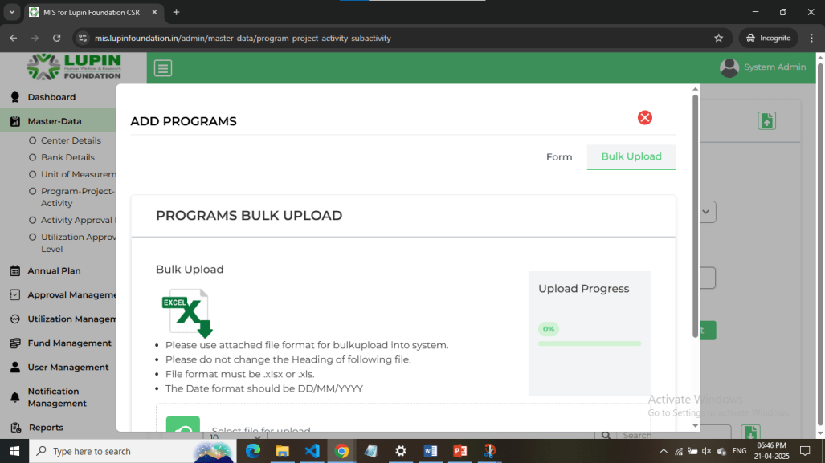
This is the Program Bulk upload page. Click on Excel icon to download the template and upload your data.

Slide 31

This is the Add Projects page. Add Projects and see their list below. Click on Bulk upload in the top right to upload the projects in bulk.

Slide 32

This is the Projects Bulk Upload page. Download the template after clicking on Excel icon and add your data.

Slide 33

This is Add Activity page. Add Activities and see their list below. Click on Bulk Upload to upload the Activities in bulk.

Slide 34
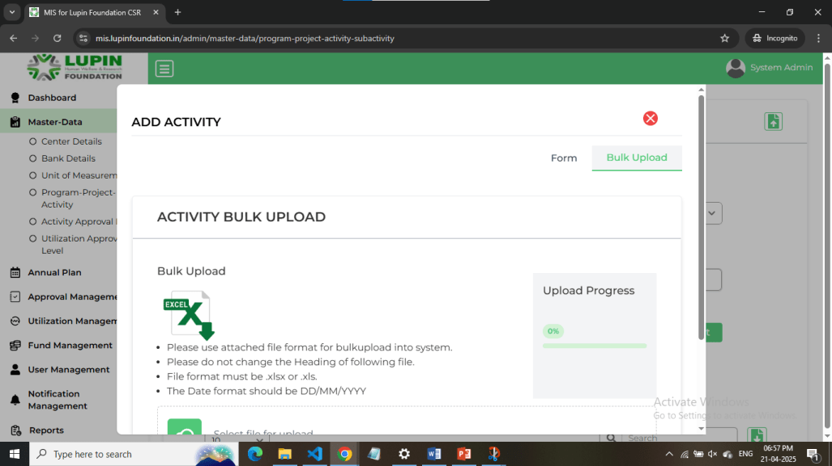
This is Activity Bulk Upload page. Download the template after clicking on excel icon and add your data

Slide 35
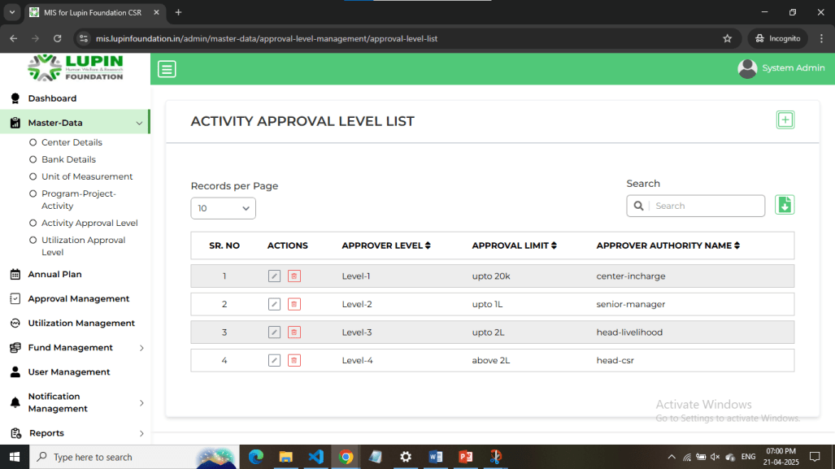
This is Activity Approval Level List page. Click on + icon in the top right to add activity approval levels as per their roles.

Slide 36
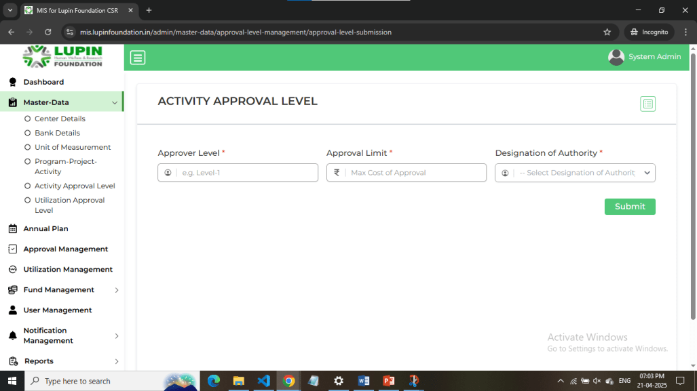
This is the Activity Approval Level page. Fill up the data and click Submit. See the list of activity approval levels by clicking on top right list icon.

Slide 37

This is Utilization Approval Level List Page. Click on + icon to add Utilization Approval Levels as per their roles.

Slide 38
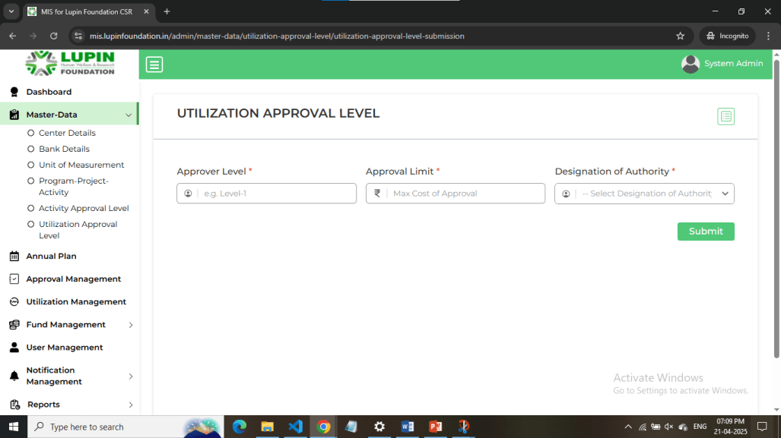
This is Utilization Approval Level list page. Add your data and click on Submit. Click on top right list icon to navigate to list.

Slide 39
Annual Plan Management

Slide 40
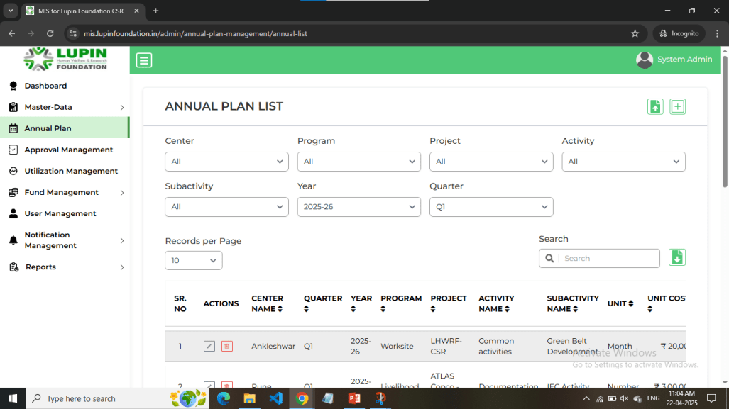
This is Annual Plan List Page. Click on + icon in the top-right corner to add a new Annual Plan. Click on upload button adjacent to it for adding Annual Plans in bulk. Click on download icon near Search input to download the data.

Slide 41
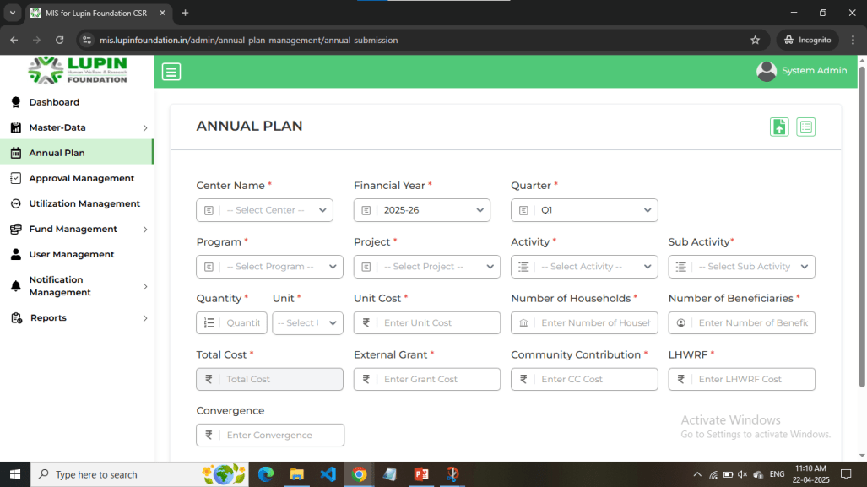
This is Annual Plan form page. Click on list icon at top-right corner to navigate to Annual Plan list.

Slide 42
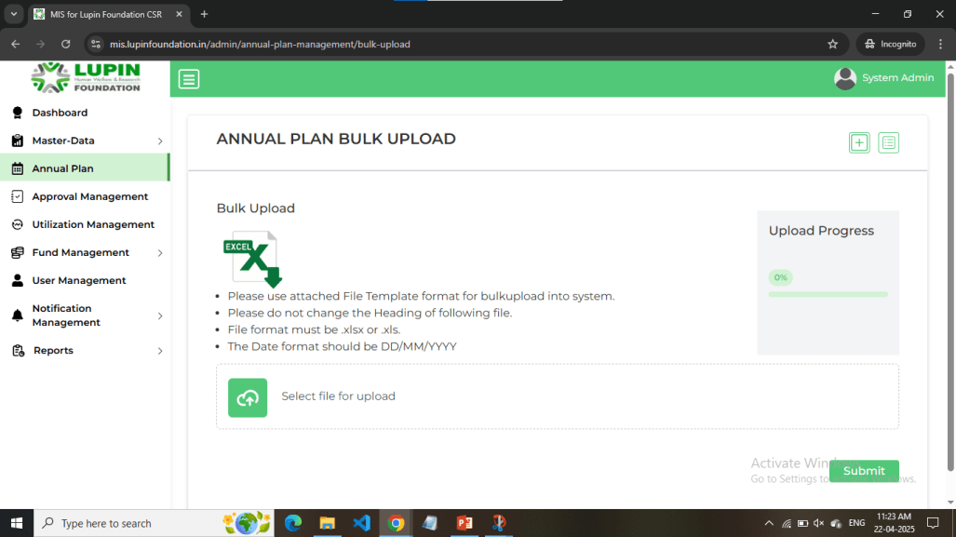
This is Annual Plan Bulk upload page. Click on excel icon to download the template. Add your data and upload it.

Slide 43
Approval Management

Slide 44
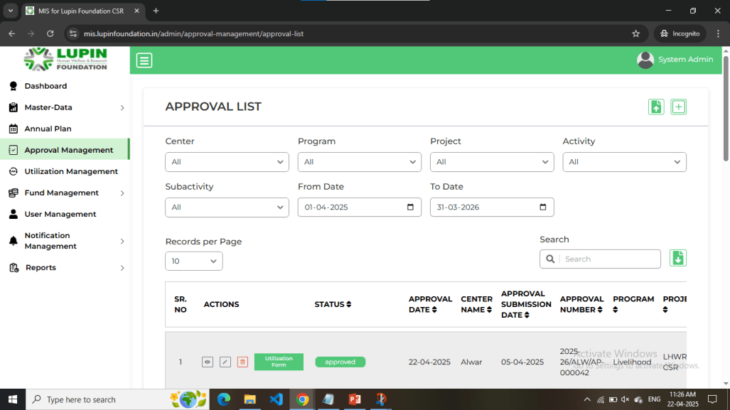
This is Approval List Page. Click on + icon in the top-right corner to add a new Approval. Click on upload button adjacent to it for adding Approvals in bulk. Click on download icon near Search input to download the data.

Slide 45
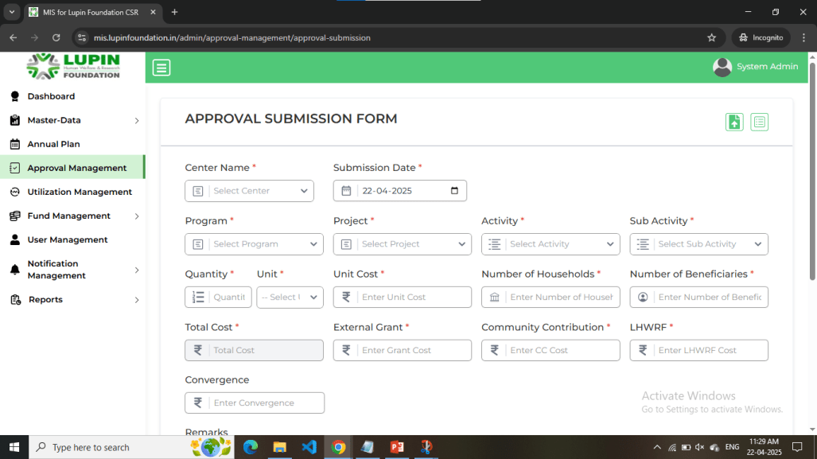
This is Approval Submission form page. Click on list icon at top-right corner to navigate to Approval list.

Slide 46
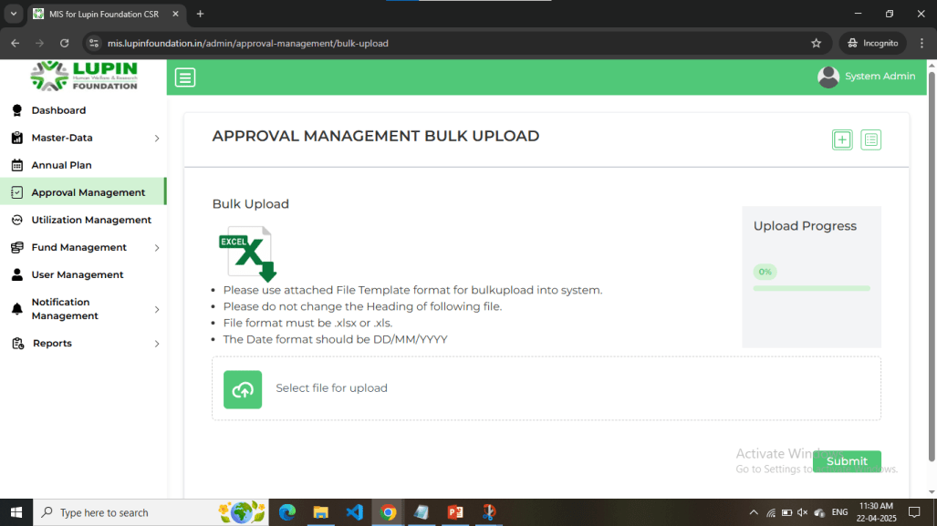
This is Approval Bulk upload page. Click on excel icon to download the template. Add your data and upload it.

Slide 47
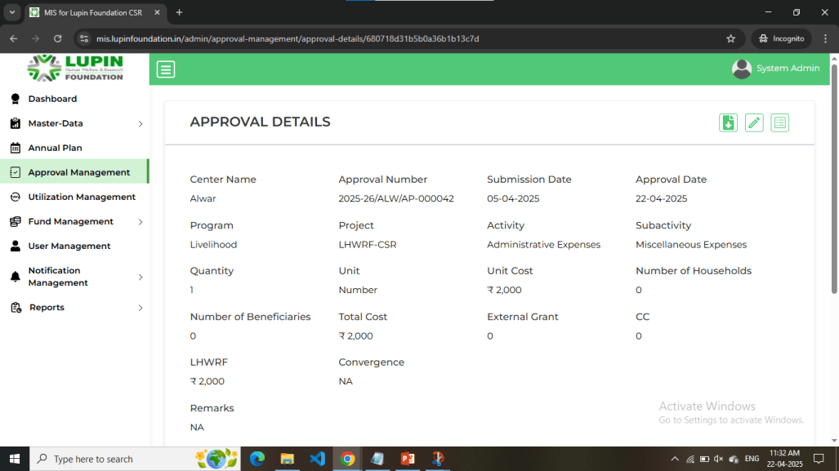
This is Approval Details page. If the authority is a valid user, he can approve or reject the Approval. Also, you can download this page in pdf format by clicking on download icon in top-right corner.

Slide 48
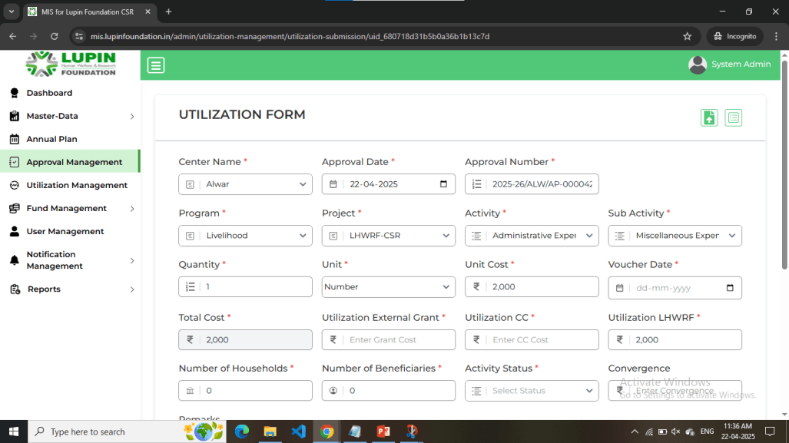
This is Utilization form page. If approval gets approved by all valid authorities, you can see this button in actions column of Approval list.

Slide 49
Utilization Management

Slide 50
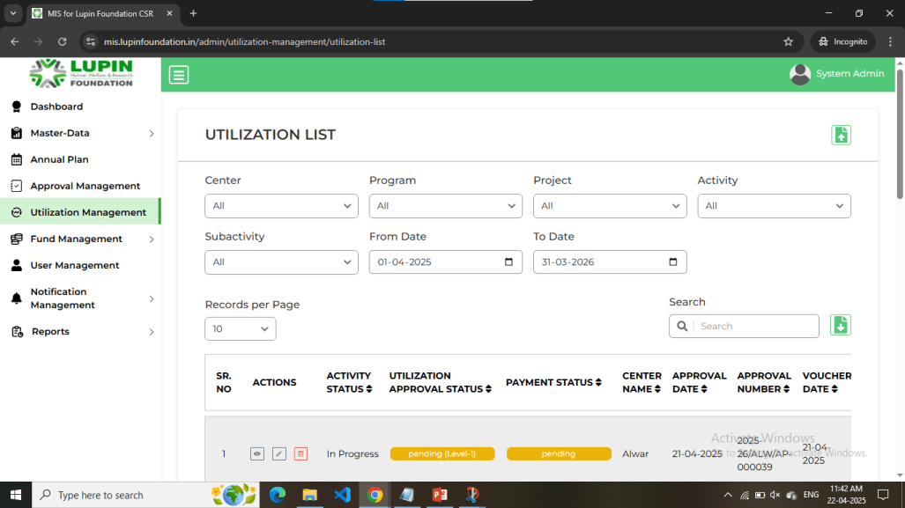
This is Utilization List Page. Click on upload button adjacent to it for adding Utilizations in bulk. Click on download icon near Search input to download the data.

Slide 51
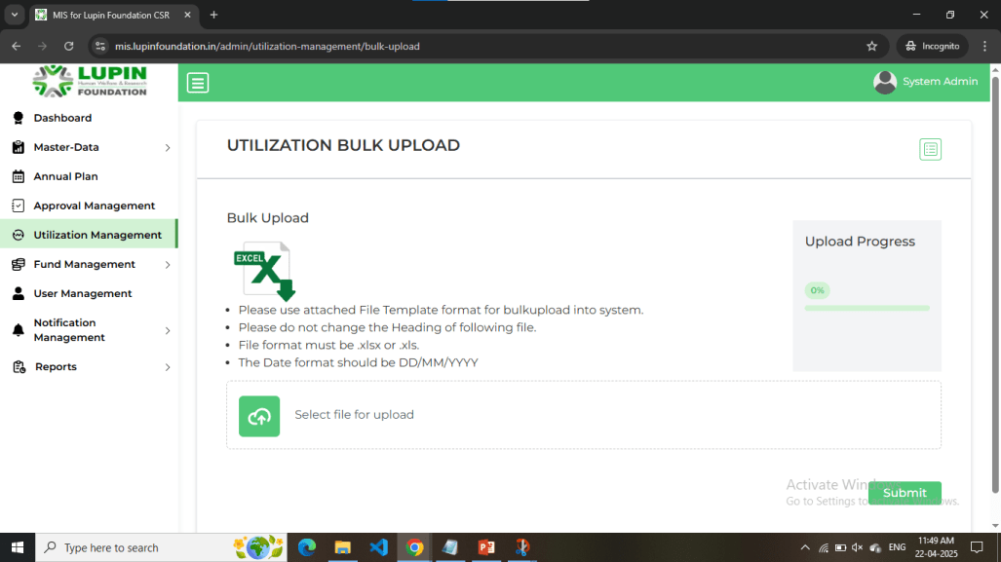
This is Utilization Bulk upload page. Click on excel icon to download the template. Add your data and upload it.

Slide 52
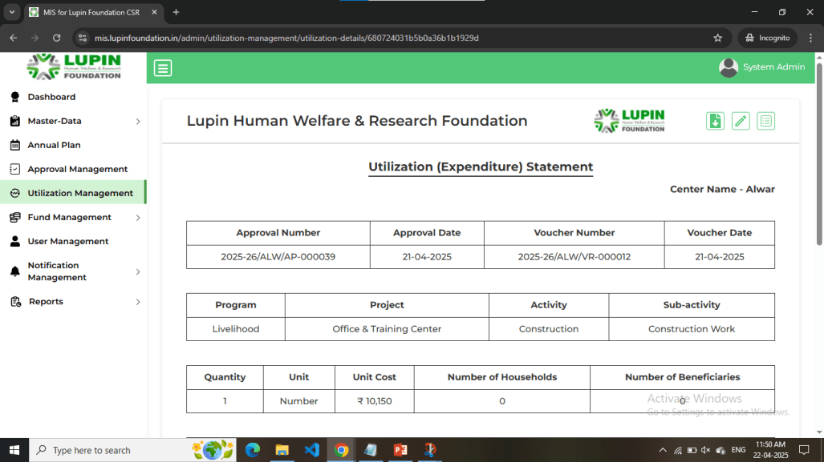
This is Utilization Details page. If the authority is a valid user, he can approve or reject the Utilization Approval. Also, you can download this page in pdf format by clicking on download icon in top-right corner.

Slide 53
Fund Management

Slide 54
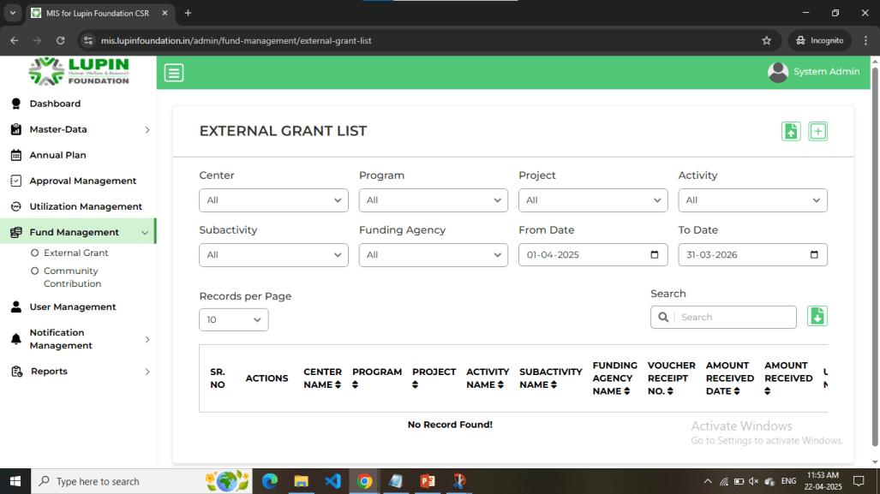
This is External Grant List Page. Click on + icon in the top-right corner to add a new External Grant. Click on upload button adjacent to it for adding External Grants in bulk. Click on download icon near Search input to download the data.

Slide 55
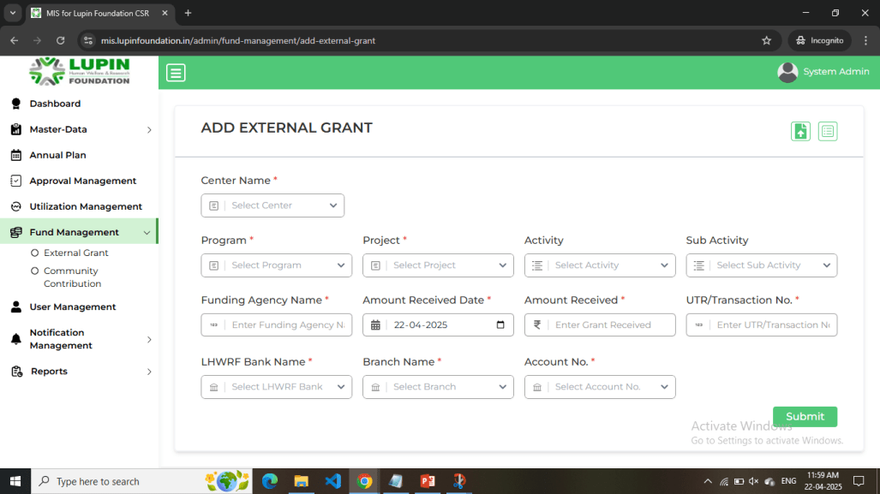
This is External Grant Submission form page. Click on list icon at top-right corner to navigate to External Grant list.

Slide 56
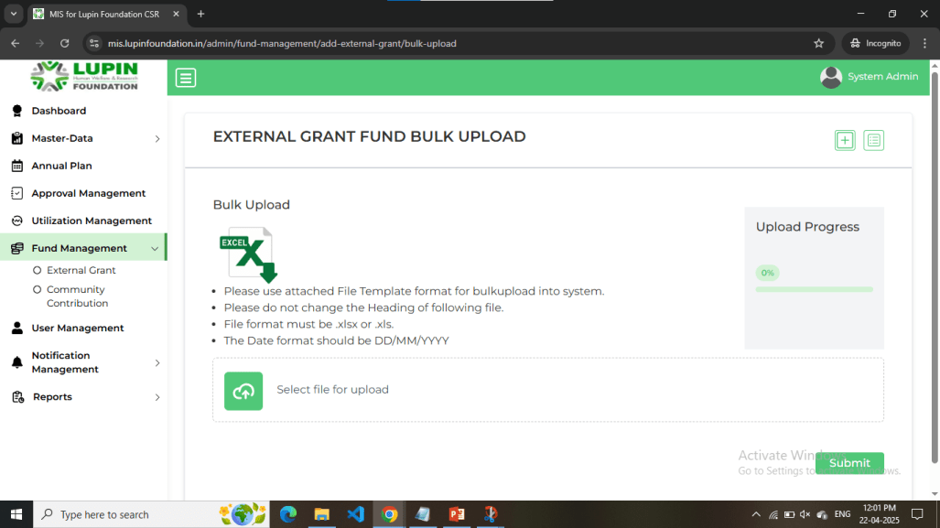
This is External Grant Bulk upload page. Click on excel icon to download the template. Add your data and upload it.

Slide 57
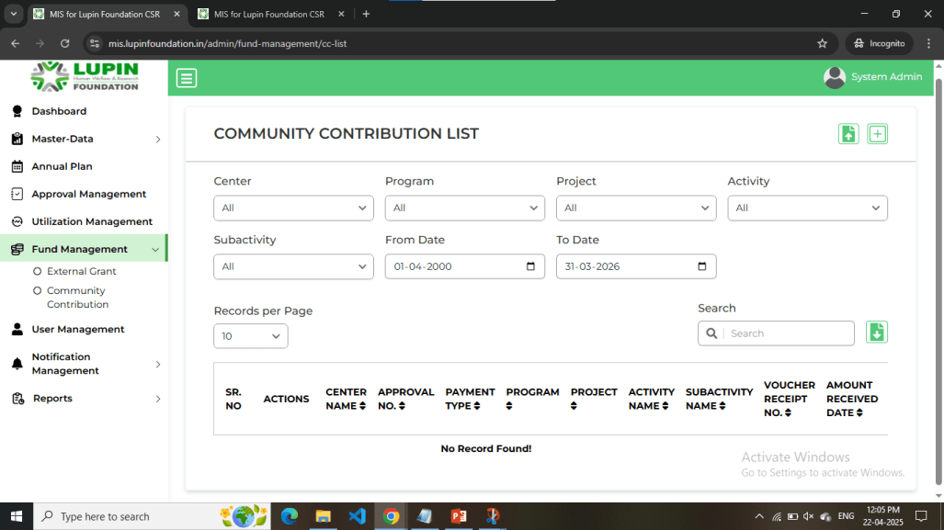
This is Community Contribution List Page. Click on + icon in the top-right corner to add a new Community Contribution. Click on upload button adjacent to it for adding Community Contributions in bulk. Click on download icon near Search input to download the data.

Slide 58
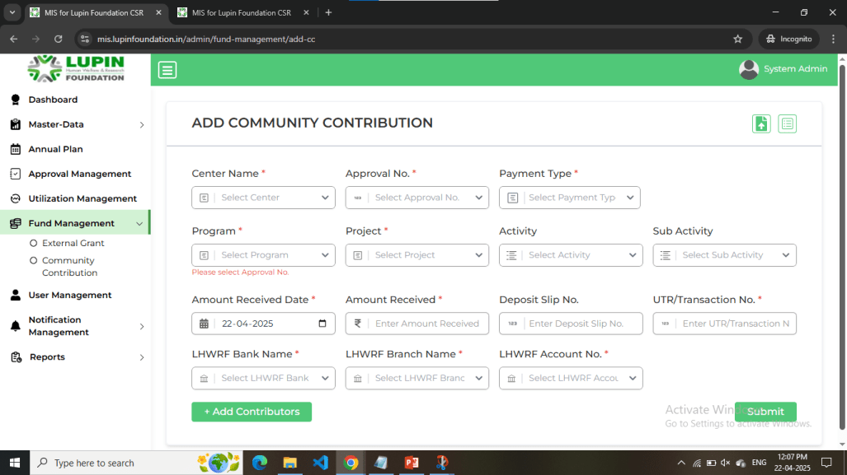
This is Community Contribution Submission form page. Click on list icon at top-right corner to navigate to Community Contribution list.

Slide 59
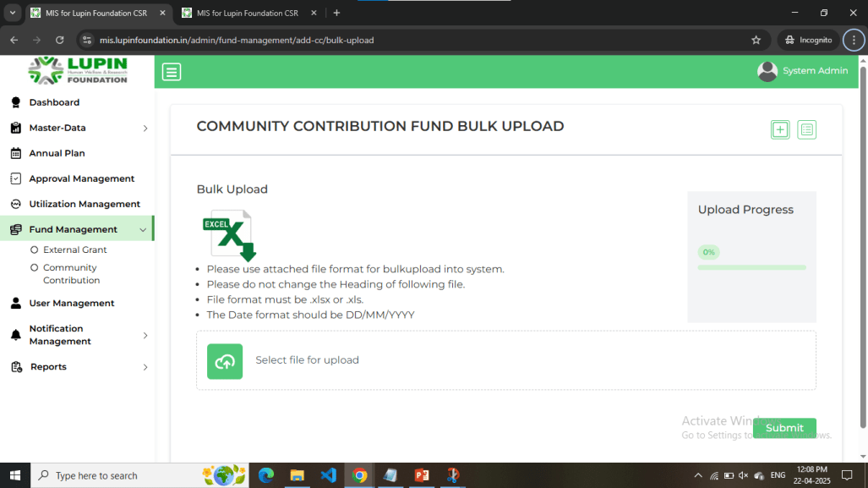
This is Community Contribution Bulk upload page. Click on excel icon to download the template. Add your data and upload it.

Slide 60
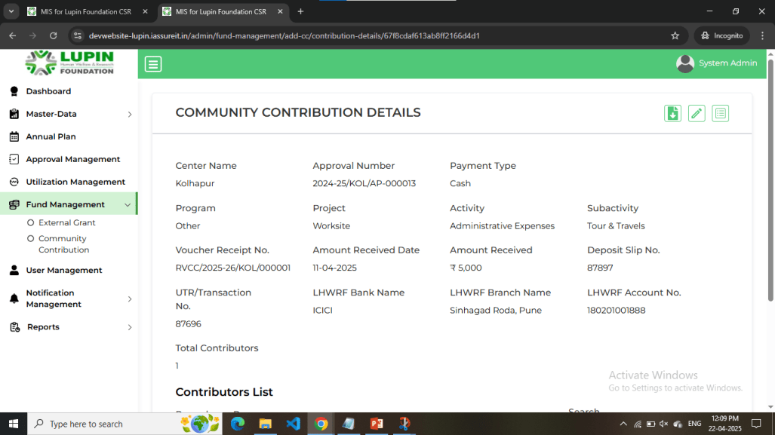
This is Community Contribution Details page. You can download this page in pdf format by clicking on download icon in top-right corner.

Slide 61
Reports

Slide 62
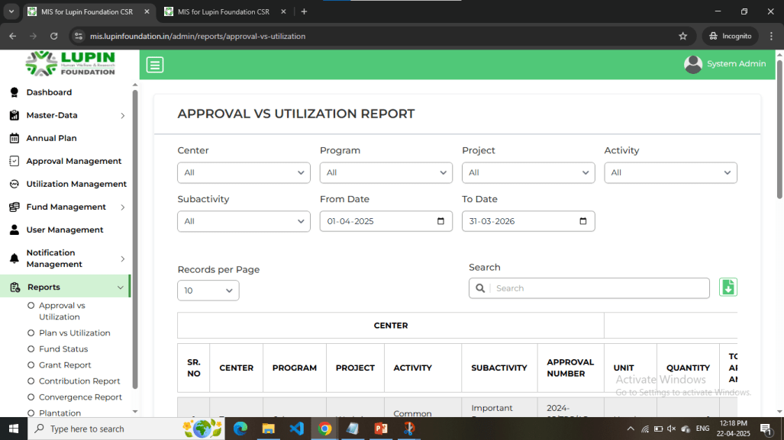
This is Approval vs Utilization Report Page. Click on download icon near Search input to download the report.

Slide 63
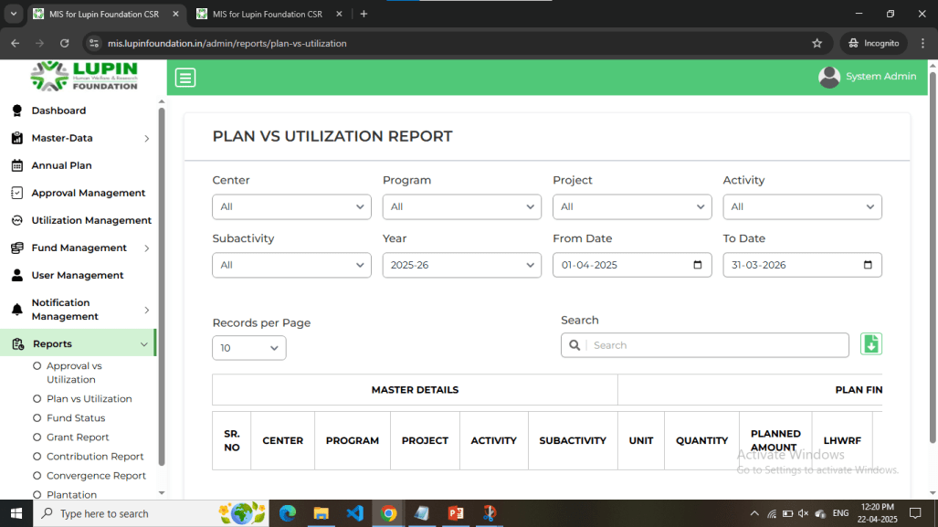
This is Plan vs Utilization Report Page. Click on download icon near Search input to download the report.

Slide 64
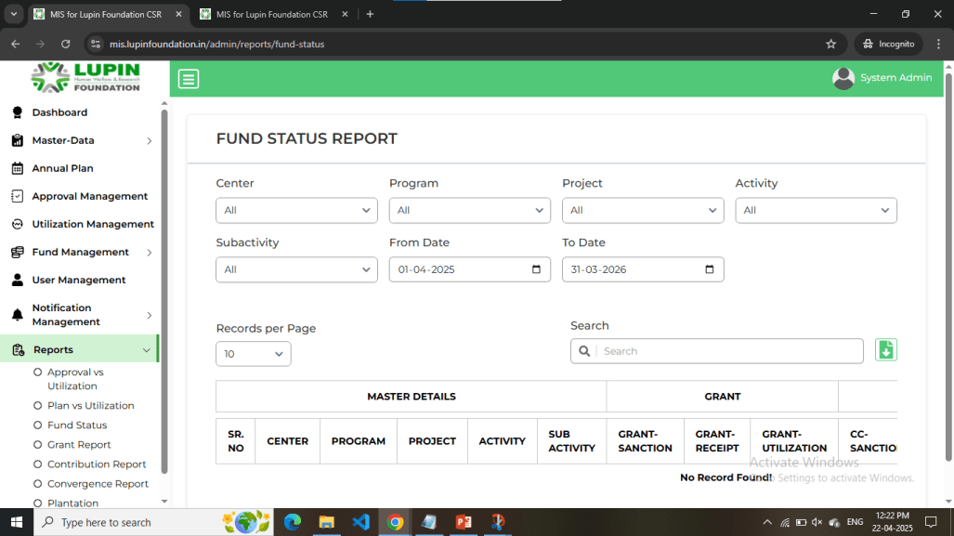
This is Fund Status Report Page. Click on download icon near Search input to download the report.

Slide 65

This is Grant Report Page. Click on download icon near Search input to download the report.

Slide 66

This Contribution Report Page. Click on download icon near Search input to download the report.

Slide 67

This is Convergence Report Page. Click on download icon near Search input to download the report.

Slide 68

This is Plantation Report Page. Click on download icon near Search input to download the report.

Slide 69

This is WRD Report Page. Click on download icon near Search input to download the report.

