Slide 1
Product Page Enhancements

Slide 2
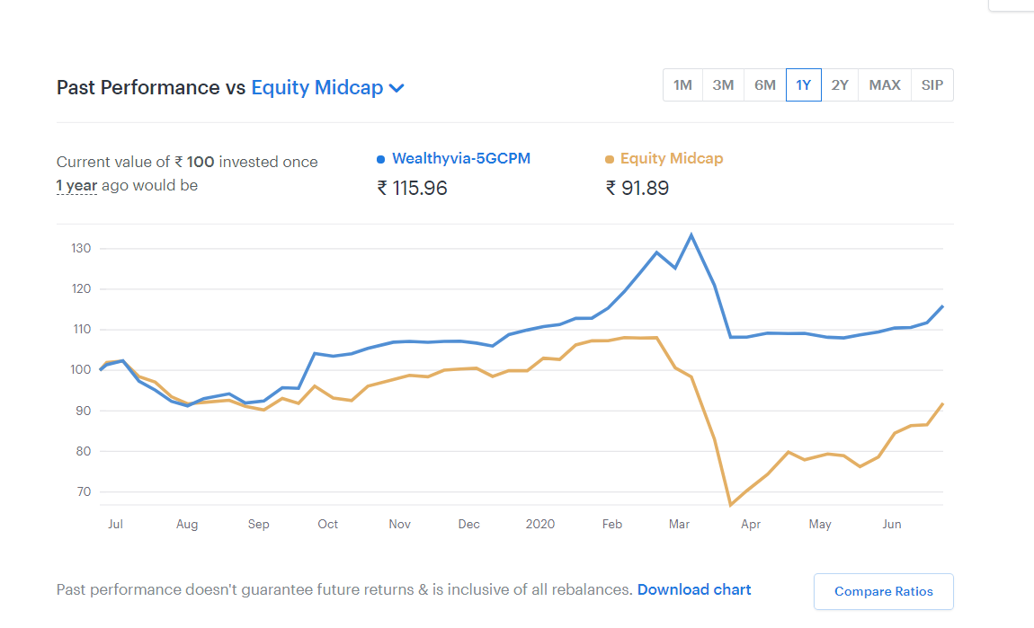
Update Below graph using csv from link at products . Csv is at download chart
https://arthavruddhi.smallcase.com/smallcase/AVCMO_0002/stocks

Slide 3
All 3 products are to be added for such charts
5GCPM
Superfocus (page to be added in offering)
SafeHaven
If possible for USA , will give one online portfolio

Slide 4
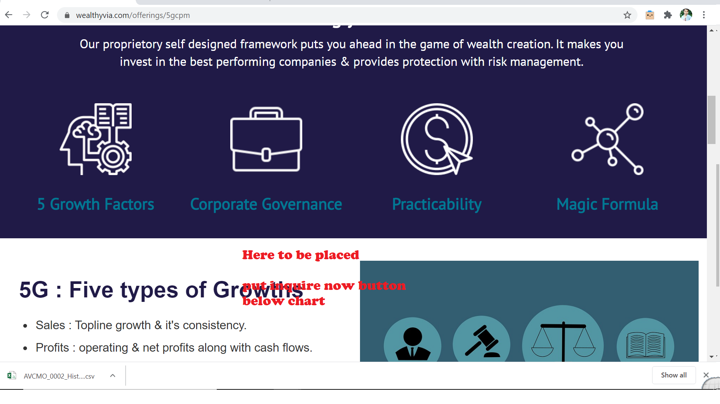
Where to place chart
Below First big window

