Slide 1
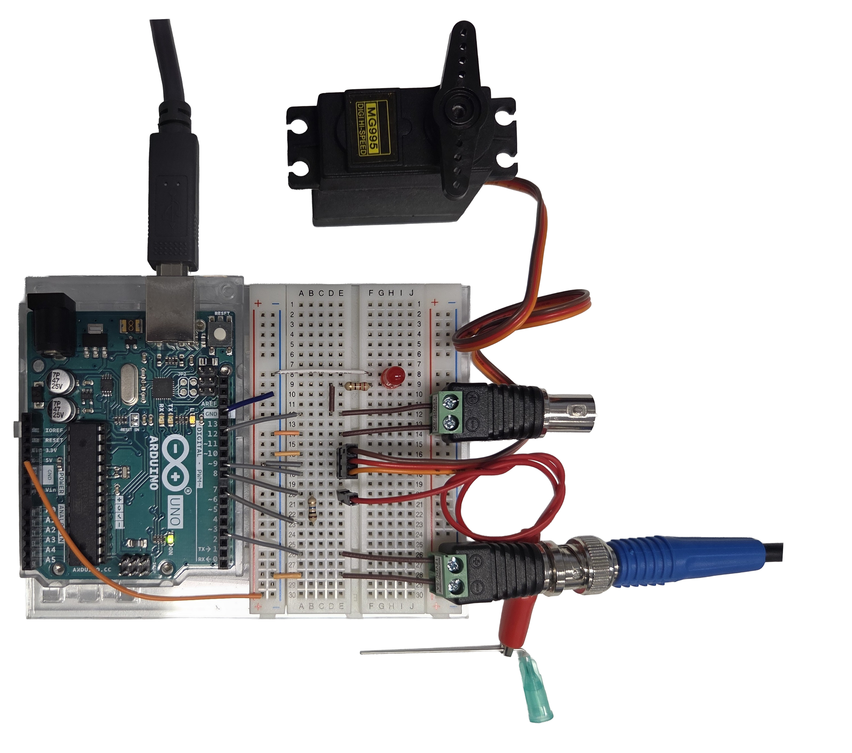
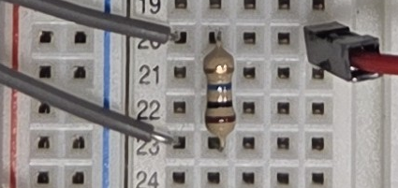
Serial Communication Raw Δt Values via USB
Servo Motor Lickspout Positioning
- (GND) + (5V) D9
Firmware: CapacitiveSensor Library Servo Library Threshold Configuration Lick Counting Serial Communication Triggering
5V (lick)
GND
0V (baseline)
D12
Lick Out 1x 5v TTL Pulse
GND
5V (In)
D3
0V (Out)
Lickspout Control In/Out
GND
Receive Pin
Antenna
Lickspout (Capacitive Sensor) 18 Gauge Needle
U
t_{receive} – t_{send} = Δt Δt changes if sensor is touched due to increased capacity
Send Pin
1MΩ Resistor sensitivity configuration Up to 10 MΩ

