Slide 1
My Sparta Game Project Beat the Tiles
By Ross Brown

Slide 2
Demo
Click to Play

Slide 3
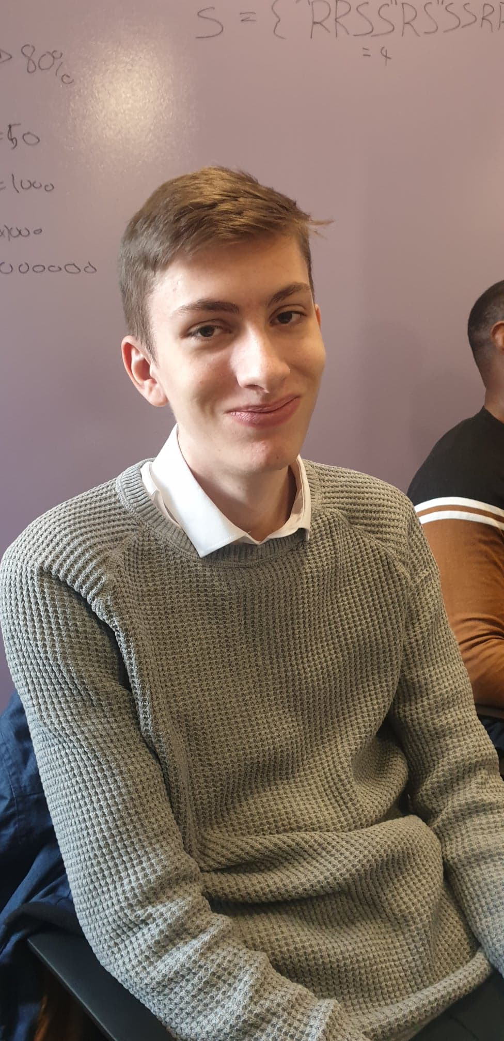
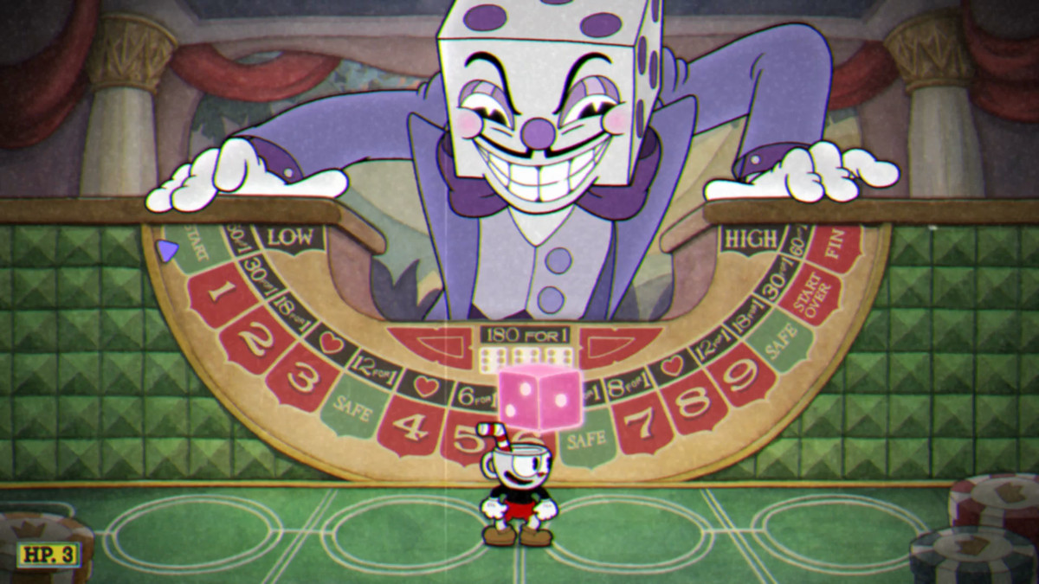
My Inspiration

Slide 4

Problems…

Slide 5

With More Time
Panels, not Multiple forms
More Games or Tiles
Better Design

Slide 6
Any Questions?
Thank you for your time!

