Slide 1
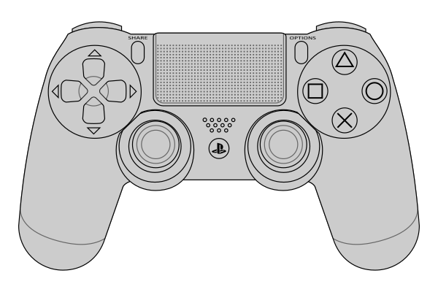
R1 pushed : task scenario
R2 pushed : etc motion
Gravity mode
Fext nominal/object
1. home
gripper open/close
2. +x w/ estimation
+x w/o estimation
3. set object parameter
stop with current pose
4. impedance control w/ Fext
back to init position

