Slide 1
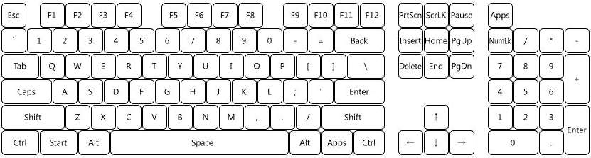
Test move
WBD
global
WBD
local
Chicken
Head+
Chicken
Head-
Mobile
back
Arm Jog
Estimat.
est.
trigger
null
Null w/ mobile
jog -y
jog +z
jog +y
print
Mobile jog
+x w/ stop
-x w/ stop
stop
gravity
home
jog -x
jog +z
jog +x
grasp
apply object
admittance
impedance
apply Fext
Mobile
impe
apply Fext
Impe
w/ K
Control

