Slide 1
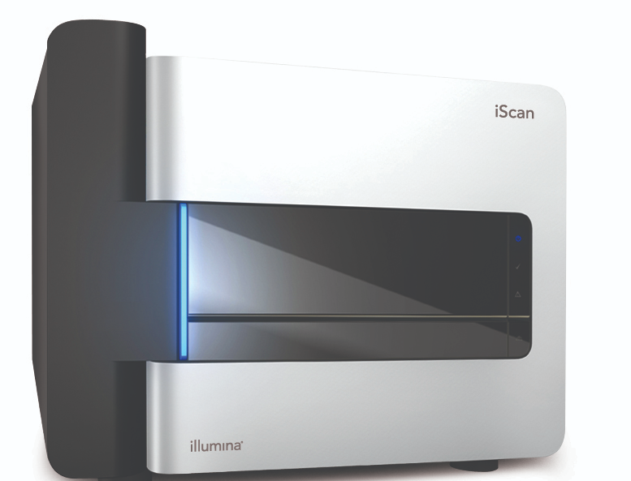

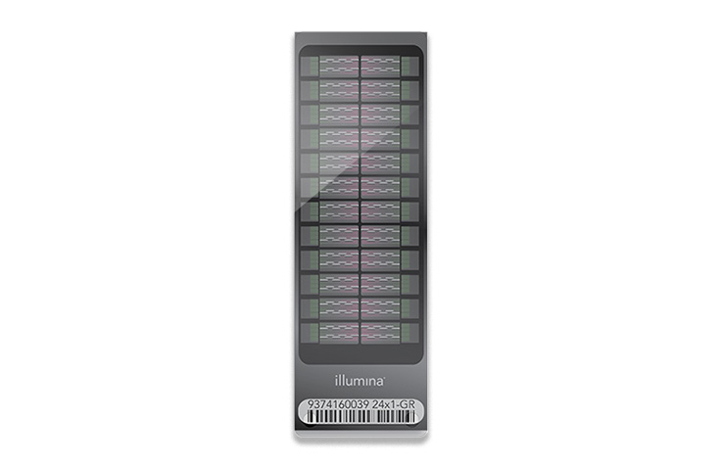


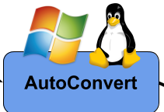









Convert Illumina IDAT files to GTC files
gtc_final_report.py
Convert Illumina GTC files to VCF files
Convert Illumina GTC files to VCF files
gtc_final_report.py
locus_summary.py
locus_summary.py
Output
outputLocus
Output
outputLocus
output
VCFTools

Slide 2
