Slide 1

Group Project #2
RECREATE THE BICLASS DATABASE START SCHEMA

Slide 2

Project Overview
Project Members and Structure
The project involves multiple team members:
Sarmad Ali, Daniel Gargiullo, Augusta Na, Jascharan Singh, Carlos Vega Lemus, and Oksana Weigand-Suminski.
Each member contributes to various aspects, facilitating collaborative success.

Slide 3
SSMS Lifecycle Steps
This table summarizes the essential steps involved in the SSMS lifecycle, detailing both the processes and corresponding tasks performed by the team.
Lifecycle Steps | Description | Tasks
Planning | Formulating project framework | Draft project management tools
Analysis | Ensure code adheres to guidelines | Clarify questions with peers
Design | Develop individual procedures | Set data input parameters
Implementation | Test procedures in SSMS | Verify outputs and views
Maintenance | Fix issues and re-execute procedures | Confirm functionality of views

Slide 4
Stored Procedures
Daniel's Contributions
Sarmad's Contributions
Jascharan 's Contributions
Daniel re-created the BIClass Database Star Schema by processing the FileUpload.OriginallyLoadedData table into ParsedFileUpload.OriginallyLoadedData, creating computed columns for reloading data. He also replaced identity keys with sequence objects for more flexibility and maintainability.
Sarmad created the Process.usp_TrackWorkFlow procedure to track workflow steps by inserting data into the Process.WorkflowSteps table. It accepts parameters for start time, description, row count, and user authorization, using a sequence object for the WorkFlowStepKey and recording start and end times.
Jascharan created the stored procedure Process.usp_ShowWorkflowSteps. This procedure is designed to query the Process.WorkflowSteps table, enabling the tracking and viewing of workflow step details such as descriptions, row counts, and start and end times of data processing activities.
Notes:
DANIEL worked on re-creating the BIClass Database Star Schema using the FileUpload.OriginallyLoadedData table. As part of this task, he processed the FileUpload.OriginallyLoadedData table into the ParsedFileUpload.OriginallyLoadedData table. During this process, Daniel created new computed columns to extract and organize the data needed for reloading.
Additionally, Daniel modified all of the tables' primary keys, eliminating the identity key and replacing it with sequence objects to ensure a more flexible and maintainable schema.
The following tables were created:
Process.WorkflowSteps
DbSecurity.UserAuthorization
[CH01-01-Dimension].[DimProductCategory]
[CH01-01-Dimension].[DimProductSubcategory]
SARMAD created the stored procedure Process.usp_TrackWorkFlow, which tracks workflow steps by inserting data into the Process.WorkflowSteps table. The procedure accepts parameters for the start time, workflow description, the number of rows processed, and a user authorization key. It then inserts a new record into the WorkflowSteps table, using a sequence object to generate the WorkFlowStepKey and recording the start and end times. This stored procedure facilitates the tracking and logging of the data processing workflow.
JASCHARAN was responsible for creating stored procedures to load individual tables into the star schema. This included writing procedures to process and load data into various dimension and fact tables, ensuring that each table was populated with the appropriate data from source systems.
In addition, Jascharan created the stored procedure Process.usp_ShowWorkflowSteps. This procedure is designed to query the Process.WorkflowSteps table, enabling the tracking and viewing of workflow step details such as descriptions, row counts, and start and end times of data processing activities. This procedure helps ensure transparency and logging of the steps involved in the workflow.

Slide 5

Systems Integration
Collaboration Process
Work Division
The team held regular meetings to synchronize efforts, discuss specifications, and ensure that all procedures integrate effectively.
Tasks were divided based on expertise and interest, enabling each member to focus on specific stored procedures and ensuring seamless integration.

Slide 6
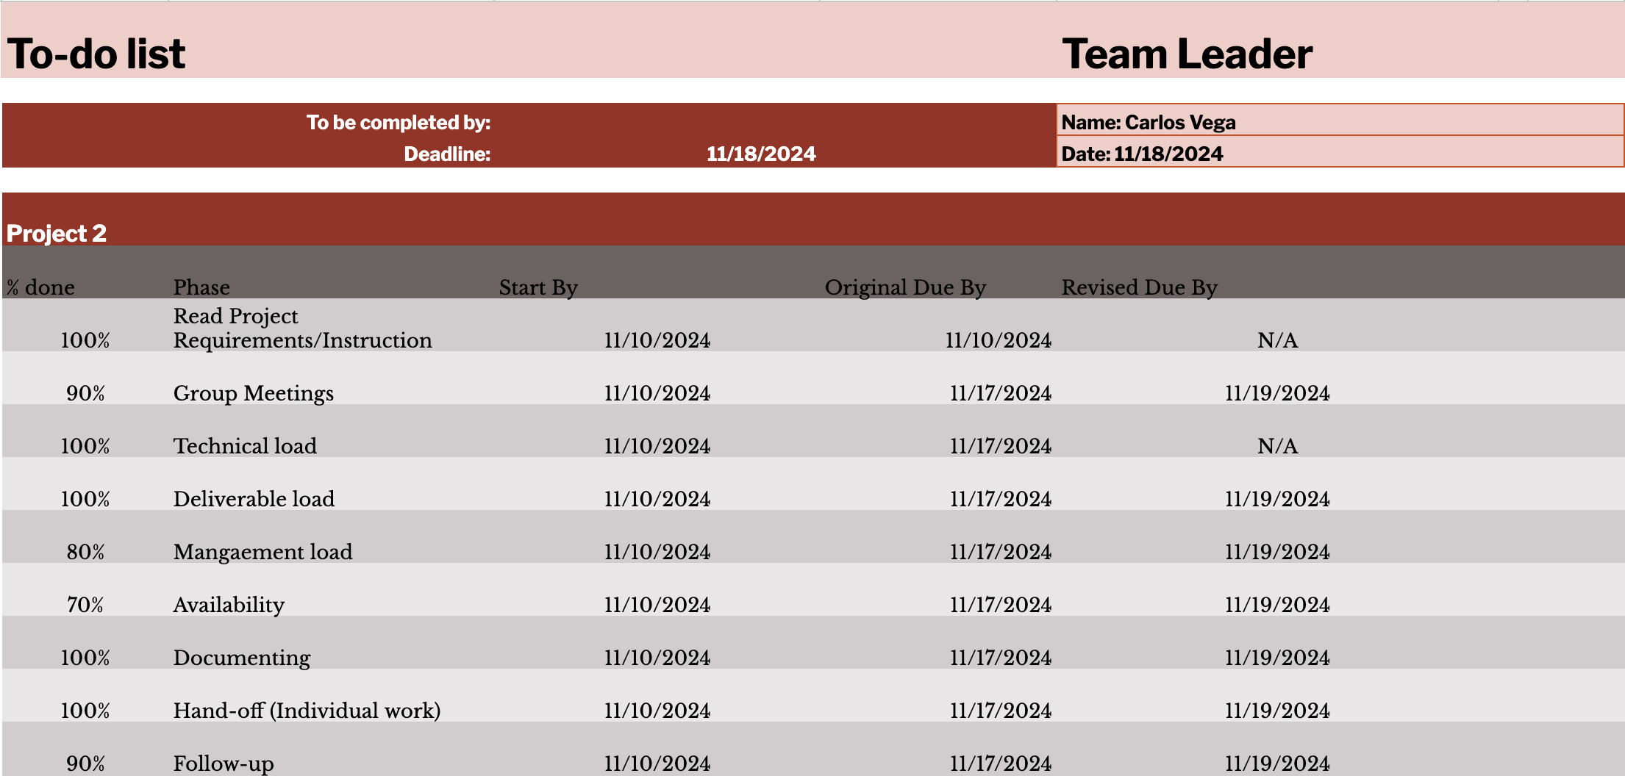

Slide 7
Testing & Maintenance
Testing Procedures
Each stored procedure was tested individually in SSMS. The team utilized truncation for retesting and documented observations to ensure consistent quality.
Ongoing Maintenance
The team maintained the procedures by fixing recurring issues, validating parameter names, and confirming that views produced accurate data.

Slide 8
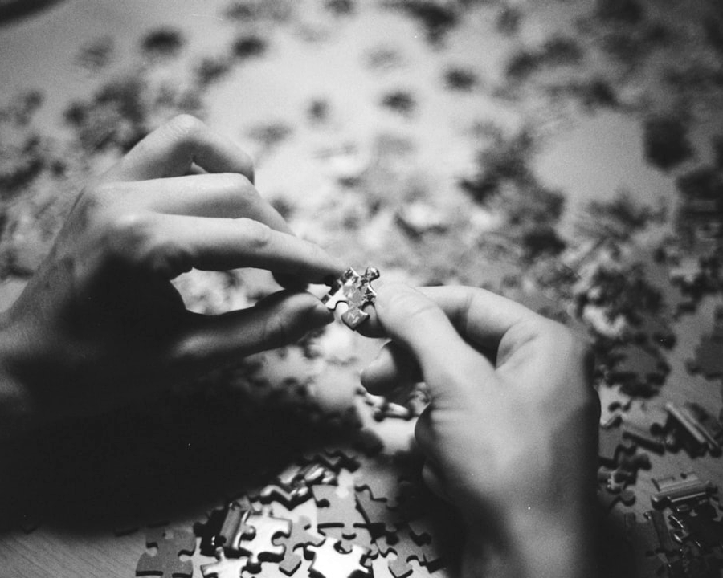
Challenges & Solutions
Key Challenges Encountered
The team faced challenges such as misunderstanding project specifications and coding errors. These were addressed through direct clarification with the professor and collaborative problem-solving.

