Slide 1
Final Project Group 2 Overview | Design| Execution
('Sarmad', 'Ali'),
('Daniel', 'Gargiullo'),
('Augusta', 'Na'),
('Jascharan', 'Singh'),
('Carlos', 'Vega Lemus'),
('Oksana', 'Weigand-Suminski');

Slide 2
1. Naming Conventions and Schema Organization
The schema design of the QueensClassSchedule database emphasizes modularity and logical separation, organizing related tables to streamline maintenance and scalability. This design philosophy ensures clarity, enforces data integrity through foreign keys, and uses descriptive naming conventions to create a self-documenting structure that supports efficient data management and querying.
1. Course Schema
CREATE SCHEMA [Course]
Contains:
-- Class
-- Course
-- CourseInstructor
-- ModeOfInstruction
2. Location Schema
CREATE SCHEMA [Location]
Contains:
-- BuildingLocation
-- RoomLocation
3. Department Schema
CREATE SCHEMA [Department]
Contains:
-- Department
-- Instructor

Slide 3
Naming Standards All database objects follow strict naming conventions
1. Table Names:
Singular nouns
PascalCase
Prefixed with schema name
Example:
[Course].[CourseInstructor]
[Location].[BuildingLocation]
2. Column Names:
PascalCase
Meaningful prefixes
Consistent suffixes
Example:
UserAuthorizationKey
DateOfLastUpdate
BuildingLocationID

Slide 4
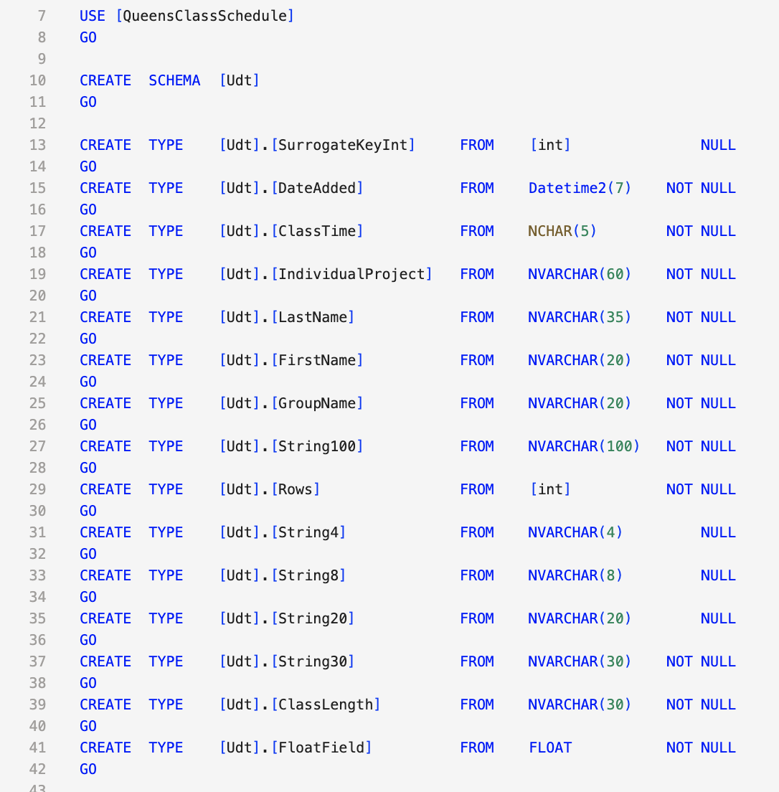
2. User Defined Data Types (UDTs)
These UDTs are used extensively throughout our database.
The database implements a comprehensive system of User Defined Data Types (UDTs) under the [Udt] schema. This approach provides several key benefits:
Ensures data consistency across tables
Simplifies maintenance by centralizing data type definitions
Makes the database self-documenting
Reduces errors in column definitions

Slide 5
Key UDTs and Their Implementation
Basic Data Types
CREATE TYPE [Udt].[SurrogateKeyInt] FROM [int] NULL
CREATE TYPE [Udt].[String30] FROM [nvarchar](30) NOT NULL
CREATE TYPE [Udt].[String100] FROM [nvarchar](100) NOT NULL
CREATE TYPE [Udt].[DateAdded] FROM [datetime2](7) NOT NULL
SurrogateKeyInt is used for all primary key columns
CREATE TABLE [Course].[Class](
[ClassID] [Udt].[SurrogateKeyInt] IDENTITY(1,1) NOT NULL,
[Enrollment] [Udt].[SurrogateKeyInt] NULL,
[Credits] [Udt].[SurrogateKeyInt] NULL,
-- Other columns...)

Slide 6
Specialized Data Types
CREATE TYPE [Udt].[ClassLength] FROM [nvarchar](30) NOT NULL
CREATE TYPE [Udt].[ClassTime] FROM [nchar](5) NOT NULL
CREATE TYPE [Udt].[FirstName] FROM [nvarchar](20) NOT NULL
CREATE TYPE [Udt].[LastName] FROM [nvarchar](35) NOT NULL
These domain-specific UDTs enforce business rules and data consistency. For example, the ClassTime type is used in:
CREATE TABLE [DbSecurity].[UserAuthorization](
[UserAuthorizationKey] [Udt].[SurrogateKeyInt] IDENTITY(1,1) NOT NULL,
[ClassTime] [Udt].[ClassTime] NULL DEFAULT ('10:45’),
-- Other columns...)

Slide 7
Reuse Patterns
1. Audit Trail Pattern:
[DateAdded] [Udt].[DateAdded] NULL,
[DateOfLastUpdate] [Udt].[DateAdded] NULL
This pattern appears in nearly every table, ensuring consistent timestamp handling.
2. Name Handling Pattern:
[FirstName] [Udt].[FirstName] NOT NULL,
[LastName] [Udt].[LastName] NOT NULL
Used in both instructor and user tables

Slide 8
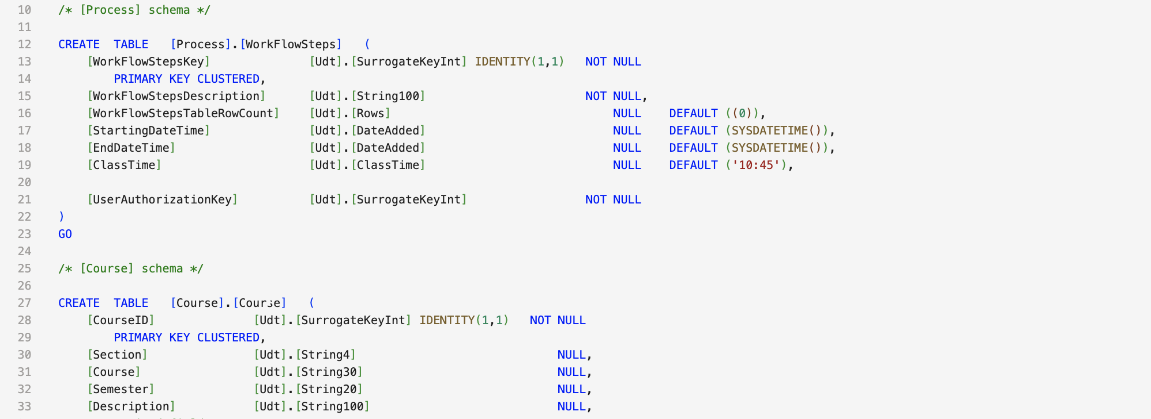
3. Constraints and Data Integrity | Primary Key Constraints
Every table has a surrogate key with these characteristics:
[ClassID] [Udt].[SurrogateKeyInt] IDENTITY(1,1) NOT NULL,
PRIMARY KEY CLUSTERED ([ClassID] ASC)

Slide 9
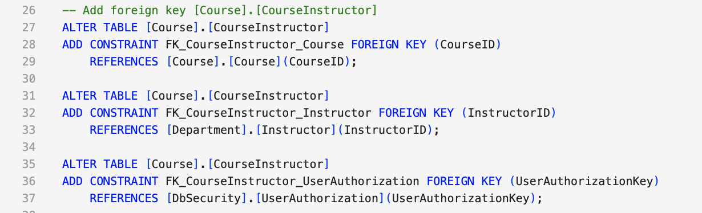
Foreign Key Constraints Complex relationships are managed through carefully designed foreign keys
These constraints:
Ensure referential integrity
Prevent orphaned records
Maintain data consistency

Slide 10
Default Constraints Automatic value population for audit fields
ALTER TABLE [Course].[Class]
ADD DEFAULT (sysdatetime()) FOR [DateAdded]
ALTER TABLE [DbSecurity].[UserAuthorization]
ADD DEFAULT ('10:45') FOR [ClassTime]

Slide 11
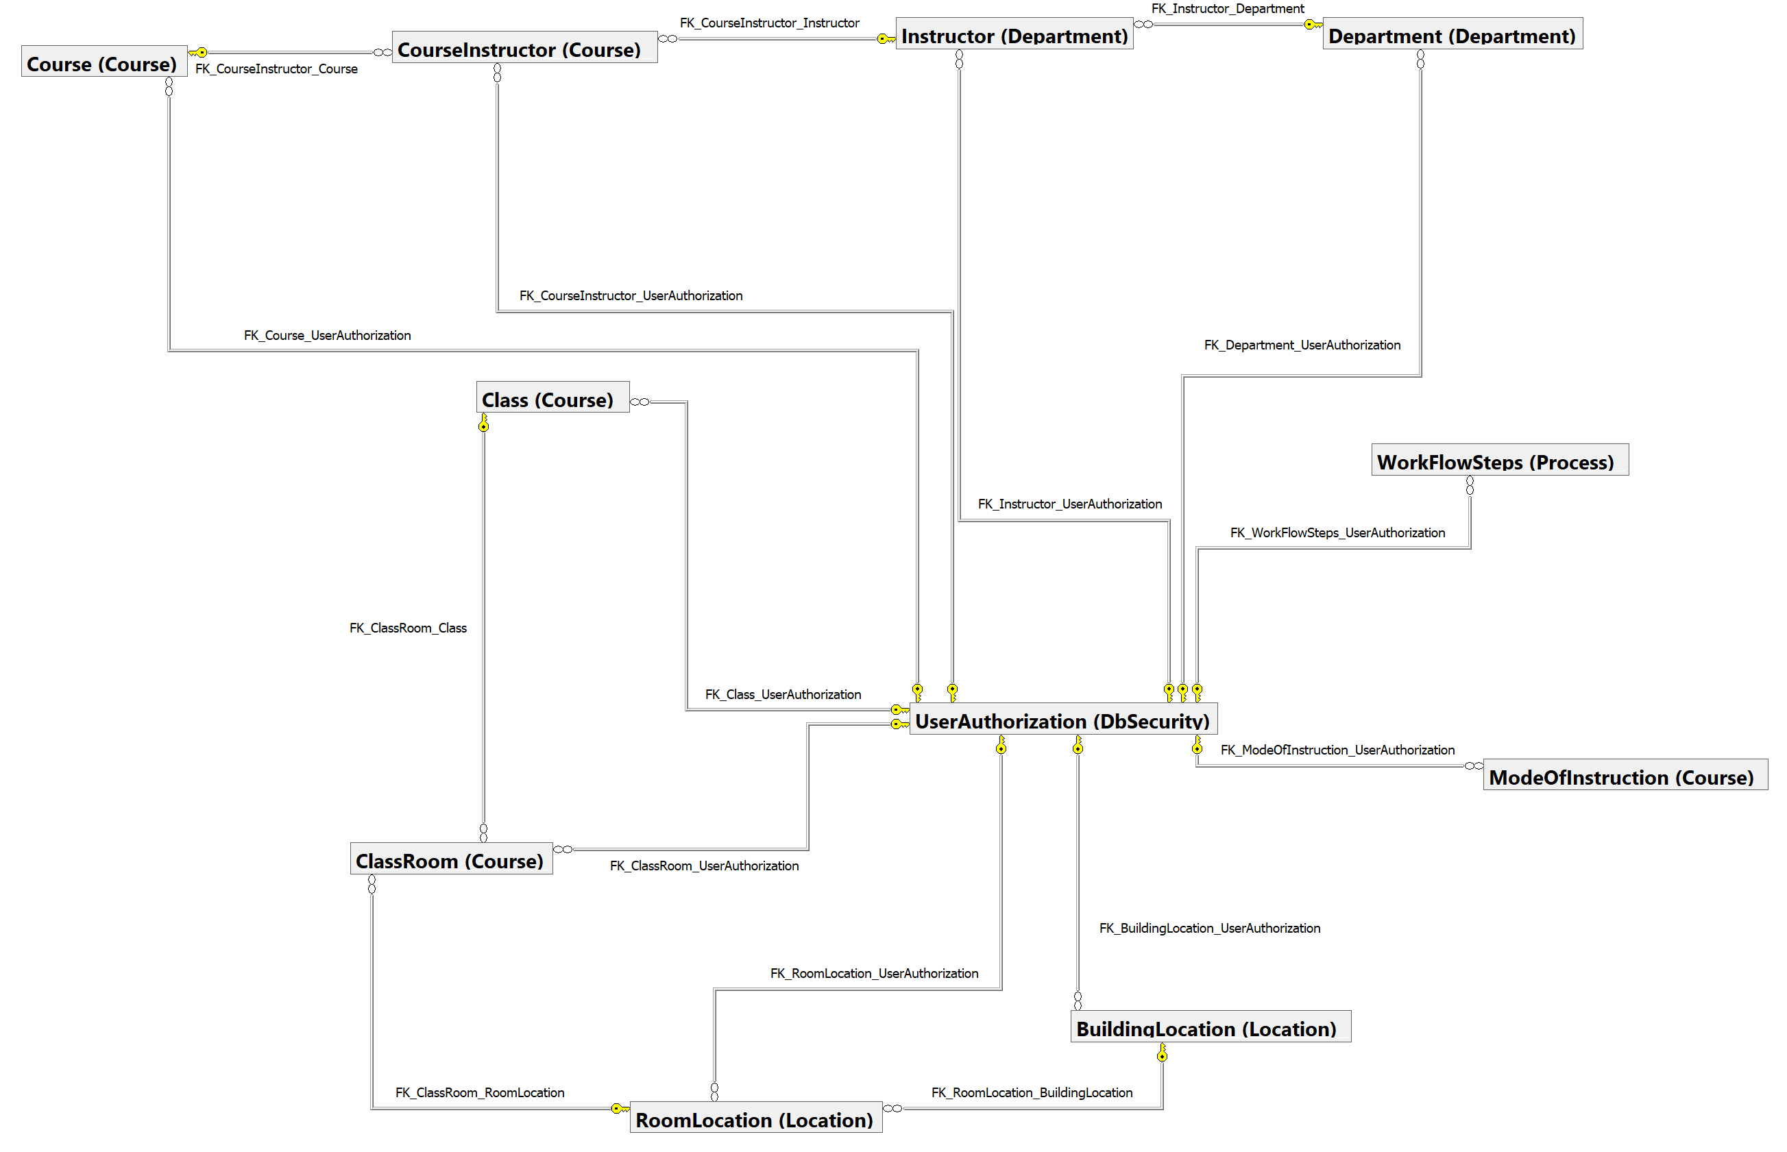
4. Database Design Models
The Conceptual Data Model (CDM) of the QueensClassSchedule database focuses on the high-level entities such as Course, Instructor, RoomLocation, and Class, and their relationships. It highlights key associations, such as the many-to-many relationship between Course and Instructor managed by the CourseInstructor bridge table, and the linkage of Class to physical locations through RoomLocation

Slide 12
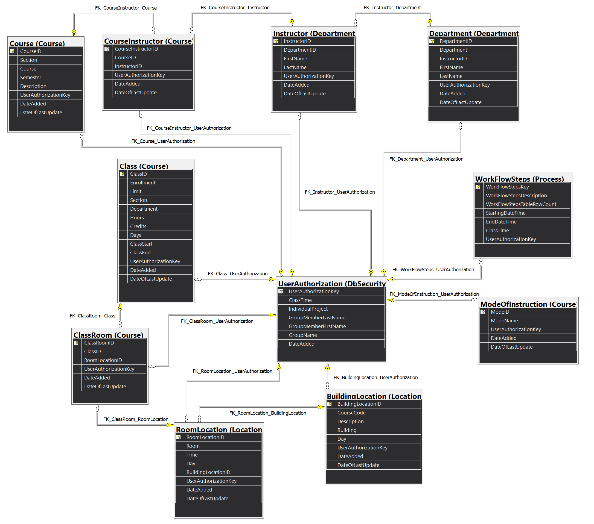
The Logical Data Model (LDM) of the QueensClassSchedule database defines the detailed attributes for each entity, such as Course with CourseID, Section, and Semester, and Instructor with InstructorID, FirstName, and LastName. It organizes the relationships between entities while specifying all attributes required to describe and maintain them, ensuring consistency and normalization across the design.

Slide 13
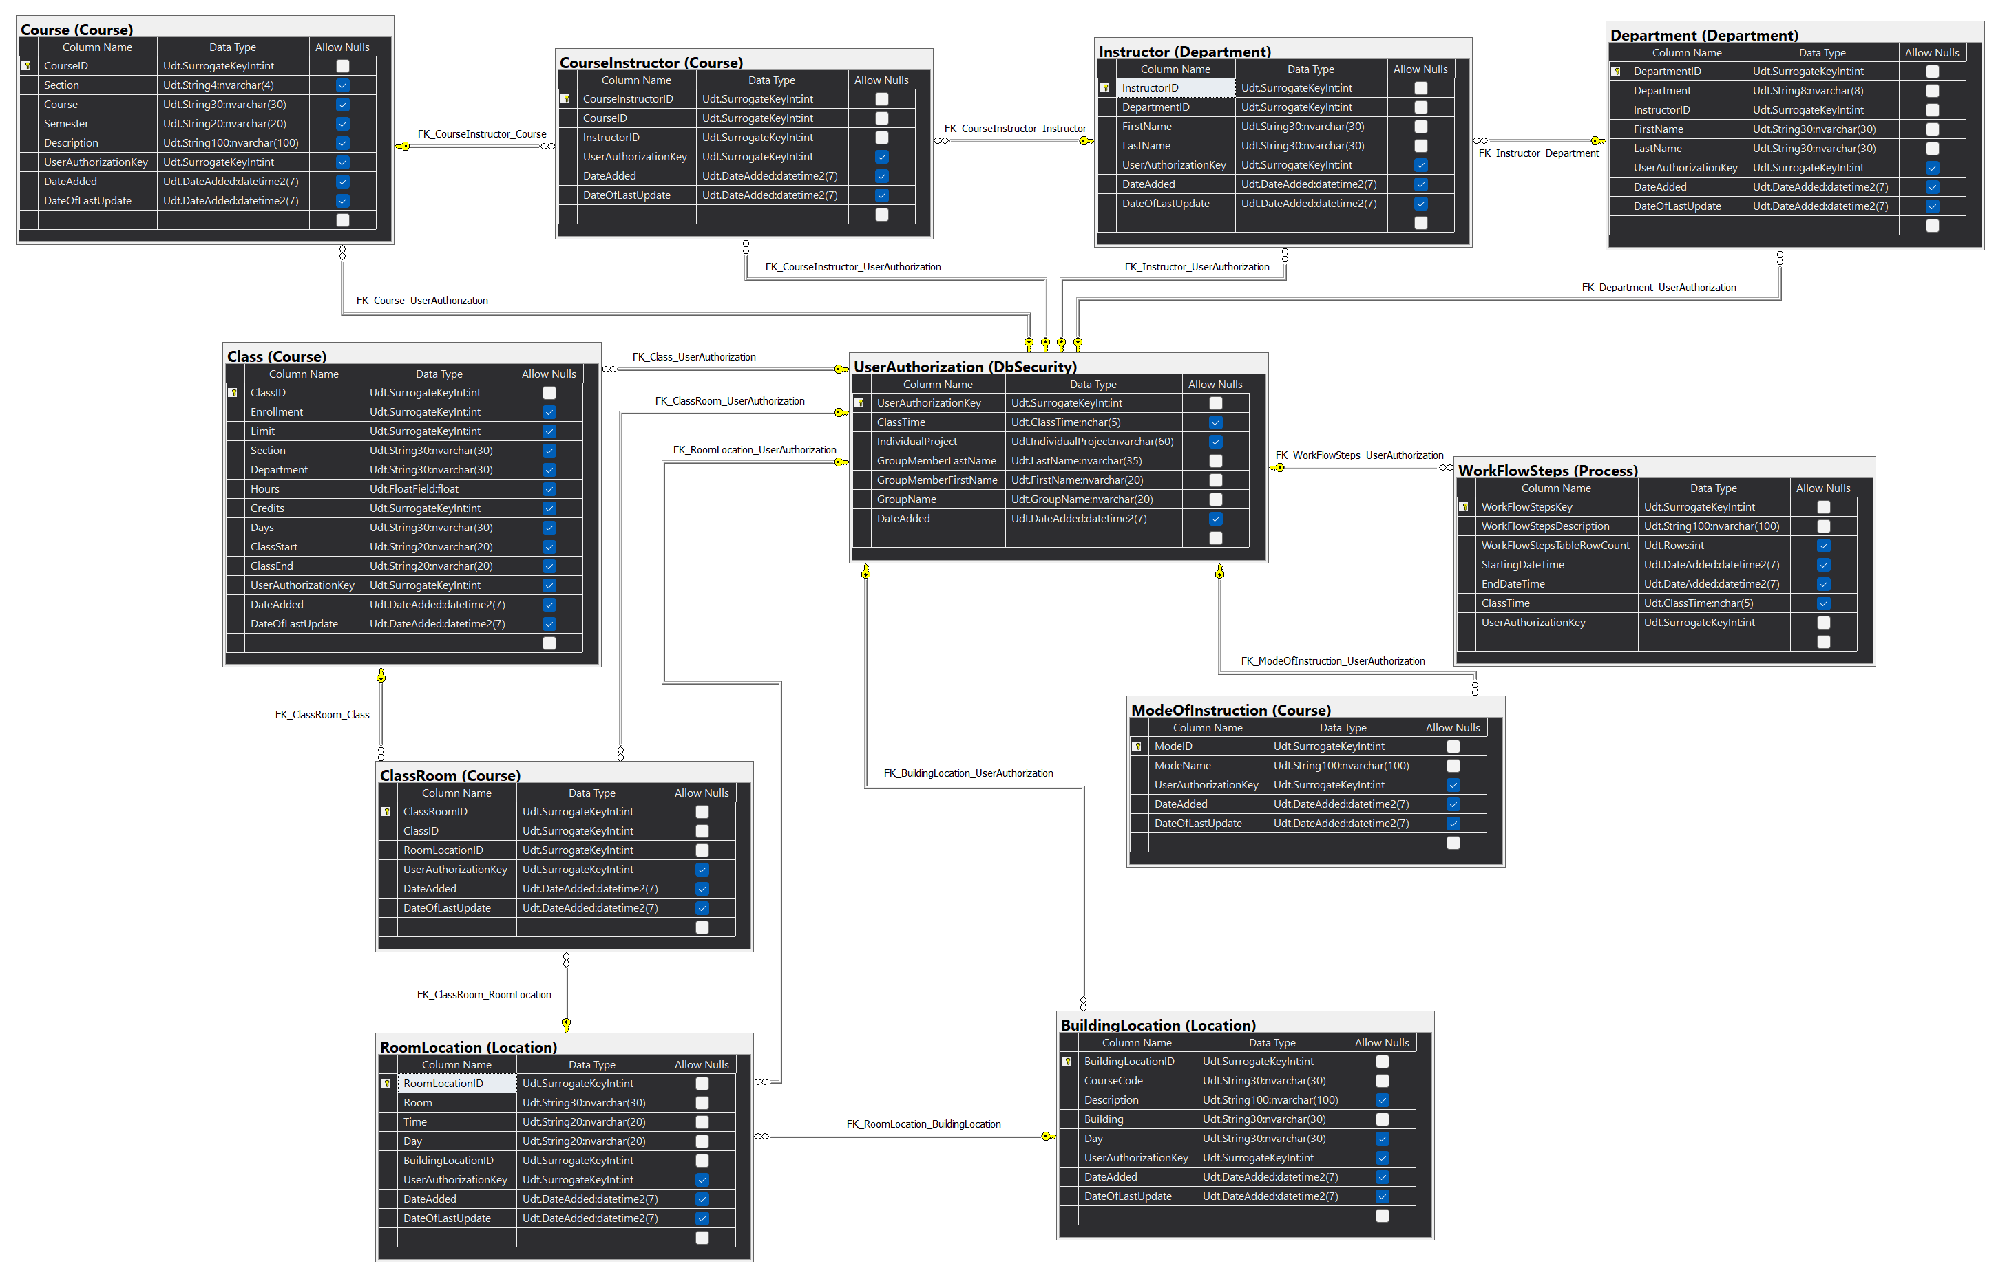
The Physical Data Model (PDM) of the QueensClassSchedule database translates entities into tables with defined columns, data types, and relationships, such as CourseInstructor linking CourseID and InstructorID with foreign keys. It includes user-defined data types (UDTs) for consistency, default constraints for timestamps, and primary keys for unique identification, ensuring the database structure supports efficient storage and query performance.

Slide 14
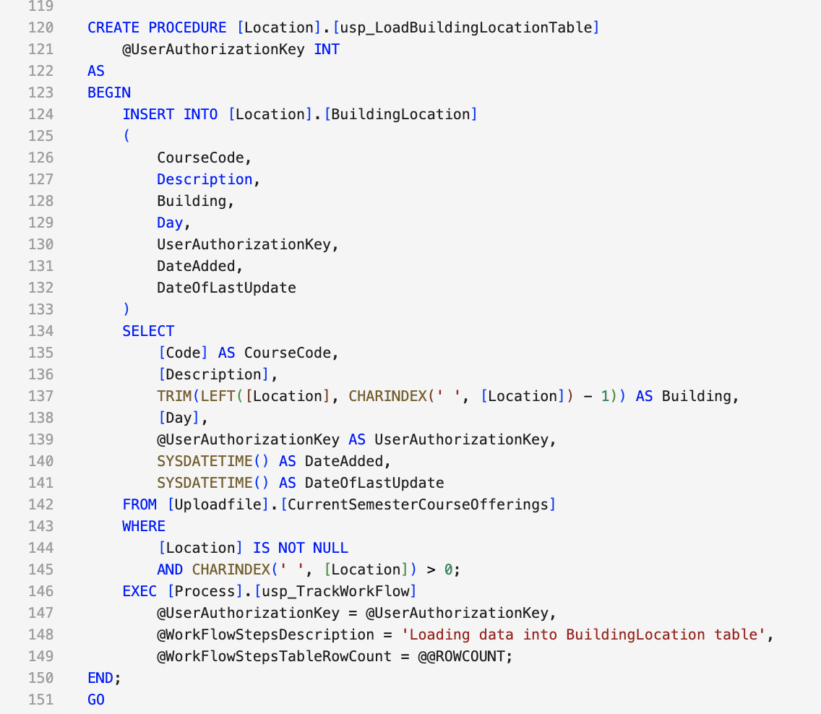
5. Stored Procedures
The QueensClassSchedule database includes a range of stored procedures designed to automate key tasks, enforce data consistency, and improve maintainability. Each stored procedure is purpose-built, with clear input parameters, operational logic, and workflow tracking.
Benefits
Automation: Streamlines repetitive tasks like loading data and adding constraints.
Consistency: Ensures database integrity through standardized operations.
Traceability: Workflow tracking provides a clear audit trail for debugging and accountability.

Slide 15
6. Data Cleansing Strategy
Course Information Parsing
One of the most complex data cleansing challenges involved parsing the course information string. The raw data contains combined information in formats like "CSCI 313 (3, 3)".
Challenge 1: Extracting Department Code
Original data: "CSCI 313 (3, 3)"
LEFT([Course (hr, crd)], CHARINDEX(' ', [Course (hr, crd)]) - 1) AS Department
This extracts just the department code (e.g., "CSCI").
The code:
Uses CHARINDEX to find the first space
LEFT function to extract everything before that space
Handles variations in department code length

Slide 16
Challenge 2: Parsing Credits and Hours
-- Extract hours (first number in parentheses)
TRY_CAST(
TRIM(
SUBSTRING(
[Course (hr, crd)],
CHARINDEX('(', [Course (hr, crd)]) + 1,
CHARINDEX(',', [Course (hr, crd)]) - CHARINDEX('(', [Course (hr, crd)]) - 1
)
) AS FLOAT
) AS Hours,
-- Extract credits (second number in parentheses)
TRY_CAST(
TRIM(
SUBSTRING(
[Course (hr, crd)],
CHARINDEX(',', [Course (hr, crd)]) + 1,
CHARINDEX(')', [Course (hr, crd)]) - CHARINDEX(',', [Course (hr, crd)]) - 1
)
) AS INT
) AS Credits
This complex parsing:
Uses nested SUBSTRING operations to extract numbers
Handles potential data quality issues with TRY_CAST
Removes unnecessary whitespace with TRIM

Slide 17
Name Formatting
Original data: "Smith, John"
INSERT INTO [Department].[Instructor]
(
LastName,
FirstName
)
SELECT DISTINCT
SUBSTRING([Instructor], 1, CHARINDEX(',', [Instructor]) - 1) AS LastName,
LTRIM(SUBSTRING([Instructor],
CHARINDEX(',', [Instructor]) + 1,
LEN([Instructor]) - CHARINDEX(',', [Instructor]))
) AS FirstName
FROM [Uploadfile].[CurrentSemesterCourseOfferings]
WHERE [Instructor] IS NOT NULL
AND CHARINDEX(',', [Instructor]) > 0;
This code:
Handles NULL values
Validates comma presence
Removes leading/trailing spaces from FirstName
Preserves special characters in names

Slide 18
SARMAD ALI QUERIES
Group 2

Slide 19
Instructor Department Affiliation Analysis
Purpose: To identify instructors teaching in multiple departments and rank them by the number of departments they are associated with.
Why It’s Important:
Highlights cross-departmental teaching, revealing instructors playing pivotal roles across disciplines.
Helps in identifying resource sharing and departmental collaboration opportunities.
2. Instructor Workload Analysis
Purpose: To analyze the workload of instructors based on the number of classes taught, departmental affiliations, total teaching hours, and average class hours.
Why It’s Important:
Provides insights into workload balance, identifying overburdened or underutilized instructors.
Supports academic planning and equitable distribution of teaching assignments.
3. Class Enrollment and Instructor Analysis
Purpose: To evaluate class enrollment levels, categorize classes by enrollment status, and determine the number of instructors assigned to each class.
Why It’s Important:
Identifies under-enrolled or over-enrolled classes for resource optimization.
Highlights classes lacking adequate instructor support, ensuring better scheduling and planning.

Slide 20
Jascharan Singh
Group 2

Slide 21
Database Management Highlights
1. Procedure: Organizing Instructor Data
• Automates data cleaning from raw uploads.
• Splits names (e.g., “Doe, John”), assigns departments, tracks updates.
• Ensures consistent, accurate instructor records.
2. Foreign Keys: Maintaining Relationships
• Class ↔ Department: Ensures classes belong to valid departments.
• Course ↔ Instructor: Links courses to responsible instructors.
• Room ↔ Building: Associates rooms with their buildings.
• Enforces data consistency and prevents mismatches.
3. Key Insights from Queries
• Department Performance: Total courses, average enrollments, seat utilization.
• Class Capacity: Flags near-full, empty, or underutilized classes.
• Advanced Analysis: Highlights thriving vs. underperforming departments.

Slide 22
Augusta Na’S QUERIES
Group 2

Slide 23
Retrieve all instructors that teach an accounting course.
SELECT DISTINCT ci.InstructorID
INNER JOIN Course.course and department.instructor
LIKE ‘COURSE%’
Order By LastName
To insure that there will be no duplicate results we use DISTINCT and we use it on InstructorID’s specifically because the ID is unique and won’t cause a problem.
Inner Join is used to join the instructor and the course tables.
Like operator and % is used to find all matching beginning letters.
Order BY the last name is for viewing pleasure.
Find course that have less than average total courses
GROUP BY Left(Course, 4)
CROSS JOIN CourseCount and AverageCount
We use a cte to find CourseCount and AverageCount.
Using Left(string, number of char) function we correctly identify and group the subjects together.
Using CROSS JOIN and WHERE < we can compare all the subjects to the average course count.
Find all Courses offered in the ‘PH’ building on Monday and Wednesdays
Like’%M%’ AND
count()
We use Like operator again however because of how the data is stored we need to use the ‘%’ sandwiching our keyword and use AND because we want to find specifically monday and Wednesday classes.
Count() function is used to find the count after the conditions above.
Find the most frequently used Classrooms.

Slide 24
Carlos Vega
Group 2

Slide 25
Course Capacity Analytics.
Analyze and monitor course enrollment patterns and capacity utilization across all departments at Queens College.
Core Metrics Calculated
Formula ( Enrollment/limits) * 100
Categories
High >= 90%
Medium 70-89%
Low <70%
Department Course Distribution
Analyze the distribution of courses offering different academic levels within each department at Queens College
Course Levels
100-level
200-level
300-level
400-level
Instructor Teaching Load
Analyze teaching workload distribution across instructors at Queens College.
Course Load Metrics
Count total distinct courses taught
Number of course sections
Sum teaching hours
Total credits being taught.

Slide 26
THANK YOU!

