Slide 1
ClinicConnect
Bridging the gap between patients and institutions in healthcare

Slide 2
Goals/Overview
A third-party, patient-facing platform that enables patients to find clinical trials to participate in.
Motivation: COVID-19 Vaccine Trials
End goal of increasing enrollment in clinical studies, with the hope of progressing scientific development.

Slide 3
Roadmap
What We Do
Workflow
Demonstration of Capabilities
Further Work

Slide 4
What We Do

Slide 5
Core Functionalities
Processes demographic data to filter for relevant studies.
Processes input about individual level of risk.
Provides map view of studies based on the user’s location.
Provides information regarding important study parameters.
Study type, clinical condition, full description, inclusion/exclusion criteria, phase of development, enrollment figures, contact information
Enable filtering and searching of these trials.
Allow easy contact of study leads through native email client.

Slide 6
Platform Workflow

Slide 7
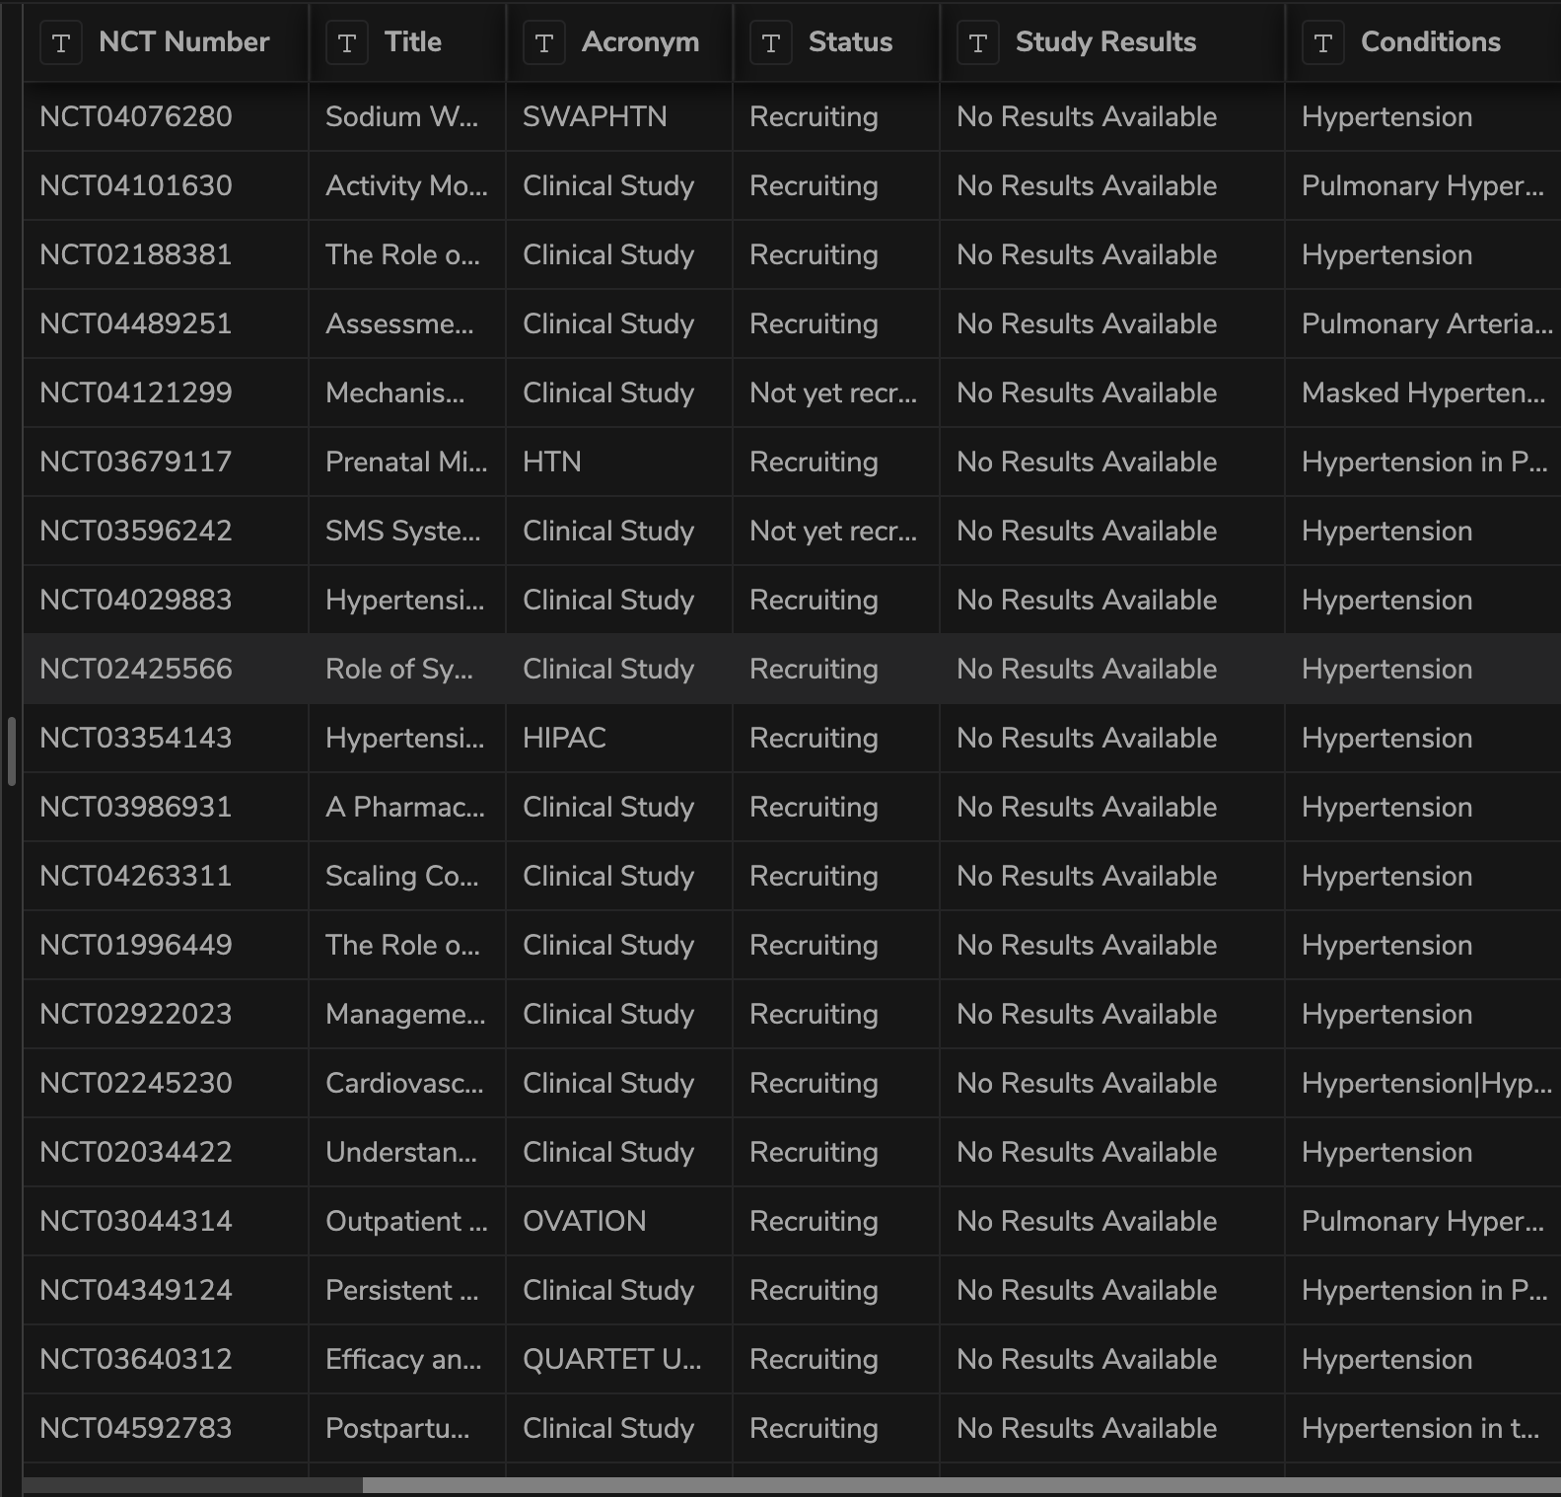
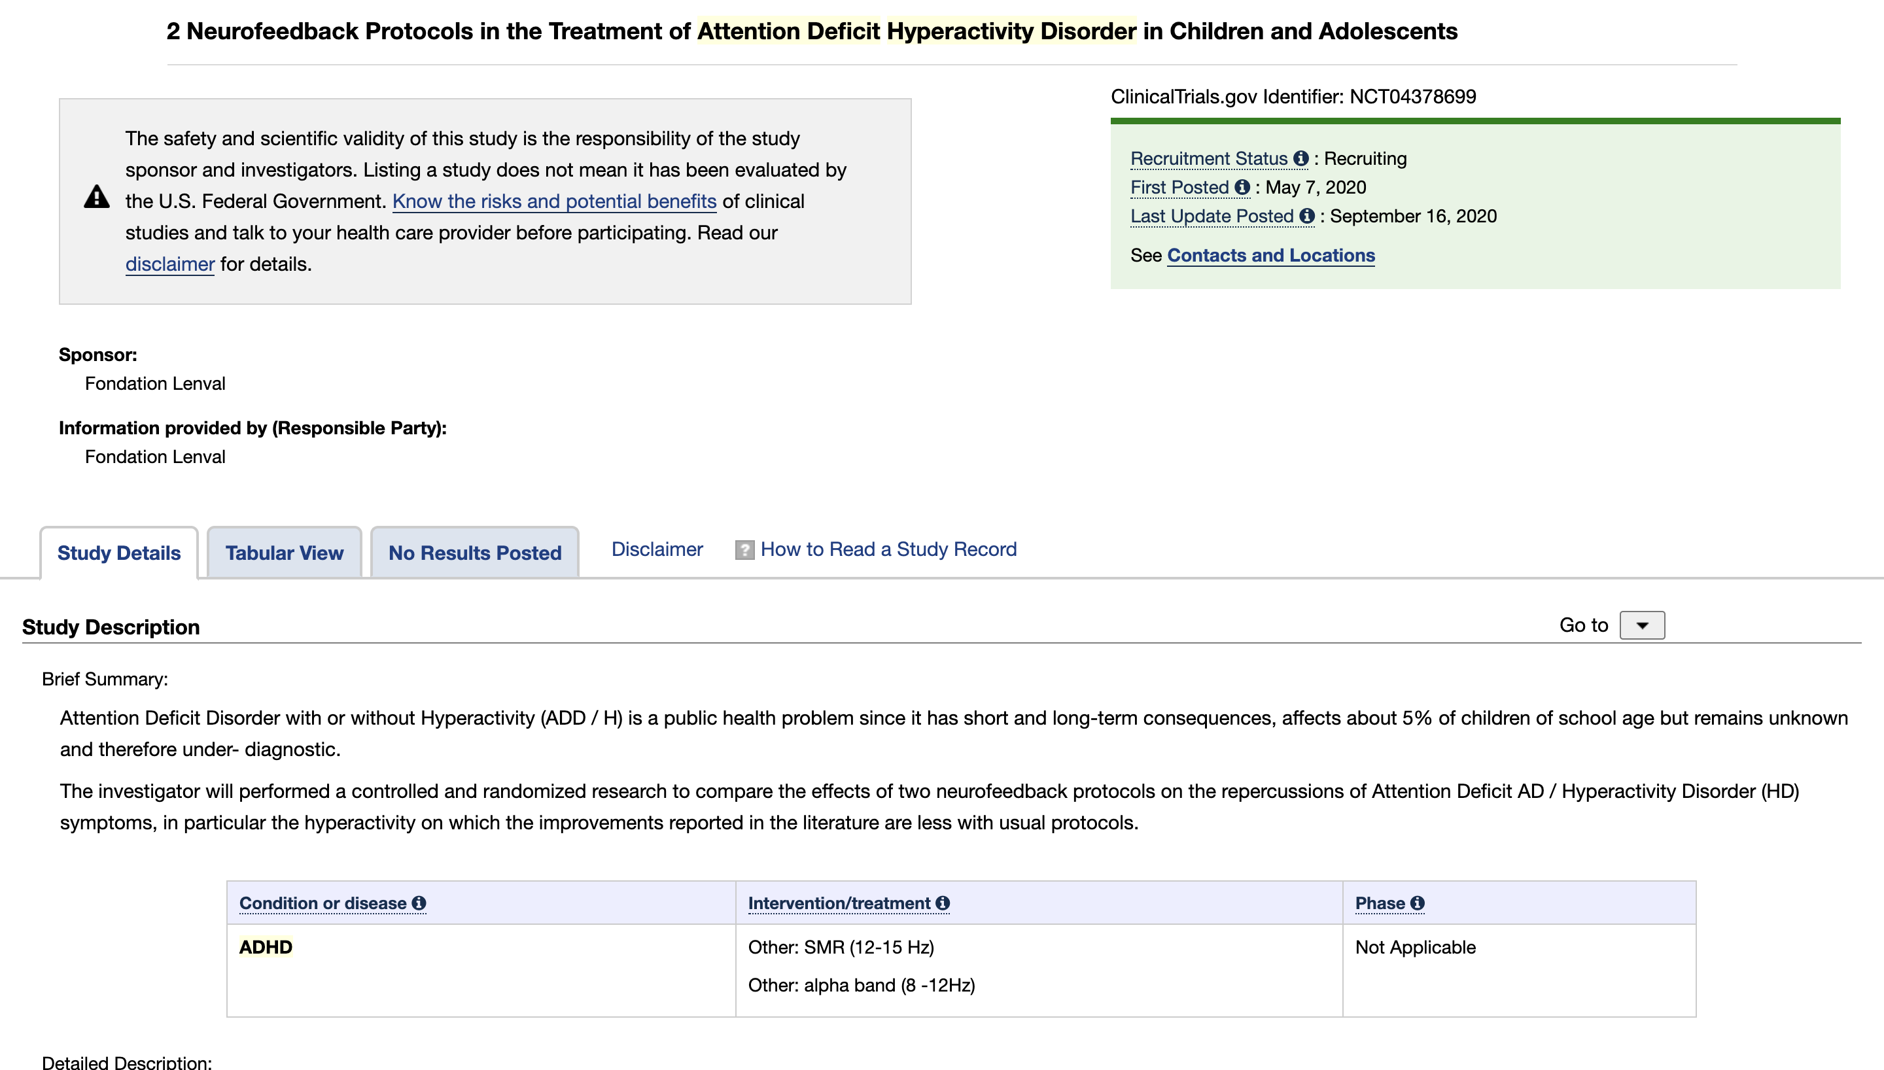
Stage 1: Dropbase Database Population
ClinicalTrials.Gov
Dropbase Database

Slide 8
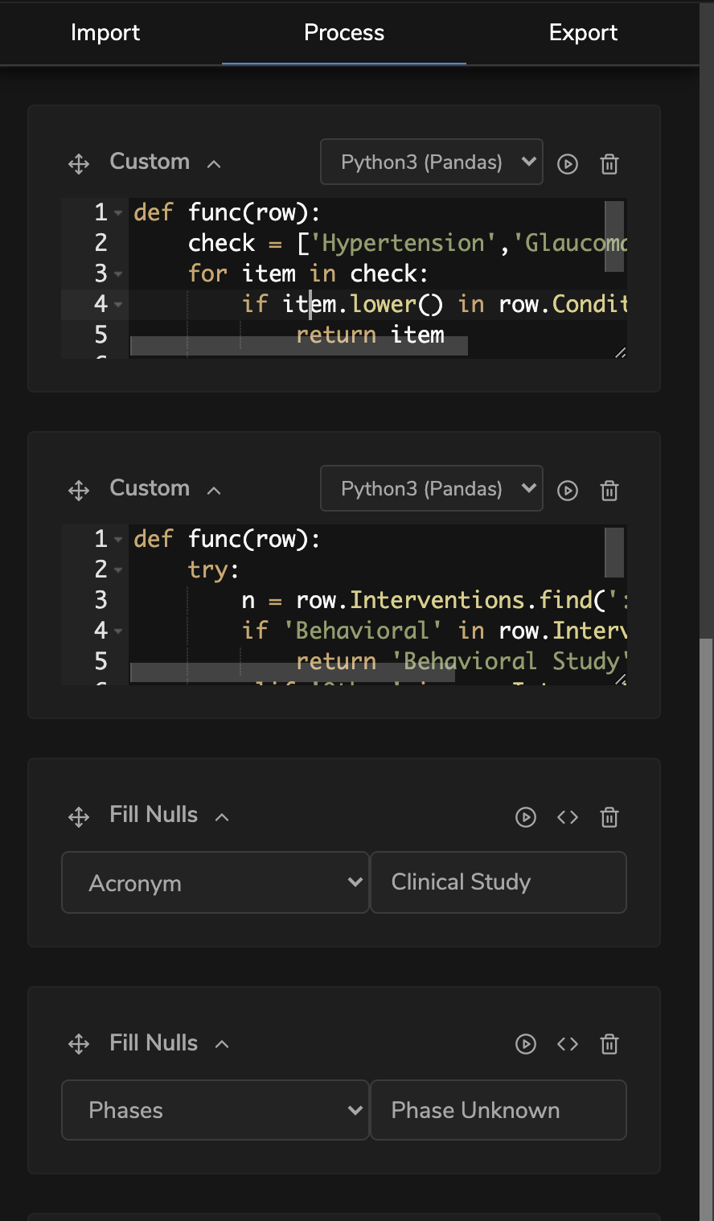
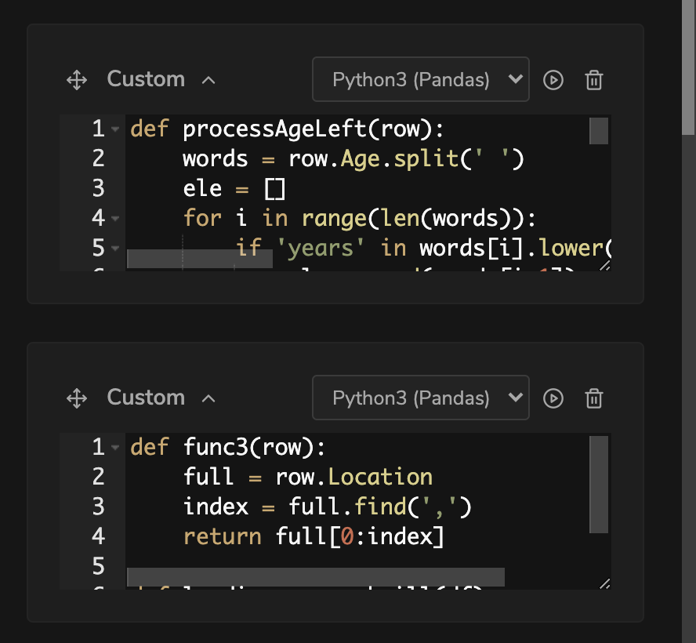
Stage 2: Dropbase Cleaning, Processing, Computation

Slide 9
Stage 3: User Query and Map View

Slide 10
Stage 4: Information and Contact

Slide 11
Demonstration of Capabilities

Slide 12
Further Work
Automatic updates to the database and platform based on newly instituted clinical studies.
Integration of more logic control on inclusion and exclusion criteria to further improve the user experience.
Approach governmental bodies to support the platform and increase its uptake amongst the general population.

