Slide 1

Summer Training/Internship Presentation
Project Topic : Path Finding Visualizer
Name | Registration No
Chirag | 12409735
Ishan Walia | 12412548
Submitted By: Amarinder Kaur, Sudha Shanker Prasad

Slide 2
Course Content
C++ Basics
Arrays
Graphs
Queues (BFS)
Stacks (DFS)
Searching Algorithms
Greedy Algorithms (A*)
Priority Queue (Dijkstra)
Time & Space Complexity

Slide 3
Project Details
Project Name
Path Finding Visualizer (Google Maps Style)
Problem Statement
Finding the shortest path between two points is an important problem in navigation systems like Google Maps. This project helps users understand how different pathfinding algorithms work through interactive visualization.
Objective
Visualize pathfinding algorithms.
Find the shortest path.
Compare different algorithms.
Learn graph traversal in an easy way.
Technologies Used
C++
HTML
CSS
JavaScript

Slide 4
Algorithms Used
Breadth First Search (BFS)
Depth First Search (DFS)
Dijkstra's Algorithm
A* Search Algorithm
Features
Interactive Grid
Start & End Nodes
Wall Drawing
Animated Path Visualization
Maze Generator
Live Statistics
Project Outcome
Improved understanding of graph algorithms.
Learned shortest-path techniques.
Developed problem-solving and visualization skills.
Built a Google Maps-style interactive application.

Slide 5
Project Code
#include <bits/stdc++.h>
using namespace std;
int dr[] = {-1, 1, 0, 0};
int dc[] = {0, 0, -1, 1};
int dijkstra(vector<vector<int>>& g, pair<int,int> s, pair<int,int> t) {
int R = g.size(), C = g[0].size();
vector<vector<int>> dist(R, vector<int>(C, INT_MAX));
priority_queue<tuple<int,int,int>,
vector<tuple<int,int,int>>,
greater<>> pq;
dist[s.first][s.second] = 0;
pq.push({0, s.first, s.second});
while (!pq.empty()) {
auto [d, r, c] = pq.top(); pq.pop();
if (r == t.first && c == t.second) return d;
if (d > dist[r][c]) continue;
for (int k = 0; k < 4; ++k) {
int nr = r + dr[k], nc = c + dc[k];
if (nr < 0 || nc < 0 || nr >= R || nc >= C) continue;
if (g[nr][nc] == -1) continue; // wall
int nd = d + g[nr][nc]; // weight
if (nd < dist[nr][nc]) {
dist[nr][nc] = nd;
pq.push({nd, nr, nc});
}
}
}
return -1; // unreachable
}

Slide 6
BFS Logic Code (C++)
void BFS(int start)
{
queue<int> q;
visited[start] = true;
q.push(start);
while (!q.empty())
{
int node = q.front();
q.pop();
cout << node << " ";
for (int next : graph[node])
{
if (!visited[next])
{
visited[next] = true;
q.push(next);
}
}
}
logic
Start
↓
Push Start Node into Queue
↓
Pop Front Node
↓
Visit Node
↓
Push Unvisited Neighbours
↓
Repeat until Queue is Empty

Slide 7
DFS Logic Code
void DFS(int node) { visited[node] = true; cout << node << " "; for (int next : graph[node]) { if (!visited[next]) { DFS(next); } } }
Start
↓
Visit Current Node
↓
Go to First Unvisited Neighbour
↓
Repeat Recursively
↓
Backtrack if Needed
↓
Stop

Slide 8
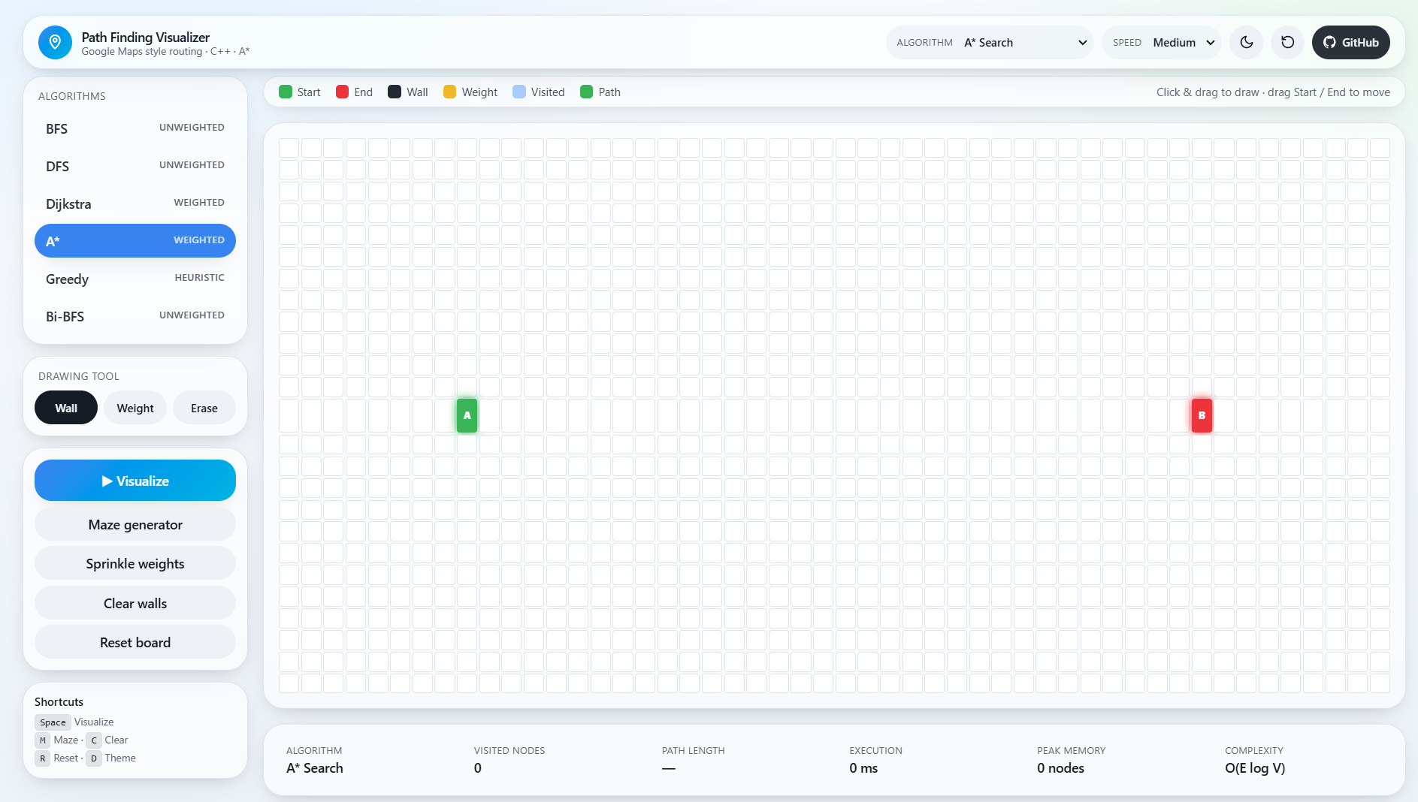
Project Screenshots

Slide 9
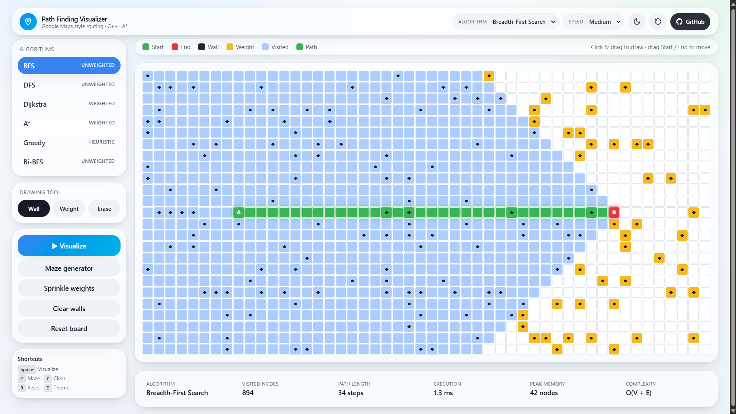

Slide 10
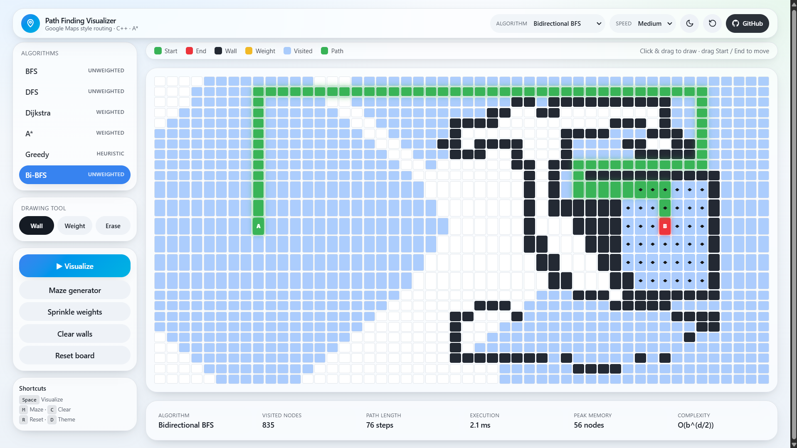

Slide 11
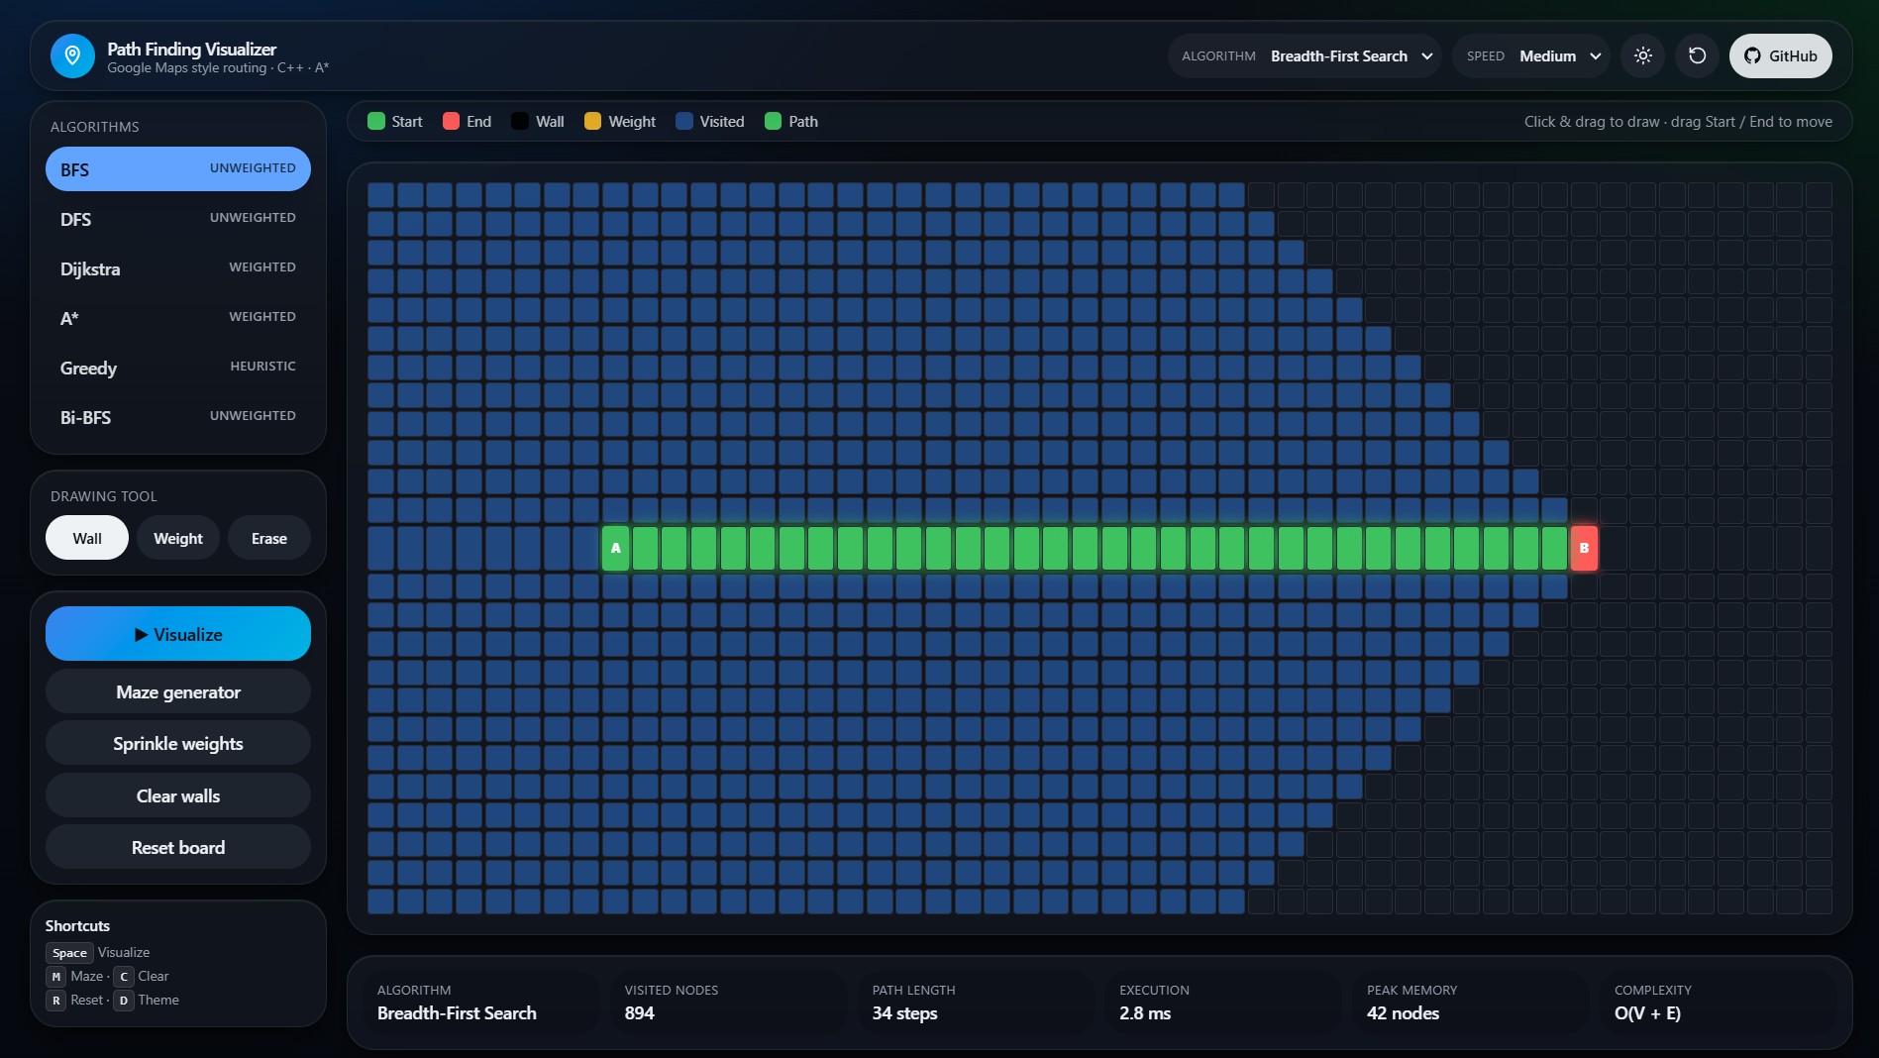
Project Outcomes

Slide 12


