Slide 1
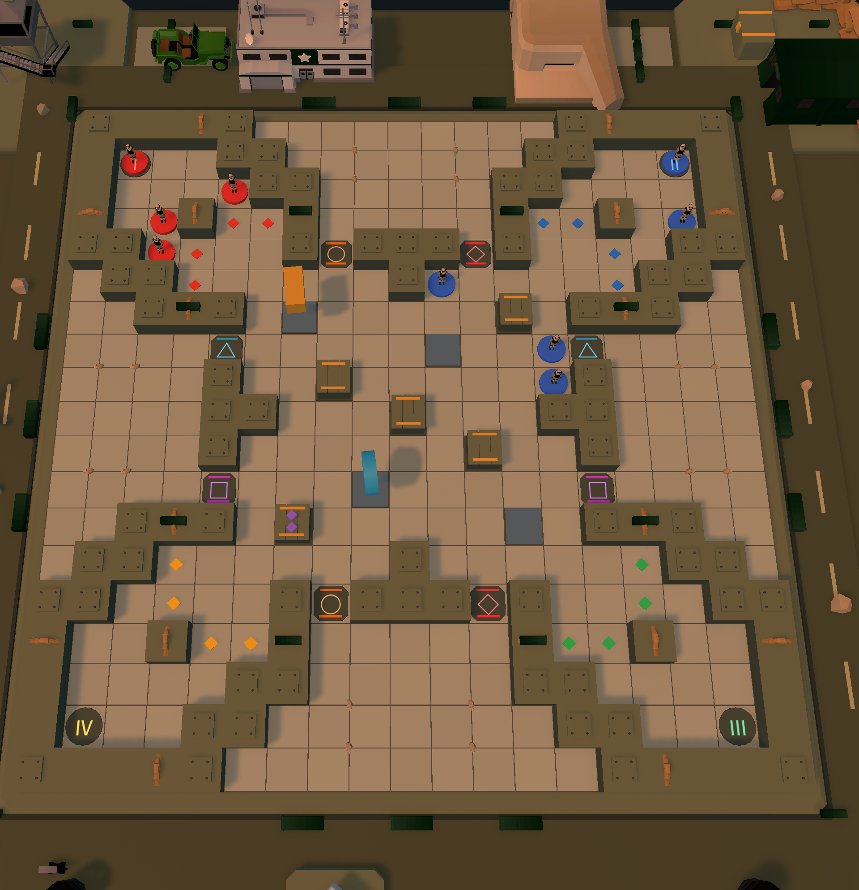
A CLOCKWORK TABLETOP TACTICS GAME
DRIFTLINE
Roll. Slide. Surround. Connect.
Four teams enter an ancient clockwork board. Dice decide how far you drift — walls decide when you stop. Connect five in a row, or be the last team standing.

Slide 2
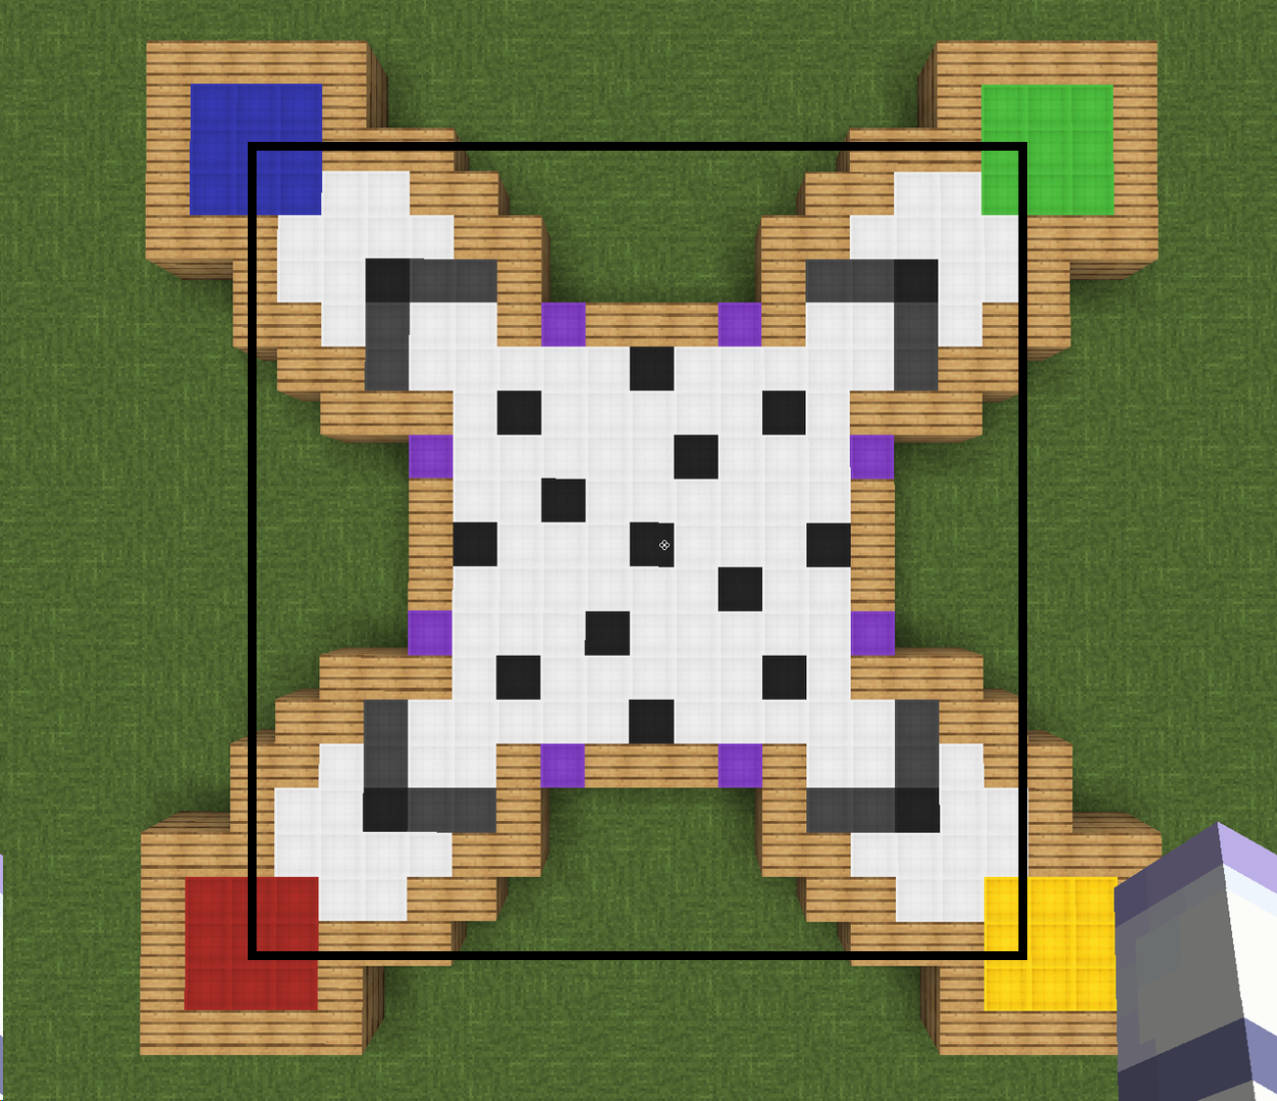
WHY THIS GAME
Inspiration & World
Three games I grew up on
I've played Go for years. Driftline fuses it with the other two boards on our family table: Go's shared-breath captures, Gomoku's five-in-a-row finish, and the dice, deployment and bumping of Aeroplane Chess.
Built in Minecraft first
I love Minecraft, so before a single line of code I built the first board block by block — the four colored corners, the wall tiles and the portals were all there from day one. Every rule since is an iteration of that wooden prototype.
THE WORLD
The four corner colors survived the move to Unity — they became the four expeditions racing for the Realm Key.
The first board — built in Minecraft before a single line of code
DRIFTLINE · PORTFOLIO
02 / 09

Slide 3
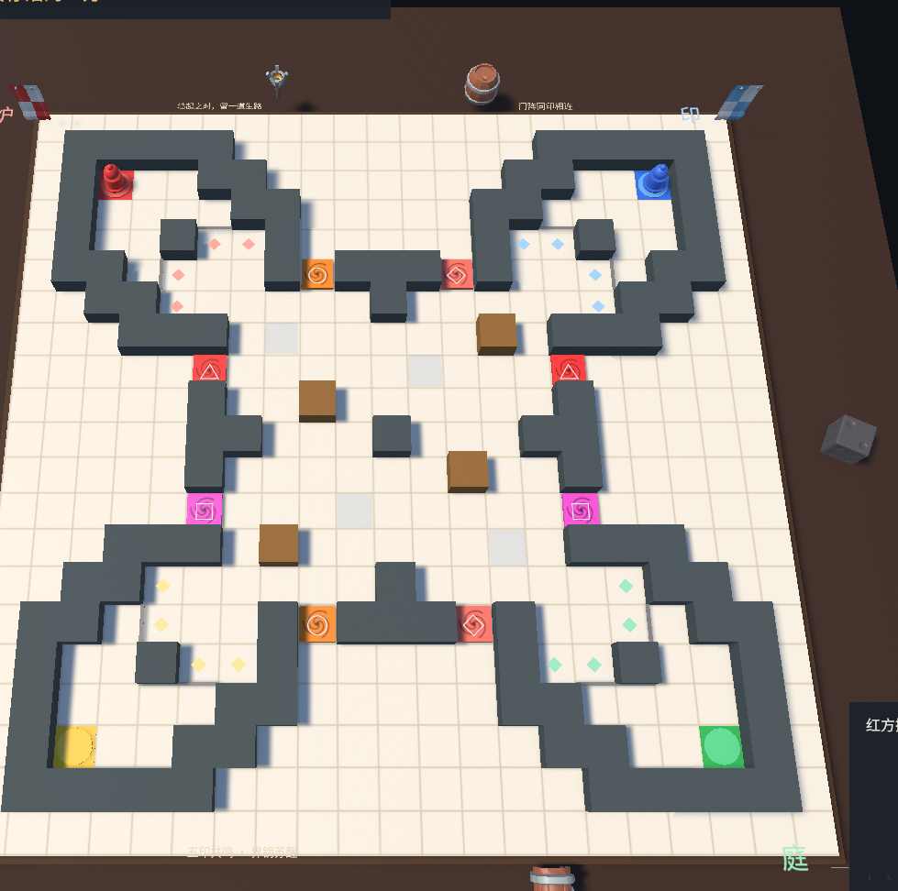
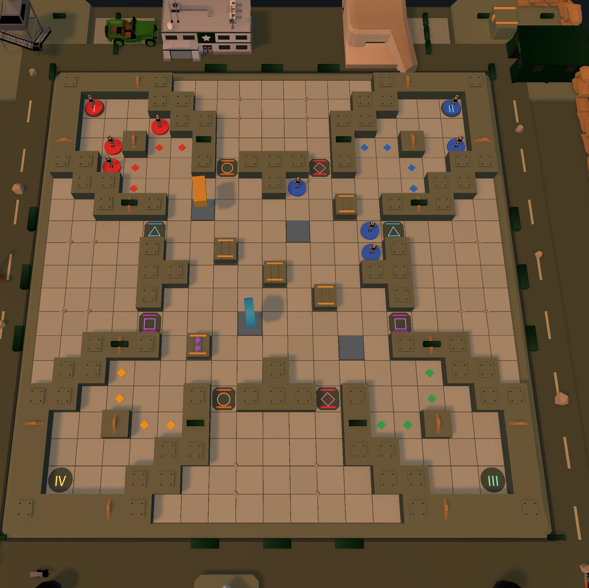
PROTOTYPE → UNITY
From Blocks to Board
01
The Minecraft board
02
First Unity build
03
Today
Wood, wool and colored clay — corners, walls and portals already in place.
A grey-box grid with real rules — every core mechanic already playable.
Five arenas, LAN multiplayer, and an AI that actually plans.
Same four corners, same walls, same portals — the wooden sketch and the shipped game still agree with each other.
DRIFTLINE · PORTFOLIO
03 / 09

Slide 4
HOW A TURN WORKS
Core Loop
Roll the die
Bench piece to deploy?
no
Choose a piece
Spend an item?
no
Pick a route
& a stop
Commit — red circles preview every capture
yes
yes
yes — same piece keeps going
Deploy at spawn — free, once before sliding
Brake · Phase
Ram · Breach
Match won!
yes
Five in a row? One team left?
Turn settles — surrounds, walls cycle, pickups top up
no
Slides left?
The piece drifts — walls stop it, portals jump, rams bite
yes
no
no — next turn
ITEMS — SPAWN ON THE BOARD AT WEIGHTED RANDOM
PASS WALL
EMERGENCY STOP
COLLISION CAPTURE
BREAK WALL
Slide straight through one wall.
Brake on golden stop tiles.
Ram a piece — instant removal.
Tear down a wall, open a lane.
DRIFTLINE · PORTFOLIO
04 / 09

Slide 5
THE BOARD FIGHTS BACK
A Living Board
TURN N — one diagonal ring stands
TURN N+1 — the other ring stands
The wall cycle
Eight slots form two diagonal rings. Every time the turn passes they trade: one pair rises, the other drops. The toggle alone can capture a group.
the turn
passes
Pickups live in the walls
Pickups sprout only on lowered slots, and a rising wall buries them. Two stay visible at most, topped up as turns pass. Phase, Brake and Breach are common — Ram is one pull in ten.
Wall slot stands
Wall slot lowered
Pickup-item
Portal — 4 pairs
Spawn corner
A rising wall blocks slides and shares no liberties — the toggle itself settles captures, and whatever it covers is buried.
Four portal pairs
Two run vertical, two lateral. You land facing the center; a blocked exit cancels the jump.
DRIFTLINE · PORTFOLIO
05 / 09

Slide 6
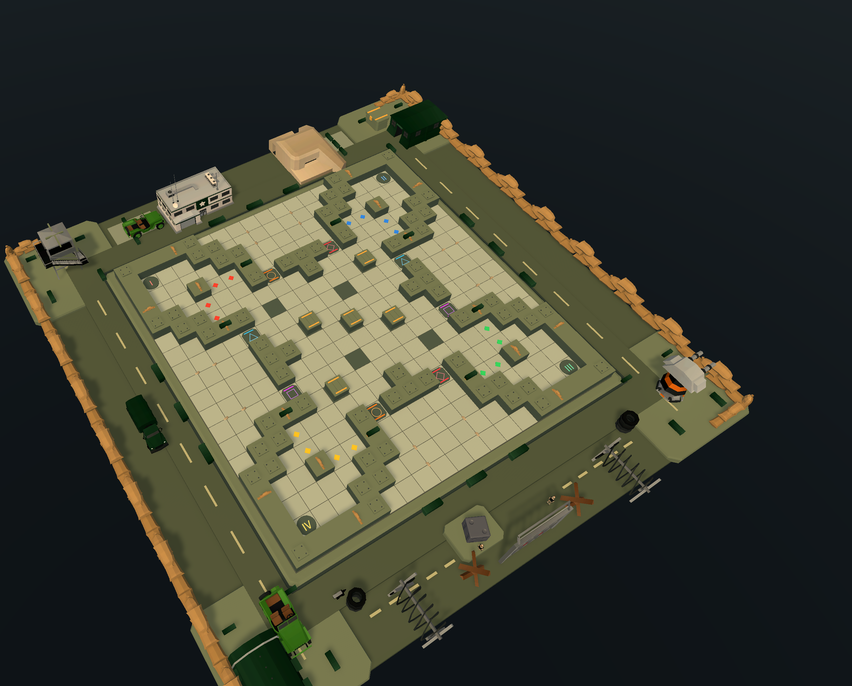
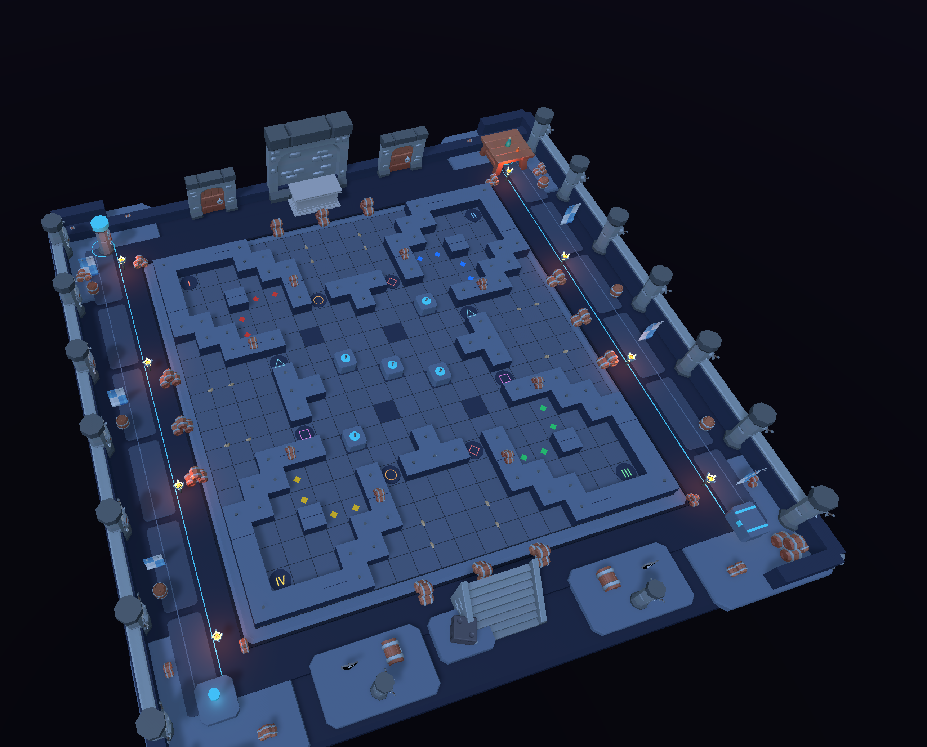
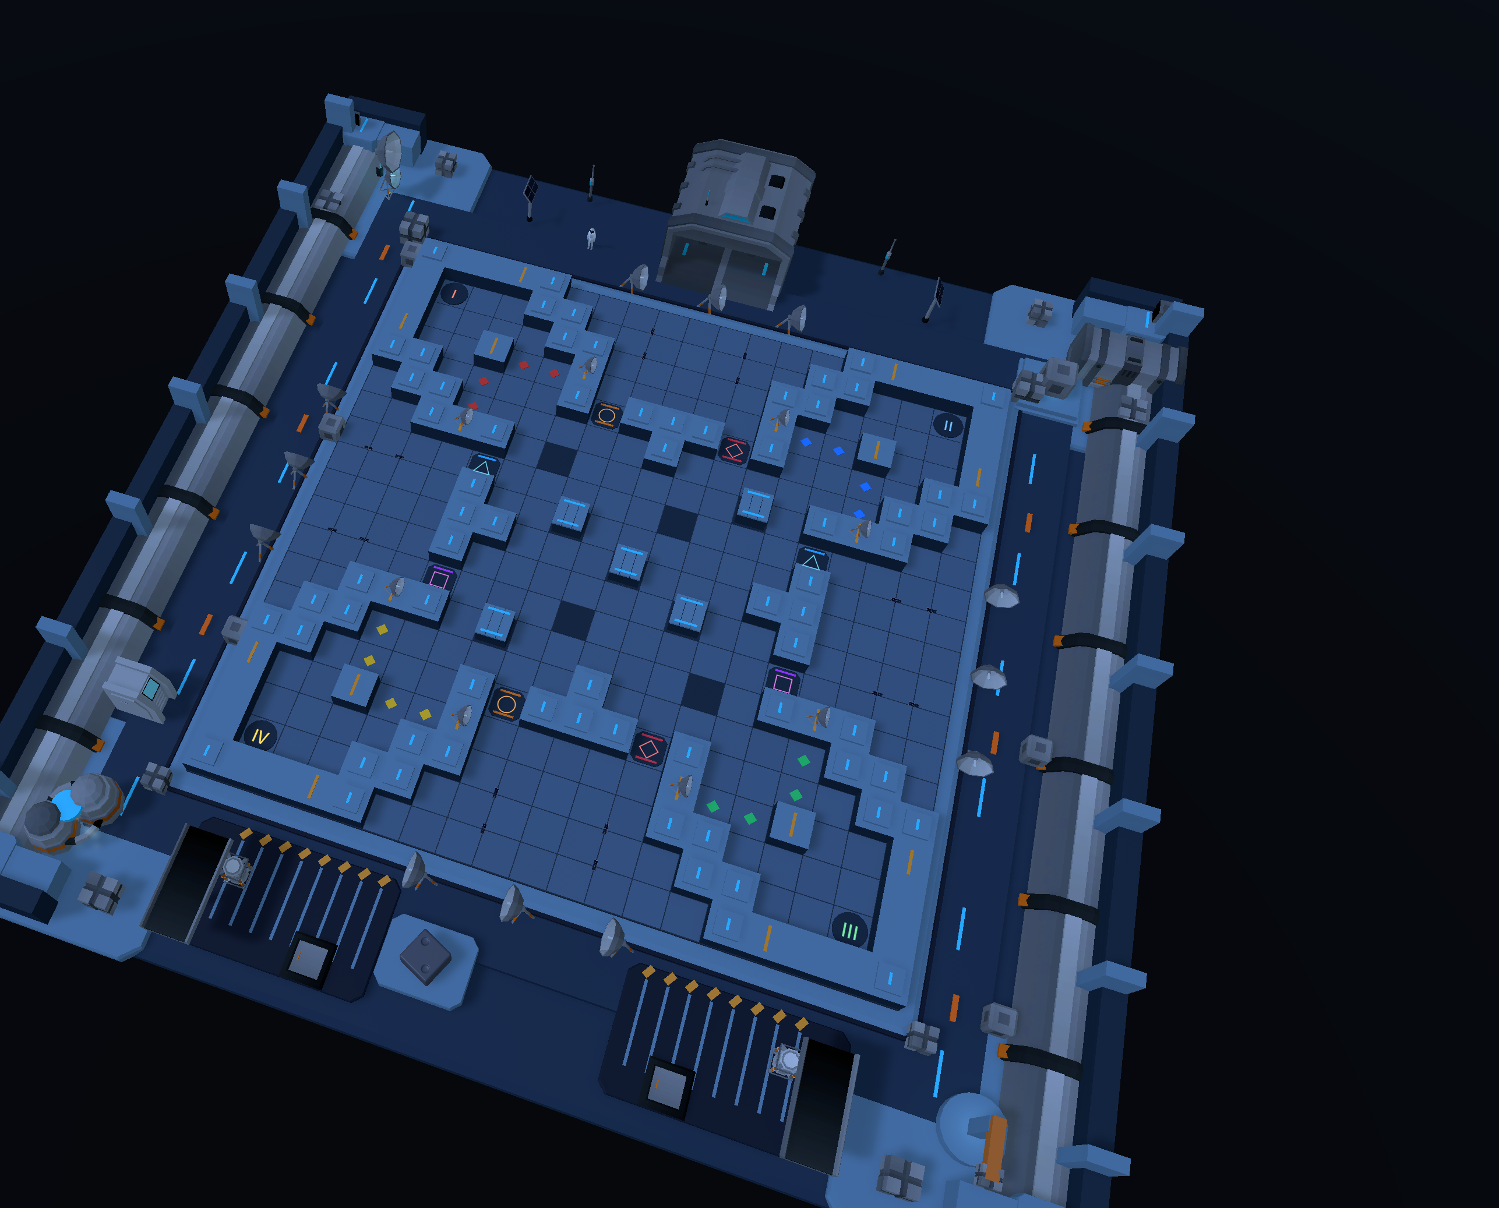
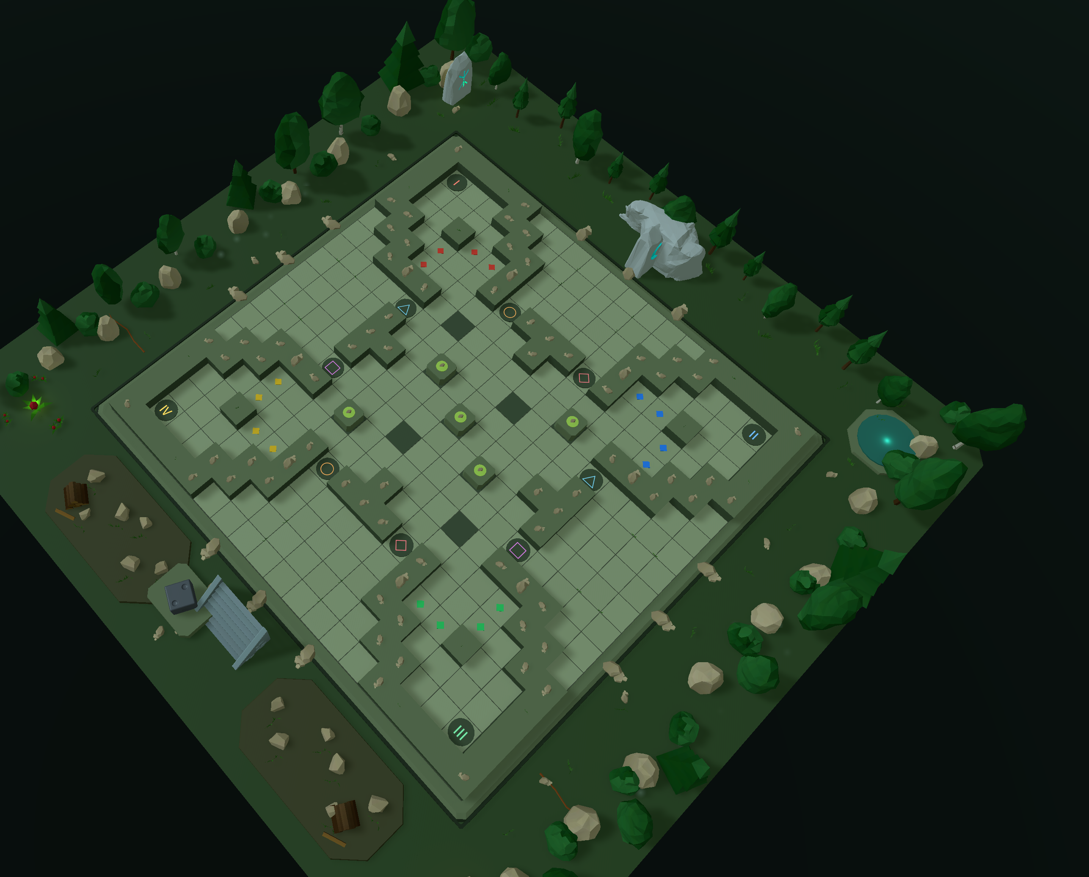
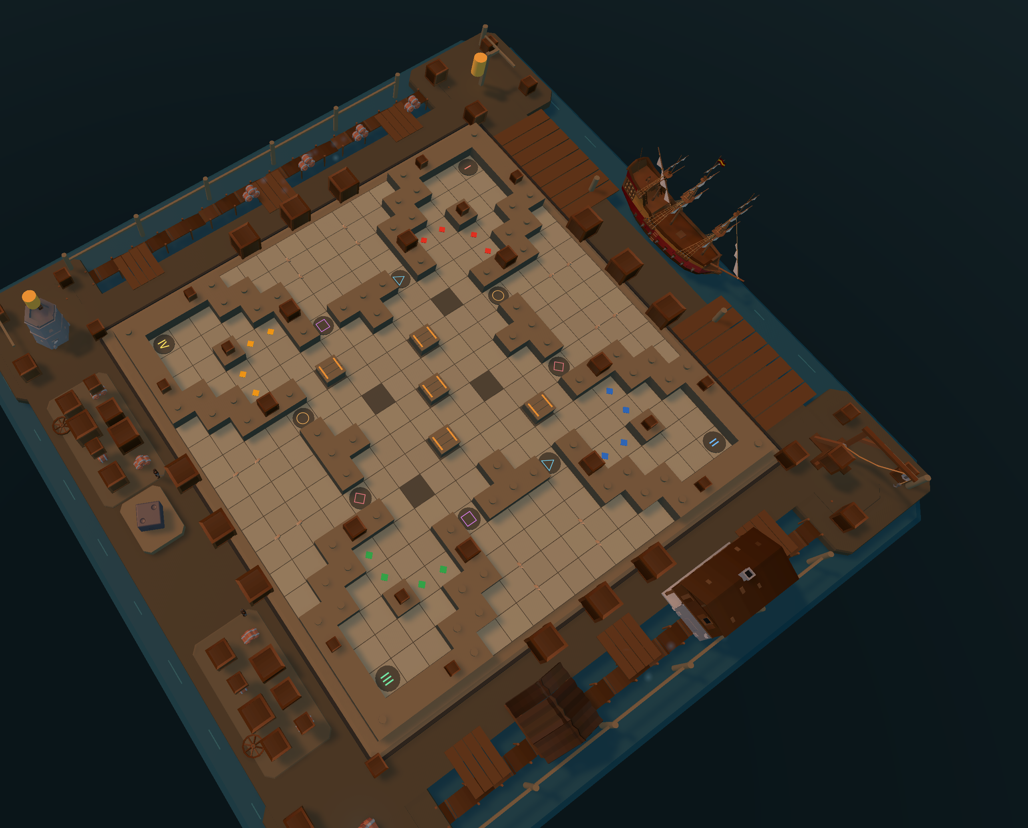
ONE RULESET, FIVE ARENAS
Five Battlefields
FRONTLINE FORTRESS
RUNE DUNGEON
STARSHIP HANGAR
TWILIGHT GROVE
TIDAL HARBOR
Sandbags, watchtowers,
diesel trucks
Crystal light in
sunken halls
Deck plates and
engine glow
Altars under dark
canopies
Docks, cargo and
a moored ship
Board, walls, props, backdrop and the light itself all swap between arenas — two environment moods apiece, and the host's choice follows everyone into the match.
DRIFTLINE · PORTFOLIO
06 / 09

Slide 7
TWO WAYS TO KILL
Capture & Surround
Collision capture
Surround — Go-style liberties
Slide into an enemy with movement to spare and it is removed on impact — no contest, no counter-play. The attacker ends its move on the victim's tile.
A connected block shares liberties from open tiles, spawn gates and lowered wall slots; walls and portals give none. Zero liberties means capture — and your own moves can never self-capture.
removed on impact
0 liberties → the block is captured ！
Every removal: −1 HP for that team.
shaded tile — mechanism wall
Every cause — ram, surround, wall change — is spelled out in the action preview.
WIN — FIVE IN A ROW or LAST TEAM STANDING
Connect five pieces in any direction — horizontal, vertical or diagonal — for an instant victory.
Every team has 5 HP and loses one per captured piece. Bench pieces redeploy — outlive everyone.
DRIFTLINE · PORTFOLIO
07 / 09

Slide 8
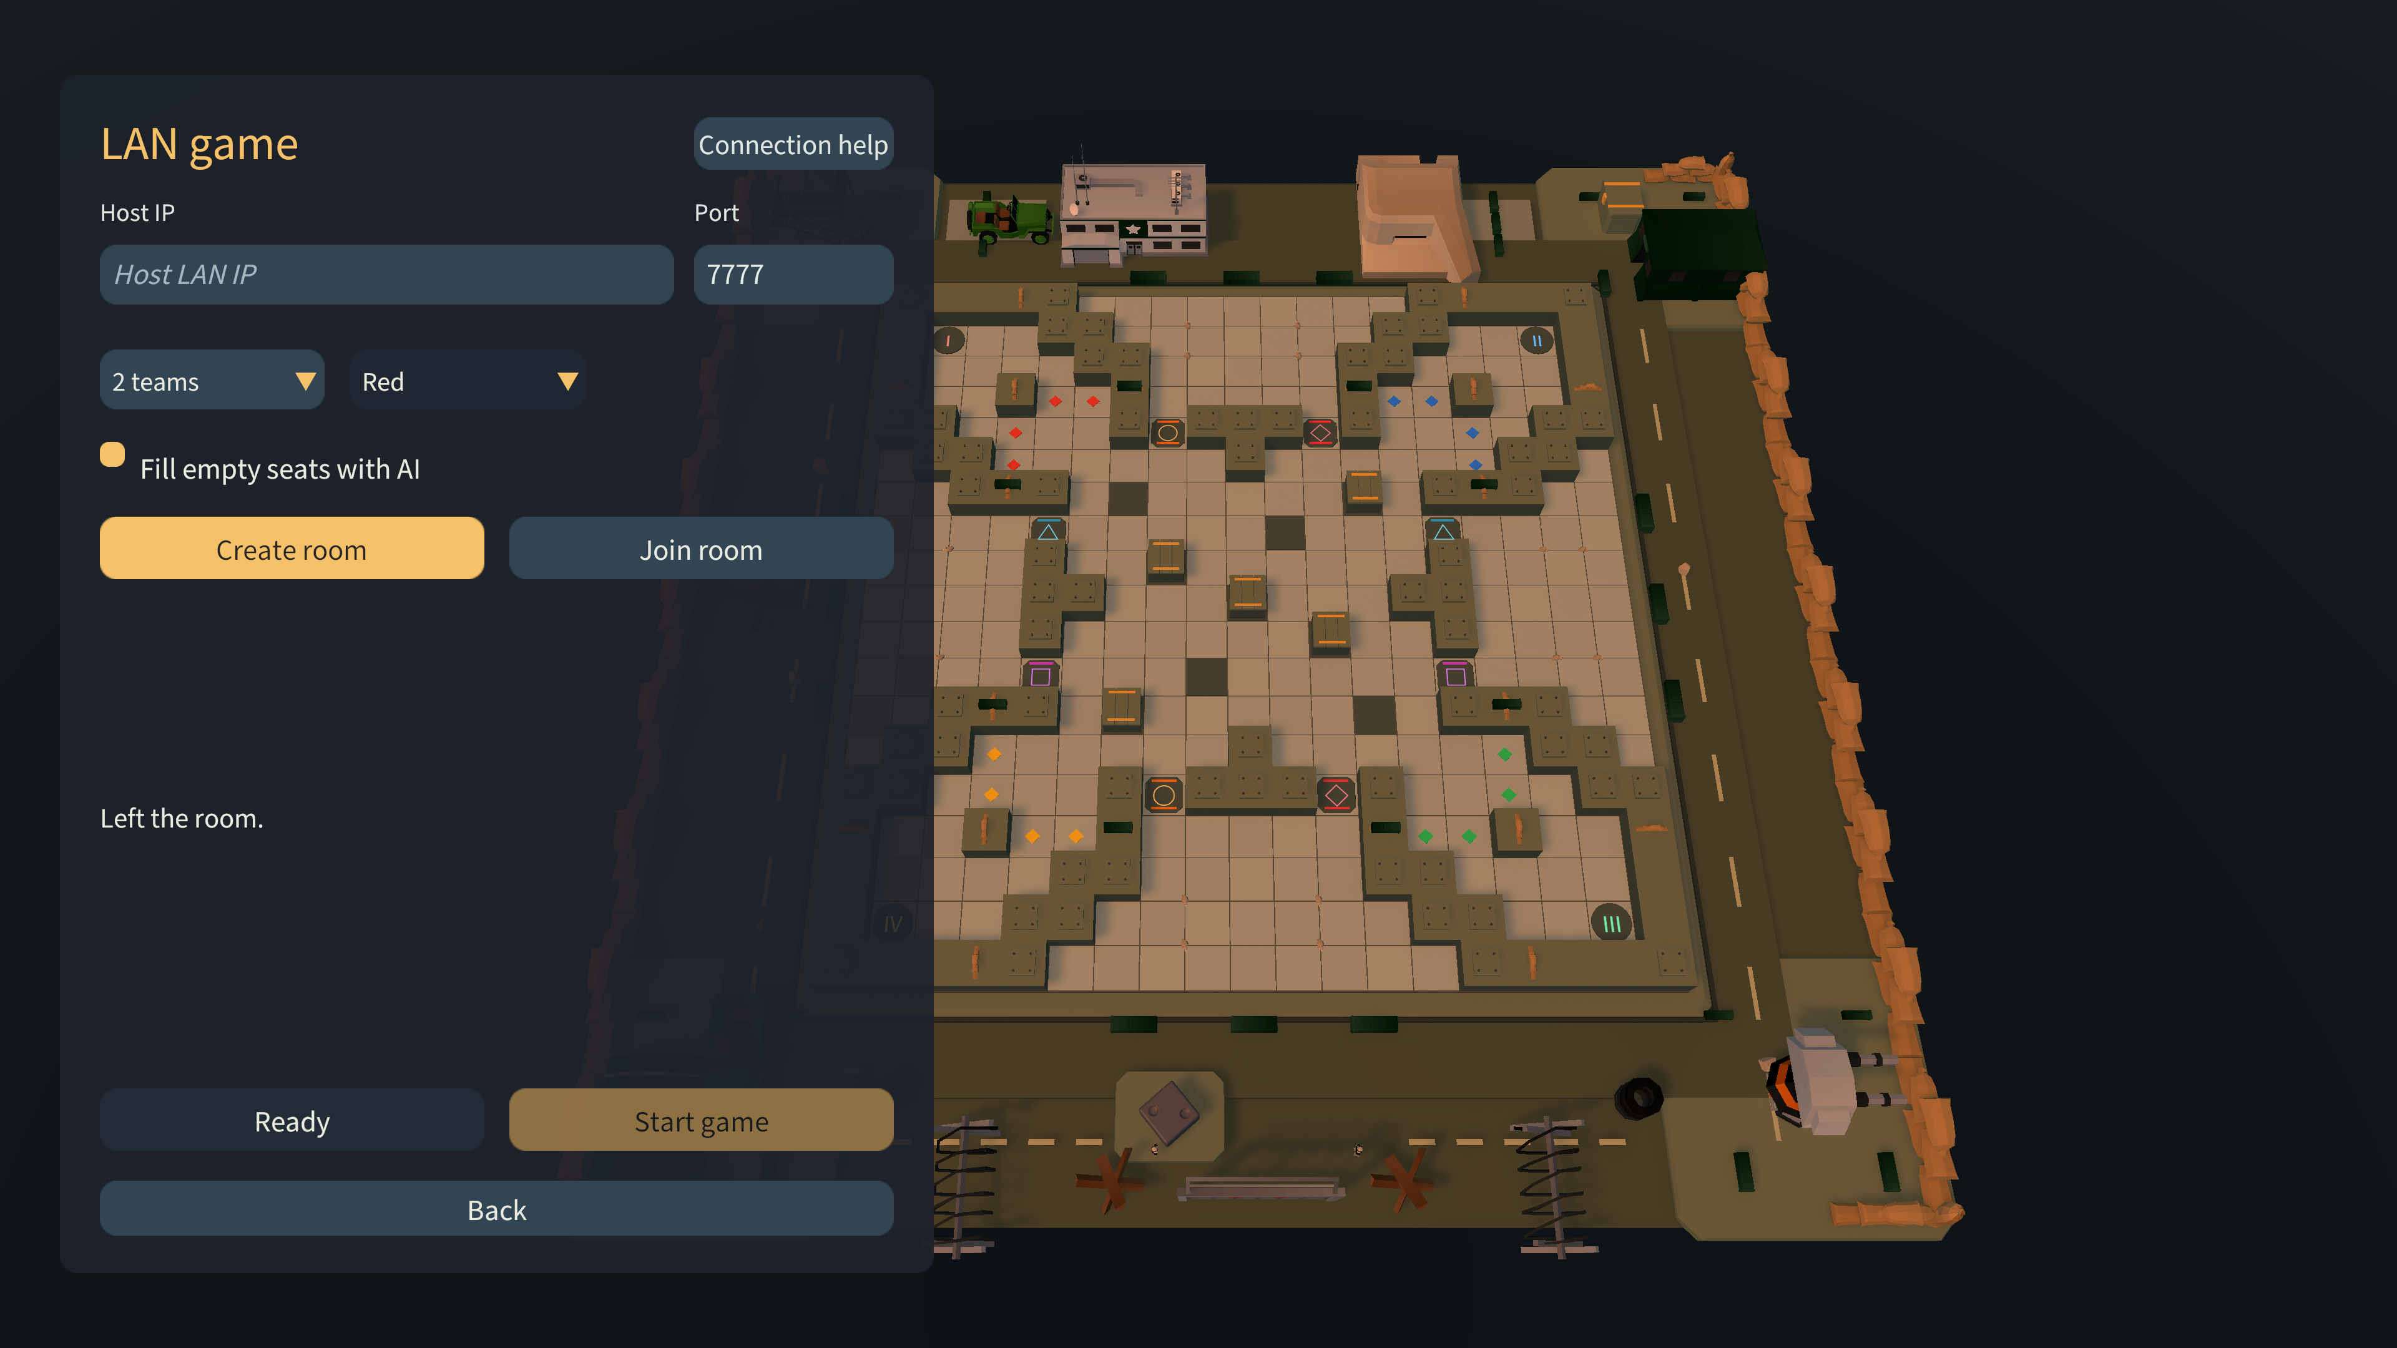
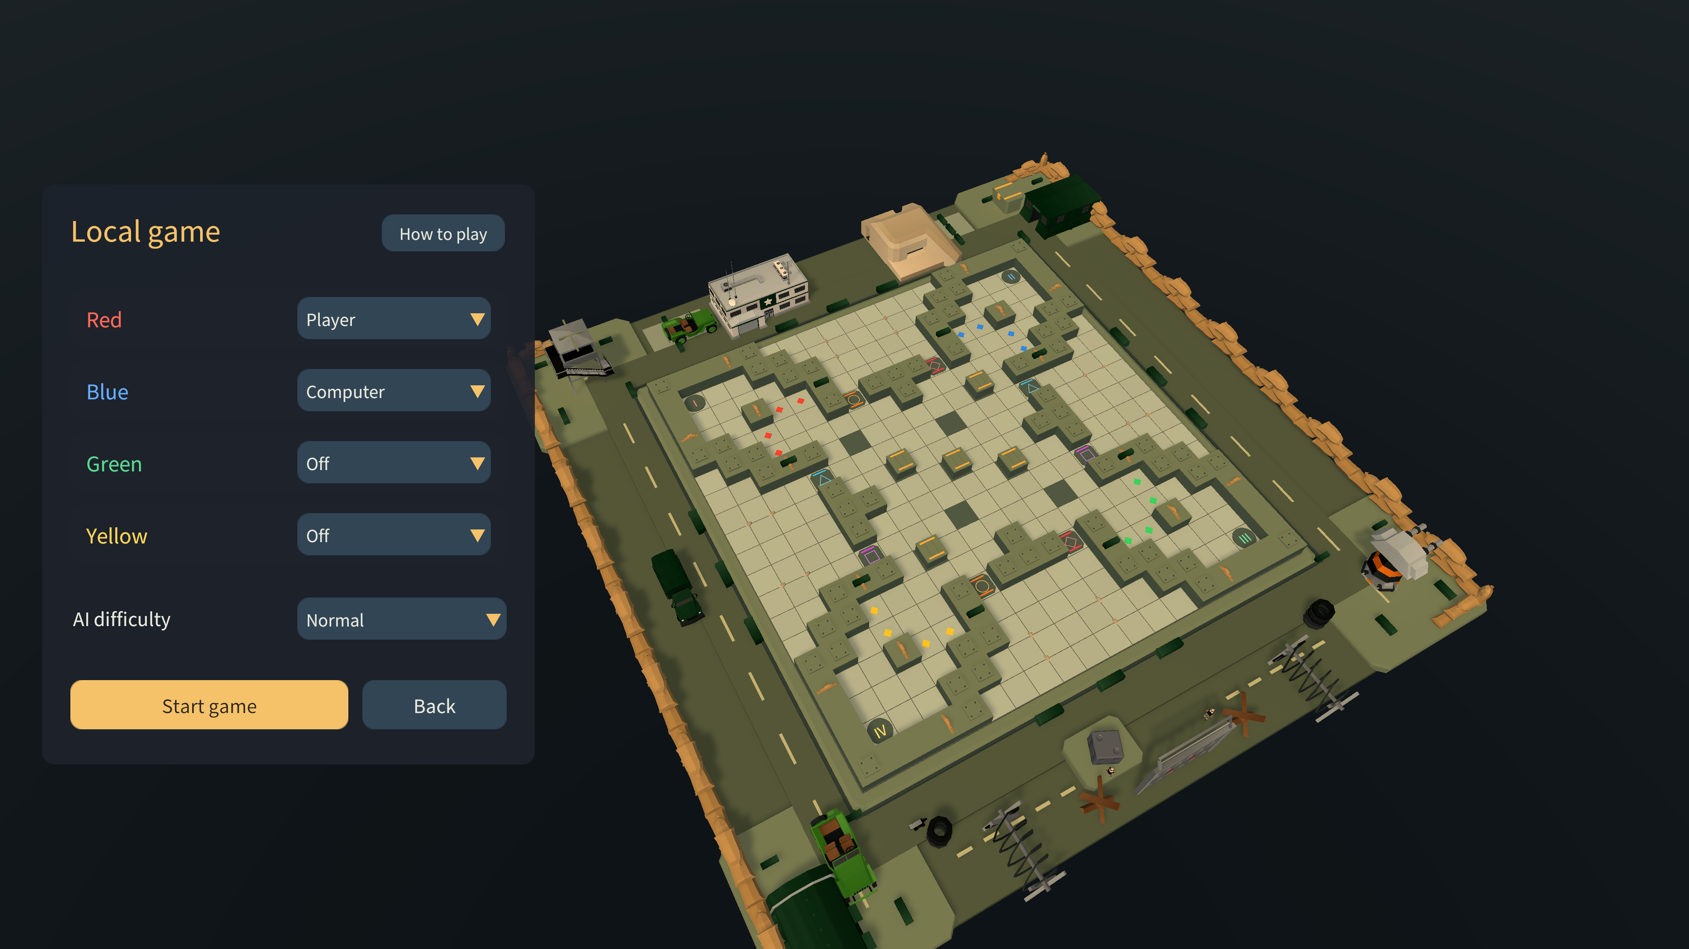
PLAY TOGETHER — OR AGAINST THE MACHINE
Multiplayer & AI
LAN — one host calls the shots
AI — it plans, but never peeks
The host simulates; everyone else just renders — no conflicts to argue about
Dropped plater could rejoin within 60 seconds — an AI pilots your seat meanwhile
Theme, dice and every move stay in lockstep for all four seats
Beam search over isolated copies of the rules — no Unity, no future knowledge
Normal thinks for about a quarter of a second a turn; Easy plays loose and fast
Sits in any empty chair, at local or online
DRIFTLINE · PORTFOLIO
08 / 09

Slide 9
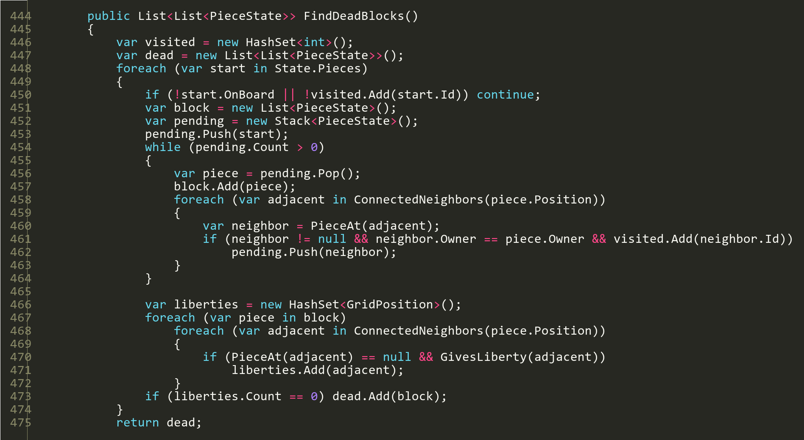
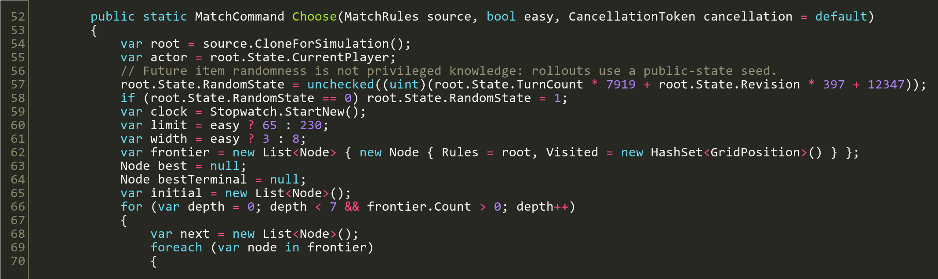
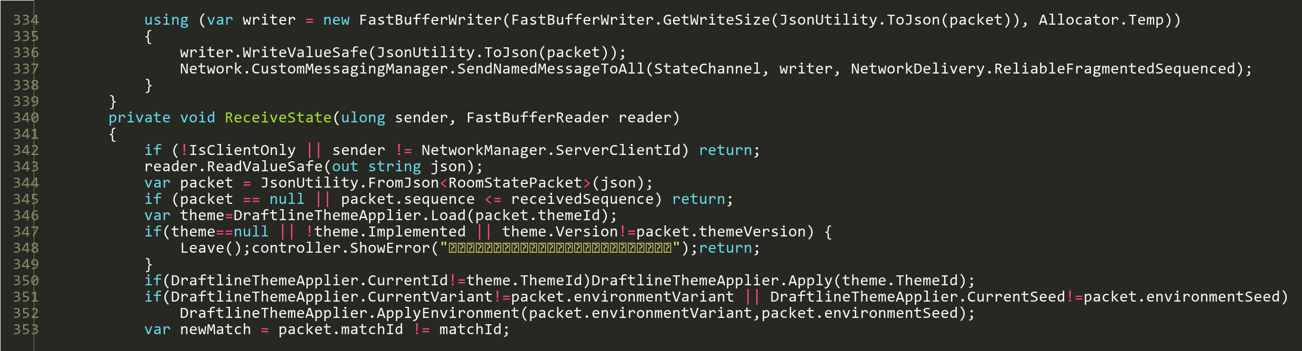
UNDER THE HOOD
Code
ComputerPlanner.cs — the beam search, on isolated copies.
DraftlineLanRoom.cs — sequenced snapshots, version-guarded.
MatchRules.cs · FindDeadBlocks() — blocks with zero liberties are captured.
DRIFTLINE · PORTFOLIO
09 / 09

