Slide 1
Quebic
FaaS Framework

Slide 2
Quebic
Quebic is a framework for writing serverless functions to run on Kubernetes. You can write your functions in any language. Currently Quebic supports only for Java and NodeJS programming models.

Slide 3
Evolution of Application development

Slide 4
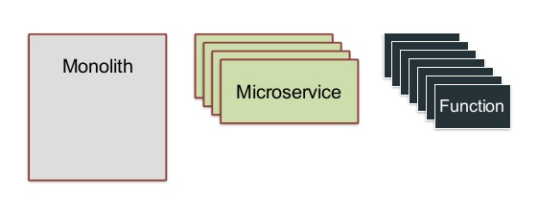
Monolith => Microservice => FaaS

Slide 5
What is serverless/FaaS
1

Slide 6
Serverless can also mean applications where some amount of server-side logic is still written by the application developer but unlike traditional architectures Is run in stateless compute containers that are event triggered, ephemeral
(may only last for one invocation), and fully managed by a 3rd party
- martinfowler.com

Slide 7
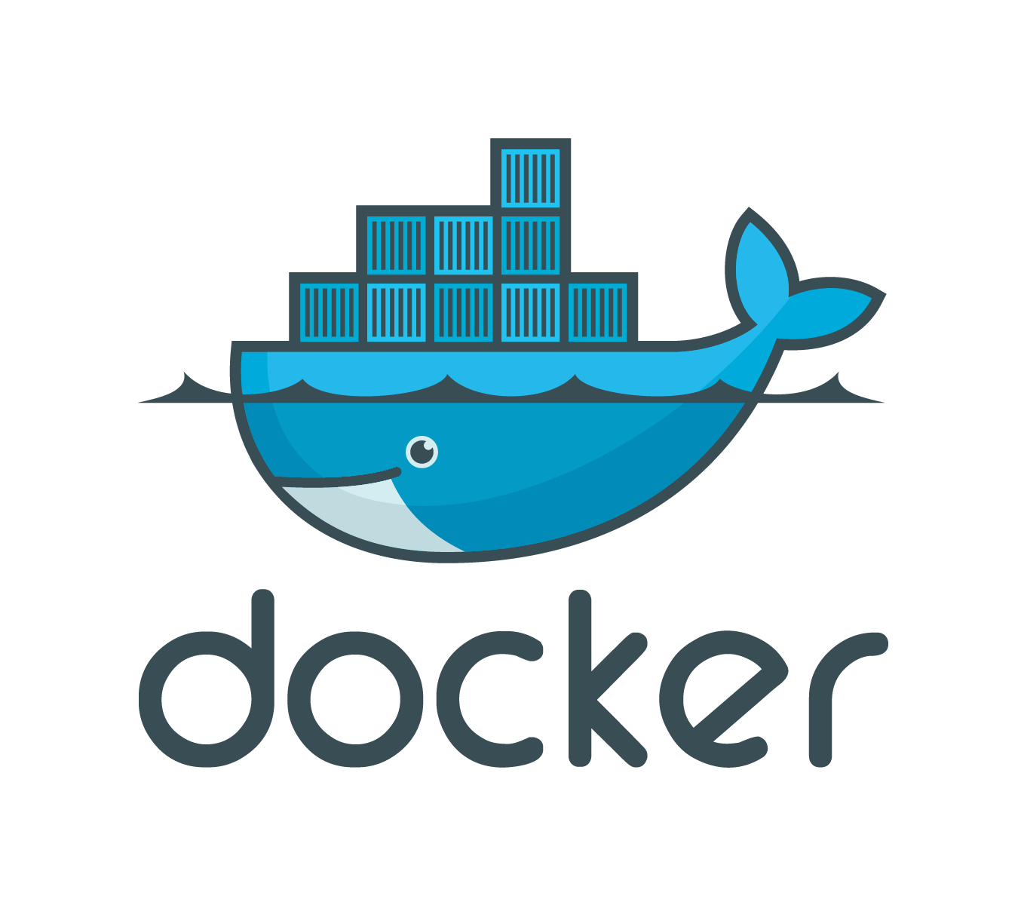
What is Docker
2

Slide 8
Docker is a computer program that performs operating-system-level virtualization also known as containerization
https://www.docker.com/what-docker

Slide 9
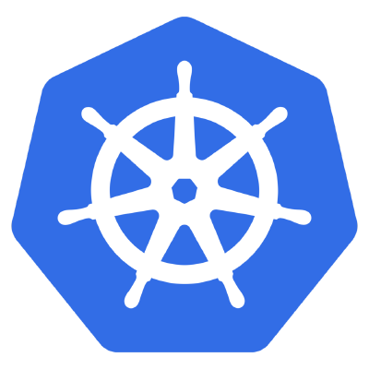
What is Kubernetes
3

Slide 10
Kubernetes is an open-source system for automating deployment, scaling and management of containerized applications that was originally designed by Google

Slide 11
Why Quebic is Used

Slide 12
What Quebic gives you
Run it in anyware
Able to run in any platform windows/linux. Just download binaries and run it. No need any 3rd party tool.
Polyglot Programming
Write your functions in any programming language. Java, JavaScript and more.
Asynchronous invocation
The event-driven messaging mechanism of Quebic enables Asyc invocations from Api Gateway to function 0r inter-functions calls.
Micro Service
Not just functions. You can write event driven microservice.
Upgrade and Downgrade
Do upgrade or downgrade for only single unit ( function ) of your system into new or previous version without breaking entire system process
Scalability
You can keep any numbers of replicas of your function. Any time you can increase or decrease replicas count.

Slide 13
How Quebic work

Slide 14
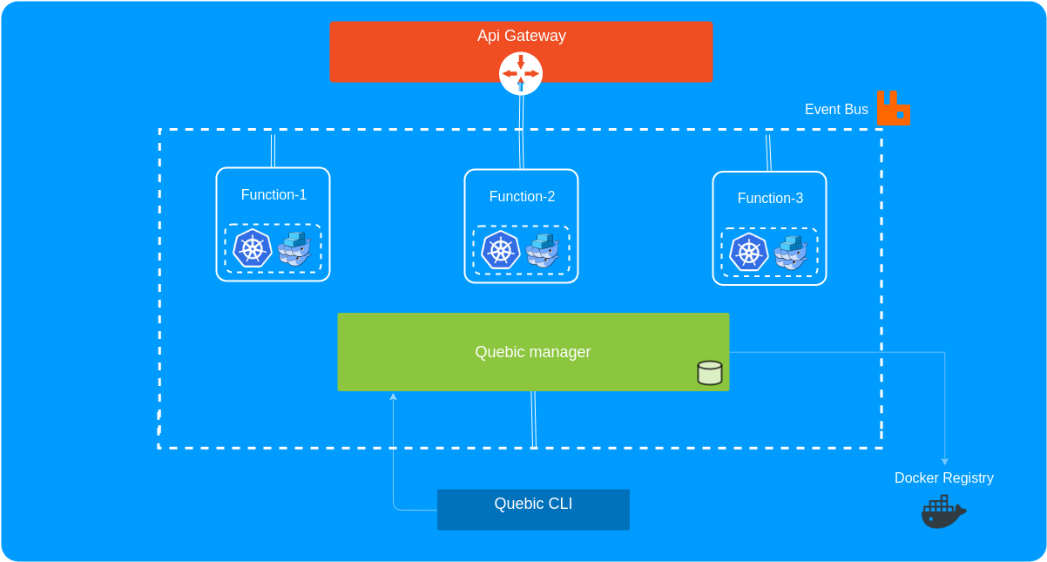

Slide 15
Quebic Functions

Slide 16
Java runtime
Sample function code
public class HelloFunction implements RequestHandler<Request, Response>{ public void handle(Request request, CallBack<Response> callback, Context context) {
//your code goes here callback.success(new Response(1, "reply success")); }
}

Slide 17
NodeJS runtime
Sample function code
exports.helloHandler = function(payload, context, callback){ //your code goes here callback('Hello world', 201); }

Slide 18
Getting Started
https://github.com/quebic-source/quebic

Slide 19
Thanks!
Any questions?
You can find me at tharanganilupul@gmail.com and Linkedin

