Slide 1



MassBFT: Fast and Scalable Geo-Distributed Byzantine Fault-Tolerant Consensus
﻿Zeshun Peng, Yanfeng Zhang, Tinghao Feng, Weixing Zhou, Xiaohua Li, Ge Yu
Northeastern University, China
Notes:
Hello, everyone. Today I will present our paper ‘MassBFT: Fast and Scalable Geo-Distributed Byzantine Fault-Tolerant Consensus’.

Slide 2
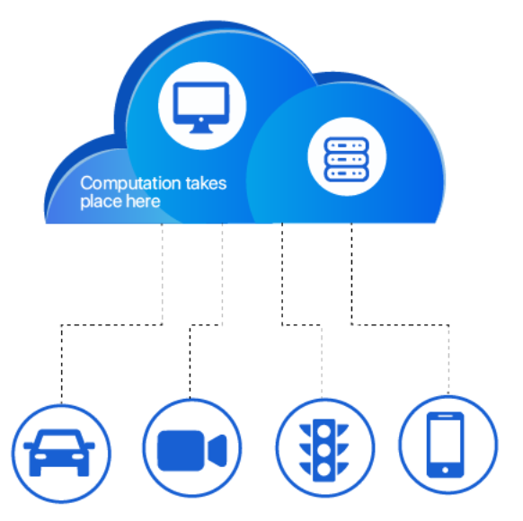

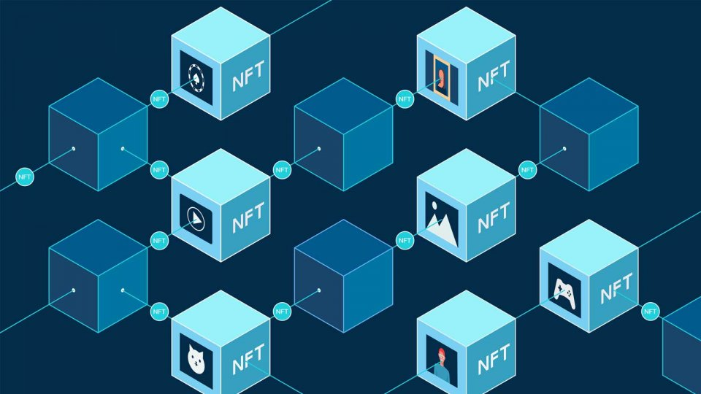
Geo-Distributed Consensus
Features: high availability, scalability, load balancing
Applications:
Edge Computing
Distributed Databases
Blockchain Technology
Notes:
Geo-distributed consensus is a fundamental technology in cross-region distributed systems. It features high availability, scalability, and load balancing. Geo-distributed consensus has become increasingly important with the rapid development of edge computing, distributed databases, and blockchain technology.

Slide 3








Geo-Distributed Consensus
Throughput is limited by cross-datacenter bandwidth.
WAN bandwidth of a node
Wide-area network (WAN)
$\sim 100$ Mbps
$\sim 100$ Mbps
LAN bandwidth of the node
$\sim 10$ Gbps
$\sim 10$ Gbps
$\sim 100$ Mbps
$\sim 100$ Mbps
Node
Node
Data center 1
Data center 2
Notes:
The throughput of geo-distributed consensus is severely limited by cross-datacenter WAN bandwidth. The WAN bandwidth of a node is about a hundred times higher than the LAN bandwidth of the node. This significant disparity creates a fundamental challenge for scaling across geographical regions.

Slide 4


Geo-Distributed Consensus
Hierarchical structure to increase WAN bandwidth utilization.
Node partitioning based on datacenter location
Local consensus to prevent Byzantine faults
Global consensus to ensure availability
Data center 1
Leader
Followers
Group $G_{1}$
Data center 2
Leader
Followers
Group $G_{2}$
Notes:
Existing systems adopt a hierarchical architecture to reduce WAN bandwidth usage. Nodes are grouped based on their data center location, as shown in the figure. Each group achieves local consensus to tolerate Byzantine faults, and then group leaders participate in global consensus to ensure availability. In our implementation, we utilize PBFT for local consensus and Raft for global consensus.

Slide 5
Geo-Distributed Consensus
Hierarchical structure to increase WAN bandwidth utilization.
Node partitioning based on datacenter location
Local consensus to prevent Byzantine faults
Global consensus to ensure availability
Leader
Followers
Group $G_{1}$
WAN utilization remains insufficient
Leader
Followers
Group $G_{2}$
Notes:
However, WAN utilization remains insufficient of these systems. Here, we present an example.

Slide 6


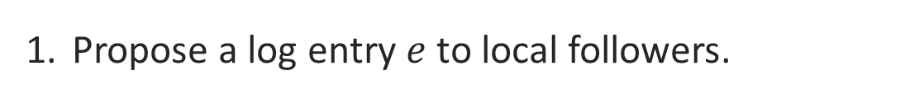
A motivate example
Phase 1: local PBFT consensus to prevent Byzantine nodes.
Leader
Followers
Group $G_{1}$
Propose a log entry $e$ to local followers.
Notes:
The hierarchical consensus consists of two phases. The first phase is a local consensus phase. The leader node batches a log entry and broadcast it to the follower nodes within the local group.

Slide 7

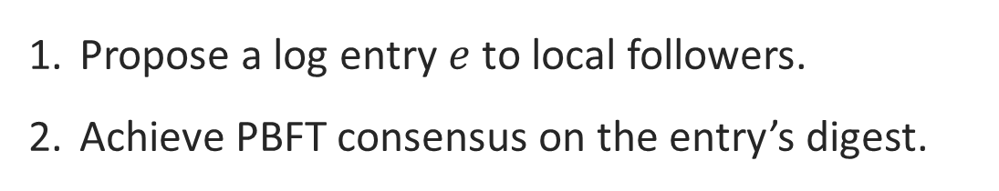
A motivate example
Phase 1: local PBFT consensus to prevent Byzantine nodes.
PBFT consensus
Group $G_{1}$
Propose a log entry $e$ to local followers.
Achieve PBFT consensus on the entry’s digest.
Notes:
Once the entry has reached more than a threshold of the nodes, for example, two-thirds, the group reaches consensus on the digest of the entry. This ensures that the entry cannot be tampered with by Byzantine nodes.

Slide 8


A motivate example
Phase 2: global Raft consensus to tolerant network partition.
Leader
Group $G_{1}$
Group $G_{2}$
The leader broadcast the entry to other groups via WAN.
Notes:
In the second phase, the entry must be replicated to other datacenters to tolerate network partitions or datacenter failures. Existing systems only use the group leader to replicate the entry. The leader broadcasts the entry to nodes in other groups via the WAN.

Slide 9


A motivate example
Phase 2: global Raft consensus to tolerant network partition.
Leader
2 of 3 entry copies may lost
Group $G_{1}$
Group $G_{2}$
The leader broadcast the entry to other groups via WAN.
Notes:
To tolerate Byzantine receivers, the leader must broadcast multiple copies of the entry to each group. For example, assumes there are two Byzantine nodes in group 2. The leader node in group 1 must send three copies to ensure that at least one honest node receives the entry. The node then locally broadcast the received copy to ensure that all honest nodes in the group receive the entry.

Slide 10
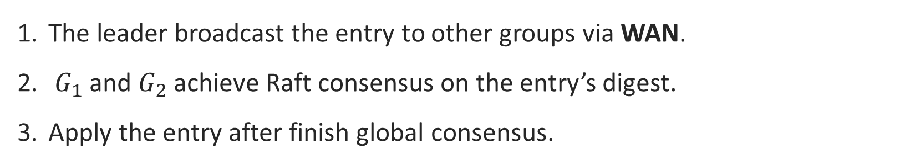
A motivate example
Phase 2: global Raft consensus to tolerant network partition.
Leader
Group $G_{1}$
Group $G_{2}$
The leader broadcast the entry to other groups via WAN.
$G_{1}$ and $G_{2}$ achieve Raft consensus on the entry’s digest.
Apply the entry after finish global consensus.
Notes:
These groups use Raft to reach consensus on the entry’s digest, ensuring that a majority of groups have received the entry to tolerate network partitions or group failures. The entry can be applied only after global consensus is completed.

Slide 11



Observations
High replication redundancy.
$f_{2}+1$ copies must be sent to tolerate $f_{2}$ Byzantine nodes in $G_{2}$.
Leader
transmitting 1 entry requires sending 3 copies
Group $G_{1}$
Group $G_{2}$
Notes:
We can observe that existing hierarchical consensus protocols have high replication redundancy. Formally, to tolerate f2 Byzantine nodes in group 2, the leader has to send at least f2 plus one copies of the entry to that group. In the example, transmitting one entry requires sending three copies.

Slide 12
Observations
Single-node WAN bottleneck.
Only the leader node broadcast logs during the global consensus.
bandwidth bottleneck
Leader
Group $G_{1}$
Group $G_{2}$
Notes:
Second, the f2 plus one copies are all sent by the same node, which creates a single-node network bottleneck.

Slide 13
A naïve solution: bijective log replication*
Allowing more nodes participating in global replication.
More copies must be sent, increasing WAN traffic.
Leader
utilizing followers
4 copies (instead of 3)
must be sent
Group $G_{1}$
Group $G_{2}$
* The fault-tolerant cluster-sending problem [FoIKS 2022]
Notes:
Existing approaches tried to eliminate the leader bottleneck by leveraging the follower nodes. However, they required the groups to send and receive even more entries. As shown in the Figure, the bijective replication requires to send 4 copies instead of 3, further increasing the total WAN traffic.

Slide 14
A naïve solution: bijective log replication
Allowing more nodes participating in global replication.
More copies must be sent, increasing WAN traffic.
Some nodes are still not utilized.
nodes still not utilized
Leader
3 of 4 entries may lost
Group $G_{1}$
Group $G_{2}$
Notes:
And some nodes still do not participate in the replication process, leading to underutilized WAN bandwidth.

Slide 15
A naïve solution: bijective log replication
Allowing more nodes participating in global replication.
More copies must be sent, increasing WAN traffic.
Some nodes are still not utilized.
nodes still not utilized
Leader
3 of 4 entries may lost
Group $G_{1}$
Group $G_{2}$
How to utilize all nodes while minimizing WAN traffic?
Notes:
So, can we design an effective replication strategy that both utilizes all nodes and minimizes WAN traffic?

Slide 16


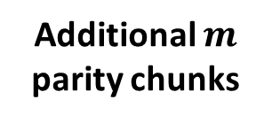

Erasure coding
Encode each entry into fault-tolerant chunks.
1. divide
$k$ data chunks
3. Chunk loss during transmission
2. encode
4. Rebuild &
validation
Additional $m$
parity chunks
Notes:
We first introduce the erasure coding technique. Erasure coding splits the original log entry into k data chunks and then generates m parity chunks. Even if some chunks are lost during WAN transmission, as long as a node obtains any k chunks, it can reconstruct the original entry. Chunk validity is protected by the entry certificate, so Byzantine nodes cannot tamper with it.

Slide 17


Encoded Bijective Log Replication
After local PBFT consensus, each sending node has the entry.
Group $G_{1}$
Group $G_{2}$
Notes:
Recall that after local PBFT consensus, each sending node has a copy of the entry.

Slide 18
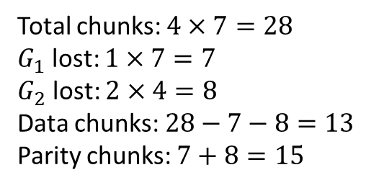
Encoded Bijective Log Replication
Each node encoding the entry based on a predefined plan.
Total chunks: $4×7=28$
$G_{1}$ lost: $1×7=7$
$G_{2}$ lost: $2×4=8$
Data chunks: $28−7−8=13$
Parity chunks: $7+8=15$
Group $G_{1}$
Group $G_{2}$
Notes:
First, each sending node independently encoding the entry into chunks based on a predefined plan.

Slide 19
Encoded Bijective Log Replication
Sending chunks according to the predefined plan.
each node receives 4 chunks
Total chunks: $4×7=28$
$G_{1}$ lost: $1×7=7$
$G_{2}$ lost: $2×4=8$
Data chunks: $28−7−8=13$
Parity chunks: $7+8=15$
each node sends 7 chunks
Group $G_{1}$
≈ 2.15 total entry copies
Group $G_{2}$
Notes:
According to the pre-defined plan, each node in group 1 sends seven chunks, and each node in group 2 receives four chunks. Since there is one Byzantine node in group 1, seven chunks are lost. In addition, eight more chunks are lost because there are two Byzantine nodes in group 2.

Slide 20
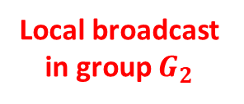

Encoded Bijective Log Replication
Recovering the entry despite chunk loss.
Total chunks: $4×7=28$
$G_{1}$ lost: $1×7=7$
$G_{2}$ lost: $2×4=8$
Data chunks: $28−7−8=13$
Parity chunks: $7+8=15$
Local broadcast in group $G_{2}$
Group $G_{1}$
Group $G_{2}$
Notes:
After the nodes in group 2 exchange their received chunks, each honest node receives at least 13 chunks, which is enough to recover the original entry.

Slide 21
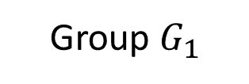
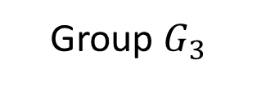
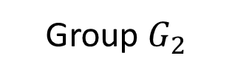
Encoded Bijective Log Replication
Aggregate the bandwidth of all nodes in a group.
Groups with more nodes propose entries faster.
Group $G_{1}$
Group $G_{2}$
Group $G_{3}$
≈ 20 entries/s
≈ 35 entries/s
≈ 35 entries/s
Notes:
The encoded bijective log replication aggregates the bandwidth of all nodes in a group. Groups with more nodes can propose entries faster.

Slide 22
Encoded Bijective Log Replication
Aggregate the bandwidth of all nodes in a group.
Groups with more nodes propose entries faster.
When all groups propose entries concurrently:
Group $G_{1}$
Group $G_{2}$
Group $G_{3}$
≈ 20 entries/s
≈ 35 entries/s
≈ 35 entries/s
How to establish a global order of these entries?
Notes:
However, a new question arise: when all groups propose entries concurrently, how can we establish a global order of these entries to fully exploit the bandwidth of all groups?

Slide 23






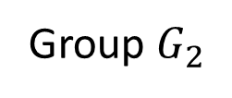
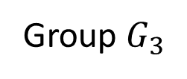
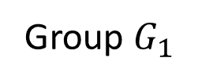
Log Ordering Bottleneck
Existing systems (e.g., GeoBFT [VLDB 2020]) predefined the order of entries.
Execute order
time
: apply the entry
Group $G_{1}$
Group $G_{2}$
Group $G_{3}$
Notes:
Existing systems, such as GeoBFT, adopt the round-based ordering to order the entries propose by different groups. We first provide an example to show the limitation of the round-based ordering. Round-based ordering assumes all groups propose entries at the same rate and uses a predefined order to execute these entries. In the figure, the entry proposed by group 1 is executed first.

Slide 24
Log Ordering Bottleneck
Works perfectly when the groups are of equal size.
: apply the entry
Execute order
time
Group $G_{1}$
Group $G_{2}$
Group $G_{3}$
Notes:
Then group 2’s entry.

Slide 25
Log Ordering Bottleneck
Works perfectly when the groups are of equal size.
: apply the entry
Execute order
time
Group $G_{1}$
Group $G_{2}$
Group $G_{3}$
Notes:
Then group 3’s entry.
We can see that the round-based ordering works perfectly when the groups are of equal size.

Slide 26


Log Ordering Bottleneck
Failed when $G_{2}$ and $G_{3}$ propose entries faster than $G_{1}$.
: apply the entry
Execute order
time
slow
Group $G_{1}$
wait for $G_{1}$
Group $G_{2}$
wait for $G_{1}$
Group $G_{3}$
Notes:
However, when groups 2 and 3 have more nodes, they propose entries faster than group 1.

Slide 27
Log Ordering Bottleneck
Force all groups propose entries at the same rate.
: apply the entry
Execute order
time
slow
Group $G_{1}$
synchronous wait
Group $G_{2}$
synchronous wait
Group $G_{3}$
Notes:
We can see that the entries proposed by group 2 and 3 cannot be executed until group 1 proposes an entry, causing synchronous waits.

Slide 28
Log Ordering Bottleneck
$G_{2}$ and $G_{3}$’s throughput is limited by $G_{1}$.
: apply the entry
Execute order
time
slow
Group $G_{1}$
synchronous wait
Group $G_{2}$
synchronous wait
Group $G_{3}$
Notes:
In other words, the throughput of group 2 and 3 are limited by group 1.

Slide 29
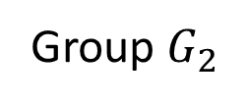
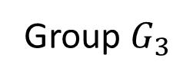
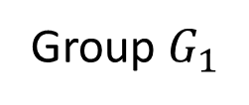
Asynchronous log ordering
Phase 1: Every group replicate entries at its own maximum rate.
Replicate first, determine order later.
Group $G_{2}$
encoded bijective replication
Group $G_{1}$
encoded bijective replication
Group $G_{3}$
Notes:
Therefore, we propose asynchronous log ordering to eliminate this bottleneck. The key idea is to allow these groups to replicate their entries at their maximum rate, and the system asynchronously orders the entries that complete replication later. The algorithm consists of three phases.
The first phase is log replication. Each group replicates entries at its own maximum rate using the encoded bijective replication described earlier.

Slide 30
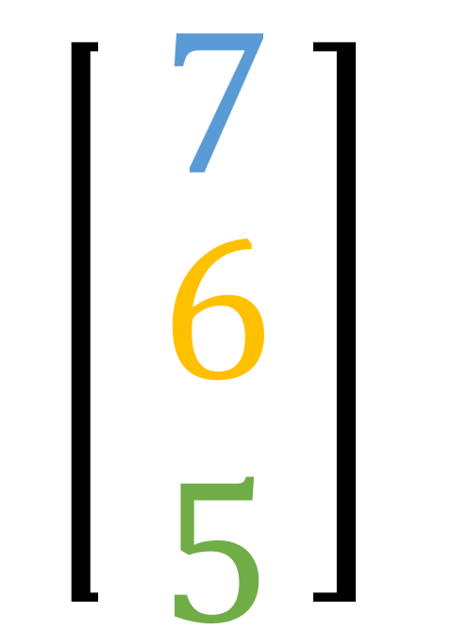
Asynchronous log ordering
Phase 2: Achieve consensus on the entry’s vector timestamp (VTS).
VTS=
Group $G_{2}$
After replicate an entry, consensus perform asynchronously on its VTS with digest.
VTS=
Group $G_{1}$
VTS=
Group $G_{3}$
Notes:
After an entry finished replication, it is assigned by a timestamp. The timestamp assignment is decentralized to tolerate slow groups. Entries finish replication earlier have smaller timestamps, so that they can be ordered before the entries that finish replication later.

Slide 31



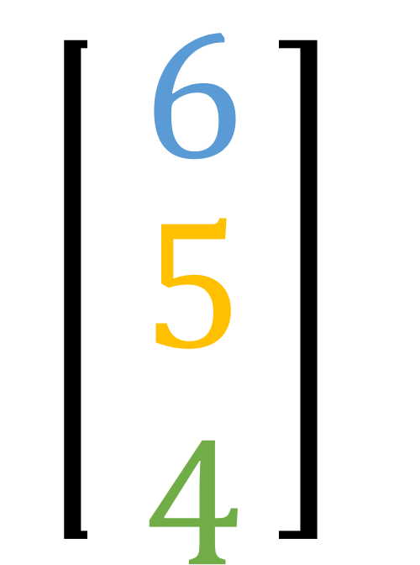
Asynchronous log ordering
Phase 3: Deterministically ordering these vector timestamps (VTS).
Deterministic ordering
(Algorithm 2)
Entries finished replication and timestamp assignment
Notes:
Each node maintains an entry pool to store entries that have been assigned vector timestamps, and uses a deterministic ordering algorithm to order these entries. Although the entry arrived out-of-order in a streaming manner, the ordering algorithm ensures a consistent total order for these entries.

Slide 32
Asynchronous log ordering
Fault tolerance:
Out-of-order entry arrival.
Slow sending groups.
Slow receiving groups.
Crashed groups.
Byzantine/crashed nodes.
Pros:
Fully utilize bandwidth of all groups.
Cons:
An additional 0.5 RTT to achieve consensus.
Notes:
Asynchronous log ordering provides fault tolerance for out-of-order entry arrival, slow sending or receiving groups, crashed groups, and Byzantine nodes. It can fully utilize the bandwidth of all groups, at the cost of an additional 0.5 RTT to achieve consensus.

Slide 33
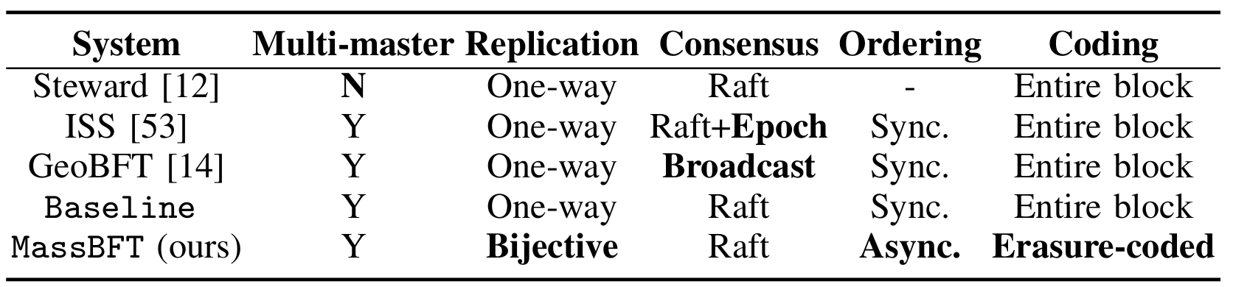
Experiments
Competitors:
Workloads:
Smallbank, TPC-C, YCSB
Environment:
Worldwide cluster: Hong Kong, London, Silicon Valley (156 - 206 ms RTT)
Nationwide cluster: Zhangjiakou, Chengdu, Hangzhou (26.7 - 43.4 ms RTT)
3 groups × 7 nodes/group, 8-core CPU, 16GB RAM per node
WAN: 20 Mbps/node, LAN: 2.5 Gbps/node
Notes:
To show the performance of MassBFT, we compare it with three geo-distributed consensus protocols, including Steward, ISS, and GeoBFT.
We build a worldwide cluster and a nationwide cluster separately, each cluster contains 3 groups and each group contains 7 nodes.
Each node has an independent WAN interface with 20 Mbps bandwidth.

Slide 34
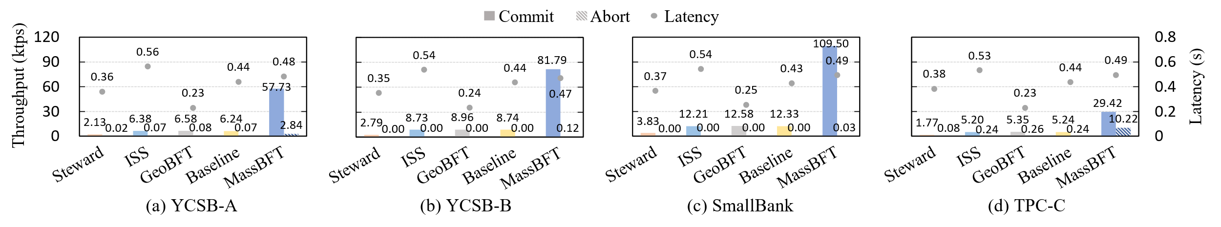
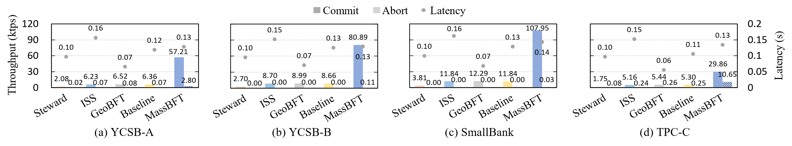
Overall performance
MassBFT outperforms competitors by 5.5-28.6× in throughput.
Fig. 1: Performance on the worldwide cluster.
MassBFT outperforms competitors by 5.5-28.3× in throughput.
Fig. 2: Performance on the nationwide cluster.
Notes:
We first compare MassBFT with the competitors in terms of throughput and latency under the two clusters, respectively. The results show that MassBFT exhibits the highest throughput under all workloads. The performance gain comes from the encoded bijective log replication, which eliminates the bandwidth bottleneck of the leader node and reduces the amount of transmitted data.

Slide 35
﻿Results under Heterogeneous Resource
Group $G_{1}$: 4 nodes; Groups $G_{2}$ & $G_{3}$: 7 nodes each.
BR
EBR
EBR+A
Fig. 3: Throughput breakdown.
Fig. 4: Latency over time.
BR: ﻿bijective replication only
EBR: ﻿encoded bijective replication (1.7× throughput improvement)
﻿EBR+A: EBR with asynchronous log ordering (1.5× further throughput improvement)
Notes:
We reduce the number of nodes in group 1 to 4 and perform a throughput breakdown.
As shown in Figure 3, our encoded replication improves throughput by 1.7 times compared to traditional bijective replication. Asynchronous ordering further improves throughput by 1.5 times.

Slide 36
Scalability
Fig. 5: Increasing the number of nodes in each group.
Fig. 6: Increasing the number of groups.
Encoded bijective replication aggregates the bandwidth of nodes in a group.
Increasing the number of groups increases WAN communication overhead.
Notes:
As shown in figure 5, when scaling the number of nodes in a group, the encoded bijective replication aggregates the bandwidth of nodes in a group, increasing overall throughput.
However, as shown in figure 6, when increasing the number of groups, the total WAN communication increase, resulting in lower performance.

Slide 37
Fault tolerance
Fig. 7: Performance under failures.
MassBFT is robust under node failures and group failures.
Notes:
We also perform experiments under failure scenarios. In the node failure experiment, each group contains two Byzantine nodes. To simulate data center crashes, we simultaneously kill all nodes in a group. Figure 7 shows that MassBFT is robust against these failures.

Slide 38
Conclusion
We propose encoded bijective replication to improve the log replication efficiency of a group.
We propose asynchronous log ordering to enable all groups to propose entries at their own maximum rate.
Notes:
In summary, we propose encoded bijective replication to improve the log replication efficiency within a group.
We propose asynchronous log ordering to enable all groups to propose entries at their own maximum rate.

Slide 39
Thank you for listening!

