Slide 1
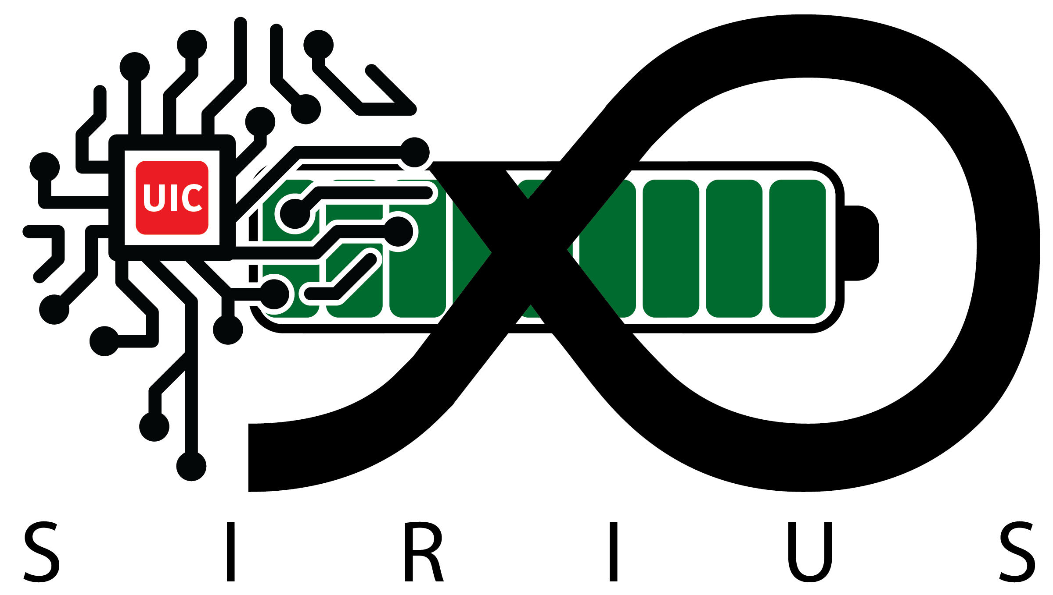
SunSift: Solar-Powered Intelligent Sensing through Informative Sample Selection
Shayan Gerami
Department of Electrical and Computer Engineering
University of Illinois Chicago

Slide 2
Introduction
Edge computing is expanding with billions of IoT devices for smart cities, healthcare, and agriculture.
Energy-harvesting IoT devices suffer from unpredictable power loss, making deep learning tasks unreliable.
SunSift enables batteryless CNN inference on energy-harvesting nodes, supporting sustainable and autonomous edge intelligence.

Slide 3
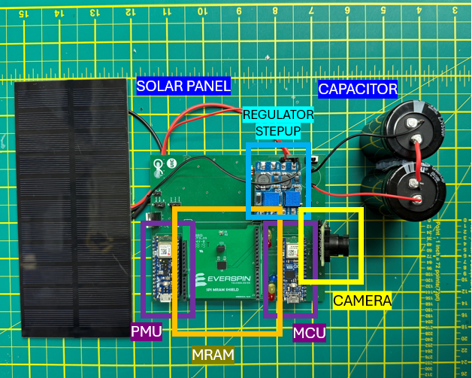
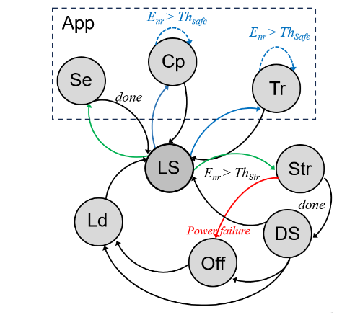
Solution and Prototype
Voltage-driven finite state machine manages sensing, computing, storing, transmitting and sleeping states.
Selective MRAM checkpointing saves essential data before power loss.
Integrated with TensorFlow Lite for Microcontrollers to classify informative vs. non-informative samples for federated learning.

Slide 4
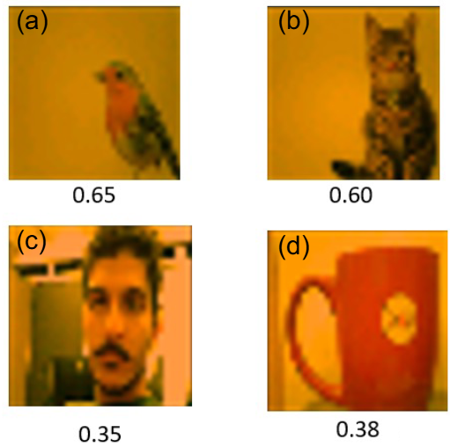
Results and Summary
Achieved 71.51 % accuracy in identifying informative CIFAR-10 samples despite frequent power interruptions.
Provides a foundation for distributed federated learning on energy-harvesting IoT devices.

Slide 5

Thank you!
Shayan Gerami
sgera@uic.edu

