Slide 1
PYTHON期末報告
SpeechRecognition + mechinanize
指導教授：蕭漢威 老師
林書弘、陳岱怡

Slide 2

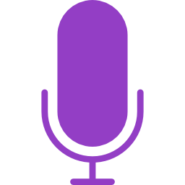
套件安裝
SpeechRecognition
pip install SpeechRecognition
Pip install pyaudio
mechanize
pip install mechanize

Slide 3

~講解程式碼~

Slide 4
Thanks For Listening

