Slide 1
Effects of Publicly Available Datasets in Groundwater Availability Estimation in the Southern High Plains of Texas
Presentation by Abdullah Karim
11/04/2016

Slide 2
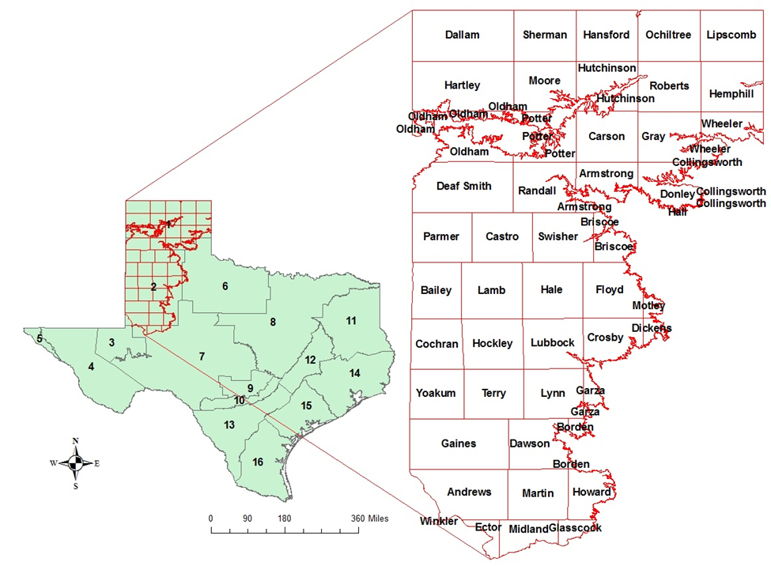
Study Area

Slide 3
Texas Policies
  Rule-of-capture: Landowners have the right to capture the water beneath their property
  Groundwater conservation districts (GCDs): Engage in joint planning activities and develop Desired Future Conditions (DFCs) for the aquifer, and manage groundwater resources
  Current decision: Managed depletion rate that requires at least 40% - 80% of the current saturated thickness of the aquifer to be available at the end of the planning horizon (GMA-1, 2010)
  GMAs monitor aquifer conditions to ensure that the DFCs are being met

Slide 4
Questions
  How different are the publicly available datasets (TWDB and USGS data)?
  What data is missing?
  How do they affect groundwater availability estimation?
  Which parts of the Southern High Plains region require more monitoring?
  How to improve existing dataset?

Slide 5
Groundwater Availability Estimation: Elements
  Saturated thickness calculation:
Land Surface Datum (LSD)
Depth to Water Table (DWT)
Saturated thickness= LSD – DWT - AQB
Available water= S_{y} X Saturated thickness
Saturated
Thickness
Aquifer Bottom (AQB)
Mean Sea Level (MSL)

Slide 6
Data Set
Sources of Parameters for Calculating Saturated Thickness
Land Surface Datum (LSD) | Depth to Water Table (DWT) | Aquifer Bottom (AQB) | Specific Yield (S_{y})
TWDB: (Groundwater Database (GWDB)) | TWDB: (Groundwater Database (GWDB)) | Groundwater Availability Model (GAM) | Groundwater Availability
 |  |  | Model (GAM)
USGS (High Plains Aquifer Water-Level Monitoring Study (HPWLMS)) | USGS (High Plains Aquifer Water-Level Monitoring Study) | USGS Water Resources NSDI Node | USGS Water Resources NSDI Node
USGS (National Elevation Dataset (NED))
  GWDB: http://www.twdb.texas.gov/groundwater/data/gwdbrpt.asp
  GAM: http://www.twdb.texas.gov/groundwater/models/gam/index.asp
  USGS Water Resources NSDI Node: http://water.usgs.gov/lookup/getgislist
  HPWLMS: http://ne.water.usgs.gov/ogw/hpwlms/

Slide 7
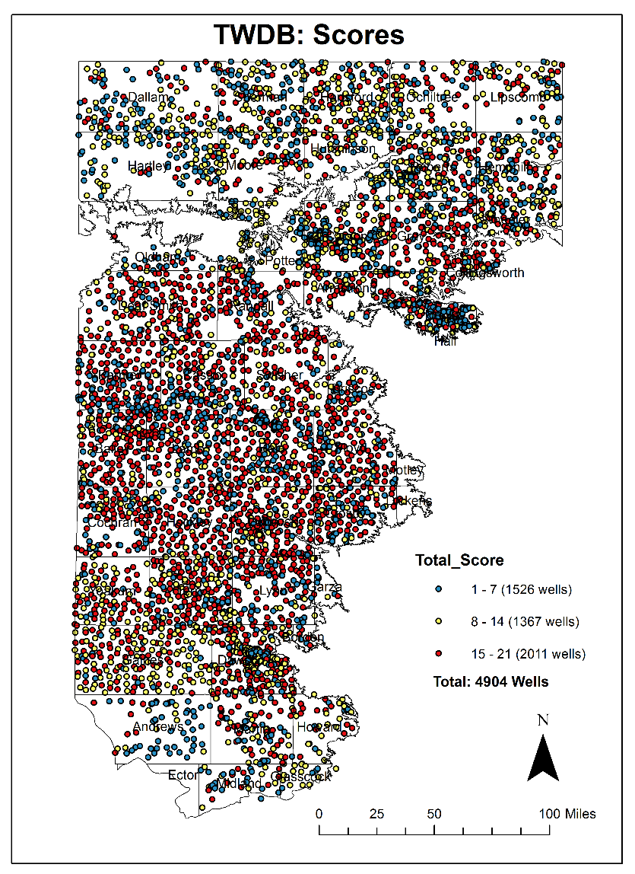
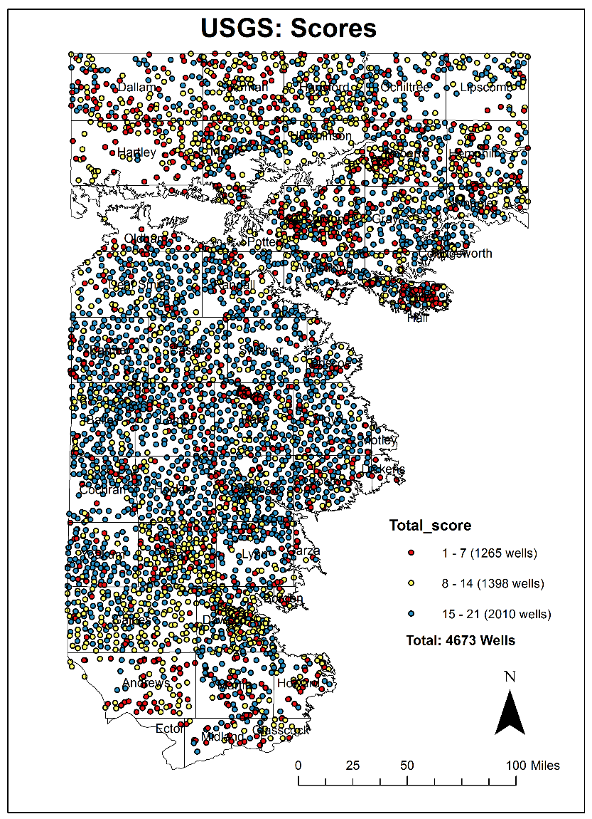
Existing Wells
  Well depth (1 point)
  Well screening (1 point)
  Water level (up to 19 points)

Slide 8
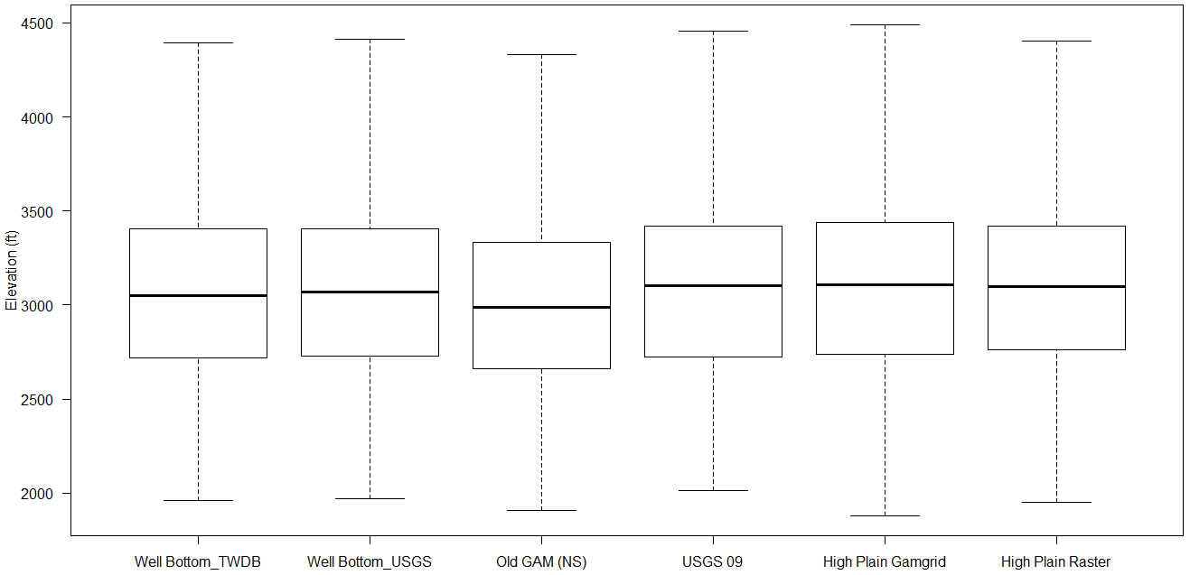
  Bottoms_raw all:
 | Min. | 1st Qu. | Median | Mean | 3rd Qu. | Max.
WellBottomTWDB | 1960 | 2717 | 3051 | 3054 | 3407 | 4396
WellBottomUSGS | 1968 | 2731 | 3070 | 3065 | 3405 | 4530
OldGAM | 1910 | 2660 | 2990 | 3003 | 3332 | 4460
USGS09 | 2015 | 2725 | 3103 | 3080 | 3418 | 4549
HighPlainGamgrid | 1880 | 2740 | 3110 | 3091 | 3440 | 4490
HighPlainRaster | 1953 | 2763 | 3100 | 3090 | 3418 | 4594

Slide 9
  Bottoms_raw_all: 1.Old Gam (NS), 2. USGS 2009, 3. HP Gamgrid, 4. HP Raster
# STATISTICS of INDIVIDUAL LAYERS
# Layer MIN MAX MEAN STD
# ---------------------------------------------------------------
1 1910.0000 4460.0000 3069.4212 476.6601
2 2014.7290 4548.8564 3079.6307 470.5738
3 1880.0000 4490.0000 3092.3111 477.8559
4 1953.4230 4593.7510 3089.9164 479.7209
# ===============================================================
# COVARIANCE MATRIX
# Layer 1 2 3 4
# --------------------------------------------------------------------------
1 129606.35368 123105.93060 125628.81797 125496.63635
2 123105.93060 127047.79135 127556.82416 127818.48935
3 125628.81797 127556.82416 130935.63486 129809.59465
4 125496.63635 127818.48935 129809.59465 131385.56986
# ==========================================================================
# CORRELATION MATRIX
# Layer 1 2 3 4
# --------------------------------------------------------------------------
1 1.00000 0.95936 0.96438 0.96171
2 0.95936 1.00000 0.98899 0.98932
3 0.96438 0.98899 1.00000 0.98970
4 0.96171 0.98932 0.98970 1.00000
# ==========================================================================

Slide 10
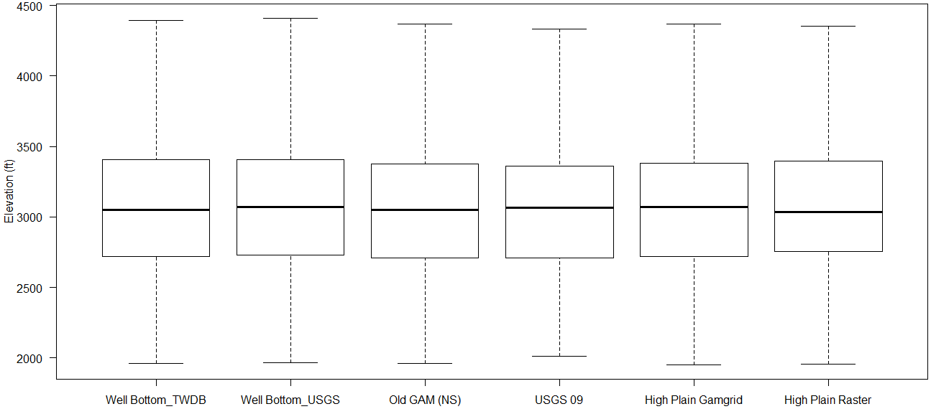
  Bottoms_points:
 | Min. | 1st Qu. | Median | Mean | 3rd Qu. | Max.
WellBottomTWDB | 1960 | 2717 | 3051 | 3054 | 3407 | 4396
WellBottomUSGS | 1968 | 2731 | 3070 | 3065 | 3405 | 4530
OldGAM | 1960 | 2710 | 3050 | 3030 | 3375 | 4370
USGS09 | 2015 | 2712 | 3067 | 3040 | 3362 | 4387
HighPlainGamgrid | 1950 | 2720 | 3070 | 3046 | 3380 | 4400
HighPlainRaster | 1956 | 2753 | 3036 | 3047 | 3397 | 4457

Slide 11
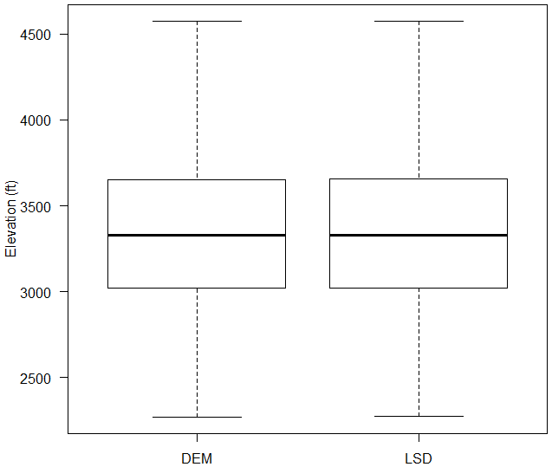
  TWDB: Top
 | Min. | 1st Qu. | Median | Mean | 3rd Qu. | Max.
DEM | 2269 | 3020 | 3329 | 3329 | 3653 | 4693
LSD | 2277 | 3020 | 3328 | 3330 | 3655 | 4694

Slide 12
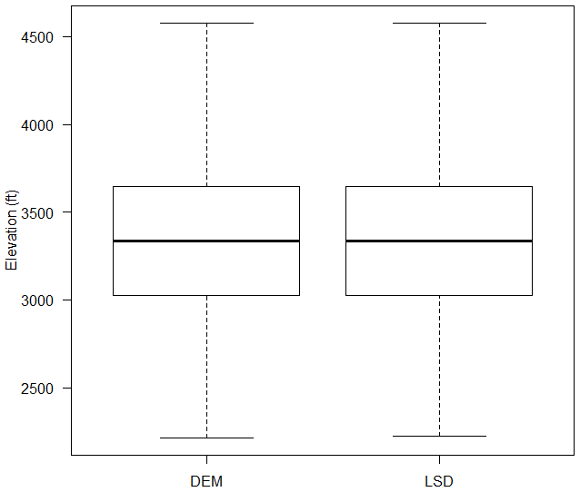
  USGS: Top
 | Min. | 1st Qu. | Median | Mean | 3rd Qu. | Max.
DEM | 2213 | 3025 | 3338 | 3336 | 3648 | 4704
LSD | 2224 | 3025 | 3338 | 3337 | 3648 | 4702

Slide 13
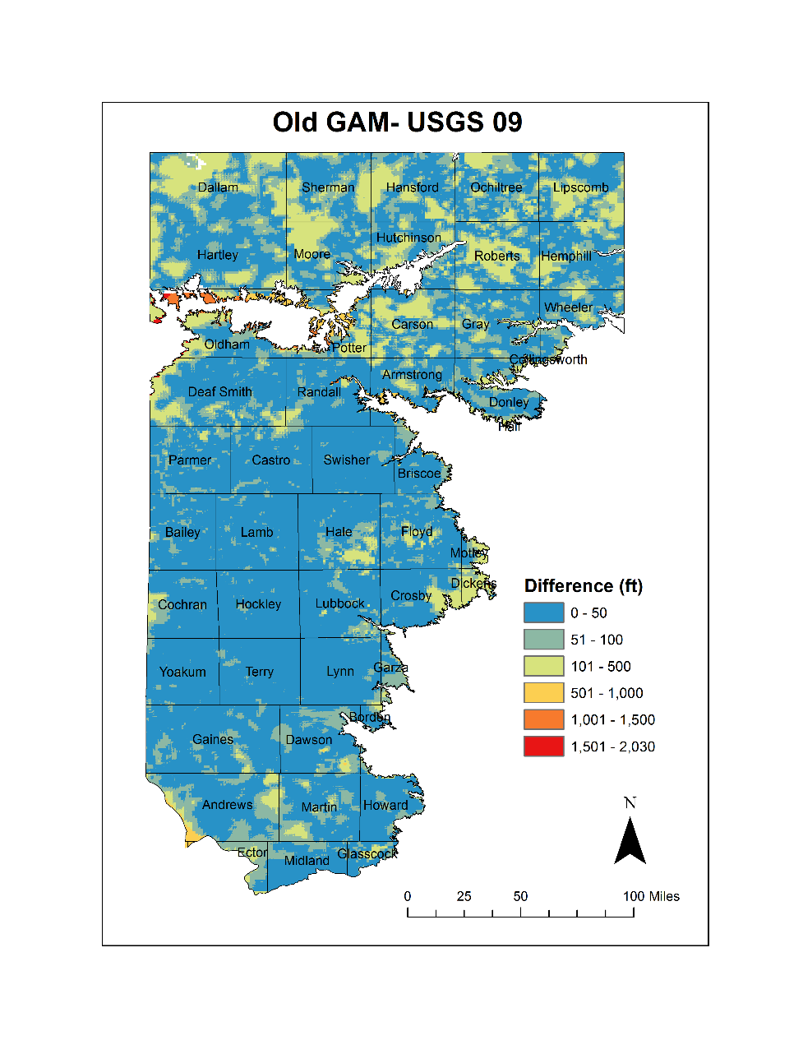
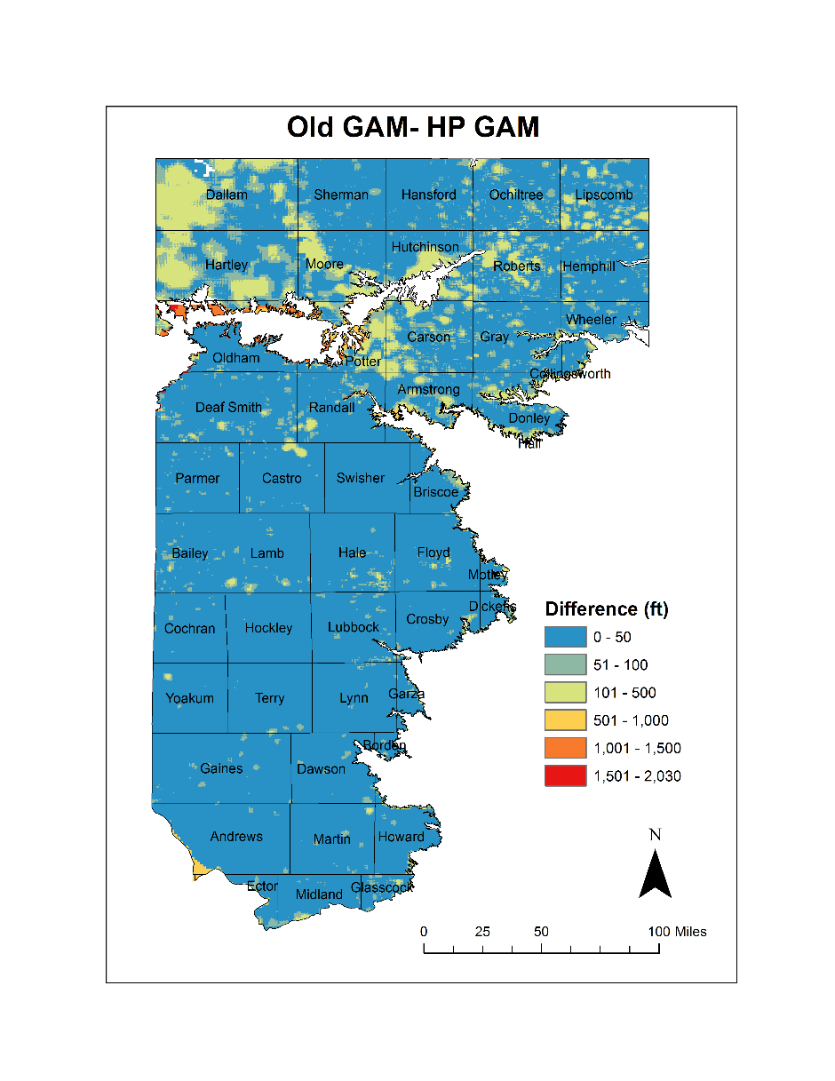
Absolute Difference

Slide 14
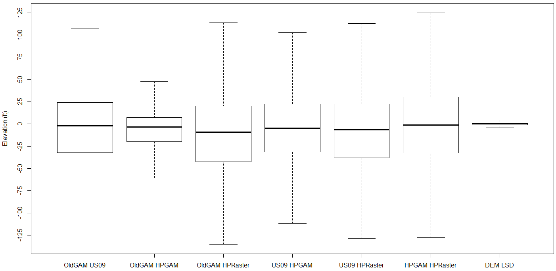
  TWDB Differences:

Slide 15
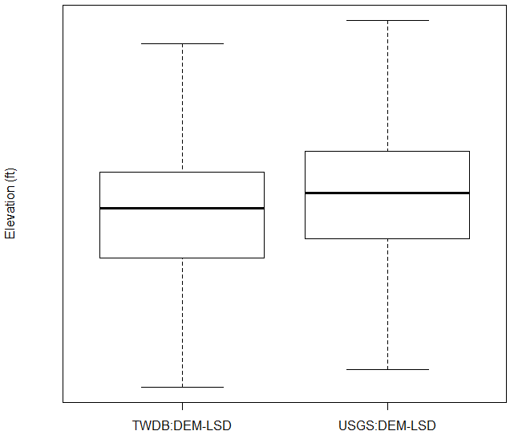
  TOP Differences:

Slide 16
  TWDB Differences:
 | Min. | 1st Qu. | Median | Mean | 3rd Qu. | Max.
OldGAM_US09 | -1125 | -32.1 | -1.995 | -9.891 | 24.08 | 305.1
OldGAM_HPGAM | -1267 | -19.92 | -3.4 | -15.51 | 7.2 | 220
OldGAM_HPRaster | -1221 | -42.23 | -9.24 | -16.97 | 20.22 | 330.4
US09_HPGAM | -326.2 | -31.25 | -4.51 | -5.618 | 22.3 | 1030
US09_HPRaster | -303.2 | -38.04 | -6.44 | -7.083 | 22.49 | 994.3
HPGAM_HPRaster | -365.3 | -32.82 | -1.339 | -1.465 | 30.42 | 348.9
DEM_LSD | -412.4 | -1 | 0.29 | -0.2743 | 1.24 | 93.76
  USGS Differences:
 | Min. | 1st Qu. | Median | Mean | 3rd Qu. | Max.
OldGAM_US09 | -1096 | -31.88 | -1.957 | -7.999 | 24.85 | 305.1
OldGAM_HPGAM | -1287 | -20 | -3.7 | -14.04 | 6.6 | 220
OldGAM_HPRaster | -1221 | -42.24 | -9.496 | -14.44 | 20.54 | 330.4
US09_HPGAM | -326.2 | -32.3 | -5.464 | -6.036 | 21.78 | 1030
US09_HPRaster | -242.4 | -38.27 | -5.828 | -6.44 | 22.61 | 993.9
HPGAM_HPRaster | -338.8 | -32.12 | -1.152 | -0.4033 | 30.73 | 348.9
DEM_LSD | -999.9 | -0.4849 | 0.6934 | -0.1332 | 1.786 | 652.5

Slide 17
  TWDB Differences:
 | Min. | 1st Qu. | Median | Mean | 3rd Qu. | Max.
OldGAM_US09 | -1125 | -32.1 | -1.995 | -9.891 | 24.08 | 305.1
OldGAM_HPGAM | -1267 | -19.92 | -3.4 | -15.51 | 7.2 | 220
OldGAM_HPRaster | -1221 | -42.23 | -9.24 | -16.97 | 20.22 | 330.4
US09_HPGAM | -326.2 | -31.25 | -4.51 | -5.618 | 22.3 | 1030
US09_HPRaster | -303.2 | -38.04 | -6.44 | -7.083 | 22.49 | 994.3
HPGAM_HPRaster | -365.3 | -32.82 | -1.339 | -1.465 | 30.42 | 348.9
DEM_LSD | -412.4 | -1 | 0.29 | -0.2743 | 1.24 | 93.76
  USGS Differences:
 | Min. | 1st Qu. | Median | Mean | 3rd Qu. | Max.
OldGAM_US09 | -1096 | -31.88 | -1.957 | -7.999 | 24.85 | 305.1
OldGAM_HPGAM | -1287 | -20 | -3.7 | -14.04 | 6.6 | 220
OldGAM_HPRaster | -1221 | -42.24 | -9.496 | -14.44 | 20.54 | 330.4
US09_HPGAM | -326.2 | -32.3 | -5.464 | -6.036 | 21.78 | 1030
US09_HPRaster | -242.4 | -38.27 | -5.828 | -6.44 | 22.61 | 993.9
HPGAM_HPRaster | -338.8 | -32.12 | -1.152 | -0.4033 | 30.73 | 348.9
DEM_LSD | -999.9 | -0.4849 | 0.6934 | -0.1332 | 1.786 | 652.5

Slide 18
  Differences within -5 ft to 5 ft
Number of Wells within -5 ft to 5 ft Difference:
 | TWDB | USGS
OldGAM_US09 | 547 | 519
OldGAM_HPGAM | 1268 | 1205
OldGAM_HPRaster | 463 | 466
US09_HPGAM | 524 | 486
US09_HPRaster | 465 | 460
HPGAM_HPRaster | 452 | 411
DEM_LSD | 4290 | 4070

Slide 19


