Slide 1
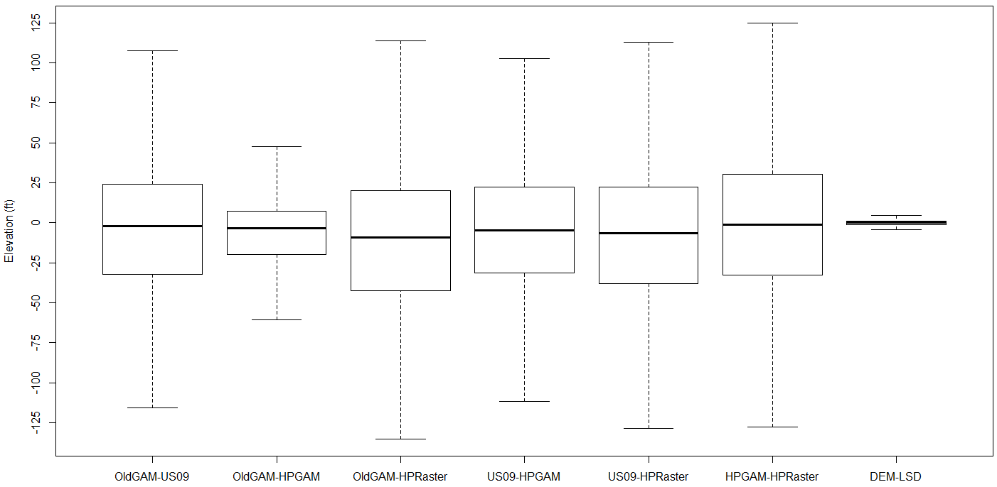
  TWDB Differences:

Slide 2
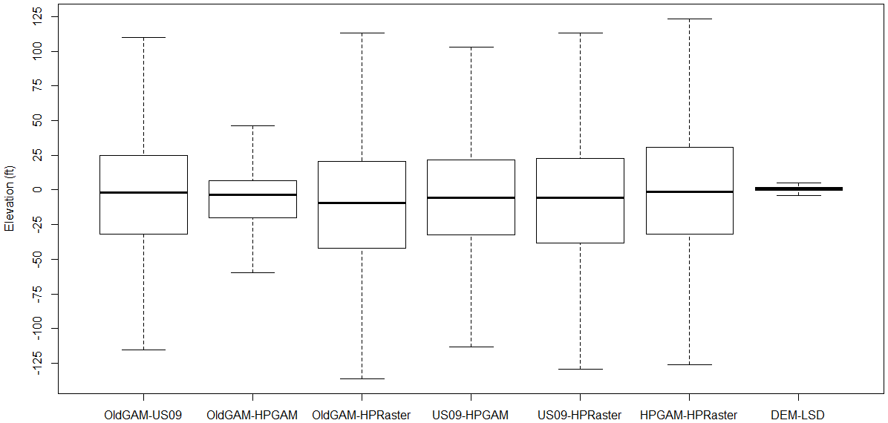
  USGS Differences:

Slide 3
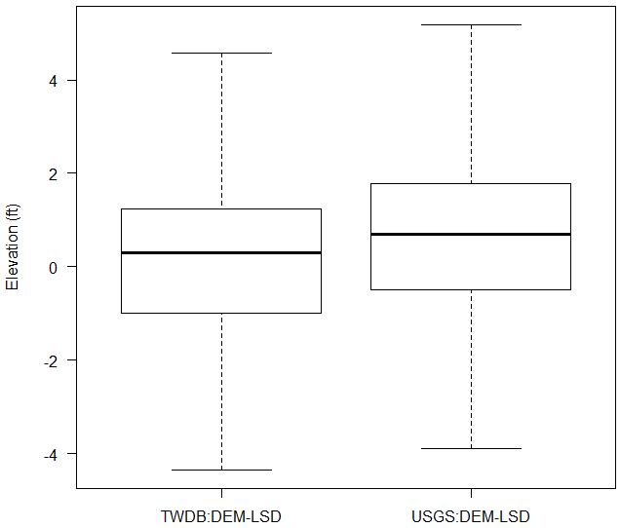
  TOP Differences:

Slide 4
  TWDB Differences:
 | Min. | 1st Qu. | Median | Mean | 3rd Qu. | Max.
OldGAM_US09 | -1125 | -32.1 | -1.995 | -9.891 | 24.08 | 305.1
OldGAM_HPGAM | -1267 | -19.92 | -3.4 | -15.51 | 7.2 | 220
OldGAM_HPRaster | -1221 | -42.23 | -9.24 | -16.97 | 20.22 | 330.4
US09_HPGAM | -326.2 | -31.25 | -4.51 | -5.618 | 22.3 | 1030
US09_HPRaster | -303.2 | -38.04 | -6.44 | -7.083 | 22.49 | 994.3
HPGAM_HPRaster | -365.3 | -32.82 | -1.339 | -1.465 | 30.42 | 348.9
DEM_LSD | -412.4 | -1 | 0.29 | -0.2743 | 1.24 | 93.76
  USGS Differences:
 | Min. | 1st Qu. | Median | Mean | 3rd Qu. | Max.
OldGAM_US09 | -1096 | -31.88 | -1.957 | -7.999 | 24.85 | 305.1
OldGAM_HPGAM | -1287 | -20 | -3.7 | -14.04 | 6.6 | 220
OldGAM_HPRaster | -1221 | -42.24 | -9.496 | -14.44 | 20.54 | 330.4
US09_HPGAM | -326.2 | -32.3 | -5.464 | -6.036 | 21.78 | 1030
US09_HPRaster | -242.4 | -38.27 | -5.828 | -6.44 | 22.61 | 993.9
HPGAM_HPRaster | -338.8 | -32.12 | -1.152 | -0.4033 | 30.73 | 348.9
DEM_LSD | -999.9 | -0.4849 | 0.6934 | -0.1332 | 1.786 | 652.5

Slide 5
  #Wells:
TWDB
L (ft) | -1300 | -1000 | -700 | -350 | -200 | -45 | -30 | -20 | -10 | -5 | 5 | 10 | 20 | 45 | 200 | 350 | 700
U (ft) | -1000 | -700 | -350 | -200 | -45 | -30 | -20 | -10 | -5 | 5 | 10 | 20 | 45 | 200 | 350 | 700 | 1000
OldGAM_US09 | 7 | 19 | 4 | 61 | 795 | 397 | 334 | 432 | 242 | 547 | 227 | 454 | 692 | 678 | 15 | 0 | 0
OldGAM_HPGAM | 11 | 13 | 6 | 49 | 501 | 199 | 294 | 608 | 599 | 1268 | 451 | 379 | 293 | 232 | 1 | 0 | 0
OldGAM_HPRaster | 15 | 9 | 1 | 46 | 1076 | 459 | 405 | 399 | 216 | 463 | 207 | 374 | 609 | 618 | 7 | 0 | 0
US09_HPGAM | 0 | 0 | 0 | 48 | 856 | 363 | 361 | 518 | 283 | 524 | 226 | 405 | 637 | 647 | 32 | 2 | 1
US09_HPRaster | 0 | 0 | 0 | 13 | 1004 | 492 | 360 | 403 | 239 | 465 | 255 | 367 | 648 | 639 | 17 | 0 | 2
HPGAM_HPRaster | 0 | 0 | 1 | 26 | 896 | 388 | 372 | 407 | 193 | 452 | 216 | 386 | 735 | 798 | 34 | 0 | 0
DEM_LSD | 0 | 0 | 2 | 0 | 6 | 10 | 14 | 73 | 269 | 4290 | 136 | 80 | 22 | 2 | 0 | 0 | 0
USGS
L (ft) | -1300 | -1000 | -700 | -350 | -200 | -45 | -30 | -20 | -10 | -5 | 5 | 10 | 20 | 45 | 200 | 350 | 700
U (ft) | -1000 | -700 | -350 | -200 | -45 | -30 | -20 | -10 | -5 | 5 | 10 | 20 | 45 | 200 | 350 | 700 | 1000
OldGAM_US09 | 2 | 10 | 4 | 67 | 763 | 371 | 317 | 410 | 228 | 519 | 219 | 426 | 660 | 661 | 16 | 0 | 0
OldGAM_HPGAM | 7 | 3 | 6 | 46 | 510 | 205 | 284 | 579 | 568 | 1205 | 420 | 341 | 290 | 208 | 1 | 0 | 0
OldGAM_HPRaster | 6 | 4 | 1 | 49 | 1042 | 430 | 393 | 382 | 191 | 466 | 187 | 337 | 578 | 596 | 11 | 0 | 0
US09_HPGAM | 0 | 0 | 0 | 45 | 825 | 367 | 359 | 499 | 272 | 486 | 213 | 367 | 593 | 617 | 26 | 2 | 1
US09_HPRaster | 0 | 0 | 0 | 10 | 972 | 458 | 333 | 383 | 217 | 460 | 236 | 345 | 616 | 617 | 24 | 0 | 2
HPGAM_HPRaster | 0 | 0 | 0 | 21 | 838 | 376 | 356 | 379 | 196 | 411 | 207 | 370 | 713 | 773 | 33 | 0 | 0
DEM_LSD | 0 | 2 | 2 | 3 | 17 | 15 | 24 | 74 | 160 | 4070 | 188 | 73 | 31 | 10 | 1 | 3 | 0
  % Wells:
TWDB
L (ft) | -1300 | -1000 | -700 | -350 | -200 | -45 | -30 | -20 | -10 | -5 | 5 | 10 | 20 | 45 | 200 | 350 | 700
U (ft) | -1000 | -700 | -350 | -200 | -45 | -30 | -20 | -10 | -5 | 5 | 10 | 20 | 45 | 200 | 350 | 700 | 1000
OldGAM_US09 | 0.14 | 0.39 | 0.08 | 1.24 | 16.21 | 8.10 | 6.81 | 8.81 | 4.93 | 11.15 | 4.63 | 9.26 | 14.11 | 13.83 | 0.31
OldGAM_HPGAM | 0.22 | 0.27 | 0.12 | 1.00 | 10.22 | 4.06 | 6.00 | 12.40 | 12.21 | 25.86 | 9.20 | 7.73 | 5.97 | 4.73 | 0.02
OldGAM_HPRaster | 0.31 | 0.18 | 0.02 | 0.94 | 21.94 | 9.36 | 8.26 | 8.14 | 4.40 | 9.44 | 4.22 | 7.63 | 12.42 | 12.60 | 0.14
US09_HPGAM |  |  |  | 0.98 | 17.46 | 7.40 | 7.36 | 10.56 | 5.77 | 10.69 | 4.61 | 8.26 | 12.99 | 13.20 | 0.65 | 0.04 | 0.02
US09_HPRaster |  |  |  | 0.27 | 20.47 | 10.03 | 7.34 | 8.22 | 4.87 | 9.48 | 5.20 | 7.48 | 13.21 | 13.03 | 0.35 |  | 0.04
HPGAM_HPRaster |  |  | 0.02 | 0.53 | 18.27 | 7.91 | 7.59 | 8.30 | 3.94 | 9.22 | 4.40 | 7.87 | 14.99 | 16.27 | 0.69
DEM_LSD |  |  | 0.04 |  | 0.12 | 0.20 | 0.29 | 1.49 | 5.49 | 87.48 | 2.77 | 1.63 | 0.45 | 0.04
USGS
L (ft) | -1300 | -1000 | -700 | -350 | -200 | -45 | -30 | -20 | -10 | -5 | 5 | 10 | 20 | 45 | 200 | 350 | 700
U (ft) | -1000 | -700 | -350 | -200 | -45 | -30 | -20 | -10 | -5 | 5 | 10 | 20 | 45 | 200 | 350 | 700 | 1000
OldGAM_US09 | 0.04 | 0.21 | 0.09 | 1.43 | 16.33 | 7.94 | 6.78 | 8.77 | 4.88 | 11.11 | 4.69 | 9.12 | 14.12 | 14.15 | 0.34
OldGAM_HPGAM | 0.15 | 0.06 | 0.13 | 0.98 | 10.91 | 4.39 | 6.08 | 12.39 | 12.15 | 25.79 | 8.99 | 7.30 | 6.21 | 4.45 | 0.02
OldGAM_HPRaster | 0.13 | 0.09 | 0.02 | 1.05 | 22.30 | 9.20 | 8.41 | 8.17 | 4.09 | 9.97 | 4.00 | 7.21 | 12.37 | 12.75 | 0.24
US09_HPGAM |  |  |  | 0.96 | 17.65 | 7.85 | 7.68 | 10.68 | 5.82 | 10.40 | 4.56 | 7.85 | 12.69 | 13.20 | 0.56 | 0.04 | 0.02
US09_HPRaster |  |  |  | 0.21 | 20.80 | 9.80 | 7.13 | 8.20 | 4.64 | 9.84 | 5.05 | 7.38 | 13.18 | 13.20 | 0.51 |  | 0.04
HPGAM_HPRaster |  |  |  | 0.45 | 17.93 | 8.05 | 7.62 | 8.11 | 4.19 | 8.80 | 4.43 | 7.92 | 15.26 | 16.54 | 0.71
DEM_LSD |  | 0.04 | 0.04 | 0.06 | 0.36 | 0.32 | 0.51 | 1.58 | 3.42 | 87.10 | 4.02 | 1.56 | 0.66 | 0.21 | 0.02 | 0.06

Slide 6
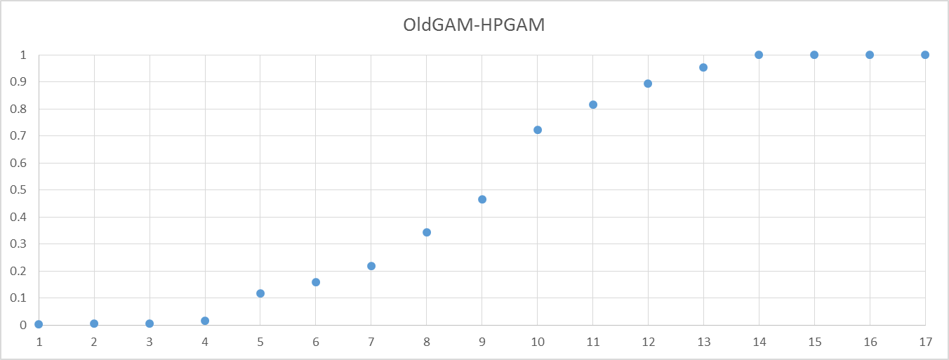
  Differences
TWDB
L | -1300 | -1000 | -700 | -350 | -200 | -45 | -30 | -20 | -10 | -5 | 5 | 10 | 20 | 45 | 200 | 350 | 700
U | -1000 | -700 | -350 | -200 | -45 | -30 | -20 | -10 | -5 | 5 | 10 | 20 | 45 | 200 | 350 | 700 | 1000
OldGAM_US09 | 0.001427406 | 0.00530179 | 0.0061175 | 0.0185563 | 0.1806688 | 0.261623 | 0.329731 | 0.417822 | 0.46717 | 0.578711 | 0.625 | 0.717577 | 0.858687 | 0.996941 | 1 | 1 | 1
OldGAM_HPGAM | 0.002243067 | 0.00489396 | 0.0061175 | 0.0161093 | 0.1182708 | 0.15885 | 0.218801 | 0.342781 | 0.464927 | 0.723491 | 0.815457 | 0.892741 | 0.952488 | 0.999796 | 1 | 1 | 1
OldGAM_HPRaster | 0.003058728 | 0.00489396 | 0.0050979 | 0.014478 | 0.2338907 | 0.327488 | 0.410073 | 0.491436 | 0.535481 | 0.629894 | 0.672104 | 0.748369 | 0.872553 | 0.998573 | 1 | 1 | 1
US09_HPGAM | 0 | 0 | 0 | 0.0097899 | 0.1843769 | 0.258413 | 0.332042 | 0.437691 | 0.495411 | 0.602284 | 0.648379 | 0.730981 | 0.860901 | 0.992862 | 0.999388 | 0.999796 | 1
US09_HPRaster | 0 | 0 | 0 | 0.0026509 | 0.2073817 | 0.307708 | 0.381117 | 0.463295 | 0.512031 | 0.606852 | 0.65885 | 0.733687 | 0.865824 | 0.996126 | 0.999592 | 0.999592 | 1
HPGAM_HPRaster | 0 | 0 | 0.0002039 | 0.0055057 | 0.1882137 | 0.267333 | 0.343189 | 0.426183 | 0.465538 | 0.557708 | 0.601754 | 0.680465 | 0.830343 | 0.993067 | 1 | 1 | 1
DEM_LSD | 0 | 0 | 0.0004078 | 0.0004078 | 0.0016313 | 0.00367 | 0.006525 | 0.021411 | 0.076264 | 0.95106 | 0.978793 | 0.995106 | 0.999592 | 1 | 1 | 1 | 1
1 | 2 | 3 | 4 | 5 | 6 | 7 | 8 | 9 | 10 | 11 | 12 | 13 | 14 | 15 | 16 | 17
-1300 to -1000 | -1000 to -700 | -700 to -350 | -350 to -200 | -200 to -45 | -45 to -30 | -30 to -20 | -20 to -10 | -10 to -5 | -5 to 5 | 5 to 10 | 10 to 20 | 20 to 45 | 45 to 200 | 200 to 350 | 350 to 700 | 700 to 1000

Slide 7
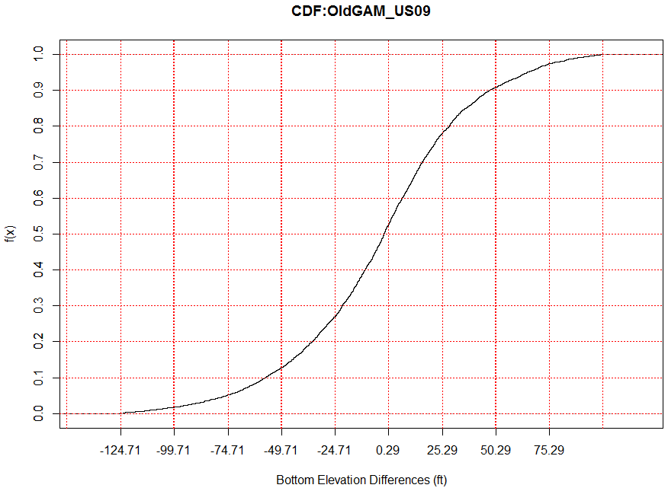
  Differences: OldGAM_US09
10% | 20% | 30% | 40% | 50% | 60% | 70% | 80% | 90% | 100%
-70.408 | -40.62 | -23.6 | -11.948 | -1.995 | 7.358 | 17.835 | 31.982 | 60.907 | 305.06

Slide 8
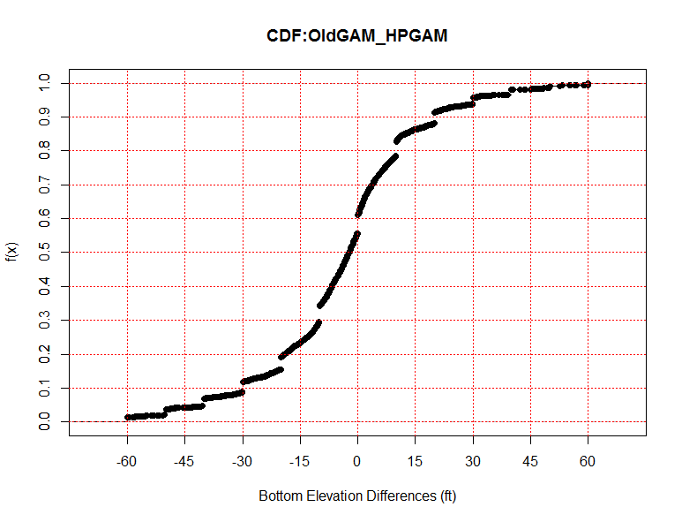
  Differences: OldGAM_HPGAM
10% | 20% | 30% | 40% | 50% | 60% | 70% | 80% | 90% | 100%
-50 | -24.28 | -13.5 | -8.7 | -3.4 | 0 | 3.6 | 10 | 22.2 | 220

Slide 9
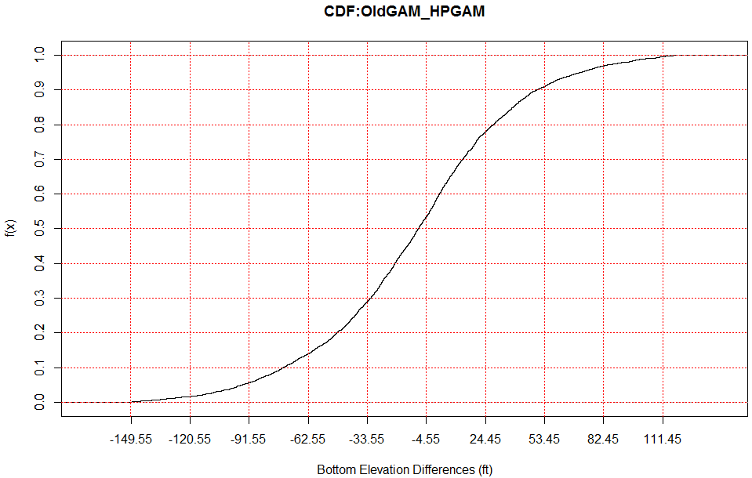
  Differences: OldGAM_HPRaster
10% | 20% | 30% | 40% | 50% | 60% | 70% | 80% | 90% | 100%
-82.6576 | -51.9262 | -34.4466 | -20.9609 | -9.23997 | 1.735889 | 13.51254 | 29.42041 | 53.95618 | 330.4341

Slide 10
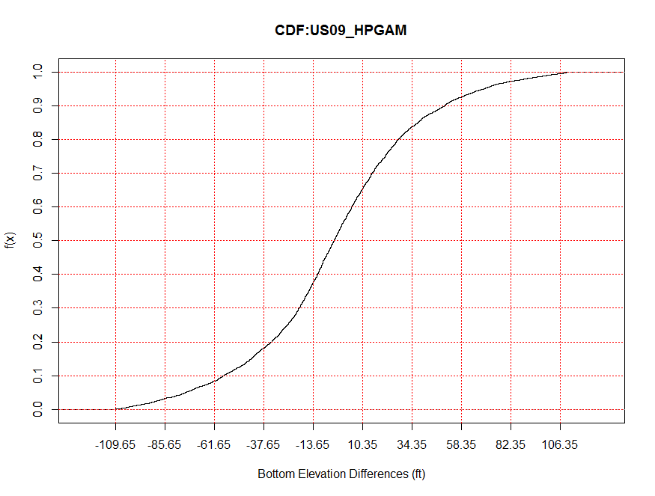
  Differences: USGS09_HPGAM
10% | 20% | 30% | 40% | 50% | 60% | 70% | 80% | 90% | 100%
-74.878 | -42.072 | -23.77 | -13.46 | -4.51 | 4.858 | 15.873 | 30.096 | 58.487 | 1030.01

Slide 11
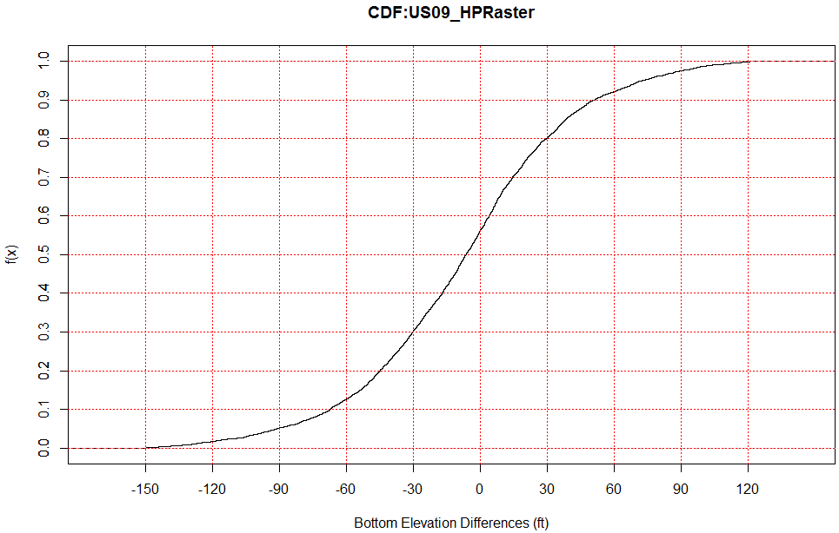
  Differences: USGS09_HPRaster
10% | 20% | 30% | 40% | 50% | 60% | 70% | 80% | 90% | 100%
-70.574 | -46.27 | -30.843 | -17.286 | -6.44 | 4.296 | 15.233 | 31.306 | 55.03 | 994.32

Slide 12
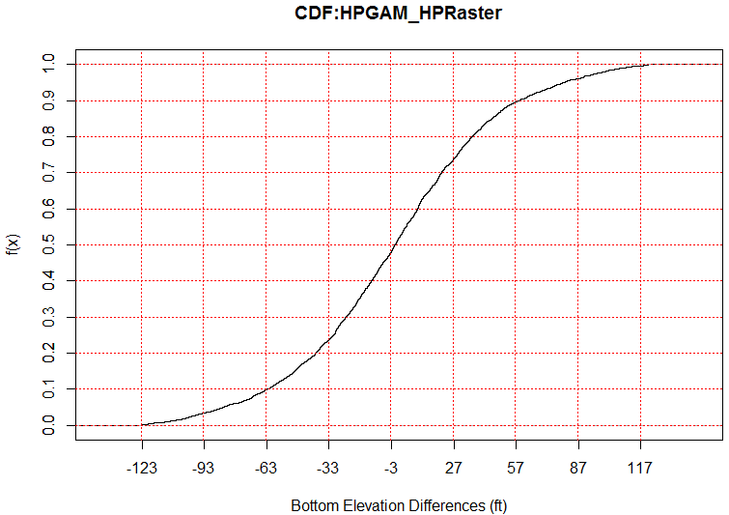
  Differences: HPGAM_HPRaster
10% | 20% | 30% | 40% | 50% | 60% | 70% | 80% | 90% | 100%
-69.5273 | -42.1497 | -26.3341 | -12.9896 | -1.33911 | 9.928369 | 22.39453 | 38.25083 | 66.03704 | 348.863

Slide 13
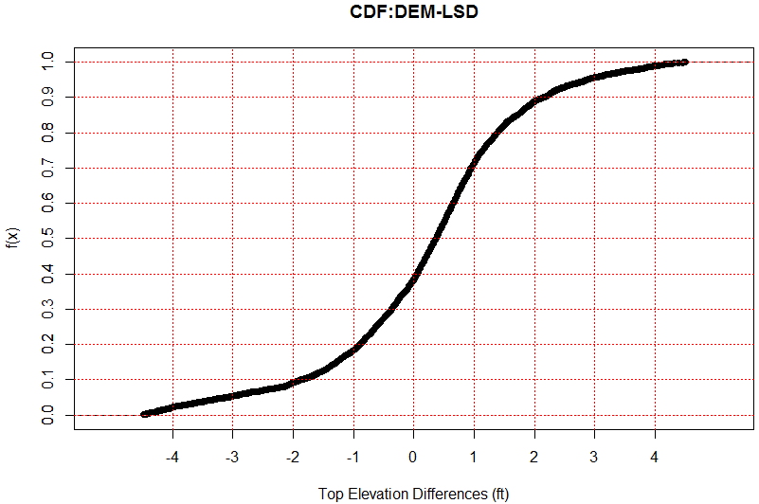
  Differences: DEM-LSD
10% | 20% | 30% | 40% | 50% | 60% | 70% | 80% | 90% | 100%
-4.357 | -1.52 | -0.661 | -0.098 | 0.29 | 0.64 | 1 | 1.55 | 2.847 | 93.76

Slide 14
