Slide 1
Maryland Sales Territory Analysis
EmporiUm | Northeast Region | In-Store Territory
WEEK 4 Capstone
Idasha Lee | Sales Manager: Shruti Reddy| Regional Director: Michael Jarvis
Notes:
[~0:30] Hi, I'm Idasha Lee, a data analyst for EmporiUm, a fictional student bookstore chain. I analyzed the Maryland territory, an in-store territory in the Northeast region, for Sales Manager Shruti Reddy and Regional Director Michael Jarvis. I'll answer each of the manager's questions, show how I got the answers, and finish with a recommendation for next quarter.

Slide 2
How I answered each question
1. SQL queries
MySQL Workbench
2. Verify totals
Cross-check results
3. PivotCharts
Excel
4. Built Recommendation on Findings
→
→
→
All scripts and charts published in the Capstone_1 GitHub repository
Notes:
[~0:30] My approach had four steps. I wrote SQL in MySQL Workbench, joining the sales, store, product and management tables. I verified every total against earlier queries so the numbers tie out. I charted results as Excel PivotCharts, then built my recommendation from the evidence. All scripts and charts are in my Capstone_1 GitHub repository.

Slide 3
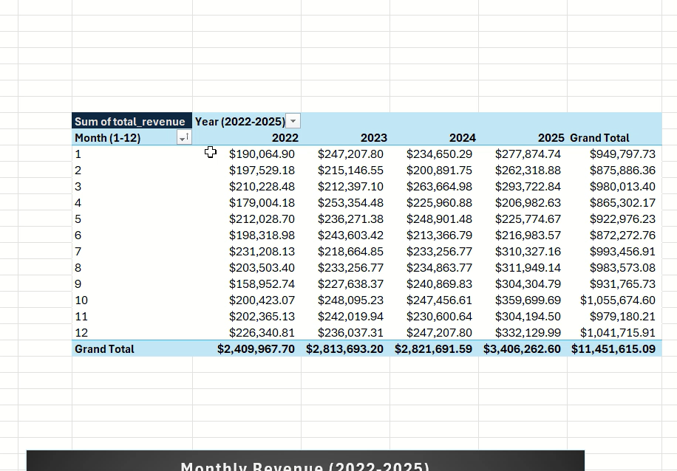
Maryland generated $11.45M over four years
$11,451,615.09
Jan 1, 2022
Dec 31, 2025
Total revenue
Start date
End date
Q1: Total revenue and date range
Notes:
[~0:40] The first question was about the total revenue and the period covered. Maryland generated $11,451,615.09 between January 1, 2022 and December 31, 2025. [SHOW WORKBENCH: Q1 query and result] I joined store sales to store locations on the store ID, filtered to Maryland, used SUM for revenue, and MIN and MAX on the transaction date for the range.

Slide 4
Revenue grew from $2.41M (2022) to $3.41M (2025)
2022: $2.41M
2023: $2.81M
2024: $2.82M
2025: $3.41M
Feb dipped in 2023-2025
Q2: Revenue by year and month
Notes:
[~1:10] Then we’d like to know revenue for month and year. Yearly revenue was $2.41 million in 2022, $2.81 million in 2023, $2.82 million in 2024 and $3.41 million in 2025. October 2025 was the strongest month, around $360,000. For next quarter, notice February: it dipped in 2023, 2024 and 2025, with a March rebound in 2024 and 2025. 2022 rose steadily, so this is a recent pattern, not every year.

Slide 5
Maryland produces 47.25% of Northeast revenue
$11,451,615.09
$24,237,526.98
47.25%
Maryland
Northeast region
Maryland's share (1 of 4 states)
Q3: Territory vs. region
Notes:
[~0:40] Maryland compared with its region. Maryland's revenue is $11.45 million. The Northeast has four states and totals $24.24 million, so Maryland produces 47.25 percent of it. An even split would give each state 25 percent, so Maryland carries almost double its even share.

Slide 6

How I calculated Maryland’s regional share
SQL: SAME SALES, TWO FILTERS (SIMPLIFIED)
SUM(ss.sale_amount)
WHERE sl.state = 'Maryland'
SUM(ss.sale_amount)
WHERE m.region = 'Northeast'
Query result | Revenue
Maryland | $11,451,615.09
Northeast | $24,237,526.98
I joined sales to store locations, then joined management by state for the region total.
I checked region names and state totals, then corrected a transcription error.
47.25%
$11,451,615.09 ÷ $24,237,526.98 × 100
ROUND(..., 2) gives Maryland’s share.
Q3: SQL totals and percentage check
Notes:
[~0:35] Here's how I calculated it. I used the same sales join twice with two filters, state equals Maryland and region equals Northeast, which needed one more join to the management table. [SHOW WORKBENCH: Q3 query] I put both totals in one query and divided. I checked the Northeast total against the four states' revenue and corrected a transcription error in my notes.

Slide 7

Technology & Accessories leads Maryland transactions
Tech & Accessories: 16,836
89,466 total transactions
~78% from North Harford
Q4: Transactions by product category
Notes:
[~0:55] Now we look at the transactions by month and category. Maryland had 89,466 transactions. Technology and Accessories leads with 16,836, Stationery is close behind at 16,655, and Textbooks is lowest at 11,639. [SHOW EXCEL: PivotChart] This is my PivotChart, with year and category from the SQL results, summing transaction counts. Every category grew in 2025 except Textbooks. One caution to take note of: about 78 percent of these transactions come from a single store.

Slide 8
How I checked the category transaction totals
SQL: COUNT SALES BY CATEGORY (JOINS NOT SHOWN)
COUNT(*) AS num_transactions,
AVG(ss.sale_amount)
AS avg_transaction
WHERE sl.state = 'Maryland'
GROUP BY sales_month,
sales_year, category
Category | Transactions
Tech & Accessories | 16,836
Stationery & Supplies | 16,655
Apparel & Merchandise | 15,547
Books (General) | 15,335
Art Supplies | 13,454
Textbooks | 11,639
Grand total | 89,466
I joined sales, store locations, products and inventory categories.
In Excel: Year in rows, Category in columns, Sum of num_transactions as values.
Count measures volume, not revenue.
Q4: SQL counts and Excel PivotTable
Notes:
[~0:35] To get this I joined sales to stores, products, and the inventory table that holds category names, then grouped by year, month and category, counting transactions and averaging the sale amount. I checked the total against a direct count of Maryland transactions, and both were 89,466.

Slide 9
One store produces about 76% of Maryland revenue
North Harford
$8,708,119
≈ 76% of Maryland
Q5: Store ranking
Notes:
[~0:35] Store ranking. This pie shows the concentration. North Harford brought in $8.7 million, about 76 percent of Maryland's revenue, from 69,530 transactions. Its average sale, about $125, is similar to other stores, so its size comes from volume. The data doesn't say why.

Slide 10
How I confirmed North Harford’s revenue share
SQL: RANK STORES BY REVENUE
SUM(ss.sale_amount)
AS total_revenue,
RANK() OVER (ORDER BY
SUM(ss.sale_amount) DESC)
AS sales_rank
GROUP BY sl.storelocation, sl.storeid
Excel revenue check | Amount
North Harford | $8,708,119.00
Other eight stores | $2,743,496.09
Maryland total | $11,451,615.09
I filtered to Maryland and ranked all nine stores.
I then compared COUNT(*), AVG(sale_amount) and SUM(sale_amount) to investigate the outlier.
76.04%
North Harford ÷ Maryland total
The data does not explain the high volume.
Q5: Store ranking and concentration check
Notes:
[~0:30] I ranked the stores with SUM for revenue and RANK OVER, ordered by revenue descending. [SHOW WORKBENCH: Q5 query] The nine stores add up to Maryland's $11.45 million, and North Harford's share is 76.04 percent.

Slide 11
Tech & Accessories drives ~71% of the other 8 stores
$1.94M of $2.74M
Technology & Accessories, the other 8 stores. Stationery has the most transactions (4,211) but the least revenue ($42,662).
AND sl.storelocation <> 'North Harford'
Q4: Revenue by category, excluding North Harford
Notes:
[~0:45] Counting transactions only tells part of the story, so I looked at revenue excluding North Harford. Among the other eight stores, Technology and Accessories earns about $1.94 million of $2.74 million, roughly 71 percent. Across all of Maryland it's about 68 percent, so the conclusion holds either way. Stationery has the most transactions in this group but the least revenue, because its average sale is about ten dollars.

Slide 12

Outside North Harford, Germantown leads
Average: ~$343K
Annapolis and Queen Anne's County (gold) are the two lowest of the eight.
AND sl.storelocation <> 'North Harford'
Q5: Store ranking, excluding North Harford
Notes:
[~0:45] To see the rest of the territory, here are the other eight stores. Germantown leads at about $585,000. Five stores fall between about $303,000 and $320,000. Annapolis and Queen Anne's County, in gold, are the lowest, at roughly $289,000 and $298,000, below the eight-store average of about $343,000.

Slide 13
Recommendation: grow the two lowest stores
Risk
Opportunity
Action
North Harford = ~76% of revenue ($8.7M of $11.45M)
Tech & Accessories = ~71% of revenue at the other 8 stores
Annapolis and Queen Anne's: reach the ~$343K average. Prioritize Technology & Accessories. Plan ahead for the February dip.
Notes:
[~1:10] My recommendation for January through March 2026. The risk is that North Harford produces about 76 percent of Maryland's revenue, so a drop there would hit the whole state. I recommend focusing on Annapolis and Queen Anne's County, the two lowest of the other eight stores, with the goal of reaching their average of about $343,000. Technology and Accessories drives about 71 percent of revenue across those eight stores, so it's the priority category. I haven't tested these two stores individually. February has dipped in each of the last three years, so the plan should be in place before then. The gap is modest, about $45,000 to $54,000 over four years, so the main benefit is lower risk.

Slide 14
Summary
Maryland: $11.45M, 47.25% of the Northeast
Revenue is concentrated: North Harford ≈ 76%
Grow the two lowest stores to reduce reliance on North Harford
Files: https://github.com/iData-lee/Capstone_1
Notes:
[~0:25] To summarize: Maryland generated $11.45 million and 47 percent of the Northeast. Revenue is heavily concentrated in North Harford. My recommendation is to grow the two lowest stores, with a plan ready before February. All queries, charts and this deck are in my GitHub repository. Thank you.

