Slide 1
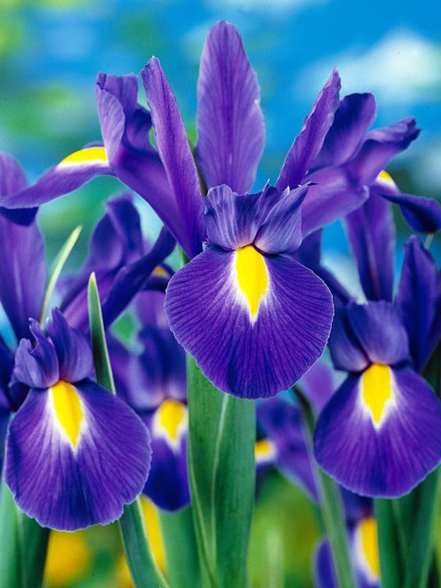
Iris Flowers Analysis and Prediction
•EDA • Classification • Prediction

Slide 2
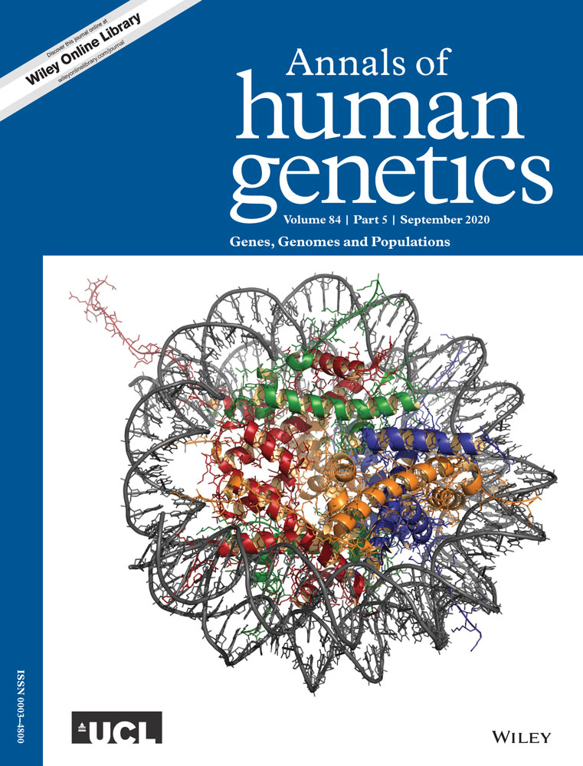
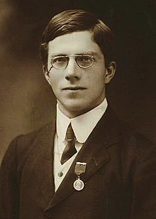
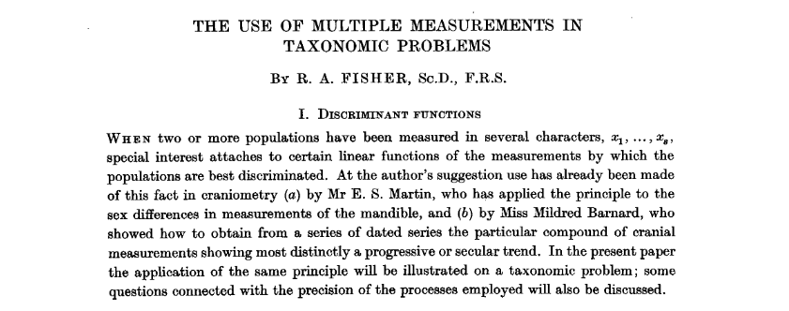
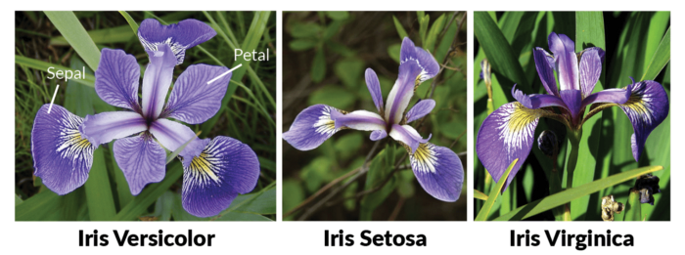
The Iris dataset was used in R.A. Fisher's classic 1936 paper, The Use of Multiple Measurements in Taxonomic Problems, and can also be found on the UCI Machine Learning Repository.
It includes three iris species with 50 samples each as well as some properties about each flower. One flower species is linearly separable from the other two, but the other two are not linearly separable from each other.

Slide 3
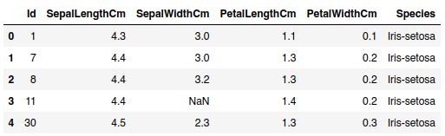
Dataset Information
iris.head()
Attribute Information:
1. sepal length in cm
2. sepal width in cm
3. petal length in cm
4. petal width in cm
5. class:
-- Iris Setosa
-- Iris Versicolour
-- Iris Virginica
Description :
The dataset provided has 135 rows
Dependent Variables : Sepal Length, Sepal Width, Petal Length, Petal Width
Independent/Target Variable : Class
Missing Values : 13

Slide 4
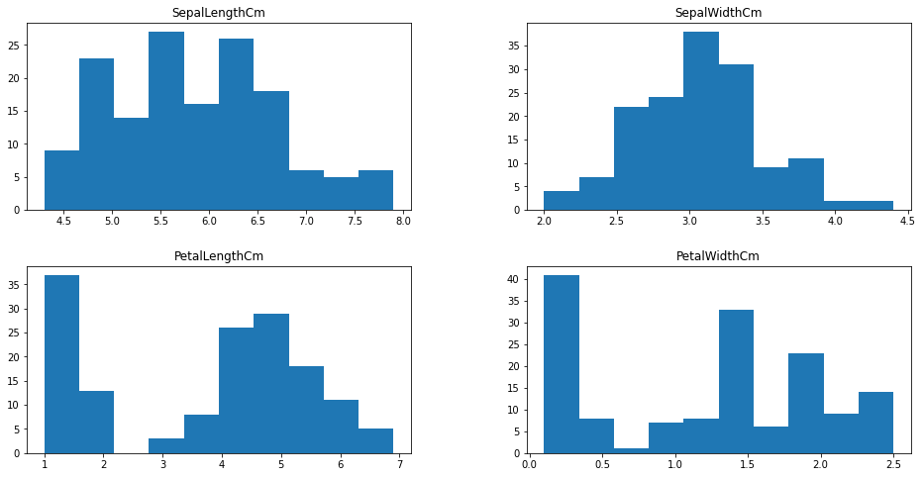
Distribution
Histogram representate how the data points are distributed with respect to the frequency.
We know that, at the overall distribution, petal length and petal width does not have a normal distribution, whereas sepal length and sepal width are uniformly distributed.

Slide 5
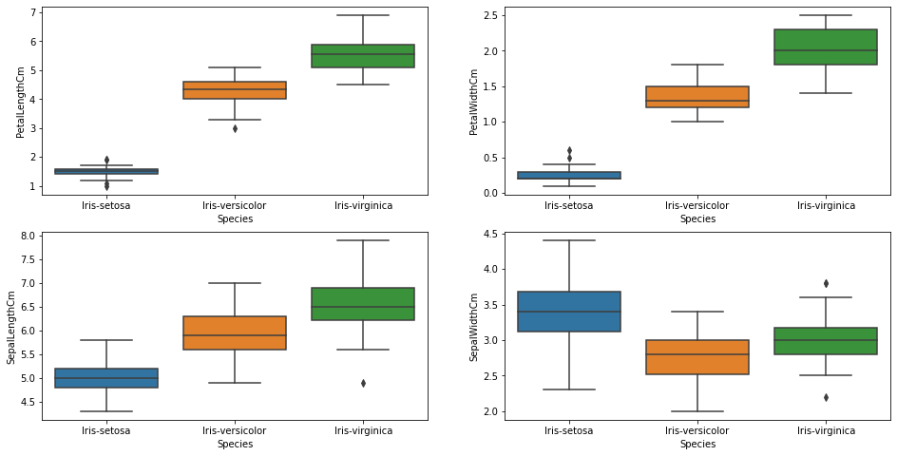
Distribution of Dependent Variables (Boxplot)
Iris setosa has outliers in Sepal Length, Sepal Width, Petal Width
Iris versi color has outlier only in Petal Length
Iris virginica has outliers in Petal Length, and Sepal Length
While all the other boxplots looked perfectly balanced, we can see that that petal width for both setosa and versicolor are positively skewed as the median lie at the lower end of the boxplot.

Slide 6
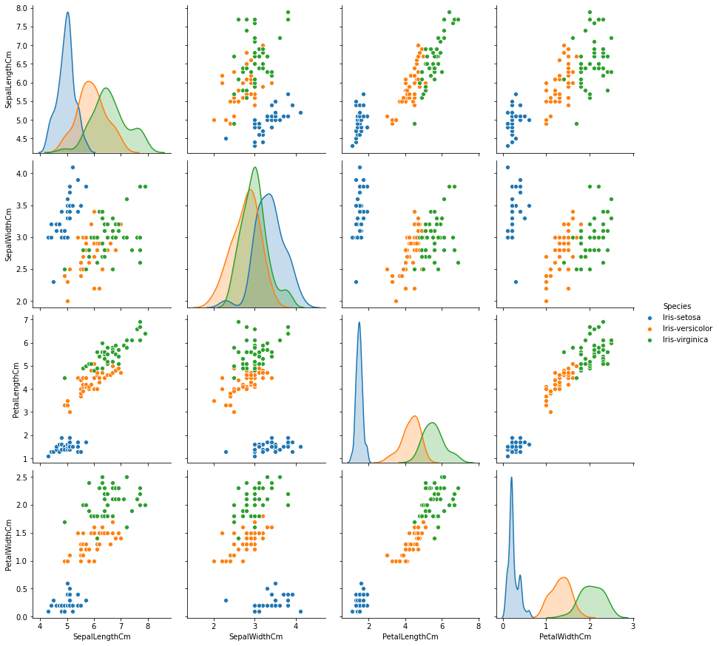
Pair plot makes high-level scatter plots to capture relationships between multiple variables and understanding the relationship between various independent features.
We can conclude:
The distribution of Iris-Setosa petal is completely different from the other 2 species
Using sepal length and sepal width, we can’t separate one species from another as the distribution is overlapping
Iris-Setosa is not normally distributed by sepal length and petal width
Petal length can be used as a differentiating factor in terms of the distribution of the 3 flower species

Slide 7
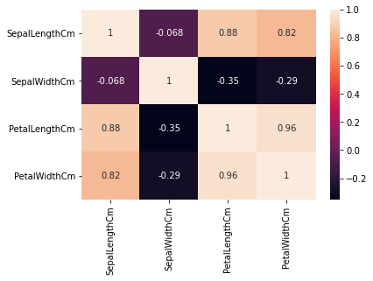
Correlation
From the heatmat plot, we see positive correlation between the length and width of all the species, however there is a distinguishing strong correlation and relationship between petal length and petal width.

Slide 8
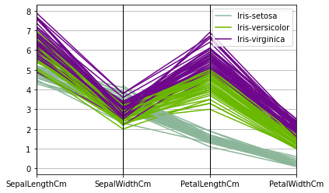

Slide 9
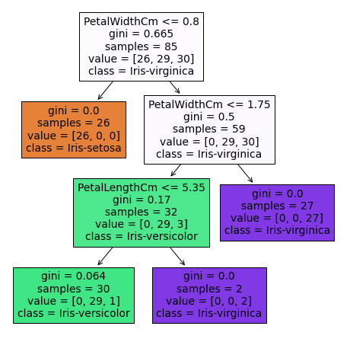

Slide 10
Thanks to:
https://archive.ics.uci.edu/ml/datasets/iris
https://www.kaggle.com/uciml/iris
https://rpubs.com/AjinkyaUC/Iris_DataSet

